Slide 1
CSCI 4401/5401: Principles of Operation Systems
James Wagner
University of New Orleans
Week 4, Lecture 8
September 7th, 2023

Slide 2
Announcements
Assignment 2 is due Monday, 9/25 @ 11:59pm.
Quiz 2 will be available after tonight’s lecture. Due Monday, 9/18 @ 11:59pm
Threads & CPU Scheduling (Lectures 5 – 7)
Same setup as last time.

Slide 3
What We’re Doing Today
Process synchronization

Slide 4
Process Synchronization

Slide 5
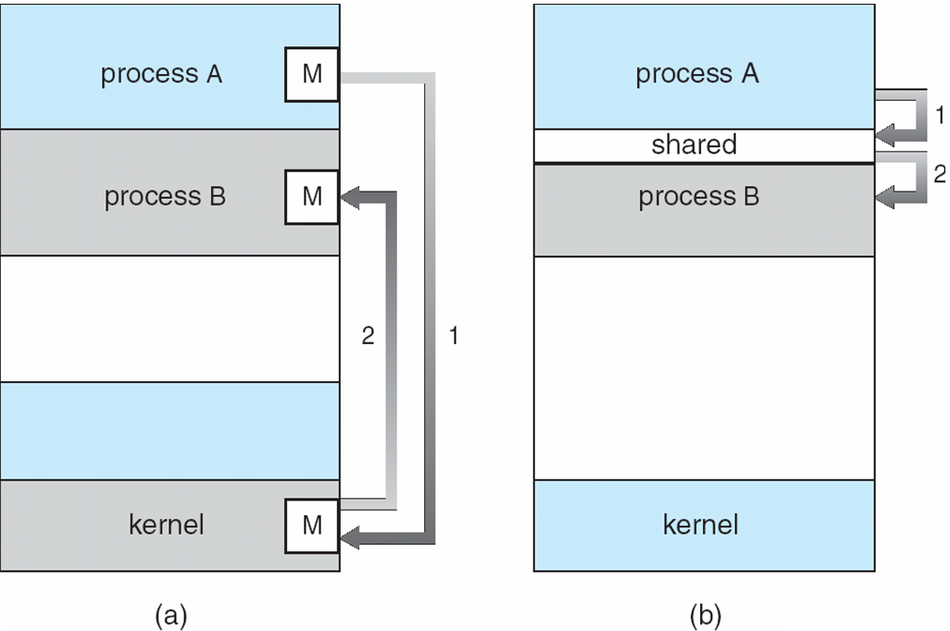
Cooperating Processes (and Threads)
Cooperating process - can affect or be affected by other processes executing in the system.
Interprocess Communication:
Message Passing
Shared Memory

Slide 6
The Need for Synchronization: Data Inconsistencies
Human synchronization example
Several authors, one document
Multiple parallel authors -> potentially conflicting authors
Insert/delete/modify
Can lead to an “inconsistent” state of the document
Inconsistent:
Not equivalent to any sequence of serial editing actions (load -> edit -> save) by authors

Slide 7
Data Inconsistencies: Human Example
Editing Author: George
Editing Author: Amy
Loads: “It was the best of times, it was the worst of times.”
Edits: “It was the best of times, it was the worst of times. I like to play basketball.”
Saves
Loads: “It was the best of times, it was the worst of times.”
Edits: “It was the best of times, it was the worst of times. I like to try new foods.”
Saves
What’s the final state of the document?

Slide 8
Process Synchronization
Problem: Concurrent access to shared data structures can result in inconsistencies.
State of shared data isn’t equivalent to any sequence of sequential accesses.
To ensure data consistency, we need mechanism to allow processes to coordinate, or synchronize, access
Synchronization imposes (partial) order on the actions of concurrent processes.

Slide 9
Producer/Consumer Paradigm
P
C

Slide 10
Producer/Consumer Paradigm
P
C

Slide 11
Producer/Consumer Paradigm
P
C
Any problems?
We can use a counter to keep track of the messages we have in shared memory.

Slide 12
P/C: Shared data & initialization
One value producer, one value consumer
Shared data:
type item is <something>;
buffer: array[0..n-1] of item
in, out: 0..n-1
counter: 0..n
Initialization:
in = 0
out = 0
counter = 0
in - pointer to next free position
out - pointer to first full position
buffer is empty when in == out
buffer is full when (in + 1) % n == out

Slide 13
Producer
repeat
nextPmsg = produce_item()
while counter == n do
null;
buffer[in] := nextPmsg
in = in + 1 mod n
counter = counter + 1
forever

Slide 14
Consumer
repeat
while counter == 0 do
null;
nextCmsg = buffer[out]
out = out + 1 mod n
counter = counter - 1
do_something(nextCmsg)
forever

Slide 15
Producer Consumer
repeat
nextp = produce_item()
while counter == n do
null;
buffer[in] = nextPmsg
in = in + 1 mod n
counter = counter+1
forever
repeat
while counter == 0 do
null;
nextCmsg = buffer[out]
out = out + 1 mod n
counter = counter-1
do_something(nextCmsg)
forever

Slide 16
Producer Consumer
repeat
nextPmsg = produce_item()
while counter == n do
null;
buffer[in] = nextPmsg
in = in + 1 mod n
counter = counter+1
forever
repeat
while counter == 0 do
null;
nextCmsg = buffer[out]
out = out + 1 mod n
counter = counter-1
do_something(nextCmsg)
forever
Operations on a shared variable

Slide 17
Operations on counter variable are not necessarily atomic at the instruction level.
counter = counter + 1 counter = counter - 1
LOAD R1 <— counter
INC R1
STORE R1 —> counter
LOAD R2 <— counter
DEC R2
STORE R2 —> counter

Slide 18
Problematic CPU execution sequence
P₀
P₁
1
LOAD R1 <— counter
INC R1
STORE R1 —> counter
2
LOAD R2 <— counter
DEC R2
STORE R2 —> counter
3
4
R1 = 1
R2 = 1
R1 = 2
R2 = 0
counter = ?

Slide 19
Race Condition
Race condition - both processes manipulate data at the same time and the outcome depends on the particular execution order.
To prevent the race condition:
Ensure only one process can manipulate a piece of data
Requires some type of processes synchronization
We will discuss various mechanisms for process synchronization.

Slide 20
The Critical-Section Problem

Slide 21
Critical Sections
N processes compete to access data in shared memory.
Each process has a code segment where shared data is accessed - critical section
We want to make sure that only one critical section can execute at a time so data doesn’t become inconsistent.
Process structure:
Entry/exit sections – section of code that requests permission to enter (or exits) critical section.
while (true) {
entry section
critical section
exit section
do normal work
}

Slide 22
Critical-Section Problem: Criteria for a Solution
Mutual Exclusion – one process in critical section at a time.
Progress – If no one is in the C.S. and someone wants in, they will eventually get in.
not prevented by someone who does not want in
Bounded Waiting – others are limited on number of C.S. entries when a process requests C.S. entry.
Prevent starvation

Slide 23
Assumptions for a Solution
We assume that each process is executing at a nonzero speed.
Otherwise, cannot guarantee it will ever give up C.S. access.
We cannot make assumptions concerning the relative execution speeds.
The solution must not contain race conditions.
We will discuss
Software-based solutions
Hardware-based solutions
Semaphores

Slide 24
Software-Based Solutions

Slide 25
Peterson’s Solution: Two-Process Mutual Exclusion
A software-based solution to the critical-section problem.
We will see:
It addresses our three requirements.
But it is restricted to two process.
Still no guarantee it will work correctly – uses a shared variable that is updated like our counter example.
However, this provides good description of the critical section problem and the complexity for a solution.

Slide 26
Two-Process Mutual Exclusion
Attempt # 1 (Idea: If turn == i, i can enter CS)
Shared data: Initialization:
turn: (0..1); turn := 0;
Each process:
repeat
while turn != i do null;
<<critical section>>
turn = j;
<<do normal work>>
forever

Slide 27
Attempt # 1: Criticism?
Answer: A process might
<<do normal work>>
forever when the other process is desperate to enter the critical section…
Cannot force two turns in a row
➔ Violates progress rule.

Slide 28
Attempt # 2
Idea: use flag array to indicate whether a process is interested in executing the CS
Shared data:
flag: array[0..1] of BOOLEAN;
Initialization:
flag[0] := flag[1] := false;

Slide 29
Attempt # 2
P₀
P₁
repeat
flag[0] := true; while flag[1] do null; <<critical section>> flag[0] := false;
<<do normal work>>
forever;
repeat
flag[1] := true; while flag[0] do null; <<critical section>> flag[1] := false;
<<do normal work>>
forever;
1
2

Slide 30
Attempt # 2
P₀
P₁
repeat
flag[0] := true; while flag[1] do null; <<critical section>> flag[0] := false;
<<do normal work>>
forever;
repeat
flag[1] := true; while flag[0] do null; <<critical section>> flag[1] := false;
<<do normal work>>
forever;
1
2
Eternal wait …

Slide 31
Attempt # 2: Criticism
Violates the progress rule:
Progress is possible but nobody makes it
i.e., processes “too polite”
This condition is a.k.a. livelock

Slide 32
Attempt # 3
Idea: Combine variables from Attempts 1,2
Shared variables:
flag: array[0..1] of BOOLEAN;
turn: (0..1);
Initialization:
flag[0] := flag[1] := false;
turn := 0;

Slide 33
Attempt # 3: Peterson’s Solution
P₀
P₁
repeat
flag[0] = true
turn = 1
while flag[1] && turn==1 do
null;
<<critical section>>
flag[0] = false
<<do normal work>>
forever
repeat
flag[1] = true
turn = 0
while flag[0] && turn==0 do
null;
<<critical section>>
flag[1] = false
<<do normal work>>
forever
Turn will be 1 or zero, not both
+ Works for two processes
- But not more …
Notes:
Still not guaranteed because turn is a shared variable.

Slide 34
Bakery Algorithm
One general n-process solution: Bakery Algorithm, or “Please take a number!”
Assign each requesting process a number.
Smallest number gets the critical section.

Slide 35
Bakery Algorithm
Shared variables:
// is the process taking a number?
choosing: array[0..n-1] of BOOLEAN;
// what number did it take?
number: array[0..n-1] of INTEGER;
Initialization:
choosing[0] = choosing[1] = … = false;
number[0] = number[1] = … = 0;

Slide 36
Bakery Algorithm Code
repeat // each process i
choosing[i] = true
number[i] = max(number) + 1
choosing[i] = false
for j in 0..n-1 loop
while choosing[j] do null;
while number[j]!= 0 and
(number[j], j)<(number[i], i) do null;
end
<<critical section>>
number[i] = 0;
<<do normal work>>
forever

Slide 37
Bakery Algorithm Code
repeat // each process i
choosing[i] = true
number[i] = max(number) + 1
choosing[i] = false
for j in 0..n-1 loop
while choosing[j] do null;
while number[j]!= 0 and
(number[j], j)<(number[i], i) do null;
end
<<critical section>>
number[i] = 0;
<<do normal work>>
forever
// Pi intends to enter the CS
// Pi gets ticket Nbr
// Pi has a ticket Nbr

Slide 38
Bakery Algorithm Code
repeat // each process i
choosing[i] = true
number[i] = max(number) + 1
choosing[i] = false
for j in 0..n-1 loop
while choosing[j] do null;
while number[j]!= 0 and
(number[j], j)<(number[i], i) do null;
end
<<critical section>>
number[i] = 0;
<<do normal work>>
forever
// Wait if Pj is getting
// a ticket Nbr

Slide 39
Bakery, Cont.
Why is it necessary to wait until a process has finished choosing in the Bakery algorithm?
P₀: (slow) choosing[0] := true; number[0] := max(number) + 1; /* 1 */ choosing[0] := false;
P₁: (fast) choosing[1] = true; number[1] = max(number) + 1; /* 1 */ choosing[1] = false;

Slide 40
Hardware Support
Bakery algorithm works but is expensive
The whole problem started because of “too simple” hardware instructions
Idea:
Provide “more complex” atomic instructions
What kind of instructions?
test-and-set, compare-and-swap, fetch-and-increment, load-link/store-conditional, …

Slide 41
Synchronization Hardware: Test and Set Lock

Slide 42
Picking up where we left off
Problems with our software-based solutions:
Not scalable – Peterson’s algorithm only applies to two processes.
Slow – the Bakery algorithm is scalable, but expensive
General Idea: any solution to the critical-section problem requires one simple tool – a lock
A process must acquire a lock before entering a critical section.
Releases the lock when it exits the CS
Race conditions are prevented by protecting critical regions with locks.

Slide 43
Atomic Instructions
Recall shared variables can be accessed and modified simultaneously.
Updating a variable is not an atomic operation
Sequence of instructions
Simple to solve for uniprocessor environment.
Prevent interrupts (preemption) when a shared variable is modified.
Complicated to disable interrupts in multiprocessor environments.
Time consuming when message is passed to all processors.
Problem for other system activity that is driven by interrupts (e.g., clock)
Solution: Have our system support special atomic hardware instructions.

Slide 44
Atomic Instructions
Atomic hardware instructions include:
Test-and-set
Compare-and-swap
Fetch-and-increment
…
Keep in mind that these instructions are atomic.
Example: If two TestAndSet() instructions are executed simultaneously (on separate CPUs), they will be executed sequentially (in an arbitrary order).
However, the machine does need to support these instructions.
We will look at test and set.

Slide 45
Test and Set Instruction
boolean TestAndSet (boolean *target){//ptr val
boolean rv = *target; //record old value
*target = TRUE; //change the value
return rv; //return the old value
}
- Lock is obtained if return value is FALSE.
- Someone already had the lock if return value is TRUE.

Slide 46
Mutual Exclusion w/ Test and Set
Critical section solution
Shared:
lock: Boolean := FALSE;
Each process:
do {
while (TestAndSet(&lock)) // pass the memory location
; // do nothing (spinlock)
//critical section
lock = FALSE;
//remainder section
} while (TRUE);

Slide 47
Test and Set Lock

Slide 48
Test and Set Lock

Slide 49
Test and Set Lock

Slide 50
Test and Set Lock

Slide 51
Test and Set Lock

Slide 52
Test and Set Lock

Slide 53
Test and Set Lock

Slide 54
Test and Set Lock

Slide 55
Test and Set Lock

Slide 56
Test and Set Lock

Slide 57
Test and Set Lock

Slide 58
Test and Set Lock: Observations
Our algorithm does achieve mutual exclusion and satisfies our progress requirement. However, think back to CPU scheduling …
It does not satisfy our bounded-waiting requirement.
What if the CS becomes free while P is ready, but the CS is locked by the time P gets the CPU?
Processes can experience starvation.
Before entering the critical section, we check to see if we’re allowed.
Sit in a tight loop and wait – busy waiting
What does it mean to have processes in busy waiting?
The bounded-waiting (or starvation) solution is fairly complicated …

Slide 59
Solution to Unbounded Waiting
Shared variables/Initialization
lock: Boolean := false;
waiting: array[0..n-1] of Boolean := (others=>false);
Local variables/Initialization
key: Boolean;
j : Integer;

Slide 60
Solution to Unbounded Waiting (2)
Each process i:
do{
waiting[i] = TRUE; // waiting GLOBAL key = TRUE; // key LOCAL while (waiting[i] && key) {
key = TestAndSet(&lock); // lock GLOBAL
}//waiting or key needs to be false to get CS
waiting[i] = FALSE;
<<critical section>>
...

Slide 61
Solution to Unbounded Waiting (3)
/* after CS execution, we need to decide
who else gets in... */
j = (i + 1) % n;
while ((j != i) and !waiting[j]) j = (j+1) % n; // scan the array in cyclic order
end loop
if (j == i) then
lock = FALSE; /* no other interest: “activate” T&S */
else
waiting[j] = FALSE; /* turn off their flag */
end if
<<normal stuff>>
} while (TRUE);

Slide 62
Unbounded Waiting Test and Set Lock: Observations
We still experience busy waiting -> wasting CPU time in the tight loops.
Let’s try something else that allows us to remove busy waiting.

Slide 63
Next Time
Semaphores
Synchronization Problems
Monitors
Maybe start deadlocks

Slide 64
Class Reminders
Assignment 2 is due Monday, 9/25 @ 11:59pm.
Quiz 2 will be available after tonight’s lecture. Due Monday, 9/18 @ 11:59pm
Threads & CPU Scheduling (Lectures 5 – 7)
Same setup as last time.

