Slide 1
CSCI 4401/5401: Principles of Operation Systems
James Wagner
University of New Orleans
Week 5, Lecture 9
September 12th, 2023

Slide 2
Announcements
Assignment 2 is due Monday, 9/25 @ 11:59pm.
Quiz 2 is due Monday, 9/18 @ 11:59pm
Threads & CPU Scheduling (Lectures 5 – 7)
Same setup as last time.

Slide 3
Upcoming Schedule
Week 5 (this week) – finish process synchronization
Week 6 – deadlocks (Chapter 6)
Week 7 – finish deadlocks and start memory management
Week 8 – review and midterm
Midterm date is Thursday, 10/5
Chapters 1, 2, & 6
Topics for the 2nd half of the semester: main memory, virtual memory, file systems, mass storage, security, and maybe some optional topics

Slide 4
What We’re Doing Today
Assignment 2 Discussion
Recap process synchronization so far
Classic Synchronization Problems
Monitors
Example: Monitors in Java

Slide 5
Assignment 2: Ideas & Discussion

Slide 6
Part 2A
1000
P
P
For (i= 1 to 3) { fork() }
i = 1
i = 2
i = 3
P
C
C
C
1001
1002
1004
P
C
P
P
1003
C
1005
C
1006
P
C
1007

Slide 7
Part 2B. Idea for Building the Process Tree
Building the tree/dictionary sounds like it is giving people the most trouble.
Step 1. Find the root parent and initialize our dictionary.
Step 2. Iterate through our (Parent, Child) pairs. For each pair …
Step 3. Look at our dictionary (key, value) pairs:
A. If Parent == key, add Child to value (which is a subdictionary)
B. Else, recursively look at value (which is a subdictionary)

Slide 8
Part 2B. Step 1
(Parent, Child)
(8144, 8148)
(8144, 8151)
(8144, 8145)
(8145, 8149)
(8150, 8157)
(8146, 8160)
(8146, 8155)
…
Initialize some variables & collect some data.
tree = {} #use a dictionary to store key-value pairs
parentList = [8144, 8144, 8144, 8145, 8150, 8146, 8146, etc.]
childList = [8148, 8151, 8145, 8149, 8157, 8160, 8155, etc.]
Find our root parent and initialize our tree.
How do we do that given our variables above?
rootID = ?
Update the tree:
tree.update(rootID: {})
Key is the rootID
Value is set to an empty dictionary
Notes:
For ppid in parentList: if ppid in childList, skip it; else, assume it’s the parent

Slide 9
Part 2B. Step 3
Step 2. Iterate through our (Parent, Child) pairs. For each pair …
Step 3. Look at our dictionary (key, value) pairs:
A. If Parent == key, add Child to value (which is a subdictionary)
B. Else, recursively look at value (which is a subdictionary)

Slide 10
Part 2B. Step 3: If parent == key, add child to value
8144
(Parent, Child)
(8144, 8148)
(8144, 8151)
(8144, 8145)
(8145, 8149)
(8150, 8157)
(8146, 8160)
(8146, 8155)
…
8148
8151
8145
8149
8157
?
8160
?
8155
?
Notes:
May not be able to match everything in one pass, maybe use a while loop? I.e., while we still have a pair to look at.
tree = {8144 : {}} tree = {8144: {8148: {}} tree = {8144: {8148: {}, 8151: {}} tree = {8144: {8148: {}, 8151: {}, 8145: {}}

Slide 11
Part 2B. Step 3: Else, recursively look at values (i.e., the subdictionaries)
8144
(Parent, Child)
(8144, 8148)
(8144, 8151)
(8144, 8145)
(8145, 8149)
(8150, 8157)
(8146, 8160)
(8146, 8155)
…
8148
8145
8151
8149
8160
?
for key, item in tree.iteritems(): #Python 2
8155
?
8157
?
for key, item in tree.items(): #Python 3
Notes:
tree = {8144: {8148: {}, 8151: {}, 8145: {8149: {}}}

Slide 12
Process Synchronization

Slide 13
Process Synchronization: Motivation
What is the race condition and how does it relate to process synchronization? Example?
What does it mean when we say that an operation is not atomic?
Hint: The counter variable example.

Slide 14
Problematic CPU execution sequence
P₀
P₁
1
LOAD R1 <— counter
INC R1
STORE R1 —> counter
2
LOAD R2 <— counter
DEC R2
STORE R2 —> counter
3
4
R1 = 1
R2 = 1
R1 = 2
R2 = 0
counter = ?

Slide 15
Process Synchronization: Toward a Solution
What is a critical section?
What are three criteria we must achieve for a solution to the critical-section problem?

Slide 16
Critical-Section Problem: Criteria for a Solution
Mutual Exclusion – one process in critical section at a time.
Progress – If no one is in the C.S. and someone wants in, they will eventually get in.
not prevented by someone who does not want in
Bounded Waiting – others are limited on number of C.S. entries when a process requests C.S. entry.
Prevent starvation

Slide 17
Process Synchronization: Toward a Solution
We discussed two software-based algorithms that are solutions to the critical-section problem:
Peterson’s Solution
Bakery Algorithm
What are the limitations/trade-offs of each?
For the Bakery Algorithm, why do we prevent a process from continuing if another process is selecting a ticket number?

Slide 18
Attempt # 3: Peterson’s Solution
P₀
P₁
repeat
flag[0] = true
turn = 1
while flag[1] && turn==1 do
null;
<<critical section>>
flag[0] = false
<<do normal work>>
forever
repeat
flag[1] = true
turn = 0
while flag[0] && turn==0 do
null;
<<critical section>>
flag[1] = false
<<do normal work>>
forever
Turn will be 1 or zero, not both
+ Works for two processes
- But not more …
Notes:
Still not guaranteed because turn is a shared variable.

Slide 19
Bakery Algorithm Code
repeat // each process i
choosing[i] = true
number[i] = max(number) + 1
choosing[i] = false
for j in 0..n-1 loop
while choosing[j] do null;
while number[j]!= 0 and
(number[j], j)<(number[i], i) do null;
end
<<critical section>>
number[i] = 0;
<<do normal work>>
forever
// Wait if Pj is getting
// a ticket Nbr

Slide 20
Bakery, Cont.
Why is it necessary to wait until a process has finished choosing in the Baker’s algorithm?
P₀: (slow) choosing[0] := true; number[0] := max(number) + 1; /* 1 */ choosing[0] := false;
P₁: (fast) choosing[1] = true; number[1] = max(number) + 1; /* 1 */ choosing[1] = false;

Slide 21
Process Synchronization: Toward a Solution
A lock is a special atomic instruction (supported by the hardware) that is a solution to the critical section problem. What does “atomic” mean?
Using locks can result in bounded waiting (i.e., starvation). However, we can solve this by iterating through waiting processes in order. What is still another problem with locks?

Slide 22
Picking up where we left off
Problems with our software-based solutions:
Not scalable – Peterson’s algorithm only applies to two processes.
Slow – the Bakery algorithm is scalable, but expensive
General Idea: any solution to the critical-section problem requires one simple tool – a lock
A process must acquire a lock before entering a critical section.
Releases the lock when it exits the CS
Race conditions are prevented by protecting critical regions with locks.

Slide 23
Atomic Instructions
Recall shared variables can be accessed and modified simultaneously.
Updating a variable is not an atomic operation
Sequence of instructions
Simple to solve for uniprocessor environment.
Prevent interrupts (preemption) when a shared variable is modified.
Complicated to disable interrupts in multiprocessor environments.
Time consuming when message is passed to all processors.
Problem for other system activity that is driven by interrupts (e.g., clock)
Solution: Have our system support special atomic hardware instructions.

Slide 24
Atomic Instructions
Atomic hardware instructions include:
Test-and-set
Compare-and-swap
Fetch-and-increment
…
Keep in mind that these instructions are atomic.
Example: If two TestAndSet() instructions are executed simultaneously (on separate CPUs), they will be executed sequentially (in an arbitrary order).
However, the machine does need to support these instructions.
We will look at test and set.

Slide 25
Test and Set Instruction
boolean TestAndSet (boolean *target){//ptr val
boolean rv = *target; //record old value
*target = TRUE; //change the value
return rv; //return the old value
}
- Lock is obtained if return value is FALSE.
- Someone already had the lock if return value is TRUE.

Slide 26
Mutual Exclusion w/ Test and Set
Critical section solution
Shared:
lock: Boolean := FALSE;
Each process:
do {
while (TestAndSet(&lock)) // pass the memory location
; // do nothing (spinlock)
//critical section
lock = FALSE;
//remainder section
} while (TRUE);

Slide 27
Test and Set Lock: Observations
Our algorithm does achieve mutual exclusion and satisfies our progress requirement. However, think back to CPU scheduling …
It does not satisfy our bounded-waiting requirement.
What if the CS becomes free while P is ready, but the CS is locked by the time P gets the CPU?
Processes can experience starvation.
Before entering the critical section, we check to see if we’re allowed.
Sit in a tight loop and wait – busy waiting
What does it mean to have processes in busy waiting?
The bounded-waiting (or starvation) solution is fairly complicated …

Slide 28
Solution to Unbounded Waiting
Shared variables/Initialization
lock: Boolean := false;
waiting: array[0..n-1] of Boolean := (others=>false);
Local variables/Initialization
key: Boolean;
j : Integer;

Slide 29
Solution to Unbounded Waiting (2)
Each process i:
do{
waiting[i] = TRUE; // waiting GLOBAL key = TRUE; // key LOCAL while (waiting[i] && key) {
key = TestAndSet(&lock); // lock GLOBAL
}//waiting or key needs to be false to get CS
waiting[i] = FALSE;
<<critical section>>
...

Slide 30
Solution to Unbounded Waiting (3)
/* after CS execution, we need to decide
who else gets in... */
j = (i + 1) % n;
while ((j != i) and !waiting[j]) j = (j+1) % n; // scan the array in cyclic order
end loop
if (j == i) then
lock = FALSE; /* no other interest: “activate” T&S */
else
waiting[j] = FALSE; /* turn off their flag */
end if
<<normal stuff>>
} while (TRUE);

Slide 31
Unbounded Waiting Test and Set Lock: Observations
We still experience busy waiting -> wasting CPU time in the tight loops.
In general, hardware-based solutions get complicated for programmers to actually use.
Let’s try something else that allows us to remove busy waiting.

Slide 32
Semaphores

Slide 33
Semaphores (by Dijkstra)
An abstract data type that can be used for synchronization does not require busy waiting.
A semaphore S is an integer variable that may be accessed using two atomic operations only:
wait(S): S := S - 1;
if S < 0 then block this process;
- put the process in waiting queue
signal(S) S := S + 1;
if S >= 0 then wakeup another process;
- put that process in the ready queue

Slide 34
Semaphores
There are multiple names for semaphore operations:
Wait(S), Down(S), P(S)
P comes from the Dutch proberen – “to test”
Signal(S), Up(S), V(S)
V comes from the Dutch verhogen – “to increment”

Slide 35
Semaphores Implementations
Binary semaphores (mutex locks)
Integer value is either 0 or 1 (lock either set or free).
Simple to implement
Counting semaphores
Integer value can range over an unrestricted domain.
Requires more sophisticated coordination

Slide 36
C.S. with Semaphores
Shared variable:
mutex: semaphore = 1;
Each process:
repeat
wait(mutex)
<<critical section>>
signal(mutex)
<<normal stuff>>
forever

Slide 37
Binary Semaphores (mutex)

Slide 38
Binary Semaphores (mutex)

Slide 39
Binary Semaphores (mutex)

Slide 40
Binary Semaphores (mutex)

Slide 41
Binary Semaphores (mutex)

Slide 42
Deadlocks
Deadlock – two or more processes are waiting indefinitely for an event that can be caused by only one of the waiting processes.
Let S and Q be two semaphores initialized to 1.
P0 is waiting for P1 to signal(Q).
P1 is waiting for P0 to signal(S).
P0 and P1 are waiting on each other – deadlock.
More on deadlocks next week.
P0
wait(S);
wait(Q);
.
.
.
signal(S);
signal(Q);
P1
wait(Q);
wait(S);
.
.
.
signal(Q);
signal(S);
T0
S=1, Q=1
T1
S=0, Q=1
T2
S=0, Q=0
T3
P0 - blocked
T4
P1 blocked
Notes:
T0: S = 1, Q = 1
T1: S = 0, Q = 1
T2: S = 0, Q = 0
T3: P0 is blocked
T4: P1 is blocked

Slide 43
Classic Synchronization Problems

Slide 44
Overview
We will talk about a few synchronization problems.
Used to test newly proposed synchronization schemes.
The Bounded-Buffer (Producer/Consumer) Problem
The Readers-Writers Problem
Dining Philosophers Problem

Slide 45
Bounded-Buffer Problem
Shared variables / Initialization
avail, empty, mutex : semaphore;
buffer: array(1..n) of item_type;
/* semaphore initialization */
avail = 0; // number of items produced
empty = n; // number of empty slots
mutex = 1; // guards critical section

Slide 46
Bounded Buffer w/Semaphores
Producer
Consumer
repeat
<produce item>
wait(empty)
wait(mutex)
<add item to buffer>
signal(mutex)
signal(avail)
forever
repeat
wait(avail)
wait(mutex)
<get item from buffer>
signal(mutex)
signal(empty)
<consume item>
forever

Slide 47
The Readers-Writers Problem
Idea: Several concurrent processes want to read/write a shared data item or file
Multiple readers no problem
Only a single writer is allowed at a time
I.e., readers or a writer, but not both concurrently
Variations to this problem depend on answers to the following questions:
If a reader is present and a writer is waiting, do we allow additional readers to enter?
If a reader is present and a writer is waiting, do we ban additional readers until a writer gets a chance?

Slide 48
Readers/Writers Problem
W₁
R₁
Shared
Data
W₂
R₂
…
…
W_{n}
R_{n}
Writers need to have exclusive access while modifying shared data.

Slide 49

R/W Solution Sketch (semaphores)
Shared
Data
W₁
R₁
readcount
W₂
R₂
mutex
…
…
write
W_{n}
R_{n}

Slide 50
R/W Solution Code (semaphores)
Shared variables/Initialization
mutex, write: semaphore;
readcount: integer;
mutex = 1;
write = 1;
readcount = 0;

Slide 51
Reader/Writer Implementation
Writer:
wait(write)
<perform write>
signal(write)
Readers:
wait(mutex)//get access to rc
readcount = readcount + 1
if( readcount == 1) //1st reader
wait (write);
signal(mutex) //release rc access
<perform read>
wait(mutex)//get access to rc
readcount = readcount - 1
if( readcount == 0)
signal(write); //last reader
signal(mutex); //release rc access

Slide 52
Reader/Writer Implementation
Writer:
wait(write)
<perform write>
signal(write)
Readers:
wait(mutex)//get access to rc
readcount = readcount + 1
if( readcount == 1) //1st reader
wait (write);
signal(mutex) //release rc access
<perform read>
wait(mutex)//get access to rc
readcount = readcount - 1
if( readcount == 0)
signal(write); //last reader
signal(mutex); //release rc access
What if removed?

Slide 53
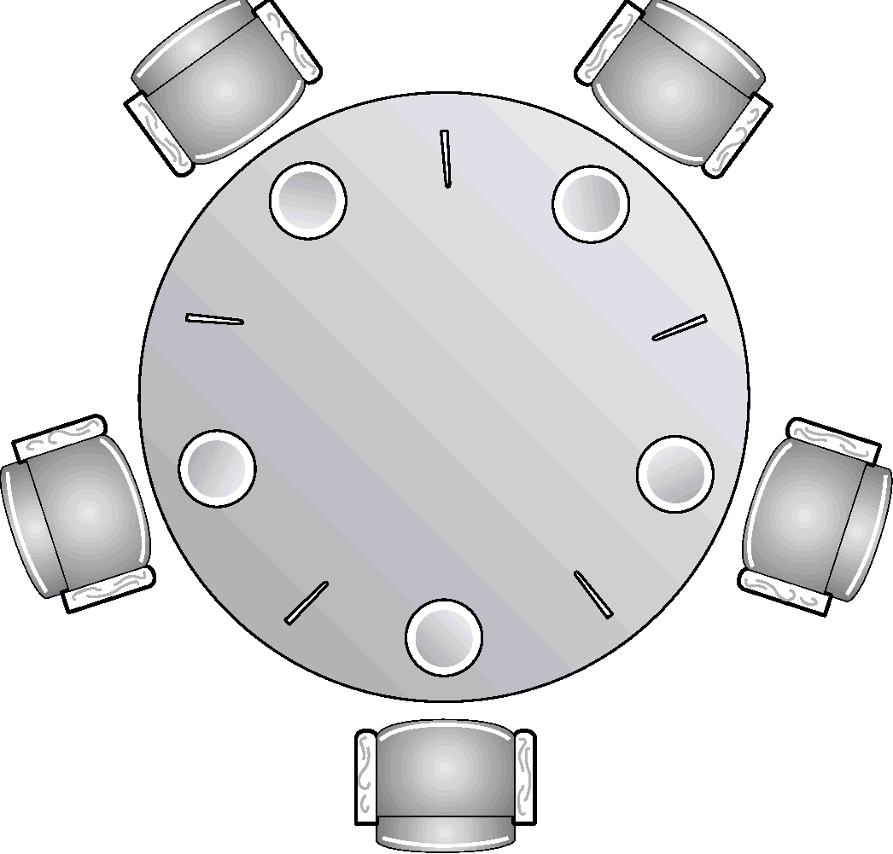
Dining Philosophers Problem
0
Callie
4
Brandon
Represents a large class of concurrency problems.
We have K philosophers seated around a circular table.
Bowl of rice in center
One chopstick between each pair of philosophers.
A philosopher can either think or eat.
Thinking – no chopsticks
Eating – needs both chopsticks but picks them up one at a time.
0
1
Fatima
3
Mark
1
4
2
3
2
Kaleb

Slide 54
Dining Philosophers Problem
0
Callie
4
Brandon
Philosopher:
while(true) {
<think for some time>
<pick up 2 chopsticks>
<eat for some time>
}
0
1
Fatima
3
Mark
1
4
2
3
2
Kaleb

Slide 55
Dining Philosophers Problem
0
Callie
4
Brandon
Idea: each chopstick is a semaphore
Grabs chopstick -> wait()
Releases chopstick -> signal()
0
1
Fatima
3
Mark
1
4
2
3
2
Kaleb

Slide 56
Dining Philosophers Problem
0
Callie
4
Brandon
philosopher(i):
while(true) {
wait(chopstick[i]) //take left
wait(chopstick[(i+1)%5]) //take right
<eat>
signal(chopstick[i])
signal(chopstick[(i+1)%5])
<think>
}
0
1
Fatima
3
Mark
1
4
2
3
2
Kaleb

Slide 57
Dining Philosophers Problem
0
Callie
4
Brandon
philosopher(0):
while(true) {
wait(chopstick[0]) //take left
...
}
philosopher(1):
while(true) {
wait(chopstick[1]) //take left
...
}
...
0
1
Fatima
3
Mark
1
4
2
3
2
Kaleb

Slide 58
Dining Philosophers Problem
0
Callie
4
Brandon
Problem?
Deadlock!
There aren’t enough chopsticks to go around!
How do you write a program where no philosopher gets stuck?
0
1
Fatima
3
Mark
1
4
2
3
2
Kaleb

Slide 59
Dining Philosophers Problem
0
Callie
4
Brandon
Some solutions …
Allow at most four philosophers at the table at once.
Only pick up a chopstick if both are available – must pickup in the CS.
Introduce asymmetry – odds pick up left then right, evens pick up right then left.
Starvation is still possible!
0
1
Fatima
3
Mark
1
4
2
3
2
Kaleb

Slide 60
Monitors

Slide 61
Problem with Semaphores
When used incorrectly by programmers, errors can be hard to detect.
Suppose we have a mutex initialized to 1, what happens if:
or a wait()/signal() could be omitted.
signal(mutex);
…
critical section
…
wait(mutex);
wait(mutex);
…
critical section
…
wait(mutex);

Slide 62
Monitor Usage
Monitor: an abstract data type which presents a set of programmer-defined operations.
A set of 1) data items and a set of 2) mutually exclusive procedures to access the data items.
Like a “class” in object-oriented jargon, but with some methods that are mutually exclusive.
Idea: Only one thread can be executing inside the monitor at a time
Java's thread synchronization is monitor-based

Slide 63
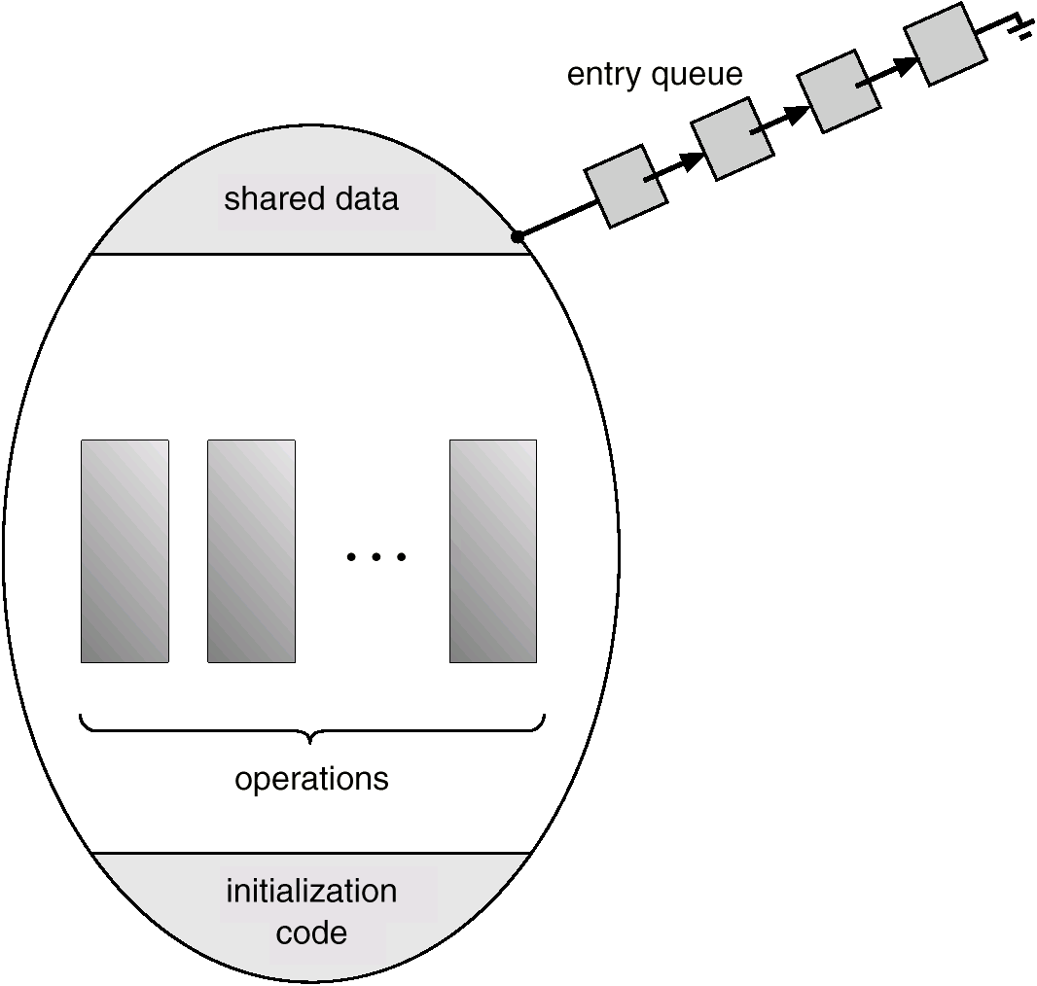
Monitors

Slide 64
Monitor Usage
Monitor MonitorName {
// shared variable declarations
procedure entry P₁() {
...
}
procedure entry P₂() {
...
}
procedure entry P_{n}() {
...
}
initialization code (...) {
...
}
}

Slide 65
Monitors
Only one “entry” procedure is allowed to execute at a time
Thus, only one thread is “active” in the monitor at once
Need to be able to suspend execution temporarily to allow other threads into the monitor
Condition variables
X.wait -- go to sleep
X.signal -- wake up 1 waiting thread

Slide 66
Dining Philosophers w/ Monitors
monitor DiningPhils {
state: array[0..4] of (thinking, eating, hungry)
self: array[0..4] of condition
void pickup (int i) {
...
}
void putdown (int i) {
...
}
void test (int i) {
...
}
initialization_code() {
for (int i = 0; I < 5; i++)
state[i] = THINKING;
}
}
- Only pickup if both chopsticks are available

Slide 67
Dining Philosophers w/ Monitors
monitor DiningPhils {
state: array[0..4] of (thinking, eating, hungry)
self: array[0..4] of condition
void pickup (int i) {
state[i] = HUNGRY;
test(i);
if (state[i] != EATING)
self[i].wait();
}
void putdown (int i) {
...
}
void test (int i) {
if ( (state[(i + 4) % 5] != EATING) &&
(state[i] == HUNGRY) &&
(state[(i + 1) % 5] != EATING)) {
state[i] = EATING;
self[i].signal();
}
initialization_code() {
for (int i = 0; I < 5; i++)
state[i] = THINKING;
}
}
- Is left chopstick free?
- Is right chopstick free?

Slide 68
Dining Philosophers w/ Monitors
monitor DiningPhils {
state: array[0..4] of (thinking, eating, hungry)
self: array[0..4] of condition
void pickup (int i) {
state[i] = HUNGRY;
test(i);
if (state[i] != EATING)
self[i].wait();
}
void putdown (int i) {
state[i] = THINKING;
test((i + 4) % 5);
test((i + 1) % 5);
}
void test (int i) {
if ( (state[(i + 4) % 5] != EATING) &&
(state[i] == HUNGRY) &&
(state[(i + 1) % 5] != EATING)) {
state[i] = EATING;
self[i].signal();
}
initialization_code() {
for (int i = 0; I < 5; i++)
state[i] = THINKING;
}
}
- Drop chopsticks & see if we can feed (wakeup) a hungry (waiting) philosopher (process) to the left and right.

Slide 69
Monitors in Java

Slide 70
Monitors in Java
Each object has a built-in monitor.
Only one active thread can own an object’s thread at a time.
Entry procedures (methods) are marked with synchronized.
A thread becomes the owner of an object’s monitor by executing a synchronized method of the object.

Slide 71
Monitors in Java
Inside the synchronized methods, our “sleep” and “wakeup” procedures are protected from race conditions.
Object.wait() – “sleep” - forces the current thread to wait until another thread invokes notify() of notifyAll() on that object.
Object.notify() – “wakeup” - wakes up a thread (non-deterministic) waiting to access the object’s monitor.
Object.notifyAll() – wakes up all threads waiting for the monitor.
For more details, take a look at the Java documentation:
https://docs.oracle.com/javase/8/docs/api/java/lang/Object.html#notify--

Slide 72
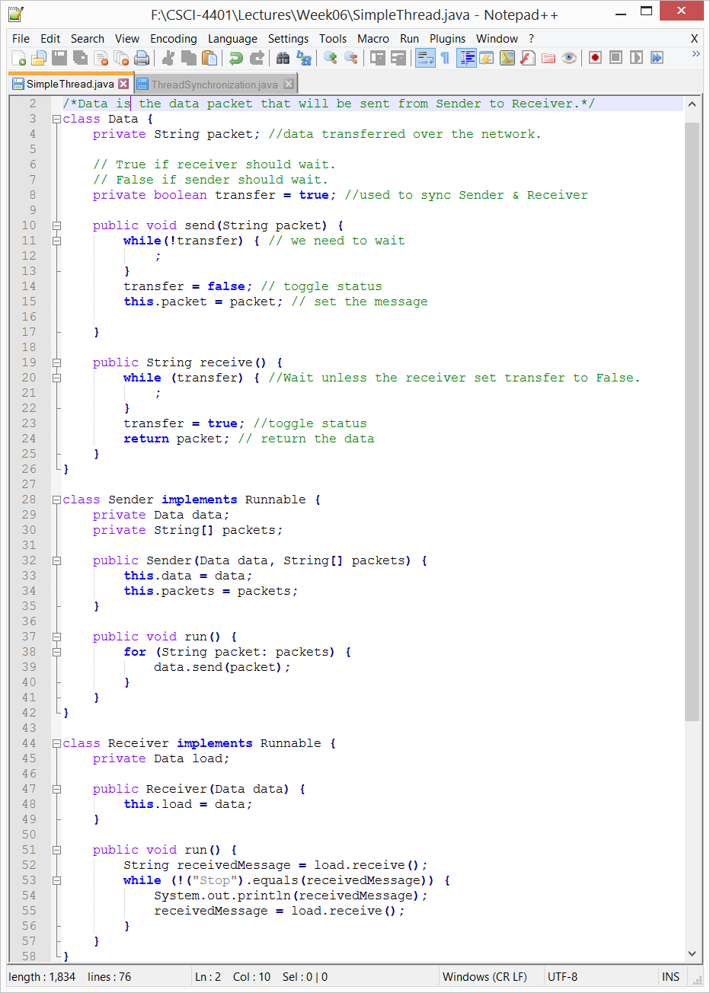
Java Thread without Monitors
SimpleThread.java
What will happen?

Slide 73
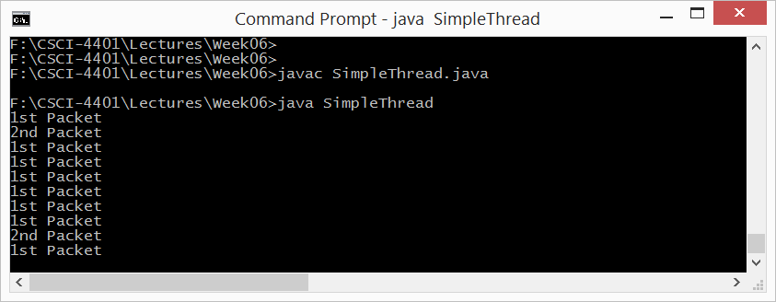
Java Thread without Monitors
SimpleThread.java

Slide 74
Java Thread without Monitors
SimpleThread.java
Deadlock!

Slide 75
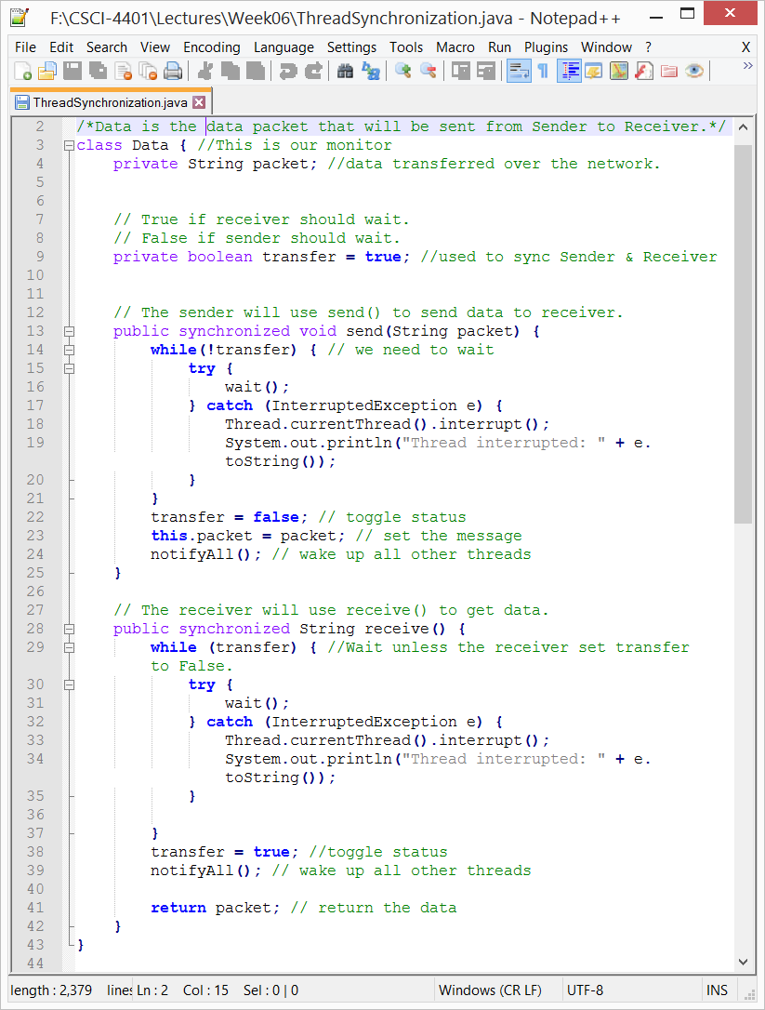
Monitors in Java
- Our synchronized procedures.
- Sleep
- Wakeup (all)
Chose random thread

Slide 76
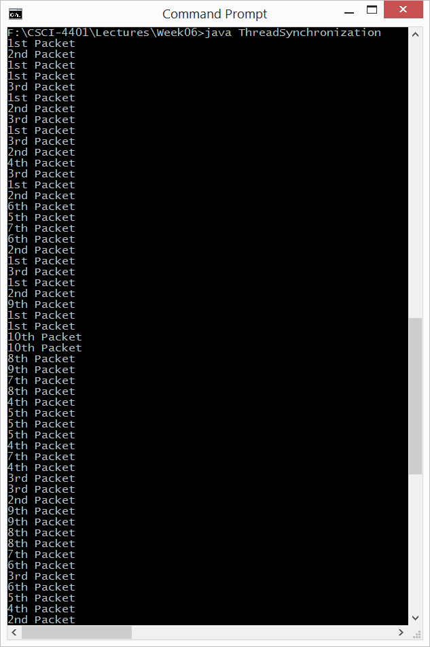
Monitors in Java

Slide 77
Transactions

Slide 78
Motivation
Database operations frequently need to carry out atomic transactions:
Either the entire transaction must either complete or not occur at all
Operating Systems can be viewed as having many of the same needs and problems as databases.
An OS can be said to manage a small database of process-related information.
Therefore, OSes can benefit from emulating some of these techniques originally designed for databases.

Slide 79
Transaction Example
Matt transfers $100 to Mitch’s bank account. All three operations are part of a single transaction:
Matt checks his bank account to make sure he has $100
Matt deducts $100 from his account
Matt adds $100 to Mitch’s bank account.
Either the entire transaction (all three operations) happens or does not.

Slide 80
Desired Criteria: ACID
Atomic: All actions in the transaction happen, or none happen.
“all or nothing”
Consistent: If each transaction is consistent, and the system starts consistent, then it ends up consistent.
“it looks correct to me”
Isolated: Execution of one transaction is isolated from that of other transactions.
“as if alone”
Durability: If a transaction commits, its effects persist.
“survives failures”

Slide 81
System Model
Atomic: A transaction is a series of actions that must either complete in its entirety or must be rolled-back as if it had never commenced.
The system is considered to have three types of storage:
Volatile storage – lost on a system crash
Non-volatile storage – usually survives on a system crash, but could still be lost
Stable storage (Durable) – “never” lost or damaged. In practice, this would be done by replicating data (more on this when we get to mass storage).

Slide 82
Log-Based Recovery
Before each step of a transaction is conducted, an entry is written to a log on stable storage:
Each transaction has a unique serial number
The first entry is a “start”
Every data changing entry specifies the transaction number, the old value, and the new value
The final entry is a “commit”
Transactions can be repeated (or undone) any number of times and the effect is the same as doing them once. Ex. “Change x from 5 to 6” rather than “add 1 to x”
After a crash, any transaction which has “commit” recorded in the log can be redone from the log information. Any which has “start”, but not “commit” can be undone.

Slide 83
Checkpoints
In the event of a crash, all data can be recovered using the log-based recovery.
However, this process can be slow and wasteful – not all transaction we repeat may not have been lost during the crash.
Alternatively, we can periodically establish a checkpoint as follows:
Write all data that has been affected by recent transactions (since the last checkpoint) to stable storage.
Write a <checkpoint> entry to the log
Now for crash recovery one only needs to find transactions that did not commit prior to the most recent checkpoint. Specifically, look for the last checkpoint record to get the most recent transactions that need to be redone or undone.

Slide 84
Concurrent Atomic Transactions
So far, we’ve only assumed one transaction at a time. Let’s now consider many transactions at once while keeping each transaction atomic.
Interleaving operations across transactions can result in better performance – similar advantages as multithreading and CPU scheduling.
Isolation: However, each transaction must execute as if it were running by itself. Otherwise, similar problems we’ve seen with process synchronization.
How do we achieve this?

Slide 85
Transaction Scheduling
A schedule, S, of transactions T1, T2, …, Tn is an ordering of the operations of transactions
Operations from different transactions can be interleaved
Must preserve the order in which the instructions appear in each individual transaction
T1
1
2
3
T2
A
B
C
D
T1
1
2
3
T2
A
B
C
D
one possible schedule:

Slide 86
Transaction Scheduling: Example
T1 transfers $100 from A to B. Each start with $1000
T2 adds 10% to each account
T1
read(A)
A = A - 100
write(A)
read(B)
B = B+100
write(B)
T2
read(A)
A = A*1.10
write(A)
read(B)
B = B*1.10
write(B)
Constraint: A+B should be
$2000 * .10 = $2200
Result: A = $990, B = $1210

Slide 87
Transaction Scheduling: Example
T1 transfers $100 from A to B. Each start with $1000
T2 adds 10% to each account
T1
read(A)
A = A - 100
write(A)
read(B)
B = B+100
write(B)
T2
read(A)
A = A*1.10
write(A)
read(B)
B = B*1.10
write(B)
Constraint: A+B should be
$2000 * .10 = $2200
Result: A = $1000, B = $1200
Consistent, but not the same
as the previous schedule.
Either is ok…

Slide 88
Transaction Scheduling: Example
T1 transfers $100 from A to B. Each start with $1000
T2 adds 10% to each account
T1
read(A)
A = A - 100
write(A)
read(B)
B = B+100
write(B)
T2
read(A)
A = A*1.10
write(A)
read(B)
B = B*1.10
write(B)
Constraint: A+B should be
$2000 * .10 = $2200
Result: A = $990, B = $1210
Same as one of the serial
schedules.
Therefore, Serializable!

Slide 89
Transaction Scheduling: Example
T1 transfers $100 from A to B. Each start with $1000
T2 adds 10% to each account
T1
read(A)
A = A - 100
write(A)
read(B)
B = B+100
write(B)
T2
read(A)
A = A*1.10
write(A)
read(B)
B = B*1.10
write(B)
Constraint: A+B should be
$2000 * .10 = $2200
Result: A = $900, B = $1100
Not consistent!

Slide 90
Scheduling Correctness
How do we judge whether a schedule is correct?
If the schedule is equivalent to some serial execution.

Slide 91
Formal Properties of Schedules
Serial Schedule: a schedule that does not interleave the actions of different transactions.
Serializable Schedule: a schedule that is equivalent to some serial execution of transactions.
Preserves consistency

Slide 92
Testing & Guaranteeing Serializability
Testing: precedence graphs (4125/5125 or another database system course)
Guaranteeing: locking protocols
Two-phase locking: either growing phase (acquiring locks) or shrinking phase (releasing locks)
Timestamp-based protocols: assign each transaction a timestamp. Rollback transaction based on their timestamps when they run into read-write conflicts
Maybe revisit this in more details with File Systems

Slide 93
Next Time
Finish process synchronization
Introduction to Deadlocks (Chapter 6)

