Slide 1
CSCI 4401/5401: Principles of Operation Systems
James Wagner
University of New Orleans
Week 5, Lecture 10
September 14th, 2023

Slide 2
Announcements
Assignment 2 is due Monday, 10/2 9/25 @ 11:59pm.
Quiz 2 is due Monday, 9/18 @ 11:59pm
Threads & CPU Scheduling (Lectures 5 – 7)
Same setup as last time.
Midterm will be Thursday, 10/5

Slide 3
Transactions

Slide 4
Motivation
Database operations frequently need to carry out atomic transactions:
Either the entire transaction must either complete or not occur at all
Operating Systems can be viewed as having many of the same needs and problems as databases.
An OS can be said to manage a small database of process-related information.
Therefore, OSes can benefit from emulating some of these techniques originally designed for databases.

Slide 5
Transaction Example
Matt transfers $100 to Mitch’s bank account. All three operations are part of a single transaction:
Matt checks his bank account to make sure he has $100
Matt deducts $100 from his account
Matt adds $100 to Mitch’s bank account.
Either the entire transaction (all three operations) happens or does not.

Slide 6
Desired Criteria: ACID
Atomic: All actions in the transaction happen, or none happen.
“all or nothing”
Consistent: If each transaction is consistent, and the system starts consistent, then it ends up consistent.
“it looks correct to me”
Isolated: Execution of one transaction is isolated from that of other transactions.
“as if alone”
Durability: If a transaction commits, its effects persist.
“survives failures”

Slide 7
System Model
Atomic: A transaction is a series of actions that must either complete in its entirety or must be rolled-back as if it had never commenced.
The system is considered to have three types of storage:
Volatile storage – lost on a system crash
Non-volatile storage – usually survives on a system crash, but could still be lost
Stable storage (Durable) – “never” lost or damaged. In practice, this would be done by replicating data (more on this when we get to mass storage).

Slide 8
Log-Based Recovery
Before each step of a transaction is conducted, an entry is written to a log on stable storage:
Each transaction has a unique serial number
The first entry is a “start”
Every data changing entry specifies the transaction number, the old value, and the new value
The final entry is a “commit”
Transactions can be repeated (or undone) any number of times and the effect is the same as doing them once. Ex. “Change x from 5 to 6” rather than “add 1 to x”
After a crash, any transaction which has “commit” recorded in the log can be redone from the log information. Any which has “start”, but not “commit” can be undone.

Slide 9
Checkpoints
In the event of a crash, all data can be recovered using the log-based recovery.
However, this process can be slow and wasteful – not all transaction we repeat may not have been lost during the crash.
Alternatively, we can periodically establish a checkpoint as follows:
Write all data that has been affected by recent transactions (since the last checkpoint) to stable storage.
Write a <checkpoint> entry to the log
Now for crash recovery one only needs to find transactions that did not commit prior to the most recent checkpoint. Specifically, look for the last checkpoint record to get the most recent transactions that need to be redone or undone.

Slide 10
Concurrent Atomic Transactions
So far, we’ve only assumed one transaction at a time. Let’s now consider many transactions at once while keeping each transaction atomic.
Interleaving operations across transactions can result in better performance – similar advantages as multithreading and CPU scheduling.
Isolation: However, each transaction must execute as if it were running by itself. Otherwise, similar problems we’ve seen with process synchronization.
How do we achieve this?

Slide 11
Transaction Scheduling
A schedule, S, of transactions T1, T2, …, Tn is an ordering of the operations of transactions
Operations from different transactions can be interleaved
Must preserve the order in which the instructions appear in each individual transaction
T1
1
2
3
T2
A
B
C
D
T1
1
2
3
T2
A
B
C
D
one possible schedule:

Slide 12
Transaction Scheduling: Example
T1 transfers $100 from A to B. Each start with $1000
T2 adds 10% to each account
T1
read(A)
A = A - 100
write(A)
read(B)
B = B+100
write(B)
T2
read(A)
A = A*1.10
write(A)
read(B)
B = B*1.10
write(B)
Constraint: A+B should be
$2000 * .10 = $2200
Result: A = $990, B = $1210

Slide 13
Transaction Scheduling: Example
T1 transfers $100 from A to B. Each start with $1000
T2 adds 10% to each account
T1
read(A)
A = A - 100
write(A)
read(B)
B = B+100
write(B)
T2
read(A)
A = A*1.10
write(A)
read(B)
B = B*1.10
write(B)
Constraint: A+B should be
$2000 * .10 = $2200
Result: A = $1000, B = $1200
Consistent, but not the same
as the previous schedule.
Either is ok…

Slide 14
Transaction Scheduling: Example
T1 transfers $100 from A to B. Each start with $1000
T2 adds 10% to each account
T1
read(A)
A = A - 100
write(A)
read(B)
B = B+100
write(B)
T2
read(A)
A = A*1.10
write(A)
read(B)
B = B*1.10
write(B)
Constraint: A+B should be
$2000 * .10 = $2200
Result: A = $990, B = $1210
Same as one of the serial
schedules.
Therefore, Serializable!

Slide 15
Transaction Scheduling: Example
T1 transfers $100 from A to B. Each start with $1000
T2 adds 10% to each account
T1
read(A)
A = A - 100
write(A)
read(B)
B = B+100
write(B)
T2
read(A)
A = A*1.10
write(A)
read(B)
B = B*1.10
write(B)
Constraint: A+B should be
$2000 * .10 = $2200
Result: A = $900, B = $1100
Not consistent!

Slide 16
Scheduling Correctness
How do we judge whether a schedule is correct?
If the schedule is equivalent to some serial execution.

Slide 17
Formal Properties of Schedules
Serial Schedule: a schedule that does not interleave the actions of different transactions.
Serializable Schedule: a schedule that is equivalent to some serial execution of transactions.
Preserves consistency

Slide 18
Testing & Guaranteeing Serializability
Testing: precedence graphs (4125/5125 or another database system course)
Guaranteeing: locking protocols
Two-phase locking: either growing phase (acquiring locks) or shrinking phase (releasing locks)
Timestamp-based protocols: assign each transaction a timestamp. Rollback transaction based on their timestamps when they run into read-write conflicts
Maybe revisit this in more details with File Systems

Slide 19
Deadlocks: What we’ve seen

Slide 20
Deadlocks
Deadlock – two or more processes are waiting indefinitely for an event that can be caused by only one of the waiting processes.
Let S and Q be two semaphores initialized to 1.
P0 is waiting for P1 to signal(Q).
P1 is waiting for P0 to signal(S).
P0 and P1 are waiting on each other – deadlock.
More on deadlocks next week.
P0
wait(S);
wait(Q);
.
.
.
signal(S);
signal(Q);
P1
wait(Q);
wait(S);
.
.
.
signal(Q);
signal(S);
T0
S=1, Q=1
T1
S=0, Q=1
T2
S=0, Q=0
T3
P0 blocked
T4
P1 blocked

Slide 21
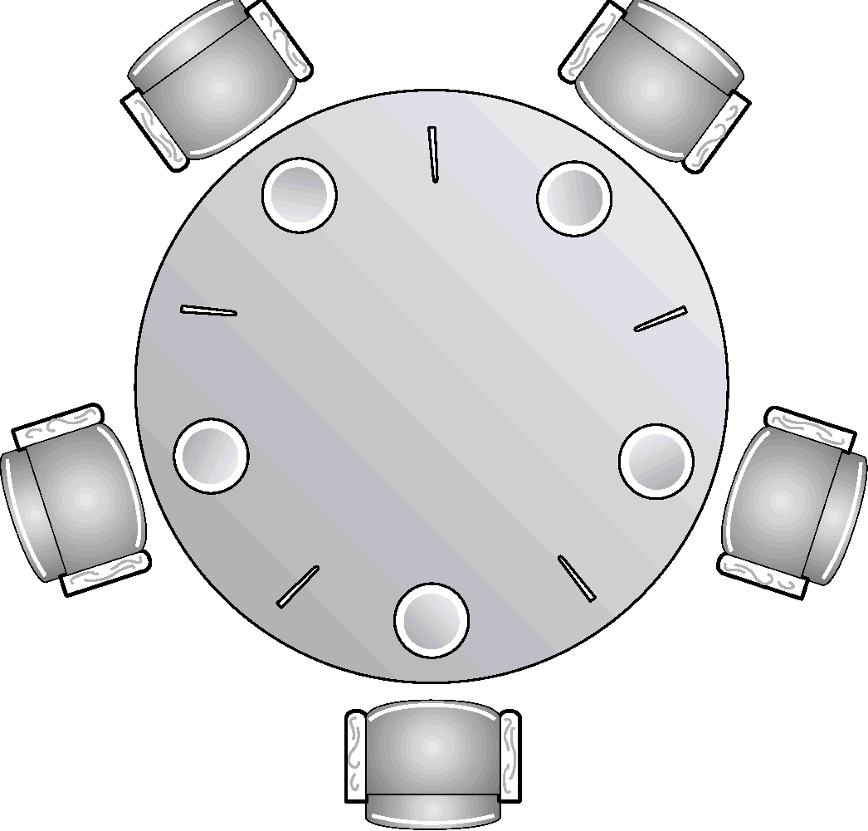
Dining Philosophers Problem
0
Callie
4
Brandon
Problem?
Deadlock!
There aren’t enough chopsticks to go around!
How do you write a program where no philosopher gets stuck?
0
1
Fatima
3
Mark
1
4
2
3
2
Kaleb

Slide 22
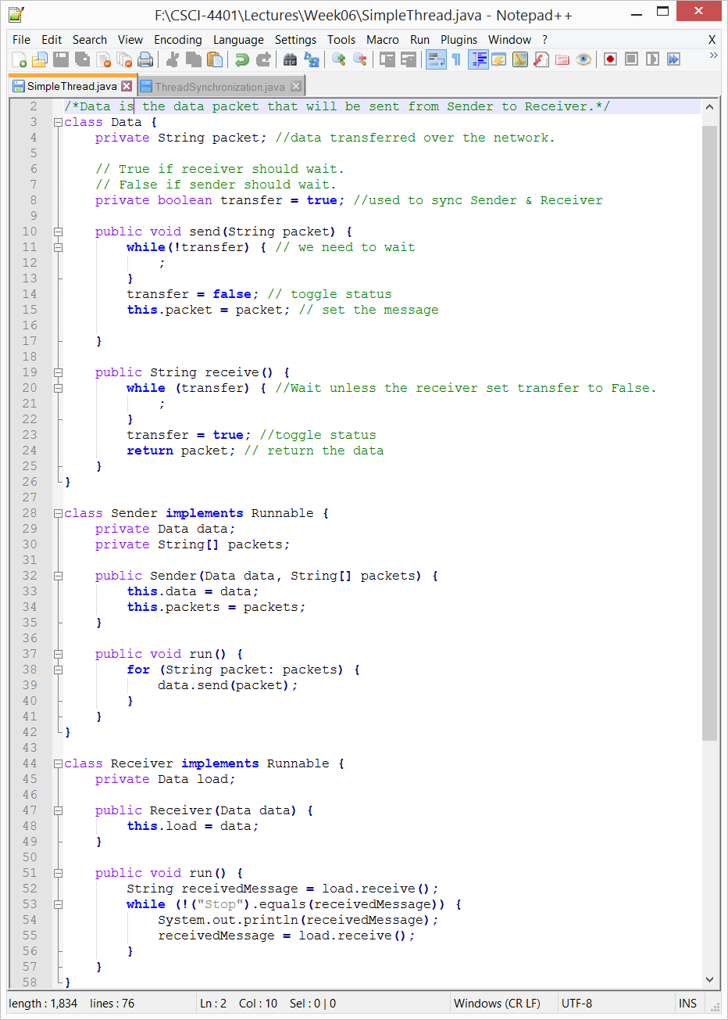
Java Thread without Monitors
SimpleThread.java
What will happen?

Slide 23
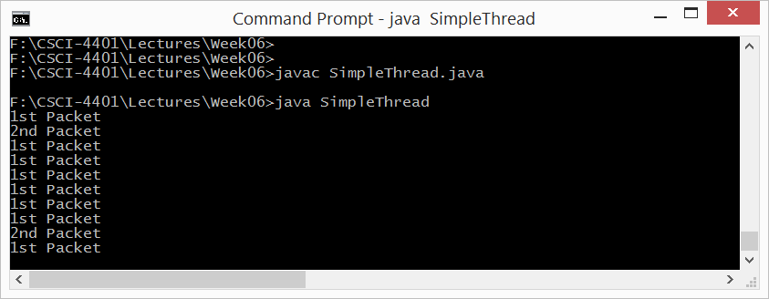
Java Thread without Monitors
SimpleThread.java
Deadlock!

Slide 24
Deadlocks

Slide 25





Bridge Crossing Example
Traffic only in one direction.
Each section of a bridge can be viewed as a resource.
If a deadlock occurs, it can be resolved if one car backs up (preempt resources and rollback).
Several cars may have to be backed up if a deadlock occurs.
Starvation is possible.

Slide 26
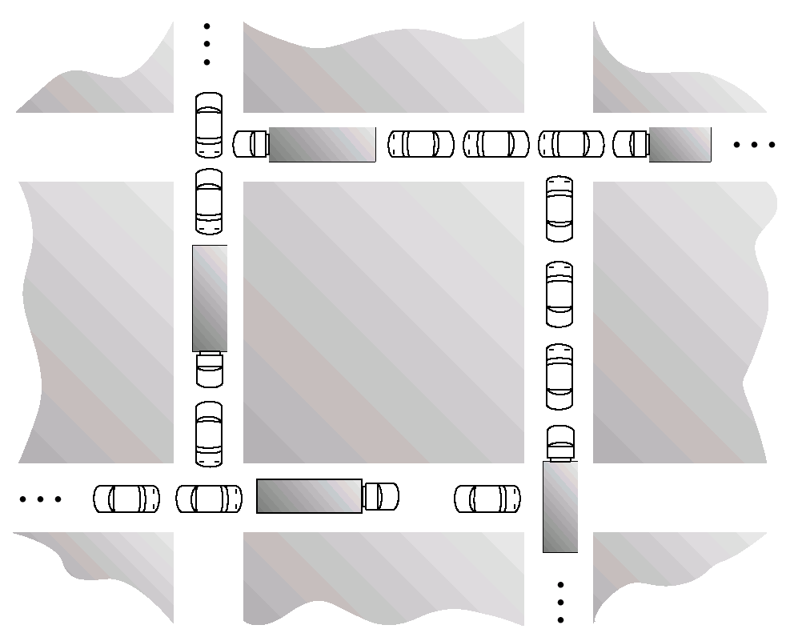
Traffic Deadlock

Slide 27
The Deadlock Problem
A set of blocked processes each holding a resource and waiting to acquire a resource held by another process in the set.
Example
System has files.
P₁ and P₂ each hold a lock on one file and each needs another one.
Example
semaphores A and B, initialized to 1
P₀ P₁
wait (A) wait(B)
wait (B) wait(A)

Slide 28
Deadlocks: System Model

Slide 29
System Model Assumptions
We have a finite number of different resource types: R₁, R₂, …, R_{n}
CPU cycles, files, memory space, I/O devices, etc.
Each resource of type R_{i} has W_{i} instances.
Ex. We have two CPUs, then we have two CPU instances.
Each process, P_{y}, utilizes a resource, R_{x}, as follows:
Request – if R_{x} is not available, P_{y} waits.
Use – P_{y} operates on R_{x}.
Release – P_{y} releases R_{x}
Resource allocation graph – models resource utilization by processes.

Slide 30
Resource-Allocation Graph
Process
Resource Type with 4 instances
P_{i} requests instance of R_{j}
P_{i} is holding an instance of R_{j}
P_{i}
R_{j}
P_{i}
R_{j}

Slide 31
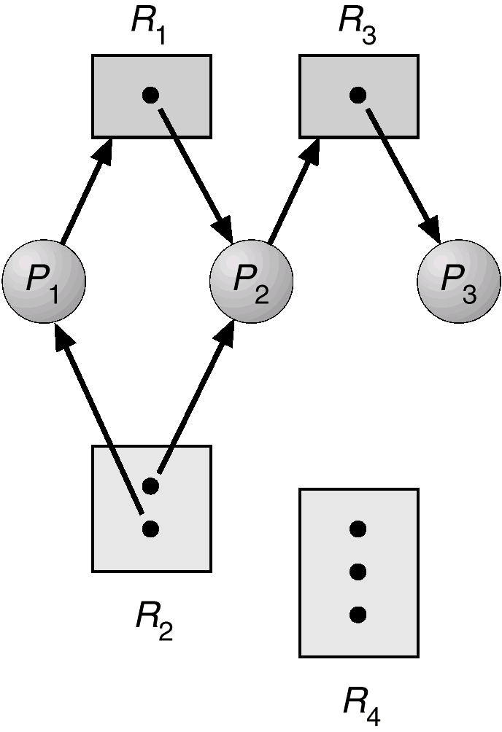
Resource-Allocation Graph Example

Slide 32
Deadlock Characterization

Slide 33
The 4 Pre-Conditions for a Deadlock
Mutual Exclusion – a resource can only be used by one process at a time.
Hold and Wait – a process holding at least one resource is waiting to acquire additional resources held by other processes.
No Preemption – resources are only released voluntarily by the process holding it.
Circular Wait –
We have a set of waiting processes {P₀, P₁, …, P_{n}}.
P₀ is waiting for a resource held by P₁.
P₁ is waiting for a resource held by P_{n}.
P_{n} is waiting for a resource held by P₀.

Slide 34
Resource Graph Example
Notes:
Deadlock?

Slide 35
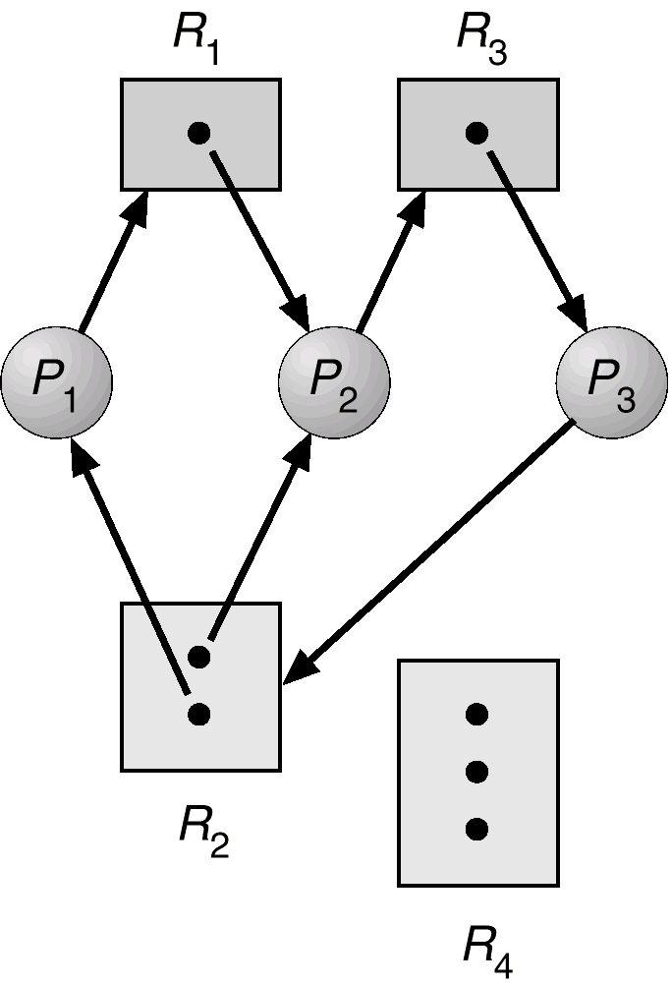
Resource Graph w/ Deadlock

Slide 36
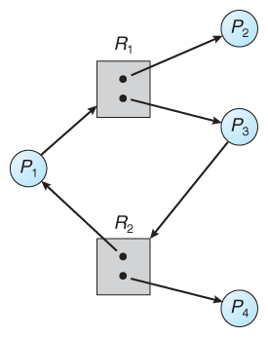
Deadlocked or Not?

Slide 37
Methods for Handling Deadlocks

Slide 38
4 Ways to Deal with Deadlocks
Prevention: design the system such that it can never enter a deadlocked state.
Avoidance: ensure that the system does not enter an “unsafe” state.
Recovery: allow the system to enter a deadlock state and then recover.
Ostrich approach: “stick your head in the sand.”
Used by most OSes (Windows and UNIX)
Application developers are responsible to handle deadlocks

Slide 39
Deal with Deadlock: Prevention
Ensure that deadlocks can never occur.
Use a set of methods to guarantee one of the four necessary conditions cannot hold:
mutual exclusion, hold and wait, no preemption, circular wait

Slide 40
Deal with Deadlock: Avoidance
Additional information must be given in advance.
What resources will a process use?
Using this knowledge, decide if the process should wait or not.

Slide 41
Deal with Deadlock: Recovery
If neither prevention or avoidance is employed, we may get deadlocks.
Use an algorithm to examine the state of the system and determine whether a deadlock has occurred.
If so, use a recovery algorithm.

Slide 42
Deal with Deadlock: Ostrich Approach
We may experience deadlocks if no prevention, avoidance, or recovery.
Undetected deadlocks will result in deterioration of system performance.
Resources are held by processes that cannot run.
Leads to more and more processes entering deadlock state.
Manual restart required.
Used by most OSes because:
Deadlocks happen infrequently (say 1/year)
Slowdown can be negligible
Cheaper approach

Slide 43
Deadlock Prevention

Slide 44
Deadlock Prevention: General Idea
All four conditions are necessary for a deadlock -> break one of them.
Mutual Exclusion
Hold and Wait
No preemption
Circular wait

Slide 45
Deadlock Prevention: Break Mutual Exclusion
OK for sharable resources, e.g., read-only files.
Is it a problem if multiple processes access a read-only file at the same time?
Bad idea for non-sharable resources, e.g., a printer.
What is the problem is multiple processes access a printer at the same time?

Slide 46
Deadlock Prevention: Break Mutual Exclusion
OK for sharable resources, e.g., read-only files.
Is it a problem if multiple processes access a read-only file at the same time?
Bad idea for non-sharable resources, e.g., a printer.
What is the problem is multiple processes access a printer at the same time?
Some resources are intrinsically non-sharable so we can’t break mutual exclusion.

Slide 47
Deadlock Prevention: Prevent Hold and Wait
To prevent hold and wait:
Guarantee that whenever a process requests a resource, it does not hold any other resources.
Request all resources at once (all-or-nothing)
Example: a process copies data from a DVD drive to a file on disk, sorts the file, and then send the results to a printer.
Holding none: initially requests only DVD drive and file, releases both, and then request the file (again) and printer.
All-or-nothing: request the DVD drive, disk file, and printer

Slide 48
Deadlock Prevention: Prevent Hold and Wait
To prevent hold and wait:
Guarantee that whenever a process requests a resource, it does not hold any other resources.
Request all resources at once (all-or-nothing)
Both have two disadvantages:
Low resource utilization: we hold onto resources for a long time.
For holding none, we can only request the file the 2nd time if the data remains in the file.
Starvation: what if we need two popular resources?

Slide 49
Deadlock Prevention: No Preemption
To break the no preemption condition:
We have a process holding some resources.
It requests another resource that is not immediately available.
Our process releases all resources it currently holds (i.e., preempted).
The preempted resources are added to the list of resources our process is waiting for.
Only restart process when it can get old and new resources it’s requesting.

Slide 50
Deadlock Prevention: Prevent Circular Wait
Impose a total ordering of all resource types.
Require that each process requests resources in an increasing order of enumeration.
Assign a unique number to each resource to decide precedence. Ex.
Tape drive = 1, disk drive = 5, printer =12
Our process can request the disk drive(5) and then the printer(12). It must release them if it then wants the tape drive(1).

Slide 51
Deadlock Avoidance

Slide 52
General Idea
Instead of ensuring one of the four deadlock conditions does not occur, use additional information -> how will the process use the resource?
Example:
Process P will request the disk drive and then the printer before releasing both resources.
Process Q will request the printer and then the disk drive before releasing both resources.
The system can then determine if a deadlock is possible and decide if a process should wait to avoid a deadlock.
Algorithms vary in the amount and type of information.
State: the number of available and allocated resources and the maximum demands of each process.

Slide 53
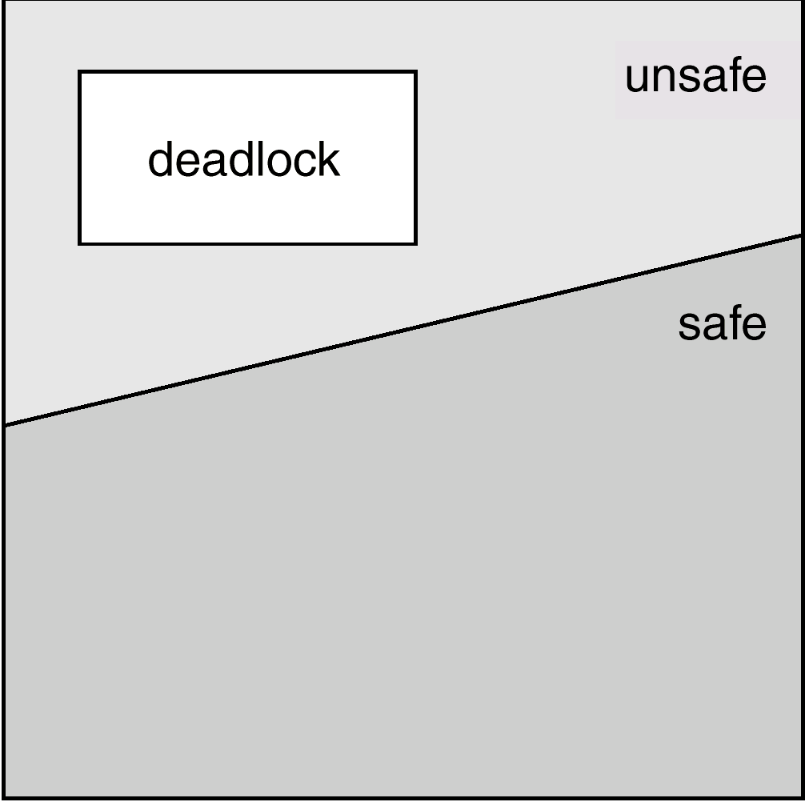
Safe State
A state is safe if the system can allocate all resources requested by all processes without entering a deadlock state.
A safe state is not a deadlocked state.
A deadlocked state is an unsafe state.
An unsafe state is not always a deadlocked state.

Slide 54
Safe Sequences
Formally: A state is safe if there exists a safe sequence of processes {P0, P1, … PN} such that all of the resource requests for Pi can be granted using the resources currently allocated to Pi and all processes Pj where j < i.
In other words: If all processes prior to Pi finish and free their resources, then Pi will be able to finish.
Example:
Our system has 12 disk drives and 3 processes {P0, P1, P2}.
Is the sequence <P1, P0, P2> safe? What about <P2, P0, P1>?
Process
P0
P1
P2
Maximum Needs
10
4
9
Current Needs
5
2
2
Notes:
Yes, 3 free. P1 runs and 5 free. P0 can run then 10 free. P2 can then run.
No, 3 free. P2 needs 7

Slide 55
Banker’s Algorithm: Introduction
Resource-allocation solution for resources with multiple instances.
Named because bankers could use to make sure that when they lend out resources, they can still service other clients.
Don’t loan out a little money to start building a house unless they are assured they have enough money to finish the house.
A process must state in advance the max resources it may request.
When a request is made, the system determines whether it creates a safe state or not.
Safe –> grant resources to process
Unsafe –> make process wait

Slide 56
Banker’s Algorithm: Data Structures
N – the number of processes
M – the number of resource categories
Available [M] – the number of available resources for each type
Max [N][M] – the max demand of each process for each resource
Allocation [N][M] – the number of resources allocated to each process
Need [N][M] – the remaining resources of each type for each process

Slide 57
Banker’s Algorithm: Data Structures
N ≡ number of processes, and
M ≡ number of resources types
3 N x M Matrices:
Need = Max - Allocation
A B C A B C A B C
P₀ 4 2 1 7 5 3 3 3 2
P₁ 1 0 1 3 2 2 2 2 1

Slide 58
Safety Verification
(Recall) when a request is made, does the request create a safe state?
In order to apply the Banker’s algorithm, we first need an algorithm to determine if a particular state is safe

Slide 59
Safety Verification: Algorithm (4 Steps)
1. Let Work and Finish be vectors of length m and n, respectively. Initialize:
Work = Available
Finish [i] = false for i = 1,2, …, n.
Indicates if a
process has finished

Slide 60
Safety Verification: Algorithm (4 Steps)
1. Let Work and Finish be vectors of length m and n, respectively. Initialize:
Work = Available
Finish [i] = false for i = 1,2, …, n.
2. Find an i such that both:
(a) Finish [i] = false
(b) Need_{i} ≤ Work
If no such i exists, go to Step 4.
The process has not finished, but could

Slide 61
Safety Verification: Algorithm (4 Steps)
1. Let Work and Finish be vectors of length m and n, respectively. Initialize:
Work = Available
Finish [i] = false for i = 1,2, …, n.
2. Find an i such that both:
(a) Finish [i] = false
(b) Need_{i} ≤ Work
If no such i exists, go to Step 4.
3. Work = Work + Allocation_{i} Finish[i] = true Go to step 2.
4. If Finish [i] == true for all i, then system is in safe state.
Indicates the process has finished and released resources

Slide 62
Resource-Request Algorithm (Banker’s Algorithm)
Now that we have a tool to determine if a particular state is safe or not, we are ready to look at the Banker’s algorithm.
This algorithm determines if a new request is safe and grants it only if it is safe to do so.
When a request is made, pretend it has been granted, and then test if the resulting state is safe.
Safe -> grant the request
Unsafe -> make the process wait

Slide 63
Resource-Request Algorithm (Banker’s Algorithm)
Request = request vector for process P_{i}. If Request_{i} [j] = k then process P_{i} wants k instances of resource type R_{j.}
1. If Request_{i} ≤ Need_{i} go to Step 2.
Else, raise error condition (process exceeded its maximum claim)
2. If Request_{i} ≤ Available, go to Step 3.
Else, P_{i} must wait (since resources are not available)
3. Pretend to allocate requested resources to P_{i} , modify the state:
Available = Available - Request_{i}
Allocation_{i} = Allocation_{i} + Request_{i}
Need_{i} = Need_{i} – Request_{i}
If safe ⇒ the resources are allocated to P_{i}
If unsafe ⇒ P_{i} must wait, and the old resource-allocation state is restored

Slide 64
Example of Banker’s Algorithm
5 processes: P₀ through P₄
3 resource types: A (10 instances), B (5 inst), and C (7 inst)
Snapshot at time T₀:
Allocation Max Available
A B C A B C A B C
P₀ 0 1 0 7 5 3 3 3 2
P₁ 2 0 0 3 2 2
P₂ 3 0 2 9 0 2
P₃ 2 1 1 2 2 2
P₄ 0 0 2 4 3 3

Slide 65
Example (Cont.)
Need is defined as Max – Allocation.
Does < P₁, P₃, P₄, P₂, P₀> satisfy safety criteria?
Allocation Max
A B C A B C
P₀ 0 1 0 7 5 3
P₁ 2 0 0 3 2 2
P₂ 3 0 2 9 0 2
P₃ 2 1 1 2 2 2
P₄ 0 0 2 4 3 3
Available
A B C
3 3 2
Need A B C P₀
P₁
P₂
P₃
P₄
Notes:
Available: T0 = 3,3,2; T1 = 5,3,2; T2 = 7,4,3; T3 = 7,4,5; T4 = 10, 4, 7; T5 = 10, 5, 7
Need: P0(7,4,3), P1(1,2,2), P2(6,0,0), P3(0,1,1), P4(4,3,1)

Slide 66
Example (Cont.)
Snapshot at time T₀:
Allocation Max Available
A B C A B C A B C
P₀ 0 1 0 7 5 3 3 3 2
P₁ 2 0 0 3 2 2
P₂ 3 0 2 9 0 2
P₃ 2 1 1 2 2 2
P₄ 0 0 2 4 3 3
The system is in a safe state since the sequence
< P₁, P₃, P₄, P₂, P₀> satisfies safety criteria.

Slide 67
Example (Cont.)
Snapshot at time T₀:
Allocation Need Available
A B C A B C A B C
P₀ 0 1 0 7 4 3 2 3 0
P₁ 3 0 2 0 2 0
P₂ 3 0 1 6 0 0
P₃ 2 1 1 0 1 1
P₄ 0 0 2 4 3 1
Executing safety algorithm shows that sequence <P₁, P₃, P₄, P₀, P₂> satisfies safety requirement.
What sequences would not satisfy our safety criteria?
Notes:
Running P0, P2, or P4 first. Etc.

Slide 68
Next Time
More on deadlocks

Slide 69
Class Reminders
Assignment 2 is due Monday, 10/2 9/25 @ 11:59pm.
Quiz 2 is due Monday, 9/18 @ 11:59pm
Threads & CPU Scheduling (Lectures 5 – 7)
Same setup as last time.
Midterm will be Thursday, 10/5

