Slide 1
CSCI 4401/5401: Principles of Operation Systems
James Wagner
University of New Orleans
Week 6, Lecture 12
September 21st, 2023

Slide 2
Announcements
Assignment 2 is due Monday, 10/2 @ 11:59pm.
Quiz 3 will be available after class and due Monday, 10/2 @ 11:59pm.
Lectures 8 – 12 (Process Synchronization & Deadlocks)
Midterm will be on Thursday, 10/5 during class.

Slide 3
What We’re Doing Today
Review & Finish Deadlocks
Start Main Memory

Slide 4
Deadlock Detection

Slide 5
Deadlock Detection: Introduction
If deadlocks are not avoided, then another approach is to 1) detect when they have occurred and 2) recover somehow.
In addition to the performance hit of constantly checking for deadlocks, a policy/algorithm must be in place for recovering from deadlocks, and there is potential for lost work when processes must be aborted or have their resources preempted.

Slide 6
Single Instance of Each Resource Type
If each resource category has a single instance, then we can use a variation of the resource-allocation graph known as a wait-for graph.
A wait-for graph can be constructed from a resource-allocation graph by eliminating the resources and collapsing the associated edges, as shown in the figure below.
An arc from Pi to Pj in a wait-for graph indicates that process Pi is waiting for a resource that process Pj is currently holding.

Slide 7
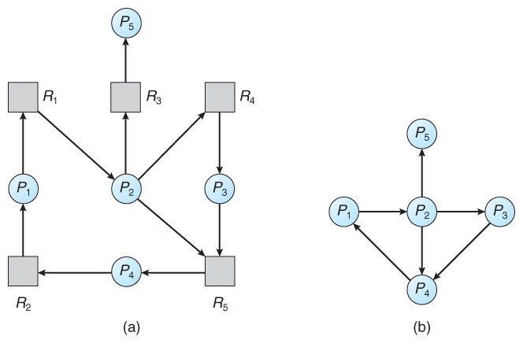
Single Instance of Each Resource Type
As before, cycles in the wait-for graph indicate deadlocks.
This algorithm must maintain the wait-for graph, and periodically search it for cycles.
Resource-allocation graph
Corresponding wait-for graph

Slide 8
Several Instances of a Resource Type
The detection algorithm outlined here is essentially the same as the Banker's algorithm, with two subtle differences in Steps 1 & 4.
Steps 2 & 3 are unchanged.

Slide 9
Several Instances of a Resource Type
The detection algorithm outlined here is essentially the same as the Banker's algorithm, with two subtle differences:
1. Let Work and Finish be vectors of length m and n, respectively. Initialize:
Work = Available
For i = 1,2, …, n :
If Allocation != 0, Finish [i] = false
Else Finish[i] = true
2. Find and i such that both:
(a) Finish [i] = false
(b) Need_{i} ≤ Work
If no such i exists, go to Step 4.
3. Work = Work + Allocation_{i} Finish[i] = true Go to step 2.
4. If Finish [i] == false for some i, then Pi is deadlocked.
*Assumes that if all other processes can finish, this process can finish.
**Only concerned about processes in a deadlock. No deadlock w/out resources.
****Makes the algorithm more specific about which process is involved.

Slide 10
Several Instances of a Resource Type
Consider, for example, the following state, and determine if it is currently deadlocked. Start with sequence < P₀, P₂, P₃, P₁, P₄>
Available
A B C
0 0 0
0 1 0 true
3 1 3 true
5 2 4 true
7 2 4 true
7 2 6 true
Allocation Need
A B C A B C
P₀ 0 1 0 0 0 0
P₁ 2 0 0 2 0 2
P₂ 3 0 3 0 0 0
P₃ 2 1 1 1 0 0
P₄ 0 0 2 0 0 2

Slide 11
Several Instances of a Resource Type
Consider, for example, the following state, and determine if it is currently deadlocked. Start with sequence < P₀, P₂, P₃, P₁, P₄>
Available
A B C
0 0 0
0 1 0
can’t run, false
Can’t run, false
Can’t run, false
Can’t run, false
Allocation Need
A B C A B C
P₀ 0 1 0 0 0 0
P₁ 2 0 0 2 0 2
P₂ 3 0 3 0 0 1
P₃ 2 1 1 1 0 0
P₄ 0 0 2 0 0 2
Available
A B C
0 0 0
Suppose P2 makes an additional request for C

Slide 12
Several Instances of a Resource Type
Consider, for example, the following state, and determine if it is currently deadlocked. Start with sequence < P₀, P₂, P₃, P₁, P₄>
Allocation Need
A B C A B C
P₀ 0 1 0 0 0 0
P₁ 2 0 0 2 0 2
P₂ 3 0 3 0 0 1
P₃ 2 1 1 1 0 0
P₄ 0 0 2 0 0 2
Available
A B C
0 0 0
What if we caught the deadlock earlier?
Ex. Before P4 entered?

Slide 13
Detection Algorithm Usage
When should the deadlock detection be done? Frequently, or infrequently?
The answer may depend on how frequently deadlocks are expected to occur, as well as the possible consequences of not catching them immediately. ( If deadlocks are not removed immediately when they occur, then more and more processes can "back up" behind the deadlock, making the eventual task of unblocking the system more difficult and possibly damaging to more processes. )

Slide 14
Detection Algorithm Usage
There are two obvious approaches, each with trade-offs:
Do deadlock detection after every resource allocation which cannot be immediately granted.
Advantage: detects the deadlock right away, while the minimum number of processes are involved in the deadlock.
Downside: extensive overhead and performance hit caused by checking for deadlocks so frequently.
Do deadlock detection only when there is some clue that a deadlock may have occurred, such as when CPU utilization reduces to 40% or some other magic number.
Advantage: deadlock detection is done much less frequently
Downside: it becomes impossible to detect the processes involved in the original deadlock, and so deadlock recovery can be more complicated and damaging to more processes.

Slide 15
Recovery from Deadlock

Slide 16
Breaking a Deadlock
Two basic options to break a deadlock:
Terminate one or more processes involved in the deadlock.
Preempt resources from deadlocked processes.

Slide 17
Process Termination
Two basic approaches, both of which recover resources allocated to terminated processes:
Terminate all processes involved in the deadlock. This definitely solves the deadlock, but at the expense of terminating more processes than would be absolutely necessary.
Terminate processes one by one until the deadlock is broken. This is more conservative but requires doing deadlock detection after each step.

Slide 18
Process Termination: One by one
In the latter case there are many factors that can go into deciding which processes to terminate next. How do you decide?
Process priorities.
How long the process has been running, and how close it is to finishing.
How many and what type of resources is the process holding. ( Are they easy to preempt and restore? )
How many more resources does the process need to complete.
How many processes will need to be terminated
Whether the process is interactive or batch.
Has the process made non-restorable changes to any resource.

Slide 19
Resource Preemption
When preempting resources to relieve deadlock, there are three important issues to be addressed:
Selecting a victim - Choosing resources to preempt from processes involves many of the decision criteria for process termination.
Rollback - Return a preempted process to a safe state prior to resource allocation.
Difficult/impossible to determine last safe state, and so the only safe rollback is to roll back all the way back to the beginning, i.e., abort the process and make it start over.
Starvation - Don’t always want to select the same victim.
Increase priority for a process each time its resources are preempted.

Slide 20
Deadlocks: Practice Problems

Slide 21
Deadlocks: Discussion
Consider a computer system that runs 5000 jobs/month and has no deadlock-prevention or deadlock-avoidance scheme. Deadlocks occur about twice/month, and the operator must terminate and rerun about 10 jobs/deadlock. Each job is worth about $2 (in CPU time), and the jobs terminated tend to be about 50% complete when aborted.
You estimate that a deadlock-avoidance algorithm (e.g., the Banker’s Algorithm) could be installed with an increase in the average execution time of about 10%/job. Since the machine has ~30% idle time, all 5000 jobs/month could still be run, although the turnaround time would increase by about ~20% on average.
What are the argument for and against installing a deadlock avoidance algorithm?
Notes:
For: Avoids deadlocks and the cost of re-runs. Increases useful utilization of resources.
Against: Increases total execution time. The total load is $10k/month. Rerunning 10 jobs costs $10 (or $20/month). Adding 10%/job would add $1000/month. You’ve also reduced the idle time for future jobs.

Slide 22
Deadlocks: Exercise
Safe Sequence: < >
What is the Need matrix?
Is the system in a safe state? What’s the sequence(s)?
Available
A B C D
1 5 2 0
Need
A B C D
Allocation Max
A B C D A B C D
P₀ 0 0 1 2 0 0 1 2
P₁ 1 0 0 0 1 7 5 0
P₂ 1 3 5 4 2 3 5 6
P₃ 0 6 3 2 0 6 5 2
P₄ 0 0 1 4 0 6 5 6
Notes:
P0 (1 5 3 2), P2 (2 8 8 6), P3 (2 14 11 8)

Slide 23
Main Memory

Slide 24
What we’re doing
We’ve discussed how the CPU can be shared by a set of processes.
CPU scheduling improves 1) CPU utilization and 2) response to users
To do this, we must keep several processes in memory.
We are next going to talk about approaches to manage memory.

Slide 25
Main Memory: Background

Slide 26
Motivation
CPU can only access main memory and registers directly.
Basic problem: an executable program must be placed into main memory in order to be run.
Placed where exactly? Memory management

Slide 27
Memory Management Issues
Managing a single program:
What management? – just place it at address 0.
Space problem: program could still be too big!
Observation: CPU does not need the whole program at once.
Multi-programming:
Mapping problems: only one process can start at address 0…

Slide 28
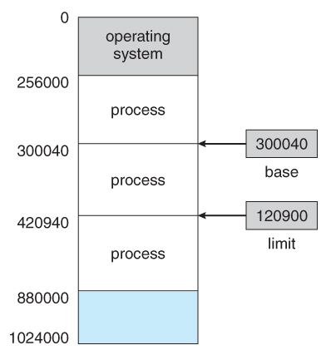
Address Space
Physical
Address
A user process must be restricted to access memory locations that belong to that particular process.
Each process uses a base register and a limit register.
Base register – smallest physical memory address
Limit register – size of the range

Slide 29
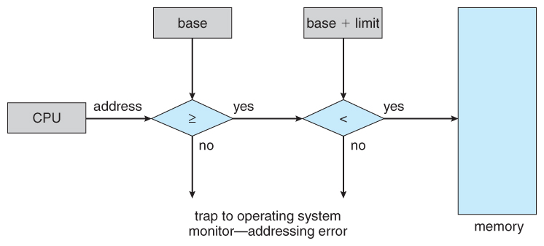
Basic Hardware
Every memory access made by a user process is checked against these two registers.
If a memory access is attempted outside the valid range, then a fatal error is generated.
Changing the base and limit registers is a privileged activity.
Only allowed by the OS kernel.

Slide 30
Address Binding
Not all processes can begin at 00000.
A user process uses a symbolic name (or a logical address) to refer to a memory address.
These logical memory addresses must be mapped or bound to physical memory addresses -> address binding
Address binding can occur at a few stages before program execution:
Compile time
Load time
Run (or execution) time

Slide 31
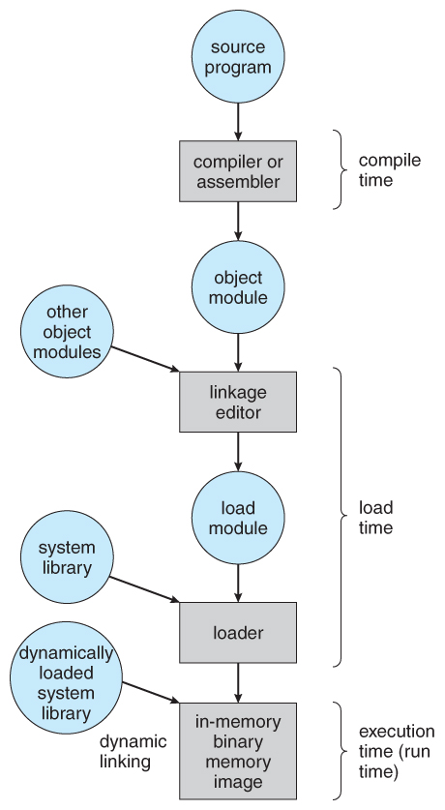
Address Binding
Compile time
If physical memory location is known at c.t., then logical = physical -> absolute code.
If starting location changes, must recompile code.
Load time
Don’t know starting location. Reference addresses relative to start -> relocatable code.
If starting location changes, reload (not recompile) program.
Run time
If a program can be moved around in memory, must delay binding until execution -> “binding on the fly”
Implemented by most OSes.
Requires special hardware, MMU.

Slide 32
Logical vs Physical Address Space
Separation of logical address space from physical address space is central to memory management.
Logical address - The address generated by the CPU.
Physical address - The address actually seen by the memory hardware.

Slide 33
Logical vs Physical Address Space
Addresses bound at compile time or load time have identical logical and physical addresses.
Addresses created at run time, however, have different logical and physical addresses.
In this case the logical address is also known as a virtual address. These terms may be used interchangeably.
The set of all logical addresses used by a program composes the logical address space, and the set of all corresponding physical addresses composes the physical address space.

Slide 34
Memory-Management Unit (MMU)
Memory-Management Unit (MMU): hardware device that handles run time mapping of logical to physical addresses
The base register is now termed a relocation register, whose value is added to every memory request at the hardware level.
Note: User programs never see physical addresses. User programs work entirely in logical address space, and any memory references or manipulations are done using purely logical addresses.

Slide 35
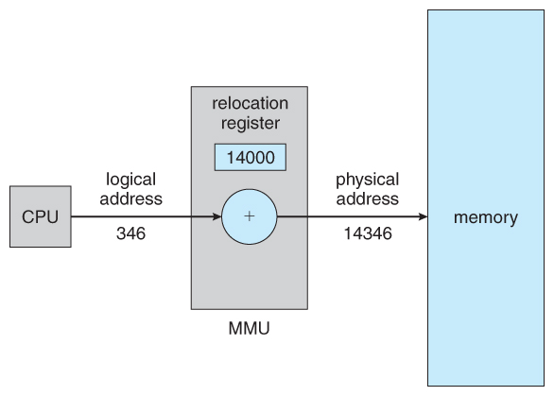
Dynamic Relocation using a Relocation Register
The value of the relocation register is added to every address generated by a user process.

Slide 36
Dynamic Loading
Rather than load an entire program into memory at once, dynamic loading loads each routine as it is called.
No special OS support required -> implemented through user program.
The advantage is that unused routines never need to be loaded.
Reduces total memory usage
Faster program startup times
The downside is added complexity and overhead.
Checking to see if a routine is loaded every time it is called
Then loading it up if it is not already loaded
When would this be more useful? Code size, use frequency, etc.
Notes:
Infrequent code (e.g., error routines)

Slide 37
Dynamic Linking
Static linking - Library modules get fully included in executable modules.
Wastes both disk space and main memory usage.
Every program that included a certain routine from the library must have their own copy of that routine linked into their executable code.
Dynamic linking – Linking is postponed until execution time.
Stub – small piece of code used to locate the appropriate memory-resident library routine (or how to load it).
When the stub is executed, it replaces itself with the address of the routine and executes the routine.
Requires some help from OS -> Processes are protected from each other -> Need to check if the routine is in another process’ memory space.

Slide 38
Dynamic Linking and Shared Libraries
Dynamic linking can be extended to library updates (e.g., bug fixes).
A library is replaced by a new version. All programs that reference the library will use the new version.
Without dynamic linking, all programs would need to be re-linked so they do not execute different library versions.
This system is known as shared libraries.

Slide 39
Main Memory: Swapping

Slide 40
Swapping
A process must be loaded into memory in order to execute.
There may not be enough memory available to keep all processes in memory at the same time.
Some processes who are not currently using the CPU may have their memory swapped out to a fast local disk called the backing store.

Slide 41
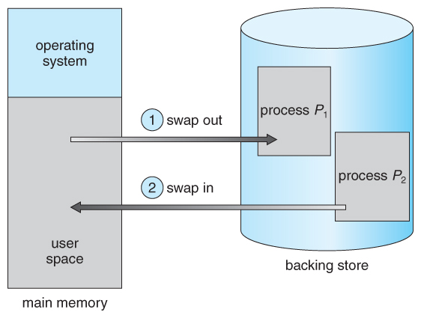
Swapping: Example
We have round-robin CPU scheduling.
When the quantum expires for a process, swap that process out and swap another into the memory we just freed.

Slide 42
Standard Swapping
Swapping is a very slow process compared to other operations.
Most modern OSes no longer use swapping, because it is too slow and there are faster alternatives (e.g., paging).
Example:
100 MB Process
50 MB/s back store transfer rate
2 seconds to swap in or out.
But 4 seconds for the round trip.
This also ignores additional overheads (e.g., latency).

Slide 43
Main Memory: Contiguous Memory Allocation

Slide 44
Contiguous Memory Allocation: Motivation
Main memory must accommodate both the OS and the various user processes.
We need an efficient way to allocate main memory.
One approach to memory management is to load each process into a contiguous space.
The OS is allocated space first, usually in low memory locations. User processes get remaining high memory.
OS
process 0
process 1
process 2

Slide 45
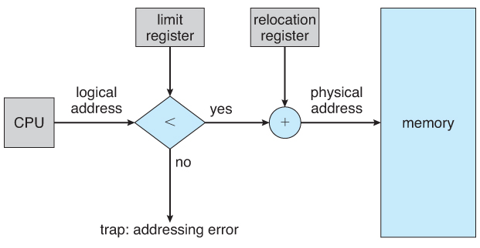
Memory Mapping and Protection
The system in the figure allows protection against user programs accessing areas that they should not.
Allows programs to be relocated to different memory starting addresses as needed and allows the memory space devoted to the OS to grow or shrink dynamically as needs change.
MMU

Slide 46
Contiguous Memory Allocation Methods
One approach: divide memory into fixed-size partitions of all equal size. Then assign each process to its own partition.
Restricts number of simultaneous processes and max size of each process
No longer used.
An alternative approach is to keep a list of unused (free) memory blocks (holes), and to find a hole of suitable size whenever a process needs to be loaded into memory.
How do decide which process gets which block?

Slide 47
Contiguous allocation: issues
OS
OS
OS
OS
process 5
process 5
process 5
process 9
process 12
…
process 10
?
process 8
process 2
process 2
process 2
process 2
process 21

Slide 48
Dynamic Storage Allocation Strategies
How do decide which process gets which block?
First fit – allocate to the first hole that is big enough
Best fit –
Allocate the smallest hole that is big enough
Must search entire list
Produces the smallest leftover hole
Worst fit –
Allocate the largest hole available
Must search entire list
Produces the largest leftover hole

Slide 49
Practice Exercises
What is the difference between logical and physical memory?
Given 5 memory partitions: 100 KB, 500 KB, 200 KB, 300 KB, & 600 KB and 4 processes: 212 KB, 417 KB, 112 KB, and 426 KB, how would the first-fit, best-fit and worst-fit algorithms place them in memory? Who makes most efficient use?
100
KB
500
KB
200
KB
300
KB
600
KB
212 KB
417 KB
112 KB
426 KB

Slide 50
Dynamic Storage Allocation Strategies
How do decide which process gets which block?
First fit – allocate to the first hole that is big enough
Best fit –
Allocate the smallest hole that is big enough
Must search entire list
Produces the smallest leftover hole
Worst fit –
Allocate the largest hole available
Must search entire list
Produces the largest leftover hole
First & Best Fit better than Worst Fit for speed and storage utilization.
First ≈ Best Fit for storage utilization, but First Fit is faster.
Observation: they all lead to fragmentation.

Slide 51
Fragmentation
All contiguous memory allocation strategies suffer from external fragmentation.
External fragmentation: the available memory is broken up into lots of little pieces, none of which is big enough to satisfy the next memory requirement, although the sum total could.
One solution: Compaction
Shuffle memory contents to place all free memory together in a large block
It may get expensive
Another solution:
Who says the logical address space has to be physically contiguous?
Divide memory into fixed-sized chunks - pages

Slide 52
Next Time
Memory management (Chapter 3)

