Slide 1
CSCI 4401/5401:
Principles of Operation Systems
James Wagner
University of New Orleans
Week 8, Lecture 14
September 28th, 2023

Slide 2
Announcements
Assignment 2 is due Monday, 10/2 @ 11:59pm.
Quiz 3 is due Monday, 10/2 @ 11:59pm.
  Lectures 8 – 12 (Process Synchronization & Deadlocks)
Midterm will be on Thursday, 10/5 during class.
  Chapters 1, 2, and 6
  Review next lecture (Lecture 14, 9/28)

Slide 3
Midterm Review

Slide 4
Midterm Details
Thursday, 10/5 in class (75 minutes)
In-person section takes in class.
Online section takes through Canvas.
  Being on Zoom is optional. If you have a problem and you are not on Zoom to tell me immediately, that is on you.
  It is your responsibility to have an internet connection. If you are worried about this, you have the option to take the exam in person – just let me know.
Covers everything up to (and including) deadlocks
  Chapters 1, 2, and 6
Open book and notes. No other resources!
Expect mostly short answer questions
5401 students will have an extra question or two
  This will be E.C. for 4401 students

Slide 5
Outline
Introduction to OSes & OS Concepts (Lecture 1 – 2)
Processes (Lectures 3 - 4)
Threads (Lectures 5 – 6)
CPU Scheduling (Lectures 7 - 8)
Process Synchronization (Lectures 8 – 10)
Deadlocks (Lectures 10 – 12)

Slide 6
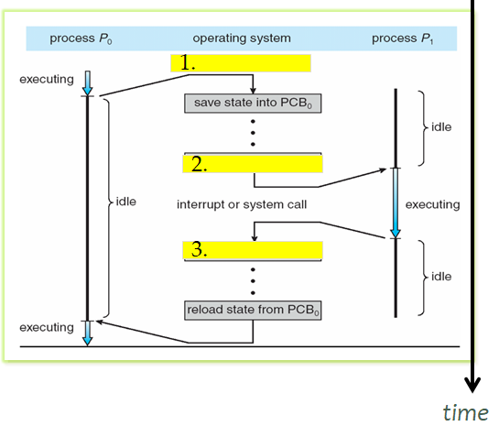
Round 1: Processes
What is a process? Draw a diagram to describe the different components.
What are the different
process states?
Draw a diagram to show
the different transitions
processes can make
between states.
Describe context switching
in your own words.
Fill in the (3) blank steps
in the diagram to help.
  Where does the PCB go
  when the state is saved?

Slide 7
Round 2: Threads
What are some differences (or trade-offs) between processes and threads? Draw figures of each to help explain.
What are the 3 multithreading models? Use diagrams to explain each.
  Given that you know the trade-offs between user-level and kernel-level threads, explain some advantages and disadvantages of each multithreading model.

Slide 8
Round 3: CPU Scheduling
Describe each of the following CPU scheduling algorithms. Draw an example diagram for each.
  First-come, first-serve
  Shortest job first (non-preemptive vs. preemptive)
  Priority Scheduling
  Round Robin
Consider the set of processes with their CPU bursts and arrival times.
Process Burst Time(ms) Arrival Time(ms)
P1 10 0
P2 4 3
P3 2 7
P4 1 9
P5 5 12
A. Draw three Gantt charts to illustrate the process execution for FCFS, preemptive SJF, and RR (q = 1ms) scheduling algorithms.
B. What is the waiting time of each process for each algorithm?
C. Which algorithm results in the minimum avg waiting time?

Slide 9
Round 3: CPU Scheduling
Consider the set of processes with their CPU bursts and arrival times.
Process Burst Time(ms) Arrival Time(ms)
P1 10 0
P2 4 3
P3 2 7
P4 1 9
P5 5 12
A. Draw three Gantt charts to illustrate the process execution for FCFS, preemptive SJF, and RR (q = 1ms) scheduling algorithms.
B. What is the waiting time of each process for each algorithm?
C. Which algorithm results in the minimum avg waiting time?
P?
P1
P1
P1
P1
P1
P1
P1
P1
P2
P2
P2
P2
P3
P3
P4
P5
P5
Time
(ms)
0
1
2
3
4
5
6
7
8
9
10
11
12
12
13
14
15
16
17
18
19
20
21
22

Slide 10
Round 3: CPU Scheduling
Consider the set of processes with their CPU bursts and arrival times.
Process Burst Time(ms) Arrival Time(ms)
P1 10 0
P2 4 3
P3 2 7
P4 1 9
P5 5 12
A. Draw three Gantt charts to illustrate the process execution for FCFS, preemptive SJF, and RR (q = 1ms) scheduling algorithms.
B. What is the waiting time of each process for each algorithm?
C. Which algorithm results in the minimum avg waiting time?
P?
P1
P1
P1
P1
P1
P1
P1
P1
P2
P2
P2
P2
P3
P3
P4
P5
P5
Time
(ms)
0
1
2
3
4
5
6
7
8
9
10
11
12
12
13
14
15
16
17
18
19
20
21
22

Slide 11
Round 3: CPU Scheduling
Consider the set of processes with their CPU bursts and arrival times.
Process Burst Time(ms) Arrival Time(ms)
P1 10 0
P2 4 3
P3 2 7
P4 1 9
P5 5 12
A. Draw three Gantt charts to illustrate the process execution for FCFS, preemptive SJF, and RR (q = 1ms) scheduling algorithms.
B. What is the waiting time of each process for each algorithm?
C. Which algorithm results in the minimum avg waiting time?
P?
P1
P1
P1
P1
P1
P1
P1
P1
P2
P2
P2
P2
P3
P3
P4
P5
P5
Time
(ms)
0
1
2
3
4
5
6
7
8
9
10
11
12
12
13
14
15
16
17
18
19
20
21
22

Slide 12
Round 4: Process Synchronization
What is meant by the term race condition? Give some examples.
  How is it related to the term critical section?
  How is critical section related to mutual exclusion?
How do semaphores solve the problem of busy waiting?
How can a deadlock occur in the Dining Philosophers Problem when using semaphores? Give at least one solution to this problem (using semaphores).
What is the difference between binary semaphores (mutex) and counting semaphores? When would you want to use each?
  Ex. 20 people in line at a restaurant with 10 tables available. What’s the semaphore?

Slide 13
Round 5: Deadlocks
Describe the four pre-conditions for a deadlock. Describe the 4 ways to deal with a deadlock.
Does the following snapshot contain a safe sequence? Is so, give one.
Allocation Max Available
A B C A B C A B C
P₀ 0 1 0 7 5 3 2 2 5
P₁ 2 0 0 3 5 7
P₂ 3 0 2 3 6 2
P₃ 2 1 1 3 2 6
P₄ 0 0 2 4 3 3
 | A | B | C
P0
P1
P2
P3
P4
Time0(x):
Time1(P?):
Time2(P?):

