Slide 1
CSCI 4401/5401: Principles of Operation Systems
James Wagner
University of New Orleans
Week 8, Lecture 15
October 3rd, 2023

Slide 2
Announcements
Midterm exam will be Thursday, October 5th

Slide 3
Quiz 3 Review

Slide 4
Quiz 3: 1 - 5
What is busy waiting?
What is the critical section?
What is a monitor?
What are the deadlock pre-conditions?
What are the strategies to deal with deadlocks?
Notes:
1. Sitting in a tight while loop
2. Code where shared data is accessed
3. Java abstract data type used for mutually exclusive procedures. One thread in a monitor at a time.
4.

Slide 5
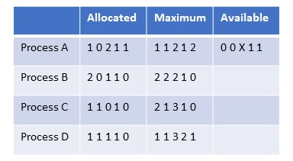
Quiz 3 #6 & 7
9. The system below has four processes and five resources. What is the smallest value of x for which this is a safe state? What would be a safe sequence?
 | R1 | R2 | R3 | R4 | R5
PA
PB
PC
PD
Time0: 0 0 2 1 1
Time1:
Time2:
Time3:
Time4:
Notes:
X = 2, PD, PC, …

Slide 6
Quiz 3: 8 & 9
Describe the Bakery Algorithm
Describe semaphores
Notes:
8. Works for many processes. A proc cannot continue if another is selecting a ticket. Two procs can get same ticket#. It’s expensive.
9. Solve busy waiting, can enter a deadlock, they use atomic operations, a mutex is a binary semaphore

Slide 7
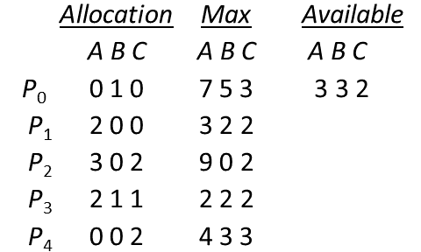
Quiz 3: #10
What sequences satisfy the safety criteria?
Notes:
We did this example in class…

Slide 8
Midterm Review

Slide 9
Midterm Details
Thursday, 10/5 in class (75 minutes)
In-person section takes in class.
Online section takes through Canvas.
Being on Zoom is optional. If you have a problem and you are not on Zoom to tell me immediately, that is on you.
It is your responsibility to have an internet connection. If you are worried about this, you have the option to take the exam in person – just let me know.
Covers everything up to (and including) deadlocks
Chapters 1, 2, and 6
Open book and notes. No other resources!
Expect mostly short answer questions
5401 students will have an extra question or two
This will be E.C. for 4401 students

Slide 10
Outline
Introduction to OSes & OS Concepts (Lecture 1 – 2)
Processes (Lectures 3 - 4)
Threads (Lectures 5 – 6)
CPU Scheduling (Lectures 7 - 8)
Process Synchronization (Lectures 8 – 10)
Deadlocks (Lectures 10 – 12)

Slide 11
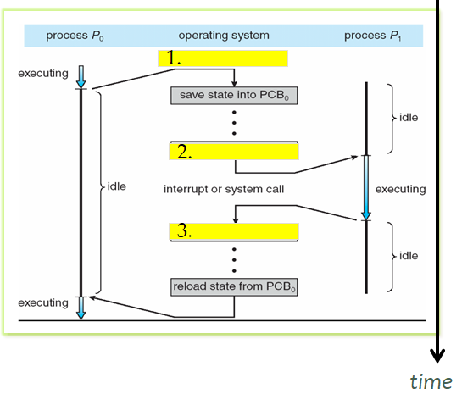
Round 1: Processes
What is a process? Draw a diagram to describe the different components.
What are the different process states? Draw a diagram to show the different transitions processes can make between states.
Describe context switching in your own words. Fill in the (3) blank steps in the diagram to help.
Where does the PCB go when the state is saved?

Slide 12
Round 2: Threads
What are some differences (or trade-offs) between processes and threads? Draw figures of each to help explain.
What are the 3 multithreading models? Use diagrams to explain each.
Given that you know the trade-offs between user-level and kernel-level threads, explain some advantages and disadvantages of each multithreading model.

Slide 13
Round 3: CPU Scheduling
Describe each of the following CPU scheduling algorithms. Draw an example diagram for each.
First-come, first-serve
Shortest job first (non-preemptive vs. preemptive)
Priority Scheduling
Round Robin
Consider the set of processes with their CPU bursts and arrival times.
Process Burst Time(ms) Arrival Time(ms)
P1 10 0
P2 4 3
P3 2 7
P4 1 9
P5 5 12
A. Draw three Gantt charts to illustrate the process execution for FCFS, preemptive SJF, and RR (q = 1ms) scheduling algorithms.
B. What is the waiting time of each process for each algorithm?
C. Which algorithm results in the minimum avg waiting time?

Slide 14
Round 3: CPU Scheduling
Consider the set of processes with their CPU bursts and arrival times.
Process Burst Time(ms) Arrival Time(ms)
P1 10 0
P2 4 3
P3 2 7
P4 1 9
P5 5 12
A. Draw three Gantt charts to illustrate the process execution for FCFS, preemptive SJF, and RR (q = 1ms) scheduling algorithms.
B. What is the waiting time of each process for each algorithm?
C. Which algorithm results in the minimum avg waiting time?
P?
P1
P1
P1
P1
P1
P1
P1
P2
P2
P3
P5
P1
P2
Time
(ms)
0
1
2
3
4
5
6
7
8
9
10
11
12
P2
P3
P4
P5
12
13
14
15
16
17
18
19
20
21
22

Slide 15
Round 3: CPU Scheduling
Consider the set of processes with their CPU bursts and arrival times.
Process Burst Time(ms) Arrival Time(ms)
P1 10 0
P2 4 3
P3 2 7
P4 1 9
P5 5 12
A. Draw three Gantt charts to illustrate the process execution for FCFS, preemptive SJF, and RR (q = 1ms) scheduling algorithms.
B. What is the waiting time of each process for each algorithm?
C. Which algorithm results in the minimum avg waiting time?
P?
P1
P1
P1
P1
P1
P2
P2
P2
P3
P5
P1
P2
P3
P4
P1
Time
(ms)
0
1
2
3
4
5
6
7
8
9
10
11
12
P1
P5
12
13
14
15
16
17
18
19
20
21
22

Slide 16
Round 3: CPU Scheduling
Consider the set of processes with their CPU bursts and arrival times.
Process Burst Time(ms) Arrival Time(ms)
P1 10 0
P2 4 3
P3 2 7
P4 1 9
P5 5 12
A. Draw three Gantt charts to illustrate the process execution for FCFS, preemptive SJF, and RR (q = 1ms) scheduling algorithms.
B. What is the waiting time of each process for each algorithm?
C. Which algorithm results in the minimum avg waiting time?
P?
P1
P1
P1
P2
P1
P2
P1
P2
P3
P1
P2
P3
Time
(ms)
0
1
2
3
4
5
6
7
8
9
10
11
12
P4
P5
P5
P5
P1
P1
P1
P5
P1
P5
12
13
14
15
16
17
18
19
20
21
22

Slide 17
Round 4: Process Synchronization
What is meant by the term race condition? Give some examples.
How is it related to the term critical section?
How is critical section related to mutual exclusion?
How do semaphores solve the problem of busy waiting?
How can a deadlock occur in the Dining Philosophers Problem when using semaphores? Give at least one solution to this problem (using semaphores).
What is the difference between binary semaphores (mutex) and counting semaphores? When would you want to use each?
Ex. 20 people in line at a restaurant with 10 tables available. What’s the semaphore?

Slide 18
Round 5: Deadlocks
Describe the four pre-conditions for a deadlock. Describe the 4 ways to deal with a deadlock.
Does the following snapshot contain a safe sequence? Is so, give one.
Allocation Max Available
A B C A B C A B C
P₀ 0 1 0 7 5 3 2 2 5
P₁ 2 0 0 3 5 7
P₂ 3 0 2 3 6 2
P₃ 2 1 1 3 2 6
P₄ 0 0 2 4 3 3
 | A | B | C
P0 | 7 | 4 | 3
P1 | 1 | 5 | 7
P2 | 0 | 6 | 0
P3 | 1 | 1 | 5
P4 | 4 | 3 | 1
Time0(x): (2, 5, 5)
Time1(P3): (4, 6, 6)
Time2(P4): (4, 6, 8)
Time3(P1): (6, 6, 8)
Time4(P2): (9, 6, 10)

Slide 19
Next time
Midterm!
Assignment 3 will be posted next week.

