Slide 1
CSCI 4401/5401: Principles of Operation Systems
James Wagner
University of New Orleans
Week 9, Lecture 16
October 12th, 2023

Slide 2
Announcements
Slight adjustment to attendance policy
Assignment 3 is due Monday, November 6th @ 11:59pm
Midterm grades do not include Assignment 2

Slide 3
What We’re Doing Today
Review the Midterm
Discuss Assignment 3
Review/Finish Main Memory

Slide 4
Midterm Review

Slide 5
Midterm Exam Results
 | Online | % | Class | % | Total | %
A | 6 | 24 | 5 | 33 | 11 | 28
B | 5 | 20 | 2 | 13 | 7 | 18
C | 0 | 0 | 3 | 20 | 3 | 8
D | 4 | 16 | 2 | 13 | 6 | 15
F | 10 | 40 | 3 | 20 | 13 | 33
Total | 25 |  | 15 |  | 40
Avg | 67.5 |  | 76.6 |  | 70.9

Slide 6
#3
P1
RA
P2
RB
P3
RC
P4
RD
P5
RE

Slide 7
#4
Need
Available
 | RA | RB | RC | RD
P1 | 3 | 2 | 2 | 1
P2 | 4 | 1 | 1 | 1
P3 | 1 | 4 | 0 | 1
P4 | 3 | 0 | 1 | 0
 | RA | RB | RC | RD
Start
Run?
Run?
Run?
Run?

Slide 8
#7
 | X | Y | Z
Time1
Time2
Time3
Time4
Time5

Slide 9
Assignment 3

Slide 10
Introduction
You will be working toward building a multi-threaded application in Java that finds the most frequent word in each file.
These files are just some arbitrary datasets. Each dataset is in a separate file.
Each problem in this assignment builds on previous problems.

Slide 11
1. Find the most frequent word in a file
How can you approach this problem?
Separating words in unstructured text can be a challenge. I recommend using a regular expression…

Slide 12
Regular Expressions
A regular expression is a pattern describing text.
More flexible than basic wildcard operators, e.g., *
You can use regular expression to match patterns, such as:
Phone numbers
Emails
Social Security Numbers
Well-supported
Linux commands (e.g., grep, sed)
Most programming languages (e.g., Java, Python)
SQL

Slide 13
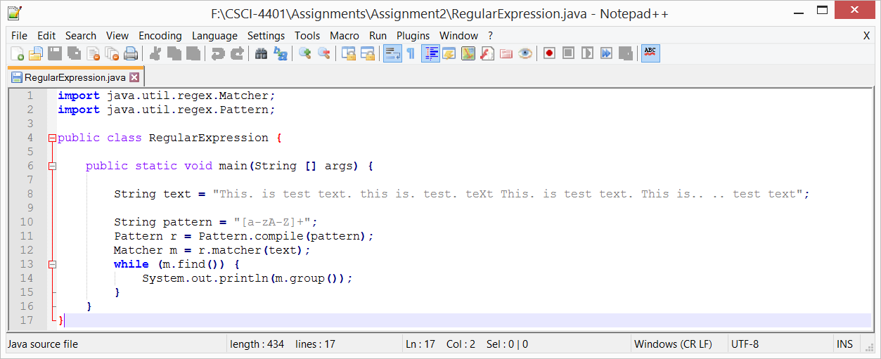
RegEx’s
[a-zA-Z] – match any character in the brackets. You can use ranges.
+ - match the previous element one or more times.
find() looks for our next pattern match
group() returns the sequence of the last pattern match

Slide 14
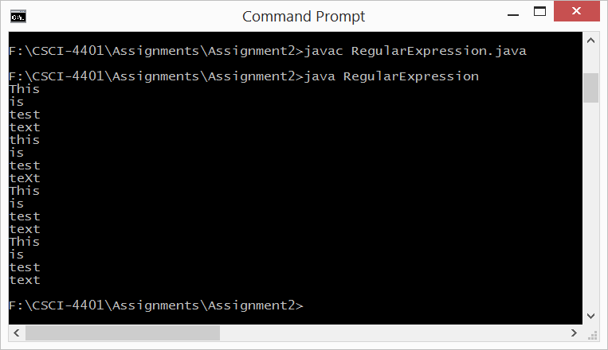
RegEx’s
You will remove case sensitivity

Slide 15
2. Multi-thread #1
We did a few Java examples in class. They are on Canvas.
I recommend using the Matrix Multiplication as a template.
Create a class that implements the Runnable interface, declare the run() method, call start(), etc.
You shouldn’t see a difference in runtime for a single file.

Slide 16
3. Many files for one thread
Iterate over all files in a directory. You can get the files as an array of strings with:
File directoryPath = new File(dir);
String fileNames[] = directoryPath.list();
Time your calculation

Slide 17
4. Multi-threaded for many files
Time your calculation
If you use a Map, you can synchronize it. Example in the assignment.
Synchronized Map
Locks the whole map
Multiple threads can’t access the map concurrently

Slide 18
5 & 6. Observations
Say something insightful.
Include terms and concepts we discussed in class.
Vague answers won’t receive credit.

Slide 19
Main Memory: Recap of Lecture 13

Slide 20
Logical vs Physical Address Space
Separation of logical address space from physical address space is central to memory management.
Logical address - The address generated by the CPU.
Physical address - The address actually seen by the memory hardware.

Slide 21
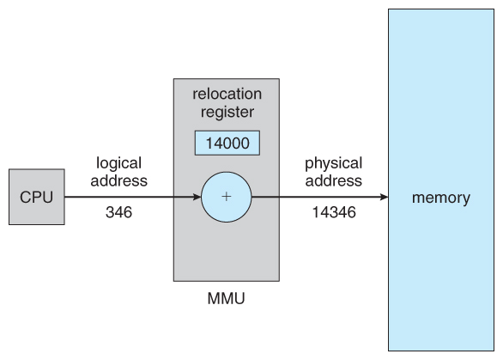
Dynamic Relocation using a Relocation Register
The value of the relocation register is added to every address generated by a user process.

Slide 22
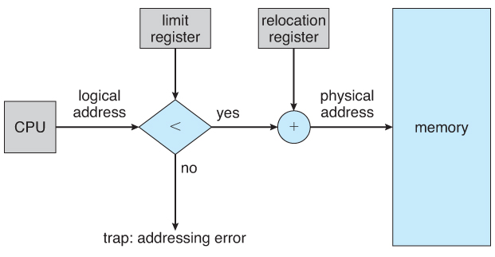
Memory Mapping and Protection
The system in the figure allows protection against user programs accessing areas that they should not.
MMU

Slide 23
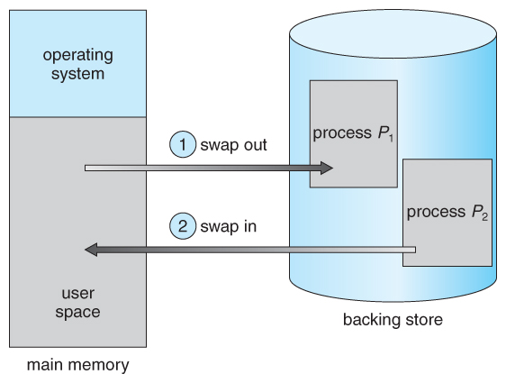
Swapping: Example
We have round-robin CPU scheduling.
When the quantum expires for a process, swap that process out and swap another into the memory we just freed.

Slide 24
Contiguous allocation: issues
OS
OS
OS
OS
process 5
process 5
process 5
process 9
process 12
…
process 10
?
process 8
process 2
process 2
process 2
process 2
process 21

Slide 25
Dynamic Storage Allocation Strategies
How do decide which process gets which block?
First fit – allocate to the first hole that is big enough
Best fit –
Allocate the smallest hole that is big enough
Must search entire list
Produces the smallest leftover hole
Worst fit –
Allocate the largest hole available
Must search entire list
Produces the largest leftover hole
First & Best Fit better than Worst Fit for speed and storage utilization.
First ≈ Best Fit for storage utilization, but First Fit is faster.
Observation: they all lead to fragmentation.

Slide 26
Review
What is the difference between logical and physical memory?
Given 5 memory partitions: 100 KB, 500 KB, 200 KB, 300 KB, & 600 KB and 4 processes: 212 KB, 417 KB, 112 KB, and 426 KB, how would the first-fit, best-fit and worst-fit algorithms place them in memory? Who makes most efficient use?
417
212
112
100
KB
500
KB
200
KB
300
KB
600
KB
600 – 212 = 388
426

Slide 27
Review
Explain the difference between internal and external fragmentation.
Assuming 1 KB page size, what are the page numbers and offsets for the following address references?
2375
19366
30000
256
16385

Slide 28
Main Memory: Paging

Slide 29
Paging
Paging is a memory management scheme that allows the physical address space of a process to be discontinuous.
Allocate memory in fixed-sized blocks – pages
Eliminates problems with external fragmentation
Easy to manage the backing store (it can experience fragmentation too)
Paging is a common memory management technique used today.

Slide 30
Basic Method
The basic idea behind paging is to
Break physical memory into fixed-sized blocks called frames.
Break logical memory into fixed-sized blocks called pages.
The backing store is also divided into fixed-sized blocks
Size is a power of 2 defined by the hardware.
Between 512 bytes and 16 MB per page
Any page (from any process) can be placed into any available frame.
The page table is used to look up what frame a particular page is stored in at the moment.
Paging leads to internal fragmentation – leftover, unused space within pages.

Slide 31
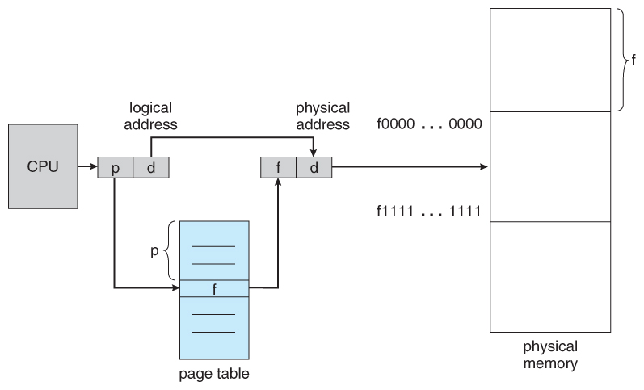
Paging Hardware
Page number (p)
Page offset (d) – within the page
Frame address (f)
Frame address + page offset = physical memory address

Slide 32
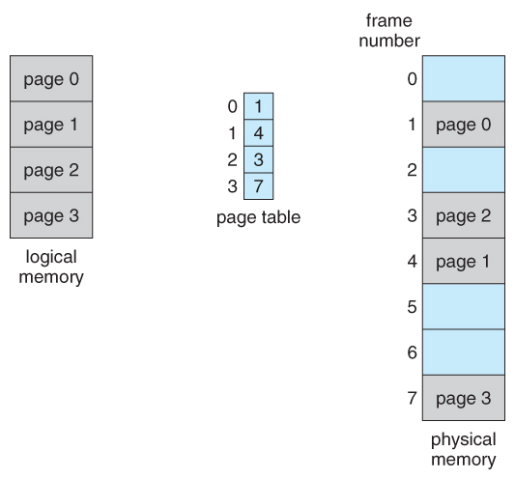
Paging Model of Logical to Physical Memory

Slide 33
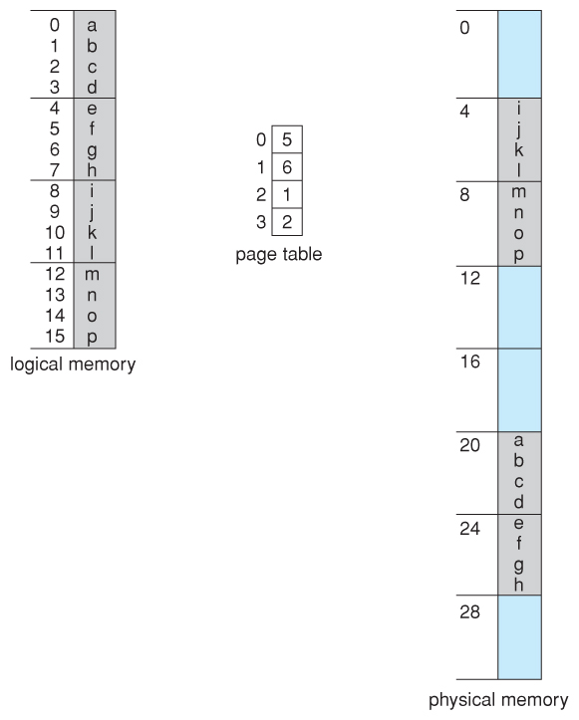
Example
Page Number
0
1
2
3
Page size = 4 bytes
Physical memory = 32 bytes
(8 pages)
Displacement within the page = val – (page size * page #)

Slide 34
Internal Fragmentation
There is no external fragmentation with paging. All blocks of physical memory are used, and no problem of finding the right sized hole.
We do experience internal fragmentation though. Memory is allocated in chunks the size of a page and, on average, the last page will only be half full.
What is the worst case (process size) for internal fragmentation?
Larger pages waste more memory but are more efficient in terms of overhead.

Slide 35
Page Tables
Page table entries are typically 32-bit numbers, allowing access to 2^32 physical page frames.
If frame size is 4 KB, that translates to 16 TB of addressable physical memory.
When a process requests memory, free frames are allocated from a free-frame list and inserted into that process’s page table.
Processes are blocked from accessing anyone else’s memory
All of their memory requests are mapped through their page table.
No way to generate an address that maps into another process’ memory space.
The OS must keep track of each individual process page table.
Updates it when a process’ pages get moved in and out of memory.
Apply correct page table when servicing system calls for a particular process.

Slide 36
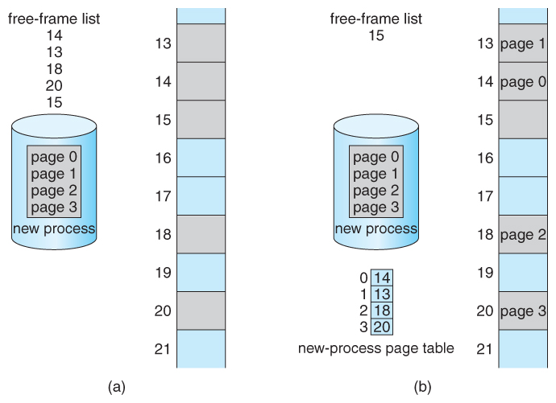
Page Tables: Example
A process is allocated frames from a free-frame list.

Slide 37
Page Tables in Memory
A page table is kept in main memory.
Page-table base register (PTBR) points to the page table.
Page-table length register (PTLR) indicates size of the page tables.
Problem: every data/instruction access requires two memory accesses:
One for the page table and one for the data/instruction
Memory access is slowed down by a factor of 2
Solution: translation look-aside buffer (TLB)

Slide 38
Translation Look-Aside Buffer (TLB)
Translation Look-Aside Buffer (TLBs)
Special high-speed memory device
Benefit of the TLB is that it can search an entire table for a key value in parallel, and if it is found anywhere in the table, then the corresponding lookup value is returned.
Contains only a few of the page table entries.
When the CPU generates a logical address, the page number is presented to the TLB.
If found (TLB hit), the frame number is immediately returned.
If not (TLB miss), a memory reference to the page table must be made.

Slide 39
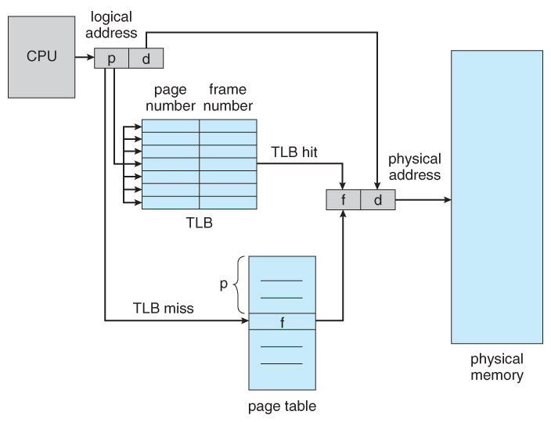
Paging Hardware with TLB

Slide 40
Access Time
The TLB is very expensive and therefore very small (not large enough to hold the entire page table).
Hit ratio - percentage of time that a page number is found in the TLB.
80% hit ratio means we find the desired page number 80% of the time.
Example,
100 ns to access main memory
20 ns to search the TLB
A mapped memory access with a TLB hit takes 120 ns total
A TLB miss takes 220 ns total
Search the TLB (20 ns) + access memory for the page table (100 ns) + access the desired byte (100 ns)

Slide 41
Protection
The page table can also help to protect processes from accessing memory that they shouldn’t, or their own memory in ways they shouldn’t.
Valid-invalid bit attached to each entry in the page table:
“valid” - the page is in the process’ logical address space. Thus, a legal page.
“invalid” - the page is not in the process’ logical address space.
Dirty bit attached to each entry in the page table:
“dirty” – the page has been modified and still needs to be written to disk
“clean” – the page has not been modified so we can abandon it
This is comes into play for the idea of lazy writes – don’t write modifications back to disk immediately. Why?
Notes:
Do lazy writes at an idle time. Might make a modification to the page later

Slide 42
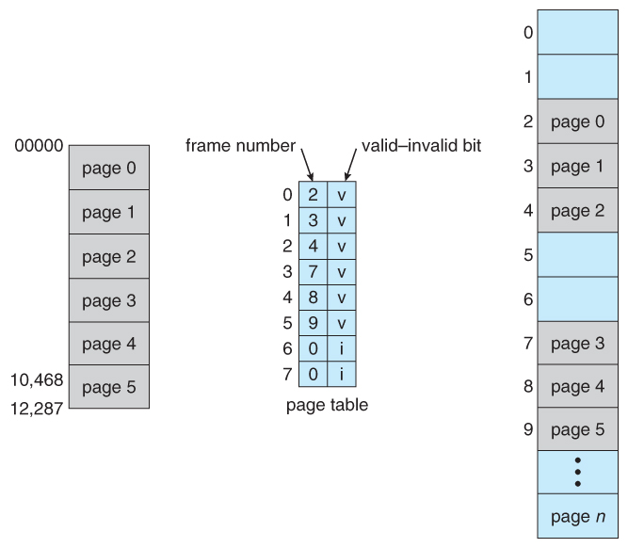
Valid (v) & Invalid (i) bit in a page table
Valid/invalid bits “mask-off” entries in the page table not used by the current process.
Example: Page Size = 2 KB, Process Size = 10,468 bytes

Slide 43
Shared Pages
Besides simplifying memory allocation, another advantage of paging is the possibility of sharing common code.
One copy of read-only (or reentrant) code is shared among processes.
No writes or changes can happen to this code (safe to re-enter).
Enforced by OS
Each process has its own logical copy but only one physical copy exists.
Example:
Multiple process execute the same code for a text editor.
Each process modifies different data with the text editor.

Slide 44
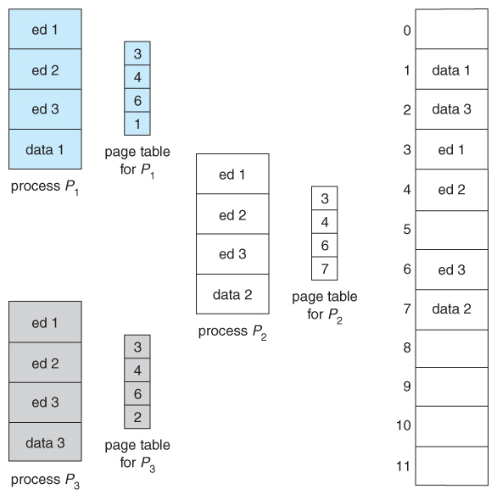
Shared Pages Example

Slide 45
Main Memory: Structure of Page Tables

Slide 46
Single Level Page Tables
A single level page table is essentially a list of entries.
How many page table entries do we need for the following system?
Address space = 4 GB (2^32 bytes)
Page size = 4 KB (2^12 bytes)
Now assume each entry uses 4 bytes (2^2). What’s the total size of the page table?
Notes:
Page table must have 2^20 entries. Page table size = 2^22 or 4MB

Slide 47
Page Table Structure: Overview
Page tables can consume a lot of memory.
How do we actual store and lookup entries in page tables?
Multilevel page tables
Tree of page tables
Inverted page tables
The mapping is inverted: frame -> page

Slide 48
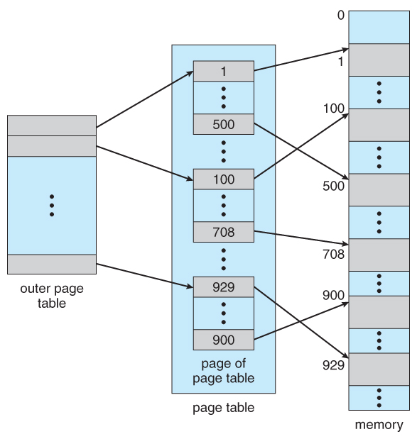
Multilevel Page Tables
Break up the logical address space into multiple page tables.
Example: two-level page table.
Same idea as a B-Tree index

Slide 49
Example: Two-Level Page Table Scheme
Page size = 8 bytes
Entry = 2 bytes
0
●
4
●
8
●
12
●
0
Frame10
1
Frame80
2
Frame2
3
Frame12
4
Frame20
...
…
Main Memory

Slide 50
Mapping within the Multilevel Scheme
A logical address (on a 32-bit machine with 4KB page size) is divided into:
A page number consisting of 20 bits.
A page offset consisting of 12 bits.
Since the page table is paged, the page number is further divided into:
A 10-bit page number.
A 10-bit page offset.
Where p₁ is an index into the outer page table, and p₂ is the displacement within the page of the leaf page table.
page number
page offset
p₁
p₂
d
10
10
12

Slide 51
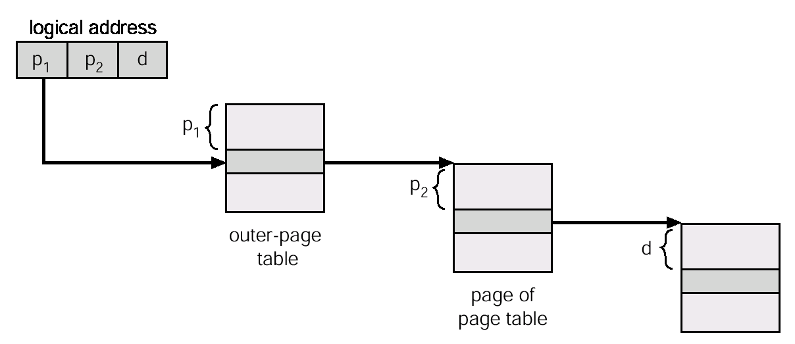
Two-Level Page Paging Illustrated

Slide 52
Inverted Page Tables
Two-level page tables can get large because they also include virtual memory address (more on that later).
Another approach is to use an inverted page table.
Instead of listing all pages for a particular process, an inverted page table lists all pages currently loaded in memory, for all processes
i.e., there is one entry per frame instead of one entry per page.
Access to an inverted page table can be slow, as it may be necessary to search the entire table in order to find the desired page (or to discover that it is not there).
Can use hashing to speed it up, but requires two memory reads

Slide 53
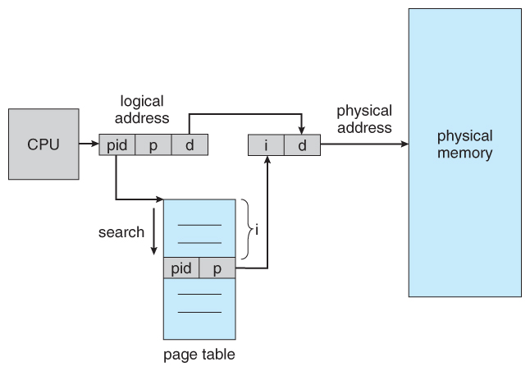
Inverted Page Table Example
<process id, page #>
Identifies address space
offset i = the frame #

Slide 54
Main Memory: Segmentation

Slide 55
Segmentation
Users think of their memory as a collection of segments:
Methods, procedures, or functions
Objects, arrays, or variables
Memory segmentation supports this view by providing addresses with a segment number (mapped to a segment base address) and an offset from the beginning of that segment.
We will look at a process broken up into segments. However, this could be taken a step further by storing a page table for each segment.

Slide 56
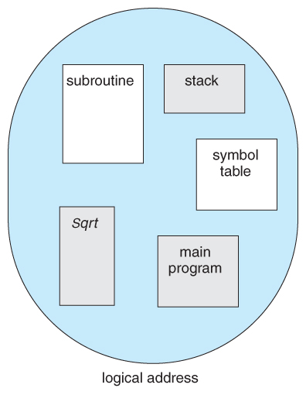
Segmentation Example
Each segment has a name and length.

Slide 57
Logical View of Segmentation
1
4
1
2
3
2
4
3
physical memory space
user space

Slide 58
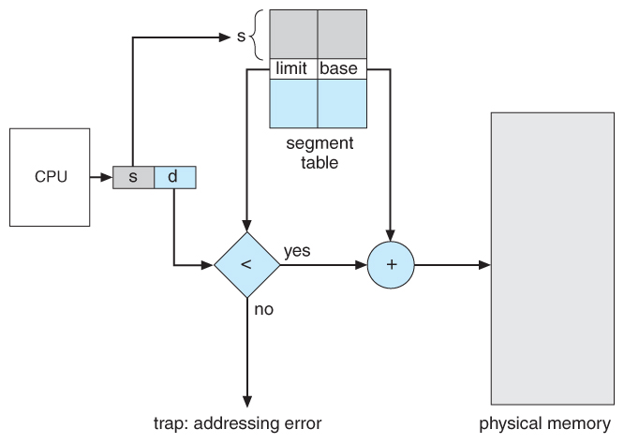
Segmentation Hardware

Slide 59
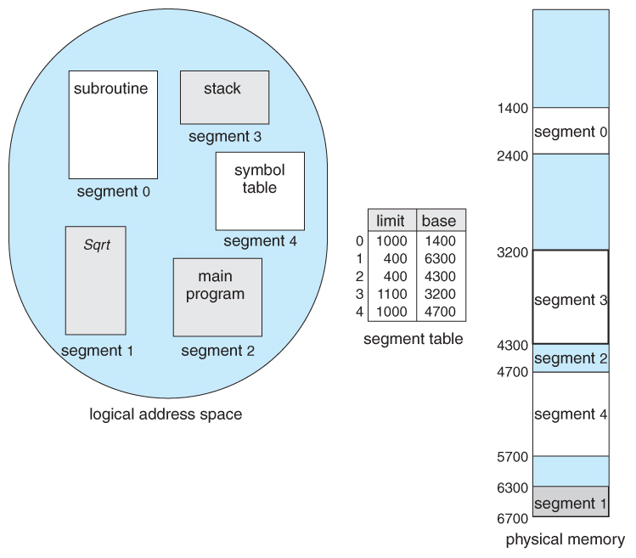
Example of Segmentation
A user makes a reference to byte 53 of segment 2. What physical location does this map to?

Slide 60
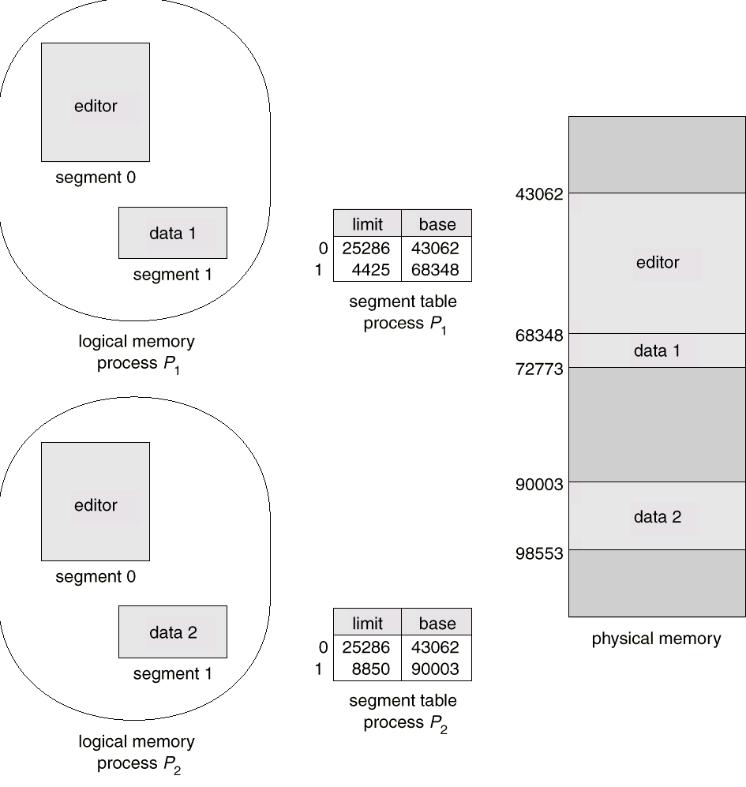
Sharing of Segments

Slide 61
Review
Consider a paging system with the page table stored in memory.
If a memory reference takes 200 ns, how long does a paged memory reference take?
If we add TLBs, and 75% of all page-table references are found in the TLBs, what is the effective memory reference time? (Assume that finding a page table entry in the TLBs takes zero time, if there.)
What if the time to access the TLB is 2 ns?
Notes:
400ns
0.75(0 + 200) + 0.25(0 + 200 + 200) = 250ns
0.75(2 + 200) + 0.25(2 + 200 + 200) = 252ns

Slide 62
Paging Hardware with TLB

Slide 63
Review
Consider the following segment table:
What are the physical addresses for the following logical addresses (segment #, segment offset)?
0, 430
1, 10
2, 500
3, 400
4, 112
Segment | Base | Length
0 | 219 | 600
1 | 2300 | 14
2 | 90 | 100
3 | 1327 | 580
4 | 1952 | 96

Slide 64
Next time
Virtual Memory

