Slide 1
CSCI 4401/5401: Principles of Operation Systems
James Wagner
University of New Orleans
Week 10, Lecture 18
October 17th, 2023

Slide 2
Announcements
Assignment 3 is due Monday, November 6th @ 11:59pm

Slide 3
What We’re Doing Today
Review/Finish Main Memory
Page Tables
Segmentation
Virtual Memory:
Background
Demand Paging
Page Replacement
Allocation of Frames

Slide 4
Main Memory: Structure of Page Tables

Slide 5
Single Level Page Tables
A single level page table is essentially a list of entries.
How many page table entries do we need for the following system?
Address space = 4 GB (2^32 bytes)
Page size = 4 KB (2^12 bytes)
Now assume each entry uses 4 bytes (2^2). What’s the total size of the page table?
Notes:
Page table must have 2^20 entries. Page table size = 2^22 or 4MB

Slide 6
Page Table Structure: Overview
Page tables can consume a lot of memory.
How do we actual store and lookup entries in page tables?
Multilevel page tables
Tree of page tables
Inverted page tables
The mapping is inverted: frame -> page

Slide 7
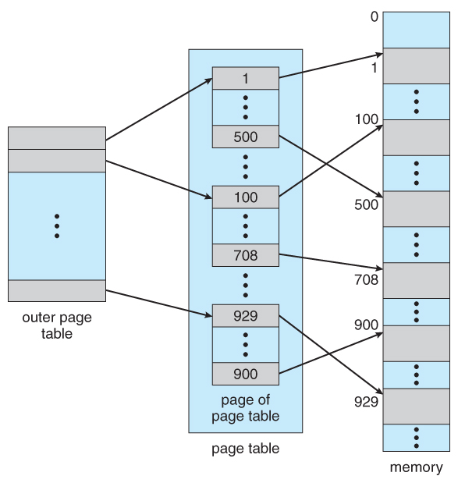
Multilevel Page Tables
Break up the logical address space into multiple page tables.
Example: two-level page table.
Same idea as a B-Tree index

Slide 8
Example: Two-Level Page Table Scheme
Page size = 8 bytes
Entry = 2 bytes
0
●
4
●
8
●
12
●
0
Frame10
1
Frame80
2
Frame2
3
Frame12
4
Frame20
...
…
Main Memory

Slide 9
Mapping within the Multilevel Scheme
A logical address (on a 32-bit machine with 4KB page size) is divided into:
A page number consisting of 20 bits.
A page offset consisting of 12 bits.
Since the page table is paged, the page number is further divided into:
A 10-bit page number.
A 10-bit page offset.
Where p₁ is an index into the outer page table, and p₂ is the displacement within the page of the leaf page table.
page number
page offset
p₁
p₂
d
10
10
12

Slide 10
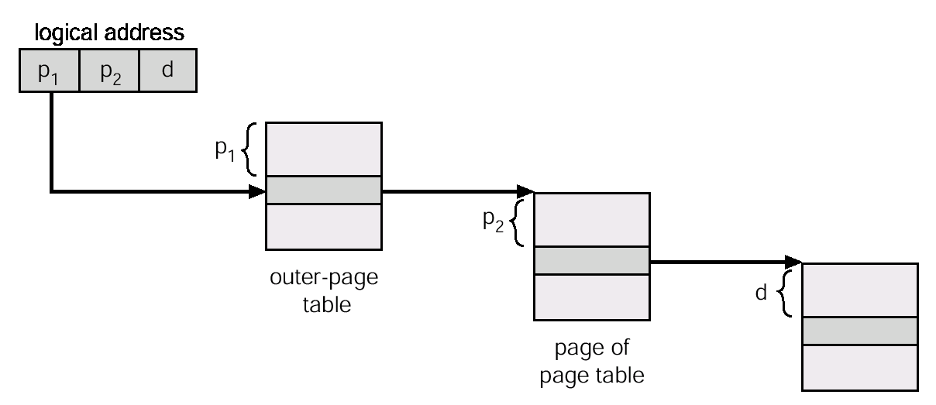
Two-Level Page Paging Illustrated

Slide 11
Inverted Page Tables
Two-level page tables can get large because they also include virtual memory address (more on that later).
Another approach is to use an inverted page table.
Instead of listing all pages for a particular process, an inverted page table lists all pages currently loaded in memory, for all processes
i.e., there is one entry per frame instead of one entry per page.
Access to an inverted page table can be slow, as it may be necessary to search the entire table in order to find the desired page (or to discover that it is not there).
Can use hashing to speed it up, but requires two memory reads

Slide 12
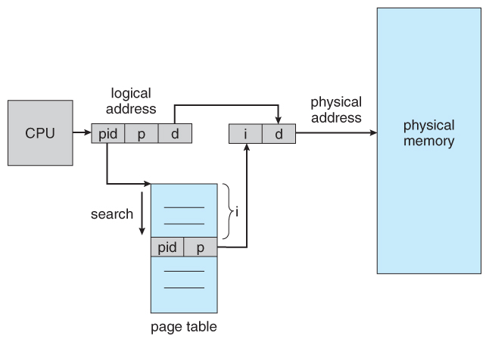
Inverted Page Table Example
<process id, page #>
Identifies address space
offset i = the frame #

Slide 13
Main Memory: Segmentation

Slide 14
Segmentation
Users think of their memory as a collection of segments:
Methods, procedures, or functions
Objects, arrays, or variables
Memory segmentation supports this view by providing addresses with a segment number (mapped to a segment base address) and an offset from the beginning of that segment.
We will look at a process broken up into segments. However, this could be taken a step further by storing a page table for each segment.

Slide 15
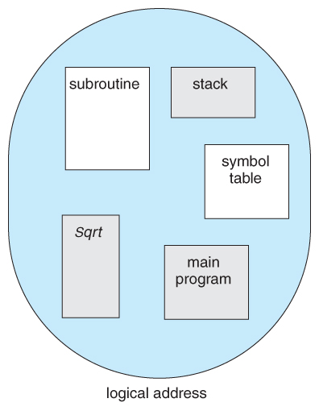
Segmentation Example
Each segment has a name and length.

Slide 16
Logical View of Segmentation
1
4
1
2
3
2
4
3
physical memory space
user space

Slide 17
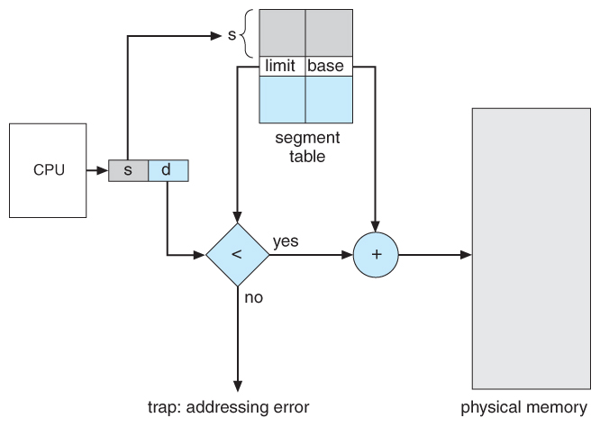
Segmentation Hardware

Slide 18
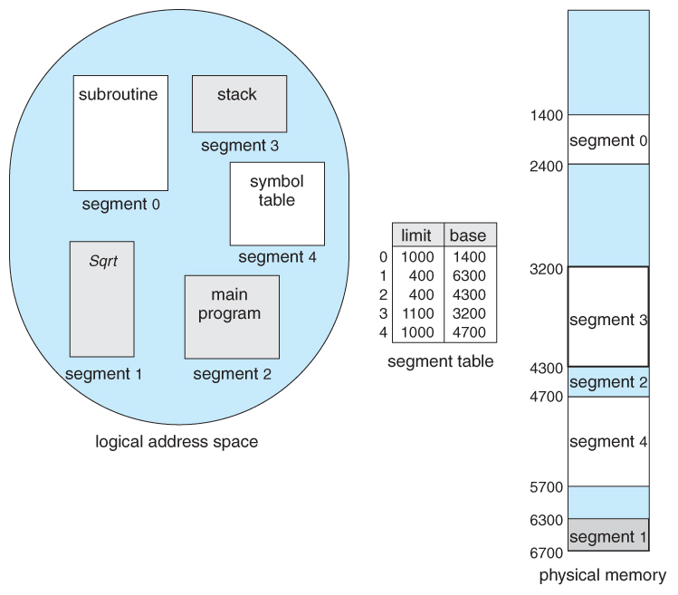
Example of Segmentation
A user makes a reference to byte 53 of segment 2. What physical location does this map to?

Slide 19
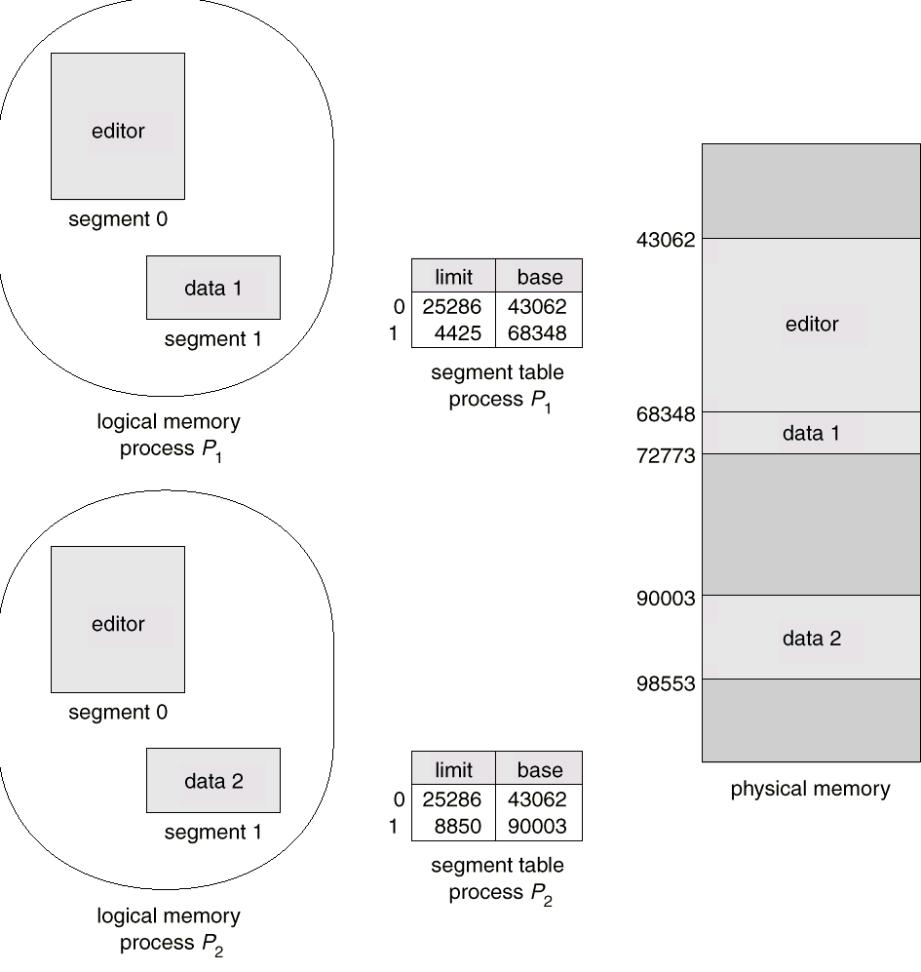
Sharing of Segments

Slide 20
Review
Consider a paging system with the page table stored in memory.
If a memory reference takes 200 ns, how long does a paged memory reference take?
If we add TLBs, and 75% of all page-table references are found in the TLBs, what is the effective memory reference time? (Assume that finding a page table entry in the TLBs takes zero time, if there.)
What if the time to access the TLB is 2 ns?
Notes:
400ns
0.75(0 + 200) + 0.25(0 + 200 + 200) = 250ns
0.75(2 + 200) + 0.25(2 + 200 + 200) = 252ns

Slide 21
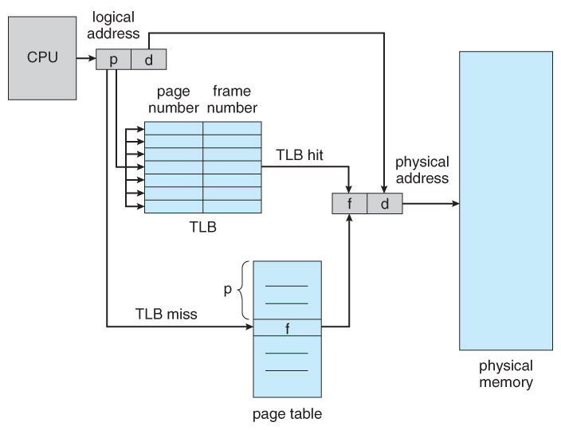
Paging Hardware with TLB

Slide 22
Review
Consider the following segment table:
What are the physical addresses for the following logical addresses (segment #, segment offset)?
0, 430
1, 10
2, 500
3, 400
4, 112
Segment | Base | Length
0 | 219 | 600
1 | 2300 | 14
2 | 90 | 100
3 | 1327 | 580
4 | 1952 | 96
Notes:
A. 219 + 430 = 649. B. 2310. C. Illegal D. 1727 E. Illegal

Slide 23
Virtual Memory: Background

Slide 24
Background
We talked about how to avoid memory fragmentation by breaking process memory down into smaller pieces (pages) and storing the pages in non-contiguous memory.
However, the entire process still must be stored in memory somewhere.
Most processes do not need all of their pages at once:
Error handling code is not needed unless specific errors occur.
Arrays, lists, and tables are often allocated more memory than they need.
Certain options and features of a program may be used rarely.
Accessing what we need, when we need it has benefits:
Program size - not limited to available physical memory.
CPU utilization - run more programs at the same time.
Faster programs - less I/O is needed to swap programs into memory.

Slide 25
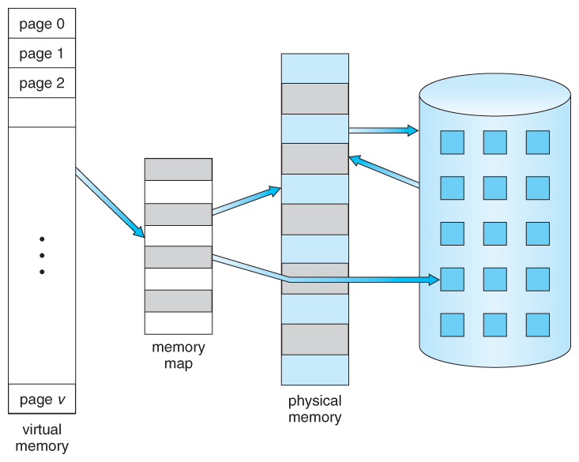
Virtual Memory >> Physical Memory

Slide 26
Virtual Memory: Benefits
Separates user logical memory from physical memory.
Allows execution of partially loaded program.
Logical Address space can therefore be much larger than physical address space.
Allows address spaces to be shared by several processes (i.e., page sharing)
Allows for more (potentially) efficient process creation.

Slide 27
Virtual Memory: Demand Paging

Slide 28
Demand Paging
The basic idea behind demand paging is that when a process is swapped in, its pages are not swapped in all at once.
Swap pages in only when the process needs them (on demand).
Less I/O needed
Less memory needed
Faster (initial) response
More simultaneous processes

Slide 29
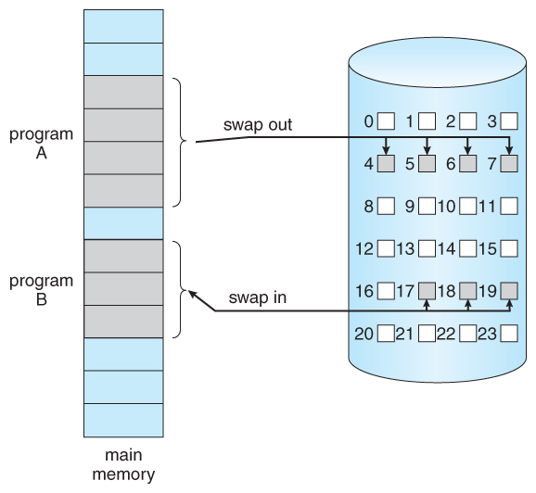
Transfer of a Page from Memory to Disk

Slide 30
Implementation
With each page table entry, a valid-invalid bit is associated.
1 (or “v”) – in memory
0 (or “i”) – not in memory
If the process only ever accesses pages that are loaded in memory (or memory resident pages), then the process runs exactly as if all the pages were loaded into memory.

Slide 31
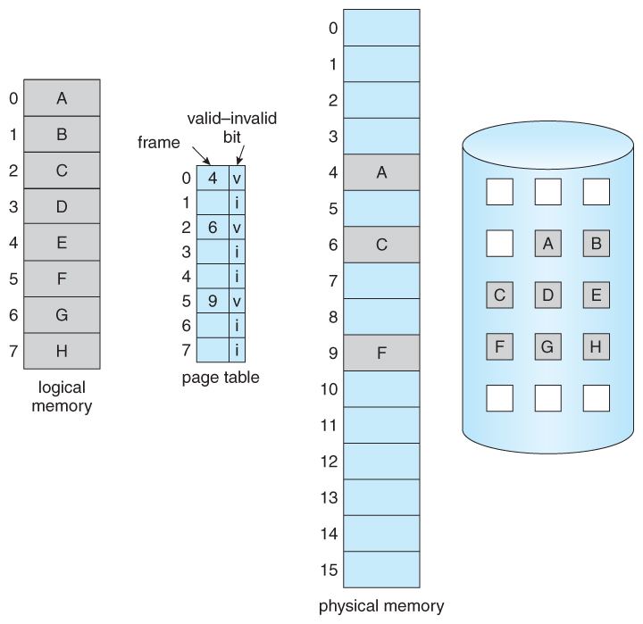
Page Table: Valid-Invalid Bit

Slide 32
Page Faults
When a page not in memory (invalid) is needed, then a page fault trap is generated, which must be handled in a series of steps:
Determine if the request is a valid (as in not illegal) memory access.
If the invalid (as in illegal)) reference, terminate process. Otherwise, the page must be paged in.
A free frame is located from the free-frame list.
A disk operation is scheduled to bring in the page from disk.
The I/O wait may block the process, allowing some other process to use the CPU in the meantime.
When the I/O operation is complete, update the process’ page table with the new frame number and changed the valid-invalid bit.
Restart the instruction that was interrupted by the page fault.

Slide 33
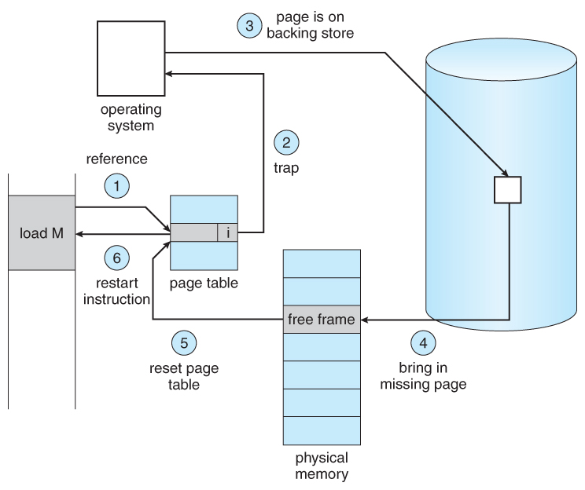
Page Fault Steps

Slide 34
More Detailed Page Fault Sequence
Trap to the operating system
Save the process state
Check that the page reference was legal and determine the location of the page on disk.
Issue a read from the disk to a free frame:
Wait in the device queue until the read is serviced.
Wait for the device seek and/or latency time
Transfer the page to a free frame
While waiting, allocate the CPU to another process (CPU scheduling)
Update the page table to reflect the new page is in memory.
Wait for the CPU to be allocated to the process again.
Restore the process state.

Slide 35
Performance of Demand Paging
Just how big of a performance hit do we see from page faults? Let’s compute the effective access time
Memory-access time (ma) ranges from 10 – 200ns, we’ll assume 200ns.
Let p be the probability of a page fault (0 ≤ p ≤ 1).
Effective access time = (1 – p) * ma + (p * page fault time)
What is the page fault time? Assume servicing a page fault takes 8 ms.
8,000,000 ns (or 40,000 times a normal ma)
Many steps to service a page fault , e.g., seek, latency.
With a page fault rate of p (on a scale from 0 to 1), the effective access time is now:
effective access time = (1 – p) * 200ns + (p * 8ms) = (1 – p) * 200ns + (p * 8000000ns) = 200 + (p * 7,999,800) ns
This clearly depends heavily on p…

Slide 36
Performance of Demand Paging
effective access time = (1 – p) * 200ns + (p * 8ms) = (1 – p) * 200ns + (p * 8000000ns) = 200 + (p * 7,999,800) ns
If only one access in 1000 causes a page fault, the effective access time drops from 200 ns to 8.2µsec, a slowdown of a factor of 40 times.
Effective access time = 200 + (0 * 7,999,800) = 200ns
Effective access time = 200 + (0.001 * 7,999,800) = 8200ns = 8.2µs
In order to keep the slowdown less than 10%, the page fault rate must be less than 0.0000025 or 1 in 399,990 accesses.
Effective access time = 200 + (0.0000025 * 7,999,800) = 220ns

Slide 37
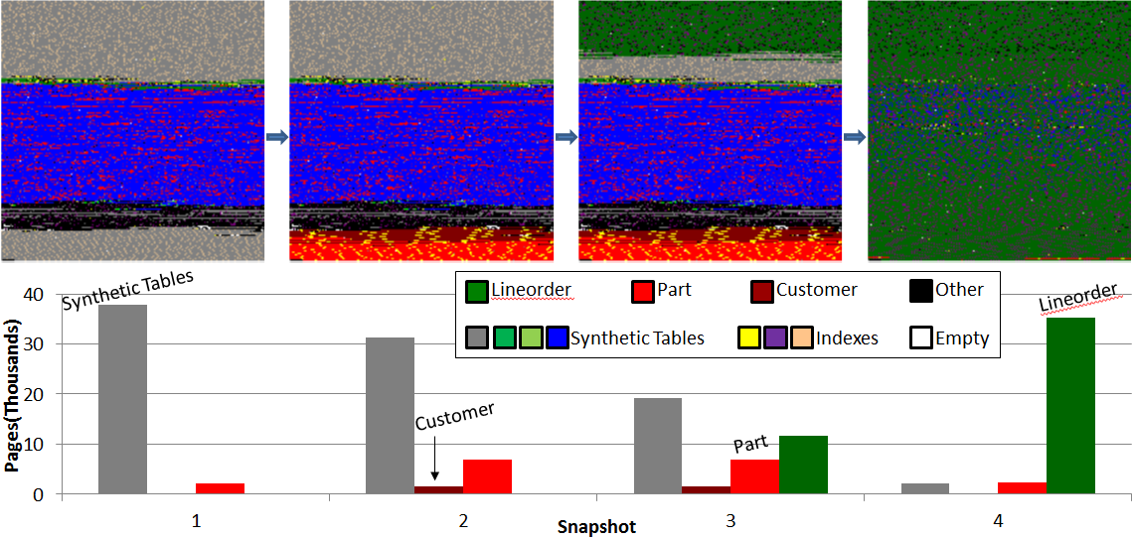
Demand Paging Example: Database Memory
Each snapshot = 400 MB (or 50,000 x 8 KB pages)

Slide 38
Virtual Memory: Page Replacement

Slide 39
Page Replacement: Motivation
For best use of virtual memory, we load several processes into memory at the same time.
We only load the pages that are actually needed by each process at any given time.
Not enough room to load many processes if we load in the entire process.
Memory is also needed for other purposes (such as I/O buffers).
What happens if a process suddenly decides it needs more pages and there aren’t any free frames available?

Slide 40
How to handle no available frames?
There are several possible solutions to consider:
Swap an entire process out of memory, freeing up its page frames.
OK in some situations. We’ll revisit this…
Page Replacement - find some page in memory that’s not being used, and swap it out to disk, freeing up a frame
It is the most common solution.
Many algorithms for page replacement. We will talk about them next…

Slide 41
Basic Page Replacement
Page-fault processing assumed that free frames would be available.
Now the page-fault handling must be modified to free up a frame if necessary, as follows:
Find the location of the desired page on the disk.
Find a free frame:
If there is a free frame, use it.
Otherwise, use a page-replacement algorithm to select a victim frame.
Read the desired page and store it in the (newly) free frame. Update all related page and frame tables.
Restart the process that was waiting for this page.

Slide 42
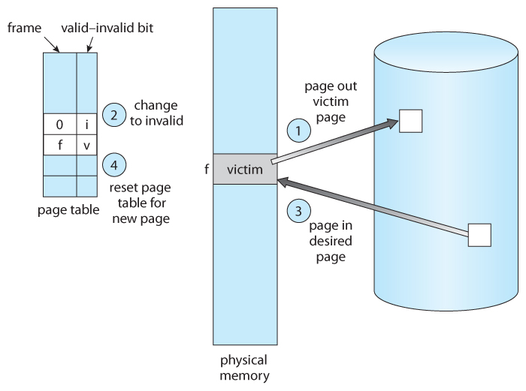
Page Replacement

Slide 43
Page Replacement Algorithms
The overall goal of algorithms: lowest page-fault rate
Disk access is so slow relative to memory access, even slight improvements to these algorithms can yield large improvements in overall system performance.
Optimal Solution:
Always replace the page that will not be used for the longest time.
Optimal algorithm requires clairvoyance.
Evaluation:
Use strings of memory references to compare performance.
Example:
7, 0, 1, 2, 0, 3, 0, 4, 2, 3, 0, 3, 2, 1, 2, 0, 1, 7, 0, 1

Slide 44
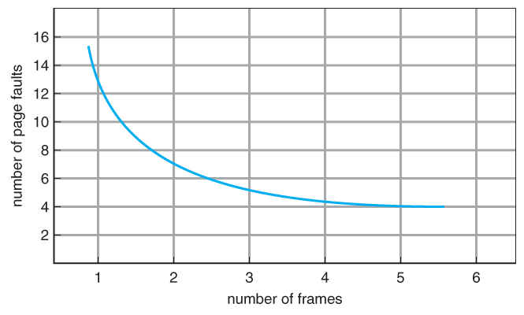
Page Faults vs # of Frames (Expected)
As number of frames increases, page faults should decrease.

Slide 45
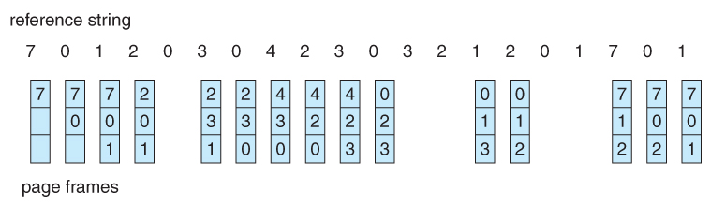
FIFO Page Replacement
First-in, first-out (FIFO) - simple & obvious page replacement strategy
As new pages are brought in, they are added to the tail of a queue. The page at the head of the queue is the next victim.
Example: 20 page requests result in 15 page faults. Initially, we have 3 empty frames.
PF
PF
PF

Slide 46
FIFO: Belady’s Anomaly
Although FIFO is simple and easy, it is not always efficient.
Belady’s Anomaly can occur with FIFO.
Increasing the number of frames may increase the number of page faults.
Example ref string:
1 2 3 4 1 2 5 1 2 3 4 5
1
1
1
1
1
1
1
1
1
2
1
4
frames
2
2
2
2
2
2
2
3
3
3
3
3
3
4
4
4
4
4
1
1
1
4
4
3
frames
2
2
5
5
5
3
5
5
5

Slide 47
FIFO: Belady’s Anomaly
Although FIFO is simple and easy, it is not always efficient.
Belady’s Anomaly can occur with FIFO.
Increasing the number of frames may increase the number of page faults.
Example ref string:
1 2 3 4 1 2 5 1 2 3 4 5
1
1
1
1
5
5
5
5
4
4
4
frames
2
2
2
2
1
1
1
1
5
3
3
3
3
2
2
2
2
4
4
4
4
3
3
3
1
1
1
4
4
4
5
5
5
3
frames
2
2
2
1
1
1
1
1
3
3
3
2
2
3
4

Slide 48
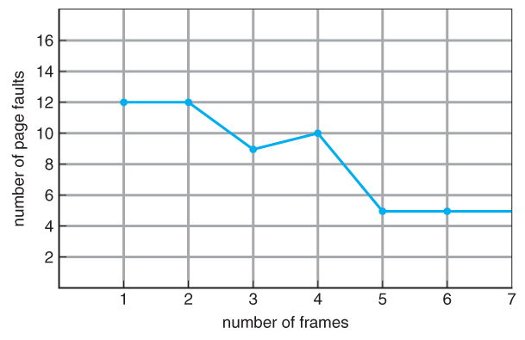
Belady’s Anomaly

Slide 49
Optimal Page Replacement
Optimal page-replacement algorithm
Solution to Belady’s Anomaly
Yields the lowest possible page faults (and no Belady’s Anomaly).
Called OPT or MIN
“Replace the page that will not be used for the longest time in the future.”

Slide 50
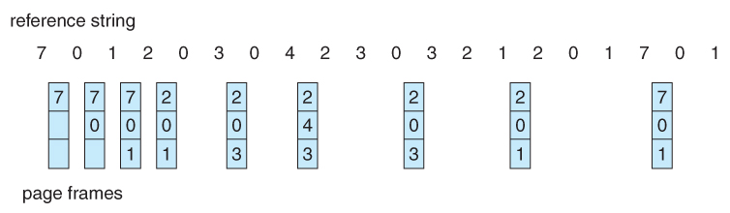
Optimal Page Replacement : Example
9 page faults with OPT

Slide 51
Optimal Page Replacement: Observations
OPT cannot be implemented in practice because it requires foretelling the future, but it makes a nice benchmark for the comparison and evaluation of real proposed new algorithms.
In practice, most page-replacement algorithms try to approximate OPT by predicting (estimating) in one fashion or another what page will not be used for the longest period of time.
The basis of FIFO is the prediction that the page that was brought in the longest time ago is the one that will not be needed again for the longest future time, but there are many other prediction methods that strive to match OPT.

Slide 52
LRU Page Replacement
The prediction behind Least Recently Used (LRU) algorithm is that the page that has not been used in the longest time is the one that will not be used again in the near future.
What’s the difference between FIFO and LRU?
Some view LRU as analogous to OPT, except looking backward instead of forward.
Note: Neither LRU or OPT exhibit Belady’s Anomaly.

Slide 53
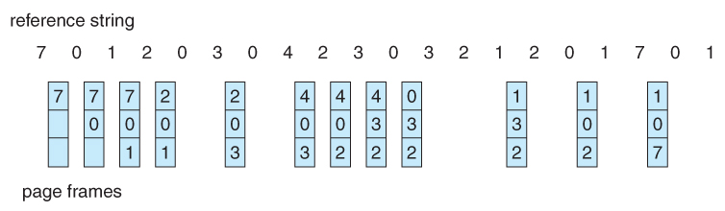
LRU Page Replacement
Example: LRU produces 12 page faults (15 for FIFO and 9 for OPT)

Slide 54
LRU Page Replacement
LRU is considered a good replacement policy and is often used.
The problem is how exactly to implement it -> how to determine an order for the frames. Two simple approaches:
Counter
Each memory access increments a counter
Record last time of use in the page table
Requires a linear search
Stack
Keep a stack of page numbers in a double linked list
Move referenced page to top
LRU page is at the bottom
Requires 6 pointers (at worst) to be changed

Slide 55
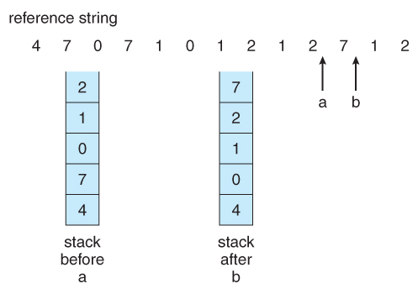
Stack Implementation of LRU Algorithm

Slide 56
LRU-Approximation Page Replacement
Full implementation of LRU requires hardware support, and few systems provide the full hardware support necessary.
Solution: reference bit in the page table
With each page, associate a bit, initially = 0.
When a page is referenced, set bit to 1.
Replace the page which is 0 (if one exists). We don’t know order though…
Second-Chance (“Clock”) Algorithm
Essentially a FIFO, except the reference bit gives pages a “second chance”.
If the page to be replaced (in clock order) has bit = 1, then:
Set bit to 0
Leave page in memory
Move to next page
Notes:
Counter or stack implementation requires hardware support

Slide 57
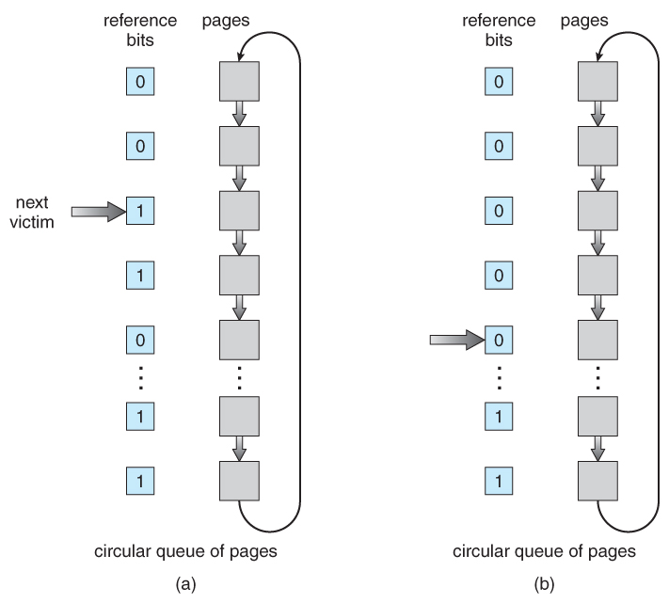
Second-Chance (Clock) Algorithm
Notes:
When we find ref but = 0, replace that page with the new page we bring end – it’s at the end of the queue

Slide 58
Enhanced Clock Algorithm
Combine reference and “dirty” (recently modified) bit:
(ref, dirty)
(0, 0) – Neither recently used or modified (best to replace)
(0, 1) – Not recently used but modified
(1, 0) – Recently used but clean
(1, 1) – Recently used and modified
Looking for the page in the lowest numbered category: (0, 0), then (0, 1), then (1, 0), and then (1, 1)
The main difference between this algorithm and the previous one is the preference for replacing clean pages if possible.
Notes:
May have to scan the queue several times now…

Slide 59
Counting-Based Page Replacement
There are algorithms based on counting the references to a given page:
Least Frequently Used, LFU – replace the page with lowest reference count.
Most Frequently Used, MFU – replace the page with the highest frequency count.
Question: What’s the rationale and a problem for each LFU and MFU?
In general, counting based algorithms are not commonly used, as they are expensive to implement and do not approximate OPT well.
Notes:
LFU – replace the page with a small reference cnt. A problem if a page is used a lot initially, but never again.
MFU – the page with the smallest cnt has yet to be used.

Slide 60
Applications and Page Replacement
Some application (e.g., database systems) understand their data access and caching needs better than the general-purpose OS and should therefore be given reign to do their own memory management.
Sometimes such programs are given a raw disk partition to work with containing raw data block and no file system structure. It is then up to the application to use this disk partition as extended memory or for whatever reasons it sees fit.

Slide 61
Next Time
Finish Virtual Memory
Allocation of Frames
Thrashing
Allocating Kernel Memory

