Slide 1
CSCI 4401/5401:
Principles of Operation Systems
James Wagner
University of New Orleans
Week 10, Lecture 19
October 19th, 2023

Slide 2
Announcements
Assignment 3 is due Monday, November 6th @ 11:59pm
Quiz 4 will be available after class and is due Monday, October 30th @ 11:59pm.
  Main Memory & Virtual Memory

Slide 3
What We’re Doing Today
Finish Virtual Memory:
Allocation of Frames
Thrashing
Review Main Memory and Virtual Memory

Slide 4
Virtual Memory:
Page Replacement

Slide 5
Page Replacement: Motivation
For best use of virtual memory, we load several processes into memory at the same time.
We only load the pages that are actually needed by each process at any given time.
  Not enough room to load many processes if we load in the entire process.
  Memory is also needed for other purposes (such as I/O buffers).
What happens if a process suddenly decides it needs more pages and there aren’t any free frames available?

Slide 6
How to handle no available frames?
There are several possible solutions to consider:
Swap an entire process out of memory, freeing up its page frames.
  OK in some situations. We’ll revisit this…
Page Replacement - find some page in memory that’s not being used, and swap it out to disk, freeing up a frame
  It is the most common solution.
  Many algorithms for page replacement. We will talk about them next…

Slide 7
Basic Page Replacement
Page-fault processing assumed that free frames would be available.
Now the page-fault handling must be modified to free up a frame if necessary, as follows:
Find the location of the desired page on the disk.
Find a free frame:
  If there is a free frame, use it.
  Otherwise, use a page-replacement algorithm to select a victim frame.
Read the desired page and store it in the (newly) free frame. Update all related page and frame tables.
Restart the process that was waiting for this page.

Slide 8
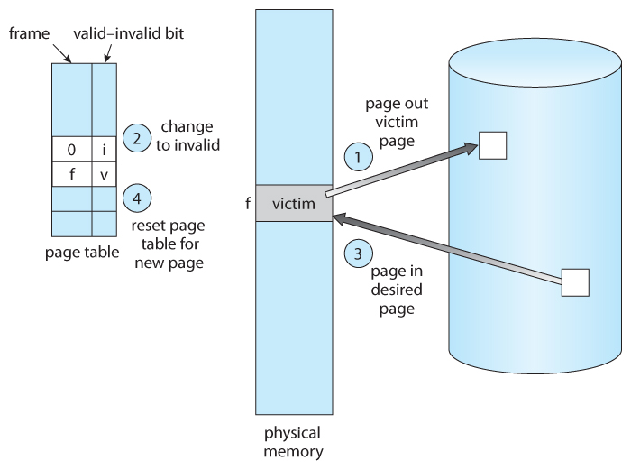
Page Replacement

Slide 9
Page Replacement Algorithms
The overall goal of algorithms: lowest page-fault rate
  Disk access is so slow relative to memory access, even slight improvements to these algorithms can yield large improvements in overall system performance.
Optimal Solution:
  Always replace the page that will not be used for the longest time.
  Optimal algorithm requires clairvoyance.
Evaluation:
  Use strings of memory references to compare performance.
  Example:
    7, 0, 1, 2, 0, 3, 0, 4, 2, 3, 0, 3, 2, 1, 2, 0, 1, 7, 0, 1

Slide 10
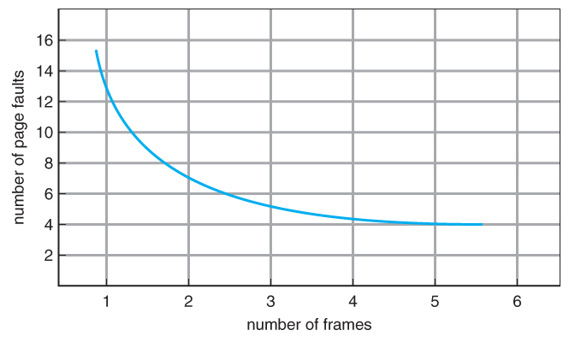
Page Faults vs # of Frames (Expected)
As number of frames increases, page faults should decrease.

Slide 11
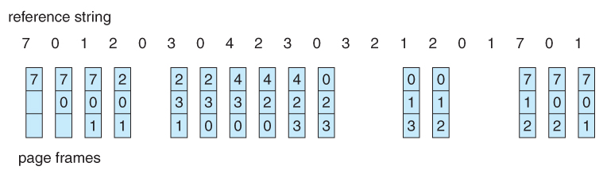
FIFO Page Replacement
First-in, first-out (FIFO) - simple & obvious page replacement strategy
As new pages are brought in, they are added to the tail of a queue. The page at the head of the queue is the next victim.
Example: 20 page requests result in 15 page faults. Initially, we have 3 empty frames.
PF
PF
PF

Slide 12
FIFO: Belady’s Anomaly
Although FIFO is simple and easy, it is not always efficient.
Belady’s Anomaly can occur with FIFO.
  Increasing the number of frames may increase the number of page faults.
Example ref string:
1 2 3 4 1 2 5 1 2 3 4 5
1
1
1
1
1
1
1
2
1
5
5
5
5
4
4
4
frames
2
2
2
2
1
1
1
1
5
2
2
3
3
3
3
2
2
2
2
3
3
4
4
4
4
3
3
3
4
4
1
1
1
4
4
4
5
5
5
4
3
frames
2
2
2
1
1
1
3
3
5
3
3
3
2
2
2
4
5
5

Slide 13
FIFO: Belady’s Anomaly
Although FIFO is simple and easy, it is not always efficient.
Belady’s Anomaly can occur with FIFO.
  Increasing the number of frames may increase the number of page faults.
Example ref string:
1 2 3 4 1 2 5 1 2 3 4 5
1
1
1
1
5
5
5
5
4
4
4
frames
2
2
2
2
1
1
1
1
5
3
3
3
3
2
2
2
2
4
4
4
4
3
3
3
1
1
1
4
4
4
5
5
5
3
frames
2
2
2
1
1
1
1
1
3
3
3
2
2
3
4

Slide 14
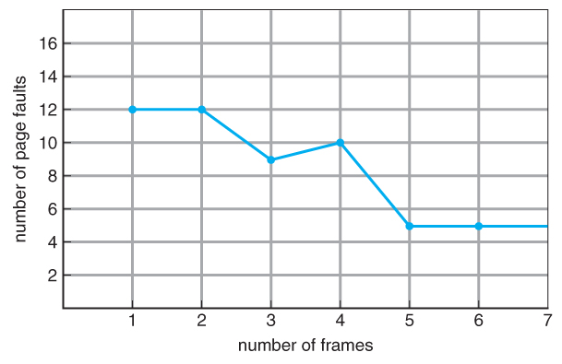
Belady’s Anomaly

Slide 15
Optimal Page Replacement
Optimal page-replacement algorithm
  Solution to Belady’s Anomaly
  Yields the lowest possible page faults (and no Belady’s Anomaly).
  Called OPT or MIN
“Replace the page that will not be used for the longest time in the future.”

Slide 16
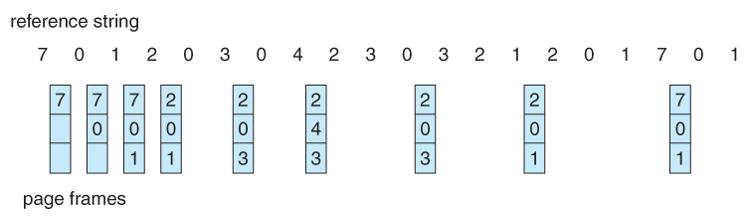
Optimal Page Replacement : Example
9 page faults with OPT

Slide 17
Optimal Page Replacement: Observations
OPT cannot be implemented in practice because it requires foretelling the future, but it makes a nice benchmark for the comparison and evaluation of real proposed new algorithms.
In practice, most page-replacement algorithms try to approximate OPT by predicting (estimating) in one fashion or another what page will not be used for the longest period of time.
The basis of FIFO is the prediction that the page that was brought in the longest time ago is the one that will not be needed again for the longest future time, but there are many other prediction methods that strive to match OPT.

Slide 18
LRU Page Replacement
The prediction behind Least Recently Used (LRU) algorithm is that the page that has not been used in the longest time is the one that will not be used again in the near future.
  What’s the difference between FIFO and LRU?
Some view LRU as analogous to OPT, except looking backward instead of forward.
Note: Neither LRU or OPT exhibit Belady’s Anomaly.

Slide 19
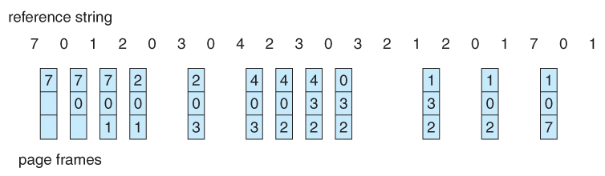
LRU Page Replacement
Example: LRU produces 12 page faults (15 for FIFO and 9 for OPT)

Slide 20
LRU Page Replacement
LRU is considered a good replacement policy and is often used.
The problem is how exactly to implement it -> how to determine an order for the frames. Two simple approaches:
Counter
  Each memory access increments a counter
  Record last time of use in the page table
  Requires a linear search
Stack
  Keep a stack of page numbers in a double linked list
  Move referenced page to top
    LRU page is at the bottom
  Requires 6 pointers (at worst) to be changed

Slide 21
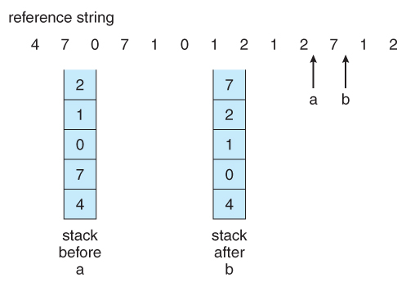
Stack Implementation of LRU Algorithm

Slide 22
LRU-Approximation Page Replacement
Full implementation of LRU requires hardware support, and few systems provide the full hardware support necessary.
Solution: reference bit in the page table
  With each page, associate a bit, initially = 0.
  When a page is referenced, set bit to 1.
  Replace the page which is 0 (if one exists). We don’t know order though…
Second-Chance (“Clock”) Algorithm
  Essentially a FIFO, except the reference bit gives pages a “second chance”.
  If the page to be replaced (in clock order) has bit = 1, then:
    Set bit to 0
    Leave page in memory
    Move to next page
Notes:
Counter or stack implementation requires hardware support

Slide 23
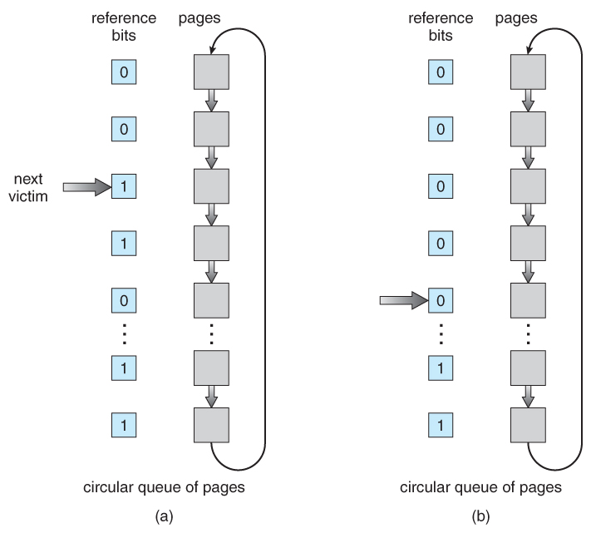
Second-Chance (Clock) Algorithm
Notes:
When we find ref bit = 0, replace that page with the new page we bring end – it’s at the end of the queue

Slide 24
Enhanced Clock Algorithm
Combine reference and “dirty” (recently modified) bit:
  (ref, dirty)
  (0, 0) – Neither recently used or modified (best to replace)
  (0, 1) – Not recently used but modified
  (1, 0) – Recently used but clean
  (1, 1) – Recently used and modified
Looking for the page in the lowest numbered category: (0, 0), then (0, 1), then (1, 0), and then (1, 1)
The main difference between this algorithm and the previous one is the preference for replacing clean pages if possible.
Notes:
May have to scan the queue several times now…

Slide 25
Counting-Based Page Replacement
There are algorithms based on counting the references to a given page:
Least Frequently Used, LFU – replace the page with lowest reference count.
Most Frequently Used, MFU – replace the page with the highest frequency count.
Question: What’s the rationale and a problem for each LFU and MFU?
In general, counting based algorithms are not commonly used, as they are expensive to implement and do not approximate OPT well.
Notes:
LFU – replace the page with a small reference cnt. A problem if a page is used a lot initially, but never again.
MFU – the page with the smallest cnt has yet to be used.

Slide 26
Applications and Page Replacement
Some application (e.g., database systems) understand their data access and caching needs better than the general-purpose OS and should therefore be given reign to do their own memory management.
Sometimes such programs are given a raw disk partition to work with containing raw data block and no file system structure. It is then up to the application to use this disk partition as extended memory or for whatever reasons it sees fit.

Slide 27
Virtual Memory:
Allocation of Frames

Slide 28
Allocation of Frames
There are two important tasks for virtual memory management:
Page-replacement
Frame-allocation
If we have 93 free frames and two processes, how many frames does each process get?

Slide 29
Minimum Number of Frames
A minimum number of frames allocated must be defined.
Not enough pages can affect performance.
  What if a single instruction requires 3 frames but 2 are allocated?
The absolute minimum number of frames that process must be allocated is dependent on system architecture.
  Corresponds to the worst-case scenario of the number of pages that could be touched by a single instruction.

Slide 30
Allocation Algorithms
Equal allocation
  M frames available
  N processes to share them
  Each process gets M/N frames
Proportional Allocation
  Allocate frames proportionally to the process size
  If the size of P_{i} is S_{i} and S is the total sum of all S_{i}, then the allocation for a process P_{i} is:
  a_{i} = m * S_{i}/S, where m is the total frames available
Variations on proportional allocation could incorporate process priority.
All allocations fluctuate over time as the available free frames fluctuates.
  Still subject to the minimum allocation constraints.

Slide 31
Global vs Local Allocation
Local replacement
  A process is allocated a fixed number of frames.
  The process selects what page to replace only from its allocated frames.
Global replacement
  Any page may be a potential victim, whether it currently belongs to the process or not.
Trade-offs:
Local - allows processes to manage their own page-fault rates.
Local – may not make unused frames available to other processes.
Global – leads to better throughput (more common approach).

Slide 32
Virtual Memory: Thrashing

Slide 33
Thrashing
If a process doesn’t have enough pages, the page-fault rate ↑.
Example: A process needs to bring a page into memory. However, a page needed in the near future must be swapped out.
Thrashing - A process spends more time paging than executing.

Slide 34
Cause of Thrashing
If CPU utilization is too low, the OS brings new processes into system.
  A global page-replacement algorithm is used.
A process needs more frames – starts faulting and takes frames from other processes.
Those processes need those frames – they fault and take frames from other processes.
Processes must wait for page swaps so they leave the ready queue.
The OS sees a decrease in CPU utilization so it brings in more processes.
Eventually, the system would essentially grind to a halt.

Slide 35
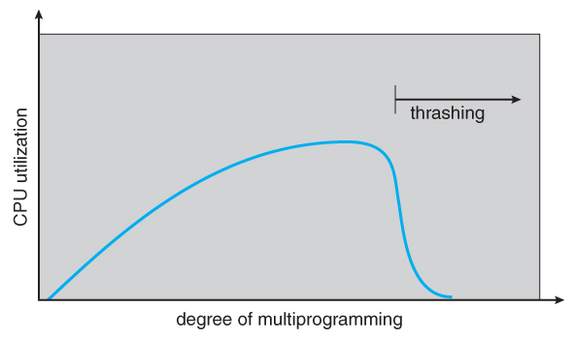
Cause of Thrashing

Slide 36
Locality Model
Thrashing Solution: provide processes with the frames they need “right now.”
  How do we know what that is?
The locality model states that a process moves from one locality to the next.
A locality is a set of pages that are actively used together:
  Defined by program structure and data structures.
  Code locality (e.g., a loop)
  Data locality (e.g., an array)
If we could just keep the frames involved in the current locality, then page faulting would be primarily on switches from one locality to another.
  E.g., when one function exits and another is called.
Notes:
Note that the locality model is the unstated principle behind caching.

Slide 37
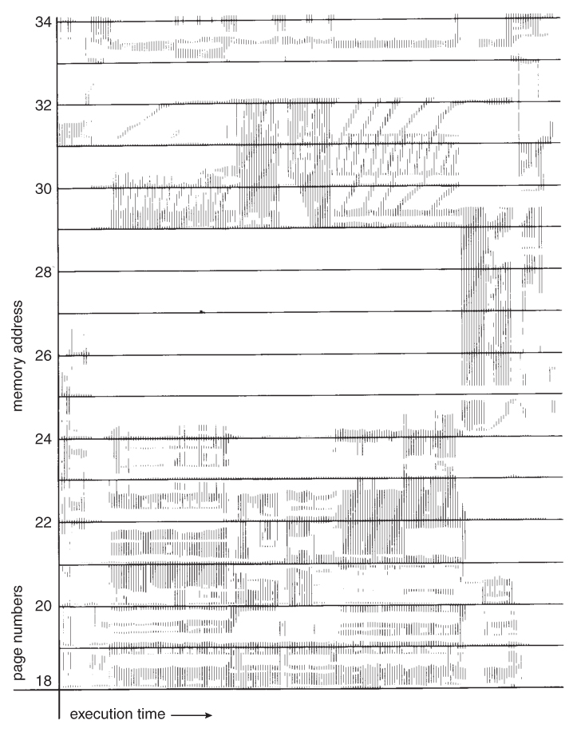
Locality
Memory-reference pattern

Slide 38
Working-Set Model
The working-set model is based on the concept of locality
A working-set window is a fixed number of page references, delta (∆).
  Delta is a parameter that must be defined
Examine the most recent page references in ∆. These pages are the working set for a given time.

Slide 39
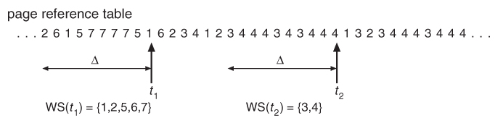
Working-Set Model
∆ = 10 memory references
Working set at t₁ = {1, 2, 5, 6, 7}
Working set at t₂ = {3, 4}
What happens if delta is too small? Too large?
Notes:
Note that the working set is an approximation of a program’s locality.

Slide 40
Working-Set Model
∆ = 10 memory references
Working set at t₁ = {1, 2, 5, 6, 7}
Working set at t₂ = {3, 4}
If ∆ is too small, then it will not encompass entire locality.
If ∆ is too large, then it encompasses several localities.
Notes:
Note that the working set is an approximation of a program’s locality.

Slide 41
Working-Set Model: Frame Demand
Let D be the total frame demand or the sum of the working set sizes (WSS) for all processes.
  D = ∑ WSS_{i}
If D > total number of available frames ⇨ thrashing
If D < the available frames, then additional processes can be launched.
If D exceeds the total number of available frames, then suspend a process.

Slide 42
Tracking the Working Set
Problem: how do we track of the working set? It’s a moving window.
  At each memory reference a new reference appears at one end and the oldest reference drops off the other end.
  Ex. How do we decide to create a new working set at T2?
Notes:
We can use a timer and reference bits in the page table. In the page table store the time of last use and if it was referenced since the last tick. However, this still gets expensive to implement – need to scan the entire page table to determine the working set.

Slide 43
Page-Fault Frequency
A more direct approach is to recognize that what we really want to control is the page-fault rate and to allocate frames based on this directly measurable value.
If the page-fault rate exceeds a certain upper bound, then gains frames.
If it is below a given lower bound, then loses frames.
May still need to suspend a process if PF rate increases, but no available frames.

Slide 44
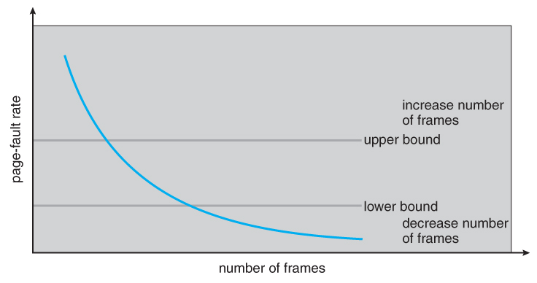
Page-Fault Frequency

Slide 45
Review
6
5
4
6
5
6
5
4
6
5
4
3
2
6
5
4
Consider the following page reference string. How many page faults will occur for the following replacement algorithms, assuming 3 frames?
  FIFO
  Optimal
  LRU
6
5
4
3
2
5
4
3
1 2 3 4 2 1 5 6 2 1 2 3 7 6 3 2 1 2 3 6
1
1
1
2
2
3

Slide 46
6
OPT
4
1
6
1
1
1 2 3 4 2 1 5 6 2 1 2 3 7 6 3 2 1 2 3 6
6
5
1
1
1
1
5
4
2
2
2
5
4
2
2
2
5
3
5
LRU
1 2 3 4 2 1 5 6 2 1 2 3 7 6 3 2 1 2 3 6
1
1
1
2
2
3

Slide 47
Review
Does increasing the number of frames always decrease (or not change) the number of page faults? Why or why not?
Consider a demand-paging system with 4 processes running. The system was recently measured to determine CPU utilization and the amount of paging to disk. For each case, what is happening?
  CPU utilization = 13%, disk utilization = 97%
  CPU utilization = 87%, disk utilization = 3%
  CPU utilization = 13%, disk utilization = 3%

Slide 48
Review
What is the difference between contiguous memory allocation and paging?
What does the page table store?
On a system with paging, a process cannot access memory that it does not own. Why?
What is the purpose of paging the page tables (e.g., hierarchical paging)?
Under what circumstances do page faults occur? Describe the actions taken by the OS when a page fault occurs.

Slide 49
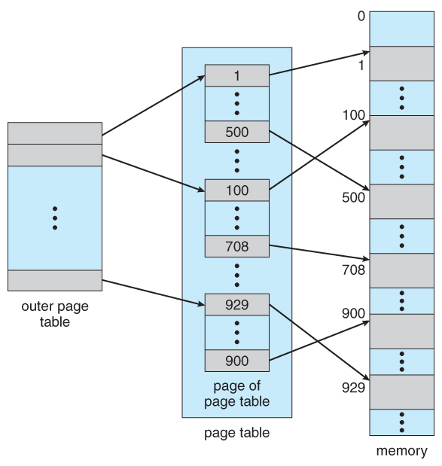
Review

Slide 50
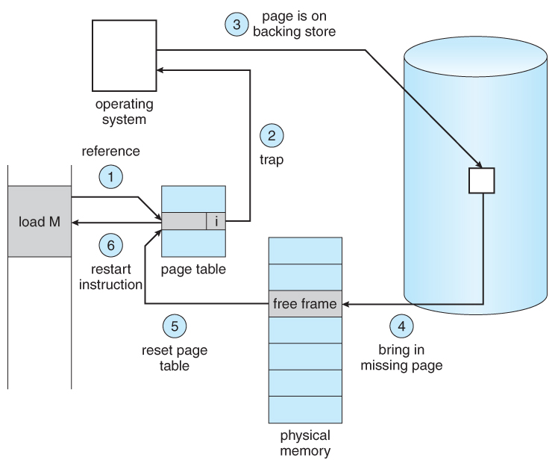
Review

Slide 51
Review
When a virtual address is translated to a physical address, the MMU first determines the page number and the page offset and then uses the page table to determine the physical address. Assume that the page size is 512 bytes and the page table below. Determine if the virtual address reference will cause a page fault. If not, what is the physical address?
  2560
  2559
Page ID | Valid Bit | Frame #
0 | 1 | 13
1 | 0 | 4
2 | 1 | 5
3 | 1 | 4
4 | 1 | 9
5 | 0 | 10
6 | 1 | 2
Notes:
2559 -> int(2559/512), 9 * 512 + (2559 % 512) = 5119

Slide 52
Next Time
File Systems

