Slide 1
CSCI 4401/5401: Principles of Operation Systems
James Wagner
University of New Orleans
Week 11, Lecture 20
October 24th, 2023

Slide 2
Announcements
Assignment 3 is due Monday, November 6th @ 11:59pm
Quiz 4 is due Monday, October 30th @ 11:59pm.
Main Memory & Virtual Memory

Slide 3
What We’re Doing Today
Introduction to File Systems (Chapter 4)
File Concept
Access Methods
Directory and Disk Structure
File-System Mounting
File Sharing
Protection
File System Structure

Slide 4
Review
What is the difference between contiguous memory allocation and paging?
What does the page table store?
On a system with paging, a process cannot access memory that it does not own. Why?
What is the purpose of paging the page tables (e.g., hierarchical paging)?
Under what circumstances do page faults occur? Describe the actions taken by the OS when a page fault occurs.

Slide 5
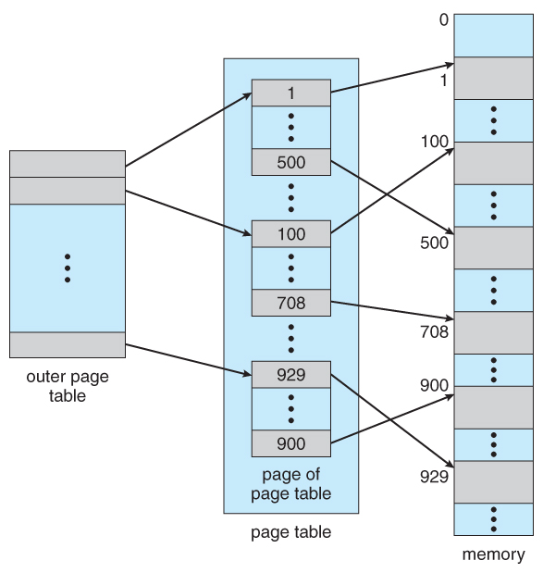
Review

Slide 6
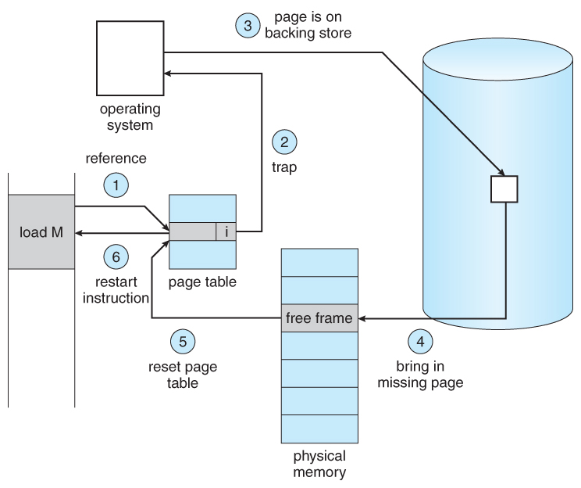
Review

Slide 7
Review
When a virtual address is translated to a physical address, the MMU first determines the page number and the page offset and then uses the page table to determine the physical address. Assume that the page size is 512 bytes and the page table below. Determine if the virtual address reference will cause a page fault. If not, what is the physical address?
2560
2559
Page ID | Valid Bit | Frame #
0 | 1 | 13
1 | 0 | 4
2 | 1 | 5
3 | 1 | 4
4 | 1 | 9
5 | 0 | 10
6 | 1 | 2
Notes:
2559 -> int(2559/512), 9 * 512 + (2559 % 512) = 5119

Slide 8
File Systems Introduction

Slide 9
Why Do We Need File Systems?
The amount of data we can store in a process address space is limited.
We want to ability to store large amounts of data.
When a process terminates the information is lost.
We may need to store useful data that was processed.
Multiple processes may need to access data from the same resources.
What if a file needs to be accessed by multiple processes?
Storing the information in a single process is not convenient.
Information sharing should be independent of any one process.

Slide 10
Persistent Storage
Think of persistent storage (e.g., disk drives or solid state drives) as a linear storage space.
Persistent storage is broken up into fixed size blocks (i.e., the minimum I/O unit) with read and write access.
How do we find the information (i.e., the blocks)?
How do we protect one user’s data from another user?
How do we manage the blocks (free and allocated)?

Slide 11
File System Definition
File systems provide the abstraction that answers these questions.
Just as we had an abstract view of a process for memory, files provide us an abstraction for persistent storage.
Files are a logical unit of information
File system: the part of the operating system dealing with files.
NTFS – used by Windows
FAT – used for early versions of Windows and smaller devices (e.g., thumb drives)
APFS – developed for MacOS X
EXT 4 – used by Linux

Slide 12
File Concept

Slide 13
The File Concept
Secondary storage:
Persistent (nonvolatile), large, cheap
Cannot be accessed by the CPU directly.
Multitude of storage devices:
HDD, SSD, CD, DVD, etc.
Need a common abstraction to make sense to the user.
File:
A named collection of (related) data recorded on secondary storage.
All data must be organized in a file in order to be placed in secondary storage.

Slide 14
The File Concept
The user doesn’t care where on the disk a file is stored, whether it’s stored contiguously, etc.
These low-level details are abstracted away from the user.
This abstraction allows the user to:
Name files
Specify file location in a directory (not disk)
Access the file via a human-readable name
Provide protection (read, write, execute)

Slide 15
What’s in a File?
Anything
Sequence of words, bytes
Simple Structure
Lines
Complex Structure
Formatted document (like this PowerPoint)
Compiled Java file (.class)
Structure is in the eye of the interpreter:
A .mp3 file makes no sense to javac
A .class file makes no sense to your mp3 player

Slide 16
Interpreting a File: Attributes
Name – human-readable identifier
Identifier - non-human-readable identifier
Type - text, executable, Word, etc.
Location – pointer to file location on disk.
Size – in bytes or pages/blocks
Protection - indicates who is allowed to read, write, and execute.
Time, date, owner ID - useful for protection and monitoring use.

Slide 17
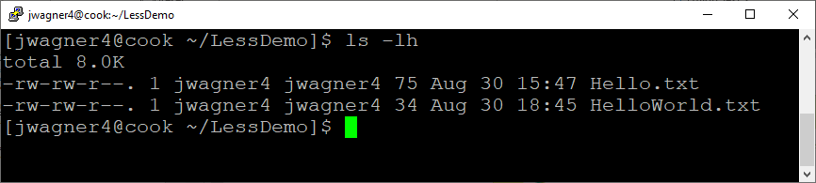
File Attributes Examples
ls -lh
ls lists the file names
-l give us more detailed information
-h make it human readable
permissions
owner
group
size(bytes)
modification(date & time)
link count

Slide 18
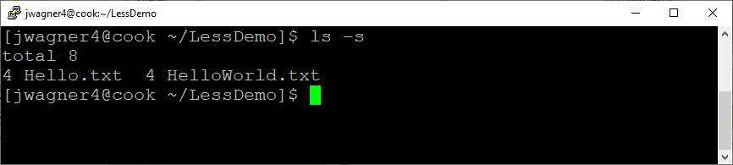
File Attributes Examples
ls -s
ls lists the file names
-s gives the size in blocks
size(blocks)

Slide 19
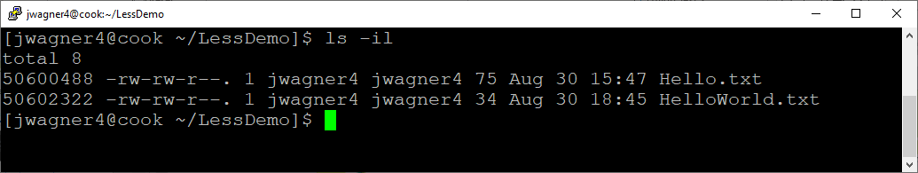
File Attributes Examples
ls -il
-i gives us the inode. Not really readable to us. We’ll come back to inodes.

Slide 20
Using a File: Operations
Create – find space in the file system and add new entry
Delete – find the file in the directory and release file space
Rename – rename file “old” to “new”
Open – open an existing file for access
Close – close access to the file
Write – sys call specifying the file name and data to write
Read – sys call specifying the file name and where to store the blocks
Seek – reposition within a file
Truncate – erase file contents but keep attributes

Slide 21
File Operations
Is the open() system call essential? What would be the consequences of not having it?
Is the any difference between using the rename() system call vs. copying the file to a new file and deleting the old file?
We will talk about some of these details later on when we get to file system implementation.
Notes:
If no open(), every read would require us to specify the name of the file accessed. We would have to fetch the i-node every time.
Yes, rename does not change creation time or last modification, but creating the new file does. Also, if storage is full, the copy might fail. A copied file also inherits permissions.

Slide 22
Using a File: Operations
Most file operations require searching the file directory. A smaller, open-file table speeds up this process:
Open (F_{i}) – search the directory structure on disk for entry F_{i} and move the content into memory.
Close (F_{i}) – move the content of entry F_{i} in memory to disk.

Slide 23
Open-File Table
File pointer – tracks the last read/write location
File-open count – number of open files. Close() helps keep the number of entries small.
Disk location of the file – need to locate the file on disk if we modify it.
Access rights – a process opens a file in an access mode. Allow or deny requests based on this mode.

Slide 24
File Locking
File locks allow one process to lock a file and prevent other processes from gaining access to it.
Similar idea to reader-writer locks with process synchronization.
Don’t hold an exclusive lock if you’re not using the file.
Deadlocks can occur while waiting to acquire locks.
Shared Lock – several processes can read the file concurrently.
Exclusive Lock – only one process can acquire this lock to read & write.

Slide 25
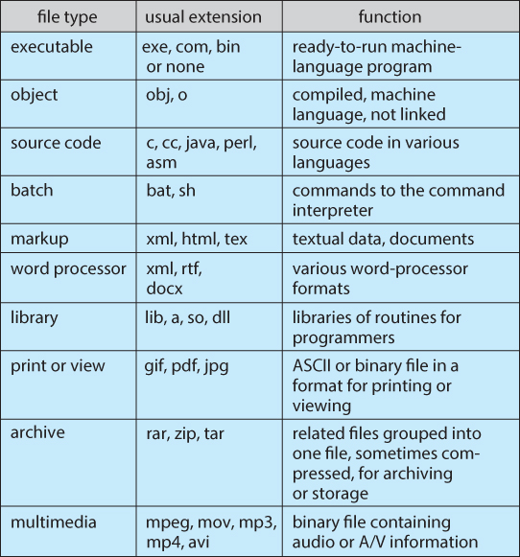
File Types
Special file extensions indicate the type of each file.
Extensions may or may not have a meaning to the OS.

Slide 26
File Structure
Some files contain an internal structure, which may or may not be known to the OS. The file type helps identify the appropriate application.
Disk files are accessed in units of blocks (e.g., 512 bytes or 1024 bytes).
OS sees files as a set of blocks
Applications can interpret the logical structures.
Blocks are the minimum I/O unit.
Internal fragmentation

Slide 27
Access Methods

Slide 28
Access Methods
Sequential Access
read next
write next
rewind
skip n records
Direct Access
read n
write n
position to n
read next
write next
rewrite n
n = relative block number

Slide 29
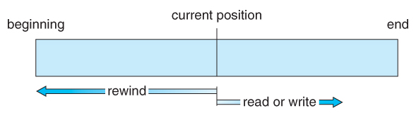
Sequential Access
Simple and generally supports a few operations:
Read next – read a record and advance to the next position.
Write next – write a record and advance to the next position.
Rewind
Skip n records

Slide 30
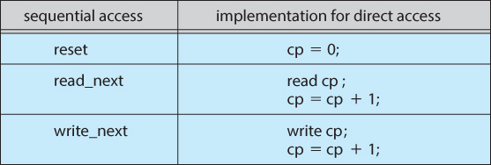
Direct Access
Jump to any record and read that record. Operations supported include:
Read n – read record number n
Write n – write record n.
Jump to record n – could be 0 or the end of file.
Sequential access can be easily emulated using direct access. The inverse is complicated and inefficient.

Slide 31
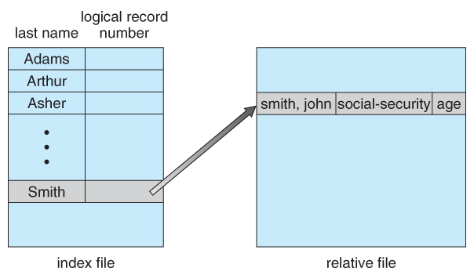
Other Access Methods
An indexed access scheme can be easily built on top of a direct access system. Very large files may require a multi-tiered indexing scheme, i.e., indexes of indexes.

Slide 32
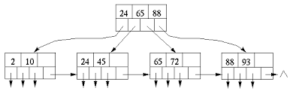
File Access Methods
Block1
Block2
Block3
Block4
Block5
Sequential Scan
Index Access
Block1
Block2
Block3
Block4
Block5
Block1
Block2
Block3
Block4

Slide 33
Directory Structure & Disk Structure

Slide 34
Storage Structure
A disk can be used in its entirety for a file system.
Alternatively, a physical disk can be broken up into multiple partitions.
Each partition becomes a virtual disk and can have its own filesystem.
Or, multiple physical disks can be combined into one volume, i.e., a larger virtual disk, with its own filesystem spanning the physical disks.

Slide 35
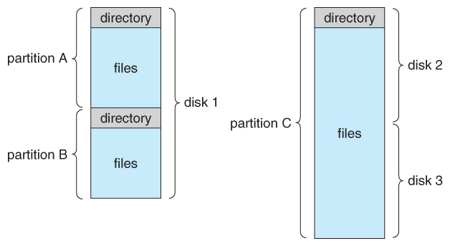
File-System Organization

Slide 36
Directories
Directory – the abstraction that allows us to organize files
Directory
Files
F₁
F₂
F₃
F₄
F_{n}

Slide 37
File Information (attributes) in a Directory
Name
Type
Address
Current length
Maximum length
Date last accessed
Date last updated
Owner ID
Protection information
…

Slide 38
Operations Performed on a Directory
Create a file – add to the directory
Delete a file – remove from the directory
List a directory – possibly ordered in different ways.
Rename a file
Link – allow a file to appear in more than one directory
Keep a single copy of the file, but create an alias
E.g., ln -s (target file or path) (symbolic-filename/pathname)
Unlink – remove a link

Slide 39
Directory Organization
Efficiency
Locate a file quickly
Naming Convenience
Two users can have the same name for different files.
The same file can have several different names.
Grouping
Logical grouping of files by properties.
E.g., all Java programs, all games, …

Slide 40
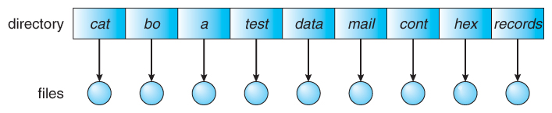
Single-Level Directory
A single directory for all files.
Simple to implement.
Trade-offs:
Each file must have a unique name
Efficiency
Usability

Slide 41
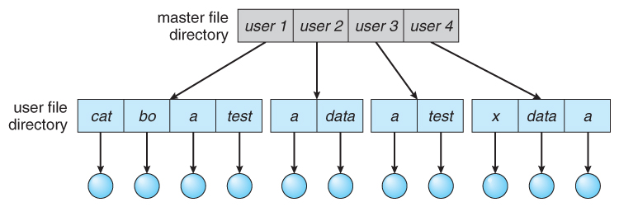
Two-Level Directory
Separate directory for each user.
File names only need to be unique within a given user directory.
A root file directory tracks all user directories.
Sharing files between users can still be a challenge.

Slide 42
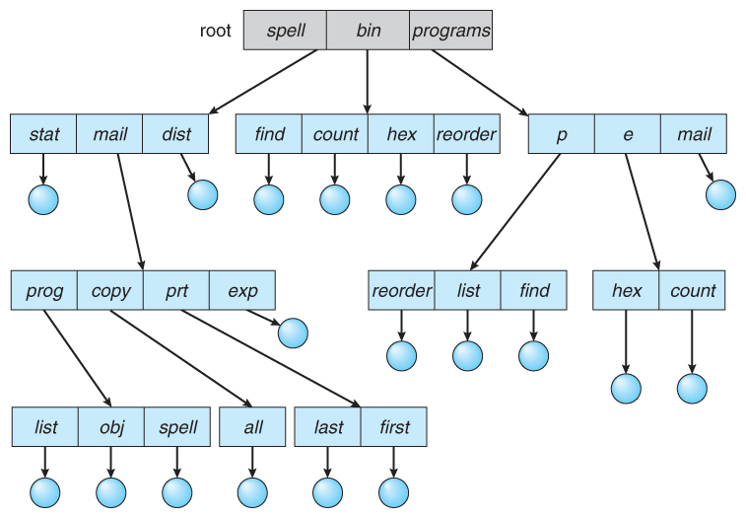
Tree-Structured Directories
An obvious extension to the two-tiered directory structure, and the one with which we are all most familiar.

Slide 43
Tree-Structured Directories
Each user/process has the concept of a current directory from which all (relative) searches take place.
Files may be accessed using either:
Absolute pathnames - relative to the root of the tree
Relative pathnames - relative to the current directory
Users can now share files by specifying pathnames.
Results in more efficient searching and grouping.

Slide 44
Path Names
In a single-level structure, naming files is simple
In a hierarchical structure, we need to specify the path name
Absolute path name – starting with the root, where is the file
/usr/csci4401/homework/HW1.doc
Inconvenient, especially when the directory structure gets deep
Relative path name – starting at the working, where is it
cd /usr/csci4401/homework/ (change the working directory)
Convenient, but make sure you’re in the correct directory

Slide 45
Acyclic-Graph Directory
Two programmers are working on the same project.
They need to share the project files.
Both also want the files in their own directory.
An acyclic-graph directory allows directories/files to be shared.
The same file/directory can be in two different directories.
Two different names (aliasing).
Only one copy - any changes made by one person are immediately visible by the other.
In UNIX this is a called a link

Slide 46
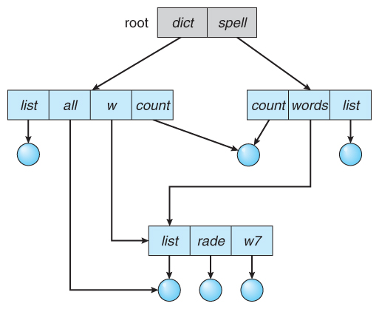
Acyclic-Graph Directories
Notes:
One problem with acyclic graph directories is cycles.

Slide 47
File System Mounting

Slide 48
File-System Mounting
Just as a file must be opened before it is used, a file system must be mounted before it can be available to processes
Mounting - combine multiple file systems into one large tree structure.
Allows a file system to be accessed.
An unmounted filesystem is mounted at a mount point (directory on which to attach it).
Mounting occurs at boot time.
An external drive such as a thumb drive is usually mounted automatically for us.

Slide 49
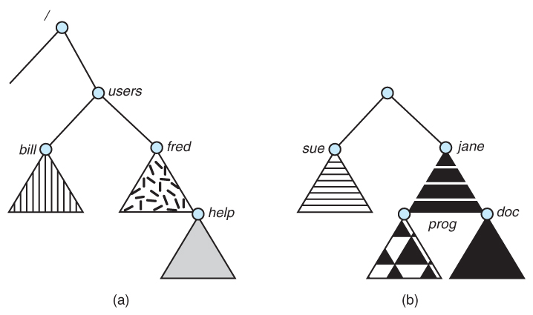
Mounted vs Unmounted Partitions
Files in b) are not available until the FS is mounted.

Slide 50
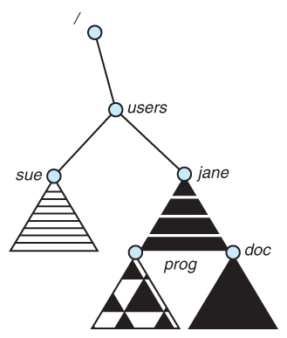
Mount Point
An empty directory serves as a root for the mounted filesystem.

Slide 51
File Sharing & Protection

Slide 52
File Sharing
Sharing of files on multi-user systems is desirable.
Files must be kept safe for protection (against deliberate malicious access).
Sharing may be done through a protection scheme -> some sort of controlled access.

Slide 53
Types of Access
The file owner/creator should be able to control what can be done and by whom:
Read – view the file contents
Write – change the file contents
Execute – load the file onto the CPU and follow the instructions
Append – add to the end of an existing file
Delete – remove a file from the system
List – view the name and other attributes of files on the system.
Higher-level operations, such as copy, can generally be performed through combinations of the above.

Slide 54
Access Control Lists
Access control lists specify all user names and the types of access for each user.
Pros – flexibility, specify anything
Cons – huge, sparse

Slide 55
UNIX Access Control
UNIX uses a set of 9 access control bits in three groups of three. These correspond to R, W, and X permissions for each of the Owner, Group, and Others. The RWX bits control the following privileges for ordinary files and directories:
Bit | Files | Directories
R | Read | Read directory contents.
W | Write | Change directory contents.
X | Execute | Access detailed directory information. If a user has X but not R, they can access a specific file.
Notes:
If a user has X but not R, they can access a specific file. i.e., cannot list the files

Slide 56
File Attributes Examples
ls -lh
ls lists the file names
-l give us more detailed information
-h make it human readable
permissions
owner
group
size(bytes)
modification(date & time)

Slide 57
UNIX Access Control
Example:
Sara is writing a new book -> should have all file operations.
Jim, Dawn, and Jill are helping with the book -> just read and write.
All other users should be able to read, not write.
Assign Jim, Dawn, and Jill to a group called “Helpers”
Bit assignments:
Sara – rwx
Helpers – rw-
Other – r--
rwxrw-r-- sara helpers

Slide 58
File System Structure

Slide 59
Secondary Storage
Hard disks are used to store file system files because of two properties:
Blocks of data can be rewritten in place.
They are direct access, allowing any block of data to be accessed.
Disks are accessed in physical blocks, not a byte at a time. Block sizes typically range from 512 bytes to 4 KB (or larger).

Slide 60
File System Design Problems
Defining how the file system should look to the user
(e.g., defining a file, operations allowed)
What algorithms and data structures should we use to map the logical file system onto the physical devices.

Slide 61
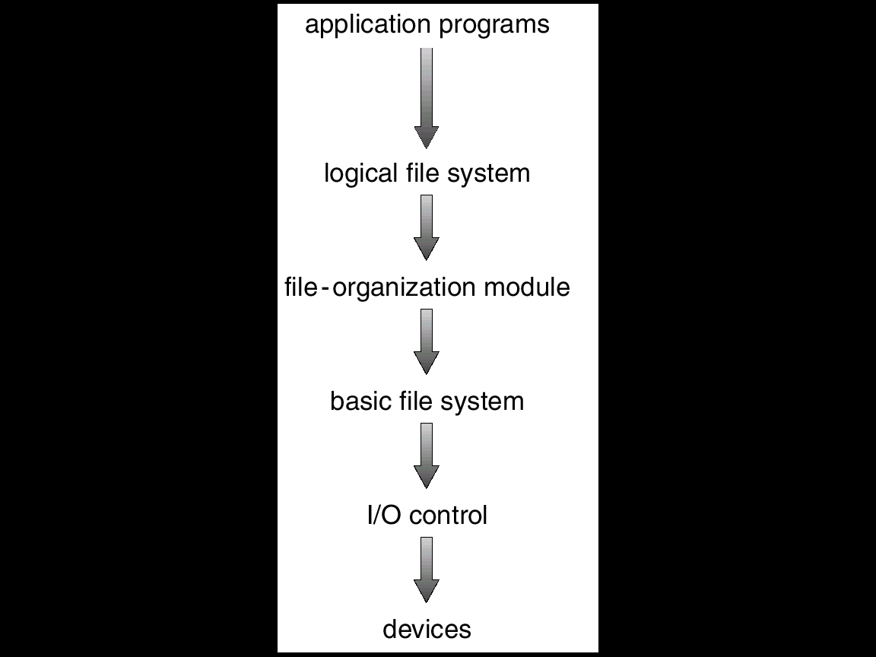
Layered Designed of File Systems
File systems are composed of many levels.
Each level uses the lower levels to create new features for use by higher levels.

Slide 62
Layered Designed of File Systems
Devices (e.g., disk drives) – very bottom.
I/O Control (i.e., device drivers) – low-level transfer of data between main memory and disk.
A “translator”
Input – high-level commands, e.g., “retrieve block 123”
Output – low-level, hardware-specific instructions, e.g., the specific bit patterns and device locations.

Slide 63
Layered Designed of File Systems
Basic file system
Issues generic commands to device drivers to read/write blocks.
Ex. Access the physical block on drive 1, cylinder 73, track 2, sector 10.

Slide 64
Layered Designed of File Systems
File-organization module
Knows about files and both their logical blocks and physical blocks.
Translates logical block addresses to physical addresses for the basic file system.
Free-space manager tracks and allocates unused blocks.

Slide 65
Layered Designed of File Systems
Logical file system
Manages metadata information.
All of the file-system structure except the actual data (or file contents).
Manages the directory structure.
File metadata is maintained in file-control blocks (FCB).
An inode in UNIX

Slide 66
File-System Implementation

Slide 67
Overview
We need on-disk and in-memory structures to implement a file system.
Disk structures information:
How we can boot an operating system stored there.
The total number of blocks.
The number and location of free blocks
Directory structure
Individual files.
Memory structures information:
File-system management
Performance improvements (caching)

Slide 68
On-Disk Data Structures
Boot-control block (per volume) - how to boot the OS from disk.
Address 0 of the partition
Volume control block (per volume) – contains file system info: # of blocks, size of blocks, # of free block & pointers.
Windows: master file table
UNIX: superblock
Directory (per FS) – organizes the files and contains file info: names and pointers to corresponding FCBs.
File Control Block (or I-nodes on UNIX) (per file) – contains file details: ownership, size, permissions, dates, etc.
Boot Block
Volume Control Block
File Control Blocks
Files themselves
Volume (or partition)

Slide 69
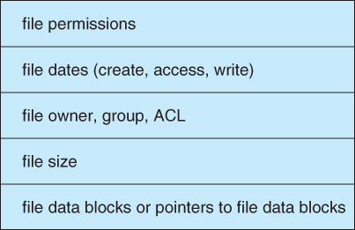
File Control Block Example

Slide 70
In-Memory Data Structures
When the file system is mounted, some data may be loaded into memory:
In-memory mount table – info about each mounted volume
In-memory directory cache – holds recently accessed directory information.
System-wide open-file table – contains a FCB copy for every currently open file in the system.
Per-process open-file table – contains a pointer to an entry in the system-wide open-file table.

Slide 71
Interaction of File System Components: File Creation
An application program calls the logical file system.
The logical file system knows the format of the directory structures.
It allocates and creates a new FCB.
Updates the directory with the new file name & FCB.

Slide 72
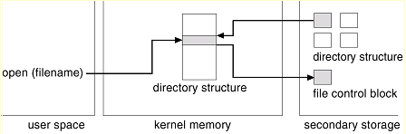
Interaction of File System Components: Open() File
The open() call passes a filename to the logical file system.
Open() searches parts of directory cached in memory for the filename.
If not found, search the directory on disk.
Copy the FCB into the system-wide open-file table in memory.
(Not shown) Add entry into the system-wide table and per-process table.

Slide 73
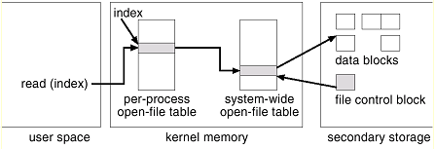
Interaction of File System Components: File Read/Write
Open() returns an index to the per-process table.
The entry in the per-process table references the system-wide table.
The system-wide table stores FCB info & processes that have a file open.
Notes:
The index (or pointer) returned by open is used for all file operations. UNIX – file descriptor, Windows – file handle. Used for other operations (read & write)

Slide 74
Interaction of File System Components: File Close()
The per-process table entry is freed
The counter in the system-wide table is decremented. If that counter reaches zero, then
The system-wide table entry is also freed.
Any data currently stored in memory cache for this file is written out to disk (if necessary).

Slide 75
Layout of Disk: Partitions
Physical disks are commonly divided into smaller units, partitions.
Disks can also be combined (more on that when we get to RAID)
Partitions can be “raw” - no FS, or “cooked” - contains a FS
Raw examples – swap space, databases, RAID
Boot partition
Raw
Pre-defined location, (e.g., address 0)
Executes the boot loader -> boots an OS from disk and executes the FS.
Root partition
Contains the OS kernel and other system files
Mounted at boot time and control is transferred from the boot loader to the kernel.
Additional file systems get mounted as we continue to boot.

Slide 76
Next Time
File System Implementation
Directory Implementation
Allocation Methods
Free-Space Management
Efficiency and Performance
Recovery

