Slide 1
CSCI 4401/5401: Principles of Operation Systems
James Wagner
University of New Orleans
Week 11, Lecture 21
October 26th, 2023

Slide 2
Announcements
Assignment 3 is due Monday, November 6th @ 11:59pm
Quiz 4 is due Monday, October 30th @ 11:59pm.
Main Memory & Virtual Memory

Slide 3
What We’re Doing Today
File Systems Implementation:
File-System Structure
File-System Implementation
Directory Implementation
Allocation Methods
Free-Space Management
Efficiency & Performance
Recovery

Slide 4
File-System Implementation

Slide 5
Overview
We need on-disk and in-memory structures to implement a file system.
Disk structures information:
How we can boot an operating system stored there.
The total number of blocks.
The number and location of free blocks
Directory structure
Individual files.
Memory structures information:
File-system management
Performance improvements (caching)

Slide 6
On-Disk Data Structures
Boot-control block (per volume) - how to boot the OS from disk.
Address 0 of the partition
Volume control block (per volume) – contains file system info: # of blocks, size of blocks, # of free block & pointers.
Windows: master file table
UNIX: superblock
Directory (per FS) – organizes the files and contains file info: names and pointers to corresponding FCBs.
File Control Block (or I-nodes on UNIX) (per file) – contains file details: ownership, size, permissions, dates, etc.
Boot Block
Volume Control Block
File Control Blocks
Files themselves
Volume (or partition)

Slide 7
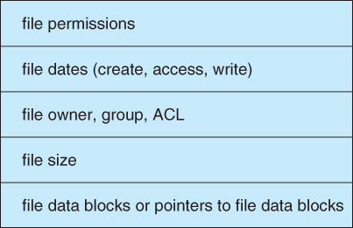
File Control Block Example

Slide 8
In-Memory Data Structures
When the file system is mounted, some data may be loaded into memory:
In-memory mount table – info about each mounted volume
In-memory directory cache – holds recently accessed directory information.
System-wide open-file table – contains a FCB copy for every currently open file in the system.
Per-process open-file table – contains a pointer to an entry in the system-wide open-file table.

Slide 9
Interaction of File System Components: File Creation
An application program calls the logical file system.
The logical file system knows the format of the directory structures.
It allocates and creates a new FCB.
Updates the directory with the new file name & FCB.

Slide 10
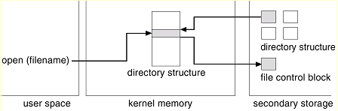
Interaction of File System Components: Open() File
The open() call passes a filename to the logical file system.
Open() searches parts of directory cached in memory for the filename.
If not found, search the directory on disk.
Copy the FCB into the system-wide open-file table in memory.
(Not shown) Add entry into the system-wide table and per-process table.

Slide 11
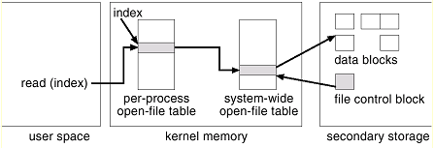
Interaction of File System Components: File Read/Write
Open() returns an index to the per-process table.
The entry in the per-process table references the system-wide table.
The system-wide table stores FCB info & # of processes that have a file open.
Notes:
The index (or pointer) returned by open is used for all file operations. UNIX – file descriptor, Windows – file handle. Used for other operations (read & write)

Slide 12
Interaction of File System Components: File Close()
The per-process table entry is freed
The counter in the system-wide table is decremented. If that counter reaches zero, then
The system-wide table entry is also freed.
Any data currently stored in memory cache for this file is written out to disk (if necessary).

Slide 13
Layout of Disk: Partitions
Physical disks are commonly divided into smaller units, partitions.
Disks can also be combined (more on that when we get to RAID)
Partitions can be “raw” - no FS, or “cooked” - contains a FS
Raw examples – swap space, databases, RAID
Boot partition
Raw
Pre-defined location, (e.g., address 0)
Executes the boot loader -> boots an OS from disk and executes the FS.
Root partition
Contains the OS kernel and other system files
Mounted at boot time and control is transferred from the boot loader to the kernel.
Additional file systems get mounted as we continue to boot.

Slide 14
Directory Implementation

Slide 15
Directory-Allocation & Management
Directory-allocation and directory-management algorithms affect the file system:
Efficiency
Performance
Reliability
Let’s look at some trade-offs of approaches…

Slide 16
Linear List
A linear list of file names with pointers.
Pros: the simplest and easiest directory structure to implement.
Cons: time-consuming to execute.
Finding a file requires a linear search.
Empty space after deletion? Mark it, keep another list, or move last entry.
Sorting makes searches faster, but complex insertions and deletions.
B-Tree index could be used.

Slide 17
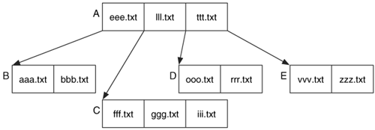
B-Tree Example w/ File Names
We can only fit 3 file names per node (or block)

Slide 18
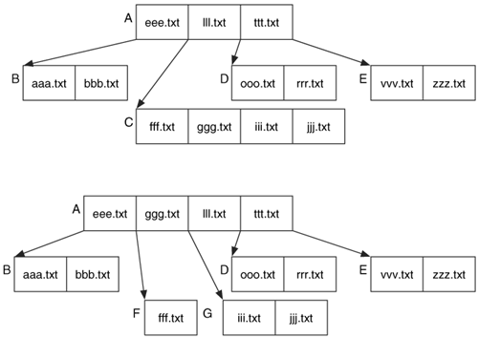
B-Tree Example w/ File Names
We can only fit 3 file names/node
jjj.txt is added, need to rebalance.

Slide 19
B-Tree Example w/ File Names
We can only fit 3 file names/node
jjj.txt is added, need to rebalance.

Slide 20
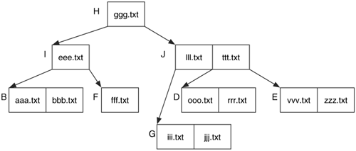
B-Tree Example w/ File Names
We can only fit 3 file names/node
jjj.txt is added, need to rebalance.
Notes:
Log(N) look up cost

Slide 21
Hash Table
Hash table - linear list, but with fixed size hash values (keys).
Pass file name and generate a hash, which serves as a pointer.
Some hash functions you may have heard of: MD5, SHA
Pros: speed up searches.
Cons:
Collisions – two files names hash to the same value.
Fixed size table –
Our hash function converts file names to an int between 0 – 63.
To create a larger table, re-compute/re-organize all other hash values.

Slide 22
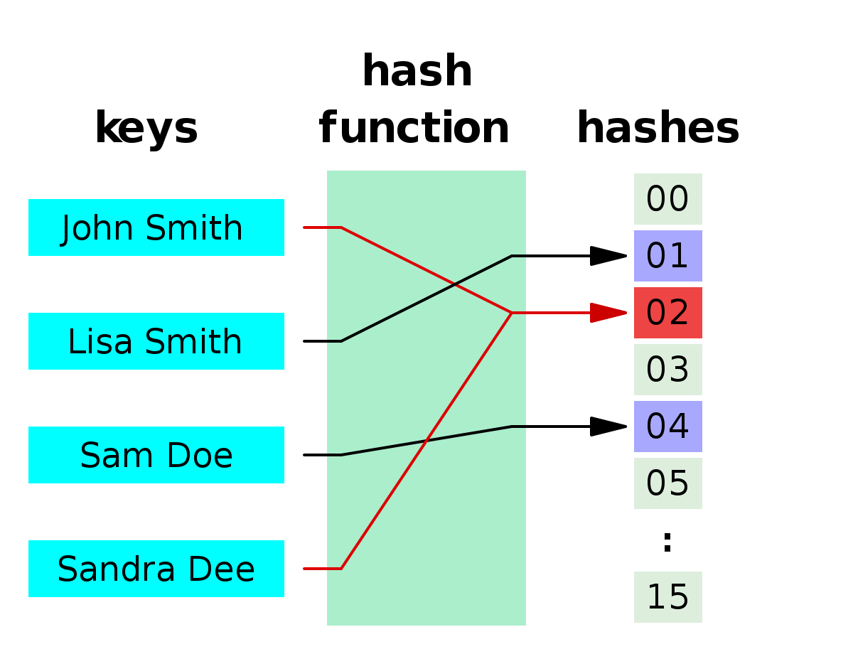
Hash Table Example

Slide 23
Allocation Methods

Slide 24
Allocation Methods
There are three major methods to store file blocks on disks:
Contiguous
Linked
Indexed
We will discuss the advantages & disadvantages of each.

Slide 25
Contiguous Allocation
Each file occupies a set of contiguous blocks on the disk.
Pros:
Very fast - reading successive blocks requires no disk head movement.
Cons:
Same issues with contiguous memory allocation. However, the cost for moving the disk heads may now justify it.
File growth is problematic:
Over-estimation - external fragmentation
Under estimation - move file
Improvement with extents – a chunk of allocated space (N blocks).

Slide 26
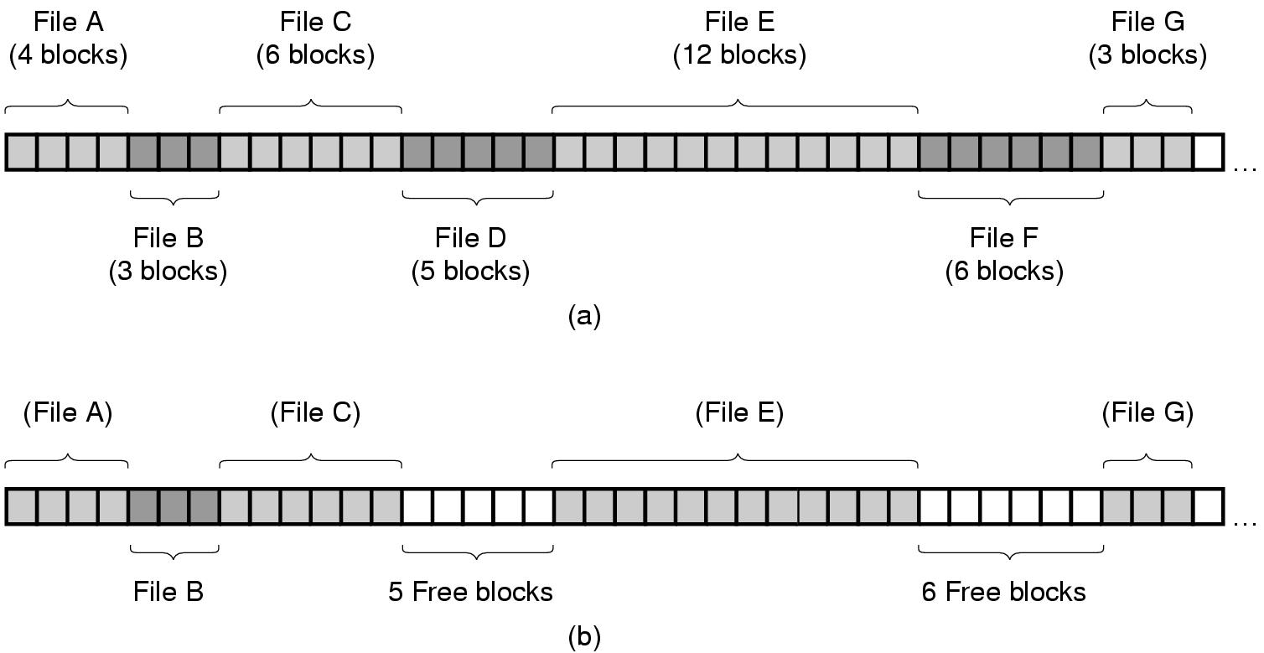
Contiguous Allocation
Contiguous allocation of disk for 7 files
The state of the disk after files D and F are deleted

Slide 27
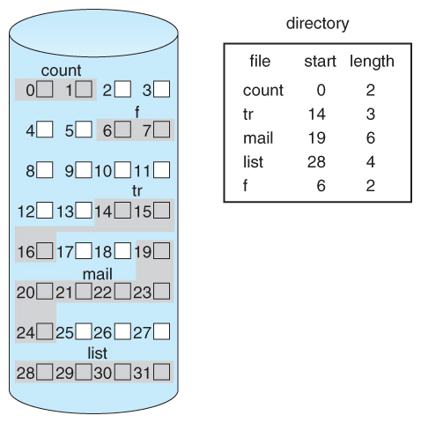
Contiguous Allocation of Disk Space

Slide 28
Linked Allocation
Each file is a linked list of blocks scattered anywhere on disk.
Pros:
Easy free-space management:
No external fragmentation
Does not require pre-known file sizes
Allows files to grow dynamically at any time.
Cons:
Links/pointers waste space (e.g., a block may be 508 bytes instead of 512 to make room for a 4-byte pointer)
Inefficient random access of blocks

Slide 29
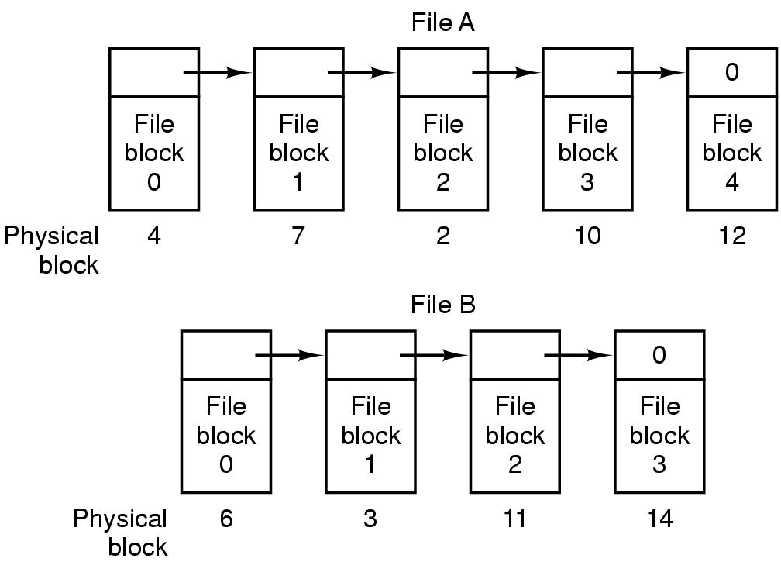
Linked Allocation
Storing a file as a linked list of disk blocks

Slide 30
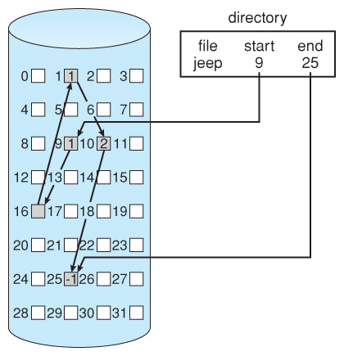
Linked Allocation of disk space
Directory contains a pointer to 1st and last blocks.
What if we only need the 2nd block?

Slide 31
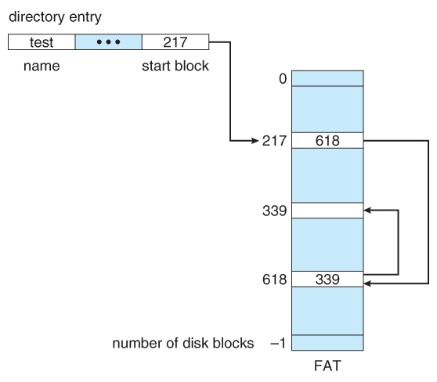
File Allocation Table (FAT)
The file allocation table (FAT) is a variation of linked allocation.
Store all links in a separate table at the beginning of the disk.
Benefit: the FAT table can be cached in memory, improving random access speeds.
end-of-file

Slide 32
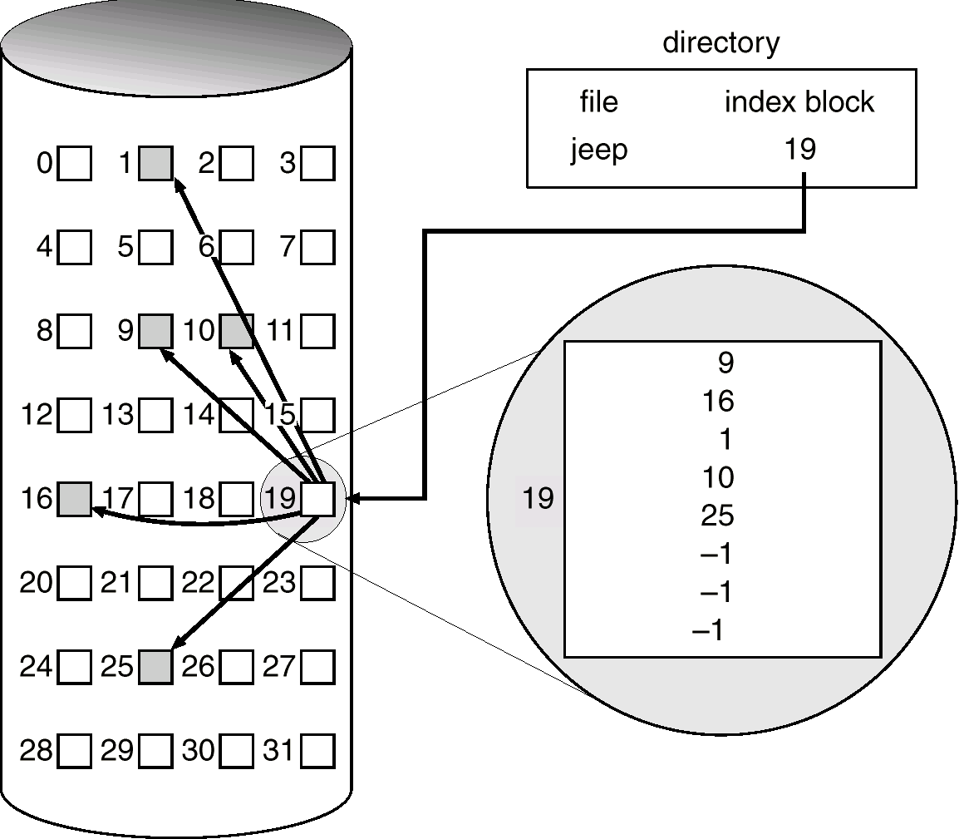
Indexed Allocation
All block pointers of a file are stored in an index
Pros:
Direct Access
No external fragmentation
Cons:
Index block overhead
Improvements:
Linked Scheme
Multi-level index
Combined Scheme

Slide 33
Indexed Allocation: Improvements
Linked Scheme:
An index block is one disk block.
The first index block contains some header information, the first N block addresses, and a pointer to additional linked index blocks.
Multi-level index – the first index block contains a set of pointers to secondary index blocks which in turn contain pointers to actual data blocks.
Combined Scheme – this is the scheme used in UNIX inodes …

Slide 34
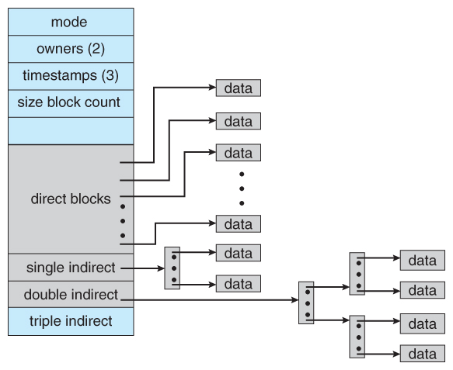
The UNIX Inode
Direct blocks
pointers for small files
Single indirect
Pointer to an index block
Double indirect
Pointer to a 2-level index
Triple Indirect
Pointer to a 3-level index
Note: index blocks may still require random access

Slide 35
I-Node Structure
File Attributes
Address of block 0
Address of block 1
Address of block 2
Address of block 3
Address of block 4
Address of block 5
Address of block 6
Ptr Single indirect
Pointer to I-node

Slide 36
I-Node Structure
Disk Blocks
i-node
(double indirect block)
i-node
Disk Blocks
File Attributes
i-node
(double indirect block)
Address of block 0
i-node
(double indirect block)
Disk Blocks
Address of block 1
Address of block 2
Address of block 3
i-node
(double indirect block)
Address of block 4
Disk Blocks
Disk Blocks
Address of block 5
i-node
(Single indirect block)
Address of block 6
Ptr Single indirect
Ptr Double I-node

Slide 37
Free-Space Management

Slide 38
Free-Space List
Disk space is limited, we need to reuse space from deleted files.
Free-space list keeps track of all free disk blocks.
Create/delete file requires updates to free-space list.

Slide 39
Bit Vector
Bit vector - each bit represents a disk block set to 0 if free or 1 if allocated.
Pros: quickly find contiguous blocks of a given size.
Cons: extra space required, e.g.,
4KB (2^12) block size, 1GB (2^30) disk size
n = 2^30/2^12 = 2^18 bits (or 32KB)
0
1
2
n-1
…
0 ⇒ block[i] free
1 ⇒ block[i] occupied
bit[i] =

Slide 40
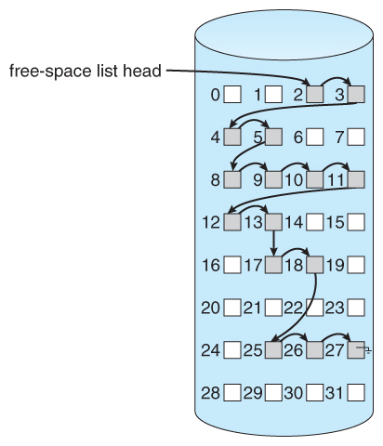
Linked List
A linked list can also be used to keep track of all free blocks.
Pros: No space overhead
Cons: contiguous space is a problem
Improvements:
Grouping – store records of consecutive free blocks: address of the 1st free block and n free blocks that follow

Slide 41
Review Questions

Slide 42
Review Exercise #1
Consider a file currently consisting of 200 blocks.
Assume: the FCB (and the index block for indexed allocation) is already in memory.
Calculate how many disk I/O operations are required for Contiguous, Linked, and Indexed (single-level) allocation strategies.
Assume: that there is no room to grow at the beginning, only at the end for contiguous allocation.
Assume: block information to be added is stored in memory.
The block is added at the beginning.
The block is added in the middle.
The block is added at the end.
The block is removed from the beginning.
The block is removed from the middle.
The block is removed from the end.

Slide 43
Review Exercise #1
File size = 200 blocks
 | Contiguous | Linked | Indexed
A) Added at beginning | 401 | 1 | 1
B) Added in middle | 201 | 102 | 1
C) Added at the end
D) Removed from beginning
E) Removed from the middle
F) Removed from the end
x reads + y write (new block) + z write (block 100 for the pointer) = ? I/O operations
Notes:
401, 1, 1
201, 102, 1
1, 3, 1
398 (or 0), 1, 0
200, 101, 0
0, 200, 0

Slide 45
File System Review
A UNIX file system has 1KB block sizes and 4 bytes are needed to store disk addresses. What is the maximum file size if an i-node contains 10 direct entries and one single, double, and triple indirect?
Pointers:
Direct = ?
Single indirect = ?
Double indirect = ?
Triple indirect = ?
Max file size = ??? GB
Notes:
Pointers = 10 direct + 256(1024/4) single indirect + 256^2 double indirect + 256^3 triple indirect
Storage = 16843018 pointers = 16843018 KB = 16.06GB

Slide 46
Efficiency and Performance

Slide 47
Efficiency
How is it stored?
UNIX inodes are preallocated on a volume (i.e., an empty disk has inodes).
Spreads them out so they will be closer to the future data blocks.
What is stored? Examples:
“Last write date” and “last access date”
Need to update this metadata
Pointer sizes for allocation and free-space management.
Small – limit file size
Larger – waste spaces
16-bit pointer = 2^16 = 64 KB
32-bit pointer = 2^32 = 4 GB
64-bit pointer = 2^64 = 16384 PB = 16 EB
Notes:
Last write date is good to determine what needs to be included in backups.

Slide 48
Performance
We can improve performance in several ways:
Caching -> store data in memory.
Memory-mapped I/O vs file system I/O
Decide when we perform writes.
Immediately or wait?
Optimize cache utilization based on file access.
Is LRU always a good use of the buffer cache?

Slide 49
Caching
Buffer cache
The OS assumes we use some block again shortly.
Separate section of main memory.
Used by: routine I/O through file system (e.g., read and write)
Page cache
Memory pages could be larger than file-system oriented blocks.
Use virtual memory to cache file data as pages – don’t need to translate disk block addresses
Used by: memory-mapped I/O

Slide 50
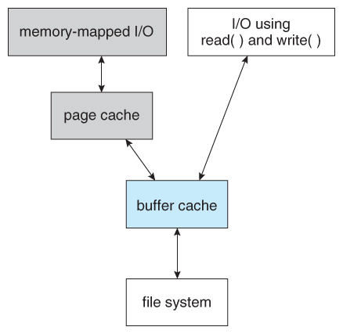
I/O without Unified Buffer Cache
Double caching – buffer cache contents are copied into the page cache.

Slide 51
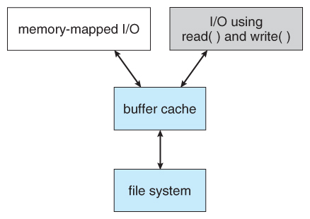
I/O using a Unified Buffer Cache
Unified buffer cache
Avoids double caching
Virtual memory can manage file-system data
Page replacement strategies become complicated:
Replace process or file pages? How many?
Set fixed limit to process pages and file-system pages.

Slide 52
Synchronous vs Asynchronous Writes
Synchronous writes:
Occur in the order in which the disk subsystem receives them.
Occur immediately, not buffered.
Asynchronous writes:
Stored in the cache.
Subsystem schedules writes (in a more efficient order).
Wait until convenient: down-time or read/write location
Asynchronous writes are the mostly used, but metadata writes are often done synchronously.

Slide 53
Page Replacement & Caching
How a file is accessed can also impact a page replacement policy.
Example: LRU is not necessarily a good policy for a sequential access.
e.g., scan the file once
Free-behind – free a page as soon as the next page in the file is requested.
Assume that we are now done with the old page
Read-ahead – a requested page and few subsequent pages are read and cached.
Assume that those pages will be needed in the near future.

Slide 54
Efficiency and Performance Case Study: Oracle Database Buffer Cache

Slide 55
Oracle Caching Experiment: Setup
400 MB buffer cache (or 53,200 8-KB pages)
Issue some SQL queries that perform full table scans (i.e., sequential access) against benchmark tables:
Table Name | # Records | Size | 8 KB Pages
Date | 2556 | 0.4 MB | 32
Supplier | 20K | 2 MB | 242
Customer | 300K | 34 MB | 4067
Part | 800K | 84 MB | 7342
Lineorder | 60M | 5.6 GB | 732K

Slide 56
Oracle Caching Experiment: Results
We can identify pages in memory using a PageID stored in each page header. Allows us to get counts.
For the smaller tables (< 40 MB or < 10% I/O buffer), the entire table is cached.
Table Name | Size | 8 KB Pages | # Pages in I/O Buffer
Date | 0.4 MB | 32 | 32 (100%)
Supplier | 2 MB | 242 | 242 (100%)
Customer | 34 MB | 4067 | 4067 (100%)
Part | 84 MB | 7342 | 125
Lineorder | 5.6 GB | 732K | 188

Slide 57
Oracle Caching Experiment: Results
What about those larger tables, Part and Lineorder? Why 125 and 188 pages?
Table Name | Size | 8 KB Pages | # Pages in I/O Buffer
Date | 0.4 MB | 32 | 32 (100%)
Supplier | 2 MB | 242 | 242 (100%)
Customer | 34 MB | 4067 | 4067 (100%)
Part | 84 MB | 7342 | 125
Lineorder | 5.6 GB | 732K | 188

Slide 58
Oracle Caching Experiment: Results
What about those larger tables, Part and Lineorder? Why 125 and 188 pages?
Oracle uses two other storage units: extents and segments
Extent = 8 pages
Segment = 8 extents (or 64 pages)
There’s also some additional overhead pages for these units, which we did not include in the count
Table Name | Size | 8 KB Pages | # Pages in I/O Buffer
Date | 0.4 MB | 32 | 32 (100%)
Supplier | 2 MB | 242 | 242 (100%)
Customer | 34 MB | 4067 | 4067 (100%)
Part | 84 MB | 7342 | 125
Lineorder | 5.6 GB | 732K | 188

Slide 59
Oracle Caching Exp: Conclusion
Free behind buffers
Don’t give the entire I/O buffer to one table
Use units of (Oracle) segments
Read ahead buffers
Prefetch some pages
Use units of (Oracle) segments
Table Name | Size | 8 KB Pages | # Pages in I/O Buffer
Date | 0.4 MB | 32 | 32 (100%)
Supplier | 2 MB | 242 | 242 (100%)
Customer | 34 MB | 4067 | 4067 (100%)
Part | 84 MB | 7342 | 125
Lineorder | 5.6 GB | 732K | 188

Slide 60
Recovery

Slide 61
Recovery
Storing data structures (e.g., directories and inodes) in memory and data caching improves performance.
What happens our system crashes?
All volatile memory is lost, and the information stored on the hard drive may be left in an inconsistent state.

Slide 62
Consistency Checking
A file system must first detect problems before correcting them.
A consistency checker (fsck in UNIX or chkdsk in Windows) runs at boot time. It looks for problems such as:
Disk blocks are both (or neither) allocated to files and on the free list.
Disk blocks are allocated to more than one file.
The # of disk blocks allocated to a file is inconsistent with the file’s size.

Slide 63
Consistency Checkers
Consistency checkers can fix some problems, but not all.
What if we lose a directory entry with linked allocation? Indexed allocation?
Directory changes are typically synchronously written, but a crash can still interrupt this write.

Slide 64
Log-Based Recovery
With consistency checking, we allow structures to break, and we repair.
Problems with consistency checking:
Inconsistency may be irreparable – lose files.
Could take time – what if we have terabytes of data to check?
Solution: log-based recovery (or write all metadata changes to a log).

Slide 65
Transactions
Transaction - a set of changes for performing a specific task.
e.g., moving a file
Log-based transaction-oriented (aka journaling) filesystems guarantee that a transaction either completes or can be rolled back to a safe state.
The transaction either happens or it does not.
No partial transactions
E.g., we either move the file or not. There is no in between.

Slide 66
Log-Structured File Systems
Log-based transaction-oriented filesystems:
All operations are written (or committed) synchronously to a log.
A pointer keeps track of which changes in the log are completed.
When a transaction is completed those operations can be safely removed from the log.
At any given time, the log will contain information pertaining to uncompleted transactions only - actions were committed but transaction did not finish.
If we crash:
Using the log, complete the remaining transactions.
Or if the transaction was aborted, then undo the changes.

Slide 67
Backup and Restore
Disks fail, it’s part of life. Data should be copied to another device (e.g., magnetic tapes, hard drives) so it can be restored.
It is important to conduct backups regularly to recover lost data. Example backup schedule:
Day 1 – full backup (copy all files)
Day 2 – incremental backup (copy only files that changed since Day 1)
Day 3 – incremental backup since Day 2
…
Day N – perform another full backup
A combination of full and incremental backups offers a compromise between full recoverability and the amount of storage needed.

Slide 68
Backup and Restore Discussion
Backup tapes should be tested to ensure that they are readable!
For optimal security, backup tapes should be kept off-premise.
Natural disasters: fires or floods
A thief could simply steal your data by pocketing your backup tapes
Replication - storing files on more than one computer is a less-reliable alternative – we will see RAID is a more efficient approach.
“Deleted” data persists in backups. Can be a liability:
Regulations: GDPR, HIPPA, FERPA, etc.
Beware if you are doing something illegal: https://www.cs.cmu.edu/~./enron/

Slide 69
Next Time
Finish File Systems
I/O & Mass-Storage (Chapter 5)

