Slide 1
CSCI 4401/5401: Principles of Operation Systems
James Wagner
University of New Orleans
Week 12, Lecture 22
October 31st, 2023

Slide 2
Announcements
Assignment 3 is due Monday, November 6th @ 11:59pm

Slide 3
What We’re Doing Today
Some comments on Assignment 3
Review Quiz 4
Finish File Systems
Some review
Efficiency and Performance
Recovery

Slide 4
Assignment 3 Comments
“Each thread should find the most frequent (of at least 7 characters) word for a single file.”
Don’t hardcode your threads (e.g., thread1 = …, thread2 = …, thread3 =…)
What if you had 1000’s of files to process?
Use a for loop to iterate through the files in the directory.
These aren’t “big” files, but you still need to remove unnecessary code that may eat up memory.
Read a file line by line
Use the RegEx to parse the words from each line
What should you do with the words?

Slide 5
Quiz 4 Review
#3. Physical address = ? + ?
#7. What is a page fault?
#10. When do we experience thrashing?
Let D be the total frame demand or the sum of the working set sizes (WSS) for all processes.
D = ∑ WSS_{i}
If D > total number of available frames ⇨ thrashing
If D < the available frames, then additional processes can be launched.
If D exceeds the total number of available frames, then suspend a process.
Notes:
3. Frame address + page offset
7. Bring a page into physical memory
10. Aggregate working set is larger than available memory

Slide 6
File System Review

Slide 7
Review Exercise #1
Consider a file currently consisting of 200 blocks.
Assume: the FCB (and the index block for indexed allocation) is already in memory.
Calculate how many disk I/O operations are required for Contiguous, Linked, and Indexed (single-level) allocation strategies.
Assume: that there is no room to grow at the beginning, only at the end for contiguous allocation.
Assume: block information to be added is stored in memory.
The block is added at the beginning.
The block is added in the middle.
The block is added at the end.
The block is removed from the beginning.
The block is removed from the middle.
The block is removed from the end.

Slide 8
Review Exercise #1
File size = 200 blocks
 | Contiguous | Linked | Indexed
A) Added at beginning | 401 | 1 | 1
B) Added in middle | 201 | 102 | 1
C) Added at the end | 1 | 3 | 1
D) Removed from beginning | 398 (or 0) | 1 | 0
E) Removed from the middle | 200 | 101 | 0
F) Removed from the end | 0 | 200 | 0
100 reads + 1 write (new block) + 1 write (block 100 for the pointer) = ? I/O operations

Slide 9
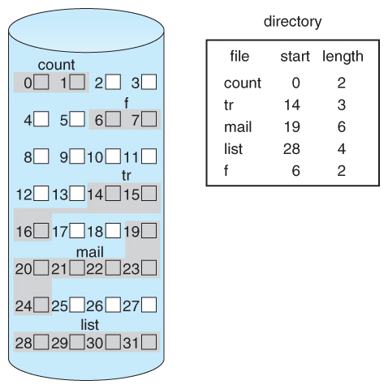
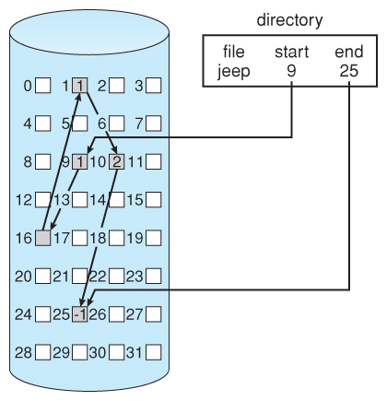
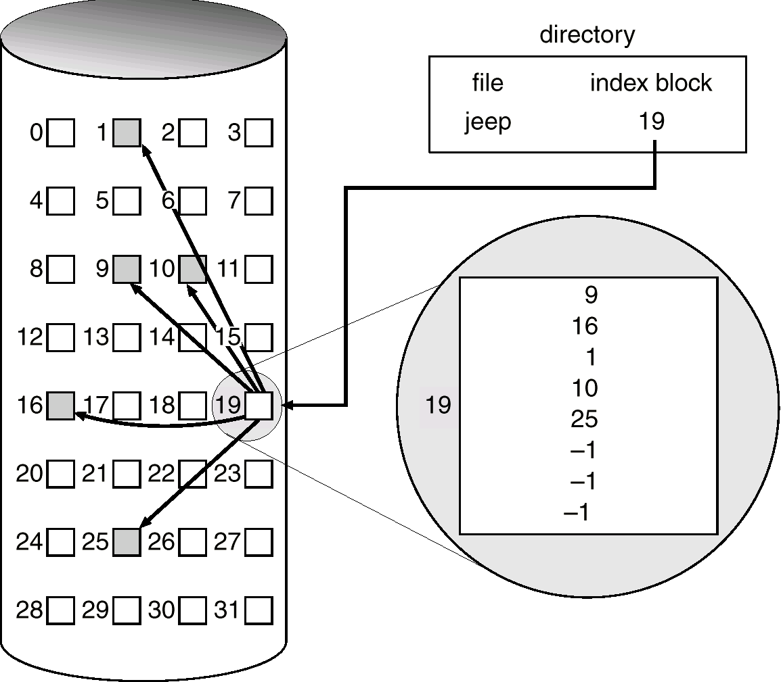

Slide 10
File System Review
Last time we discussed how UNIX i-nodes store disk block addresses. What happens as the file grows larger?
A UNIX file system has 1KB block sizes and 4 bytes are needed to store disk addresses. What is the maximum file size if an i-node contains 10 direct entries and one single, double, and triple indirect?
Pointers:
Direct = ?
Single indirect = ?
Double indirect = ?
Triple indirect = ?
Max file size = ??? GB
Notes:
Pointers = 10 direct + 256(1024/4) single indirect + 256^2 double indirect + 256^3 triple indirect
Storage = 16843018 pointers = 16843018 KB = 16.06GB

Slide 11
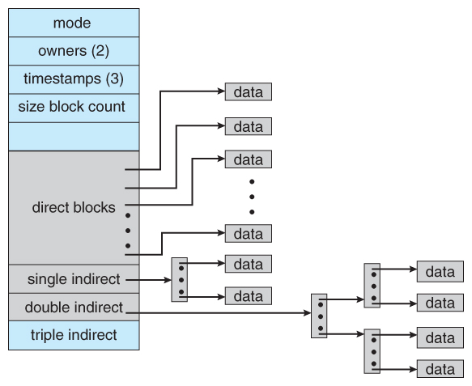
The UNIX Inode
Direct blocks
pointers for small files
Single indirect
Pointer to an index block
Double indirect
Pointer to a 2-level index
Triple Indirect
Pointer to a 3-level index
Note: index blocks may still require random access

Slide 12
I-Node Structure
Disk Blocks
i-node
(double indirect block)
i-node
Disk Blocks
File Attributes
i-node
(double indirect block)
Address of block 0
i-node
(double indirect block)
Disk Blocks
Address of block 1
Address of block 2
Address of block 3
i-node
(double indirect block)
Address of block 4
Disk Blocks
Disk Blocks
Address of block 5
i-node
(Single indirect block)
Address of block 6
Ptr Single indirect
Ptr Double I-node

Slide 13
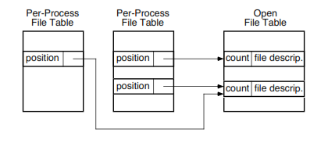
File System Review
Why is the open() system call essential? What would be the consequence of not having it?
Hint 1: Think of open() and close() vs. read()
Hint 2: Think of what open() in terms of the per-process and system-wide tables:
Notes:
Need to indicate the file to be accessed for reads and writes – open() returns the file descriptor. The system needs to get the FCB for it

Slide 14
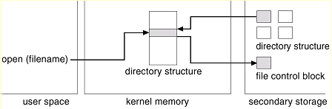
Interaction of File System Components: Open File
The open() call passes a filename to the logical file system.
Open() searches parts of directory cached in memory for the filename.
If not found, search the directory on disk.
Copy the FCB into the system-wide open-file table in memory.
(Not shown) Add entry into the system-wide table and per-process table.

Slide 15
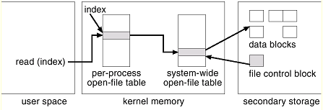
Interaction of File System Components: File Read/Write
Open() returns an index in the per-process table.
The entry in the per-process table references the system-wide table.
The system-wide table stores the FCB info.

Slide 16
Interaction of File System Components: File Close
The per-process table entry is freed
The counter in the system-wide table is decremented. If that counter reaches zero, then
The system-wide table entry is also freed.
Any data currently stored in memory cache for this file is written out to disk (if necessary).

Slide 17
File System Review
Is there a difference between renaming a file vs. copying the file to a new name and deleting the old version?
Notes:
A copied file inherits permissions. Renaming a file updates the name in the FCB. Copying a file creates a new directory entry.

Slide 18
Interaction of File System Components: File Creation
An application program calls the logical file system.
The logical file system knows the format of the directory structures.
It allocates and creates a new FCB.
Updates the directory with the new file name & FCB.

Slide 19
Efficiency and Performance

Slide 20
Efficiency
How is it stored?
UNIX inodes are preallocated on a volume (i.e., an empty disk has inodes).
Spread them out so they will be closer to the future data blocks.
What is stored? Examples:
“Last write date” and “last access date”
Need to update this metadata
Pointer sizes for allocation and free-space management.
Small – limit file size
Larger – waste spaces
16-bit pointer = 2^16 = 64 KB
32-bit pointer = 2^32 = 4 GB
64-bit pointer = 2^64 = 16384 PB = 16 EB
Notes:
Last write date is good to determine what needs to be included in backups.

Slide 21
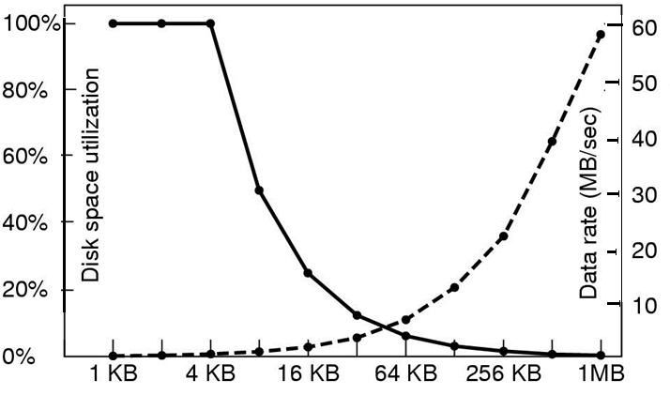
Block Size
Similar to pages in memory, what’s the tradeoff of large block sizes? Small block sizes?
(Corrected) Experiment from book w/ 4 KB files:
Block Size

Slide 22
Performance
We can improve performance in several ways:
Caching -> store data in memory.
Memory-mapped I/O vs file system I/O
Decide when we perform writes.
Immediately or wait?
Optimize cache utilization based on file access.
Is LRU always a good use of the buffer cache?

Slide 23
Caching
Buffer cache
The OS assumes we will use some block(s) again shortly.
Separate section of main memory.
Used by: routine I/O through file system (e.g., read and write)
Page cache
Memory pages could be larger than file-system oriented blocks.
Use virtual memory to cache file data as pages – don’t need to translate disk block addresses
Used by: memory-mapped I/O (i.e., virtual memory)

Slide 24
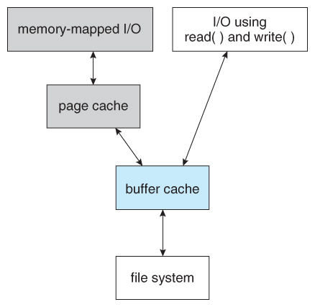
I/O without Unified Buffer Cache
Double caching – buffer cache contents are copied into the page cache.
Read() and write() go through the buffer cache and file system contents are copied twice.

Slide 25
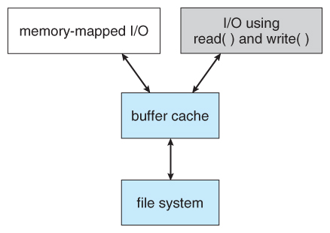
I/O using a Unified Buffer Cache
Unified buffer cache
Avoids double caching
Virtual memory can manage file-system data
Page replacement strategies become complicated:
Still use LRU
Replace process or file pages? How many?
Set fixed limit to process pages and file-system pages.

Slide 26
Synchronous vs Asynchronous Writes
Synchronous writes:
Occur in the order in which the disk subsystem receives them.
Occur immediately, not buffered.
Asynchronous writes:
Stored in the buffer cache.
System schedules writes (in a more efficient order).
Wait until convenient: down-time or read/write location
Asynchronous writes are more common, but metadata writes are often done synchronously.

Slide 27
Page Replacement & Caching
How a file is accessed can also impact a page replacement policy.
Example: LRU is not necessarily a good policy for a sequential access.
e.g., scan the file once
Free-behind – free a page as soon as the next page in the file is requested.
Assume that we are now done with the old page
Read-ahead – a requested page and few subsequent pages are read and cached.
Assume that those pages will be needed in the near future.

Slide 28
Efficiency and Performance Case Study: Oracle Database Buffer Cache

Slide 29
Oracle Caching Experiment: Setup
400 MB buffer cache (or 53,200 8-KB pages)
Issue some SQL queries that perform full table scans (i.e., sequential access) against benchmark tables:
Table Name | # Records | Size | 8 KB Pages
Date | 2556 | 0.4 MB | 32
Supplier | 20K | 2 MB | 242
Customer | 300K | 34 MB | 4067
Part | 800K | 84 MB | 7342
Lineorder | 60M | 5.6 GB | 732K

Slide 30
Oracle Caching Experiment: Results
We can identify pages in memory using a PageID stored in each page header. Allows us to get counts.
For the smaller tables (< 40 MB or < 10% I/O buffer), the entire table is cached.
Table Name | Size | 8 KB Pages | # Pages in I/O Buffer
Date | 0.4 MB | 32 | 32 (100%)
Supplier | 2 MB | 242 | 242 (100%)
Customer | 34 MB | 4067 | 4067 (100%)
Part | 84 MB | 7342 | 125
Lineorder | 5.6 GB | 732K | 188

Slide 31
Oracle Caching Experiment: Results
What about those larger tables, Part and Lineorder? Why 125 and 188 pages?
Table Name | Size | 8 KB Pages | # Pages in I/O Buffer
Date | 0.4 MB | 32 | 32 (100%)
Supplier | 2 MB | 242 | 242 (100%)
Customer | 34 MB | 4067 | 4067 (100%)
Part | 84 MB | 7342 | 125
Lineorder | 5.6 GB | 732K | 188

Slide 32
Oracle Caching Experiment: Results
What about those larger tables, Part and Lineorder? Why 125 and 188 pages?
Oracle uses two other storage units: extents and segments
Extent = 8 pages
Segment = 8 extents (or 64 pages)
There’s also some additional overhead pages for these units, which we did not include in the count
Table Name | Size | 8 KB Pages | # Pages in I/O Buffer
Date | 0.4 MB | 32 | 32 (100%)
Supplier | 2 MB | 242 | 242 (100%)
Customer | 34 MB | 4067 | 4067 (100%)
Part | 84 MB | 7342 | 125
Lineorder | 5.6 GB | 732K | 188

Slide 33
Oracle Caching Exp: Conclusion
Free behind buffers
Don’t give the entire I/O buffer to one table
Use units of (Oracle) segments
Read ahead buffers
Prefetch some pages
Use units of (Oracle) segments
Table Name | Size | 8 KB Pages | # Pages in I/O Buffer
Date | 0.4 MB | 32 | 32 (100%)
Supplier | 2 MB | 242 | 242 (100%)
Customer | 34 MB | 4067 | 4067 (100%)
Part | 84 MB | 7342 | 125
Lineorder | 5.6 GB | 732K | 188

Slide 34
Recovery

Slide 35
Recovery
Storing data structures (e.g., directories and inodes) in memory and data caching improves performance.
What happens our system crashes?
All volatile memory is lost, and the information stored on the hard drive may be left in an inconsistent state.
Before we continue, what are the ACID properties?

Slide 36
Consistency Checking
A file system must first detect problems before correcting them.
A consistency checker (fsck in UNIX or chkdsk in Windows) runs at boot time. It looks for problems such as:
Disk blocks are both (or neither) allocated to files and on the free list.
Disk blocks are allocated to more than one file.
The # of disk blocks allocated to a file is inconsistent with the file’s size.

Slide 37
Consistency Checkers
Consistency checkers can fix some problems, but not all.
What if we lose a directory entry with linked allocation? Indexed allocation?
Directory changes are typically synchronously written, but a crash can still interrupt this write.

Slide 38
Log-Based Recovery
With consistency checking, we allow structures to break, and we repair.
Problems with consistency checking:
Inconsistency may be irreparable – lose files.
Could take time – what if we have terabytes of data to check?
Solution: log-based recovery (or write all metadata changes to a log).

Slide 39
Transactions
Transaction - a set of changes for performing a specific task.
e.g., moving a file
Log-based transaction-oriented (aka journaling) filesystems guarantee that a transaction either completes or can be rolled back to a safe state.
The entire transaction either happens or it does not.
No partial transactions (i.e., they’re atomic)
E.g., we either move the file or not. There is no in between.

Slide 40
Log-Structured File Systems
Log-based transaction-oriented filesystems:
All operations are written (or committed) synchronously to a log.
A pointer keeps track of which changes in the log are completed.
When a transaction is completed those operations can be safely removed from the log.
At any given time, the log will contain information pertaining to uncompleted transactions only - actions were committed but transaction did not finish.
If we crash:
Using the log, complete the remaining transactions.
Or if the transaction was aborted, then undo the changes.

Slide 41
Backup and Restore
Disks fail, it’s part of life. Data should be copied to another device (e.g., magnetic tapes, hard drives) so it can be restored.
It is important to conduct backups regularly to recover lost data. Example backup schedule:
Day 1 – full backup (copy all files)
Day 2 – incremental backup (copy only files that changed since Day 1)
Day 3 – incremental backup since Day 2
…
Day N – perform another full backup
A combination of full and incremental backups offers a compromise between full recoverability and the amount of storage needed.

Slide 42
Backup and Restore Discussion
Backup tapes should be tested to ensure that they are readable!
For optimal security, backup tapes should be kept off-premise.
Natural disasters: fires or floods
A thief could simply steal your data by pocketing your backup tapes
Replication - storing files on more than one computer is a less-reliable alternative – we will see RAID is a more efficient approach.
“Deleted” data persists in backups. Can be a liability:
Regulations: GDPR, HIPPA, FERPA, etc.
Beware if you are doing something illegal: https://www.cs.cmu.edu/~./enron/

Slide 43
Next Time
Mass-Storage Structures (Ch 5.3 & 5.4)

