Slide 1
CSCI 4401/5401: Principles of Operation Systems
James Wagner
University of New Orleans
Week 12, Lecture 23
November 2nd, 2023

Slide 2
Announcements
Assignment 3 is due Monday, November 6th @ 11:59pm

Slide 3
What We’re Doing Today
Mass Storage (Ch 5.3 & 5.4)
Intro to Storage
Disk Scheduling

Slide 4
File Systems: Recovery

Slide 5
Recovery
Storing data structures (e.g., directories and inodes) in memory and data caching improves performance.
What happens our system crashes?
All volatile memory is lost, and the information stored on the hard drive may be left in an inconsistent state.
Before we continue, what are the ACID properties?

Slide 6
Consistency Checking
A file system must first detect problems before correcting them.
A consistency checker (fsck in UNIX or chkdsk in Windows) runs at boot time. It looks for problems such as:
Disk blocks are both (or neither) allocated to files and on the free list.
Disk blocks are allocated to more than one file.
The # of disk blocks allocated to a file is inconsistent with the file’s size.

Slide 7
Consistency Checkers
Consistency checkers can fix some problems, but not all.
What if we lose a directory entry with linked allocation? Indexed allocation?
Directory changes are typically synchronously written, but a crash can still interrupt this write.

Slide 8
Log-Based Recovery
With consistency checking, we allow structures to break, and we repair.
Problems with consistency checking:
Inconsistency may be irreparable – lose files.
Could take time – what if we have terabytes of data to check?
Solution: log-based recovery (or write all metadata changes to a log).

Slide 9
Transactions
Transaction - a set of changes for performing a specific task.
e.g., moving a file
Log-based transaction-oriented (aka journaling) filesystems guarantee that a transaction either completes or can be rolled back to a safe state.
The entire transaction either happens or it does not.
No partial transactions (i.e., they’re atomic)
E.g., we either move the file or not. There is no in between.

Slide 10
Log-Structured File Systems
Log-based transaction-oriented filesystems:
All operations are written (or committed) synchronously to a log.
A pointer keeps track of which changes in the log are completed.
When a transaction is completed those operations can be safely removed from the log.
At any given time, the log will contain information pertaining to uncompleted transactions only - actions were committed but transaction did not finish.
If we crash:
Using the log, complete the remaining transactions.
Or if the transaction was aborted, then undo the changes.

Slide 11
Backup and Restore
Disks fail, it’s part of life. Data should be copied to another device (e.g., magnetic tapes, hard drives) so it can be restored.
It is important to conduct backups regularly to recover lost data. Example backup schedule:
Day 1 – full backup (copy all files)
Day 2 – incremental backup (copy only files that changed since Day 1)
Day 3 – incremental backup since Day 2
…
Day N – perform another full backup
A combination of full and incremental backups offers a compromise between full recoverability and the amount of storage needed.

Slide 12
Backup and Restore Discussion
Backup tapes should be tested to ensure that they are readable!
For optimal security, backup tapes should be kept off-premise.
Natural disasters: fires or floods
A thief could simply steal your data by pocketing your backup tapes
Replication - storing files on more than one computer is a less-reliable alternative – we will see RAID is a more efficient approach.
“Deleted” data persists in backups. Can be a liability:
Regulations: GDPR, HIPPA, FERPA, etc.
Beware if you are doing something illegal: https://www.cs.cmu.edu/~./enron/

Slide 13
Mass-Storage Structure

Slide 14
Secondary Storage
What is the physical structure?
How do we schedule I/O to improve performance?

Slide 15
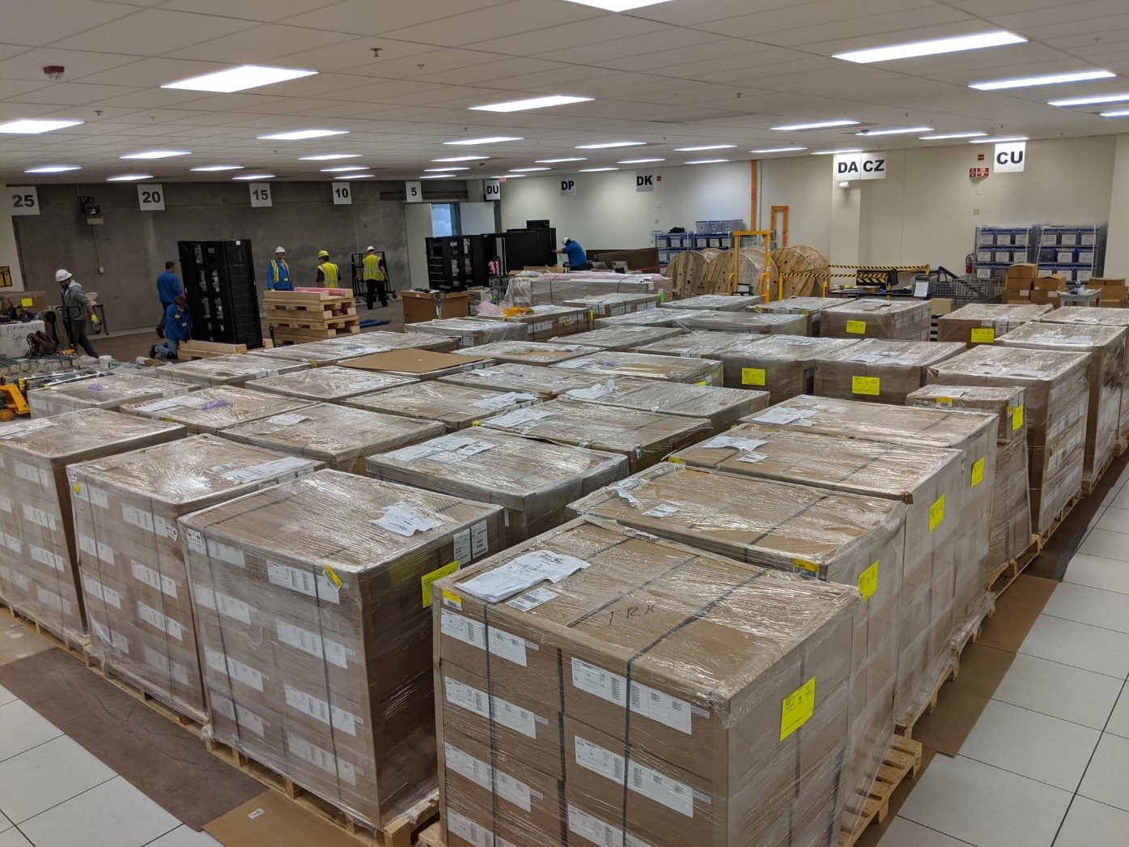
Guess the Disk Drive Storage
Argonne National Laboratory (circa 2018)
Notes:
200 PB, 1 PB = 1024 TB, assume 1.5 TB drives, HDD dimensions ~ 4” x 6” x 1”, 1 box = 28” x 18” x 12” = 7 x 3 x 12 / box = 250/box.
1 pallet = 16 boxes = 4000 HDDs
40 pallets = 160,000 HDDs = 240,000 TB or 230 PB

Slide 16
Magnetic Disks
Traditional magnetic disks have the following basic structure:
Platters – cover both sides with magnetic media to record data.
Read-write head – “flies” just above each platter surface.
Disk arm – move the read-write head.
Tracks – circular areas that divide platters.
Sectors – divide up tracks (512 bytes or larger).
Cylinder – the set of tracks that are at one arm position.

Slide 17
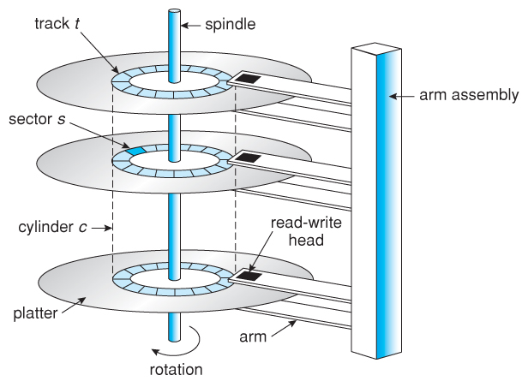

Moving-head Disk Mechanism

Slide 18
Disk Speed
Disk speed is mainly dependent on two things:
Seek time (or random access time)
Time to move the heads from one cylinder to another
Typically the slowest step (4 – 5ms)
Rotational latency
Time for a sector to rotate around and come under the read/write head.
2nd slowest step
Ex. A disk rotates at 7200 rpm (120 rps) and the average rotational latency is ½ a revolution. (0.008sec/revolution) * .5 revolutions = ~4ms
Transfer rate – an additional overhead to move the data electronically.
On the order of MB/s

Slide 19
Solid State Drives
Solid State Drives (SSDs) use memory technology as a small fast HDD.
Pros - no moving parts
They are much faster than traditional hard drives.
Certain problems such as scheduling disk accesses simply do not apply.
Cons
More expensive than hard drives
May have shorter life spans.
SSDs are especially useful as a high-speed cache of hard-disk information that must be accessed quickly, e.g., filesystem metadata.

Slide 20
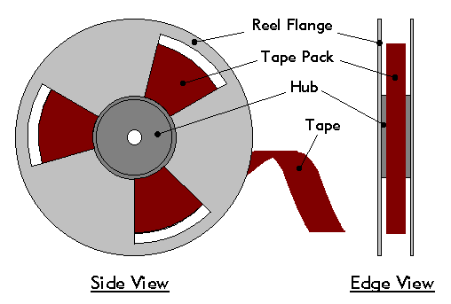
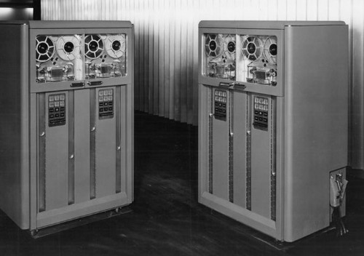
Magnetic Tapes
Magnetic tapes were once used for common secondary storage before the days of hard disk drives.
Accessing a particular spot on a magnetic tape can be slow.
Today they offer a cheap solution for backups (or other data that is not accessed frequently).
IBM Tape
Unit, 1952

Slide 21
Review: Disk Drive Costs
One way to improve contiguous allocation of disk is to compact the disk when a file is deleted.
Copying the file requires a seek and rotational delay to read a file followed by the transfer rate. Then the same work again for the write.
Assume:
Seek time = 5 ms
Rotational delay = 4 ms
Transfer rate = 8 MB/s (2^23 bytes/sec)
Avg file size = 8 KB (2^13 bytes)
How long does it take to read a file into main memory and write it back?
How long would it take to compact half of a 16 GB disk?
8GB = 2^33 bytes
Notes:
5ms + 4ms to start transfer. To read 2^13 bytes at a transfer rate of 2^23 bytes/sec = 2^-10 sec = 0.977ms. Read total = 9.977ms. Read + write = 9.977ms * 2 = 19.954ms
Copy 8 GB, which is 2^20 files. 19.954 ms * 2^20 files = 20,923 sec = 5.8hrs

Slide 22
Disk Scheduling

Slide 23
Disk Scheduling
Disk transfer speeds are limited by seek time and rotational latency.
Disk requests include:
the disk address
memory address
number of sectors to transfer
whether the request is a read or write
If requests are queued to access disk, we can benefit from scheduling.
FCFS
SSTF
SCAN
C-SCAN
LOOK

Slide 24
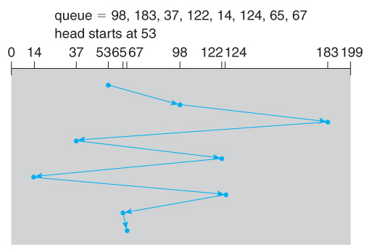
FCFS Scheduling
First-come, first-serve is simple and intrinsically fair, but not efficient.
Example: I/O block requests has wild cylinder swings.
What’s the total cylinder movement? 640

Slide 25
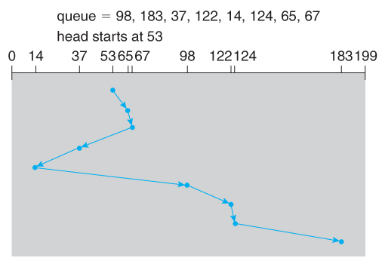
SSTF Scheduling
Shortest-seek-time-first is more efficient but may lead to starvation.
Example: SSTF reduces the total head movement to 236 cylinders.
Note: the distance could be reduced to 208 by starting with 37 and 14.

Slide 26
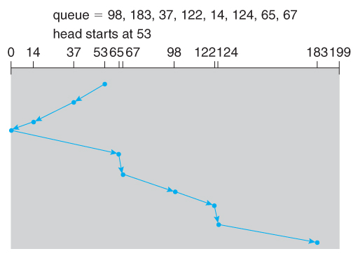
SCAN Scheduling
The SCAN algorithm (aka the elevator algorithm) moves back and forth from one end of the disk to the other.
Wide variation in access time: a request can arrive just before or just after the moving head has passed.

Slide 27
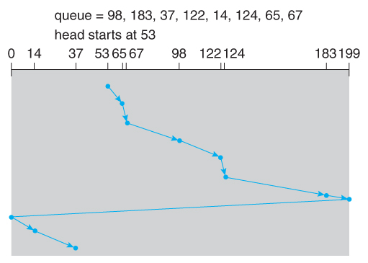
C-SCAN Scheduling
The circular-SCAN algorithm improves upon SCAN by treating all requests in a circular queue fashion.
Once the head reaches the end of the disk, it returns to the other end without processing any requests and then starts again.
Note: the big jump does not count as a head movement

Slide 28
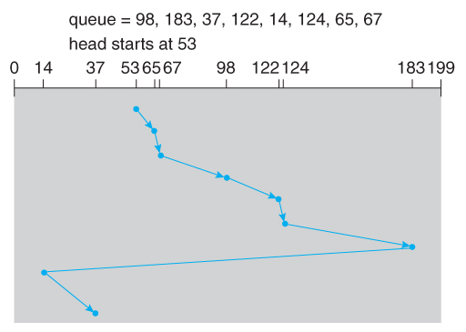
LOOK Scheduling
LOOK scheduling improves upon SCAN and C-SCAN by not moving the heads any farther towards the end of the disk than any request.
C-LOOK Example:

Slide 29
Selecting a Disk-Scheduling Algorithm
For low loads (process one request at a time) all algorithms are equal.
For slightly larger loads, SSTF offers better performance than FCFS, but may lead to starvation when loads become heavy enough.
For busier systems, LOOK eliminates starvation problems.
SSTF or LOOK are generally reasonable defaults.

Slide 30
Review
Suppose a disk drive has 5000 cylinders numbered 0 – 4999. The drive is currently serving a request at cylinder 143, and the previous request was at cylinder 125. The queue of pending requests, in FIFO order, is:
86, 1470, 913, 1774, 948, 1509, 1022, 1750, 130
Starting from the current head position, what is the total distance (in cylinders) that the disk arm moves to satisfy all the pending requests for each of the following disk-scheduling algorithms?
FCFS
SSTF
SCAN
LOOK
C-SCAN
C-LOOK
Notes:
FCFS -- 7081
SSTF (143, 130, 86, 913, 948, 1022, 1470, 1509, 1750, 1774) -- 1745
SCAN – (143, 913, 948 , 1022, 1470, 1509, 1750, 1774, 4999, 130, 86) -- 9769
LOOK - (143, 913, 948 , 1022, 1470, 1509, 1750, 1774, 130, 86) -- 3319
C-SCAN - (143, 913, 948 , 1022, 1470, 1509, 1750, 1774, 4999, 0, 86, 130) -- 4985
C-LOOK- (143, 913, 948 , 1022, 1470, 1509, 1750, 1774, 86, 130) -- 3363

Slide 31
Next Time
Finish Mass Storage:
RAID
Discuss Assignment 4
Quiz 5 will be posted after next lecture

