Slide 1
CSCI 4401/5401: Principles of Operation Systems
James Wagner
University of New Orleans
Week 13, Lecture 24
November 7th, 2023

Slide 2
Announcements
Assignment 4 is due Wednesday, November 29th @ 11:59pm
Quiz 5 will open after class today and due Thursday, 11/16 @ 11:59 pm.
File System and Mass Storage (Lectures 20 – 24)
I will post an E.C. assignment in the next week or two
E.C. will be applied to final exam score
Problems will be meant as a review to also help/encourage you to prepare for the exam.

Slide 3
What We’re Doing Today
Discuss Assignment 4
Mass Storage
Disk Scheduling
RAID

Slide 4
Assignment 4

Slide 5
Overview
You will construct a resource allocation graph to detect cycles. If a deadlock is detected, report the resources and processes involved.
I’ll give you input files like the following:
For action, W – wants and R - releases
Process | Action | Resource
1 | W | 1
2 | W | 2
3 | W | 6
2 | W | 6
… | … | …

Slide 6
Example
Process 1 wants resource 1 – Resource 1 is allocated to process 1.
Process 2 wants resource 2 – Resource 2 is allocated to process 2.
Process 3 wants resource 6 – Resource 6 is allocated to process 3.
Process 2 wants resource 6 – Process 2 must wait.
Process | Action | Resource
1 | W | 1
2 | W | 2
3 | W | 6
2 | W | 6
4 | W | 3
5 | W | 1
1 | R | 1
3 | W | 3
5 | R | 1
4 | W | 2
P1
R1
P2
R2
P3
R6

Slide 7
Example
Process | Action | Resource
1 | W | 1
2 | W | 2
3 | W | 6
2 | W | 6
4 | W | 3
5 | W | 1
1 | R | 1
3 | W | 3
5 | R | 1
4 | W | 2
Process 1 wants resource 1 – Resource 1 is allocated to process 1.
Process 2 wants resource 2 – Resource 2 is allocated to process 2.
Process 3 wants resource 6 – Resource 6 is allocated to process 3.
Process 2 wants resource 6 – Process 2 must wait.
Process 4 wants resource 3 – Resource 3 is allocated to process 4.
Process 5 wants resource 1 – Process 5 must wait.
Process 1 releases resource 1 – Resource 1 is allocated to process 5.
Process 3 wants resource 3 – Process 3 must wait.
Process 5 releases resource 1 – Resource 1 is now free.
Process 4 wants resource 2 – Process 4 must wait.
DEADLOCK DETECTED: Processes 2, 3, 4, and Resources 2, 3, 6, are found in a cycle.

Slide 8
The Basics
Read an input file line-by-line.
For each line, I recommend:
split() using the space character – returns an array of values
May have to use trim() to remove extra spaces or newline character
The array returned by split()
A[0] is the process
A[1] is the action
A[2] is the resource

Slide 9
Building the Graph
For each (process, action, resource) line, we want to do the following:
Add a node for the process (only if it doesn’t exist).
Add a node for the resource (only if it doesn’t exist).
If action is “w”, add an edge.
Else action is “r”, remove an edge.
P1
R1

Slide 10
Building the Graph: Nodes
Nodes represent processes and resources. You can create a single Node class to represent these objects.
What should a Node store?
ID – the # associated with it
Type – represents process or resource (could be a Boolean value)
Maybe some other info to help us test for deadlocks later?
the other nodes its connected to
the resources the process is waiting on (or the processes that are waiting on the resource)
This class doesn’t need a whole lot of code. Maybe ~10-15 lines.
P1
R1

Slide 11
Building the Graph: RAG Structure
The RAG class will be the bulk of the work (~120 – 140 lines). We need to do things such as (but not limited to):
addNode() – add processes and resources as the come in
addEdge() – connect processes and resources using the actions
removeEdge() – disconnect processes and resources using the actions
deadlockTest() – test to see if a deadlock is present
P1
R1

Slide 12
Building the Graph: RAG.addNode()
First, we need to check to see if the node exists in our graph.
Maybe use a list to store all of the nodes we have?
If it doesn’t exist, add it.
For each entry, do this for the process and the resource.
If you follow the suggestions above, this should be ~8 lines.

Slide 13
Building the Graph: RAG.addEdge()
If the action is “W” or wants, look at the corresponding Process and Resource.
If the process is already waiting on other resources:
No edge to add
Update any waiting list(s) stored by the Node(s)
“Process X is already waiting. Do nothing.”
Else if the resource node is already connected to another node (i.e., another process), the process must wait.
No edge to add
Update any waiting list(s) stored by the Node(s)
“Process X must wait”
Else
“Resource A is allocated to Process X.”
Update any connected-to list(s) stored by the Node(s)
If you follow the structure above, ~20 -25 lines of code

Slide 14
Building the Graph: RAG.removeEdge()
If the action is “R” or releases, look at the corresponding Process and Resource.
Update any connected-to list(s) stored by the Node(s)
If the resource has an Nodes (i.e., processes) in its waiting list,
Select a process
Update the waiting lists.
Call addEdge() for the resource and process
Else
“Resource A is now free.”
If you follow the structure above, ~20 – 25 lines

Slide 15
Building the Graph: RAG.deadlockTest()
How could you go about determining if there’s a deadlock?
You want to follow a path. What could you keep track of?
This will be the bulk of the code.
P1
R1
R2
P2
Notes:
Track the number of visits. Maybe another attribute to store with each Node. You can initialize to value to 0 when you start the test.

Slide 16
Disk Scheduling

Slide 17
Disk Scheduling
Disk transfer speeds are limited by seek time and rotational latency.
Disk requests include:
the disk address
memory address
number of sectors to transfer
whether the request is a read or write
If requests are queued to access disk, we can benefit from scheduling.
FCFS
SSTF
SCAN
C-SCAN
LOOK

Slide 18
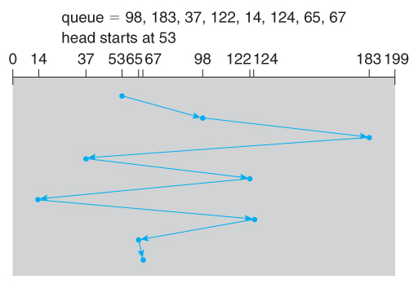
FCFS Scheduling
First-come, first-serve is simple and intrinsically fair, but not efficient.
Example: I/O block requests has wild cylinder swings.
What’s the total cylinder movement? 640

Slide 19
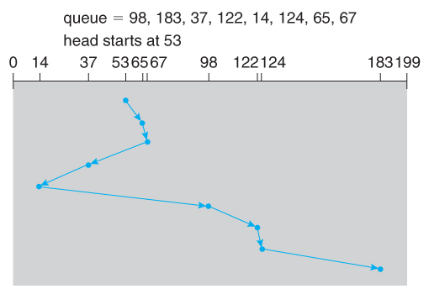
SSTF Scheduling
Shortest-seek-time-first is more efficient but may lead to starvation.
Example: SSTF reduces the total head movement to 236 cylinders.
Note: the distance could be reduced to 208 by starting with 37 and 14.

Slide 20
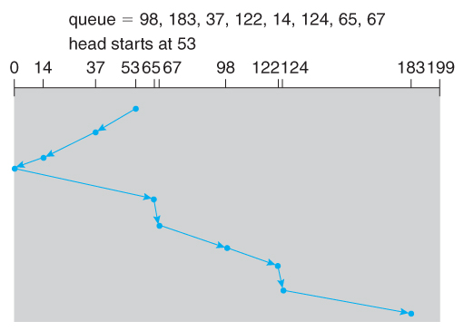
SCAN Scheduling
The SCAN algorithm (aka the elevator algorithm) moves back and forth from one end of the disk to the other.
Wide variation in access time: a request can arrive just before or just after the moving head has passed.

Slide 21
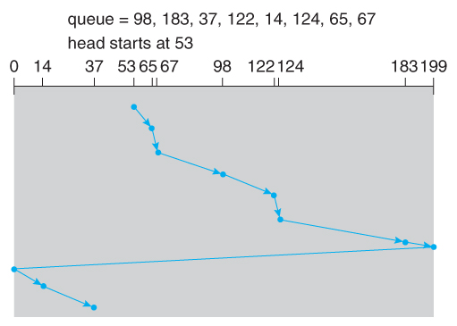
C-SCAN Scheduling
The circular-SCAN algorithm improves upon SCAN by treating all requests in a circular queue fashion.
Once the head reaches the end of the disk, it returns to the other end without processing any requests and then starts again.

Slide 22
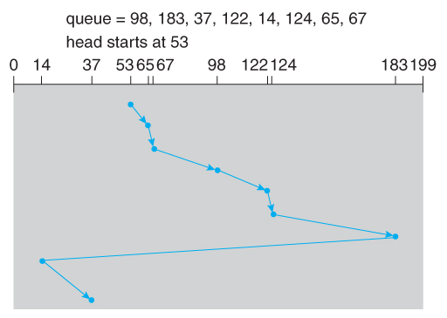
LOOK Scheduling
LOOK scheduling improves upon SCAN and C-SCAN by not moving the heads any farther towards the end of the disk than any request.
C-LOOK Example:

Slide 23
Selecting a Disk-Scheduling Algorithm
For low loads (process one request at a time) all algorithms are equal.
For slightly larger loads, SSTF offers better performance than FCFS, but may lead to starvation when loads become heavy enough.
For busier systems, LOOK eliminates starvation problems.
SSTF or LOOK are generally reasonable defaults.

Slide 24
Review
Suppose a disk drive has 5000 cylinders numbered 0 – 4999. The drive is currently serving a request at cylinder 143, and the previous request was at cylinder 125. The queue of pending requests, in FIFO order, is:
86, 1470, 913, 1774, 948, 1509, 1022, 1750, 130
Starting from the current head position, what is the total distance (in cylinders) that the disk arm moves to satisfy all the pending requests for each of the following disk-scheduling algorithms?
FCFS
SSTF
SCAN
LOOK
C-SCAN
C-LOOK
Notes:
FCFS -- 7081
SSTF (143, 130, 86, 913, 948, 1022, 1470, 1509, 1750, 1774) -- 1745
SCAN – (143, 913, 948 , 1022, 1470, 1509, 1750, 1774, 4999, 130, 86) -- 9769
LOOK - (143, 913, 948 , 1022, 1470, 1509, 1750, 1774, 130, 86) -- 3319
C-SCAN - (143, 913, 948 , 1022, 1470, 1509, 1750, 1774, 4999, 0, 86, 130) -- 4985
C-LOOK- (143, 913, 948 , 1022, 1470, 1509, 1750, 1774, 86, 130) -- 3363

Slide 25
Review
None of the disk-scheduling algorithms except FCFS is truly fair. Why?
Why is fairness important?
Notes:
New requests for the track can arrive as the read-write moves over those positions.
Prevent long response times.

Slide 26
RAID Structure

Slide 27
RAID Overview
Disk drives continue to get cheaper. It is economically feasible to attach many disks to a computer system.
If we operate disks in parallel, we can improve I/O rates.
Many disk can also improve reliability by introducing redundancy – failure of one disk doesn’t mean a loss of data.
Redundant arrays of independent disks (RAID) is a group of hard drives that use some form of duplication to increase reliability and/or speed.

Slide 28
Improvement of Reliability via Redundancy
The chance that some disk out of a set of N disks will fail is much higher than the chance of a specific disk failing.
Mean time to failure (MTTF) – average of the predicted time of an inherent failure.
Example
MTTF for one disk = 100,000 hours = 4166 days
MTTF for an array of 100 disks = 100,000/100 = 1000 hours = 41.66 days
Storing only one copy of our data will result in a significant loss of data.

Slide 29
Redundancy
To improve reliability, we can introduce redundancy.
An intentional replication vs redundancy that leads to update anomalies.
Store extra information that is not normally needed but can be used in the event of a disk failure.
We can lose a disk without losing data.
The simplest (but most expensive) form of redundancy is mirroring, which duplicates every disk.
Every write is carried out on both disks.
Data will only be lost if our second disk fails before the first disk is replaced.

Slide 30
Mirroring
Failure with mirroring depends on two factors:
MTTF
Meant time to repair (MTTR) – the time it takes to replace failed disk and restore data on it.
Example:
MTTF = 100,000 hours, assume this is independent for each disk
MTTR = 10 hours
The mean time to data loss of a mirrored disk is
100,000^2 / (2 * 10) = 500 * 10^6 hours = 57,000 years!
Note: the independent disk failure assumption is not always safe: power failures could lead to corrupt data, natural disasters, manufacturing defects, as both age probability of failure increases, etc.

Slide 31
Improvement in Performance via Parallelism
Mirroring also gives us better performance of reads – read operations can be satisfied from any available copy.
Multiple disks can be reading different blocks simultaneously in parallel.
Another way to improve disk access is data striping – spread data across multiple disks.

Slide 32
Striping
Bit-level striping – the bits of each byte are striped across multiple disks.
Ex. 8 disks, then each 8-bit byte would read in parallel. A single disk read can access 8 * 512 bytes = 4KB in the same amount of time to read 512 bytes from a single disk.
Block-level striping – spread a filesystem across multiple disks on a block-by-block basis (most common). For N disks and J blocks, (J mod N).
Ex. Block J is on disk 0, block J + 1 is on disk 1, …

Slide 33
Mirroring vs. Striping
Mirroring gives us high reliability, but it is expensive.
Striping gives us high data-transfer rates but does not improve reliability.
There are a number of different schemes that combine the principles of mirroring and striping in different ways to balance reliability vs. performance.
These schemes are the RAID levels. We will talk about 9 of them, but there can be more.

Slide 34
RAID Levels

Slide 35
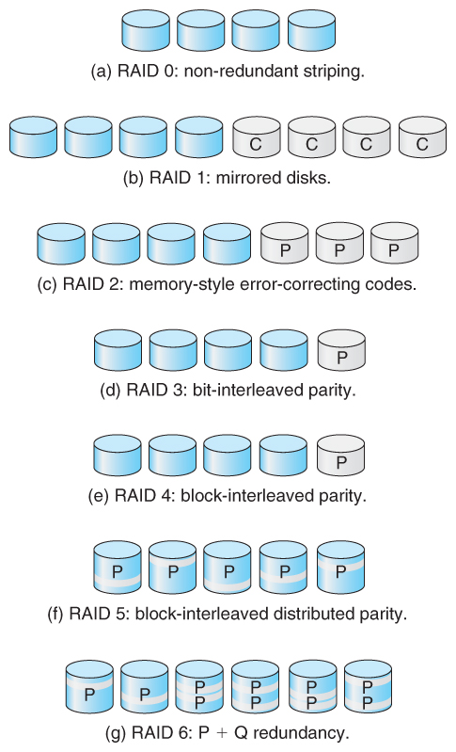
RAID Levels
Not shown are
RAID 0 + 1
RAID 1 + 0

Slide 36
RAID Levels 0 & 1
RAID Level 0 – striping only, no mirroring
No redundancy. If one drive fails, the entire array fails.
Improves performance. Transfer rate (reads & writes) is N times high for N drives.
RAID Level 1 – mirroring only, no striping
Useful when read performance or reliability is more important than write performance.
Read requests can be serviced by any drive, but write performance is equal to the slowest disk.

Slide 37
RAID Level 0
Advantages
Disadvantages
Simple, easy to implement
No parity calculations
Increased I/O performance
Not “True” RAID – no fault tolerance.
If one drive fails, we lose all data.

Slide 38
RAID Level 1
Advantages
Disadvantages
Simple design
Disk failure is easy – just copy to a replacement disk
Higher transfer rates
Highest overhead – 100%

Slide 39
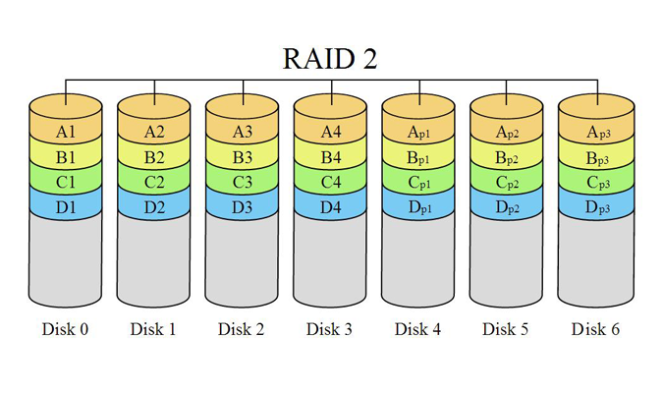
RAID Level 2
RAID Level 2 – use bit level striping on data disks and store error-correcting codes (ECC) called parity bits for each block on ECC disks. Example:
Store parities on ECC disks (4 disks requires 3 ECC disks).
Reconstruct using the ECC bits (and a complex algorithm – Hamming Code)
Need all drives to calculate the ECC.
Not as practical as other RAID levels and has rarely been used.
Example
WordA on Disks 0 – 3
WordA ECC on Disks 4 – 6
Disks 4 – 6 can be used to repair WordA
Notes:
Expensive to maintain and expensive recovery algorithm

Slide 40
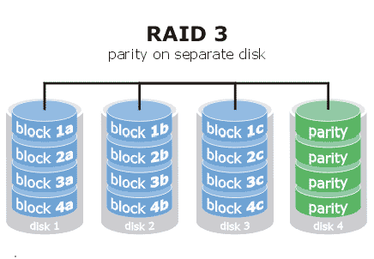
RAID Level 3
RAID Level 3 – similar to RAID level 2 but assume that each disk drive is doing its own error detection – we know which disk contains the bad data.
Only need to store a single parity bit for each stripe (across disks).
Can detect but not repair – need to replace the failed disk
Level 3 greatly reduces the parity overhead and error detection cost of RAID level 2, but it is still rarely used.

Slide 41
RAID Level 2 vs 3
RAID Level 3 is able to correct single bit errors using only one parity drive. What is the point of RAID level 2? After all, it also only corrects one error and takes more drives to do so.
RAID level 2 not only recovers from crashed drives, but also from undetected transient errors. If one drive delivers a single bad bit, RAID level 2 will correct this, but RAID level 3 will not.

Slide 42
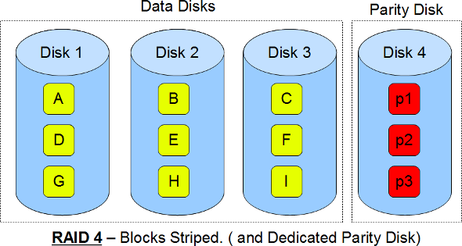
RAID Level 4
RAID Level 4 – similar to RAID level 3 but now use block-level striping.
Blocks can now be read independently and changes to a block only require writing the data block and the parity block rather than involving all disks.
If one disk fails, the parity block can be used with the corresponding blocks from other disks to restore the blocks of the failed disk.
We can now add more disks (initialized to zero) to our system without affecting the parity results.
Still rarely used.

Slide 43
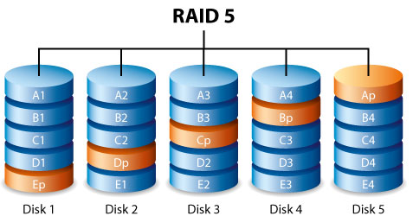
RAID Level 5
RAID Level 5 - Similar to RAID level 4 except now we distribute the parity blocks.
More evenly balanced system load.
Example:
Array of 5 disks
The parity for block N is stored at disk (N mod 5) + 1.
Note: the same disk cannot hold both data and parity for the same block – both could be lost.

Slide 44
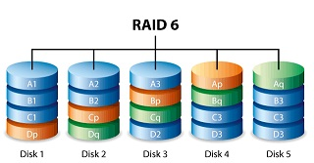
RAID Level 6
RAID Level 6 – similar to RAID level 5 but now stores multiple parity blocks distributed across the array of disks.
Allows for multiple disk failures.
Very complex and poor write performance. Not really used.

Slide 45
RAID Levels 0 + 1 and 1 + 0
There are two RAID Levels which combine RAID levels 0 and 1 to provide both performance and reliability at the expense of disk cost.
RAID Level 0 + 1 – disks are first striped, and then the striped disks are mirrored.
RAID Level 1 + 0 – mirror disks in pairs, and then stripe the mirrored pairs.
Same performance and storage overhead as 0 + 1.
Has an advantage in the case of disk failures.

Slide 46
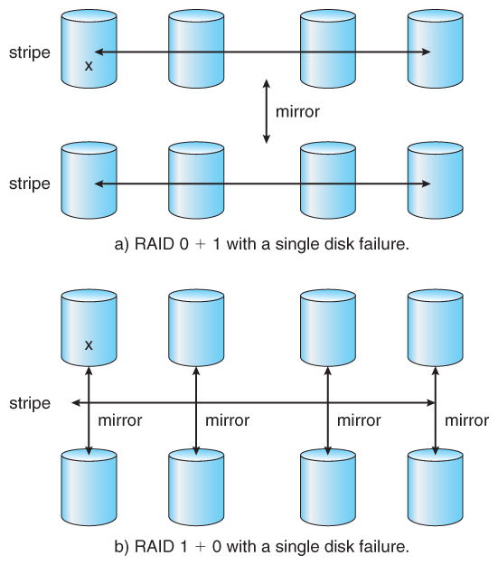
RAID Levels 0 + 1 & 1 + 0
Notes:
0 + 1 – if one disk fails, lose the entire stripe.
1 + 0 – if one disk fails, use the second mirror set.

Slide 47
Nested RAID Levels
Note that more RAID levels that combine two or more standard levels exist. E.g.,
RAID 5 + 0
RAID 6 + 0
https://en.wikipedia.org/wiki/Nested_RAID_levels#RAID_10

Slide 48
Selecting a RAID Level
Trade-offs in selecting the optimal RAID level depend on the application:
Cost and volume of data
Reliability
Performance
Rebuild time – can affect the likelihood that a second disk fails while repairing the first.
Rebuild is the easiest for RAID level 1. All other levels need to access all other disks in the array to rebuild a failed disk.

Slide 49
Selecting a RAID Level
RAID level 0 may be used in high-performance applications where data loss is not critical (e.g., video editing).
RAID 0 + 1 is popular when both performance and reliability are important, e.g., small databases, but expensive.
RAID level 5 is often preferred to store large volumes of data (e.g., file servers)
RAID level 6 should offer better reliability than level 5, but not supported by many implementations.
Also need to consider:
How many disks should be in a given RAID set. More disks yields higher data transfer rates, but more $$$.
How many disks to protect with a single parity bit. Protecting more disks saves $, but higher chance of a second disk failure during repair.

Slide 50
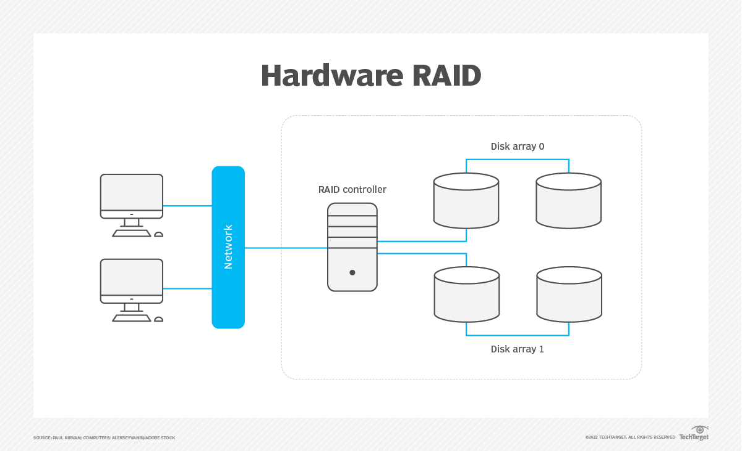
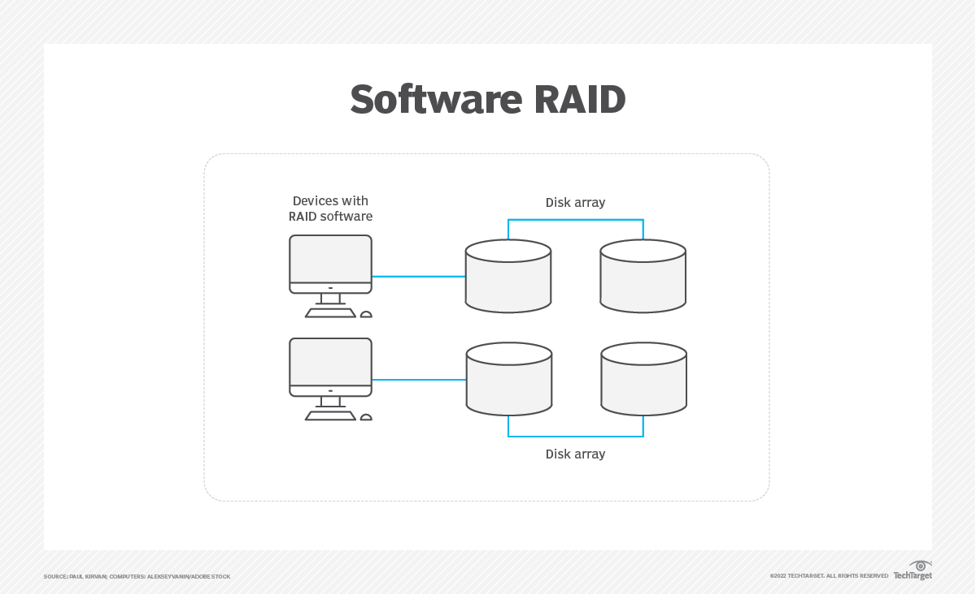
RAID Implementation
Hardware RAID
Software RAID
Managed by controllers independent of the OS.
Disk controller software is installed on and must be compatible with the OS.
Notes:
Hardware RAID is more expensive (cost for the external controller) but software requires processing power from the host OS. Controller can also go down. Replacing is easier on hardware: swap disk, for software: tell the OS to stop using and replace. Hardware is older and software is more common on newer systems.

