Slide 1
CSCI 4401/5401: Principles of Operation Systems
James Wagner
University of New Orleans
Week 13, Lecture 25
November 9th, 2023

Slide 2
Announcements
Assignment 4 is due Wednesday, November 29th @ 11:59pm
Quiz 5 is due Thursday, 11/16 @ 11:59 pm.
File Systems and Mass Storage (Lectures 20 – 24)
I will post an E.C. assignment in the next week
E.C. will be applied to final exam score
Problems will be meant as a review to also help/encourage you to prepare for the exam.

Slide 3
What We’re Doing Today
Protection and Security (Chapter 9)
Protection Goals & Principles
Protection Access Matrix
The Security Problem
Program Threats

Slide 4
Protection: Goals and Principles

Slide 5
Goals of Protection
Protection: a mechanism to control the access of programs, processes, or users to resources.
“Prove” access policies are always obeyed.
Prevent stupidity, errors, and accidents.
Protection is internal – how do we provide controlled access?
Security is external – how do we guard against unauthorized access or damage?

Slide 6
Principles of Protection
Principle of least privilege - programs, users, and systems should be given just enough privileges to perform their tasks.
Limits damage if the entity is compromised (e.g., abused, bug)
Privilege management can be coarse-grained or fine-grained:
Coarse-grained is simpler, but less precise.
Fine-grained is more complex, higher overhead, but more secure.
The root account should not be used for normal daily activities.
The system administrator should also have an ordinary account.
Reserve use of the root account for only necessary tasks.

Slide 7
Domain of Protection

Slide 8
Domain of Protection
A computer can be viewed as a collection of processes and objects.
Both hardware and software objects.
Need-to-know principle – a process should only have access to those objects it needs to accomplish its task.

Slide 9
Domain Structure
Protection domain - specifies the resources that a process may access.
Each domain defines a set of objects and the types of operations that may be invoked on each object.
Access right - is the ability to execute an operation on an object.
A domain is defined as a set of < object, {access right set} > pairs.
Example: what domain must a processes be in to read file 1?
Domain 1
Domain 2
Domain 3
File1{R}
File2{R}
File1{RW}
File4{RWX}
File5{RW}
File6{RWX}
Printer2{W}
Printer1{W}
Notes:
Domains do not have to be disjoint.

Slide 10
Domain Switching
Domains can be associated with users, processes, procedures, etc.
Our programs frequently have to move from one domain to another.
Domain switching allows a process to move to another domain, which might also require domain content to be changed.
Crossing domains is dangerous and is commonly used to attack systems.
Why do we need it?
We want users to have controlled access to resources they don’t have direct access to.
Notes:
More on domain switching in a couple slides.

Slide 11
Access Matrix

Slide 12
Access Matrix
Our model of protection can be viewed as an access matrix:
columns - objects
rows - domains
entries within the matrix indicate a set of access rights
Domain | File1 | File2 | File3 | File4 | File5 | Printer1 | Printer2
1 | Read Write |  |  |  |  |  | Print
2 |  | Read | Read Write Execute | Read Write |  | Print | Print
3 |  | Read Write |  | Read | Read Write Execute |  | Print
Notes:
Note this is an abstract view.

Slide 13
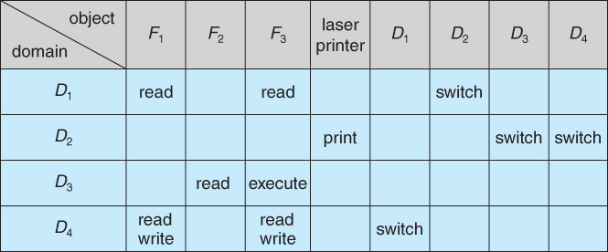
Domain Switching
Domain switching is represented in this model as “switch”.
Example: A process in D2 can switch to D3 or D4.

Slide 14
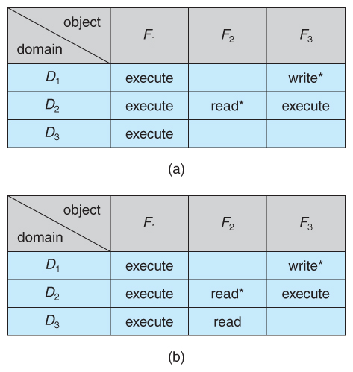
Copy Rights
The ability to copy rights is denoted by an asterisk. Processes in that domain can copy that access within the same column, i.e., for the same object.
A process in D2 can copy the read operation into any entry associated with F2.
Another way to write Figure_a.

Slide 15
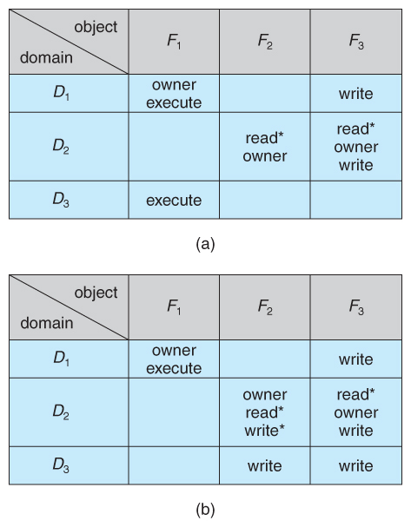
Owner Rights
The owner right has the privilege of adding or removing rights.
D1 is the owner of F1, and D2 is the owner of F2 and F3.
Figure_a can be modified as such.

Slide 16
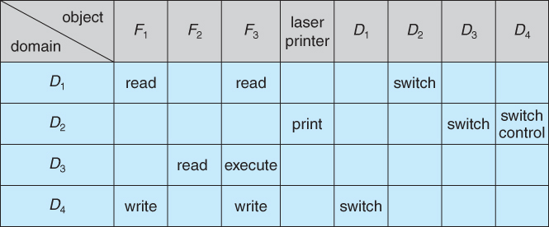
Control Rights
Copy & owner rights only allow rights to be changed within a column.
Control rights allow a process operating in one domain to remove the rights available in other domains.
Only applies to domain objects
Example: A process in domain D2 removes the read access rights in domain D4.
Notes:
Go back 3 slides for original version

Slide 17
Implementation of Access Matrix

Slide 18
Implementation of Access Matrix
The access matrix will likely be sparse.
Doesn’t represent protection well.
A few options to implement the access matrix:
Global table
Per-object access list
Per-domain capability list
Lock-key

Slide 19
Global Table
The simplest approach is one big global table with entries: < domain, object, right-set >
This table could be large, won’t fit into main memory.
Difficult to group objects.
If everyone can read an object, we still need a separate entry in each domain.
Domain | File1 | File2 | File3 | File4 | File5 | Printer1 | Printer2
1 | Read Write |  |  |  |  |  | Print
2 |  | Read | Read Write Execute | Read Write |  | Print | Print
3 |  | Read Write |  | Read | Read Write Execute |  | Print
Notes:
Each file usually belongs to one user and will only have entries for that user. 100s of other user domains would be empty for that file

Slide 20
Per-Object Access List aka Access Control Lists (ACL)
Each column of the table can be kept as an access list for an object. < domain, right-set >
Only store domains with a non-empty access right set.
Maintained by the OS
Object | Domain Right Set
File 1 | {Domain 1 – RW}
File 2 | {Domain 2 – R, Domain 3 – RW}
File 3 | {Domain 2 – RWX}
…

Slide 21
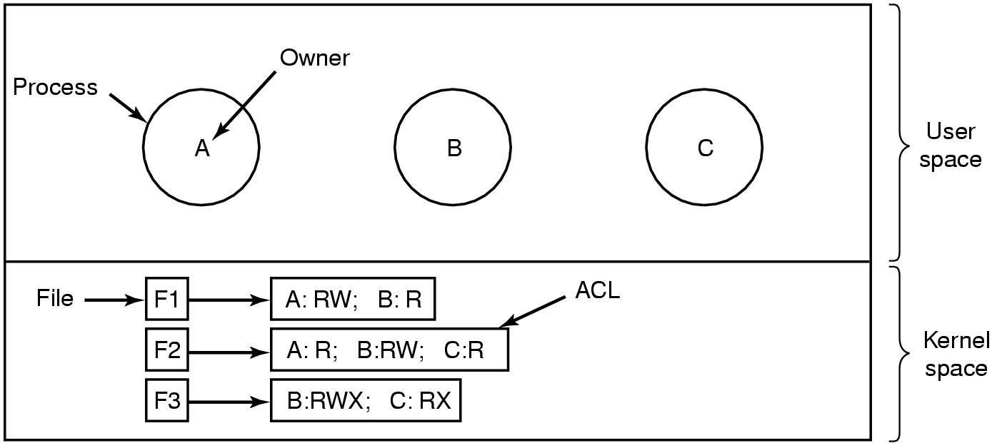
Access Control Lists
Notes:
Each process belongs to a different domain, A, B, or C. And 3 Files. Each file has an ACL. In reality, rights are given to users, not processes.

Slide 22
Setting ACLs for Files
Linux uses Access Control Lists to store read, write, and execute permissions for three types of users (or groups): owner, group, and other.
For those of you who are curious on more info and settings:
https://docs.oracle.com/cd/E19455-01/805-7229/6j6q8svdb/index.html

Slide 23
Per-Domain Capability List
Instead of object-based, a capability list is domain-based. < object, right-set >
Capability lists are associated with each domain, but not directly accessible by them.
Still maintained by the (trusted) OS.
Otherwise, the domain can just add to the list…
Domain | Object Right Set
Domain 1 | {File 1 - RW}
Domain 2 | {File 2 – R, File 3 - RWX}
Domain 3 | {File 2 - RW}
…

Slide 24
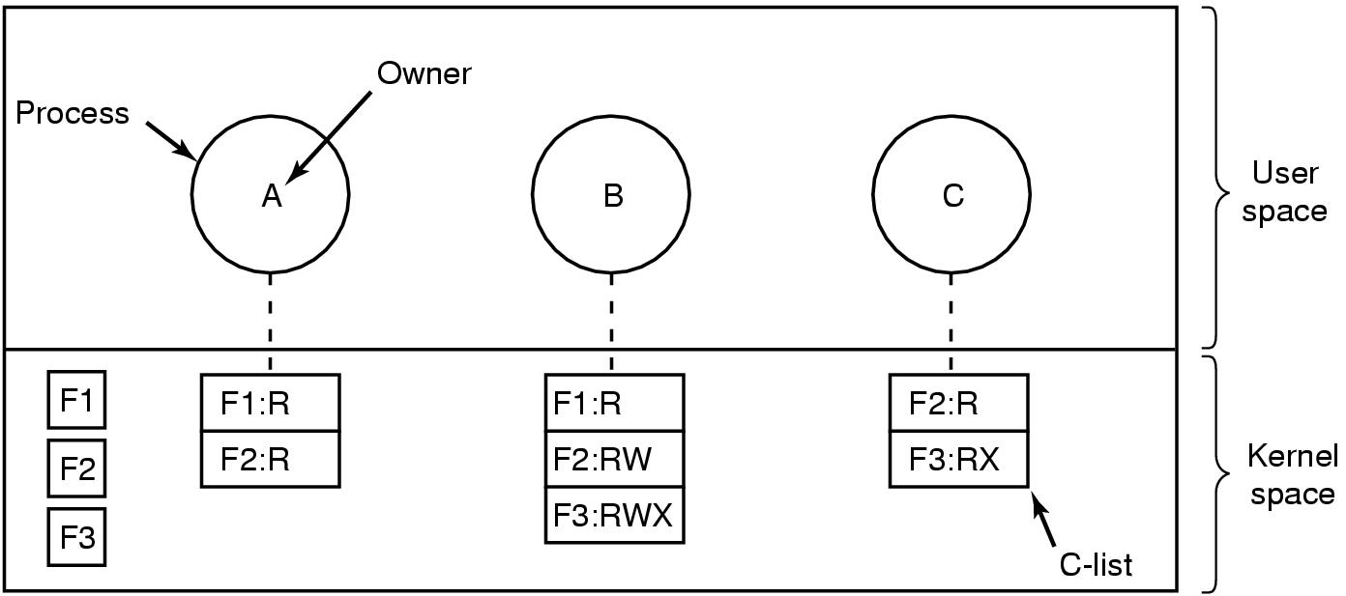
Per-Domain Capability List

Slide 25
Comparison
Global table – simple, but the table can be large.
Access lists – corresponds to the needs of users but determining the access-rights information for a domain is difficult. The rights for a domain are not localized.
Capability lists – inverse of access lists. Removing user access may be difficult.
Many system employ some combinations. Linux uses Access Control Lists.
Notes:
Who can access a file? Vs What files can this domains access?

Slide 26
Protection Review
How does the principle of least privilege aid in system protection? How can implementing “POLP” still have failures?
Discuss the strengths and weaknesses of implementing an access matrix using capabilities that are associated with domains.
Think: how do we check to see who has access to File X? Which files does domain A have access to?
Discuss the strengths and weaknesses of implementing an access matrix using access lists that are associated with objects.
Think: how do we check to see who has access to File X? What files does domain A have access to?
Notes:
ACLs correspond to the needs of users. When a user creates an object, they can specify which domains can access the object. Determining the access rights for a domain are difficult.
Capability lists do not correspond to the needs of users – better for localizing info for a given process. A process attempting access simply needs to check the capability list.

Slide 27
Protection Review
Suppose that a system has 1000 objects and 100 domains. 1% of objects are accessible (e.g., r, w, and/or x) in all domains. 10% of objects are accessible in two domains. The remaining 89% are accessible in only one domain. Assume that one unit of space is required to store an access right (r, w, x), object ID, or a domain. How much space is needed to store:
Global table?
Access Control List?
Capability List?
Notes:
Global table = 1000 x 100 = 100,000 units of space
ACL = each {Domain – access rights} takes 2 units. 1% = 10 objects * 100 domains * 2 = 2000 units. 10% = 100 objects * 2 domains * 2 = 400. 89% = 890 objects * 1 domain * 2 = 1780. 4180 total.
Capability. 1% = 100 domains * 10 objects * 2 = 2000. etc. Same as ACL 4180.

Slide 28
Protection Review
Mark wants his files readable by everyone in the class except Robin. Would access control lists or capability lists be easier?
Notes:
ACL

Slide 29
The Security Problem

Slide 30
Protection vs Security
Protection
Prevent accidental misuse of resources
Cooperating users sharing a system, generally legitimate purposes
Security
Prevent deliberate attacks
Individuals intentionally attempting to steal or damage information

Slide 31
Goal of Security
In reality, total security cannot be achieved.
The goal is to make security breaches a rare occurrence, not the norm.
“an arms race”, “build the wall higher”
Threat – the potential for a security violation or a known vulnerability.
Attack – an attempt to break security.
The most common types of violations include:
Breach of confidentiality
Breach of integrity and availability
Theft of service
Denial of service

Slide 32
Common Violations: Breach of Confidentiality
Unauthorized reading of data (or data theft).
One of the most common goals of intruders.
Data theft may include:
credit-card numbers
trade secrets
patents
secret formulas
manufacturing procedures
medical information
financial information

Slide 33
Common Violations: Breach of Integrity and Availability
Unauthorized modification or destruction of data.
Sometimes done just for “fun” of causing havoc and for bragging rites.
Compromised data examples may include:
Modified source code (to open security holes)
Tampering with financial records
Destroying a criminal record
Vandalism of web sites is a common form of this violation.

Slide 34
Common Violations: Theft of Service
Unauthorized use of resources.
Theft of resources may include:
Theft of CPU cycles
Installation of an unauthorized file server

Slide 35
Common Violations: Denial of Service (DOS)
Preventing legitimate use of the system.
Often by overloading and overwhelming the system with an excess of requests for service.

Slide 36
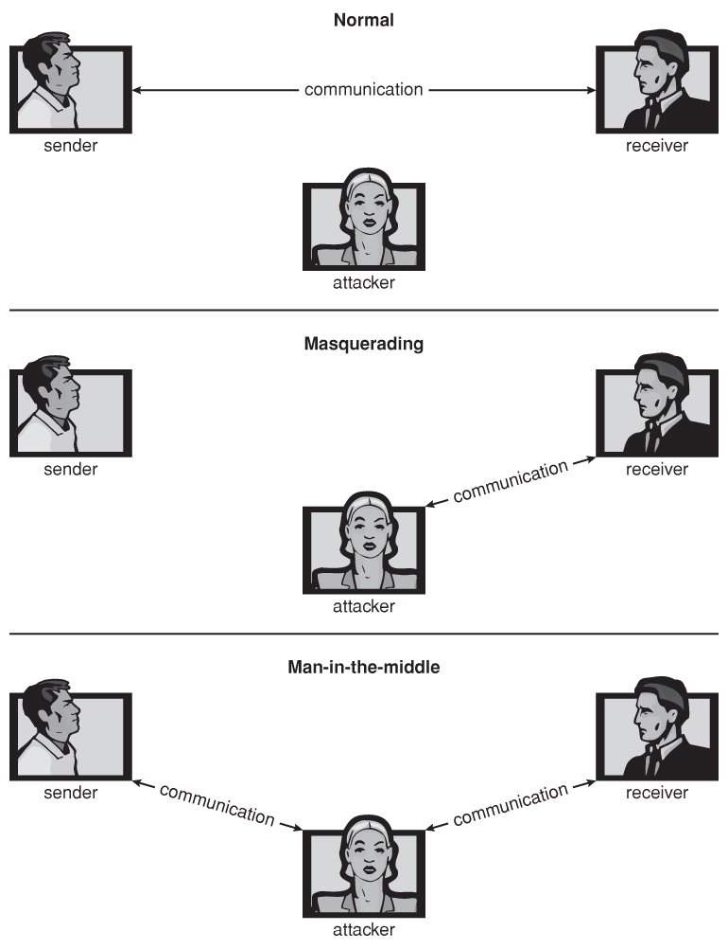
Methods to Breach Security
Masquerading – the attacker pretends to be trusted 3rd party.
Man-in-the-middle – a variation of masquerading where the attacker masquerades as both ends of the conversation.

Slide 37
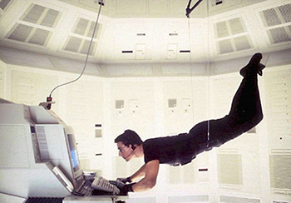
Four Levels of System Protection
To protect a system, we must take security measures at four levels:
Physical (Not an OS Problem)
The easiest way to steal data is to pocket the backup tapes.
Access to the console or workstation

Slide 38
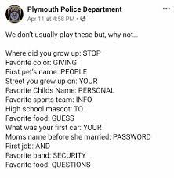
Four Levels of System Protection
Human (Not an OS Problem)
Users should be trustworthy. Hopefully, they won’t be coerced.
Social engineering - fooling trustworthy people:
Phishing - innocent-looking e-mail or web site fools people.
E.g., spam e-mails pretending to be from a bank.
Dumpster diving – searching for passwords that are written down.
Password cracking – get passwords by watching users type it in, knowing something about a user (e.g., pet’s name), or trying all dictionary words.

Slide 39
Four Levels of System Protection
Operating System
Runaway processes (denial of service)
Memory-access violations
Stack overflow violations
And many others…
Network
Data can be intercepted
Communication can be disrupted

Slide 40
Program Threats

Slide 41
Program Threats
Processes are the only way to accomplish work on a computer.
Therefore, writing or changing a process to breach security is a common goal of attackers.
We’ll talk about a few common program threats:
Trojan horse
Trap door
Logic bomb
Stack and buffer overflow
Virus

Slide 42
Trojan Horse
Trojan horse – a program that contains a malicious code segment in addition to its visible actions.
A classic Trojan horse is one that emulates a login program
An unsuspecting user tries to login and notices “password incorrect”.
The user tries again and is successful with the legitimate terminal.
The emulator stole the password.

Slide 43
Trojan Horse Solutions
Two solutions to Trojan horses are:
Have the system print usage statistics on logouts.
Require typing a non-trappable key sequences, e.g., Control-Alt-Delete
(This is why modern Windows systems require the Control-Alt-Delete sequence to login. It cannot be emulated or caught by ordinary programs; that key sequence transfers control over to the OS).
Detection vs. Prevention

Slide 44
Trojan Horse: Spyware
Spyware is a version of a Trojan horse that is often included in “free” software downloaded off the Internet.
Spyware programs commonly generate pop-up browser windows and may also collect information about the user.
Another common task of spyware is to send out spam e-mail messages which then purportedly come from the infected user.

Slide 45

Trap Door
Trap door – when a programmer (or hacker) deliberately inserts a security hole that they can use later to access the system.
A trap door could use rounding errors to embezzle money.
A clever trap door could be inserted into a compiler.
The compiled program would contain a security hole.
Inspection of the code being compiled would not reveal any problems.
Traps doors are hard to detect. Once a system has been compromised, that system can never be fully trusted again.
Even the backup tapes may contain a cleverly hidden trap door.

Slide 46
Logic Bomb
Logic bomb – code that is not designed to cause havoc all the time but only when a certain set of circumstances occurs.
Examples:
Specific date or time
An employee creates one to go off when they are fired
Specific website or application is launched (e.g., banking)

Slide 47
Code Injection
An attacker introduces “injected” code to perform unintended actions.
Common examples are cross-site scripting (or HTML injection) and SQL injection.
Web UI
Enter ID:
ID | Name | Address | …
1 | Alice A | 123 Main
2 | Bob A | 456 Main
3 | Alice B | 789 Main
4 | Bob B | 102 Main
1
Application Code
userInput = userID
Data = execute(“SELECT * FROM Employee WHERE ID = “ + userInput)

Slide 48
Code Injection: SQL Injection
Entering “1” is fine but what if we enter:
“1 OR 5 = 5”
“1; DROP TABLE Employee”
Web UI
Enter ID:
ID | Name | Address | …
1 | Alice A | 123 Main
2 | Bob A | 456 Main
3 | Alice B | 789 Main
4 | Bob B | 102 Main
1
Application Code
userInput = userID
Data = execute(“SELECT * FROM Employee WHERE ID = “ + userInput)

Slide 49
Stack and Buffer Overflow
A classic method of attack which exploits bugs in code:
Overflow an input field until it writes into the stack.
Overwrite the current return address on the stack with the address of the exploit code (in Step 3)
Write a set of code for the next space in the stack, e.g., spawn a shell.
Example: A web page form expects a user name. The attacker could send the user name, plus extra characters to overflow the buffer and reach the stack, plus a new return address to load onto the stack, plus the code the attacker wants to run.
Usually requires some trial and error.

Slide 50
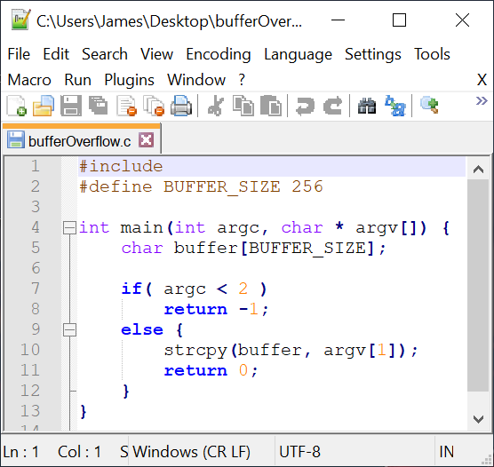
Buffer Overflow Example
Consider if argv[1] exceeds 256 characters
strcpy() will overflow the buffer, overwriting adjacent areas of memory.
Could be avoided using strncpy() with a limit of 255 characters.
Notes:
the strcpy function copies the string pointed to by s2 into the object pointed to by s1. It returns a pointer to the destination

Slide 51
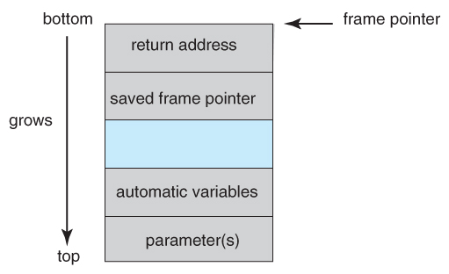
Stack Structure
What’s the vulnerability though?
We have parameters passed to the function, local function variables, address of the stack frame, and return address.
Array elements extend to higher addresses, i.e., an array “grows” towards the bottom of the stack.
When a buffer overflows with too much input data, it can eventually overwrite the return address, changing where the program jumps to when it returns.
Notes:
Goal is to overwrite the return address so that it points to some malicious code

Slide 52
Stack and Buffer Overflow
Now we want to insert some “bad” code and get the program to jump to it.
Code must be entered via the input into the buffer (not a lot of room).
One approach is code that opens a shell process “exec(/bin/sh)”.
Actually, we need to compile our “bad” code, and then using a debugging tool, extract the minimum extent that includes the necessary instructions.
The bad code is then padded with as many extra bytes as are needed.
The address of the buffer is inserted into the return address location.
The result block of information is provided as “input” copied into the buffer by the original program.

Slide 53
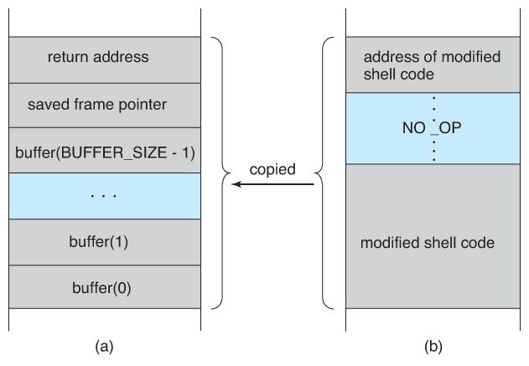
Stack and Buffer Overflow
Stack frame from main().
Our “bad” code input.
Notes:
NO_OP is extra padding of no operation code.

Slide 54
Stack and Buffer Overflow
It may take a lot of knowledge to exploit code with a buffer overflow attack.
Famous hacks such as the buffer overflow attack are well known. It doesn’t take a lot of skill to follow the instructions…
Script Kiddies – hackers with only rudimentary skill of their own but the ability to copy the efforts of others.

Slide 55
Viruses
Virus - fragment of code embedded in a legitimate program designed to replicate itself (by infecting other programs).
Viruses are more likely to infect PCs than UNIX because programs in the latter have limited authority to modify other users’ programs and critical system structures.
Virus dropper – used to deliver a virus to systems, usually some form of a Trojan horse, and usually via e-mail or unsafe downloads.
Notes:
Linux: most users use a normal account and log into root when they need to make specific changes. Windows: most users just access an admin account
Windows typically uses binary files to install applications. Linux installs applications from package managers and software repos – typically verified by the Linux distribution.

Slide 56
Types of Viruses
File – virus appends itself to a file. Changes the start of the program. When it is executed, it returns control to the program to go unnoticed.
Macro – virus written as a macro in Excel, Word, etc.
Source code – looks for source code and modifies it to include the virus
Polymorphic – changes (the virus signature) each time the virus is installed to avoid antivirus software.
Encrypted – includes decryption code along with the encrypted virus – they decrypt themselves.
That’s just a few…

Slide 57
Review

Slide 58
Review
Buffer-overflow attack can be avoided by using better programming methods. Discuss what some of these could be.

Slide 59
Next Time
More on Chapter 9:
System and Network Threats
Cryptography as a Security Tool
Implementing Security Defenses

