Slide 1
CSCI 4401/5401: Principles of Operation Systems
James Wagner
University of New Orleans
Week 14, Lecture 27
November 16th, 2023

Slide 2
Announcements
Assignment 4 is due Wednesday, November 29th @ 11:59pm
Quiz 5 is due tonight @ 11:59 pm.
File Systems and Mass Storage (Lectures 20 – 24)
Quiz 6 will be available after lecture and due Monday, 11/27 @ 11:59 pm.
Security (Lectures 25 – 27)
Assignment 5: E.C. is up and due Tuesday, 11/28 @ 6:00pm
E.C. will be applied to final exam score
Problems will be meant as a review to also help/encourage you to prepare for the exam.
Final Exam is Thursday, 12/7 from 8:00pm – 10:00pm

Slide 3
What We’re Doing Today
Finish Security
Virtualization

Slide 4
Cryptography as a Security Tool

Slide 5
Messaging Passing
Within a single computer message passing is safe, reliable, and secure.
The OS knows the sender/receiver
On a network things aren’t straightforward
A rogue computer (or e-mail sender) may spoof their identity
Trust
How can we be sure that the messages received are from a trusted source?
Confidentiality
How can we ensure that sent messages are received only by the intended recipient?

Slide 6
Cryptography
Cryptography can help with both trust and confidentiality with secrets and keys.
Trust - the key is held by the sender so that the recipient knows that only the authentic author could have sent the message.
Confidentiality - the key is held by the recipient so that only they can receive the message accurately.

Slide 7
What is Cryptography?
There are three fundamental areas
Encryption – scramble the message so that only the intended recipient can unscramble it.
Hashing – create a number (i.e., a hash) from a message that’s hard (or impossible) to reverse.
Steganography – hide the existence of the message.
We won’t consider this…
What are example use cases of each?
Notes:
Encryption – securely exchange messages in the event they are intercepted.
Hashing – passwords and message integrity
Steganography – secretly send messages and watermarking

Slide 8
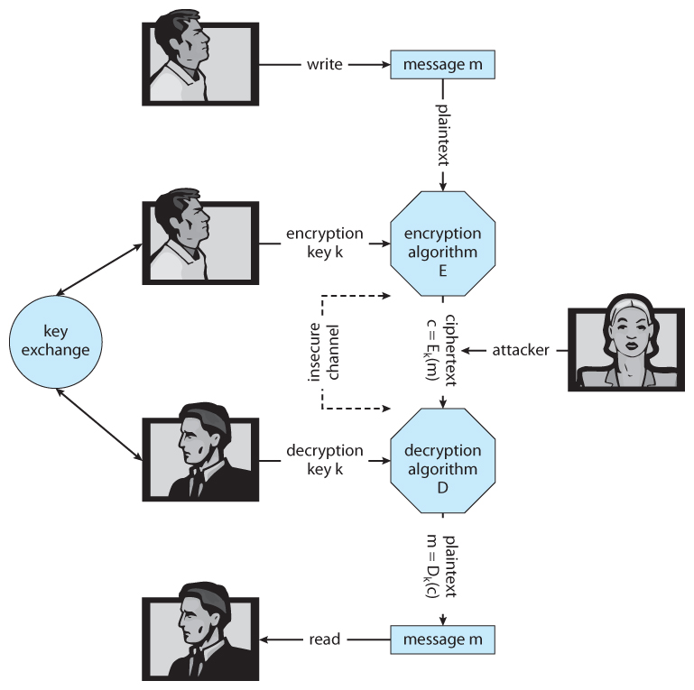
Terms
M – set of messages
K – set of keys
C – set of ciphertext
E – a function to generate ciphertexts from a m and a k.
D – a function to generate messages from a c and a k.

Slide 9
Encryption
Basic idea: encode a message so only the desired recipient can decode and read it.
Encryption has been around for 1000’s of years.
The basic steps are:
The sender creates m in plaintext.
m is passed to an E along with a k_{e}.
E(k_{e})(m) generates the c.
c can then be sent over an unsecure network, where it may be read by attackers.
The recipient enters c into D, along with a k_{d}.
D (k_{d})(m) re-generates m.

Slide 10
Caesar Shift Cipher
Assume that your message is all capital letters and replace each letter with a new letter to produce the ciphertext.
Replacement is based on a secret key
Ex. Alice and Bob agree on k = 11
Alice wants to send Bob m = “MEET ME AT NOON”.
c = “XPPE XP LE YZZY”
E(x) = (x + key) mod 26
M_{e}: (12 + 11) mod 26 = X, E_{E}: (4 + 11) mod 26 = P
D(x) = (x - key) mod 26
X_{d}: (23 – 11) mod 26 = M, P_{D}: (15 – 11) mod 26 = E
Original Char
A | B | C | D | E | F | G | H | I | J | K | L | M | N | O | P | Q | R | S | T | U | V | W | X | Y | Z
L | M | N | O | P | Q | R | S | T | U | V | W | X | Y | Z | A | B | C | D | E | F | G | H | I | J | K
Shifted Char

Slide 11
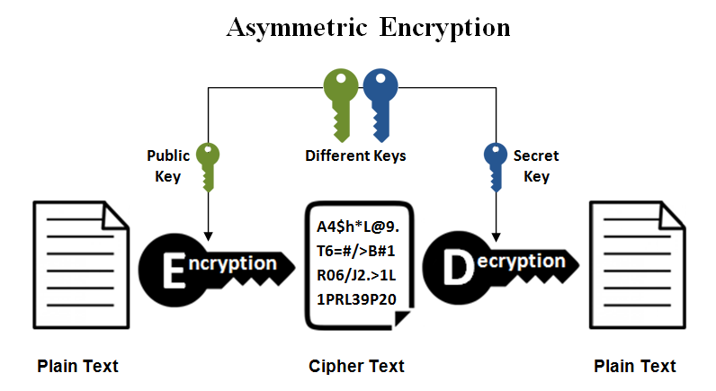
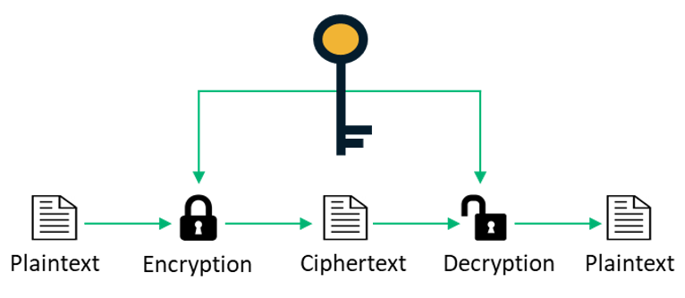
Two Main Encryption Algorithms
Symmetric Encryption
Asymmetric Encryption
The same key, k, is used for both encryption and decryption.
k must be kept secret.
Cheaper and faster, but less secure.
Best for quickly sharing messages.
Examples: DES and AES
The decryption key, k_{d}, is not the same as the encryption key, k_{e}.
k_{d} cannot be derived from k_{e}.
k_{e} can be made public.
k_{d} must be kept secret.
Slower and expensive, but more secure.
Best for authentication and key distribution.
Examples: RSA

Slide 12
Symmetric Encryption: DES
Data Encryption Standard (DES) was developed in 1975 and was the civilian standard for over 20 years.
Break messages into 64-bit chunks.
Encrypt each chunk with a 56-bit key and perform a series of transformations (those details are for a cryptography course).
Brute force to find the key takes 2^55 key tries.
Fine for the 1970s and 1980s, but by 1998 this took 3 days to crack.

Slide 13
Symmetric Encryption: AES
Advanced Encryption Standard (AES) was established by NIST in 2001 to replace DES.
Break messages into 128-bit chunks.
Encrypt each chunk with a 128, 192, or 256-bit key and perform a series of transformations (those details are for a cryptography course).
Brute force for AES-256 would take 2^255 tries.
With a high-end PC, ~27 trillion trillion trillion trillion trillion years.
With the fastest supercomputer, ~2.7 trillion trillion trillion trillion years.
The concern is when keys are stolen…

Slide 14
Asymmetric Encryption: RSA
RSA is one of the most widely used asymmetric encryption algorithms.
RSA is based on two large prime numbers, p and q (on the order of 512 bits) and their product, N.
k_{e} and k_{d} must satisfy the relationship: (k_{e} * k_{d}) % [(p – 1) * (q – 1)] == 1
The encryption algorithm is: c = E(k_{e})(m) = m^(k_{e}) % N
The decryption algorithm is m = D(k_{d})(c) = c^(k_{d}) % N
No known methods to defeat it -> requires factoring N to find p and q.
Not possible if N is large (2048 or 4096-bits)

Slide 15
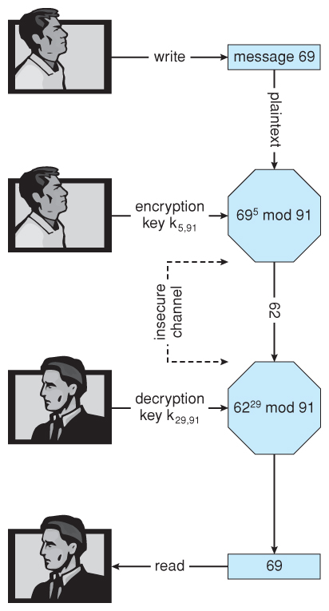
RSA: Example w/ Small Numbers
p = 7, q = 13, N = 7 * 13 = 91
(p - 1) * (q - 1) = 6 * 12 = 72
Select k_{e} < 72 and prime, say 5
Select k_{d} such that (k_{e} * k_{d}) % 72 == 1, say 29
The public key is (5, 91)
The private key is (29, 91)
Let the message, m = 42
Encrypt: c = 42⁵ % 91 = 35
Decrypt: m = 35²⁹ % 91 = 42

Slide 16
Symmetric vs Asymmetric Encryption
Note: asymmetric encryption is much more computationally expensive than symmetric encryption. It is not normally used for large transmissions.
Asymmetric encryption is suitable for small messages, authentication, and key distribution.
What’s App Example
User 1 wants to send a message to User 2
User 1 retrieves the public key for User 2 on the Wat’s App server.
User 1 encrypts using the public keys and User 2 decrypts with their private key.
Once a session is established the users can exchange an AES key.

Slide 17
Authentication and Hash Functions
Authentication verifies the identity.
Ex. Passwords
Authentication also verifies that a message was not modified.
Ex. You have files stored on a cloud service. Were they tampered with?
Hash functions, H(m), generate a small, fixed-size block of data (message digest or hash value) from any given input data.

Slide 18
Hash Function Example
Hash table for a set of SSN.
H(m) = last three digits of SSN.
Name | SSN
Alice | 111-22-1002
Bob | 212-21-2997
Carl | 345-67-8999
Deb | 987-65-3001
Hash value
000
001
002
…
997
998
999
H(m)

Slide 19
Hash Function Example
What do we do with Eve?
Ideal case is that each message maps to its own hash value.
Collision!
Name | SSN
Alice | 111-22-1002
Bob | 212-21-2997
Carl | 345-67-8999
Deb | 987-65-3001
Eve | 654-90-4002
Hash value
000
001
002
…
997
998
999
H(m)
?

Slide 20
Hash Functions
For authentication purposes, the hash function must be collision resistant on m.
That is, it should not be reasonably possible to find an alternate message m’ such that H(m’) = H(m).
Popular hash functions:
MD5
16 byte hash value
Fast, but has known vulnerabilities. Best used for checksums and data integrity.
SHA 256
32 byte hash value
Significantly slower than MD5, but is considered collision resistant… for now

Slide 21


Case Study: Database Encryption
Client Side
Disk Level (on Server)
Manages encrypt/ decrypt
Unaware of encrypt/ decrypt
“Give me the record for Alice”
Send encrypted value
Receive encrypted value
Send “Alice”
Receive “Alice”
Plaintext for Alice is “unknown” to database
Database manages encryption/decryption
Notes:
We’ve talked about encrypted data over the network. What about encrypted data on the server?

Slide 22
Case Study: Database Encryption
Disk-level vs Client-side encryption
Is memory a vulnerability?
Granularity – large vs small chunks of data
Who do you trust?
Query processing for client-side encryption is a challenge.
You are working with ciphertext…
Only equality-based expressions (e.g., WHERE Name = ‘Alice’)
No sorting
No range queries (e.g., WHERE Salary BETWEEN 50K AND 80K)
No computations (e.g., Salary * 1.10)
No wildcards (i.e., % and _)
No regular expressions

Slide 23
Database Encryption: Client Side
Property preserving encryption looks to support query processing.
Order preserving encryption - range scans and sorting
Homomorphic encryption – bounded computations
Such schemes require you to know the workload in advance.
E.g., homomorphic encryption is useless for sorting.
They are also vulnerable to inference attacks since the ciphertext preserves data properties.
E.g., I preserve the order for salary, and I know the min and max salaries.

Slide 24
Database Encryption: Client Side
With order preserving encryption, you can support range queries:
SELECT * FROM Employee WHERE Salary BETWEEN 80K AND 90K;
Don’t need to know the decrypted values. You can put those in the query:
SELECT * FROM Employee WHERE Salary BETWEEN 001 AND 003;
But you are vulnerable to inference attacks:
ID | Name | Salary
1 | Alice | 80K
2 | Bob | 70K
3 | Cindy | 90K
ID | Name | Salary
1 | Alice | 002
2 | Bob | 001
3 | Cindy | 003

Slide 25
Database Encryption: Transparent Data Encryption
Transparent data encryption (TDE)
Native to a database
Encrypts/decrypts all reads/writes to/from persistent storage and memory.
Encrypts entire pages
Uses a two-tier key management to create a separation of privileges between the system admin and database admin.
Data encryption keys are stored in the database. They are encrypted with a master key.
The master key is stored external to the database.
Memory remains a vulnerability.

Slide 26
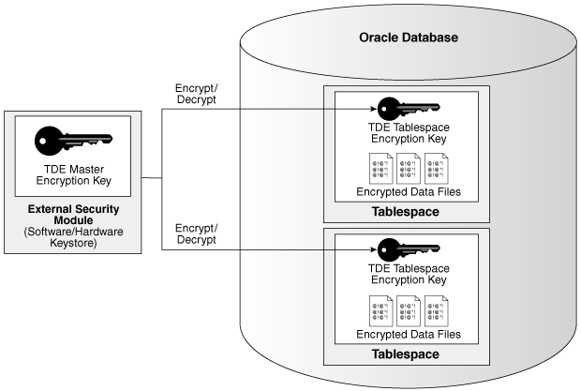
Database Encryption: Transparent Data Encryption
An intruder cannot read data from storage or backups without the master key because the data file keys are encrypted with these keys.
The security password for the master keystore can be made unknown to the database admin, e.g., the system admin may posses it.
When a user enters data:
Retrieve the master key
Decrypt the data encryption key using the master key
Use the data encryption key to encrypt the user data
Encrypted data is stored in the database
Notes:
https://docs.oracle.com/database/121/ASOAG/introduction-to-transparent-data-encryption.htm#ASOAG10137

Slide 27
Implementing Security Defenses

Slide 28
Security Policy
A security policy should be well thought-out, agreed upon, and contained in a living document that everyone adheres to.
It may include how often port scans are run, password requirements, virus detectors, etc.

Slide 29
Vulnerability Assessment
How can we determine if our security policy is correctly implemented?
Penetration testing – scan for known vulnerabilities.
Port scanning
Check for bad passwords
Unauthorized programs
New unauthorized accounts
Risk assessment – quantify or place a value on securing an entity
Value an asset, determine the odds a breach will affect that asset, and the cost to fix the vulnerability.
Notes:
How do you assign a $ cost to a vulnerability? It’s an “insurance policy”

Slide 30
Intrusion Detection
Intrusion detection attempts to detect attacks, both successful and unsuccessful attempts. Techniques vary based on:
The time that detection occurs (real-time vs. after the fact).
The types of information examined (network packets, system calls).
The response to the attack (alert an administrator or automatically stopping the attack).

Slide 31
Intrusion Detection: Two Approaches
Signature-Based Detection – scan network packets, system files, etc. for patterns of known attacks, such as text strings or binary code.
Only detects previously encountered problems; signature must be known.
Anomaly Detection – look for “unusual” activity, such as heavy load.
It can detect previously unknown attacks or “zero-day” attacks.
“Normal” may not be easy to define for a given system.
Not all “unusual” activity is the result of security attacks. If the system is bogged down on a Tuesday night, is it because of a hacker or is it because the CSCI 4401/5401 assignment is due on a Wednesday?

Slide 32
Virus Protection
Anti-virus programs are basically signature-based detection systems, which can also disinfect the affected files and return them to their original condition.
Some antivirus programs incorporate anomaly detection, such as an executable program being opened for writing.
Avoiding bootleg, free, and shared software can help reduce the chance of catching a virus but even commercial software has on occasion been infected by disgruntled workers.

Slide 33
Auditing, Account, and Logging
Auditing, accounting, and logging records can also be used to detect anomalous behavior.
Some of the kinds of things that can be logged include authentication failures and successes, logins, running of programs, network access, system calls, etc.
Discussion: a rogue system administrator.

Slide 34
Security Review
The list of all passwords is kept within the operating system. If a user manages to read this list, password protection is no longer provided. How is this problem avoided?
Compare symmetric and asymmetric encryption schemes and discuss under what circumstances a distributed system would use one or the other.
Consider asymmetric encryption.
How can we very that only the sender generated a message and anyone can read it?
Only the receiver can decrypt the message?
Only the receiver can decrypt the message and the receiver knows that only the sender could have generated the message?
What is the difference between a virus and a worm?
Notes:
1. Store hash values
2. Symmetric: speed over security. Asymmetric: confirm an identity, share a symmetric key
3. Publish the decryption/”secret” key, make the encryption/”public” key secret. Normal usage. Make both keys secret.
3. A worm is a free standing program that works by itself. A virus is a code fragment that attaches to another program. The worm reproduces by making more copies of the worm program. The virus reproduces by infecting other programs.

Slide 35
Intro to Virtualization

Slide 36
Virtual Machines
We have seen how the OS virtualizes subsystems (e.g., CPU, memory) to give applications illusions about owning the system.
What about if we:
Virtualize the whole system
Give an OS the illusions of a system that isn’t real

Slide 37
Multicomputer Environment Example
A company has many computers dedicated to different tasks connected to a high-speed network.
Email server
Web server
FTP server
E-commerce server
Etc.
Having these run on different machines has several benefits. Examples:
Reliability - if one crashes, the others are not affected.
Security – if one is compromised, no immediate access to the others
Might need a different OS for different applications.

Slide 38
Multicomputer Environment Example
Sounds good but having all of these different machines will become expensive and difficult to manage.
One solution is virtual machines. This idea has been around since the 1960s – 1970s.
The main idea is that a Virtual Machine Monitor (VMM) creates the illusion of multiple machines running on the same hardware.
VMMs are also referred to as hypervisors. We will revisit these.

Slide 39
Virtual Machine Monitors
Different servers can run on different virtual machines.
Now, the failure of one virtual machine does not bring down others.
Easier to maintain
Cheaper – less hardware, electricity, rack space, etc.
If one is compromised, the rest aren’t necessarily compromised
Safer software testing – anyone bring down their VM in HW1?
What about failures though?
If the host server fails, all of the virtual machines fail.
Most failures are caused by unreliable or buggy software (including OSes), not faulty hardware
The cloud – clients “share” the physical hardware and pay for resources given to the virtual machine.

Slide 40
Virtual Machine Monitor (VMM)
Aka hypervisor
Sits between multiple OSes and hardware (or a host OS)
Presents a hardware interface to the OSes above
Give the illusion to each OS above that it controls the whole machine
The VMs (and OSes) share the actual hardware resources
Manages (multiplexes) resources among several virtual machines.
Isolate VMs from each other
Similar to what an OS does: abstraction and resource management

Slide 41
Why virtualize?
Isolation and safety – software-related faults (e.g., bugs, poor design, mis-configuration) are more prevalent than hardware-related issues.
Efficiency and cost reduction
Testing a new app on different OSes
Co-located different users

Slide 42
Why Virtualize?
Give a reason why a software developer might use virtualization on a desktop machine being used for development.
Give a reason why an individual at home might be interested in virtualization.
What are the trade-offs of using cloud computing vs running programs locally.
Notes:
One is to have many platforms e.g., Windows, Linux, etc available to test. Also easier to reboot the VM if there’s a crash.
After upgrading to a new computer and OS, the person might want to run software that ran on the old one.
Using cloud services means you don’t have to setup and maintain infrastructure. Maybe outsource backups. Or rapidly change demands. Downside – privacy, provider could steal your data. Expanding you computing needs could be subject to demand pricing. Latency could be a factor.

Slide 43
VMM Implementation Goals
Manageability: creation, maintenance, administration, provisioning, etc.
Performance: overhead of virtualization should be small
Isolation - as if separate physical machines
Activity of one VM should not impact other active VMs
Data of one VM is inaccessible by another
Scalability: minimize cost per VM; run more VMs on hardware
Same goals as for many subsystems

Slide 44
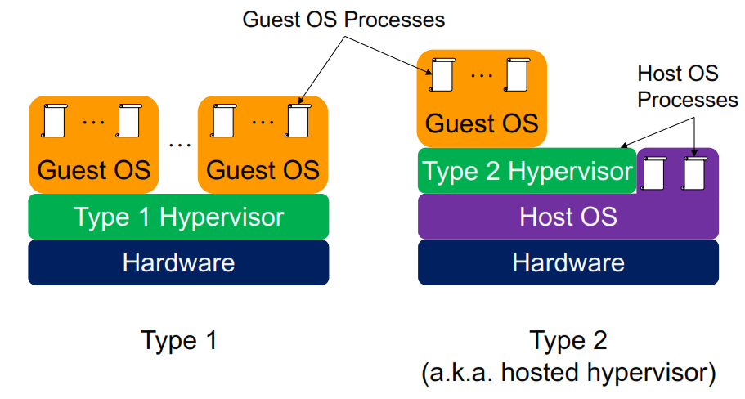
Type 1 and 2 Hypervisors

Slide 45
Requirements for Virtualization
It is important for virtual machines to act just like real machines.
It is the task of the hypervisor to provide this illusion. Three criteria to support this:
Safety: hypervisor manages all hardware
the hypervisor should have full control of the virtualized resources
Fidelity: run any software
Program behavior on a VM should be identical to as if running on bare hardware
Efficiency: performance, it should run fairly fast
Most of the code in the VM should run without intervention by the hypervisor

Slide 46
Type 1 and Type 2 Hypervisors

Slide 47
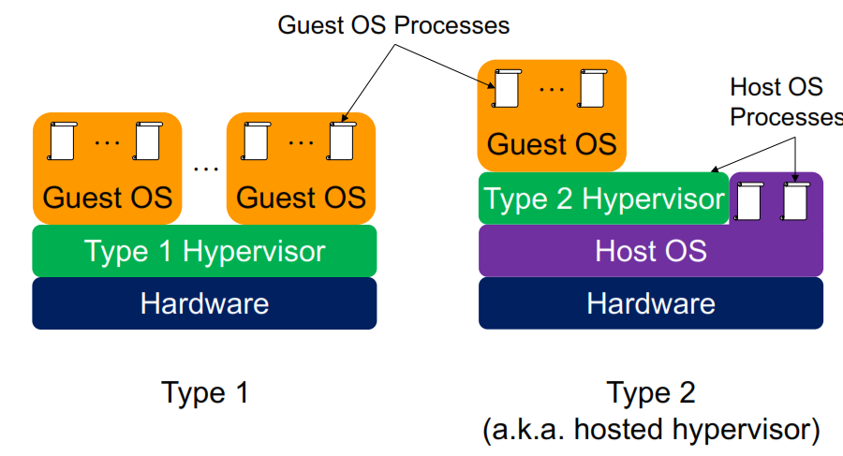
Two Approaches to Virtualization
Type 1 hypervisor vs type 2 hypervisor (aka hosted hypervisor)
Guest operating system: the operating system running on top of the hypervisor (in both cases).
Host operating system: for type 2 only, the operating system running on the hardware

Slide 48
Type 1 vs Type 2 Hypervisor
Type 1 Hypervisor software:
VMware ESX/ESXi
Hyper-V (Microsoft)
XenServer (Citrix)
Oracle VM Server for SPARC
Oracle VM Server for x86
IBM’s z/VM
Type 2 Hypervisor software:
VMware workstation
Virtualbox

Slide 49
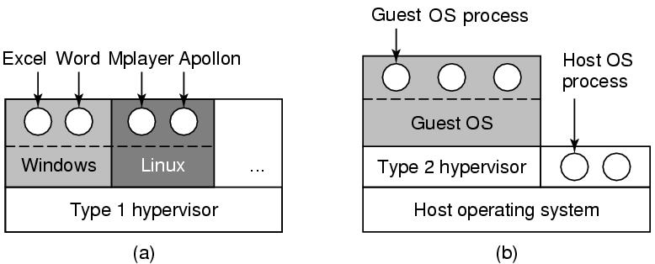
Type 1 Hypervisors
Type 1 hypervisor – like an operating system since it is the only program running in the most privileged mode.
Its job is to support multiple copies of the actual hardware, called virtual machines - similar to processes in a normal operating system.
Hardware
Hardware

Slide 50
Type 2 Hypervisors
Type 2 hypervisor – it is a program that relies on say Windows or Linux to allocate and schedule resources, very much like a regular process.
Of course, the type 2 hypervisor still pretends to be a full computer with a CPU and various devices.
Hardware
Hardware

Slide 51
Kernel Instructions
Both types of hypervisors must execute the machine’s instruction set in a safe manner.
For instance, a guest OS may change and even mess up its own page tables, but not those of others.
The virtual machine runs in user mode.
When the guest OS executes a privileged instruction, the hardware traps, since the instruction was executed in user mode.
The hypervisor then runs in kernel mode and can execute the instruction for the guest OS.

Slide 52
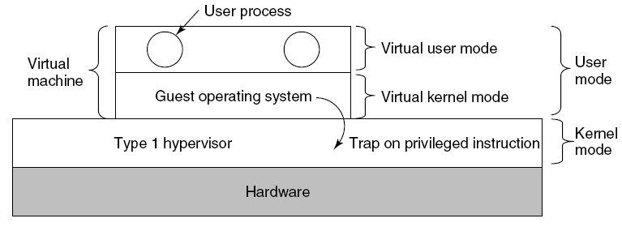
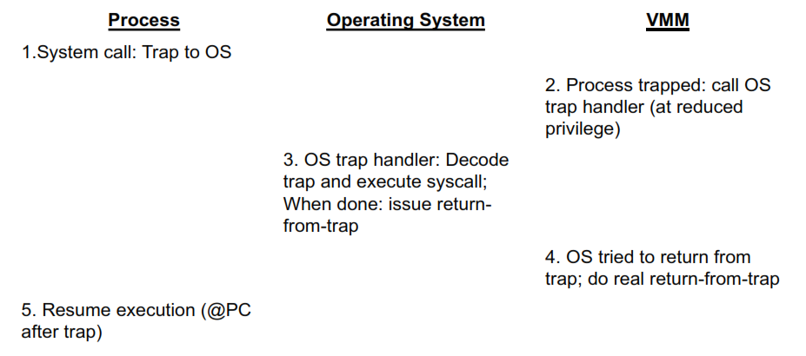
Kernel Instructions
What happens when the guest operating system (thinks it’s in kernel mode) executes an instruction that is allowed only in kernel mode?
Notes:
The VMM has the trap handler that will first get executed in kernel mode. But the VMM doesn’t know what to do with the system call so it jumps to the guest OS trap handler. When the guest OS finishes, it executes the privileged instruction, which again bounces back to the VMM

Slide 53
Memory Virtualization
Almost all modern OSes support virtual memory – mapping of pages in the virtual address space onto pages of physical memory.
This mapping is defined by multilevel page tables.
Virtualization greatly complicates memory management.
Virtual memory utilization involves sharing the physical system memory in RAM and dynamically allocating it to the physical memory of the VMs
Notes:
So far we’ve look at CPU virtualization. We also need to consider memory and I/O

Slide 54
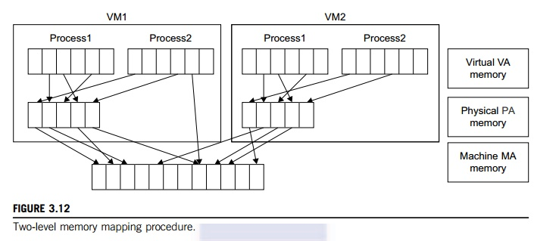
Memory Virtualization
Two stage mapping:
Virtual memory to physical memory
Physical memory to machine memory
The guest OS maps virtual addresses to the physical addresses, but the guest OS cannot directly access the actual machine memory
The VMM is responsible for mapping the guest physical memory to the actual machine memory

Slide 55
Memory Virtualization
Since each page table of the guest OSes has a separate page table in the VMM, the VMM page table is called the shadow page table.
The shadow page table keeps mappings from virtual pages within a VM to real physical pages allotted by the VMM.
When the VM tries to change the MMU to point to a specific page table, this traps to the VMM which updates the MMU to point to the shadow page table.
The shadow page table has actual mappings between virtual pages in VM and real physical pages in the machine.
Keeping shadow page table in sync with guest page table:
When guest OS updates page table, VMM updates shadow page table

Slide 56
Next Time
Start Review

