Slide 1
CSCI 4401/5401: Principles of Operation Systems
James Wagner
University of New Orleans
Week 15, Lectures 28-29
November 21st – 28th, 2023

Slide 2
Announcements
Assignment 4 is due Wednesday, November 29th @ 11:59pm
You can turn in Friday, 12/1 by 11:59pm without a late penalty
Quiz 6 is due Monday, 11/27 @ 11:59 pm.
Security (Lectures 25 – 27)
Assignment 5: E.C. is up and due Tuesday, 11/28 @ 6:00pm
E.C. will be applied to final exam score
Problems are meant as a review to also help/encourage you to prepare for the exam.
Final Exam is Thursday, 12/7 from 8:00pm – 10:00pm

Slide 3
Quiz 5 Review

Slide 4
#1
Which of the following is true for contiguous allocation of blocks on a disk drive?
A. It does not experience external fragmentation.
B. Files can grow dynamically.
C. There is no need to know (or estimate) a file size.
D. It minimizes the need for disk head movement.
Notes:
Answer: D

Slide 5
Contiguous Allocation
Each file occupies a set of contiguous blocks on the disk.
Pros:
Very fast - reading successive blocks requires no disk head movement.
Cons:
Same issues with contiguous memory allocation. However, the cost for moving the disk heads may now justify it.
File growth is problematic:
Over-estimation - external fragmentation
Under estimation - move file
Improvement with extents – a chunk of allocated space (N blocks).

Slide 6
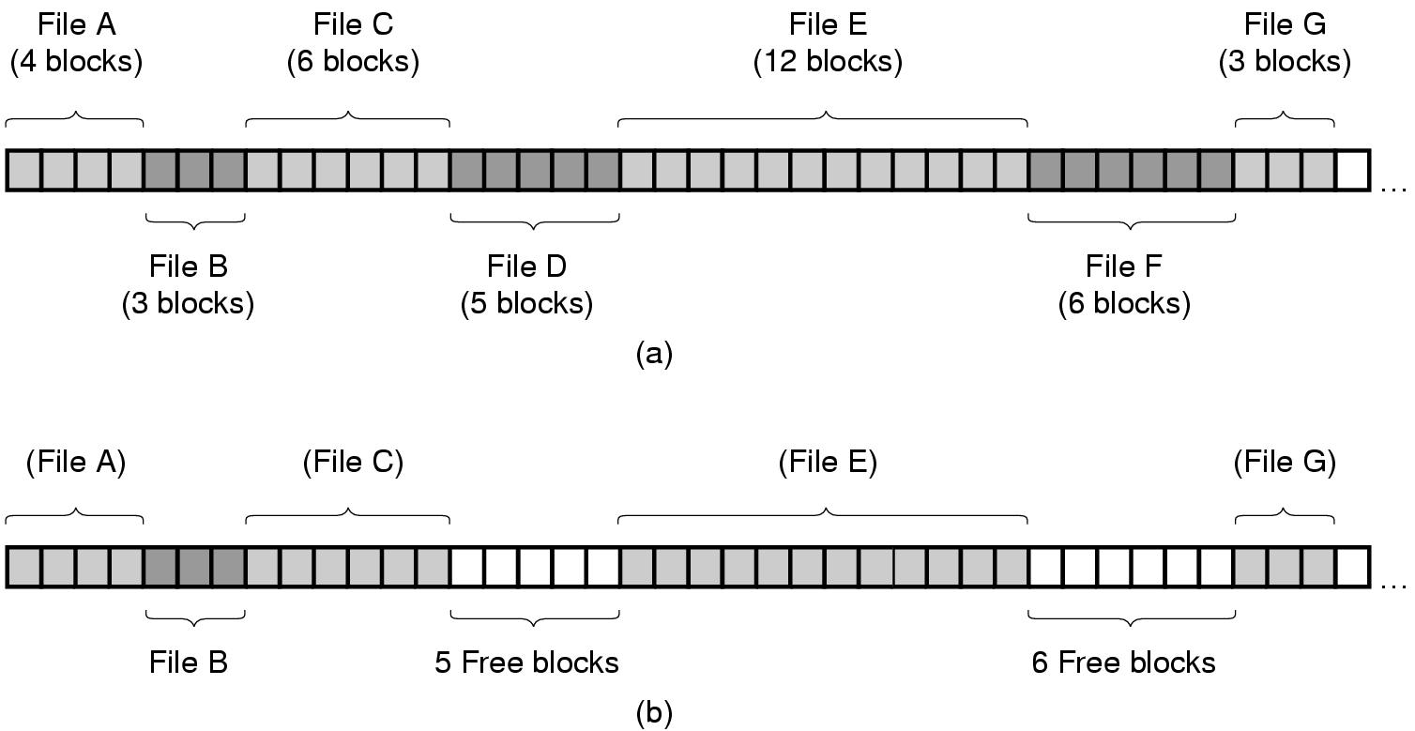
Contiguous Allocation
Contiguous allocation of disk for 7 files
The state of the disk after files D and F are deleted

Slide 7
Access Methods
Sequential Access
read next
write next
rewind
skip n records
Direct Access
read n
write n
position to n
read next
write next
rewrite n
n = relative block number

Slide 8
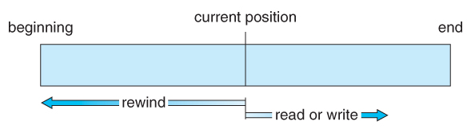
Sequential Access
Simple and generally supports a few operations:
Read next – read a record and advance to the next position.
Write next – write a record and advance to the next position.
Rewind
Skip n records

Slide 9
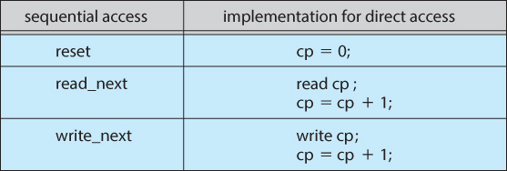
Direct Access
Jump to any record and read that record. Operations supported include:
Read n – read record number n
Write n – write record n.
Jump to record n – could be 0 or the end of file.
Sequential access can be easily emulated using direct access. The inverse is complicated and inefficient.

Slide 10
#2
Which of the following is true for linked allocation of blocks on a disk drive?
A. Random access of blocks is inefficient.
B. It experiences external fragmentation.
C. Random blocks can be accessed efficiently.
D. Storing pointers to the next block minimizes disk head movement.
Notes:
Answer: A

Slide 11
Linked Allocation
Each file is a linked list of blocks scattered anywhere on disk.
Pros:
Easy free-space management:
No external fragmentation
Does not require pre-known file sizes
Allows files to grow dynamically at any time.
Cons:
Links/pointers waste space (e.g., a block may be 508 bytes instead of 512 to make room for a 4-byte pointer)
Inefficient random access of blocks

Slide 12
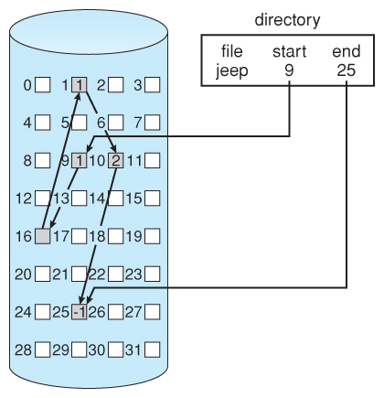
Linked Allocation of disk space
Directory contains a pointer to 1st and last blocks.
What if we only need the 2nd block?

Slide 13
#3
As files are deleted, which of the following is true?
A. There’s no advantage to reusing the blocks for those files.
B. We can use a free-space list to track blocks as they are freed.
C. We have no way of knowing which blocks become freed by a deleted file.
D. The file system does nothing when files are deleted
Notes:
Answer: C

Slide 14
Free-Space List
Disk space is limited, we need to reuse space from deleted files.
Free-space list keeps track of all free disk blocks.
Create/delete file requires updates to free-space list.

Slide 15
#4
A file system is using a contiguous allocation scheme. What can we say about the disk storage space available for a newly created file? Hint: Assume the new file is large.
A. The disk storage space available doesn’t depend on the free blocks.
B. The disk storage space available is probably less than the volume of all the free blocks.
C. The disk storage space available is about equal to the volume of all free blocks.
D. The disk storage space available is probably more than the volume of all the free blocks.
Notes:
Answer: B

Slide 16
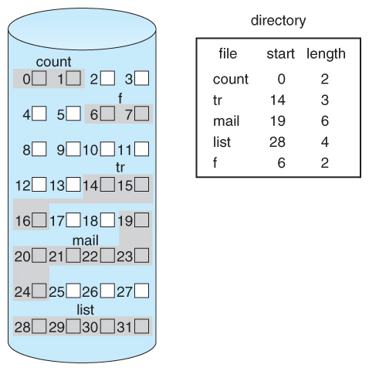
Contiguous Allocation of Disk Space

Slide 17
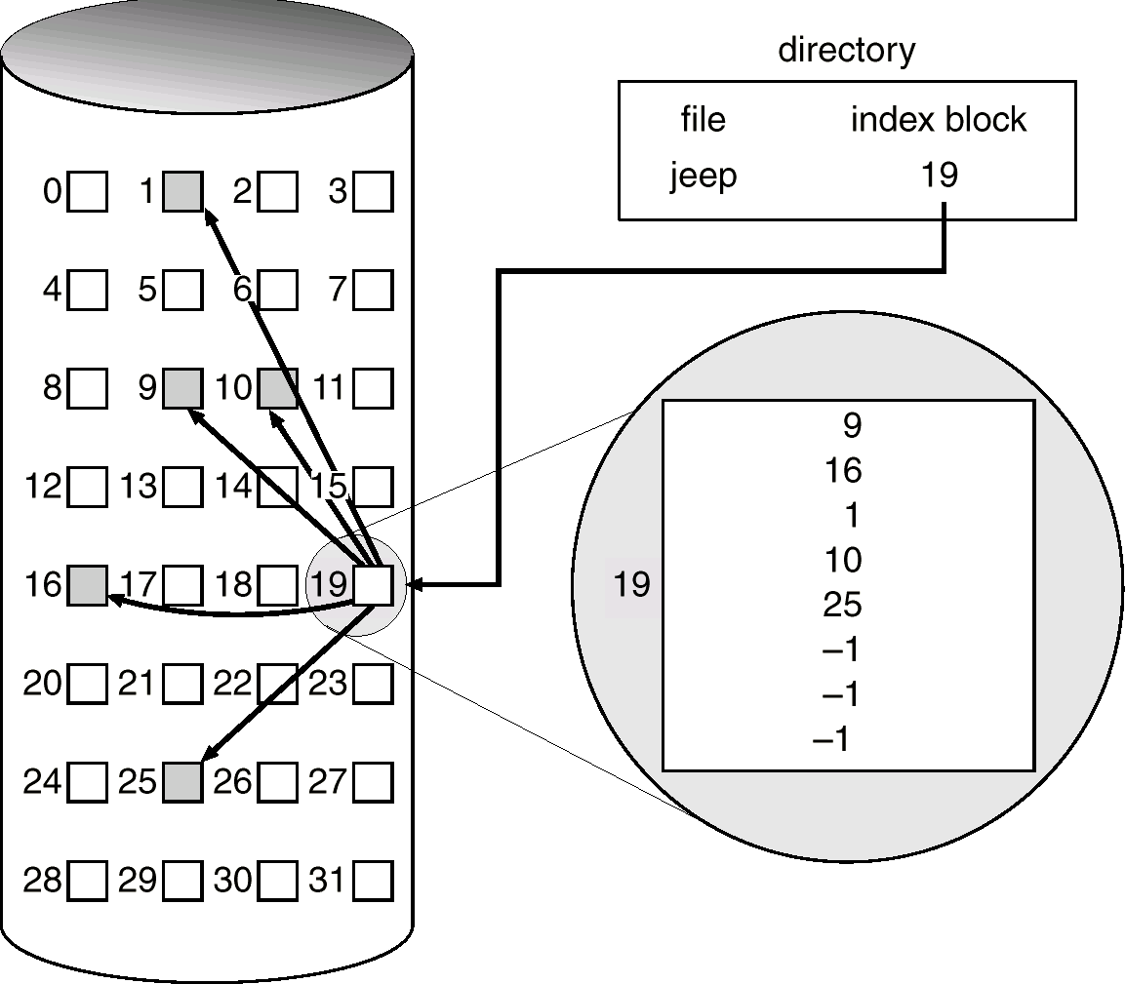

Slide 18
#5
Another file system is using file allocation tables (FAT). What can we say about the disk storage space available for a newly created file?
A. The disk storage space available doesn’t depend on the free blocks.
B. The disk storage space available is probably less than the volume of all the free blocks.
C. The disk storage space available is about equal to the volume of all free blocks.
D. The disk storage space available is probably more than the volume of all the free blocks.
Notes:
Answer: c

Slide 19
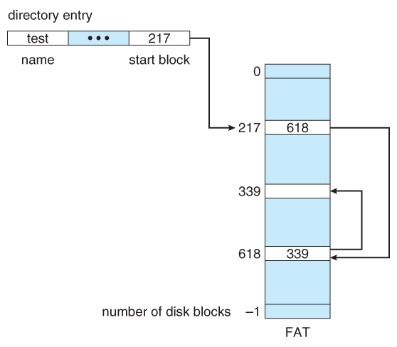
File Allocation Table (FAT)
The file allocation table (FAT) is a variation of linked allocation.
Store all links in a separate table at the beginning of the disk.
Benefit: the FAT table can be cached in memory, improving random access speeds.
end-of-file

Slide 20
#6
Which is true of a partition?
A. It can only span a single device
B. It must contain a valid file system
C. It can span multiple devices.
D. It can span multiple devices and it must contain a valid file system
Notes:
Answer: C

Slide 21
Storage Structure
A disk can be used in its entirety for a file system.
Alternatively, a physical disk can be broken up into multiple partitions.
Each partition becomes a virtual disk and can have its own filesystem.
Or, multiple physical disks can be combined into one volume, i.e., a larger virtual disk, with its own filesystem spanning the physical disks.

Slide 22
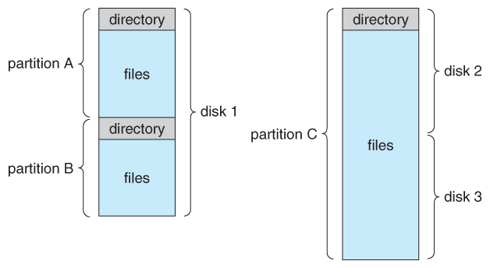
File-System Organization

Slide 23
Layout of Disk: Partitions
Physical disks are commonly divided into smaller units, partitions.
Disks can also be combined (more on that when we get to RAID)
Partitions can be “raw” - no FS, or “cooked” - contains a FS
Raw examples – swap space, databases, RAID
Boot partition
Raw
Pre-defined location, (e.g., address 0)
Executes the boot loader -> boots an OS from disk and executes the FS.
Root partition
Contains the OS kernel and other system files
Mounted at boot time and control is transferred from the boot loader to the kernel.
Additional file systems get mounted as we continue to boot.

Slide 24
#7
What access method do disk drives use to read and write data?
A. Sequential access
B. Direct (or random) access
C. Full access
D. Complex access
Notes:
Answer: B

Slide 25
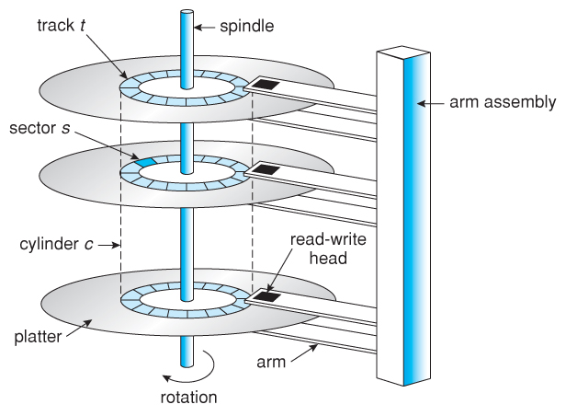

Moving-head Disk Mechanism

Slide 26
Disk Speed
Disk speed is mainly dependent on two things:
Seek time (or random access time)
Time to move the heads from one cylinder to another
Typically the slowest step (4 – 5ms)
Rotational latency
Time for a sector to rotate around and come under the read/write head.
2nd slowest step
Ex. A disk rotates at 7200 rpm (120 rps) and the average rotational latency is ½ a revolution. (0.008sec/revolution) * .5 revolutions = ~4ms
Transfer rate – an additional overhead to move the data electronically.
On the order of MB/s

Slide 27
#8
Which of the two terms below are the greatest overheads associated with disk drives?
A. Seek time
B. Rotational latency
C. Transfer rate
D. Page faults
E. Translation lookaside buffer
Notes:
Answer: A & B

Slide 28
#9
Which of the following disk scheduling algorithms can result in starvation?
A. First-come, first-serve algorithm
B. Shortest-seek-time-first algorithm
C. SCAN
D. LOOK
Notes:
Answer: B
Why was this one low?

Slide 29
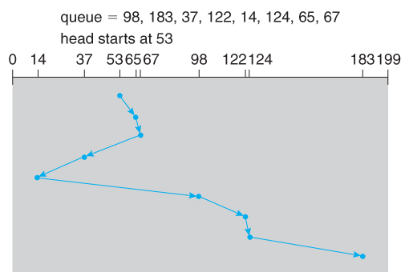
SSTF Scheduling
Shortest-seek-time-first is more efficient but may lead to starvation.
Example: SSTF reduces the total head movement to 236 cylinders.
Note: the distance could be reduced to 208 by starting with 37 and 14.

Slide 30
#10
Which of the following two describes asynchronous writes?
A. Updates to data are cached and written to disk when convenient.
B. Updates to data are written to disk immediately.
C. Updates to data are written to disk in the order they are received.
D. Updates to filesystem metadata should always be written asynchronously.
E. In the case of a power failure, asynchronous writes can cause an inconsistent state without a proper recovery mechanism.
Notes:
Answer: A & E

Slide 31
Synchronous vs Asynchronous Writes
Synchronous writes:
Occur in the order in which the disk subsystem receives them.
Occur immediately, not buffered.
Asynchronous writes:
Stored in the cache.
Subsystem schedules writes (in a more efficient order).
Wait until convenient: down-time or read/write location
Asynchronous writes are the mostly used, but metadata writes are often done synchronously.

Slide 32
Final Review

Slide 33
Final Exam Details
Thursday, 12/7 from 8:00pm – 10:00pm (120 minutes)
In-person section takes in class.
Online section takes through Canvas.
Being on Zoom is optional. If you have a problem and you are not on Zoom to tell me immediately, that is on you.
It is your responsibility to have an internet connection. If you are worried about this, you have the option to take the exam in person – just let me know.
Open book and notes. No other resources!
Expect mostly short answer questions
5401 students will have an extra question or two
This will be E.C. for 4401 students

Slide 34
Final Exam Topics
Main Memory & Virtual Memory (Ch 3, Lectures 13 – 14, 17 – 19)
File Systems (Ch 4, Lectures 20 – 22)
Mass Storage (Ch 5, Lectures 23 – 24)
Protection & Security (Ch 9, Lectures 25 – 27)

Slide 35
Main Memory
What does the memory management unit do? Give an example.
What is the difference between paging and segmentation? Some (not all) things to consider:
Page size vs segment size
Physical address = ?
Logical address = ?
Fragmentation
What is a translation look-aside buffer? Why does it improve performance?

Slide 36
Main Memory Allocation
Consider a swapping system in which memory consists of the following hole sizes in memory order:
10 MB, 4 MB, 22 MB, 18 MB, 7 MB, 9 MB, 12 MB, and 15 MB.
Which hole is taken for three successive segment requests of 12 MB, 10 MB, and 9 MB for:
First-fit algorithm?
Best-fit algorithm?
Worst-fit algorithm?

Slide 37
Paging
Assuming a 2 KB page size, what are the page numbers and offsets for the following three address references? Assume base 0 for the page numbers.
3275
20600
16543
Notes:
1. 3275/2048 = Page#1, Offset = 3275%2048 = 1227
2. Page#10, Offset 120
3. Page#8, Offset = 159

Slide 38
Mapping Logical to Physical Addresses
Consider the following page table:
Assume the page and frame size is 4 KB. What are the physical addresses for the following logical addresses (page #, page offset)?
(2, 100)
(3, 5000)
(0, 3000)
Page # | Frame #
0 | 3
1 | 4
2 | 6
3 | 2
Notes:
Frame 6 address = 24576 + Offset = 100 = 24676
Illegal memory reference
Frame 3 address = 12288, Offset = 3000 = 15288

Slide 39
Virtual Memory
How are the terms demand paging and page fault related? How does the page fault rate affect performance?
What are three page-replacement algorithms we discussed? How is Belady’s Anomaly related to these?
What is the working set size? How is it related to thrashing?
What are dirty pages?

Slide 40
Virtual Memory
Consider the following sequence of page accesses (or reference string):
1, 2, 3, 4, 1, 2, 5, 1, 2, 3, 4, 5
Assume that your system has 3 page frames. For each of the following page replacement algorithms, state the number of page faults that will occur. What about 4 page frames?
A) First-in, first-out, B) Optimal, C) Least recently used
1 | 2 | 3 | 4 | 1 | 2 | 5 | 1 | 2 | 3 | 4 | 5
Notes:
9 page faults
7 page faults
10 page faults
10 page faults
6 page faults
8 page faults

Slide 41
Virtual Memory
Consider the following sequence of page accesses (or reference string):
1, 2, 3, 4, 1, 2, 5, 1, 2, 3, 4, 5
Assume that your system has 3 page frames. For each of the following page replacement algorithms, state the number of page faults that will occur. What about 4 page frames?
A) First-in, first-out, B) Optimal, C) Least recently used
1 | 2 | 3 | 4 | 1 | 2 | 5 | 1 | 2 | 3 | 4 | 5
Notes:
9 page faults
7 page faults
10 page faults
10 page faults
6 page faults
8 page faults

Slide 42
File Systems
What is the difference between linked allocation and indexed allocation of disk space?
Advantages & disadvantages? (fragmentation, static or dynamic file size, direct access, wasted storage)
What type of allocation do file allocation tables (FAT) use? What about UNIX i-nodes?
What is the difference between synchronous and asynchronous writes? When would you want to perform each?
The least-recently algorithm (LRU) is typically used to free frames in memory. Why is LRU not ideal if you read a large file (larger than available memory) once?

Slide 43
File Systems
Consider a file currently consisting of 100 blocks. Assume: the FCB (and the index block for indexed allocation) is already in memory. Calculate how many disk I/O operations are required for Contiguous, Linked, and Indexed (single-level) allocation strategies. Assume: that there is no room to grow at the beginning, only at the end for contiguous allocation. Assume: block information to be added is stored in memory.
 | Contiguous | Linked | Indexed
Add @ begin
Add @ middle
Add @ end
Rem @ begin
Rem @ middle
Rem @ end
Notes:
Example for indexed? Example for linked?

Slide 45
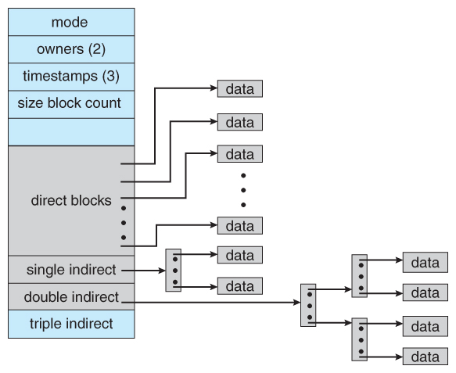
The UNIX Inode
Direct blocks
pointers for small files
Single indirect
Pointer to an index block
Double indirect
Pointer to a 2-level index
Triple Indirect
Pointer to a 3-level index
Note: index blocks may still require random access

Slide 46
I-Node Structure
Disk Blocks
i-node
(double indirect block)
i-node
Disk Blocks
File Attributes
i-node
(double indirect block)
Address of block 0
i-node
(double indirect block)
Disk Blocks
Address of block 1
Address of block 2
Address of block 3
i-node
(double indirect block)
Address of block 4
Disk Blocks
Disk Blocks
Address of block 5
i-node
(Single indirect block)
Address of block 6
Ptr Single indirect
Ptr Double I-node

Slide 47
File Systems
Last time we discussed how UNIX i-nodes store disk block addresses. What happens as the file grows larger?
A UNIX file system has 1KB block sizes and 4 bytes are needed to store disk addresses. What is the maximum file size if an i-node contains 10 direct entries and one single, double, and triple indirect?
Pointers:
Direct = ?
Single indirect = ?
Double indirect = ?
Triple indirect = ?
Max file size = ??? GB
Notes:
Pointers = 10 direct + 256(1024/4) single indirect + 256^2 double indirect + 256^3 triple indirect
Storage = 16843018 pointers = 16843018 KB = 16.06GB

Slide 48
File Allocation Table (FAT)
The file allocation table (FAT) is a variation of linked allocation.
Store all links in a separate table at the beginning of the disk.
Benefit: the FAT table can be cached in memory, improving random access speeds.
end-of-file

Slide 49
Disk Scheduling
Disk transfer speeds are limited by seek time and rotational latency.
Disk requests include:
the disk address
memory address
number of sectors to transfer
whether the request is a read or write
If requests are queued to access disk, we can benefit from scheduling.
FCFS
SSTF
SCAN
C-SCAN
LOOK

Slide 50
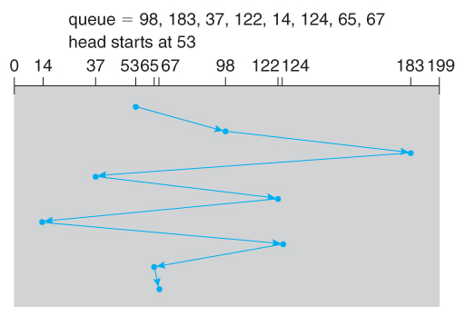
FCFS Scheduling
First-come, first-serve is simple and intrinsically fair, but not efficient.
Example: I/O block requests has wild cylinder swings.
What’s the total cylinder movement? 640

Slide 51
SSTF Scheduling
Shortest-seek-time-first is more efficient but may lead to starvation.
Example: SSTF reduces the total head movement to 236 cylinders.
Note: the distance could be reduced to 208 by starting with 37 and 14.

Slide 52
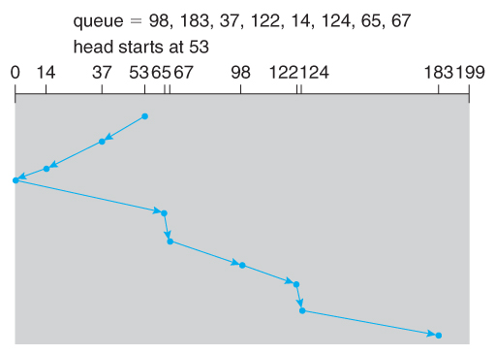
SCAN Scheduling
The SCAN algorithm (aka the elevator algorithm) moves back and forth from one end of the disk to the other.
Wide variation in access time: a request can arrive just before or just after the moving head has passed.

Slide 53
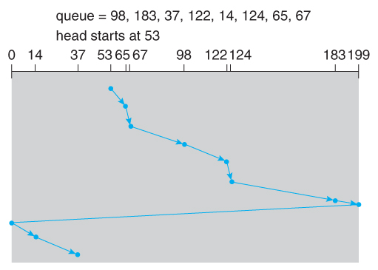
C-SCAN Scheduling
The circular-SCAN algorithm improves upon SCAN by treating all requests in a circular queue fashion.
Once the head reaches the end of the disk, it returns to the other end without processing any requests and then starts again.

Slide 54
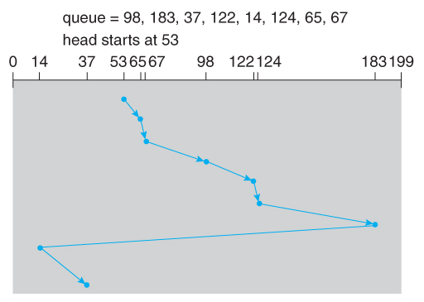
LOOK Scheduling
LOOK scheduling improves upon SCAN and C-SCAN by not moving the heads any farther towards the end of the disk than any request.
C-LOOK Example:

