Slide 1
Decorator
Gredler Andreas

Slide 2
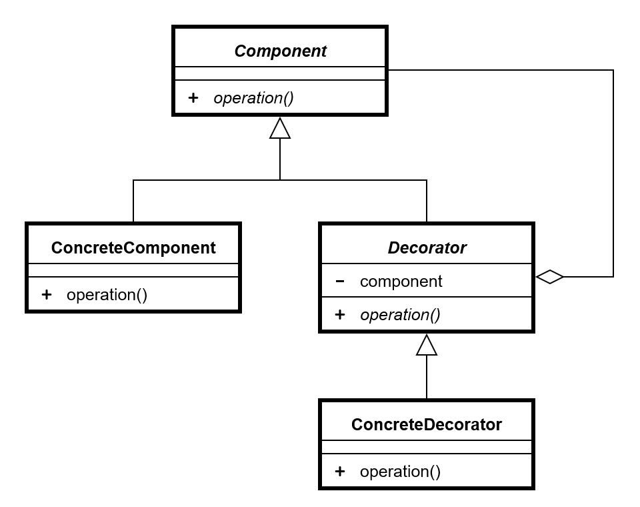
Decorator - UML

Slide 3

SOLID
Single Responsibility principle
Open/closed principle
Liskov substitution principle
Interface segregation principle
Dependency inversion principle

Slide 4
Java API
alle Unterklassen von:
java.io.InputStream
OutputStream
Reader
Writer
java.util.Collections:
checkedCollection()
synchronizedCollection()
unmodifiableCollection()

Slide 5
Java API
javax.servlet.http:
HttpServletRequestWrapper
HttpServletResponseWrapper

Slide 6
