Slide 1
Presented by: Miranda Smith CS 834 Info Retrieval
Topic-Sensitive PageRank.
Taher H. Haveliwala. 2002.
In Proceedings of the 11th international conference on World Wide Web.
TwitterRank: Finding Topic-sensitive Influential Twitterers.
Jianshu Weng, Ee-Peng Lim, Jing Jiang, and Qi He. 2010.
In Proceedings of the third ACM international conference on Web search and data mining.

Slide 2
Topic-Sensitive PageRank
Recall Page Rank
Difference between Topic Sensitive PageRank
Explain how calculated
Results of how accurate
Take Away

Slide 3
Page Rank
If page A has a link to page B, then A is saying that B is important
Random Surfer Model
Start at random page
Select, at random, link to follow
Or jump to total new page
PageRank= probability that surfer lands on page

Slide 4
PageRank Definition
Teleportation probability
Sum of PR of all pages pointing to P_{i}
PageRank of page P_{i}
Total num of pages
Number of outlinks from P_{j}
B_{Pi} is set of all pages pointing to P_{i}
Taken from Nelson cs532 week 5 PowerPoint

Slide 5

Page rank
Can also be defined as a matrix
D uniform dampening factor
L() out degree of a page
PR() PageRank of a page

Slide 6
Difference between Topic Sensitive PageRank
Compute multiple PageRanks for every page

Slide 7
Explain how calculated
Based on preselected topics
16 top-level categories of Open Directory Project
Train classifier on URLs under each category

Slide 8
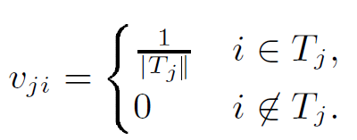
Topic Sensitive Page rank
Can also be defined as a matrix
D non-uniform dampening factor
L() out degree of a page
PR() PageRank of a page
T_{j} =set of URLs in category

Slide 9
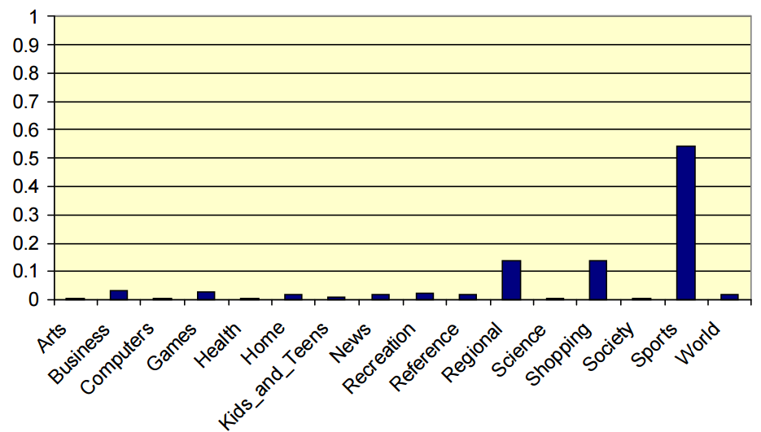
Classify Query
Query = ‘Golf’
Distribution of
topic weights
Topic-Sensitive Page Rank Haveliwala
http://infolab.stanford.edu/~taherh/papers/slides/tspr-slides.pdf

Slide 10
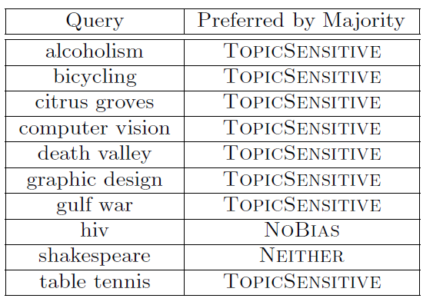
Evaluation
User Study
10 Queries
Asked which results relevant
Asked which Ranking system preferred

Slide 11
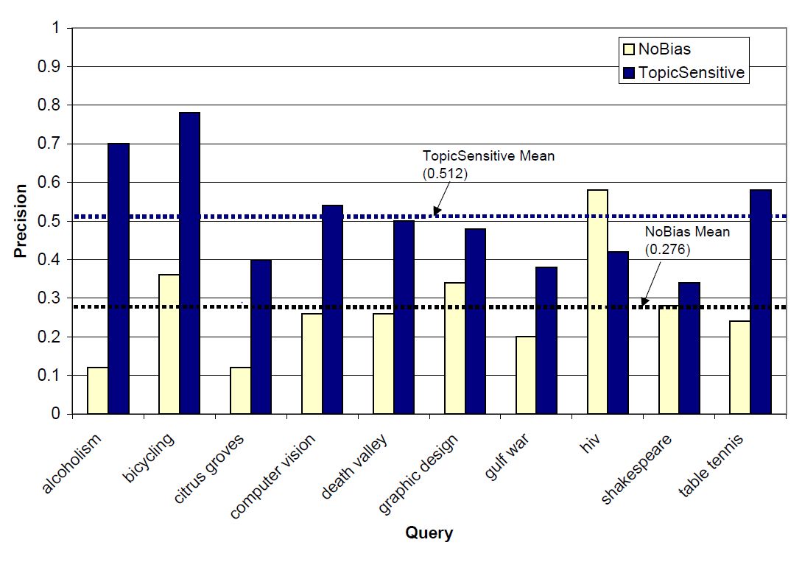

Slide 12
TwitterRank: Finding Topic-sensitive Influential Twitterers
Homophily Exists in Twitter
Explain what Twitter Rank is
How Twitter Rank works
Results
Take Away

Slide 13
TSPR vs TwitterRank
How are they related

