Slide 1
Presented by: Miranda Smith CS 834 Info Retrieval
Information Retrieval System Evaluation:
Effort, Sensitivity, and Reliability
Mark Sanderson and Justin Zobel. 2005.
In Proceedings of the 28th annual international ACM SIGIR conference on Research and development in information retrieval
A Comparison of Statistical Significance Tests for Information Retrieval Evaluation
Mark D. Smucker, James Allan, and Ben Carterette. 2007.
In Proceedings of the sixteenth ACM conference on Conference on information and knowledge management

Slide 2
Information Retrieval System Evaluation: Effort, Sensitivity, and Reliability
A comparison of the t-test, Wilcoxon, and sign tests
Compare MAP and P@10

Slide 3
Testing process
Select collection of documents
Write a set of topics
Create relevance judgements
Measure effectiveness with mean average precision, MAP
Run significance test on MAP

Slide 4
Previous Conclusions
Absolute difference in MAP of 5-6% for 2 systems run on 50 topics to be 95% confident that the results could be reproduced
Impact of significance tests on error rates?
P@10 not as reliable as MAP
Voorhees, E.M., Buckley, C. (2002) The effect of topic set size on retrieval experiment error, in Proc. ACM SIGIR, 316-323.
Tague-Sutcliffe, J., Blustein (1994) A Statistical Analysis of the TREC-3 Data, in Proc. TREC-3, 385-398.

Slide 5
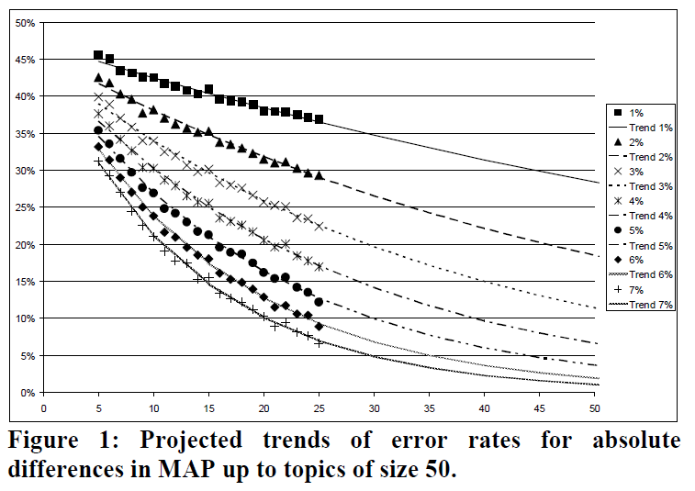
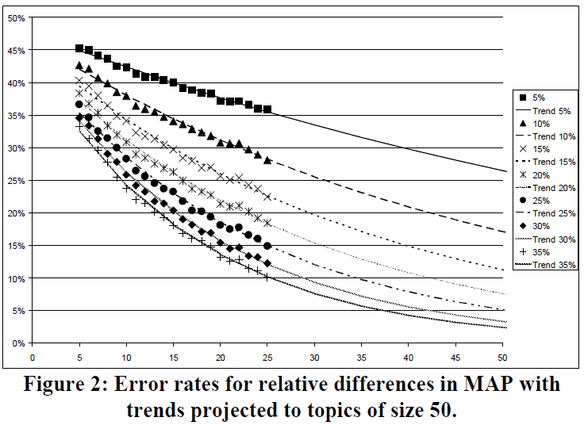
Relative difference in MAP must be >25% without significance test

Slide 6
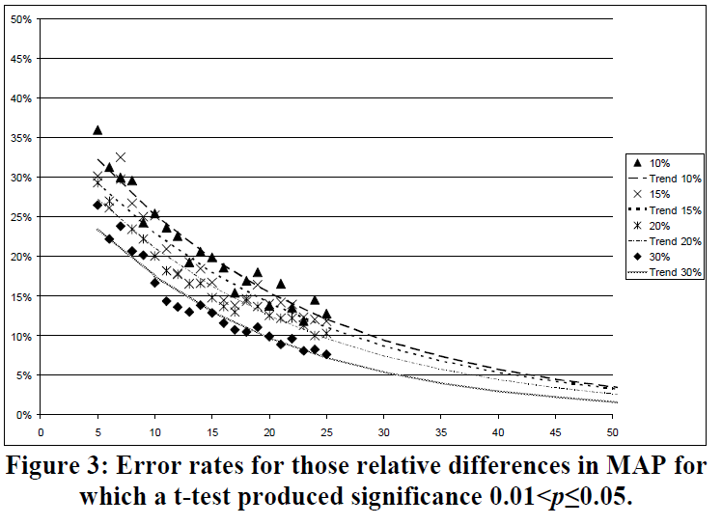
Relative difference in MAP must be > 7-8% with t-test p=< 0.05

Slide 7
T-test more accurate
T-test violates assumptions about data being tested is from normal distribution
 | Sign | Wilcoxon | T-test
Relative MAP to be confident with p =<0.05 | 17-8% | 16-10% | 13-7%

Slide 8
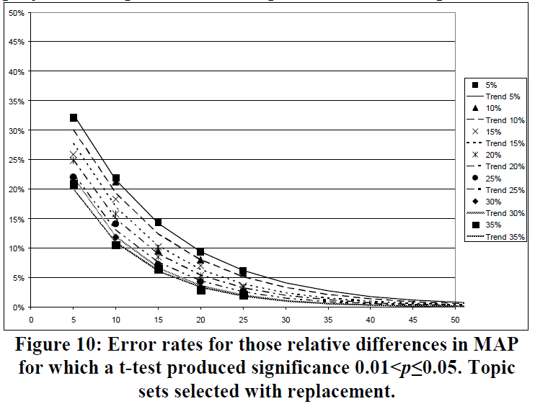
Lower bound
Independent Topic Collections
Any % difference in MAP is significant if t-test p=<0.05

Slide 9
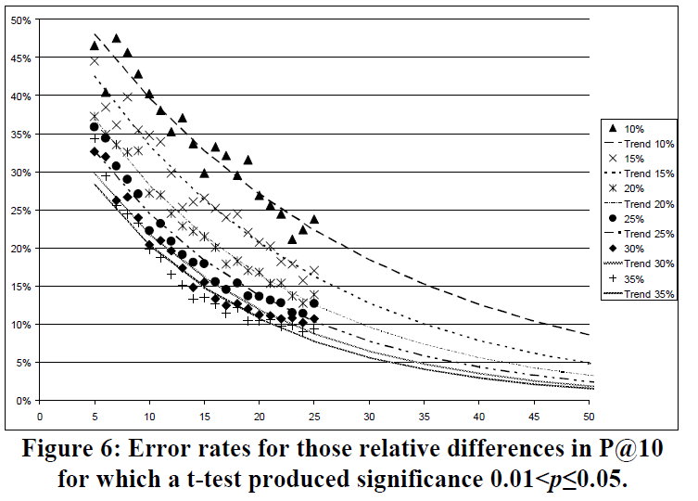
MAP more reliable than p@10

Slide 10
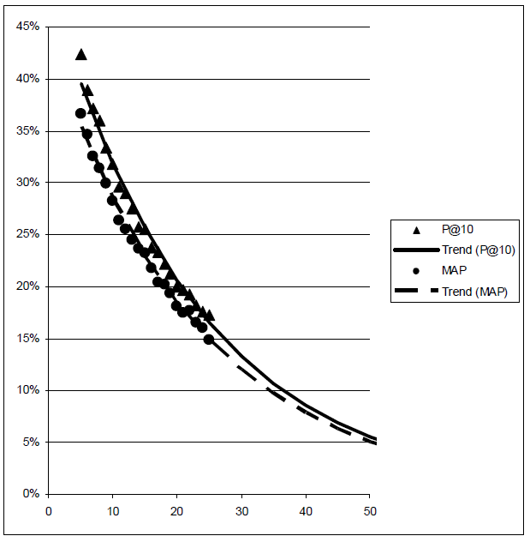
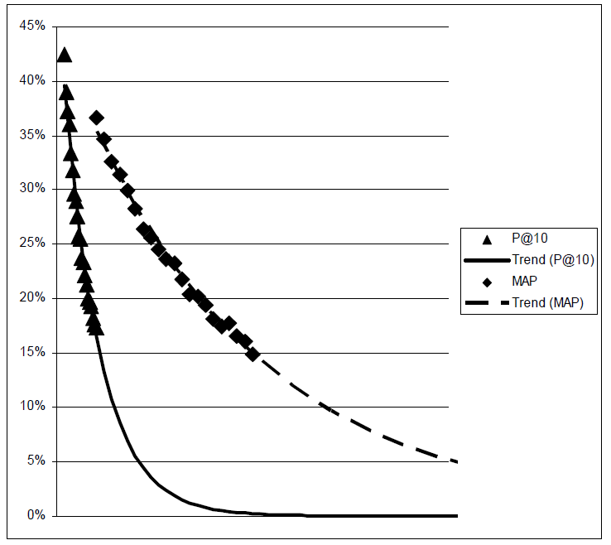
P@10 better for new collections
Error rates for 25% relative difference in P@10 and MAP against topic size.
Normalized against assessor effort.

Slide 11
Hypothesize number of topics more important than pool depth
Similar effort to create
400 topics at depth 10
50 topics to depth of 100

Slide 12
Contributions
T-test more reliable
For 50 topics
At best once significance is observed with t-test the result is significant
At worst once significance is observed with t-test and MAP relative difference of 10% is significant
For existing collections MAP is better
Creating new collections P@10 is better

Slide 13
A comparison of statistical significance tests for information retrieval evaluation.
A comparison of the
T-test
Wilcoxon
Sign
Randomization
Bootstrap

Slide 14
Randomization vs Wilcoxon vs Sign
System A and B measured on 50 topics
NULL = Any permutations of the system labels is equally likely
Create all permutations, calculate MAP for each
Alternative is to sample from all permutations
100K instead of 20M
P 0.05 ± 0.001
P 0.01 ± 0.00045
Wilcoxon and sign test are simplified versions that don’t use MAP

Slide 15
Data Collection
Different runs on TREC collections 3 & 5-8
Calculated MAP difference for each pair
Calculated P value for each test

Slide 16
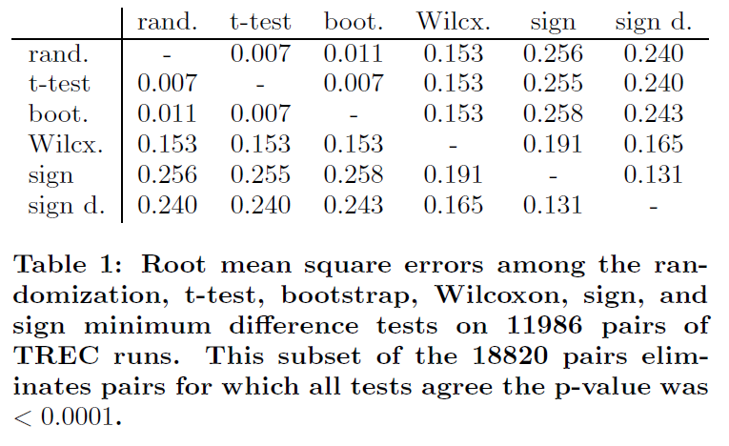
Rand, t-test, and bootstrap ≈0.01 RMSE

Slide 17
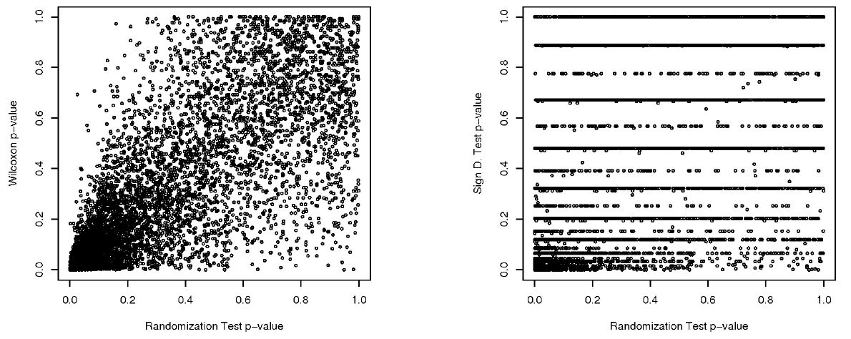
Wilcoxon and Sign test not good approximations of Randomization

Slide 18
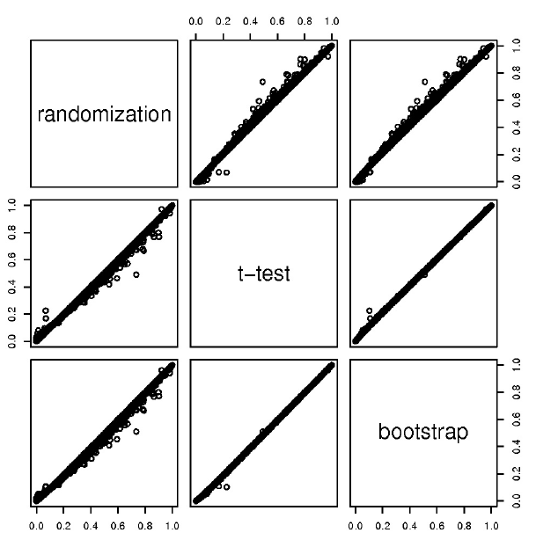
Randomization has more outliers

Slide 19
T-test vs Bootstrap vs Rand
 | T-test | Bootstrap | Rand
Assumes scores from distribution | yes | Yes | no
Assumes results from normal distribution | yes | no | no
Only use difference between means | yes | no | no

Slide 20
Conclusions
Randomization, bootstrap, and t-test produce comparable results
Avoid Wilcoxon or sign test
They recommend Randomization test

Slide 21
Contributions Comparison
Information Retrieval System Evaluation:
Effort, Sensitivity, and Reliability
A Comparison of Statistical Significance Tests for Information Retrieval Evaluation
T-test more reliable
Found specific ranges for when a result is reliable
Compared MAP and P@10
Compared Randomization, bootstrap, t-test, Wilcoxon , and sign test
Randomization, bootstrap and t-test practically the same
Prefer Randomization because it has less assumptions about the data and is more flexible

