Slide 1
Presented by: Miranda Smith CS 834 Info Retrieval
Dependence Language Model for Information Retrieval
Jianfeng Gao, Jian-Yun Nie, Guangyuan Wu, Guihong Cao. 2004.
In Proceedings of the 27th annual international ACM SIGIR conference on Research and development in information retrieval
A Markov Random Field Model for Term Dependencies
Donald Metzler and W. Bruce Croft. 2005.
In Proceedings of the 28th annual international ACM SIGIR conference on Research and development in information retrieval

Slide 2
Review of dependence language model
Pull words out of a “bucket” according to probability distribution over words in document
Rank documents by probability that the document can generate the query
Assumes independence between terms

Slide 3
Bigram Weaknesses
Does not capture more distant dependencies
“Are Lincolns the most reliable cars”
Many noisy dependencies
Going to link all adjacent words regardless of strength of dependency
“Status of nuclear proliferation treaties”

Slide 4
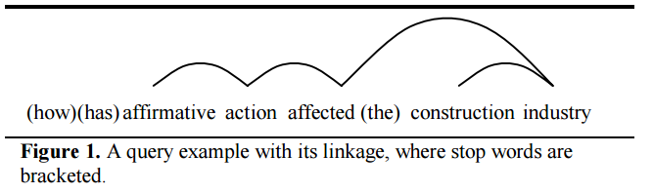
Adding Linkage
Generalization of bigram
New dependency structure called linkage
Term dependencies form an acyclic, planer graph, linking two related terms
Only consider strongest linkages

Slide 5
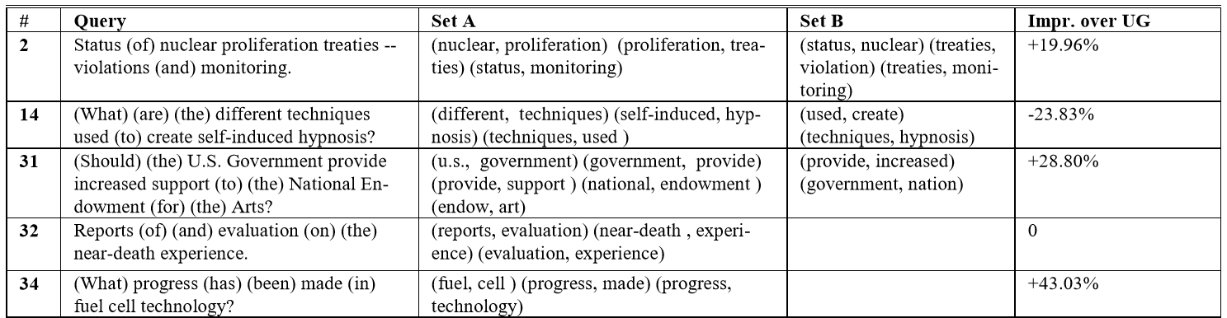
Linkage in Queries Example

Slide 6
Generating the Query
Linkage is generated from the document
Query is generated from the probability distribution of words in the document including the linkage

Slide 7
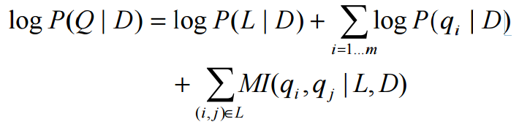



Ranking Equation
Prob of Linkage given Document
Sum of Prob of query term given document
Sum term dependencies for q_{i} and q_{j} given the linkage and the document

Slide 8
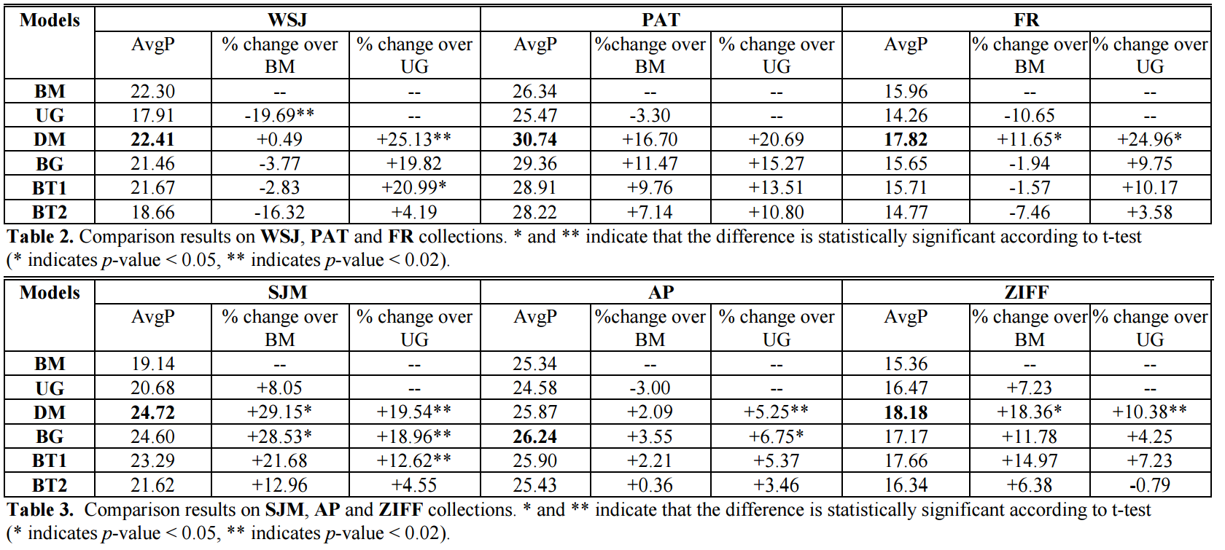
Evaluation

Slide 9
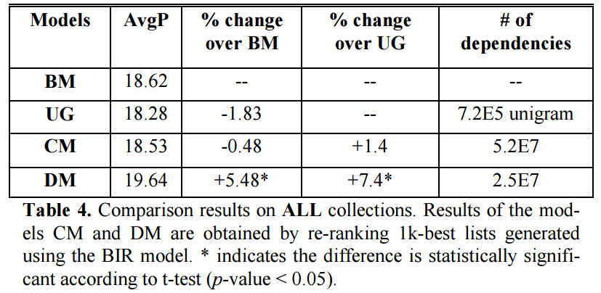
Evaluation Summary

Slide 10
Conclusion
New language model incorporating term dependence
Outperforms unigram dependence model
In practice bigram language model is good approximation
Only slightly worse performance
Less complex

Slide 11
A Markov Random Field for Term Dependencies
General framework for modeling term dependencies with Markov Random Fields
Explain Gao’s good results when historically Term Dependence Models have poor results
2 hypothesis
Dependence models will be more effective for larger collections than smaller collections
Incorporating several types of evidence (features) into a dependence model will further improve effectiveness

Slide 12
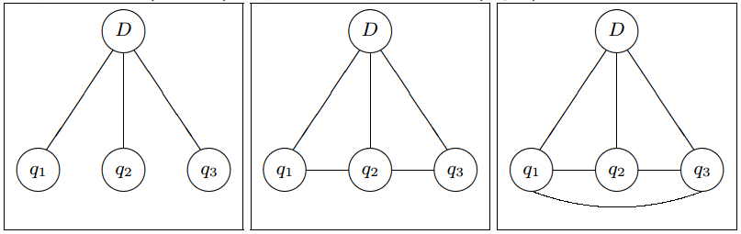
Markov Random Field
Consider dependencies between more than just a pair of terms
Constructed from a graph G
Contains document D and query nodes q_{i}
Link shows dependence

Slide 13


Using MRF
Construct graph of query term dependencies to model
Define set of potential functions over the cliques of that graph
Rank documents in descending order of
estimated from relevance distribution describing related documents and queries
General enough could emulate most other retrieval models

Slide 14
3 Variants
Full Independence
Sequential Dependence
Full Dependence

Slide 15
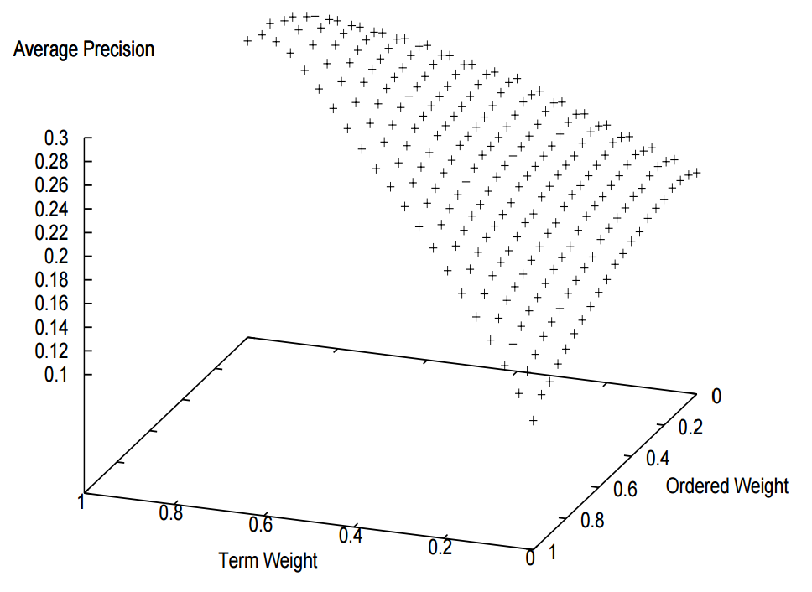
Setting Lambda Function
Made up of multiple parameters
Train by directly maximizing mean average precision, not the parameter
Found to always be concave (or close)
Use a coordinate-level hill climbing search

Slide 16
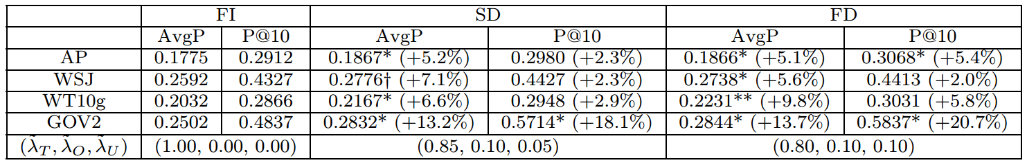
Evaluation
small
large

Slide 17
Conclusion
Created general term dependence model that can use arbitrary text features (lambda function)
Can mimic most other models based on parameters
Significant improvement on larger collections
Explains that Gao got good results because of testing on larger collections compared to previous studies

