Slide 1
Presented by: Miranda Smith CS 834 Info Retrieval
Can social bookmarking improve web search?
Paul Heymann, Georgia Koutrika, and Hector Garcia-Molina. 2008. In Proceedings of the 2008 International Conference on Web Search and Data Mining
Tag completion for image retrieval
Wu, Lei, Rong Jin, and Anil K. Jain. 2013.
IEEE Transactions on Pattern Analysis and Machine Intelligence

Slide 2
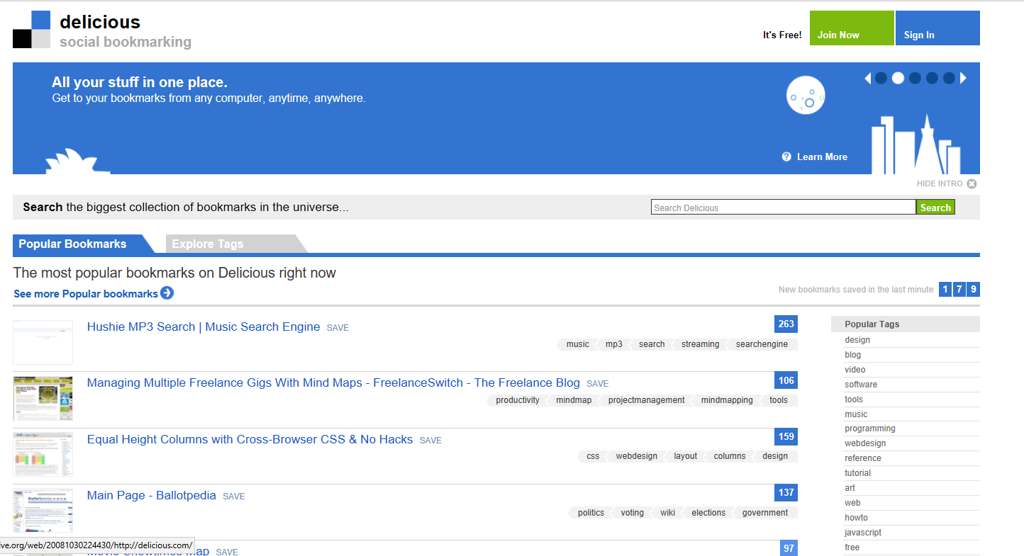
Can Social Bookmarking Improve Web Search
40 M bookmarks
https://web.archive.org/web/20081030224430/http://delicious.com/

Slide 3
Positive Factors

Slide 4
Tags are Overall Accurate
Small user study labeling over 1000 tags as
Relevant
Subjective
Spam
Most tags were deemed relevant (93%) and objective (95%)by users.

Slide 5
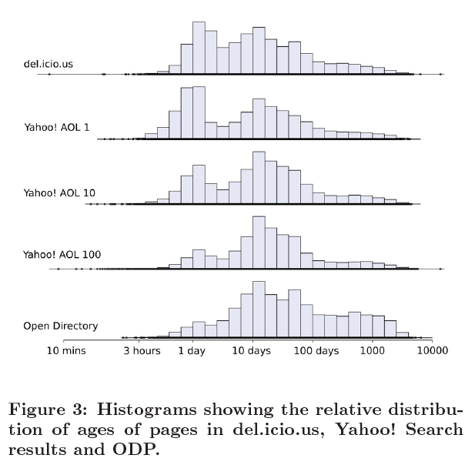
Pages posted to del.icio.us are often recently modified
del.icio.us users post interesting pages that are actively updated or have been recently created.

Slide 6
25% of URLs posted by users are new, unindexed pages
Yahoo! Search didn’t find result, then later found it
del.icio.us can serve as a (small) data source for new web pages and to help crawl ordering.

Slide 7
9% of results for search queries are URLs present in del.icio.us
AOL queries ran through yahoo
9% Resulting URLs found on del.icio.us
del.icio.us URLs are disproportionately common in search results compared to their coverage.

Slide 8
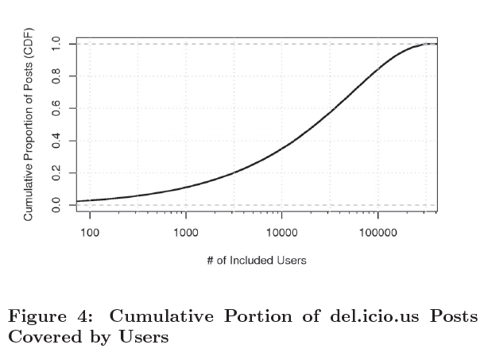
Top 10% of users only account for 56% of posts
del.icio.us is not highly reliant on a relatively small group of users
10% = <30,000 users

Slide 9
30-40% of URLs are newly posted to del.icio.us
approximately one in eight domains posted were not previously in del.icio.us
del.icio.us has relatively little redundancy in page information

Slide 10
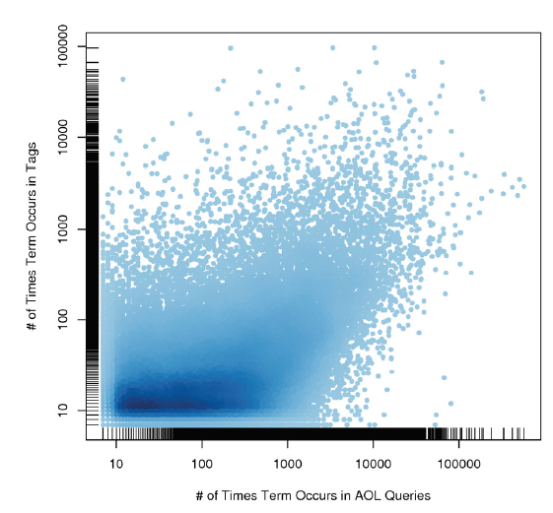
Tags are relevant to popular queries
Popular query terms and tags overlap significantly
del.icio.us may be able to help with finding relevant material for queries

Slide 11
Negative Factors

Slide 12
Posts per day is relatively small
Approximately 120,000 URLs are posted to del.icio.us each day
The number of posts per day about 10% number of blog posts per day

Slide 13
Total posts is relatively small
There are roughly 115 million public posts, coinciding with about 30-50 million unique URLs.
0.1% of the web as a whole.

Slide 14
Tags are obvious
Tags are present in the
page text of 50% of the pages they annotate
titles of 16% of the pages they annotate.
Search engine would not be gaining much new information

Slide 15
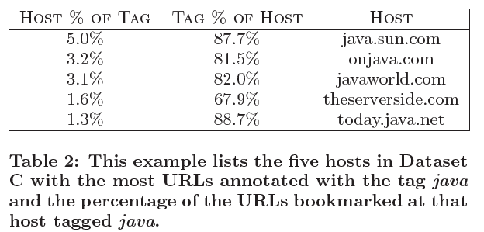
Tags highly correlate to Domains
Domains are often highly correlated with particular tags and vice versa.
Not much information gain that you couldn’t get through other means

Slide 16
Conclusion
Mixed Results
20% of tags don’t appear elsewhere in the page
Lack size and coverage to make significant impact
User Interface features to recommend tags could improve quality of tags

Slide 17
Tag Completion For Image Retrieval
Content Based Image Retrieval
Tag Based Image Retrieval
Tag Completion
Auto fill in missing tags and correct noisy tags for an image

Slide 18
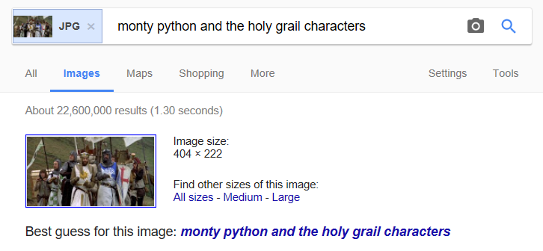
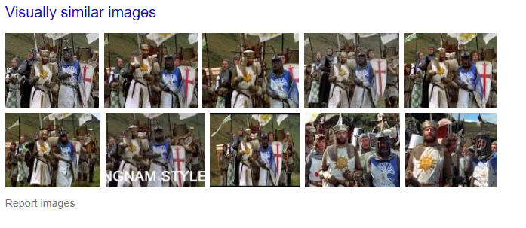

Slide 19
Tag Completion For Image Retrieval
Content Based Image Retrieval
Tag Based Image Retrieval
Tag Completion
Auto fill in missing tags and correct noisy tags for an image

Slide 20
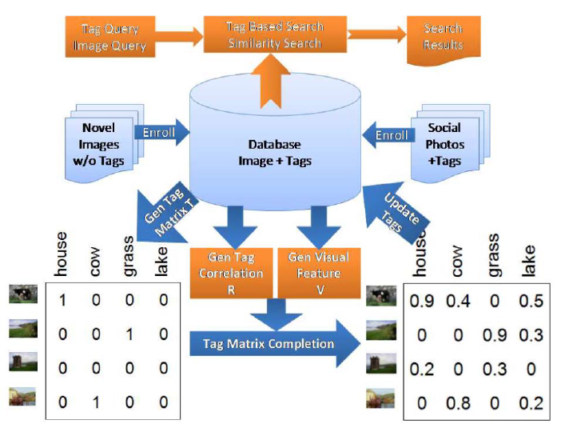

Slide 21
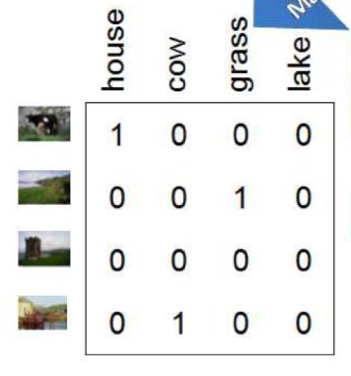
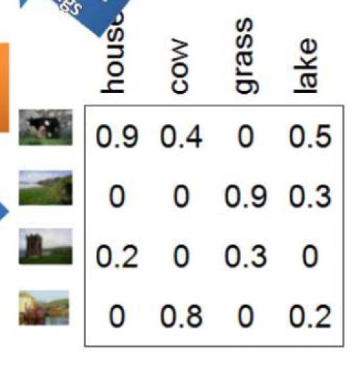

Slide 22
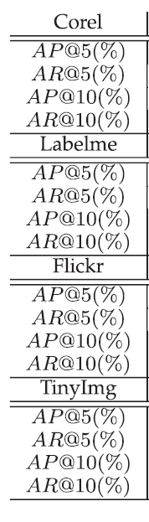
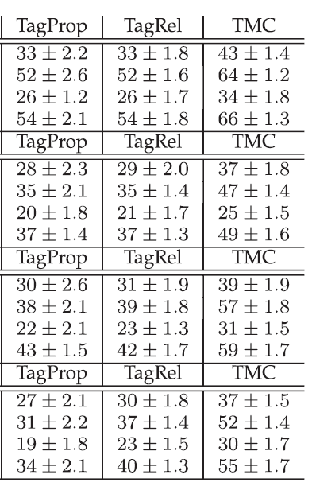
Automatic Tagging accuracy experiment
20 fold cross validation
Run fully tagged test set through TMC
With partially tagged images the precision goes down
TMC still significantly better

Slide 23
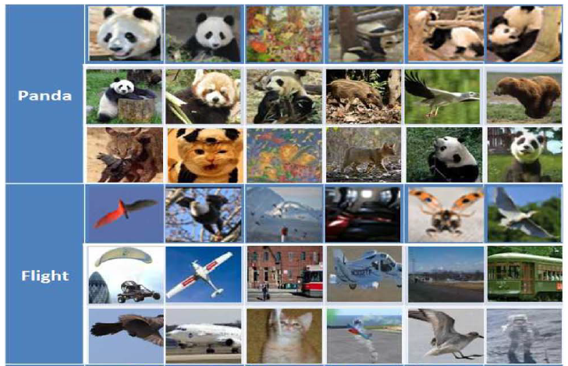
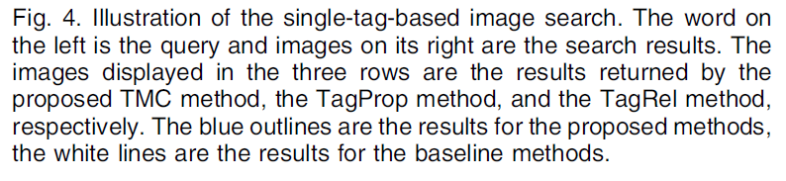
Single Tag Query
Image retrieval experiment

Slide 24
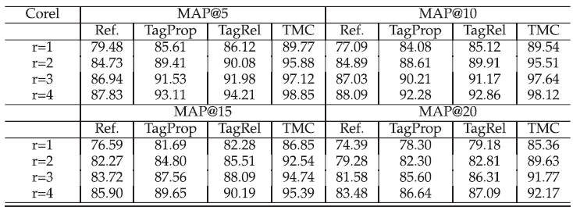
Single Tag Query MAP

Slide 25
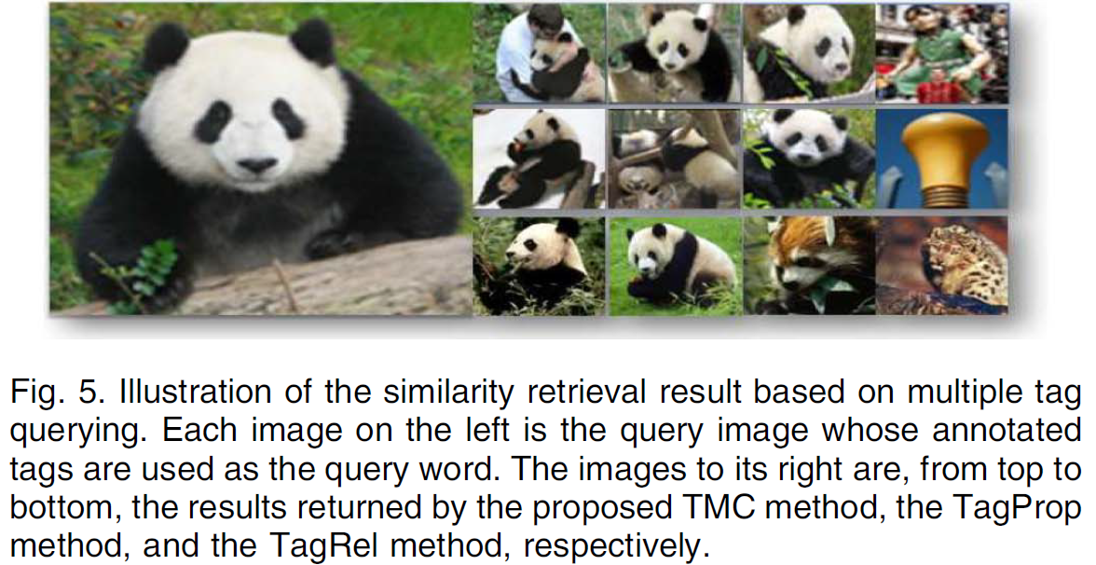
Multiple Tag Query Example

Slide 26
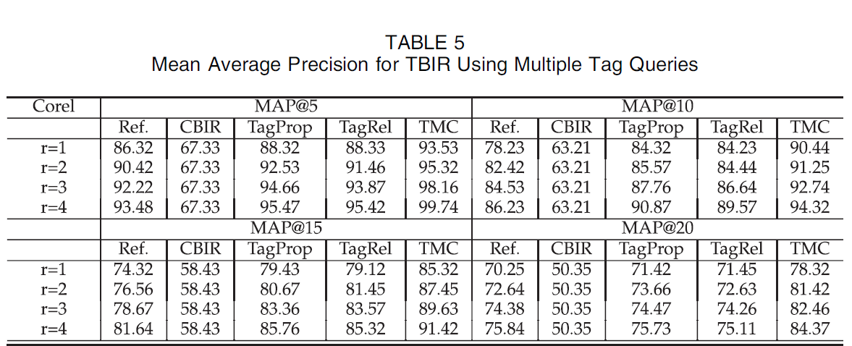
Queries with Multiple Tags MAP

Slide 27
In Review
Tag Completion For Image Retrieval
Can Social Bookmarking Improve Web Search
Tag completion solution combining imperfectly tagged images and image data
Performs significantly better than all other state of the art methods tested against
Bookmarks and tags don’t have enough unique and nonduplicate tags to be useful

