Slide 1
Presented by: Miranda Smith CS 834 Info Retrieval
Topic-Sensitive PageRank.
Taher H. Haveliwala. 2002.
In Proceedings of the 11th international conference on World Wide Web.
TwitterRank: Finding Topic-sensitive Influential Twitterers.
Jianshu Weng, Ee-Peng Lim, Jing Jiang, and Qi He. 2010.
In Proceedings of the third ACM international conference on Web search and data mining.

Slide 2
Review Page Rank
Relative importance of webpages
If page A has a link to page B, then A is saying that B is important
Random Surfer Model
Start at random page
Select, at random, link to follow
Or jump to total new page
PageRank= probability that surfer lands on page

Slide 3

Page Rank
PageRank of a page
Uniform dampening factor
Out degree of a page

Slide 4
Topic Sensitive PageRank
Compute multiple PageRanks for every page
Score for each category
Based on preselected topics
16 top-level categories of Open Directory Project
Train classifier on URLs under each category

Slide 5
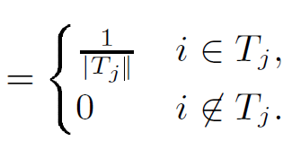
Topic Sensitive PageRank
PageRank of a page
Non-uniform dampening factor
Out degree of a page
T_{j} = set of URLs in category
d

Slide 6
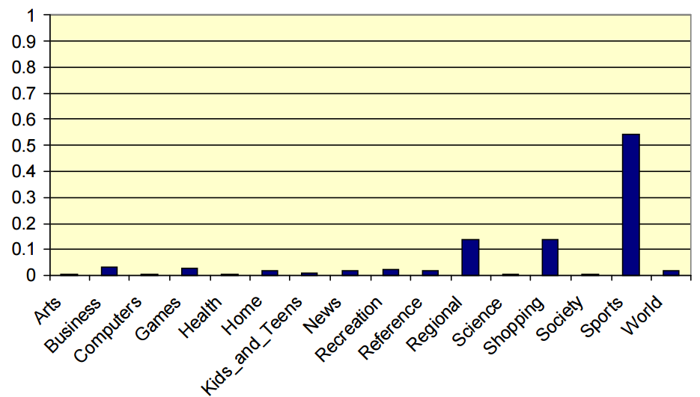
Classify Query
Query = ‘Golf’
Distribution of
topic weights
Topic-Sensitive Page Rank Haveliwala
http://infolab.stanford.edu/~taherh/papers/slides/tspr-slides.pdf

Slide 7
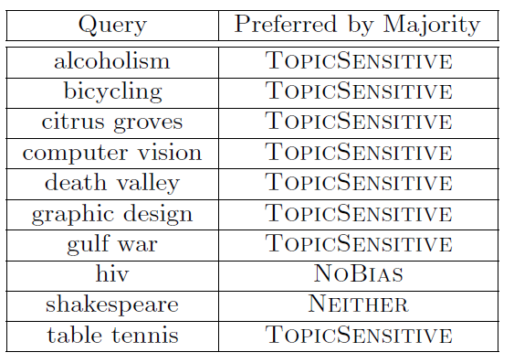
Evaluation
User Study
10 Queries
Asked which results relevant
Asked which ranking system preferred

Slide 8
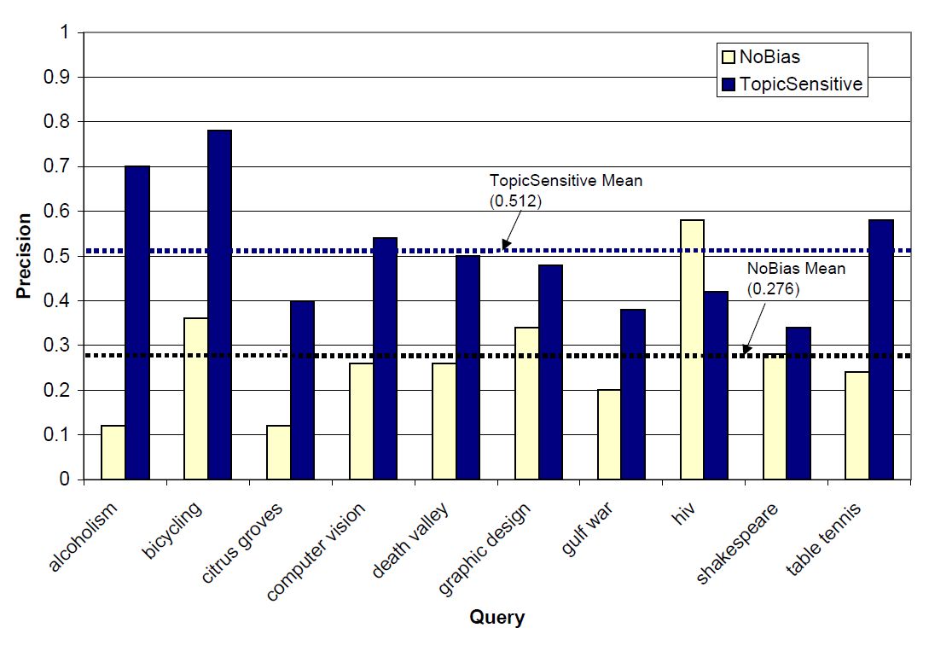

Slide 9
TwitterRank: Finding Topic-sensitive Influential Twitterers
Find influential users of Twitter
Taking into account link structure (followers) and topic similarity

Slide 10
Homophily
Prove Homophily Exists in Twitter
Homophily- people follow other people that have similar interests
Collected all tweets from a user and used a machine learning technique to determine topics
Latent Dirichlet Allocation
Compares words against each other, not against some pre-defined topics
People with following relationships are more similar than those without

Slide 11
TwitterRank
Find influential twitterers
Influential
Number of followers
Ratio between followers and friends
Interaction

Slide 12
How TwitterRank Works
Same as Topic Sensitive Page Rank
Random Surfer
Start at random page (user)
Select link to follow (following)
Or jump to total new page
PageRank(influence) = probability that surfer lands on page
Except the more similar two twitterers are, the higher the transition probability

Slide 13
Results
Evaluate TwitterRank’s ‘recommended to follow’ suggestions against actual following relationships

Slide 14
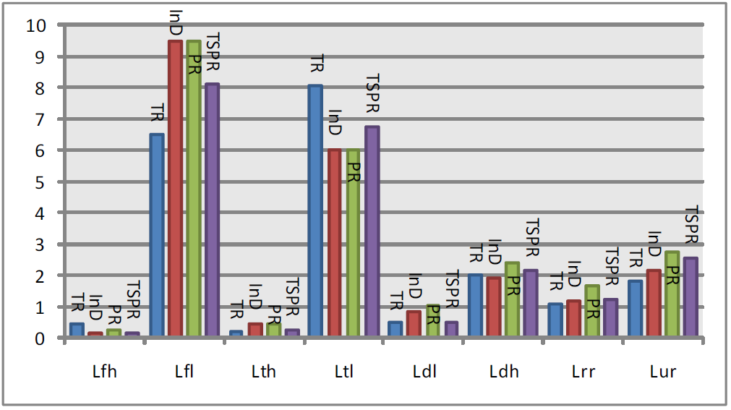
Results
Lower the value, the higher quality
TR- Twitter Rank
InD – in degree
PR- PageRank
TSPR- Topic sensitive Page Rank
Columns are different collections of users
Only significantly better for Lfl (followers low)

Slide 15
Take Away
TSPR
TwitterRank
Topics have influence over PageRank
Set of rankings for each web page
Confirms Homophily in Twitter
Algorithm to find influential Twitterers
Expands TSPR to allow different transition probabilities within a topic

