Slide 1

CROP YIELD PRIEDICTION INDIAN AGRICULTION USING MACHINE LEARNING
Name : K.VINOTHINI
Reg No : CB20S262979
Name : M.MIRANYA
Reg No : CB20S262234
Name : R.KAVIYA
Reg No : CB20S262933
Name : S.SENEGA
Reg No : CB20S262240
Course : III – BCA & CS

Slide 2
CONTENT
ABSTRACT
MODULES
EXISTINGSYSTEM
PROPOSEDSYSTEM
SAMPLE INPUT
SAMPLE OUTPUT
CONCLUSION

Slide 3
ABSTRACT
Agriculture is the backbone of every economy.
Machine learning is used to predict best crop to grow in a particular region based on the parameters like state, district, rainfall and temperature.
By analyzing these parameters optimal crop to grow in particular region will be predicted accurately.
Hence our project will be useful for farmers to predict accurate crop for production.

Slide 4
MODULES
Data collection - Better accuracy in the crop prediction, it is required to tune the parameter of the model.
Data preprocessing - Pre-processing involves adding the missing values, the correct set of data, and extracting the functionality. Data set form is important to the process of analysis.
Feature extraction - The characteristics of soil, crop and weather collected from the pre-treatment process establish the final training data collection.
Regression Random Forest – By using machine learning algorithms to make a more accurate prediction than a single model.Random forest is an ensemble of decision trees.

Slide 5
EXISTING SYSTEM
DESCRIPTION
DRAWBACKS
A vast majority of the Indian farmers believe in depending on their intuition to decide which crop to sow in a particular season.
A combination of Big Data Analytics and Machine Learning can effectively help alleviate this issue.
Based on soil crop will be recommended incase environment condition is not proper then yield will be affected.
Accurate prediction of crop with respect to soil with fertilizer is not possible.

Slide 6
PROPOSED SYSTEM
DESCRIPTION
ADVANTAGE
Proposed system provides crop recommendation based on state, district rainfall and temperature available.
Thus aim of this system is to increase the production of crops by recommending perfect crop and soil according to the region.
Increases accuracy in prediction of crop based on region with temperature and rainfall.
Time consumption is low and fast recovery of data.
Increase yield for farmers.

Slide 7
SYSTEM ARCHITECTURE
Data collection
Preprocessing
Feature extraction
Input query
Train database
RRF
Predict crop

Slide 8
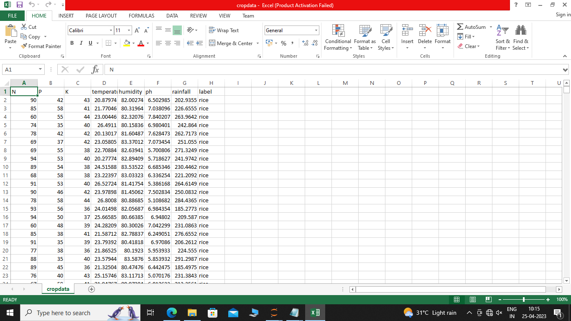
DATASET

Slide 9
SAMPLE INPUT
N P K temperature humidity ph rainfall label
0 90 42 43 20.879744 82.002744 6.502985 202.935536 rice
1 85 58 41 21.770462 80.319644 7.038096 226.655537 rice
2 60 55 44 23.004459 82.320763 7.840207 263.964248 rice
3 74 35 40 26.491096 80.158363 6.980401 242.864034 rice
4 78 42 42 20.130175 81.604873 7.628473 262.717340 rice
(2200, 8)
17600

Slide 10
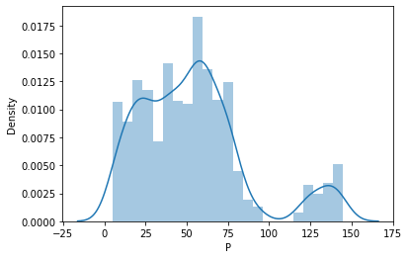
SAMPLE OUTPUT

Slide 11
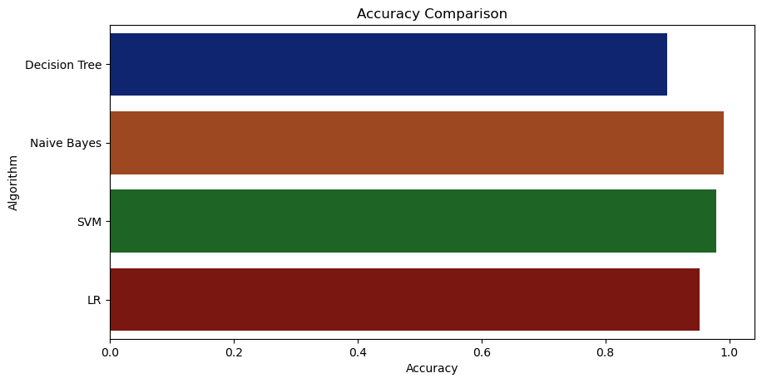

Slide 12
CONCLUSION
The Results shows that we can attain an accurate crop prediction using the Reinforcement Random Forest algorithm.
Reinforcement Random Forest algorithm achieves a largest number of crop models with a lowest models.

Slide 13
THANK YOU

