Slide 1
BFS
Breadth-first search
ARMY

Slide 2
Content of our project
01
02
03
04
Introduction to BFS
Time complexity
Coding part / Implementation
Application of given theory

Slide 3
Introduction to the BFS
Breadth-first search (BFS) is an algorithm for traversing or searching tree or graph data structures. It starts at the tree root, and explores all of the neighbor nodes at the present depth prior to moving on to the nodes at the next depth level
BFS and its application in finding connected components of graphs were invented in 1945 by Konrad Zuse, in his Ph.D. It was reinvented in 1959 by Edward F. Moore, who used it to find the shortest path out of a maze, and later developed by C. Y. Lee into a wire routing algorithm (published 1961)
ARMY

Slide 4
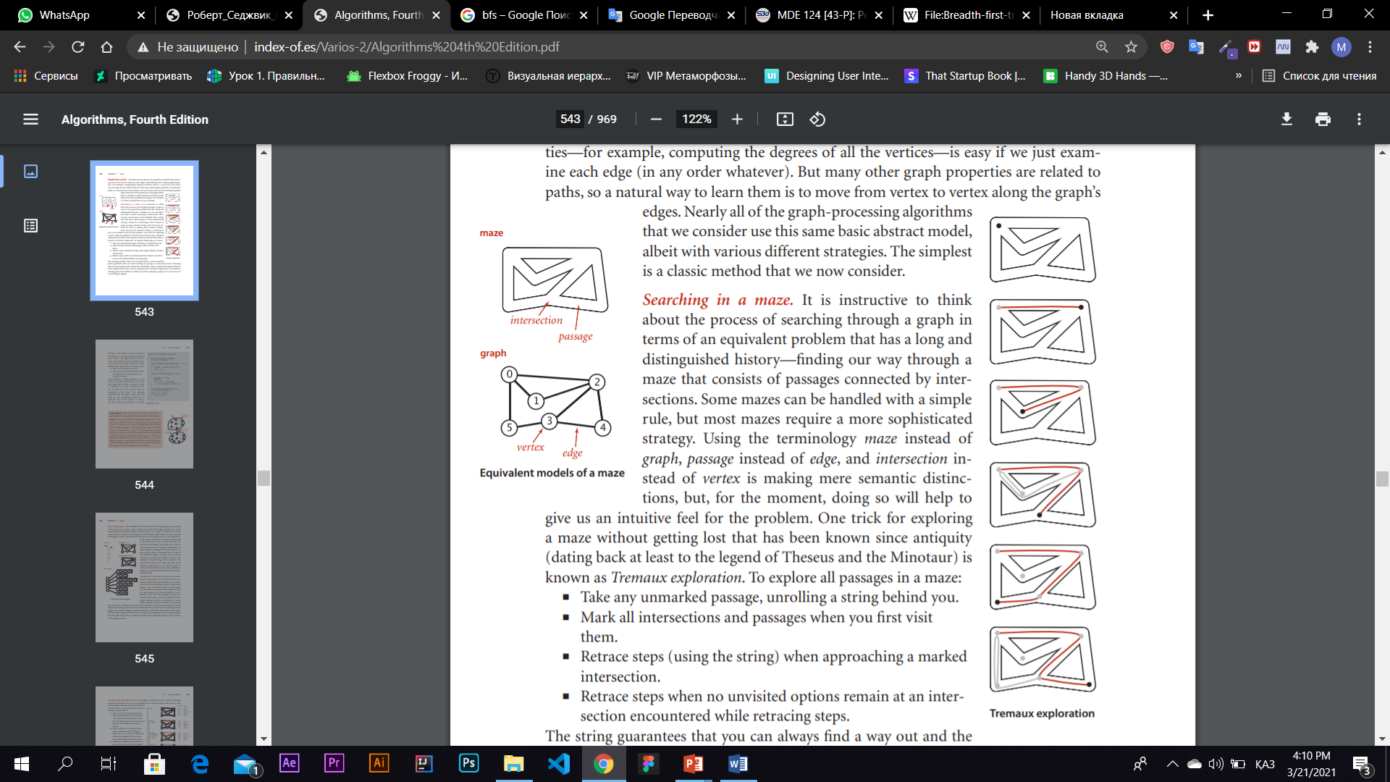
Searching in a maze
It is instructive to think about the process of searching through a graph in terms of an equivalent problem that has a long and
distinguished history—finding our way through a maze that consists of passages connected by intersections. Some mazes can be handled with a simple rule, but most mazes require a more sophisticated strategy. Using the terminology maze instead of
graph, passage instead of edge, and intersection instead of vertex is making mere semantic distinctions, but, for the moment, doing so will help to give us an intuitive feel for the problem.
To explore all passages in a maze:
■ Take any unmarked passage, unrolling a string behind you.
■ Mark all intersections and passages when you first visit
them.
■ Retrace steps (using the string) when approaching a marked
intersection.
■ Retrace steps when no unvisited options remain at an intersection encountered while retracing steps.
The string guarantees that you can always find a way out and the
marks guarantee that you avoid visiting any passage or intersection twice. Knowing
that you have explored the whole maze demands a more complicated argument that is
better approached in the context of graph search. Tremaux exploration is an intuitive
starting point, but it differs in subtle ways from exploring a graph, so we now move on
to searching in graphs.

Slide 5

Time and space complexity
12
11
1
The time complexity can be expressed as {\displaystyle O(|V|+|E|)}O(|V|+|E|), since every vertex and every edge will be explored in the worst case. {\displaystyle |V|}|V| is the number of vertices and {\displaystyle |E|}|E| is the number of edges in the graph. Note that {\displaystyle O(|E|)}O(|E|) may vary between {\displaystyle O(1)}O(1) and {\displaystyle O(|V|^{2})}O(|V|^{2}), depending on how sparse the input graph is.
When the number of vertices in the graph is known ahead of time, and additional data structures are used to determine which vertices have already been added to the queue, the space complexity can be expressed as {\displaystyle O(|V|)}O(|V|), where {\displaystyle |V|}|V| is the number of vertices. This is in addition to the space required for the graph itself, which may vary depending on the graph representation used by an implementation of the algorithm.
When working with graphs that are too large to store explicitly (or infinite), it is more practical to describe the complexity of breadth-first search in different terms: to find the nodes that are at distance d from the start node (measured in number of edge traversals), BFS takes O(bd + 1) time and memory, where b is the "branching factor" of the graph (the average out-degree).
10
2
9
3
8
4
7
5
6

Slide 6



public void BFS()
{
Queue q = new LinkedList();
for (i = 0; i < visited.length; i++)
visited[i] = false;
q.add(0);
while( ! q.isEmpty() )
{
int nextNode;
int i;
nextNode = q.remove();
if ( ! visited[nextNode] )
{
visited[nextNode] = true;
System.out.println("nextNode = " + nextNode );
for ( i = 0; i < NNodes; i++ )
if ( adjMatrix[nextNode][i] > 0 && ! visited[i] )
q.add(i);
}
}
}
Implementing Breadth First Search
Here is a pseudocode implementation of breadth-first search

Slide 7
Creating inspiring ideas and building brands
Broadcasting in Network
In networks, Breadth First Search helps a broadcasted packet to reach all nodes.
Discover All Features
Path Finding
Ford–Fulkerson algorithm
Cycle detection
in undirected graph
Social networks.
In social networks, we can find people at a given distance "n" from a person to level "n".
GPS
We can find all neighboring locations.
In Garbage Collection
Breadth First Search is used in copying garbage collection. Also Cheney's algorithm is used

Slide 8
Thanks for attention

