Slide 1


MARKIT · UNIVERSITY PROJECT
MarkIt
Smart attendance tracking for modern classrooms
A secure, web-based Attendance Management System for universities

Slide 2


THE PEOPLE BEHIND IT
Our Team
Four builders, one system
Mirazul Momen Miraz
Ratul Hassan Joy
Md. Sadakin Sanjid
Bushra Basher
ID: 202411068036
ID: 202411068032
ID: 202411068033
ID: 202411068004
MarkIt · Our Team
2
Notes:
MarkIt was built by a four-person team covering backend architecture, frontend development, database and security, and UI/UX with deployment. Introduce each teammate briefly here.

Slide 3




THE CHALLENGE
The Problem
Paper-based attendance is holding modern classrooms back
Slow to Take
Easy to Forge
Manual roll-call eats 10-15 minutes of every class.
Proxy attendance goes unnoticed on a paper sheet.
Hard to Summarize
Error-Prone Records
Compiling monthly reports means hours of manual tallying.
Lost sheets and illegible handwriting corrupt the record.
MarkIt · The Problem
3
Notes:
Universities still rely on paper attendance sheets, which are slow to take, easy to forge through proxy sign-ins, and painful to summarize into reports. Lost or illegible sheets also make the record unreliable. This is the gap MarkIt was built to close.

Slide 4

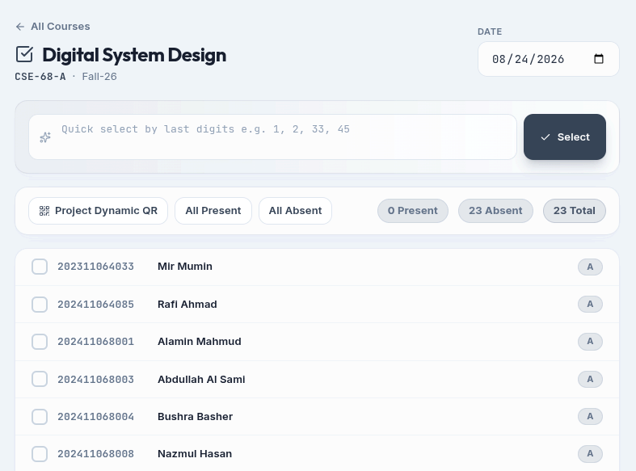



THE SOLUTION
Our Solution
MarkIt replaces paper with a fast, secure digital system
bumarkit.vercel.app/attendance/take
Digital in Seconds
Mark attendance from any device in moments.
Prevents Proxy Attendance
Digital identity matching stops fake sign-ins.
Auto Reports & Analytics
Instant PDF and CSV exports, no manual work.
Works Anywhere
Fully responsive on phone, tablet, or laptop.
MarkIt · Our Solution
4
Notes:
MarkIt lets teachers mark attendance digitally in seconds from any device, while preventing proxy attendance and generating reports automatically. The mockup on the right shows the roll-call view teachers actually use in class, with live present and absent counts.

Slide 5



UNDER THE HOOD
Technology Stack
A modern, production-grade web stack
Frontend
Backend
Deployment
React 18 (Vite)
Node.js + Express 4
Vercel — static frontend
React Router v6
MongoDB + Mongoose 8
Vercel — serverless backend
TanStack Query v5
JSON Web Token auth
MongoDB Atlas cloud DB
Axios + auto token refresh
bcryptjs password hashing
TailwindCSS (glassmorphism)
lucide-react + react-hot-toast
MarkIt · Technology Stack
5
Notes:
MarkIt is built on a modern JavaScript stack end to end. React with Vite and TanStack Query powers a fast, responsive frontend, while Express and MongoDB with Mongoose handle the API and data layer. The whole system deploys serverlessly on Vercel with MongoDB Atlas as the managed database.

Slide 6




HOW IT FITS TOGETHER
System Architecture
Client-server design with clear separation of concerns
React SPA
REST API
MongoDB Atlas
(Client)
(Express)
(Database)
Frontend Layers
API Layers
Managed Cloud DB
Pages
Routes
Fully managed by MongoDB Atlas
Layout components
Middleware
Automatic backups & scaling
UI components
Controllers
Accessed only via Mongoose models
Context providers (Auth, Theme)
Models
API service layer
MarkIt · System Architecture
6
Notes:
MarkIt follows a classic client-server architecture: the React single-page app talks to a REST API over HTTPS, and the API talks to MongoDB Atlas. The frontend separates pages, layout, UI components, and context providers, while the API follows an MVC-style layering of routes, middleware, controllers, and models.

Slide 7




SECURE BY DESIGN
Authentication Flow
Dual-token pattern keeps sessions seamless and secure
1. Sign In
2. Tokens Issued
3. 401 Intercepted
4. Silent Retry
User submits email + password credentials.
15-min access token + 7-day refresh token, both httpOnly cookies.
Axios interceptor catches expiry, queues requests.
Token refreshes & rotates; request retries automatically.
MarkIt · Authentication Flow
7
Notes:
Authentication uses a dual-token pattern: a short-lived 15-minute access token and a long-lived 7-day refresh token, both delivered as httpOnly cookies so JavaScript can never touch them. When the access token expires, the Axios interceptor transparently refreshes it and retries the request, so users never notice. Refresh tokens are only ever stored as bcrypt hashes and rotate on every use.

Slide 8








DEFENSE IN DEPTH
Security Features
Nine layers of protection, built in from the ground up
Bcrypt Hashing
httpOnly Cookies
Token Rotation
Cost factor 12 — never stored in plain text
SameSite, immune to JS/XSS token theft
Refresh tokens rotate with reuse detection
Brute-Force Lockout
Rate Limiting
Helmet + CORS
15-min lock after 5 failed attempts
Middleware applied on all API routes
Security headers, trusted origins only
Input Sanitization
Role-Based Access
Validated Uploads
Validation, NoSQL injection & HPP protection
Admin vs teacher enforced at route level
Profile images checked, sized & compressed
MarkIt · Security Features
8
Notes:
Security is layered throughout the stack: bcrypt password hashing, httpOnly SameSite cookies, refresh token rotation with reuse detection, brute-force lockouts, rate limiting, Helmet security headers, strict CORS, thorough input sanitization against NoSQL injection, role-based access control, and validated profile image uploads.

Slide 9




CORE FEATURE
Student Roster Management
Enroll, organize, and maintain the official student record
Flexible Enrollment
Instant Search
Add students one at a time, or bulk-import up to 500 at once from a spreadsheet.
Find any student instantly by name or roll ID.
Cascading Filters
Safe Editing
Narrow the roster by department, then batch, then section.
Edit records or bulk-delete, with confirmation dialogs on every destructive action.
MarkIt · Student Roster Management
9
Notes:
The roster module is where admins set up the official student record: enrolling students individually or importing up to 500 at once, searching instantly by name or roll ID, and filtering with cascading department, batch, and section dropdowns. Every destructive action, like bulk delete, requires confirmation.

Slide 10




CORE FEATURE
Taking Attendance
A fast roll-call, with a shortcut for large classes
Quick Select
QR Code Scanning
Students scan QR to make attendance
Highlight Feature
Teacher types: "1, 2, 33, 45"
One-Tap Toggles
Mark each student present or absent with a single tap.
The system intelligently matches last digits to full student IDs using batch-aware regex patterns.
Live Counters
"All Present" / "All Absent" shortcuts plus a running total.
30 students
Existing sessions can be edited and resubmitted safely.
marked in seconds
MarkIt · Taking Attendance
10
Notes:
Taking attendance is a simple roll-call list with one-tap present and absent toggles, live counters, and shortcuts to mark everyone at once. The standout feature is Quick Select: a teacher can type just the last digits of roll numbers and the system intelligently matches them to full student IDs, turning a 30-student roll call into a few seconds of work.

Slide 11

CORE FEATURE
Dynamic QR + Biometric Attendance
From projection to a verified check-in on the teacher's screen — in seconds, and impossible to fake
MarkIt · Dynamic QR + Biometric Attendance
11

Slide 12
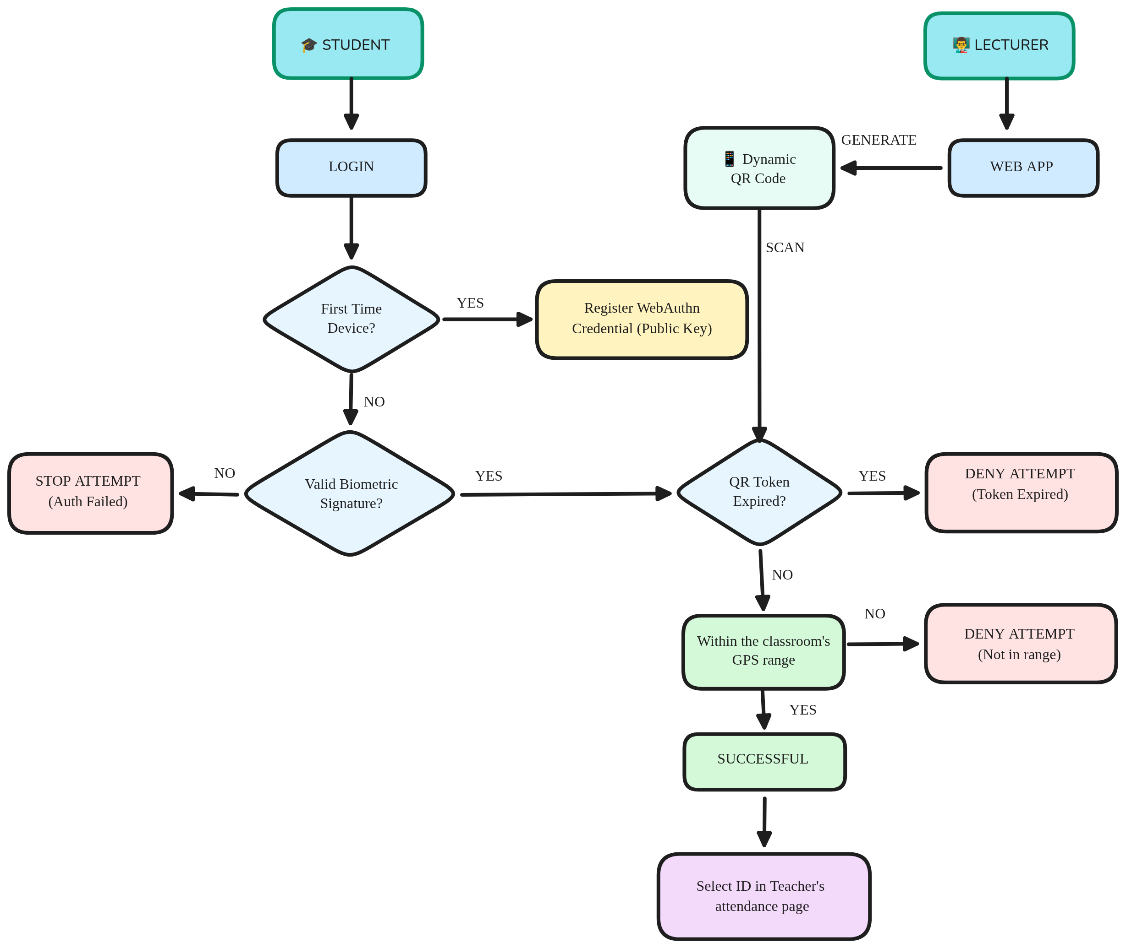
CORE FEATURE
Dynamic QR + Biometric Attendance
From projection to a verified check-in on the teacher's screen — in seconds, and impossible to fake
Cheat-proof by design
• Tokens expire in ~30 seconds — screenshots are worthless to absent friends
• Every credential is cryptographically bound to one student's device
• Biometric data never leaves the phone — only a signed proof reaches the server
Teacher stays in command
• Verified students auto-tick on the projected roster in real time
• Manual selection stays available side-by-side as a fallback
• Attendance is written to the database only after teacher review & submit
MarkIt · Dynamic QR + Biometric Attendance
11

Slide 13






Statistical Data
Online Attendance System — anti-spoofing & scan-verification metrics
98.6%
1.4%
2.1s
Biometric verifications succeed
Biometric attempts denied
Avg. scan-to-tick latency
Face ID / fingerprint, signed on-device
Failed challenge stops attempt, no DB write
Within the 3s teacher-screen polling window
312
96
~30s
Expired-token scans rejected
New device registrations
Token acceptance window
Per 30 days — screenshot / replay attempts blocked
Per 30 days — public key only, first-time use
Signed challenge must land inside this window
Illustrative sample metrics shaped around the system's actual QR rotation, polling, and token-window settings — replace with real telemetry once logging is wired up.

Slide 14



CORE FEATURE
Reports, History & Analytics
Every session recorded, summarized, and export-ready
Full Attendance History
Interactive Summaries
One-Click Exports
Browse every past session by class or by day.
Visual summary views highlight trends at a glance.
Download PDF (via PDFKit) or CSV anytime.
Zero
Anytime
Private
paperwork for monthly reports
export-ready PDF & CSV
personal rosters for teachers
MarkIt · Reports, History & Analytics
12
Notes:
Teachers and admins can browse the full attendance history by class or day, view interactive summaries, and export everything to PDF or CSV with one click. Teachers can also keep private, course-specific rosters separate from the official university list, which stays view-only for admins.

Slide 15

ACCESS CONTROL
Roles & Permissions
Three roles, cleanly separated by responsibility
Admin
Teacher
Student
University-wide dashboards & stats
Section-only dashboard & counts
Personal attendance dashboard
Manage students, sessions & terms
View assigned sections only
Views own enrolled courses only
Assign teachers to sections
Take & resubmit attendance
Cannot mark attendance
Cannot alter attendance records
Mark, edit & export attendance
Changes own password & photo
View reports across all sections
View reports for own sections
Read-only self-service access
MarkIt · Roles & Permissions
13
Notes:
MarkIt separates duties cleanly across three roles. Admins manage the university-wide roster, sessions, and teacher assignments but cannot alter attendance records. Teachers take attendance only for their assigned sections. Students are strictly read-only: they view their own dashboard, courses, and history, manage their own password and photo, and can never mark or edit attendance.

Slide 16


WHY IT MATTERS
Benefits for Teachers
What changes on an ordinary teaching day
With Paper
With MarkIt
10-15 minutes per class
Seconds, with Quick Select
Laptop or paper sheet required
Works on a phone during class
Manual monthly report compilation
Export-ready PDF & CSV anytime
Proxy attendance risk
Digital identity matching prevents it
MarkIt · Benefits for Teachers
14
Notes:
For teachers day to day, the difference is stark: a 10-15 minute paper roll-call becomes a few seconds with Quick Select, monthly reports go from manual compilation to an instant export, and proxy attendance is prevented rather than just hoped against.

Slide 17

CLOUD INFRASTRUCTURE
Deployment & Scalability
Serverless by design — no infrastructure to manage
Frontend
Backend
Database
Static React build served via Vercel's global CDN edge network.
Express API runs as Vercel serverless functions — scales automatically.
MongoDB Atlas — managed, auto-scaling cloud database with backups.
MarkIt · Deployment & Scalability
15
Notes:
MarkIt ships with a fully serverless deployment: the React frontend is a static build served from Vercel's edge network, the Express backend runs as Vercel serverless functions that scale automatically with demand, and MongoDB Atlas provides a managed, auto-scaling database with built-in backups. There is no server to patch or provision.

Slide 18




WHAT'S NEXT
Future Enhancements
Where MarkIt goes from here
SMS / Email Alerts
Biometric Integration
Native Mobile App
Trend Analytics
Automatic absence notifications to guardians.
Fingerprint verification for high-stakes exams.
Dedicated iOS and Android companion apps.
Dashboards surfacing attendance patterns over time.
MarkIt · Future Enhancements
16
Notes:
Looking ahead, the roadmap includes QR-code self check-in, automatic SMS and email absence alerts for guardians, biometric verification for high-stakes exams, dedicated mobile apps, and richer analytics dashboards that surface attendance trends over a term.

Slide 19
SOURCES
References
1. Student Attendance System Using QR Code:
https://www.researchgate.net/publication/370480492_Fraud_Mitigation_in_Attendance_Monitoring_Systems_using_Dynamic_QR_Code_Geofencing_and_IMEI_Technologies
2. https://www.academia.edu/116222825/Fraud_Mitigation_in_Attendance_Monitoring_Systems_using_Dynamic_QR_Code_Geofencing_and_IMEI_Technologies
3. https://www.researchgate.net/publication/398552187_QR_Code-Based_Attendance_Systems_in_Education_A_Systematic_Literature_Review_on_Data_Accuracy_and_Sustainable_School_Management
4. https://www.scribd.com/document/1068356136/A-dynamic-geofencing-and-dwell-time-validation-system-for-secure-attendance-tracking-in-higher-education-methodological-proposal
5. https://research-portal.uea.ac.uk/en/publications/fraud-mitigation-in-attendance-monitoring-systems-using-dynamic-q/
6. https://www.ijasi.org/index.php/ijasi/article/view/138
7. https://proceeding.raskhamedia.or.id/index.php/cessmuds/article/download/14/13
8. http://rsisinternational.org/journals/ijriss/uploads/vol10-iss1-pg7855-7867-202602_pdf.pdf
9. https://journal.cattleyadf.org/index.php/jatilima/article/download/2281/1281/8642
10. https://www.scribd.com/document/853501940/QR-Code-Based-Student-Attendance-System-Rushi
11. https://papers.ssrn.com/sol3/Delivery.cfm/6614320.pdf?abstractid=6614320&mirid=1
12. https://www.ijert.org/attendify-a-cloud-based-multi-factor-attendance-system-using-qr-code-facial-recognition-and-geofencing-ijertv15is040611
MarkIt · References
18

Slide 20


Thank You
Questions & Discussion
MarkIt · Smart attendance tracking for modern classrooms
MarkIt · Thank You
19
Notes:
Thank the audience and open the floor for questions. Be ready to speak to the tech stack choices, the security model, and the Quick Select feature, since those tend to draw the most questions.

