Slide 1
SQL
Presented By: Mirazul Islam Java Instructor, EU

Slide 2
SQL Introduction
Standard language for querying and manipulating data
Structured Query Language
Data Definition Language (DDL)
Create/alter/delete tables and their attributes
Data Manipulation Language (DML)
Query one or more tables – discussed next !
Insert/delete/modify tuples in tables

Slide 3
Table name
Attribute names
Product
PName | Price | Category | Manufacturer
Gizmo | $19.99 | Gadgets | GizmoWorks
Powergizmo | $29.99 | Gadgets | GizmoWorks
SingleTouch | $149.99 | Photography | Canon
MultiTouch | $203.99 | Household | Hitachi
Tuples or rows

Slide 4
SQL Query
SELECT <attributes>
FROM <one or more relations>
WHERE <conditions>

Slide 5
Simple SQL Query
Product
PName | Price | Category | Manufacturer
Gizmo | $19.99 | Gadgets | GizmoWorks
Powergizmo | $29.99 | Gadgets | GizmoWorks
SingleTouch | $149.99 | Photography | Canon
MultiTouch | $203.99 | Household | Hitachi
SELECT * FROM Product WHERE category=‘Gadgets’
PName | Price | Category | Manufacturer
Gizmo | $19.99 | Gadgets | GizmoWorks
Powergizmo | $29.99 | Gadgets | GizmoWorks
“selection”

Slide 6
The LIKE operator
s LIKE p: pattern matching on strings
p may contain two special symbols:
% = any sequence of characters
_ = any single character
SELECT * FROM Products WHERE PName LIKE ‘%gizmo%’

Slide 7
Eliminating Duplicates
Category
Gadgets
Photography
Household
SELECT DISTINCT category
FROM Product
Compare to:
Category
Gadgets
Gadgets
Photography
Household
SELECT category
FROM Product

Slide 8
Ordering the Results
SELECT pname, price, manufacturer
FROM Product
WHERE category=‘gizmo’ AND price > 50
ORDER BY price, pname
Ties are broken by the second attribute on the ORDER BY list, etc.
Ordering is ascending, unless you specify the DESC keyword.

Slide 9
PName | Price | Category | Manufacturer
Gizmo | $19.99 | Gadgets | GizmoWorks
Powergizmo | $29.99 | Gadgets | GizmoWorks
SingleTouch | $149.99 | Photography | Canon
MultiTouch | $203.99 | Household | Hitachi
SELECT DISTINCT category
FROM Product
ORDER BY category
?
SELECT Category
FROM Product
ORDER BY PName
?
?
SELECT DISTINCT category
FROM Product
ORDER BY PName

Slide 10
Keys and Foreign Keys
Company
CName | StockPrice | Country
GizmoWorks | 25 | USA
Canon | 65 | Japan
Hitachi | 15 | Japan
Key
Product
PName | Price | Category | Manufacturer
Gizmo | $19.99 | Gadgets | GizmoWorks
Powergizmo | $29.99 | Gadgets | GizmoWorks
SingleTouch | $149.99 | Photography | Canon
MultiTouch | $203.99 | Household | Hitachi
Foreign key

Slide 11
Aggregation
SELECT avg(price)
FROM Product
WHERE maker=“Toyota”
SELECT count(*)
FROM Product
WHERE year > 1995
SQL supports several aggregation operations:
sum, count, min, max, avg
Except count, all aggregations apply to a single attribute

Slide 12
Aggregation: Count
COUNT applies to duplicates, unless otherwise stated:
SELECT Count(category)
FROM Product
WHERE year > 1995
same as Count(*)
We probably want:
SELECT Count(DISTINCT category)
FROM Product
WHERE year > 1995

Slide 13
Simple Aggregations
Purchase
Product | Date | Price | Quantity
Bagel | 10/21 | 1 | 20
Banana | 10/3 | 0.5 | 10
Banana | 10/10 | 1 | 10
Bagel | 10/25 | 1.50 | 20
SELECT Sum(price * quantity)
FROM Purchase
WHERE product = ‘bagel’
50 (= 20+30)

Slide 14
Grouping and Aggregation
Purchase(product, date, price, quantity)
Find total sales after 10/1/2005 per product.
SELECT product, Sum(price*quantity) AS TotalSales
FROM Purchase
WHERE date > ‘10/1/2005’
GROUP BY product
Let’s see what this means…

Slide 15
HAVING Clause
Same query, except that we consider only products that had
at least 100 buyers.
SELECT product, Sum(price * quantity)
FROM Purchase
WHERE date > ‘10/1/2005’
GROUP BY product
HAVING Sum(quantity) > 30
HAVING clause contains conditions on aggregates.

Slide 16
General form of Grouping and Aggregation
SELECT S
FROM R₁,…,R_{n}
WHERE C1
GROUP BY a₁,…,a_{k}
HAVING C2
S = may contain attributes a₁,…,a_{k} and/or any aggregates but NO OTHER ATTRIBUTES
C1 = is any condition on the attributes in R₁,…,R_{n}
C2 = is any condition on aggregate expressions

Slide 17
Joins
Product
Company
PName | Price | Category | Manufacturer
Gizmo | $19.99 | Gadgets | GizmoWorks
Powergizmo | $29.99 | Gadgets | GizmoWorks
SingleTouch | $149.99 | Photography | Canon
MultiTouch | $203.99 | Household | Hitachi
Cname | StockPrice | Country
GizmoWorks | 25 | USA
Canon | 65 | Japan
Hitachi | 15 | Japan
SELECT PName, Price FROM Product, Company WHERE Manufacturer=CName AND Country=‘Japan’ AND Price <= 200
PName | Price
SingleTouch | $149.99

Slide 18
Joins
Product (pname, price, category, manufacturer)
Company (cname, stockPrice, country)
Find all products under $200 manufactured in Japan; return their names and prices.
Join between Product and Company
SELECT PName, Price FROM Product, Company WHERE Manufacturer=CName AND Country=‘Japan’ AND Price <= 200

Slide 19
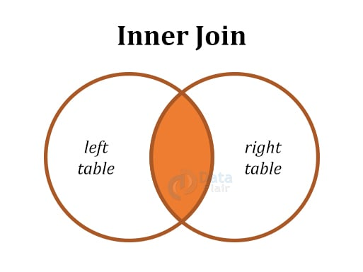
SELECT *
FROM tableName1
INNER JOIN tableName2
ON tableName1.matchingColumn = tableName2.matchingColumn ;

Slide 20
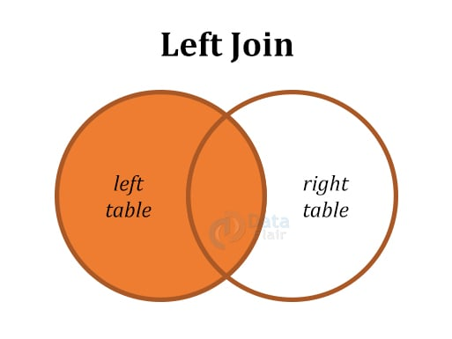
SELECT *
FROM DataFlair_emp1
LEFT JOIN DataFlair_emp2
ON dataflair_emp1.emp_id = dataflair_emp2.emp_id ;

Slide 21
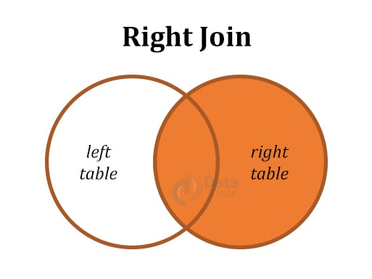
SELECT *
FROM tableName1
RIGHT JOIN tableName2
ON tableName1.matchingColumn = tableName2.matchingColumn ;

Slide 22
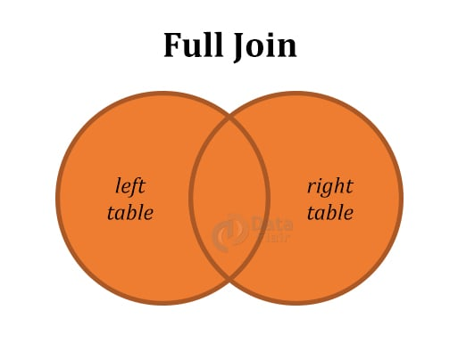
SELECT *
FROM tableName1
RIGHT JOIN tableName2
ON tableName1.matchingColumn = tableName2.matchingColumn ;

