Slide 1
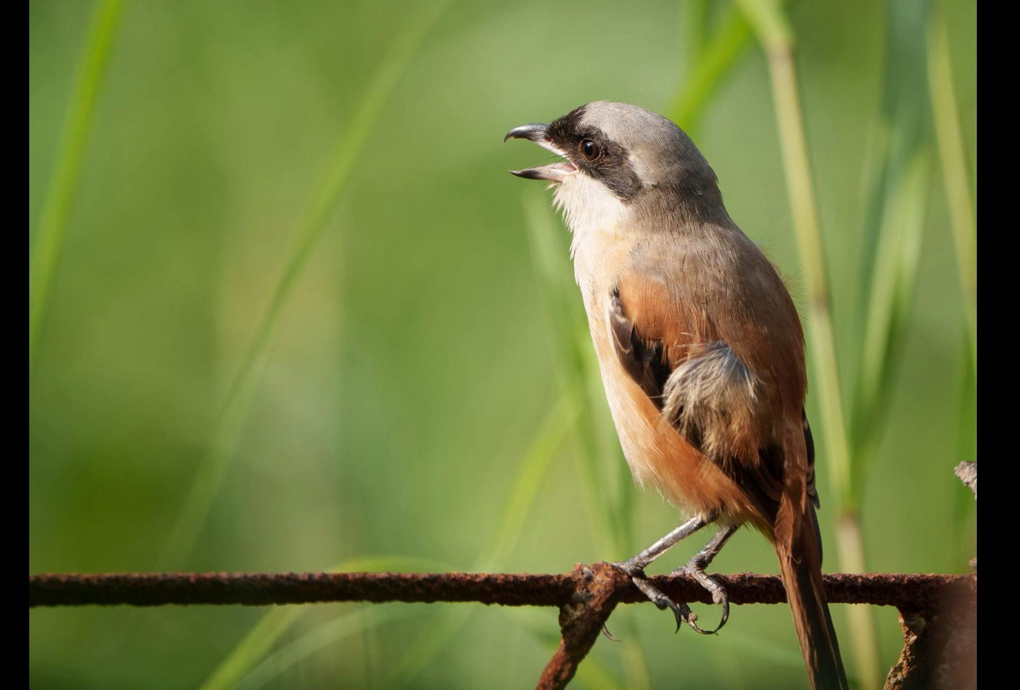
Real Time Bird Sound Classifier
Team--AI Alligator
Members--Haizhou Yu,
Kun Lu,
Haochen Liu

Slide 2
Real-Time Bird Sound Classifier
Problem: Identifying bird sounds is crucial for understanding nature and for hobbies, but it remains a time-consuming and difficult task for educators, hobbyists, and conservation groups who lack specialized skills or resources.
Goal: By embedding an on-device neural network which can be adaptable for bird song recognition directly from environmental audio. AI Alligator aims to demonstrate the system which enables continuous, low-power bird detection without cloud connectivity.
Platform: TinyML on Arduino – runs neural network inference locally; CPP.

Slide 3
System Design / Method
• Hardware: Arduino TinyML Kit + built‑in microphone
• Software: C++ inference + TinyML model (TensorFlow Lite)
• Workflow:
1. Collect dataset (Kaggle / existing)
2. Train and quantize TinyNN model
3. Deploy to Arduino for on‑device inference
• Performance Targets: Accuracy ≥ 95%, Latency < 1s

Slide 4
Deliverables / Schedule / Roles
Expected deliverables: Working demo + GitHub + documentation + final report
Team Roles:
Haizhou Yu – Team Lead / Testing/ Coordination
Kun Lu – Hardware Integration & Setup
Haochen Liu – Model Training & Inference
Timeline:
Week 2: Proposal
Week 4: Midterm presentation
Week 6: Prototype integration
Final week: Demo

