Slide 1
AI Alligators – Bird Sound Recognition
Presented by Kelvin Kun Lu, Haochen Liu, Haizhou Yu

Slide 2
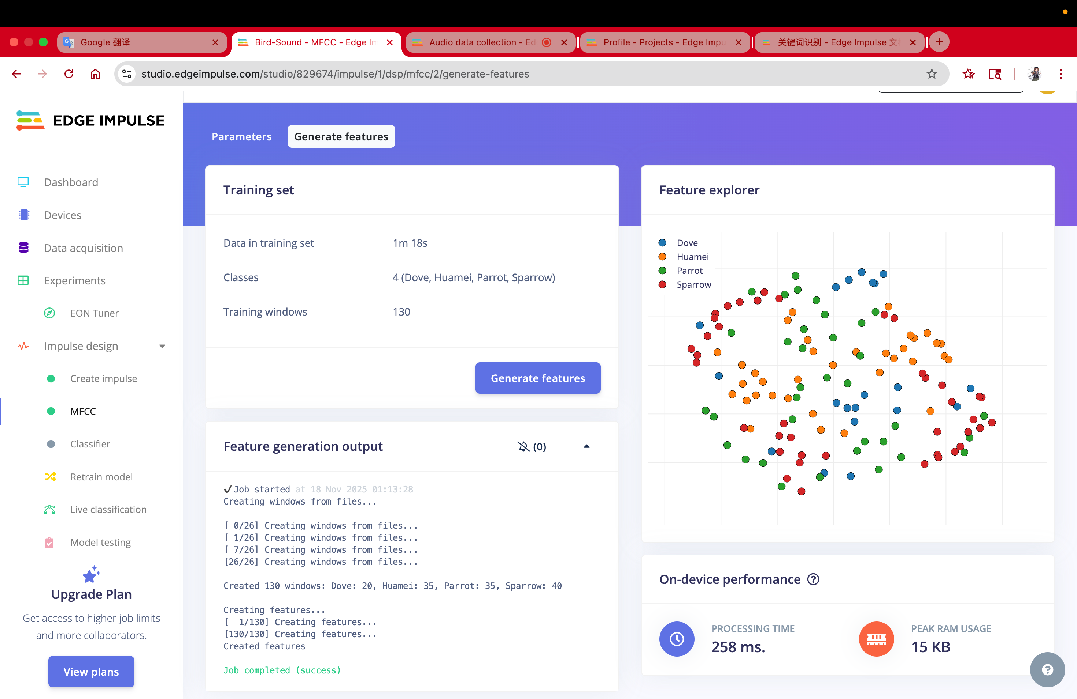
Edge Impluse
Existing Dataset from Hugging face, combined with our own samples

Slide 3
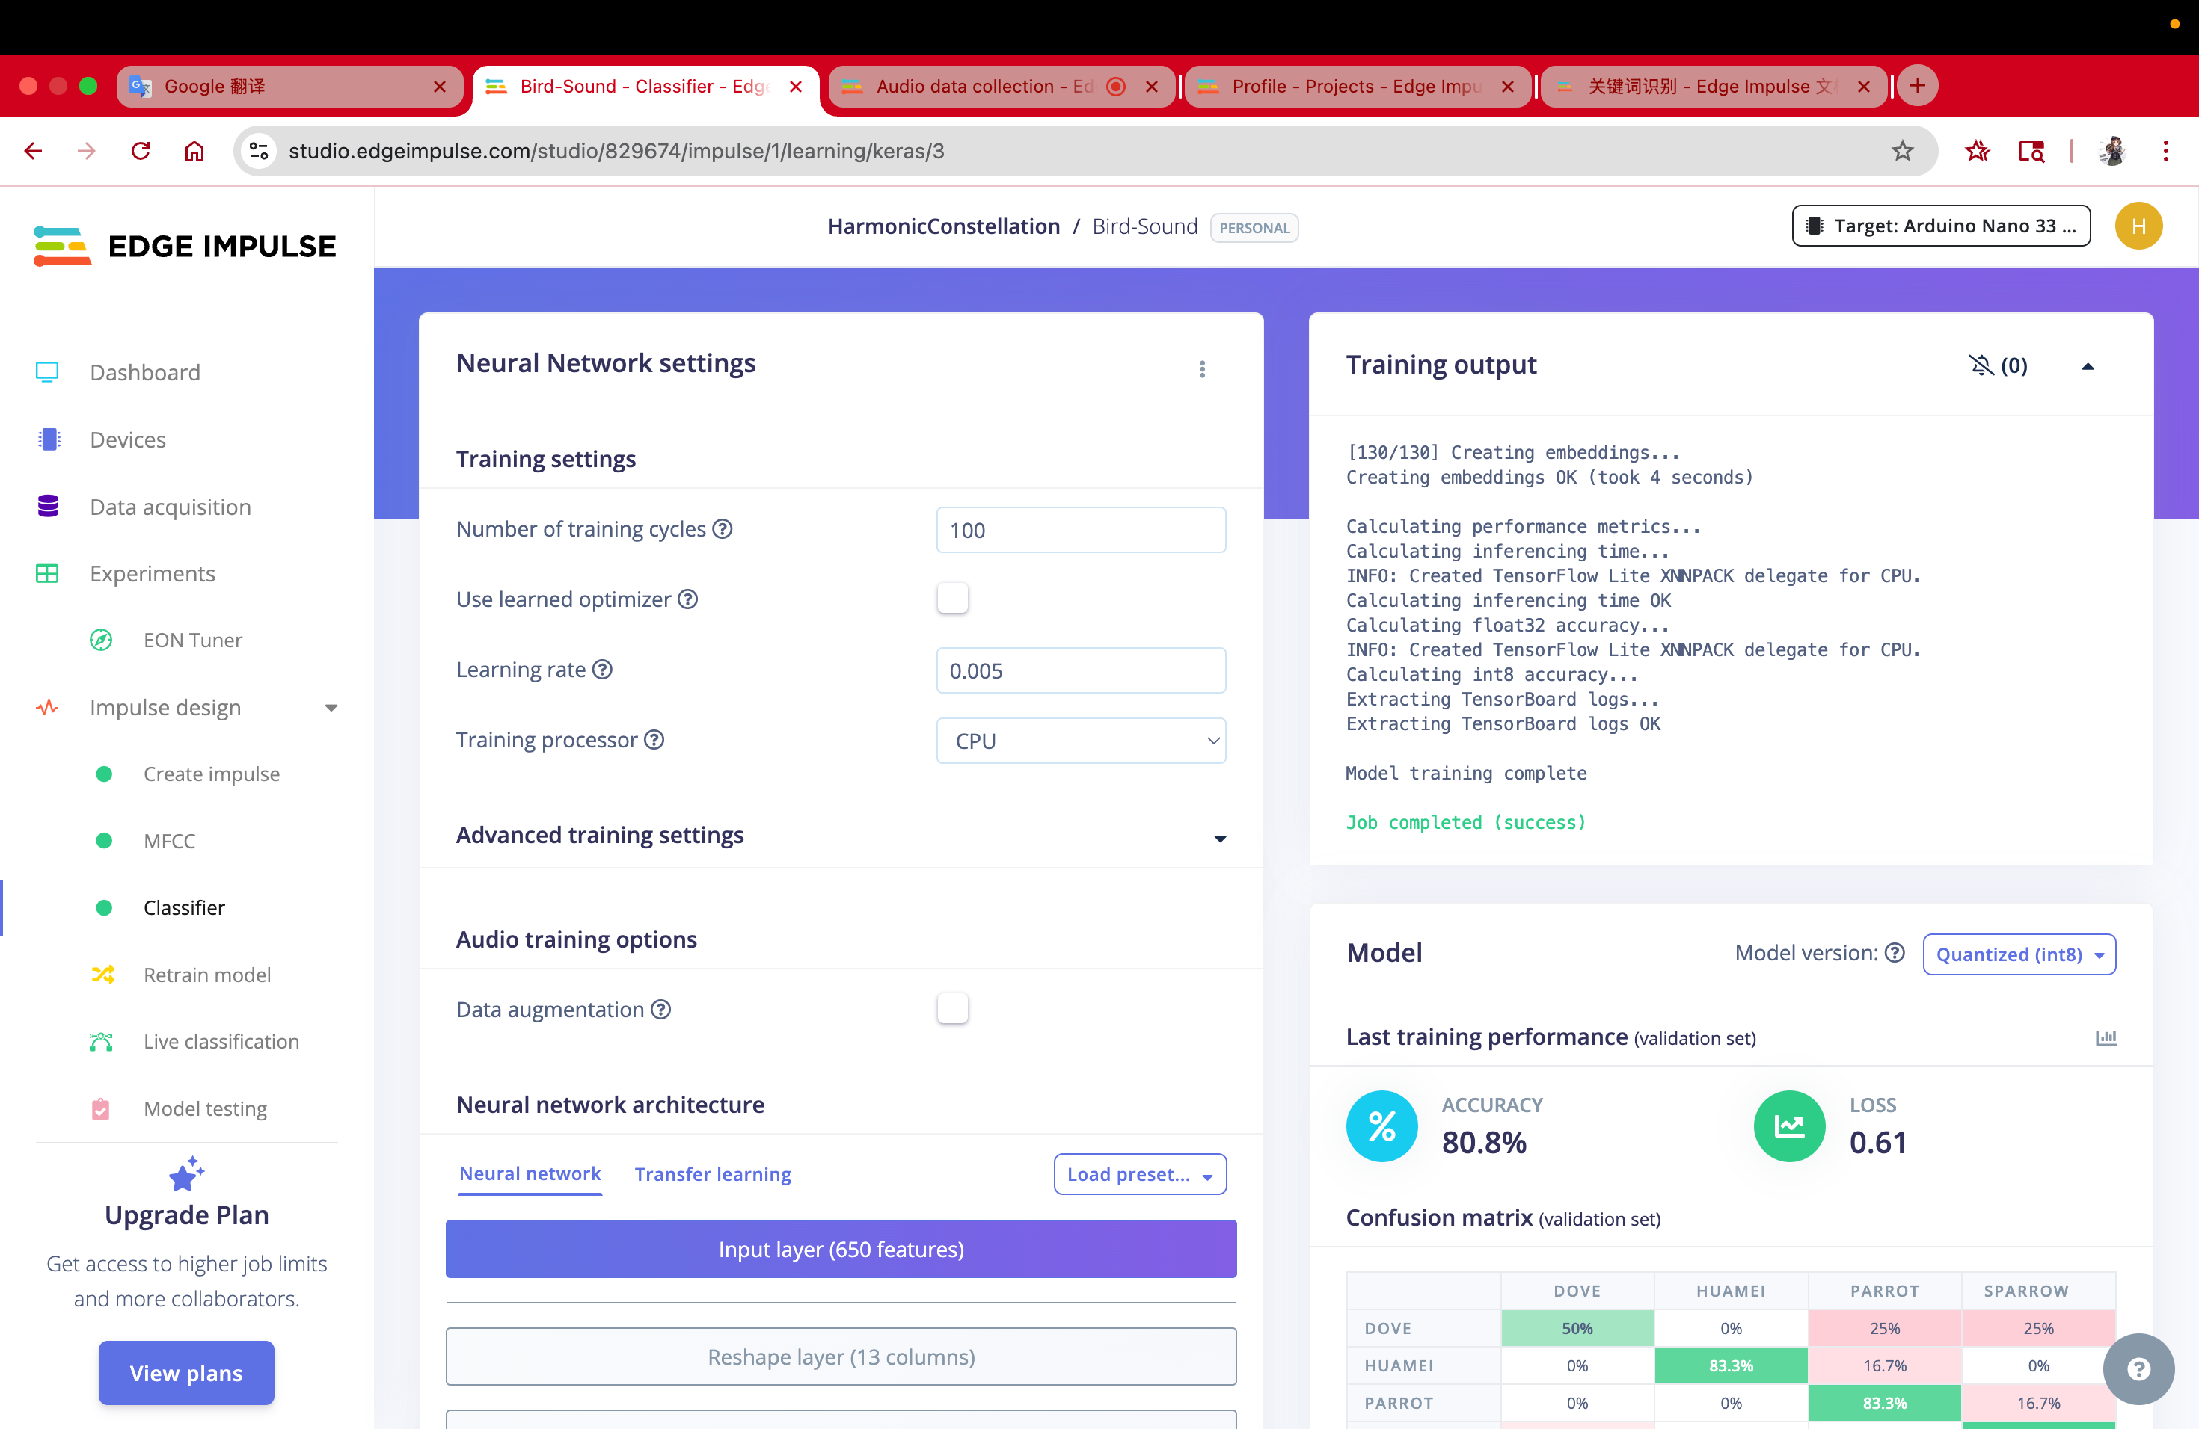
Preliminary testing and training
0.61 Training Loss
80.8% accuracy
Not Ideal, but normal for this stage
Next step, optimize training data

Slide 4
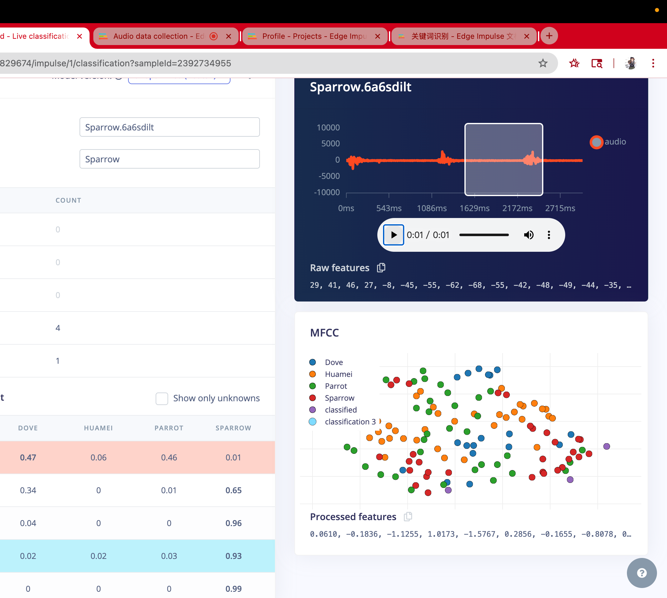
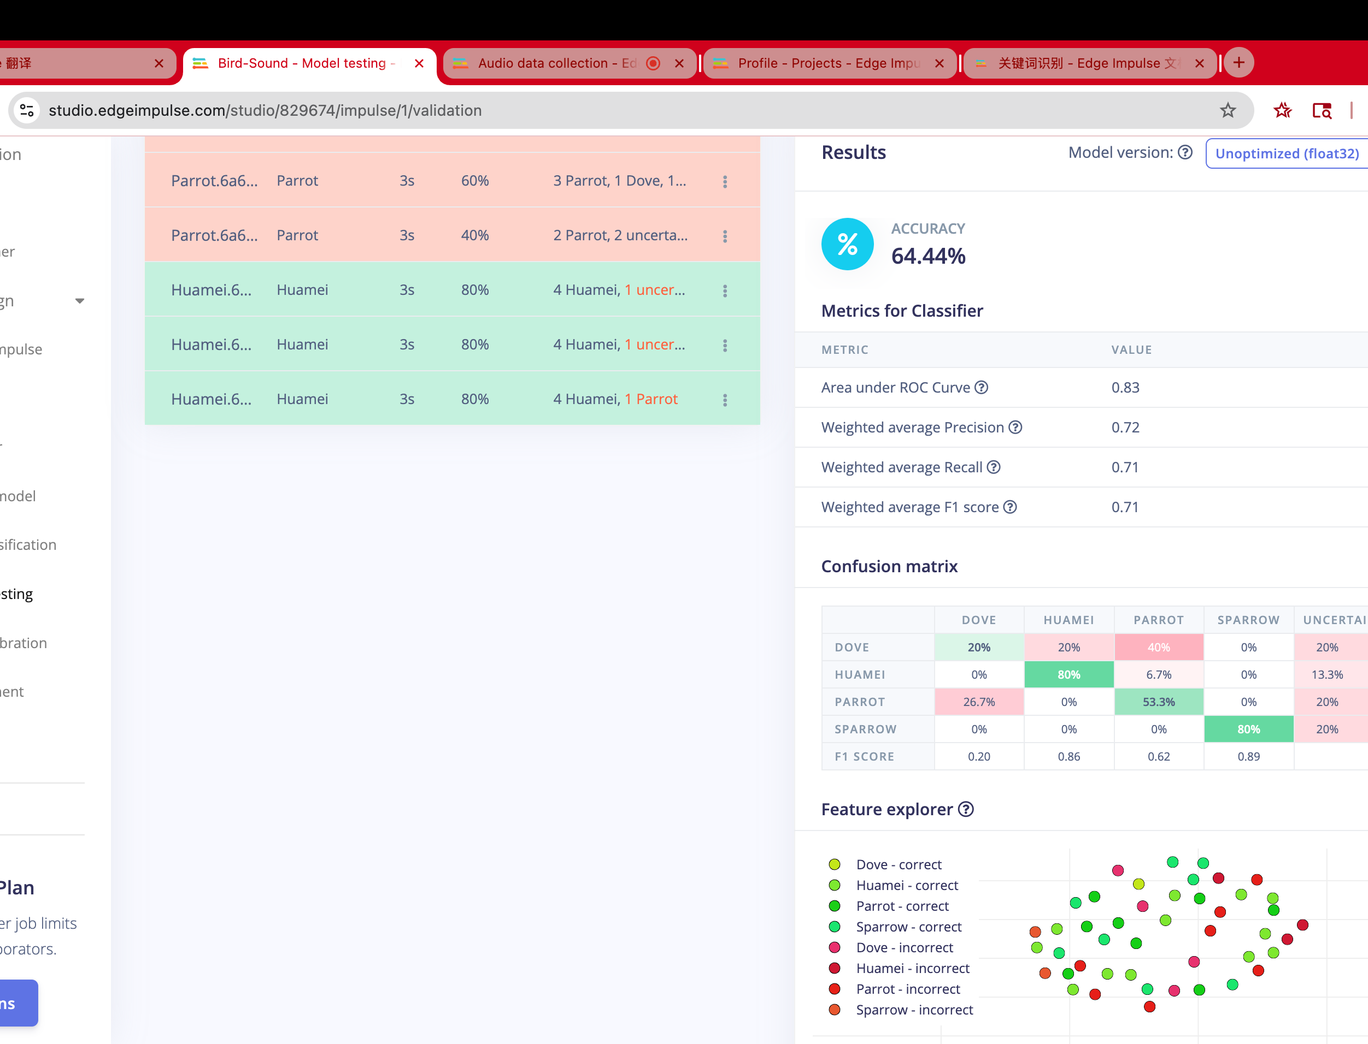
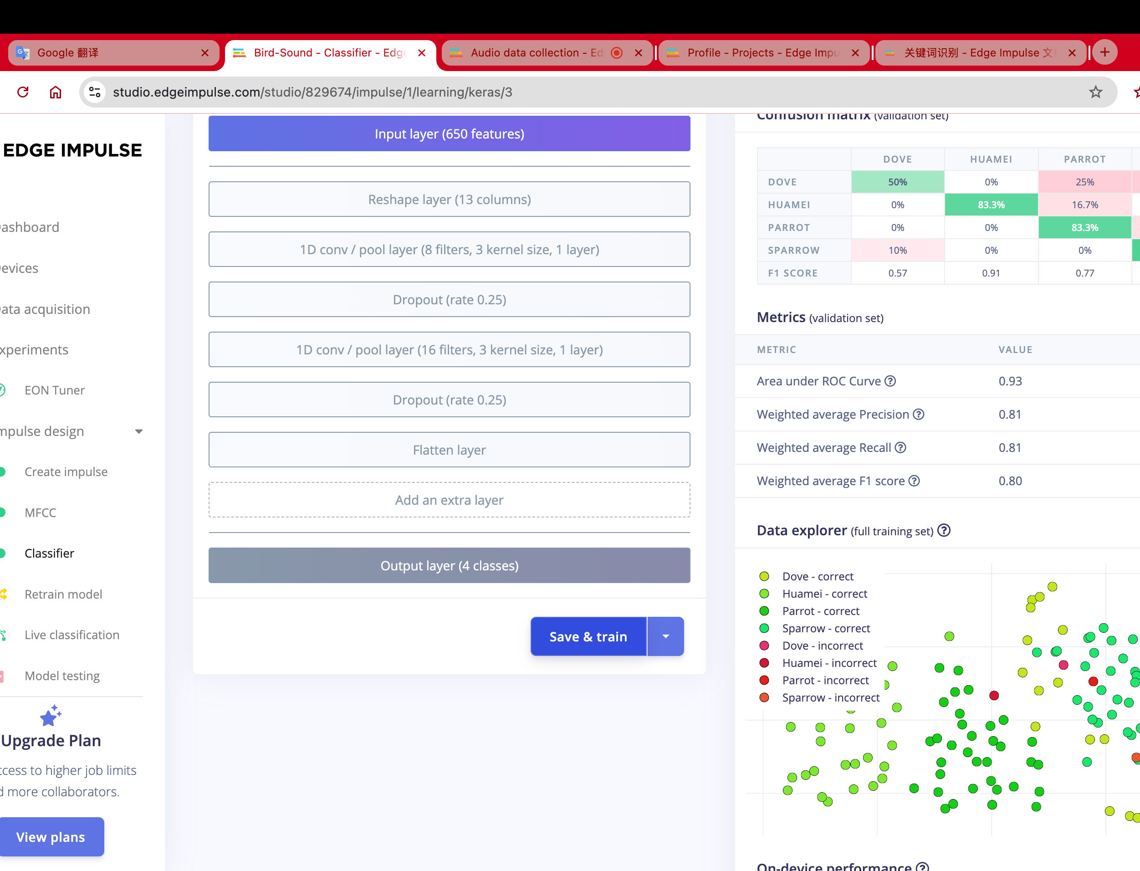
Data Diagnosis
4 Birds
Some performed well
We think this is due to training sample issue

Slide 5
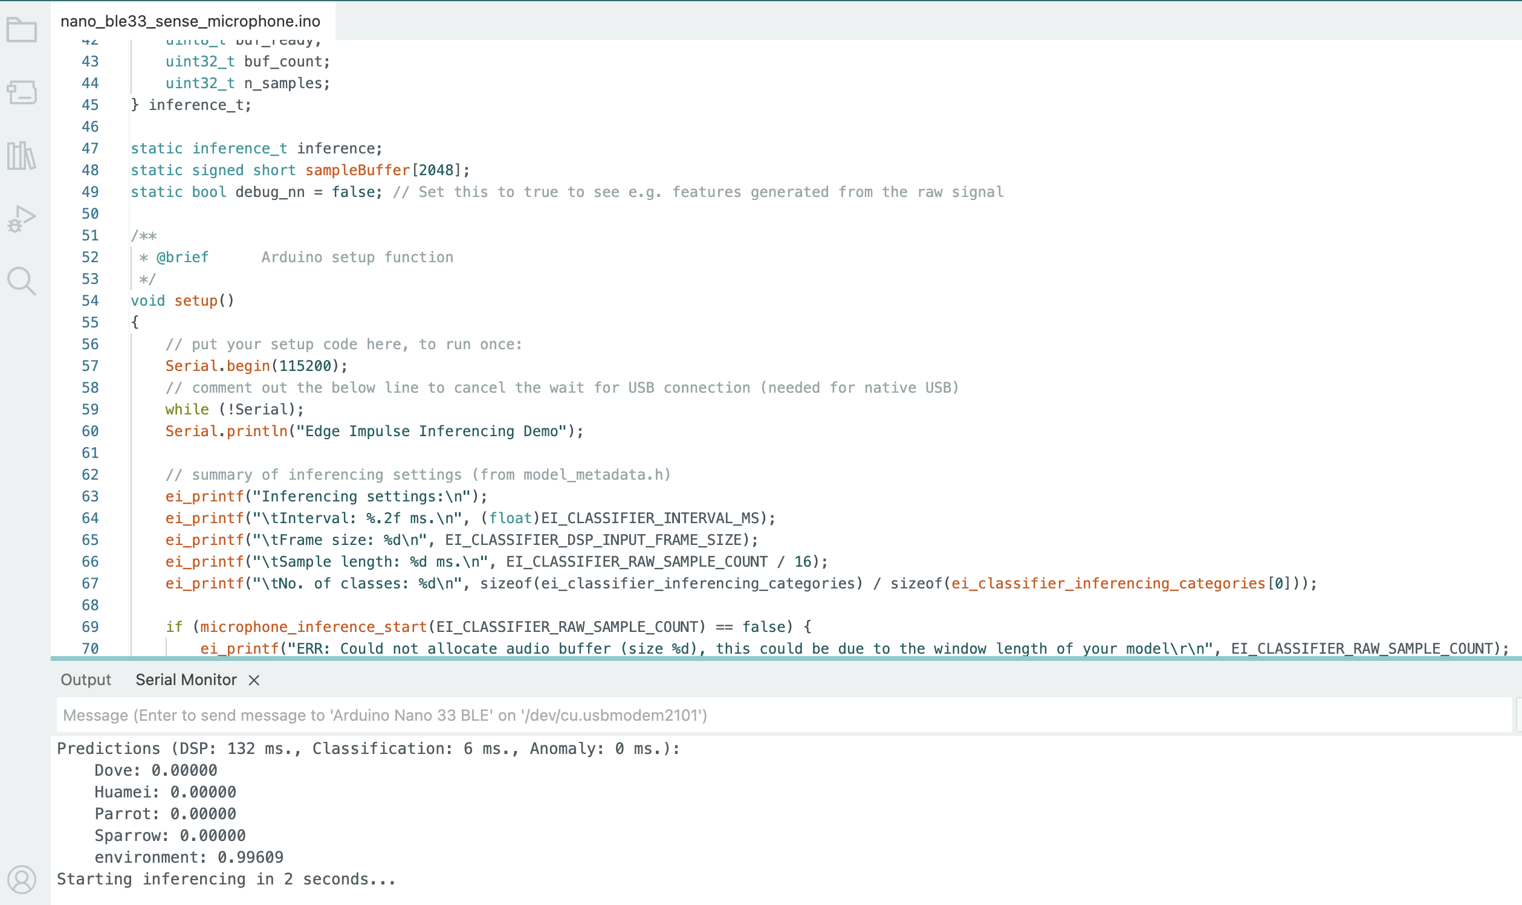
Data Access

Slide 6
Current Status
Already on board
Debugging edge impulse library issues
Collect accuracy data

Slide 7
Next steps?
For implementation include more spices
Analysis of Data
-Accuracy across species
deliverables
-Report, etc.

