Slide 1
Autostack
Frank Wu, Tony Xu, Anson Lu, Yingming Ma

Slide 2
Motivation
Problem
  Built an alignment system for stacking the 2D materials in our capstone project
  Current alignment relies on human visual judgment, which takes time
Need
  Automatically detect flakes
  Extract flake position & size
  Provide real-time feedback for motion control
Our Direction
  Edge Detection
  YOLO Recognition
  Integrate with Raspberry Pi 5

Slide 3
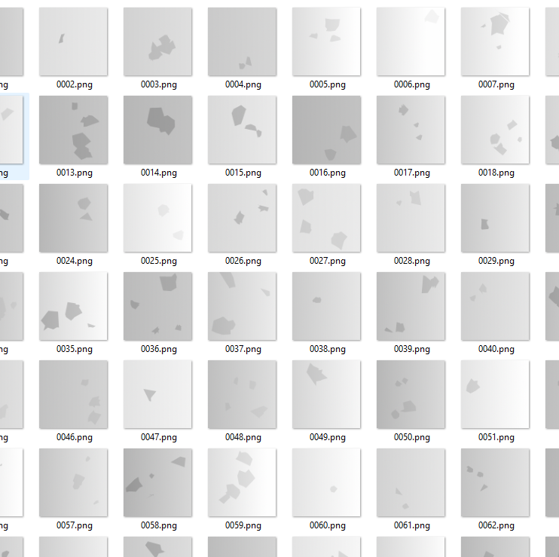
Yolo Recognition
Difficult to find a large dataset of 2D material flakes online
Use code generated shapes to mimic actual flakes, providing a large enough dataset

Slide 4
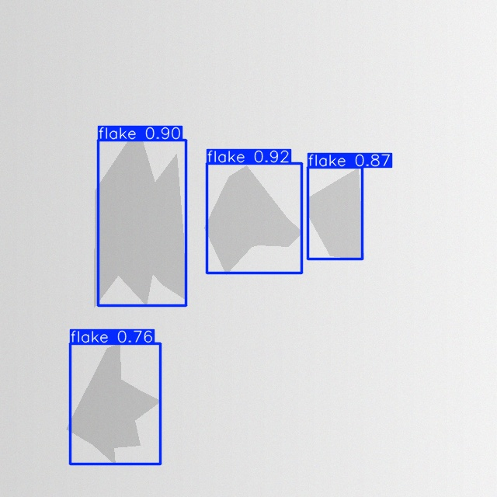
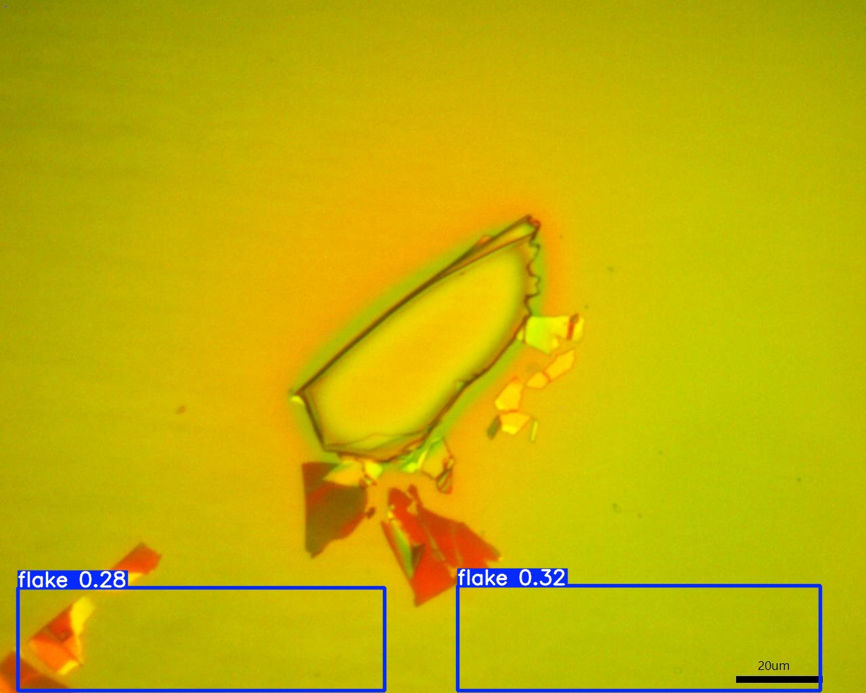
Yolo Recognition
On the actual flakes detection failed
On the generated flakes it's able to detect properly

Slide 5
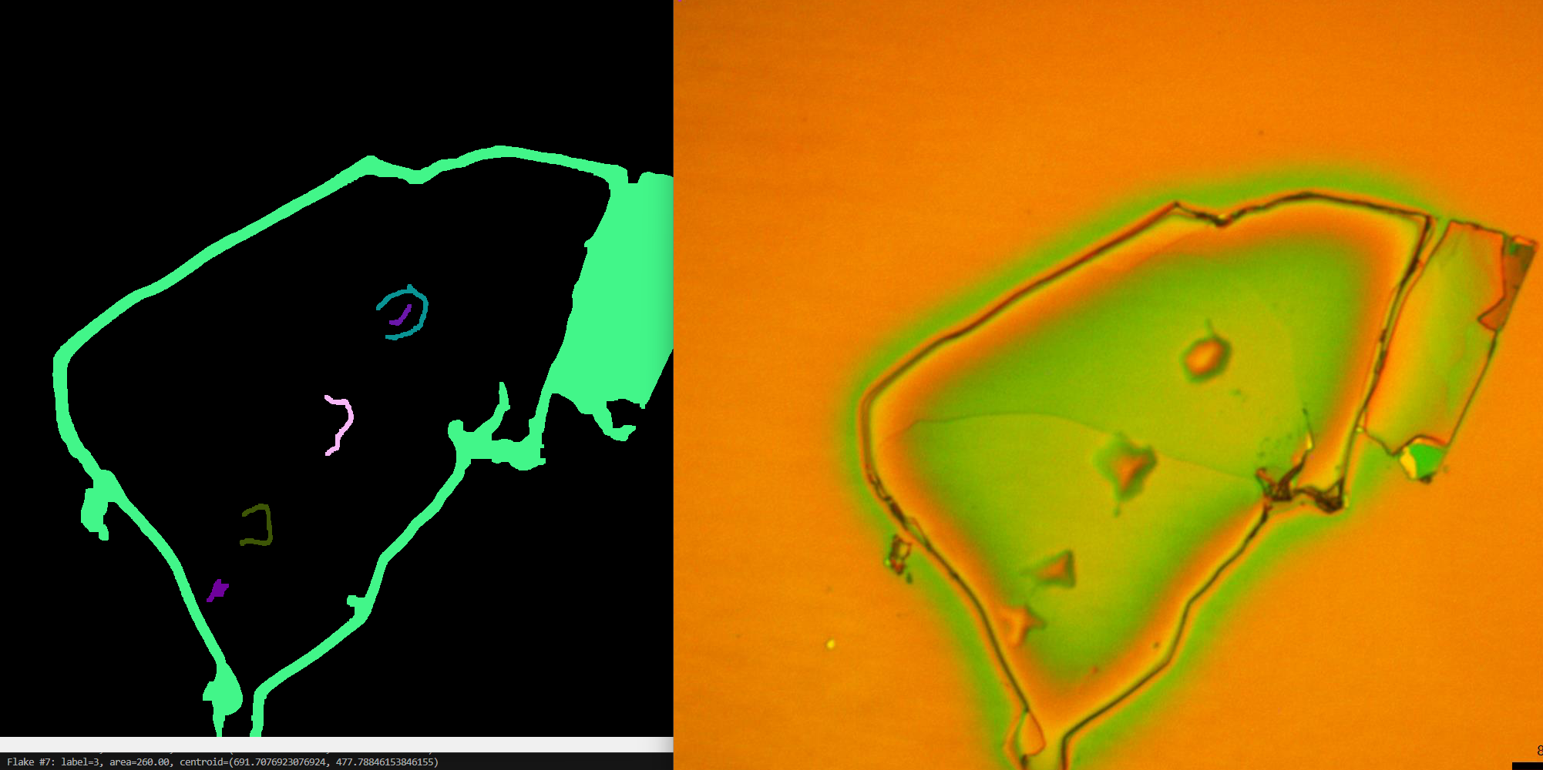
Yolo Recognition – Future Thoughts
Generate a more comprehensive dataset with shapes of different colors and background
Use algorithm-based filters or edge detection to process the image first making it easier for AI to detect

Slide 6
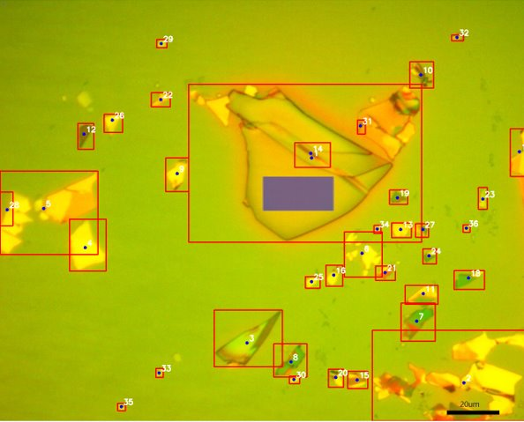
Edge Detection
Process Steps:
  Detect sharp edges in the image using Canny edge detection.
  Connect and close edges to form solid regions.
  Identify closed regions by extracting their outer contours and treating each connected region as a flake.
  Compute the centroid and bounding box for each flake to determine its location and size

Slide 7
Future Work
Preprocess imaging data to stitch individual video frames into a single composite overview image
Integrate detection algorithms with the motor control system to enable automated motion based on detected flakes
Validate and characterize the performance of the fully integrated system
Enhance flake detection algorithms for higher accuracy and robustness

