Slide 1

AUTOSTACK
Frank Wu, Yingming Ma, Tony Xu, Anson Lu
Fall 2025

Slide 2
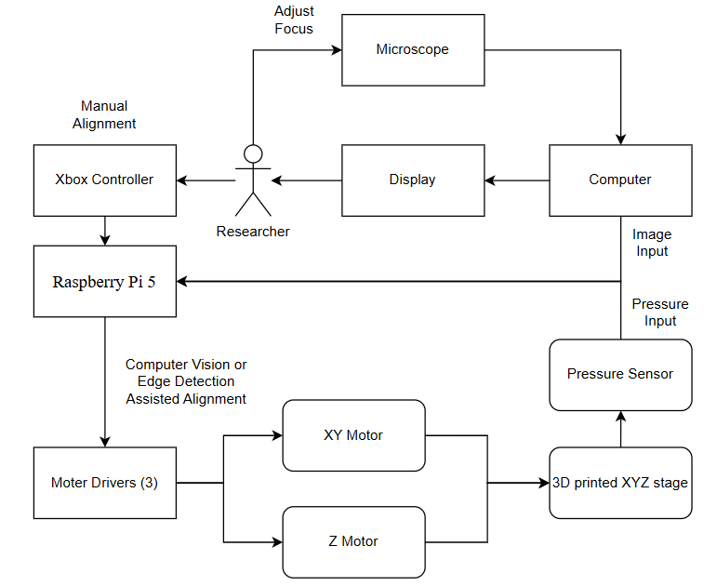
Design: Block diagram
Notes:
Make sure this is readable without too many acronyms
High enough level to fit on a slide

Slide 3
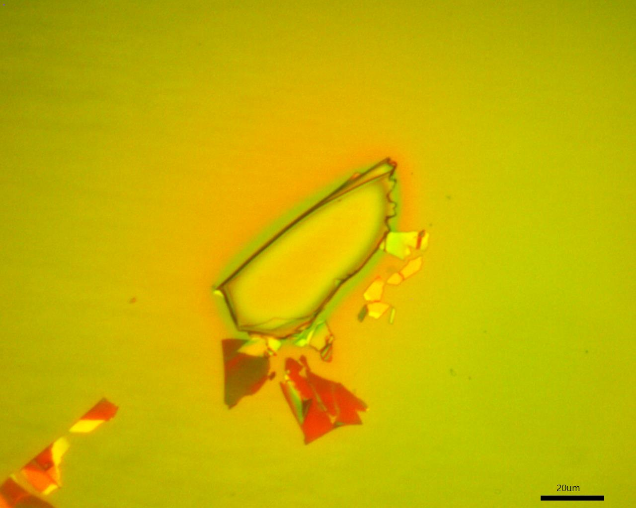
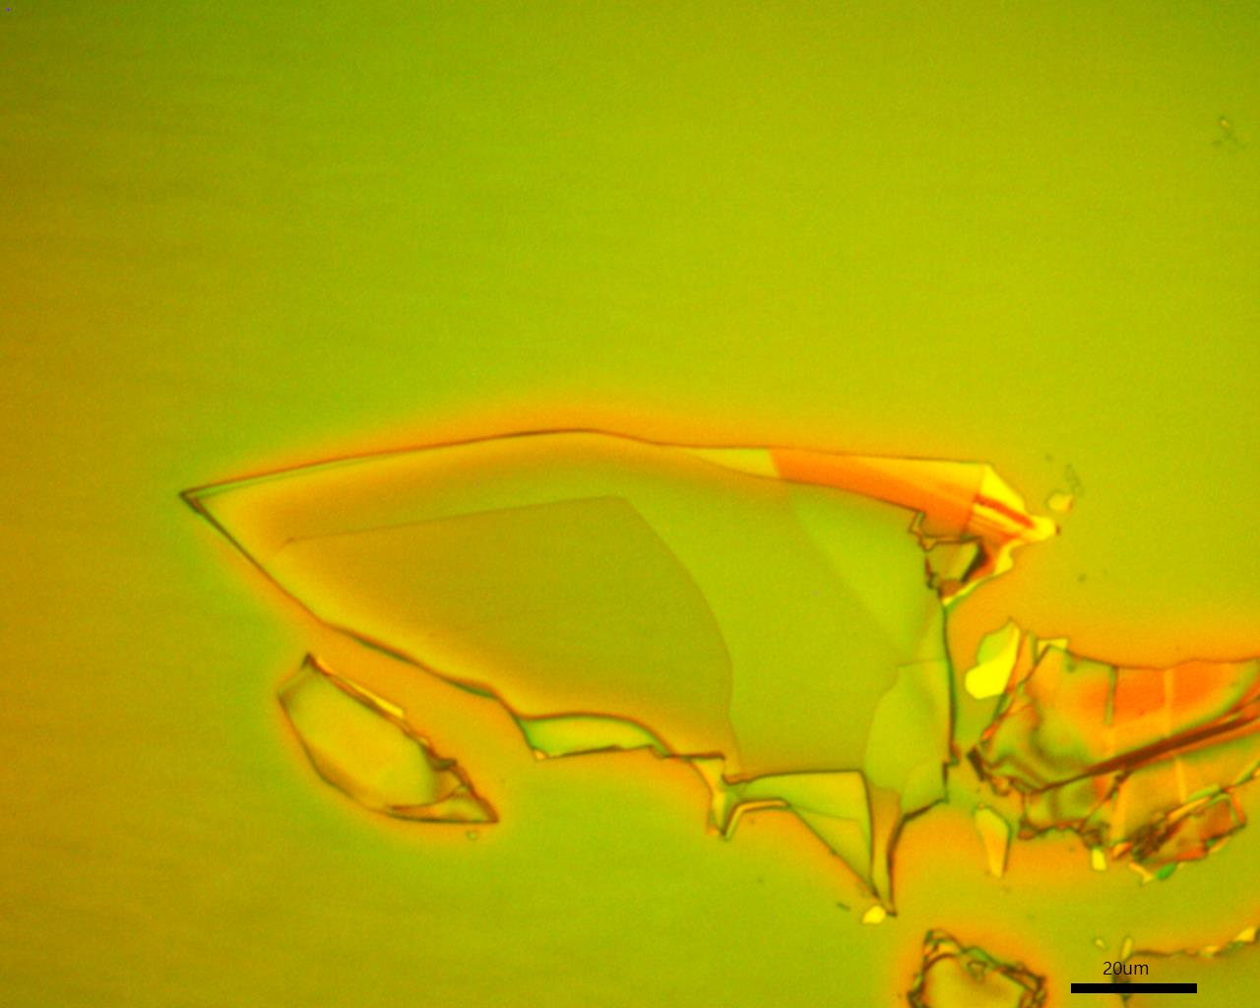
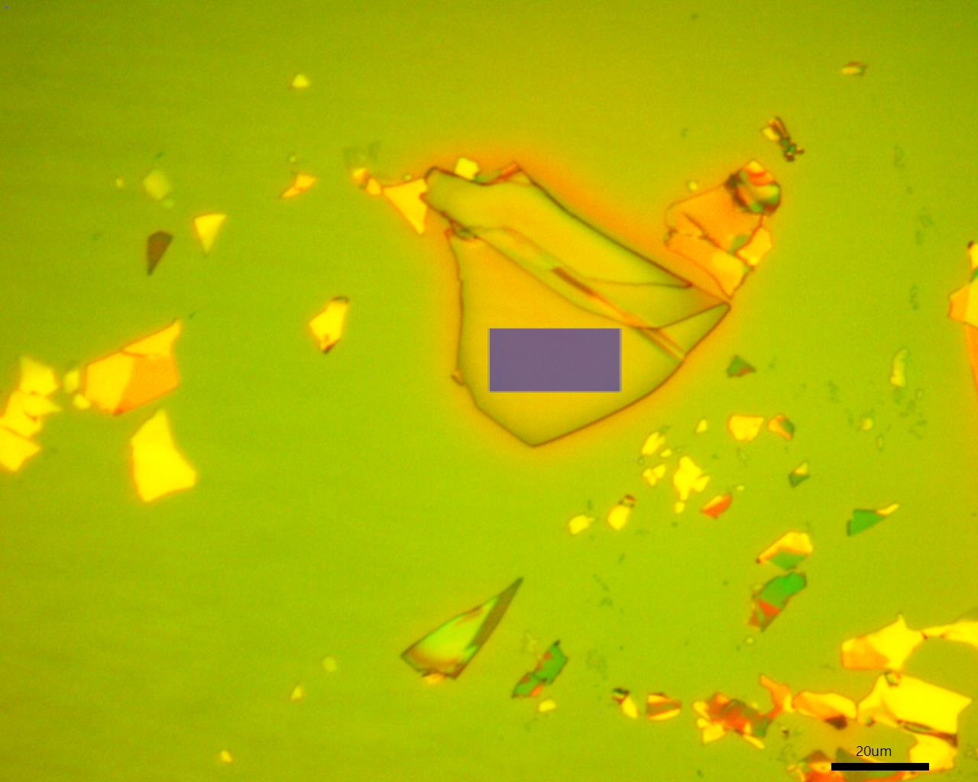
Example Of Metal Flakes:
Notes:
Make sure this is readable without too many acronyms
High enough level to fit on a slide

