Slide 1

asdas
Edge-AI Waste Classification on OpenMV H7
Course：AI hardware
Members : Mengzi Cheng
Shuai Tu
Sirui You
Xueyi Zhang
Team Name : Circuit Board Layout
Notes:
亮亮图文旗舰店
https://liangliangtuwen.tmall.com

Slide 2
Contents
1
2
3
Project Design
Waste Image Dataset
Edge Impulse
4
5
6
Data Preprocessing
Impulse Design
Model configuration
& training results

Slide 3


3
Project Design
Training &
Performance Tuning
Data Import
Upload the processed images to Edge Impulse, create labels and dataset splits
Train the model multiple times on Edge Impulse, tuning epochs, batch size and other parameters.
01
03
05
02
04
Dataset
Preparation
Model & Impulse
Design
Deployment
Use the public Trash Net waste image dataset from GitHub
Choose an image classification neural network as the learning block and set key hyperparameters.
Check model size, RAM usage and inference time in Edge Impulse to evaluate feasibility on OpenMV H7.

Slide 4
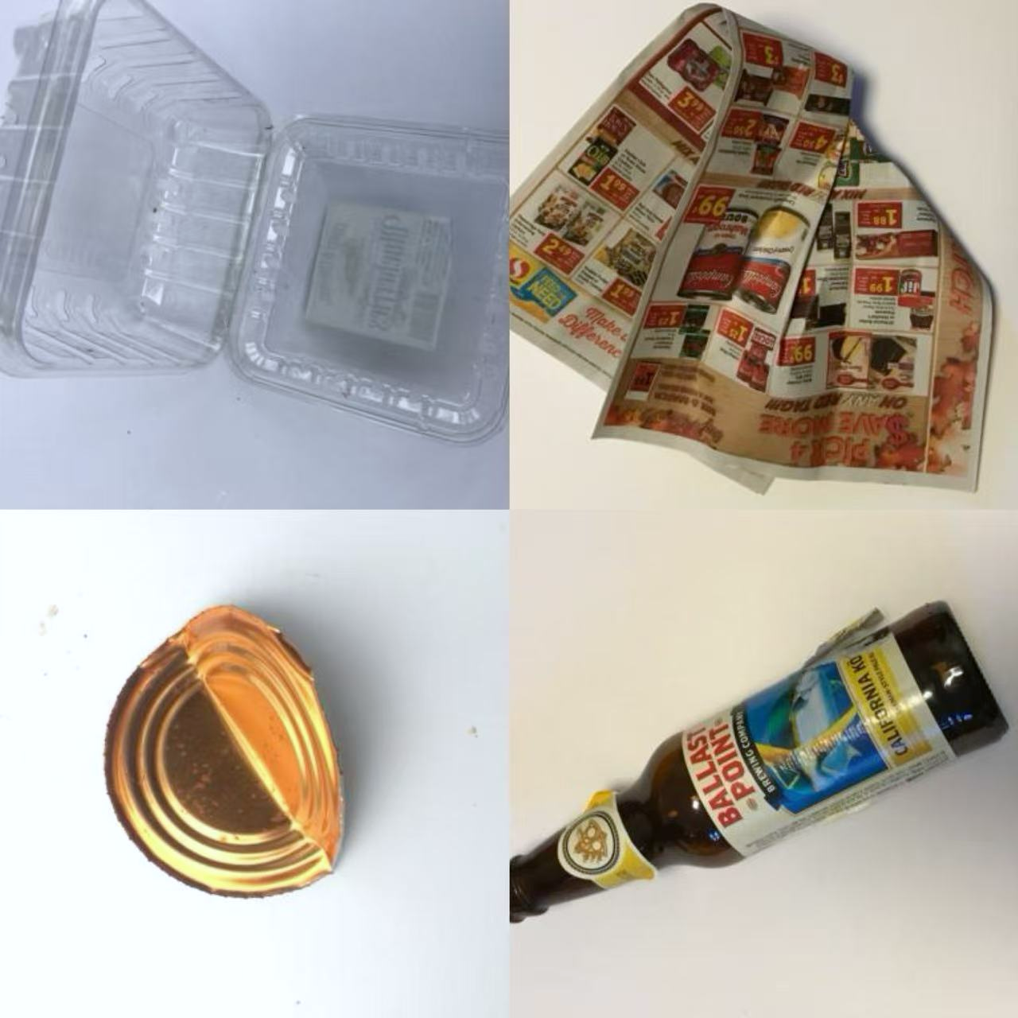
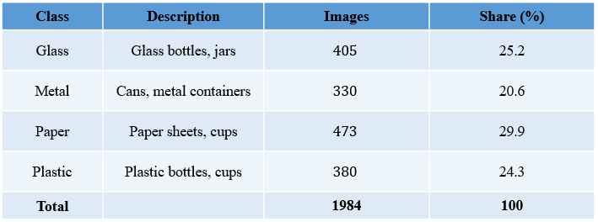
Waste Image Dataset – Trash Net
Source: GitHub repository
Task: Single-image multi-class classification of household waste
Classes (4): glass, metal, paper, plastic
Image resolution: 512 × 384 pixels (RGB)
Acquisition setup: Captured with iPhone cameras under room light
Total number of images: 1,984
Example images from the Trash Net
Plastic / Paper
Metal / Glass

Slide 5
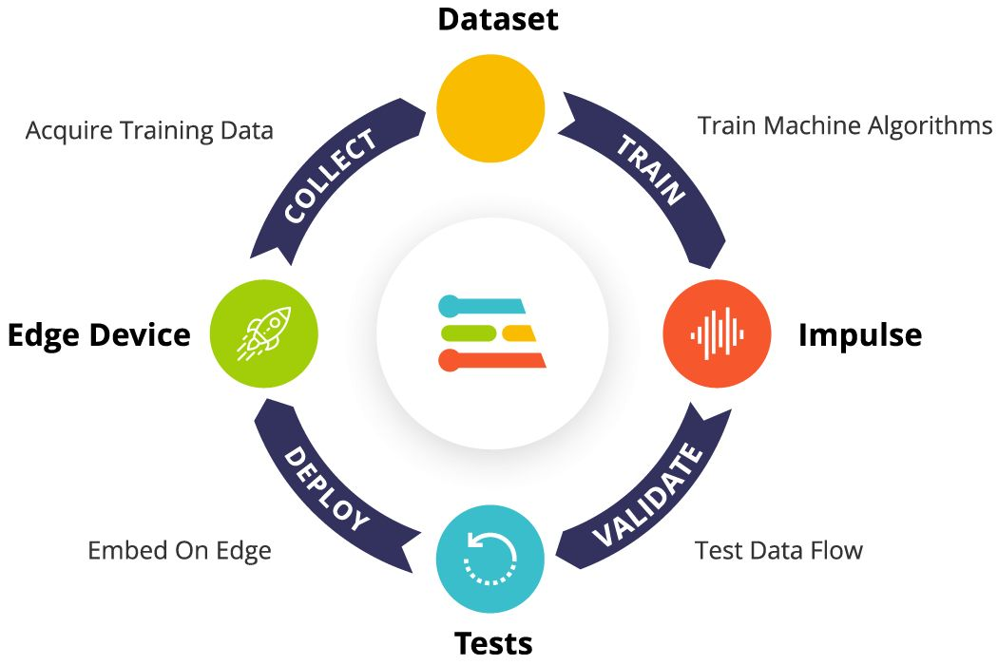
Edge Impulse Platform for Embedded ML
In this project, we use Edge Impulse mainly for image classification of waste.
Module | Function | Our work in this project
Data acquisition | Import and organize datasets | Upload images from Trash Net and create labels in Edge Impulse
Impulse design | Define input, preprocessing, classifier | Set image size, normalization and image classification block
Model training | Train and optimize models | Run multiple trainings and tune epochs / batch size / augmentation
Model testing | Evaluate model performance | Check accuracy, loss curves and confusion matrix
Deployment (analysis) | Prepare export for edge devices | Check memory and latency estimates for OpenMV H7 target

Slide 6
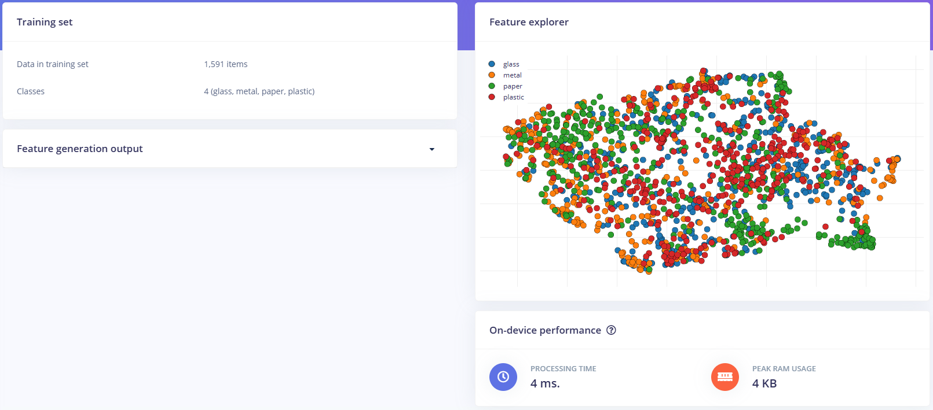
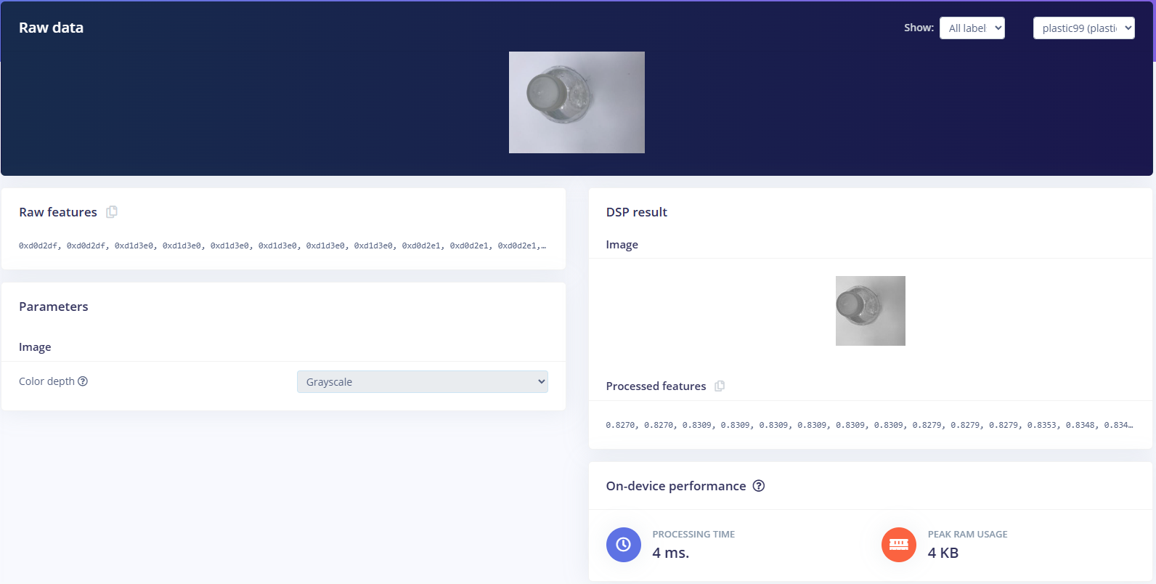
Data Preprocessing
Offline preprocessing：All images are RGB, resized to 512 × 384 pixels, and stored in class-specific folders (glass, metal, paper, plastic)
Resize mode: keep the original aspect ratio
Convert each 96 × 96 grayscale image into a normalized feature vector.
4 ms processing time and 4 KB peak RAM usage
Online preprocessing：

Slide 7
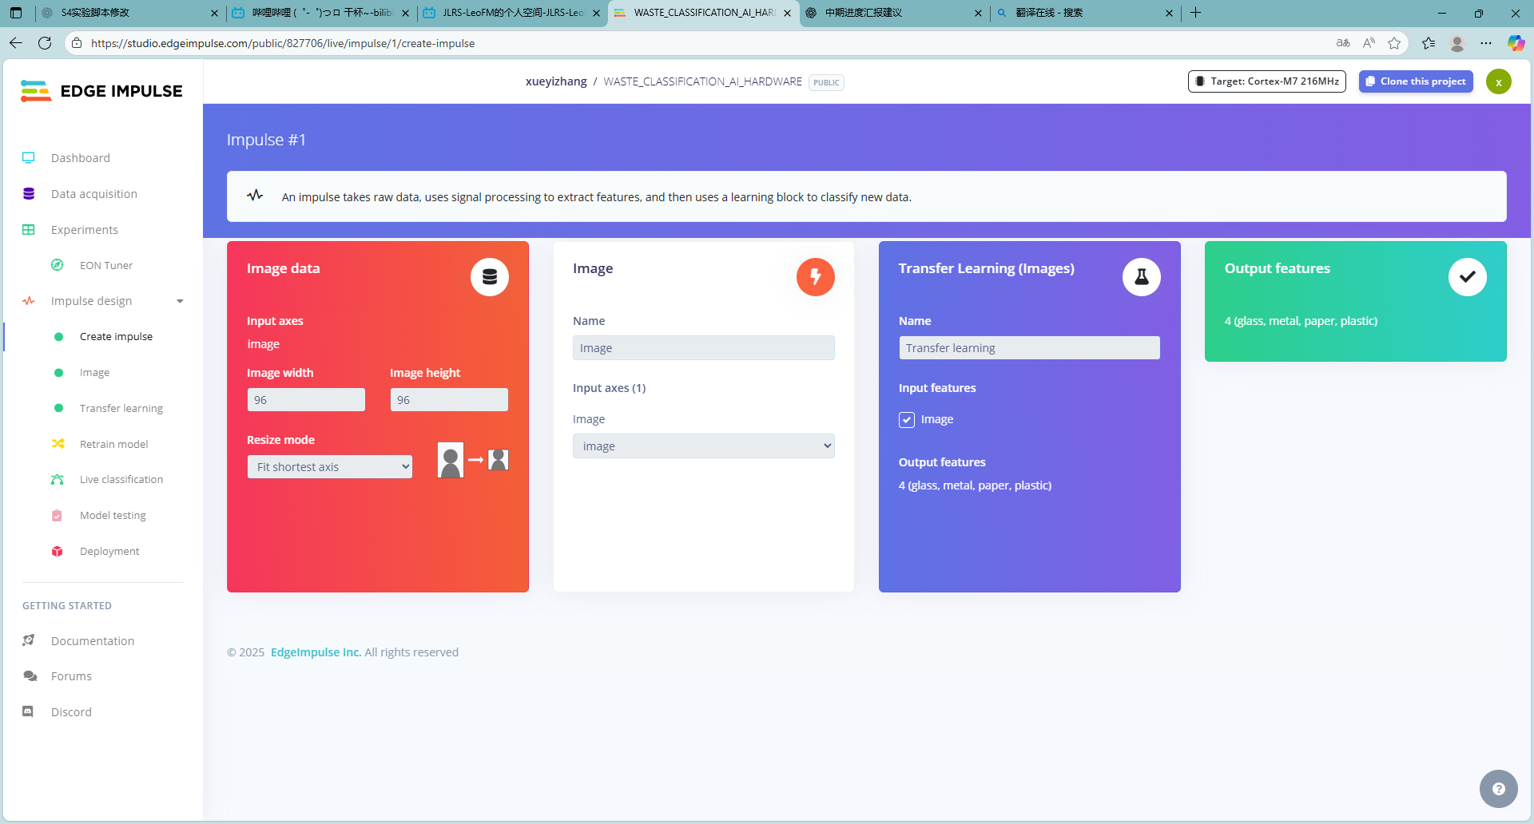
Impulse Design
Image size: 96 × 96 pixels
grayscale input
Resize mode: “Fit shortest axis” to keep the aspect ratio when resizing from 512 × 384.
Use the built-in “Transfer Learning (Images)” block as the image classifier.
The model takes the image features as input and outputs 4 classes: glass, metal, paper and plastic.

Slide 8
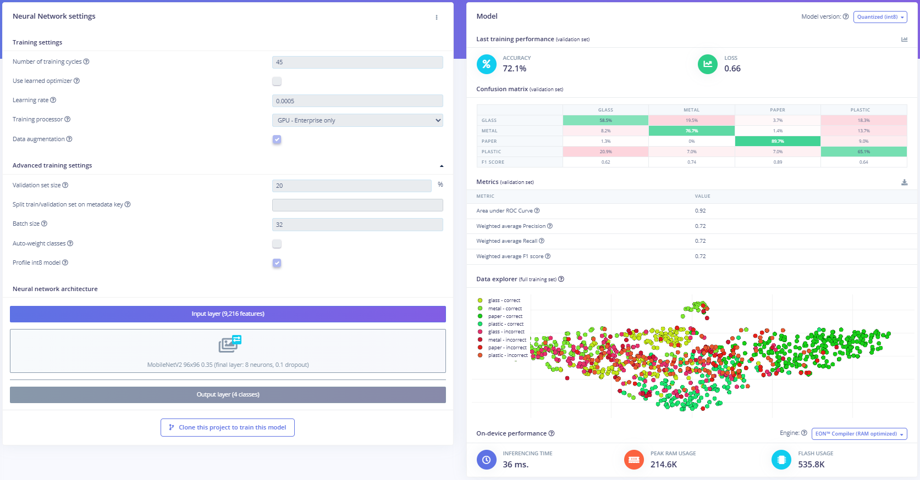
8
Model configuration & training results
Model & training settings
Backbone: MobileNetV2 96×96 0.35 (0.1 dropout)
Output: 4 classes (glass, metal, paper, plastic).
Training cycles: 45;
batch size: 32
learning rate: 0.0005.
Validation set: 20% of the data, data augmentation enabled.
Validation performance
Accuracy: 72.1%, loss: 0.66
AUC: 0.92
weighted Precision / Recall / F1: ≈ 0.72
Paper is easiest to classify (≈89.7% recall), glass and plastic remain harder.
On-device performance
Inference time: 36 ms (per image).
Peak RAM usage: ≈ 215 KB
flash usage: ≈ 536 KB.
Feasible for real-time deployment on OpenMV H7.

Slide 9
Future Work
Data
Collect or augment more samples for the “hard” classes as targeted augmentation.
Add a set of our own photos that mimic the future OpenMV
H7 camera viewpoint and background.
Hardware & Deployment
complete end-to-end deployment: build → deploy → on-device test.
Measure on-device FPS and accuracy, then perform one round of minor model adjustments based on these results.
Model
Perform small-range tuning around the current best setup (epochs, learning rate, etc.).
Explore a lighter backbone to further reduce latency on the embedded device.
Deliverables
Final demo video, code repository (Edge Impulse project + board code), and written project report.

Slide 10

THANKS
Thanks for listening
Course：AI hardware
Members : Mengzi Cheng
Shuai Tu
Sirui You
Xueyi Zhang
Team Name : Circuit Board Layout
Notes:
亮亮图文旗舰店
https://liangliangtuwen.tmall.com

