Slide 1
Towards Efficient Deep Neural Network Deployment:
Supporting Diverse Quantization in the TVM Compiler
Group Name: Eat, Sleep, Do AI
Group Member:Liangtao Dai, Elton Jhang, Haonan Ke,Xinwei Li

Slide 2
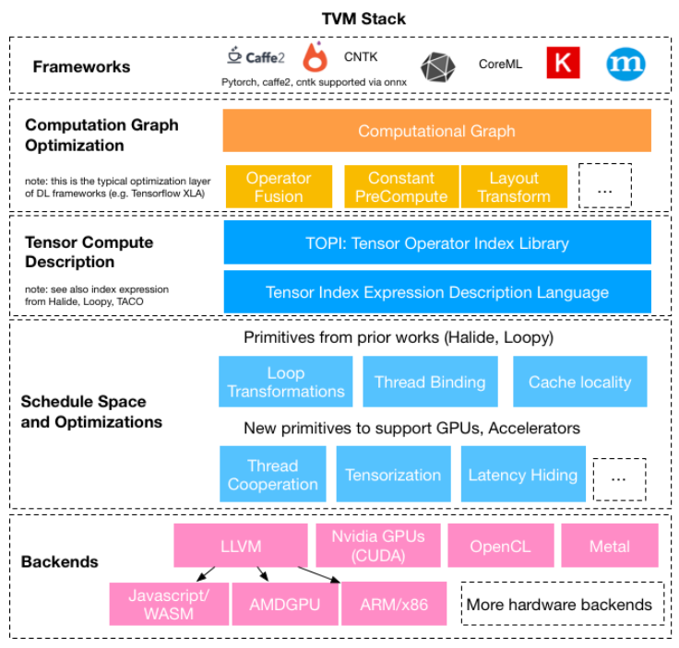
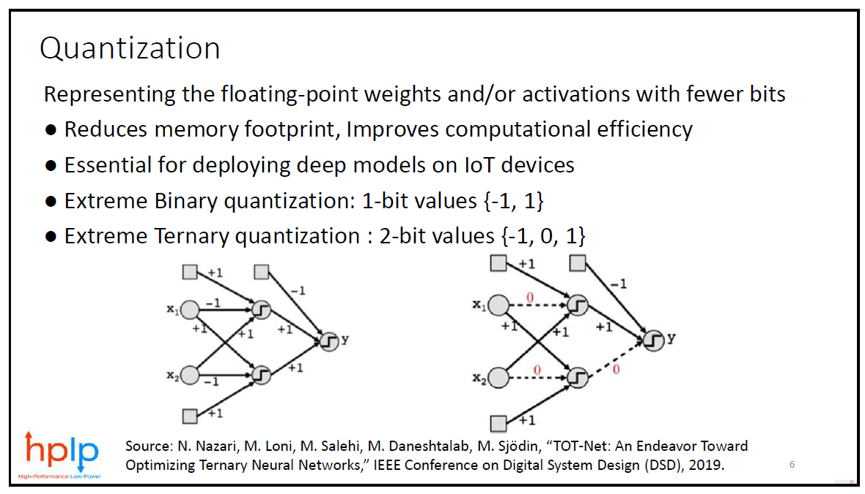
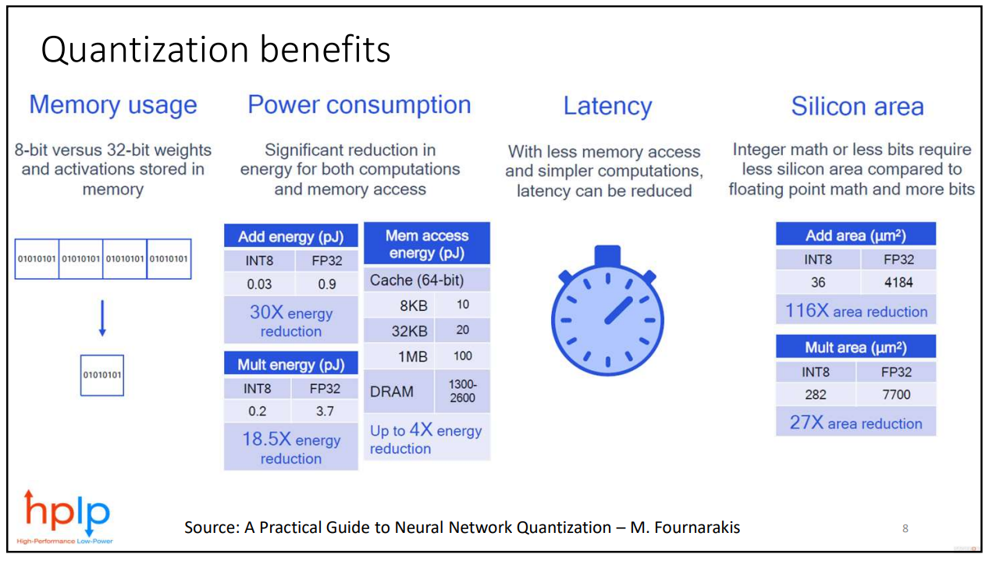
Background
Efficient Machine Learning Algorithm
Machine Learning Compiler

Slide 3
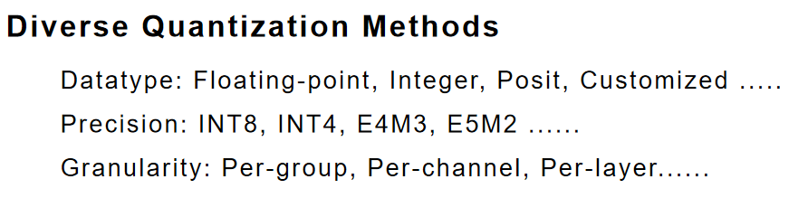
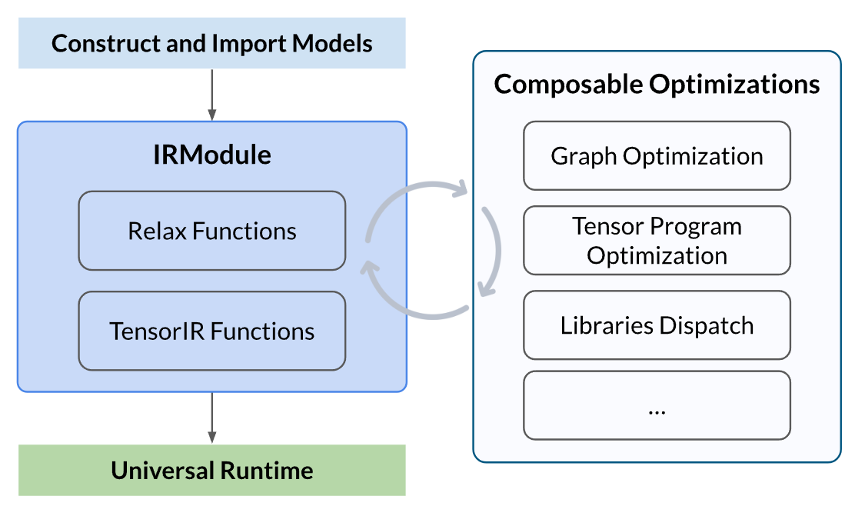

Challenges
Problems when deploying quantized model
1. Limited datatype, precision and granularity support
2. Expanding Optimization design space
3. Hardware mismatch
TVM Compilation Flow

Slide 4
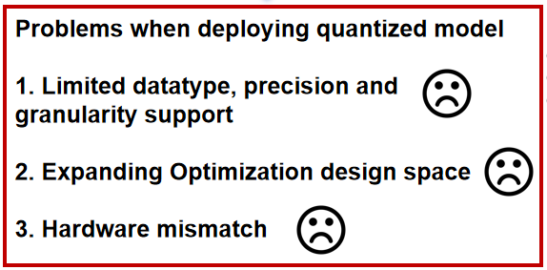


Proposed Solution
Methods:
1. Quantization-aware Transformation Pass
2. Efficient Compilation Flow Auto-Tuner
3. End-to-end TVM-based Quantizied Nerual Network Compilation Framework
Towards Efficient Deep Neural Network Deployment:
Supporting Diverse Quantization in the TVM Compiler

Slide 5
Diverse Quantization Methods
  Datatype: Floating-point, Integer, Posit, Customized .....
  Precision: INT8, INT4, E4M3, E5M2 ......
  Granularity: Per-group, Per-channel, Per-layer......

