Slide 1
Toward Efficient Large Language Model Deployment
Group Name: Eat, Sleep, Do AI
Group Member: Liangtao Dai, Elton Jhang, Xinwei Li, Haonan Ke

Slide 2
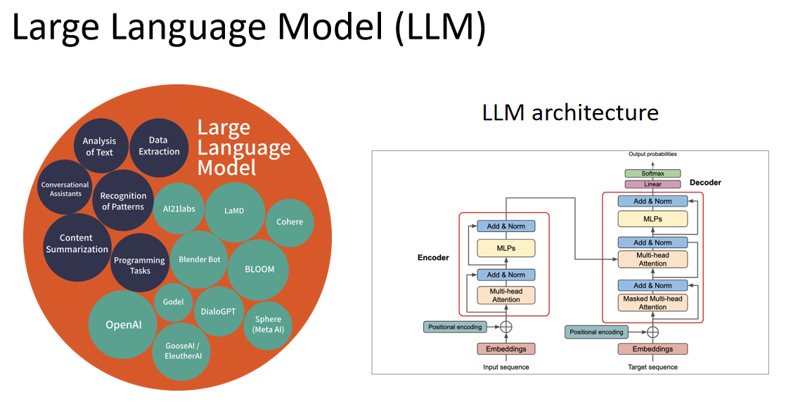
Motivation
LLM is expensive!
How can we efficient deploy LLM on resoure
limited platform?
How can we let LLM cost less and inference fast?

Slide 3
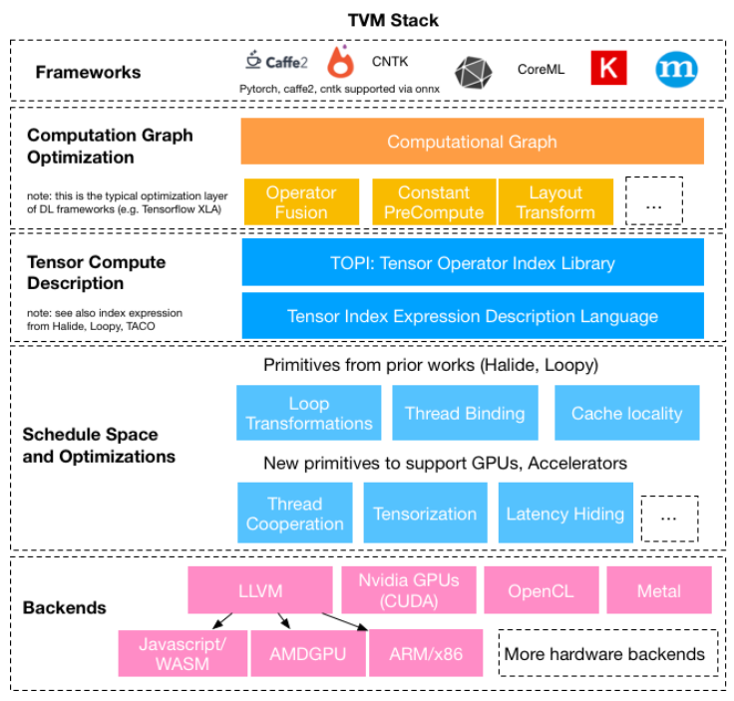
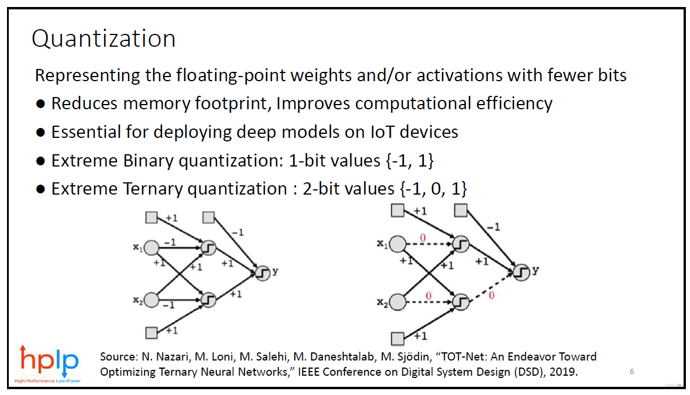
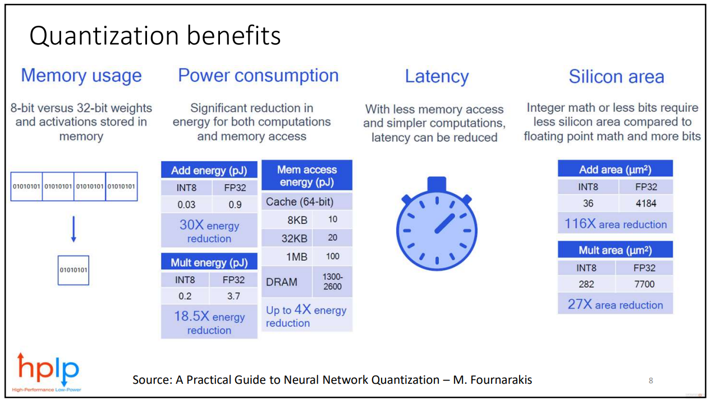
Efficient Machine Learning Algorithm
Machine Learning Compiler

Slide 4
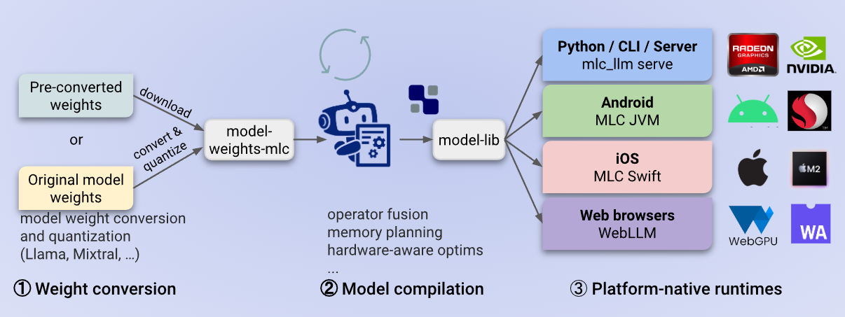
Framework
MLC LLM: Universal LLM Deployment Engine With ML Compilation

Slide 5
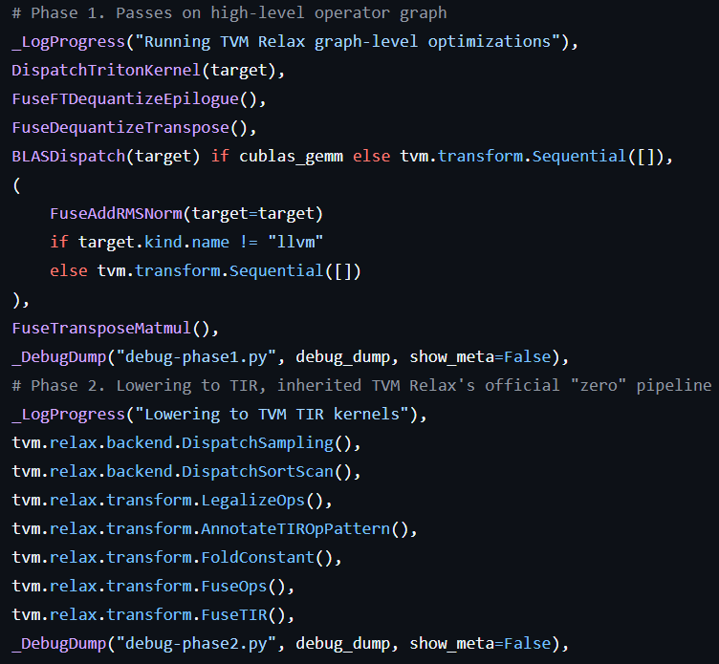
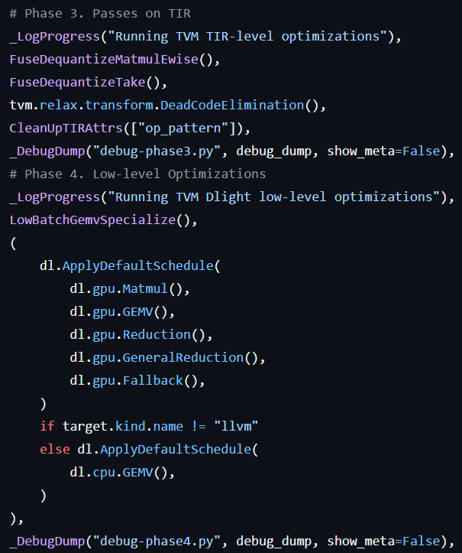
Compilation Flow of LLM

Slide 6
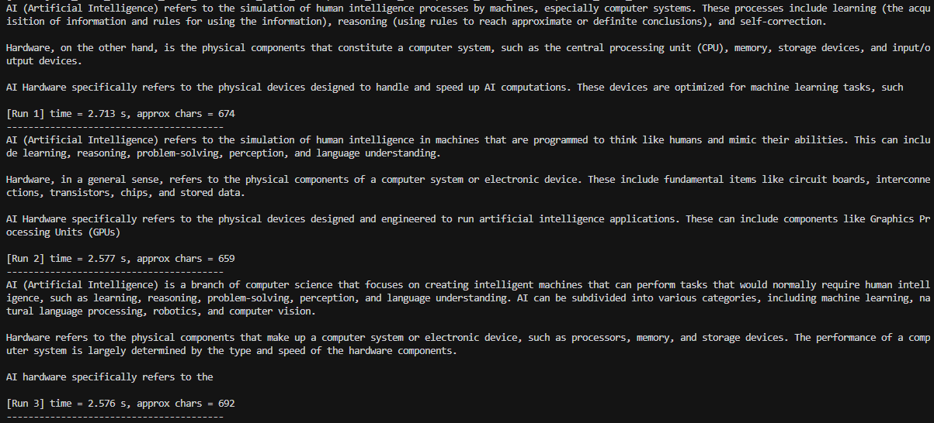
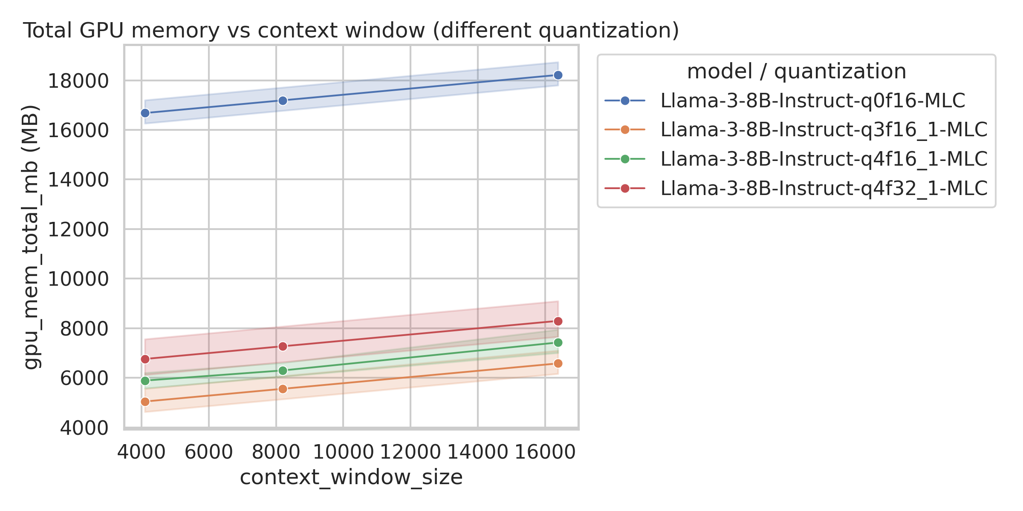
Current Status
Be able to run the quantized LLM flow on NVIDIA RTX 4090.
Be able to construct a initial design space and get metrics.

Slide 7
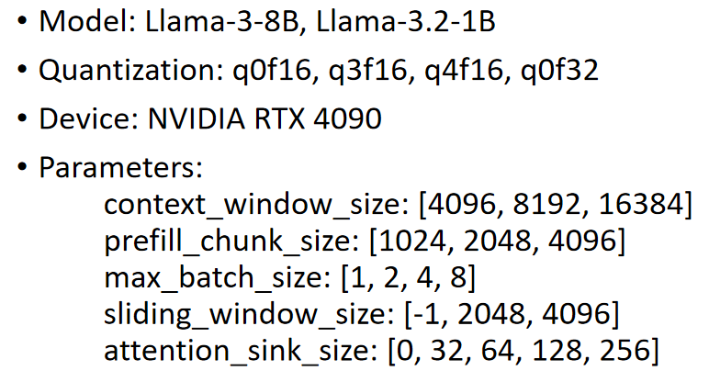
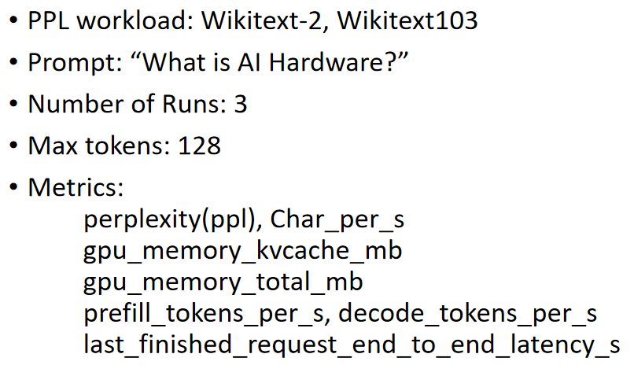
Future Plan
1. Explore Different Quantization Algorithm
2. Explore Different Parameter Candidates
3. Efficient Searching Algorithm

Slide 8
Team Member and Contribution
Liangtao Dai: MLC-LLM, TVM Environmet Setup; Design Space Exploration.
Elton Jhang: Evaluation and analysis of compilation parameters
Xinwei Li: Quantization Analysis and Evaluation, Figures and tables
Haonan Ke: Quantization Algorithm Exploration, Figures and tables

Slide 9
Thanks!

