Slide 1
Hand
Gesture
Recognition
Team name: ECE4380Group project

Slide 2
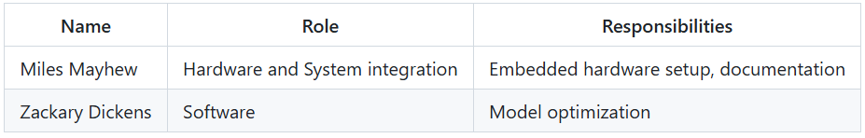
Team Member Roles

Slide 3
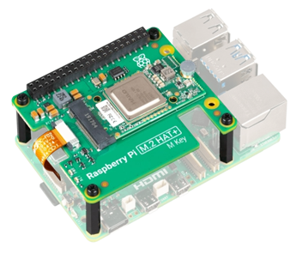
Project Overview
Using the Raspberry Pi AI Kit to identify gestures
  Open Palm
  Fist
  Point
  Thumbs up
  No Gesture
Gestures are printed when detected and measured for response time
Could enable touch-free controlling for devices

Slide 4
Limitations
Camera Quality
Minimum/Maximum Distance from Camera
Lighting Conditions

Slide 5
Plan to Finish

Slide 6
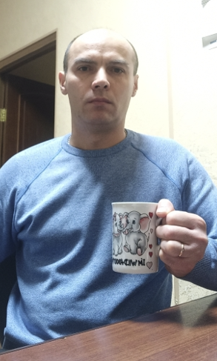
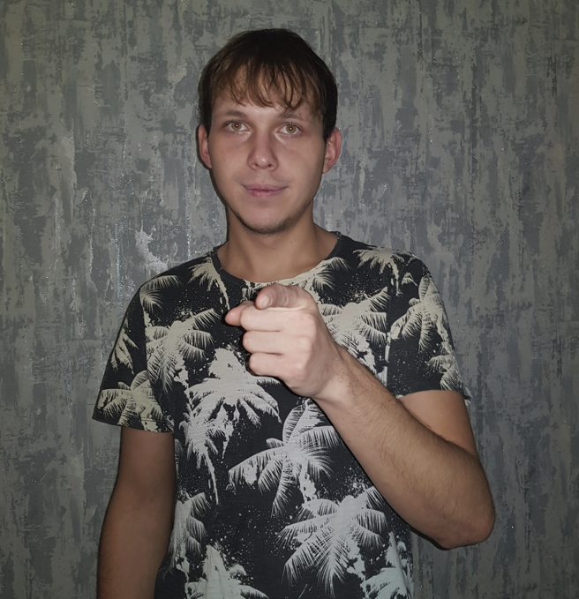
Complete Data Collection
Using the HaGRID dataset of gestures
Possibility of adding more images from Raspberry Pi AI Kit camera
No Gesture
Point Gesture

Slide 7
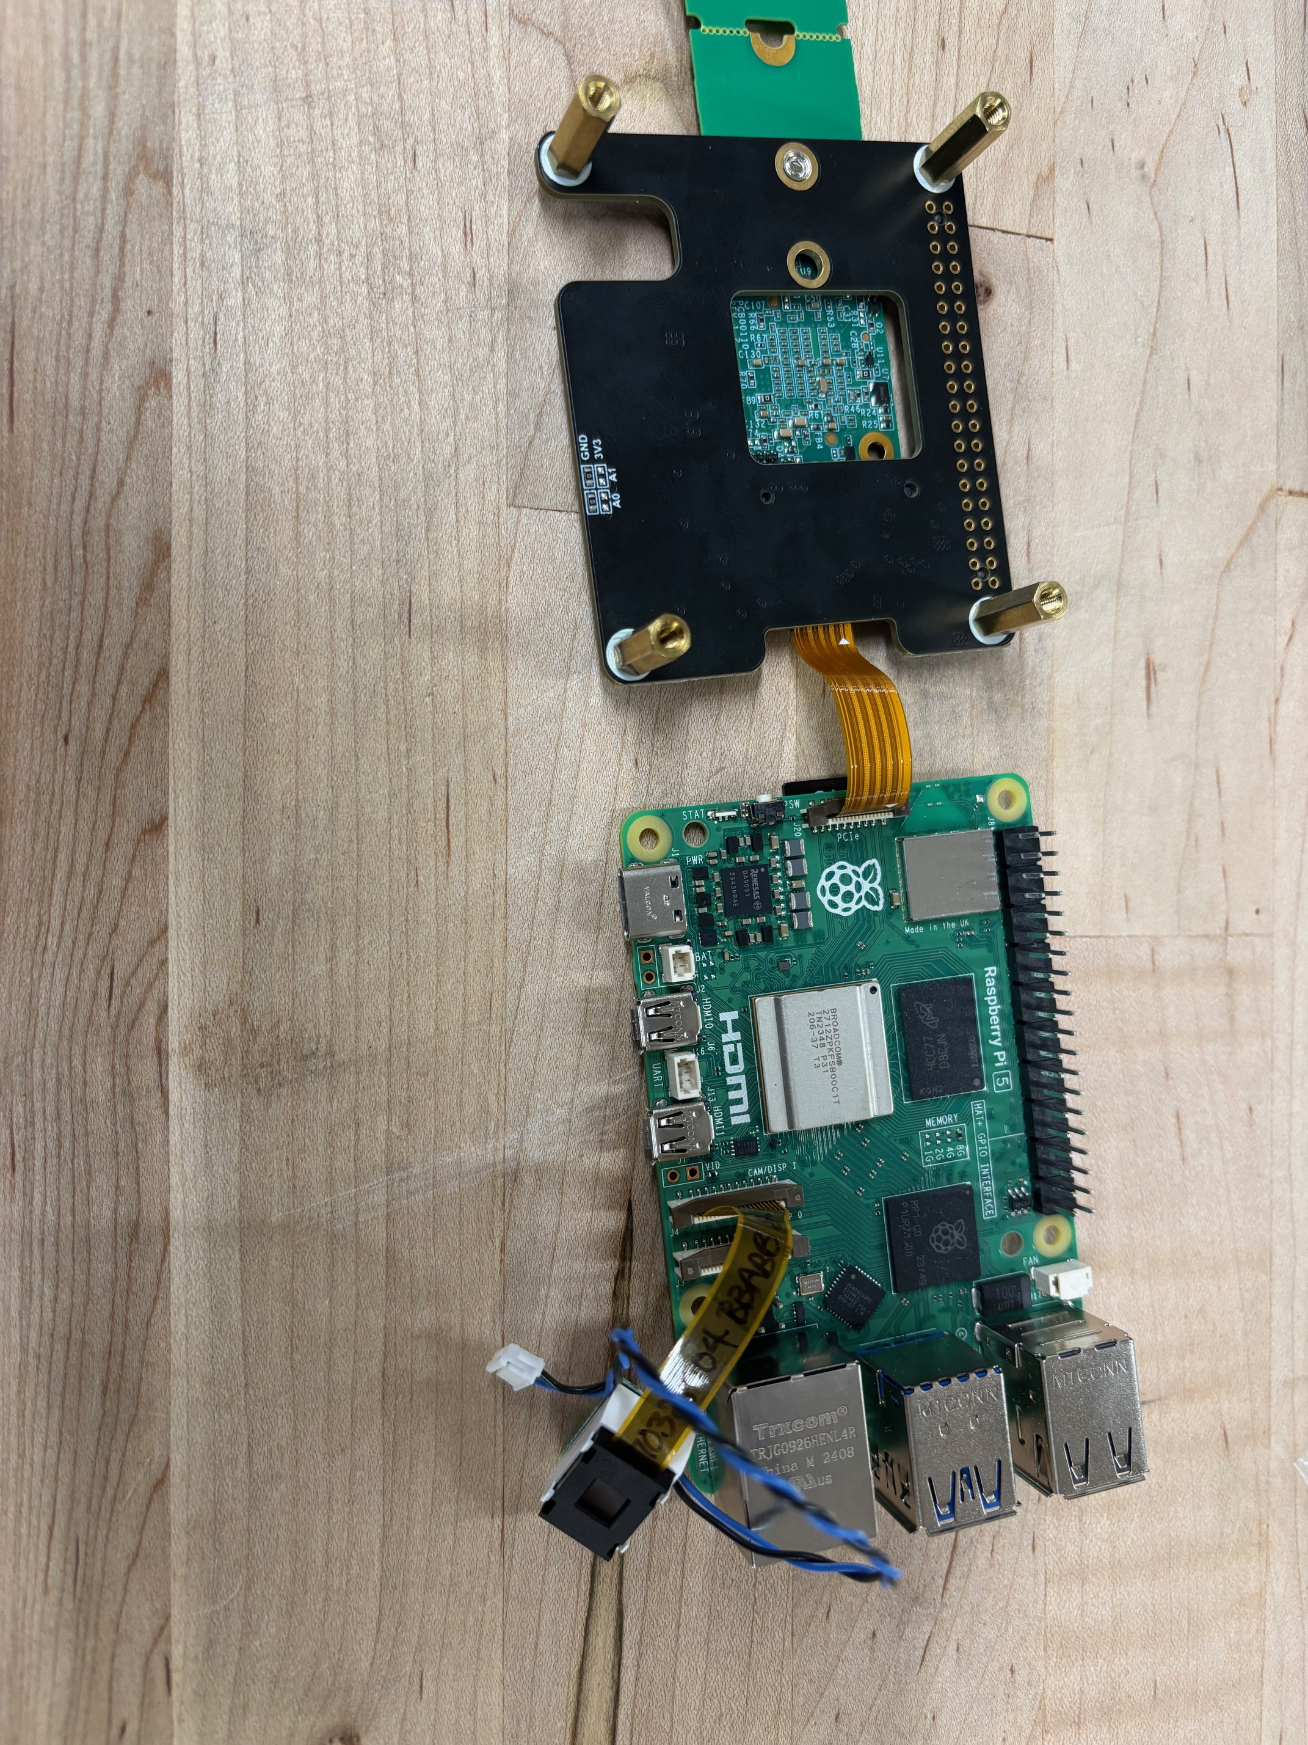
Build Model
Using tensor flow train a CNN from Data collected
Convert model to a Hailo-Compatible HEF model using Hailo dataflow Compiler
Deploy to the Raspberry PI

Slide 8
Test and Analyze Results
Test the gesture detection with different people and in different lighting conditions
Record the accuracy and speed of detections

Slide 9
Record Video Demonstration
Record video explaining the project and showcasing how it works
Discuss results and challenges
Explore possible use cases

Slide 10
Thank you

