Slide 1
Sentinel-AI
Voice & Motion Activated Multimodal Edge Security System
Presenters :
Md Nasim Afroj Taj
Mughesh Kumar NR
Uttam Kumar Saha

Slide 2
Motivation
Traditional CCTV systems record continuously, causing large energy and storage waste. Cloud-based surveillance introduces privacy risks and latency issues, while most systems lack context awareness. Sentinel-AI aims to create a smart, self-aware, voice-activated security camera that 'listens, thinks, and acts' only when needed, entirely offline on the Jetson Nano.
Energy Efficiency – Wake on voice to minimize power use.
Privacy & Security – Local AI inference; no cloud required.
Multimodal Intelligence – Combines audio + vision for contextual understanding.
Real-world Impact – Ideal for smart homes, labs, and secure environments.

Slide 3

Workflow
NVIDIA JETSON NANO
Microphone
Wake-word
Audio AI
Wake word
Cmd recog
Vision AI
Object detect
Face recog
Buzzer / Speaker
Camera
(Face Detection)
Recording DATA store
to microSD/SSD

Slide 4
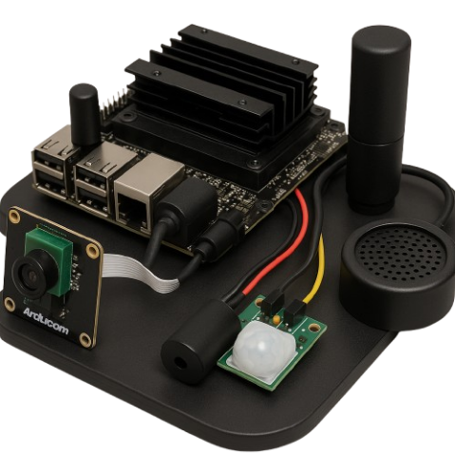
Hardware Requirements
Component | Estimated Cost (USD)
NVIDIA Jetson Nano (4 GB Dev Kit) | $99
Camera Module (USB / Pi Cam V2) | $25
MEMS Mic Array (e.g., ReSpeaker 2-Mic HAT) | $20
Buzzer / Mini Speaker | $5
LED Indicator (optional) | $2
32 GB MicroSD Card (UHS-1) | $10
5 V 4 A Power Supply | $15
Breadboard & Jumper Wires | $5
Monitor & HDMI Cable (optional) | $15
Estimated total hardware cost: $150 – $170 USD.

Slide 5
Software Requirements (Probable)
Operating System & Environment:
JetPack 5.x (Ubuntu 20.04 L4T with CUDA, cuDNN, TensorRT)
Python 3.8 + pip / virtualenv
AI Frameworks & Libraries:
Wake-word detection: Mycroft Precise / Picovoice Porcupine
Speech command: jetson-voice / Whisper-tiny
Object detection: YOLOv5-Nano / SSD MobileNet-V2 (PyTorch → TensorRT)
Face recognition: face_recognition (Dlib) / DeepFace
Optimization & vision: TensorRT, OpenCV, NumPy, Matplotlib
System & Integration Tools:
Jetson-Inference / Jetson-Utils (camera + inference)
Flask / MQTT (local alert dashboard)
ReSpeaker drivers (microphone support)
Tegrastats (performance monitoring)
Development & Deployment Tools:
VS Code / JupyterLab for coding
Git + GitHub for version control
PuTTY / Termius for SSH access
NVIDIA SDK Manager for setup
Docker / Jetson Containers for runtime isolation
Draw.io / PowerPoint for workflow & presentation

Slide 6
Thank You!

