Slide 1


Hand Gesture Recognition on an Embedded Vision System
Team: Tiny AI Hardware
Team Members: Yi Deng, Ziyu Xuan, Chance M Woosley

Slide 2
Project Overview
Goal: Implement a hand-gesture recognition system with embedded hardware
Expected Results: Successful recognition of three different gestures
Evaluation: Recognizing training dataset with 90% accuracy or above. Recognizing Real-time gestures with 85% accuracy or above

Slide 3
Related Work
“Edge impulse-based convolutional neural network for Hand Posture Recognition”[2] used edge impulse to train a variety of models on six different hand gestures. They found that MobileNetV2 was the most accurate model, although it used the most flash and ram memory.
“Implementing an AI-Driven Gesture Recognition System in MES for Enhanced Efficiency and Human-Centric Operations in Industry 5.0” [3] used a camera with OpenCV to recognize live hand gestures made by workers. They relied on geometry and deterministic rules instead of neural networks
“An Experimental Study on Deep Learning Technique Implemented on Low Specification OpenMV Cam H7 Device”[1] studies the limits of the OpenMC Cam H7 device for running CNNs and how effective CNN deployments on the device are for different applications
These sources provide examples of our tools in use, explain benefits and drawbacks of each, and show that our approach is logical
Notes:
[1] Asmara, R.A. et al. 2024. An Experimental Study on Deep Learning Technique Implemented on Low Specification OpenMV Cam H7 Device. JOIV : International Journal on Informatics Visualization. 8, 2 (May 2024), 1017–1029. https://doi.org/10.62527/joiv.8.2.2299.
[2] Gui, Y. 2024. Edge impulse-based convolutional neural network for Hand Posture Recognition. Applied and Computational Engineering. 40, (Jan. 2024), 115–119. https://doi.org/10.54254/2755-2721/40/20230636.
[3] Saporiti, N. et al. 2025. Implementing an AI-Driven Gesture Recognition System in MES for Enhanced Efficiency and Human-Centric Operations in Industry 5.0. IFAC-PapersOnLine. 59, 10 (Jan. 2025), 1660–1665. https://doi.org/10.1016/j.ifacol.2025.09.279.

Slide 4
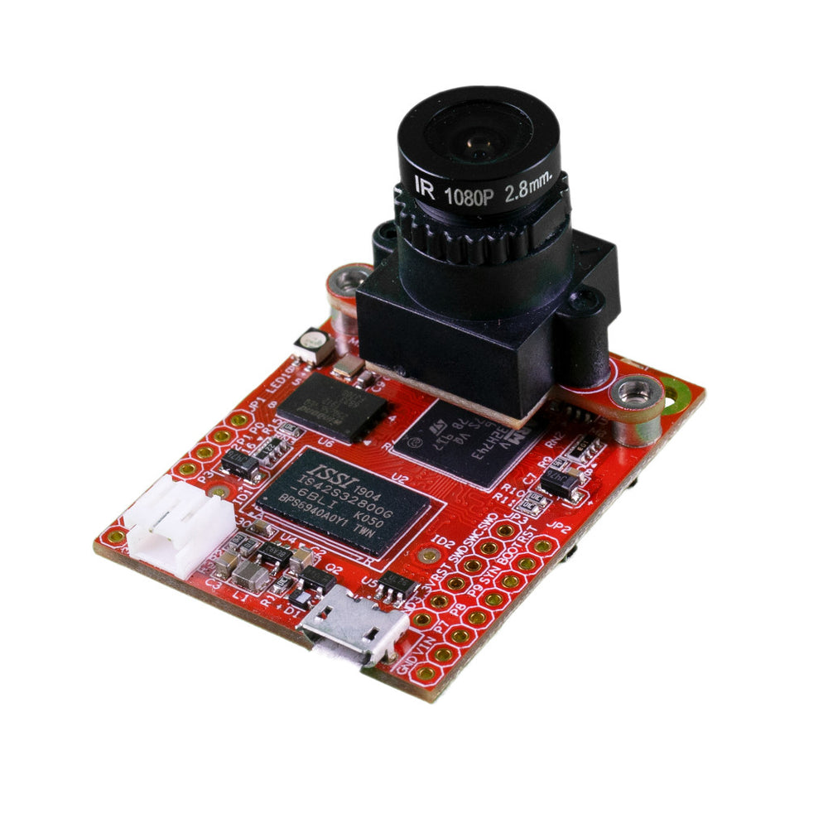
Platform
Hardware: OpenMV H7 Plus
Input device: Camera
Output: RGB LED
Training Platform: Edge Impulse

Slide 5
Motivation
Hand gestures provide a natural, touch-free interface for embedded systems
Running ML directly on-device reduces latency, power, and privacy concerns
Demonstrates that deep learning is feasible on low-resource microcontrollers
Practical relevance to HCI, accessibility, robotics, and IoT applications

Slide 6
Team & Technical Background
Chance Woosley – M.E. computer engineering – experience with high-level programming languages and embedded computing
Ziyu Xuan - -
Yi Deng - - M.E. computer engineering – experience with deep learning and cloud-edge computing

Slide 7
Team Roles
Member | Roles | Responsibilities
Yi Deng | Data & Model | Dataset collection, public dataset integration, EI training & tuning
Ziyu Xuan | Embedded System | Deployment, inference code,
Chance M Woosley | Testing & Documentation | Performance Evaluation, Report writing, GitHub management

Slide 8
Methodology
Fist: red
Data Collection
MobileNet V2 Model Training
Deployment
Real-time Testing
Palm: green
Pointing: blue
Notes:
For our methodology, we follow a simple end-to-end pipeline.
We first collect images for the three gesture classes using the OpenMV camera, and we also include some public data to make the dataset more diverse.
Next, we upload everything to Edge Impulse and train a lightweight MobileNet model that can run on the microcontroller.
After the model is trained and quantized, we deploy it onto the OpenMV H7 board.
The final step is real-time testing, where the board classifies each gesture live and maps it to different outputs—for example, a red signal for a fist, green for a palm, and blue for a pointing gesture.

Slide 9
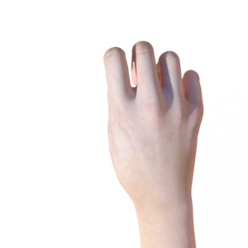
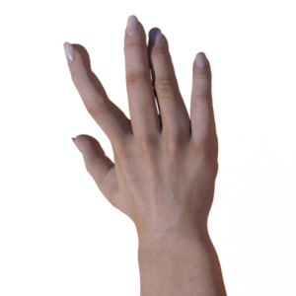
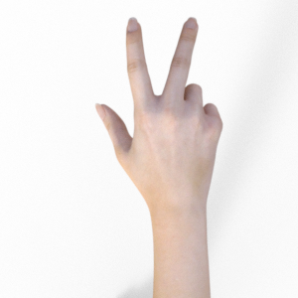
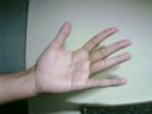
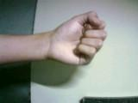

Datasets
Rock-Paper-Scissor Dataset
Our own recorded Dataset
~2850 pictures
~150 pictures

Slide 10
Innovations
Ran gesture recognition on live gestures, rather than static datasets
Live gesture-to-hardware mapping with no external compute or cloud dependency
Hybrid on-board camera/public images dataset to improve model robustness
End-to-end on-device vision pipeline, data collection, training, deployment, inference, testing, all on single low-resource MCU

Slide 11
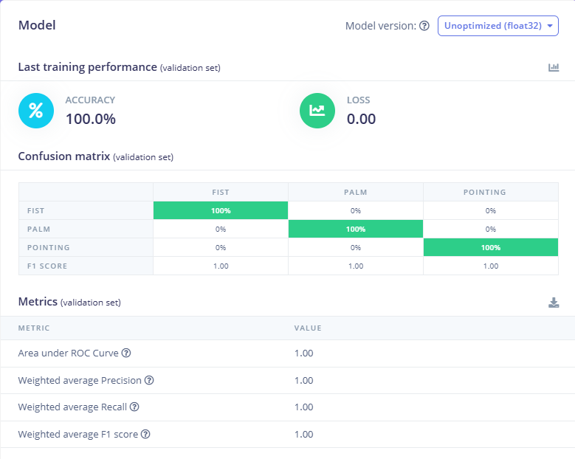
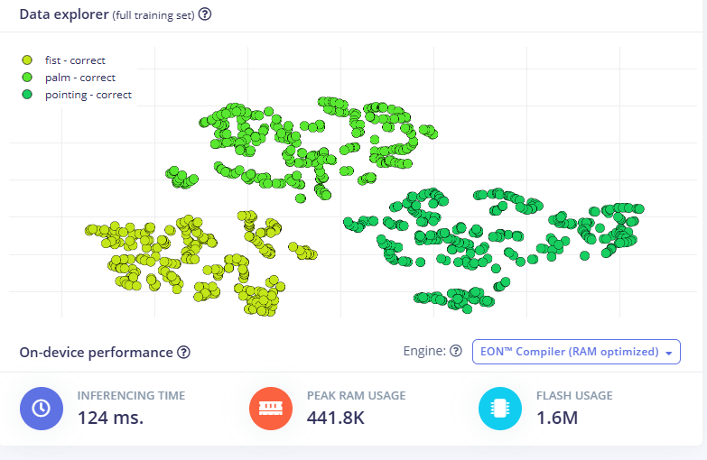
Edge Impulse Training Results

Slide 12
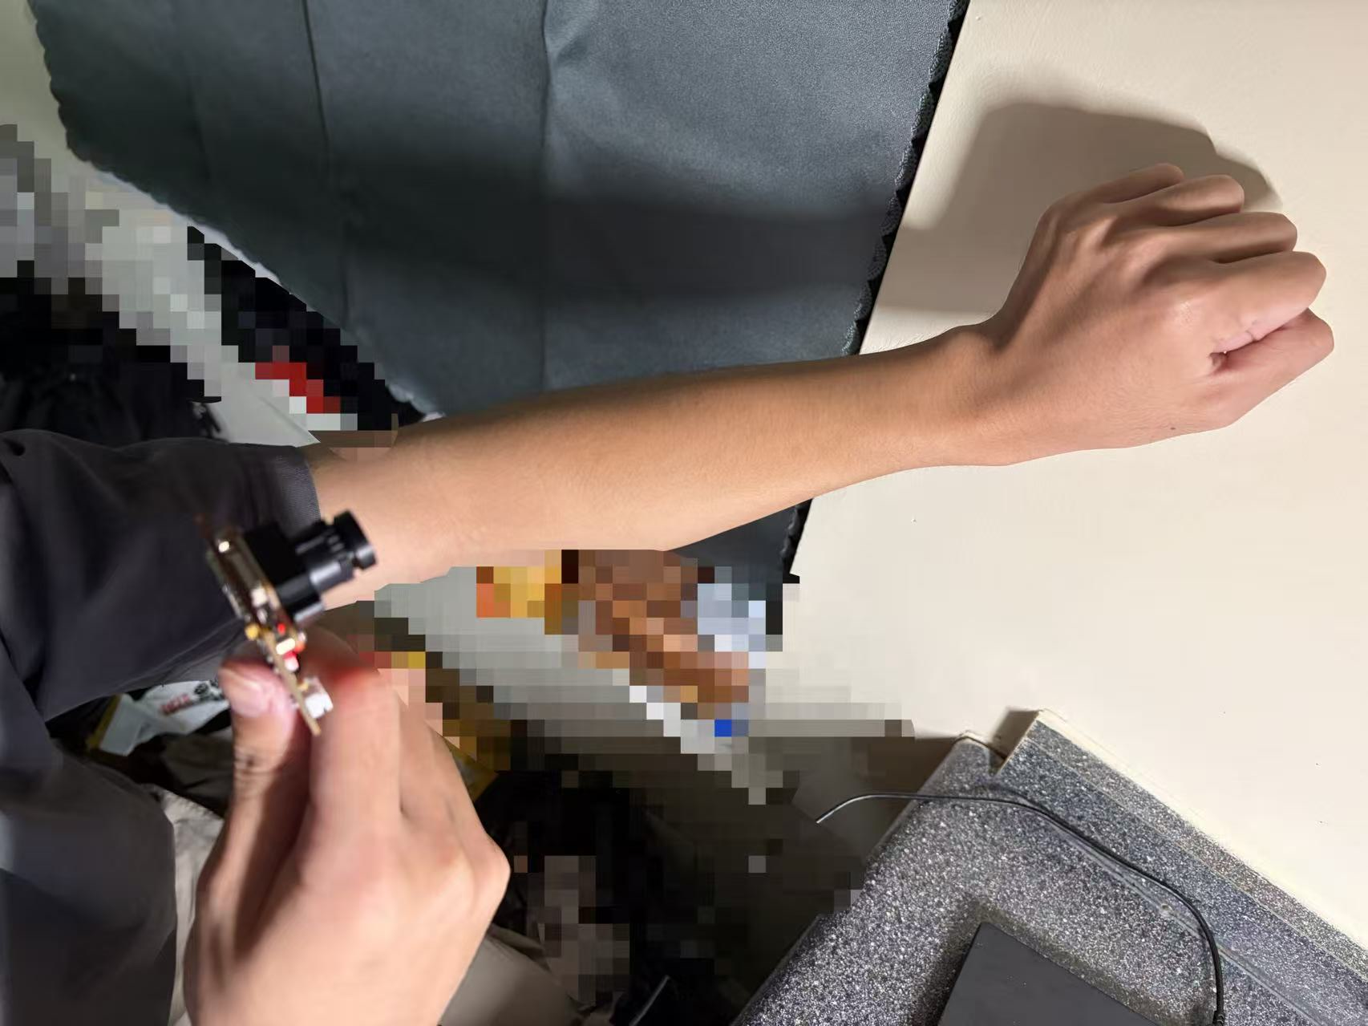
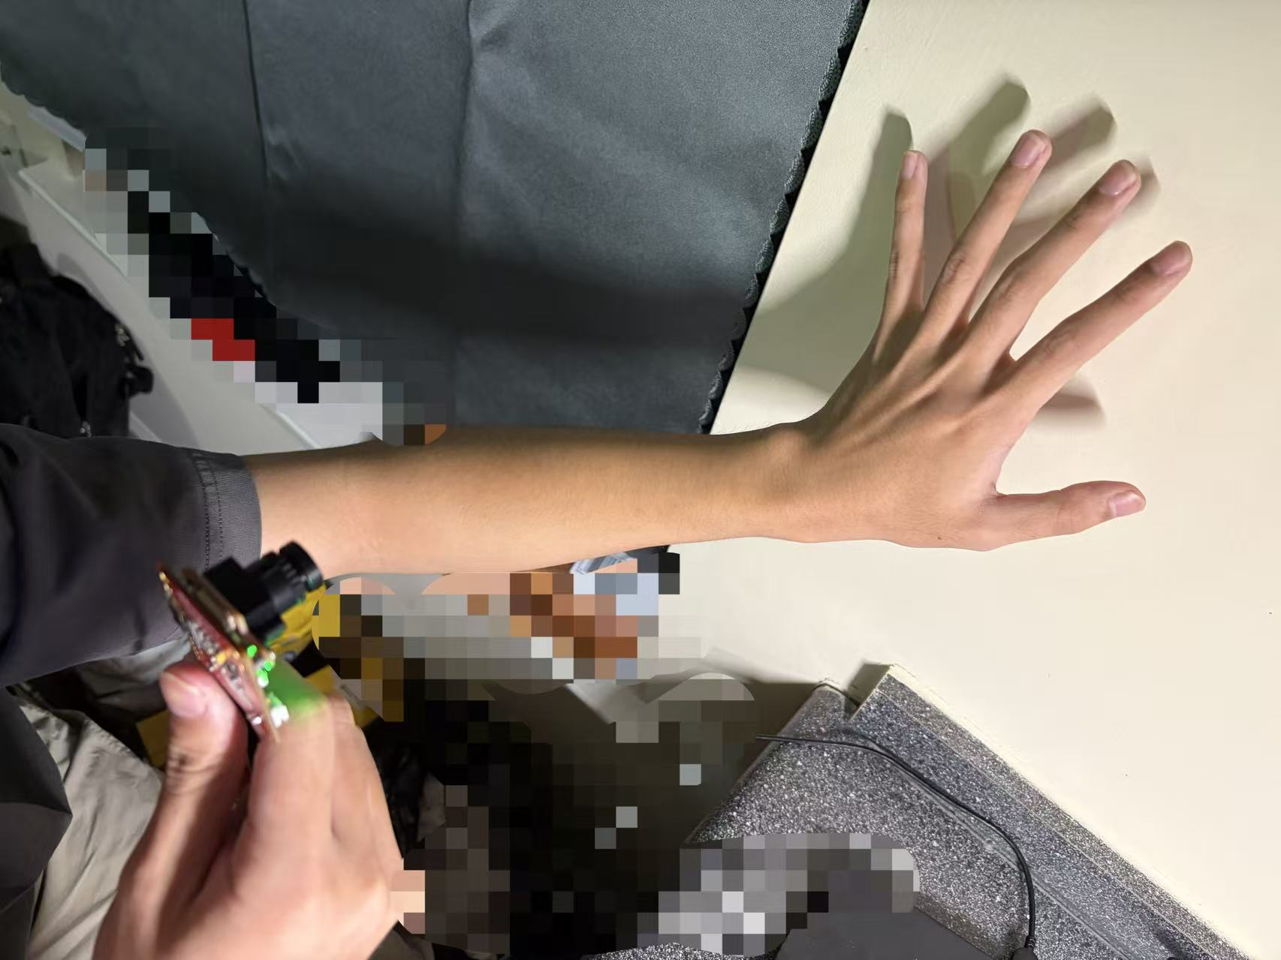
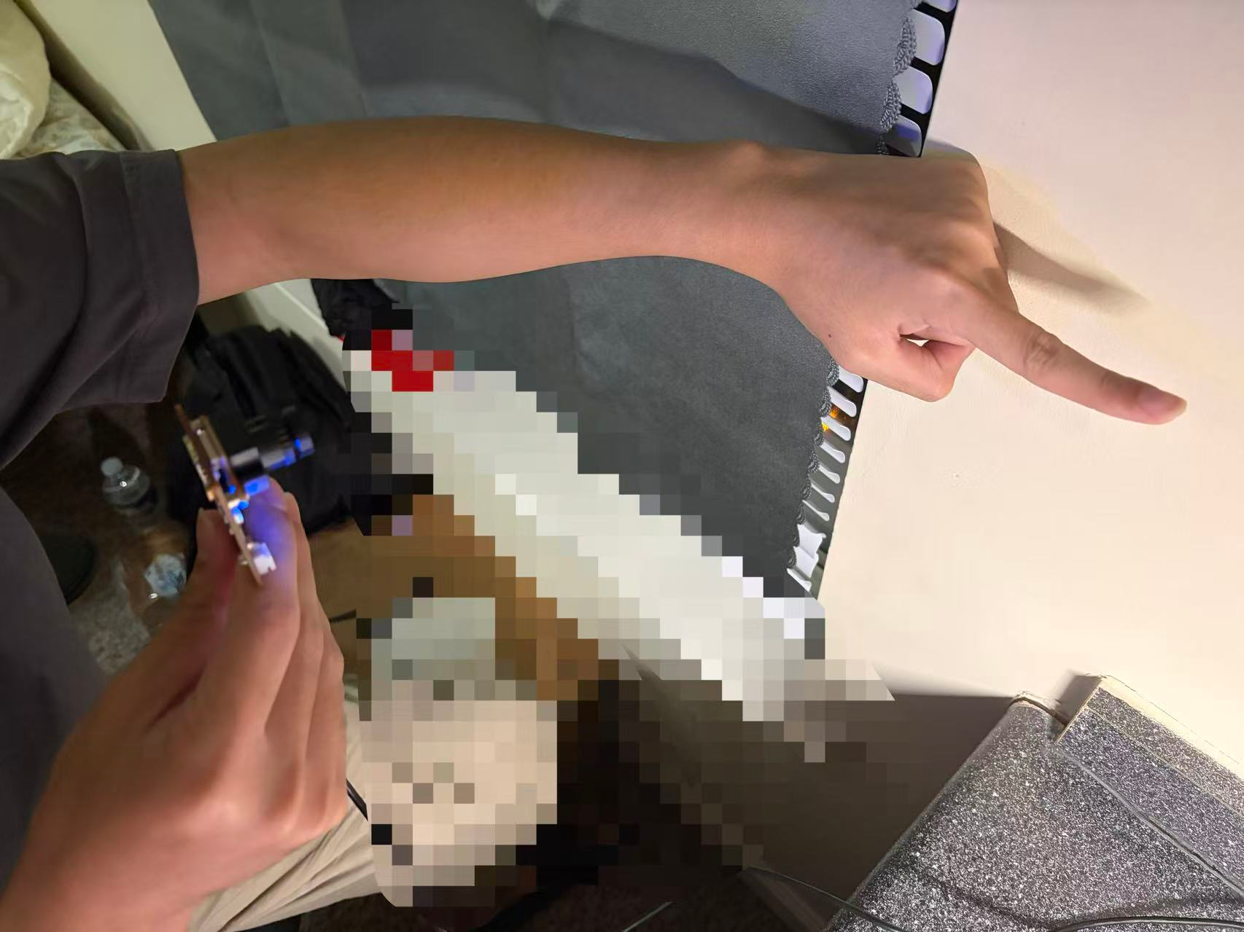
Implementation Results
palm
fist
pointing
green
red
blue

Slide 13
Test Results
 | Correct Predictions | Total Trials | Accuracy
Palm | 10 | 10 | 100%
Fist | 10 | 10 | 100%
Pointing | 9 | 10 | 90%

Slide 14
Future Work
More hand signals recognized
Video analysis instead of photo
Detect multiple gestures at once
Increase robustness for lighting conditions, background clutter, etc

Slide 15
Bibliography
[1] Asmara, R.A. et al. 2024. An Experimental Study on Deep Learning Technique Implemented on Low Specification OpenMV Cam H7 Device. JOIV : International Journal on Informatics Visualization. 8, 2 (May 2024), 1017–1029. https://doi.org/10.62527/joiv.8.2.2299.
[2] Gui, Y. 2024. Edge impulse-based convolutional neural network for Hand Posture Recognition. Applied and Computational Engineering. 40, (Jan. 2024), 115–119. https://doi.org/10.54254/2755-2721/40/20230636.
[3] Saporiti, N. et al. 2025. Implementing an AI-Driven Gesture Recognition System in MES for Enhanced Efficiency and Human-Centric Operations in Industry 5.0. IFAC-PapersOnLine. 59, 10 (Jan. 2025), 1660–1665. https://doi.org/10.1016/j.ifacol.2025.09.279.

