Slide 1
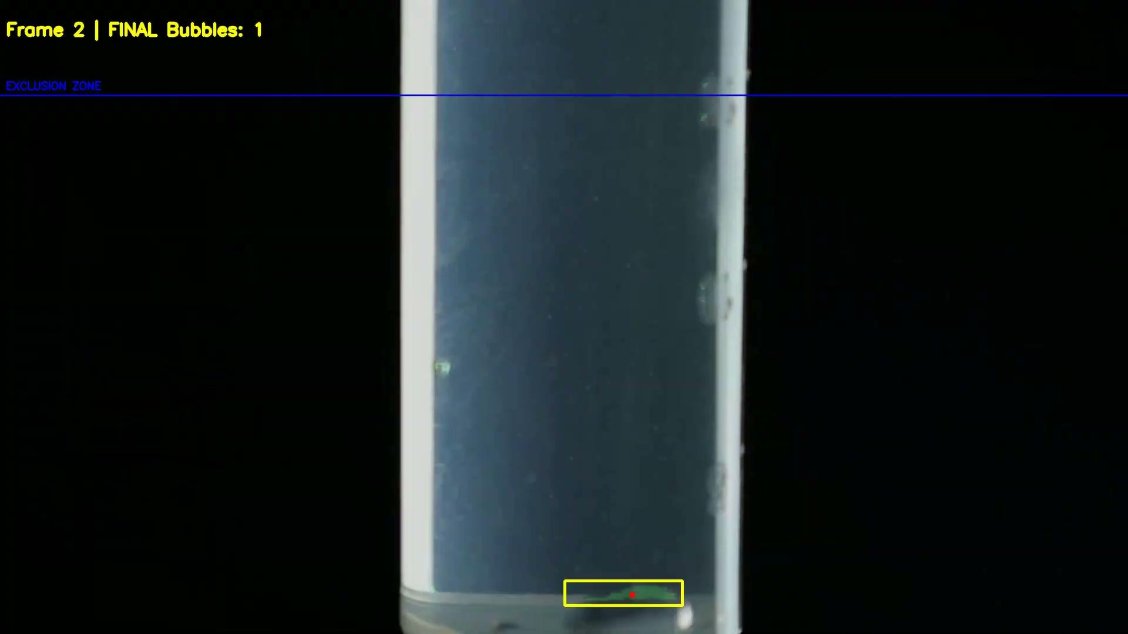
Raspi5 Bubble Detection
Final project • OpenCV and Trained CNN on Laptop • CNN on Raspberry Pi 5
TTL AI
Landon Campbell — integration & performance
Thomas Keyes — open CV software & CNN training
Tiger Zhang — CV pipeline & CNN training/deployment

Slide 2
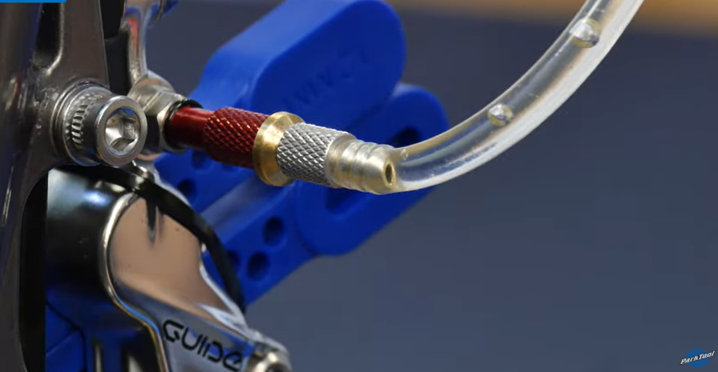
Problem & Motivation
Mountain bike brakes can trap microscopic air bubbles during bleeding
Bubbles compress → inconsistent lever feel and reduced braking performance
Manual detection is visual + subjective → need quantitative feedback
Goal: on-device processing for a bike-shop friendly tool (no cloud)
Fig. 1 Mountain bike brake bleed with bubble release

Slide 3
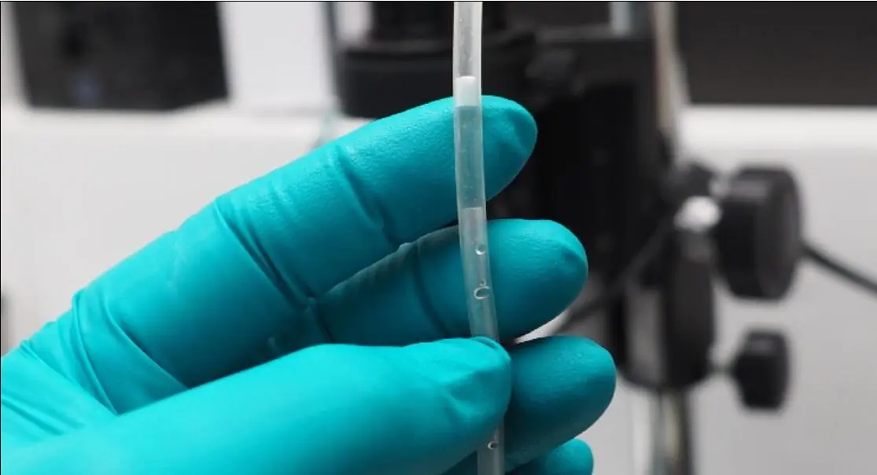
Problem & Motivation Cont.
Additional Applications:
  Medical Setting: Current ultrasonic sensors are inconsistent
    Air in IV or blood transfusion lines can cause severe complications
  Industrial fluid & fuel systems - detect air/cavitation
  Manufacturing & packaging - resin, beverage, or hydraulic quality control
  Energy & environment - fuel cells, filtration, water loops
  Generic optical flow sensor - particles, droplets, foam, or contaminants
Fig 2. Air bubble in an IV line

Slide 4
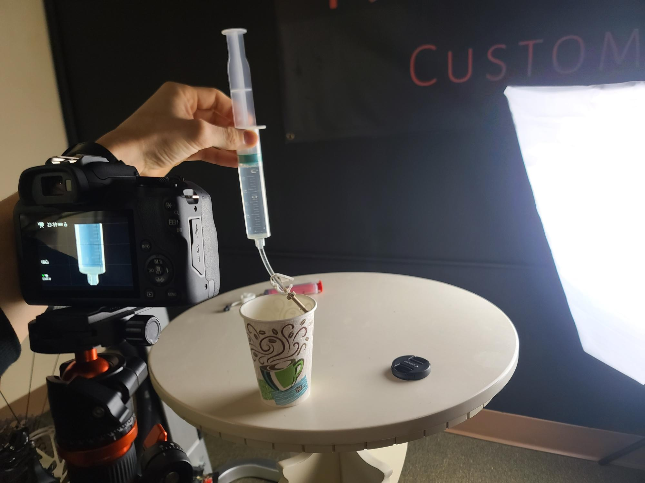
Targets (What “Good” Looks Like)
How we score it
• Count stability (per-frame + cumulative
• False positives (static artifacts removed)
• Runtime: Pi CPU vs desktop CPU/GPU (ms/frame, FPS)
• FP32 vs INT8 latency
• Pixel mask (Dice) vs manual GT
Fig 3. Camera lighting and syringe setup

Slide 5
System Architecture
Laptop
OpenCV capture + baseline
CNN segmentation training (SmallUNet)
Produces probability map
Raspberry Pi 5
CNN running on live video feed, post processing for video overlay
Outputs
Mask + boxes
Bubble stats + logs
Same post process on both paths: morphology + connected components + tracking filters
Interfaces are swappable (CV model ↔ CNN model) for A/B testing
Designed for edge-first: Pi handles camera/IO, live CNN application

Slide 6
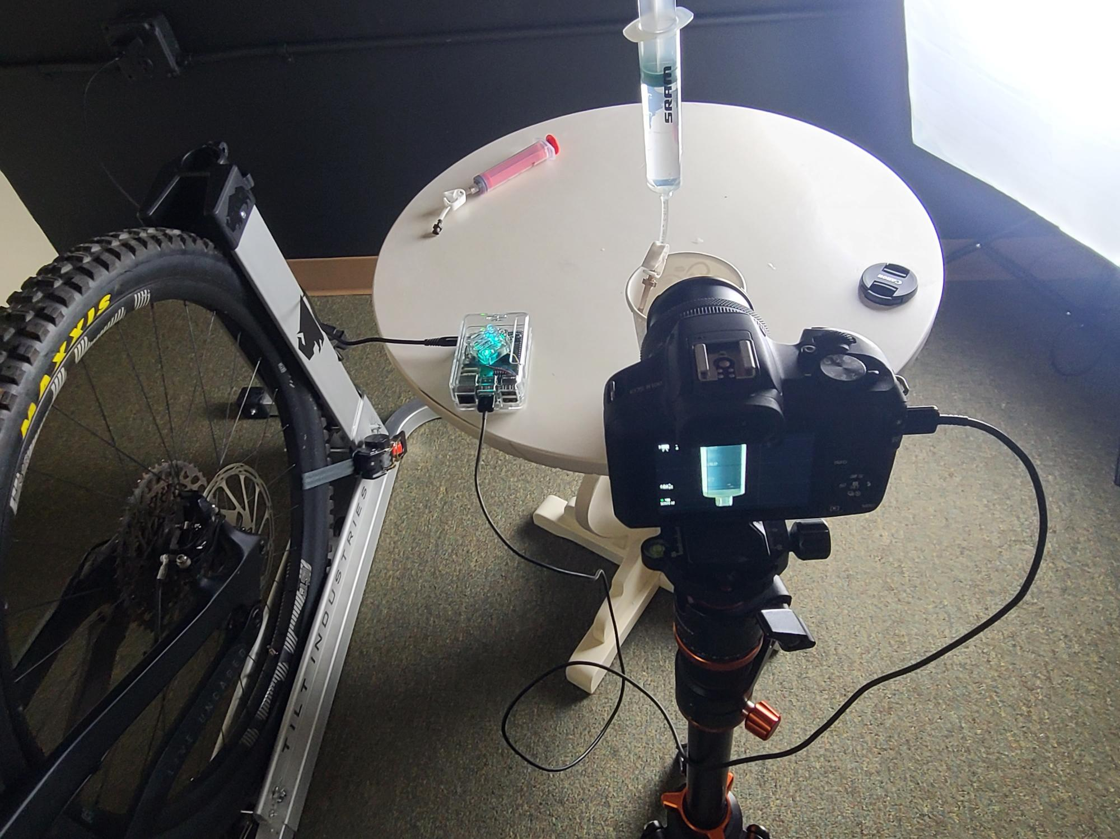
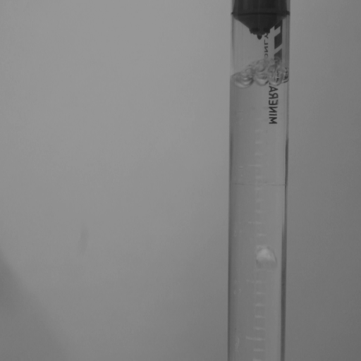
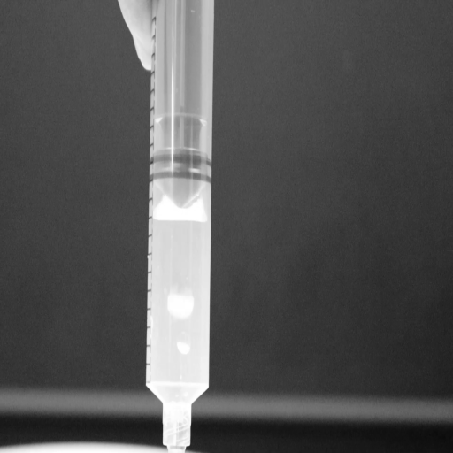
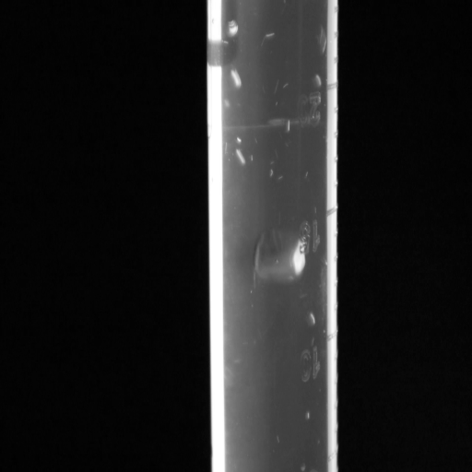
Optics & Lighting: Make Bubbles Visible
Controlled backlighting / dark background for high contrast
Fixed geometry: camera + tube/syringe + shroud to kill clutter
Stable exposure and repeatable ROI
Black background created the cleanest training + inference domain
Fig 4. Camera connected to raspi 5 for live CNN running on syringe bubbles
Light On, White Background
Light On, Black Background
Light Off, Black Background
tube
backlight
Fig 5. Lighting progression of physical setup

Slide 7


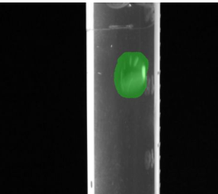
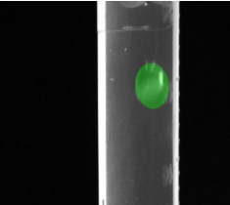
Dataset (Real Recorded Syringe Videos)
3 controlled videos:
• AIH_Bubbles.mp4 (190 frames)
• AIH_Bubbles2.mp4 (282 frames)
• AIH_Bubbles3.mp4 (183 frames)
Total: 9,344 image–mask pairs
• 8,070 manual masks (ground truth)
• 1,274 auto-masks (bootstrapped)
OpenCV auto mask segmentation
Manual mask correction
We generate multiple crops per frame → 9,344 training samples from 3 videos.
Manual mask correction overlay
CNN predicted mask overlay
Manual masks mark full bubble volume (not just highlights)
Auto-masks speed iteration and expand coverage

Slide 8
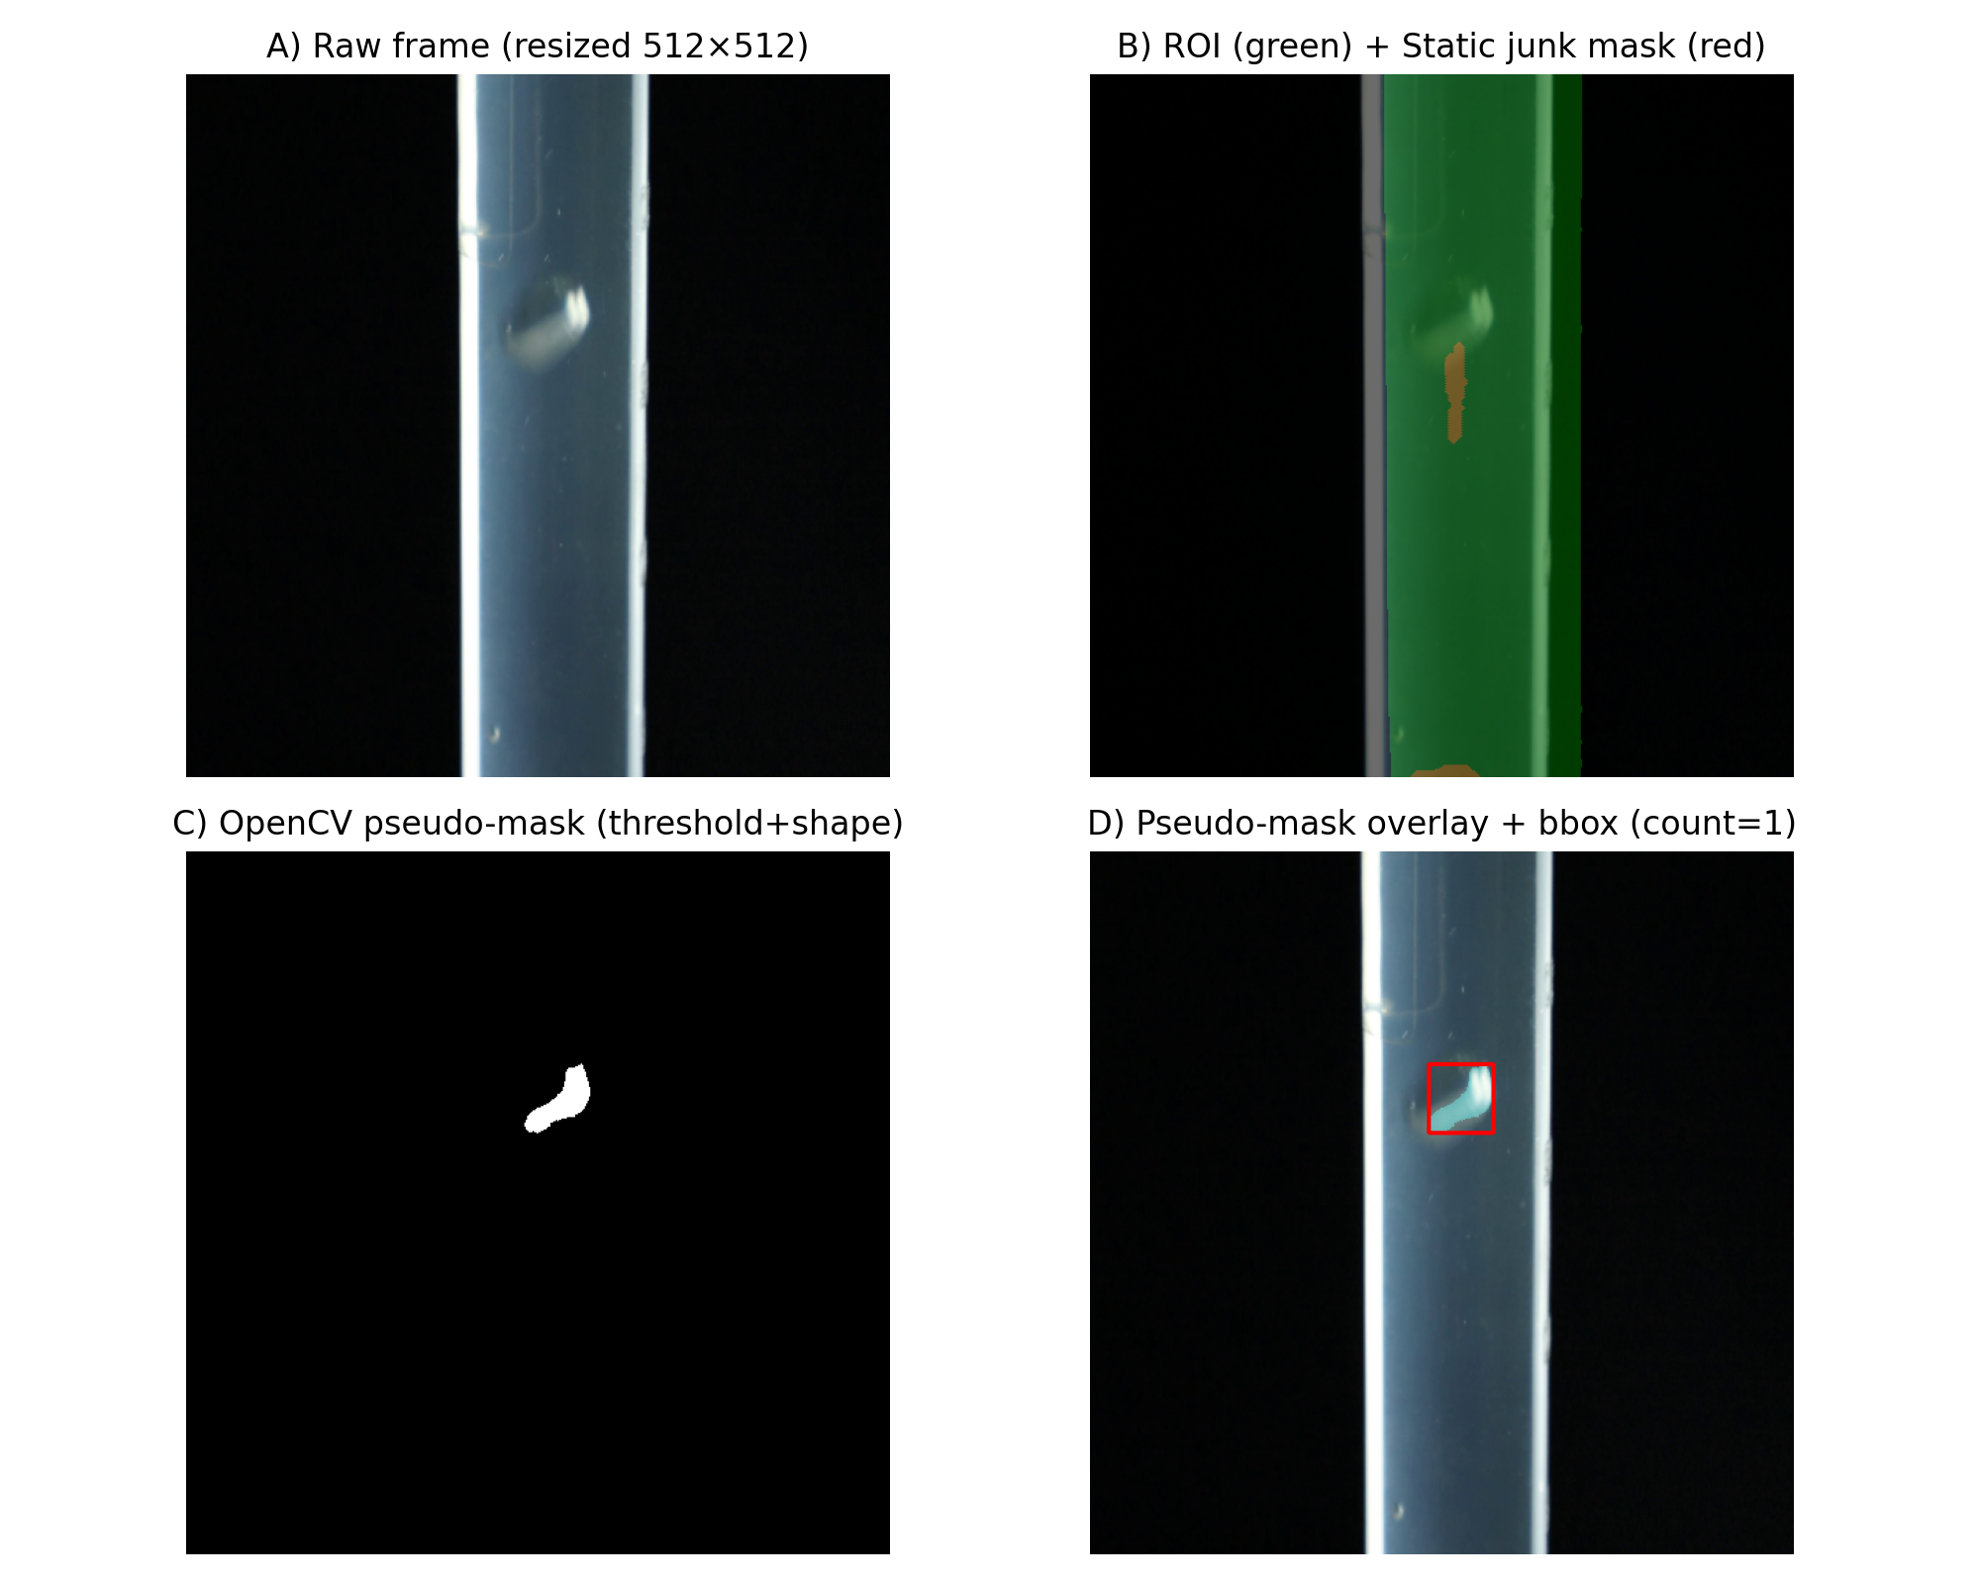
OpenCV Bootstrapping: Pseudo-Labels → Faster CNN Training
Goal: scale labeled data without hand-masking every frame
CV pipeline: (1) isolate syringe ROI → (2) threshold bright regions → (3) keep bubble-like blobs (circularity filter)
Output: 1,274 pseudo-masked samples from Bubbles3 used to expand coverage quickly
Key limitation: reflections + syringe markings can create false positives → CNN is needed for robustness

Slide 9
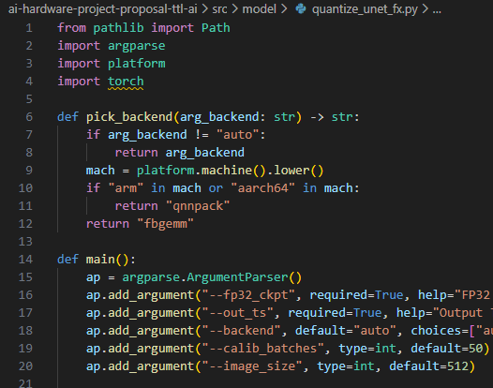
CNN Segmentation (SmallUNet) + Training Recipe
Architecture: Small U-Net-like encoder/decoder with skip connections (~233K params)
Training: 256×256 crops with weighted sampling (5× / 3× / 1×)
Loss: Focal Loss (α=0.25, γ=2.0) for extreme class imbalance
Augmentations: random crops, flips/rotations, color jitter/brightness
Training on Apple M1 (MPS); early stop at epoch 36/100
Fig 5. Snippet of quantized int8 UNET model
Validation vs manual GT: Pixel Dice is modest due to full-volume labels + refraction; system-level counting accuracy is the real KPI.

Slide 10
Key Insight: Raw CNN Output ≠ Reliable Detections
On Bubbles3 (black background), masks closely match manual labels
On Bubbles1/2, generalizes reasonably but needs heavy postprocess
Temporal filtering is essential: motion tracking removes static glare/artifacts
False Positive Rate drops with stabilization (Bubbles3)
Postprocess reduced FP by ~91% (95.1% → ~5%)

Slide 11
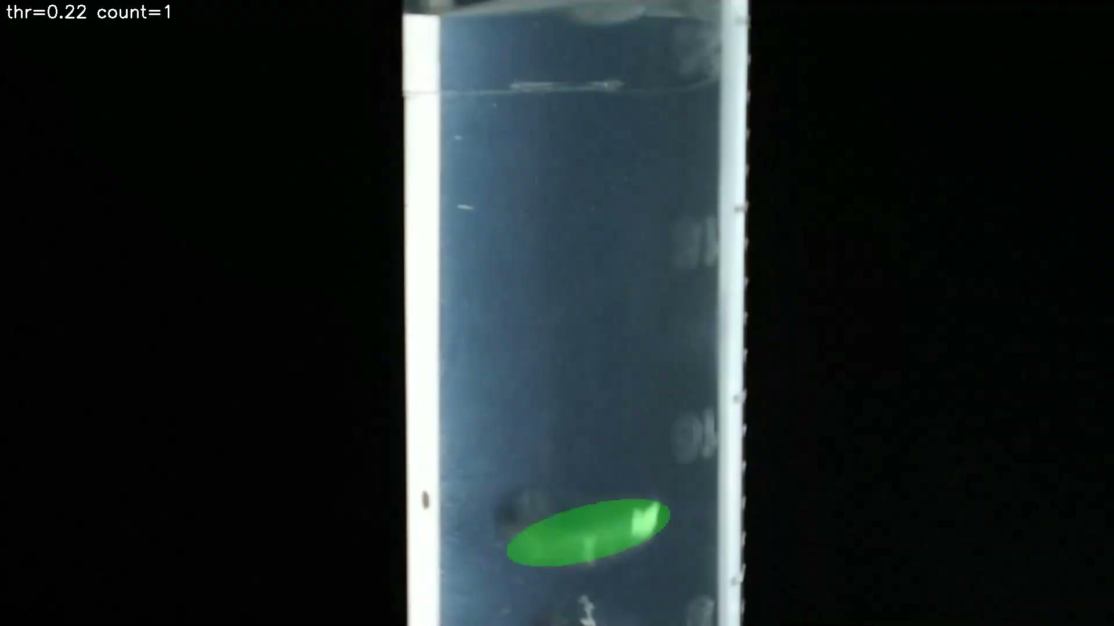
Post Processing Pipeline (What Makes It Stable)
Stage A) Suppress known junk
• ROI Mask: 256×256 tiles, stride 128 (stitch probability map)
• Static Junk Mask: Static variance filter: low variance (<10) → reject stuck detections
Stage B) Make blobs “bubble-like”
Morphology close + fill holes: 15px elliptical dilation to merge refractive clusters
Connected components: group contours into bubble instances
Stage C) Reject non-bubbles
•Ellipse/shape filters (circularity/solidity/axis-size): min area 3000 px; exclude top 15% zone
•Distance-to-edge gating (avoid syringe walls)

Slide 12
Final Validation Across All Real Videos
Video
Frames
Detections
Avg/Frame
Max
Std
GT estimate
Bubbles.mp4
190
7
0.04
1
0.19
Few actual bubbles
Bubbles2.mp4
282
113
0.40
3
0.59
Moderate bubbles
Bubbles3.mp4
183
350
1.91
7
1.17
Most bubbles
TOTAL
655
470
0.72
—
—
Validated
Ran the same CNN + postprocess pipeline on Raspberry Pi 5 CPU, desktop CPU, and desktop GPU
Benchmarked FP32 vs INT8 end-to-end latency + model time
Verified bubble-count correctness vs manual masks (labeled frames) and on unseen frames
Current demo: Pi camera capture + real-time overlay
Takeaway: counts match qualitative expectations (B1 few, B2 moderate, B3 most)

Slide 13
Hardware: Benchmarking & Deployment Status
Platform | Precision | Threads | Stride (every_n) | Model median (ms) | Core median (ms) | Total median (ms) | Total p95 (ms) | Total FPS
Raspberry Pi 5 | FP32 | 4 | 1 | 809.50 | 897.62 | 1379.34 | 2888.28 | 0.72
Raspberry Pi 5 | INT8 | 4 | 1 | 297.60 | 398.08 | 606.70 | 1514.53 | 1.65
Desktop CPU | FP32 | 8 | 2 | 27.08 | 31.67 | 41.87 | 47.08 | 23.88
Desktop GPU | FP32 | 8 | 2 | 12.49 | 16.74 | 16.97 | 19.34 | 58.92
Desktop CPU | INT8 | 8 | 2 | 25.78 | 30.16 | 30.14 | 32.54 | 33.18
Desktop GPU | INT8 | 8 | 2 | 2.78 | 7.38 | 16.22 | 21.53 | 61.66
Precision | Dice raw (mean) | Dice post (mean) | IoU raw (mean) | IoU post (mean) | Bubble count |err| (mean) | Bubble count |err| (median) | n | thr
FP32 | 0.337 | 0.627 | 0.233 | 0.546 | 0.430 | 0.0 | 79 | 0.22
INT8 | 0.320 | 0.658 | 0.217 | 0.576 | 0.405 | 0.0 | 79 | 0.22

Slide 14
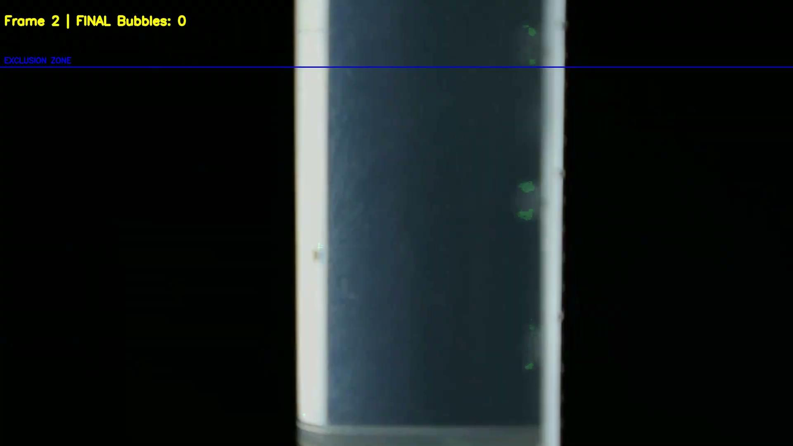
Wrap-Up & Next Steps
Working end-to-end pipeline: capture → segmentation → stabilization → bubble counts
Big lesson: temporal filtering is mandatory for reliable deployment
Next: expand labeled real footage; px→mm calibration; void-fraction metrics
Next: tighten Pi benchmarking and publish latency/FPS + power numbers

