Slide 1
HTTP Web Services & Model Serving
From MLflow champion to a production-shaped inference API
Building ML Solutions
Session 12

Slide 2


Lecture Overview
Packaging & Versioning Models for Production
Deployment Scenarios & Architectural Patterns
Service Interfaces: REST vs gRPC
Building APIs with FastAPI
Production Inference Frameworks
2

Slide 3
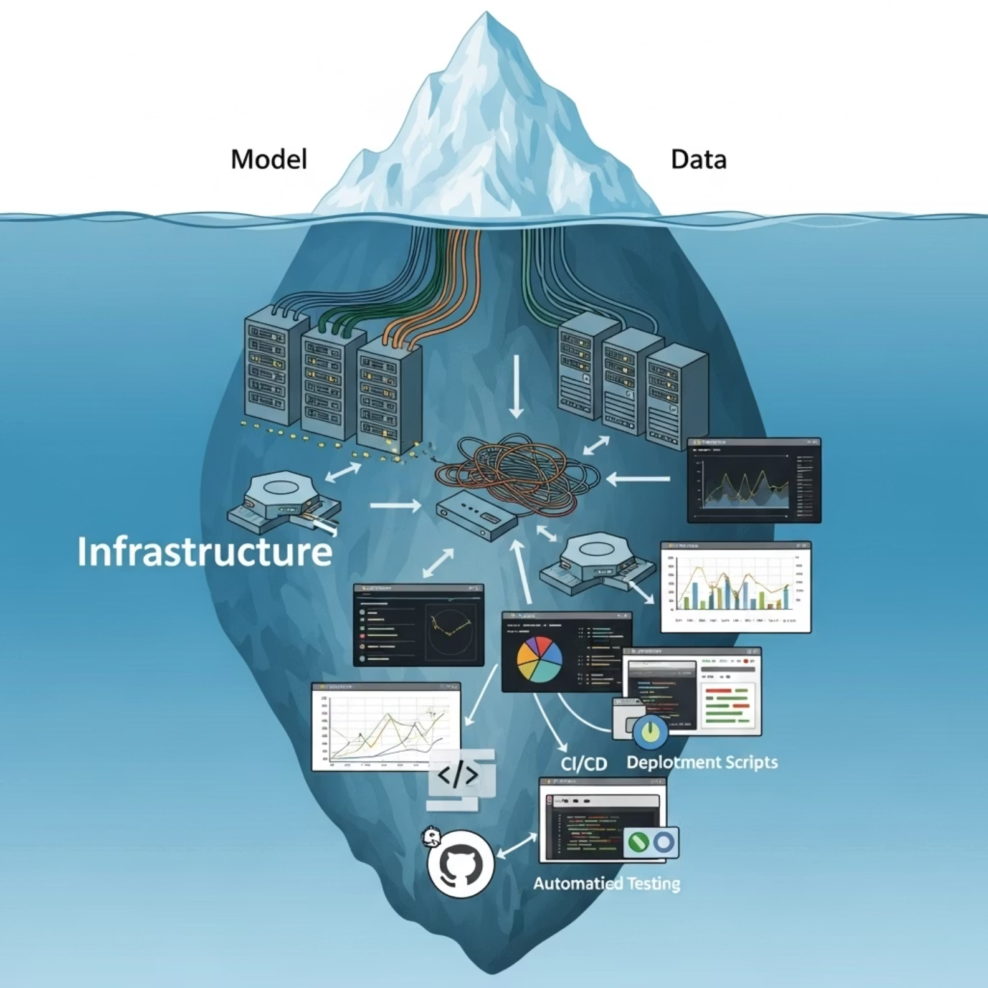
Why Is This Important?
Shipping the model as a service is the real work:
Session 6 — a stable /predict contract.
Session 8 — same contract, pretrained model.
Session 11 — champion selected in MLflow.
Session 12 — champion as an HTTP service (today).
Session 13 — Grafana & cloud observability (next).

Slide 4
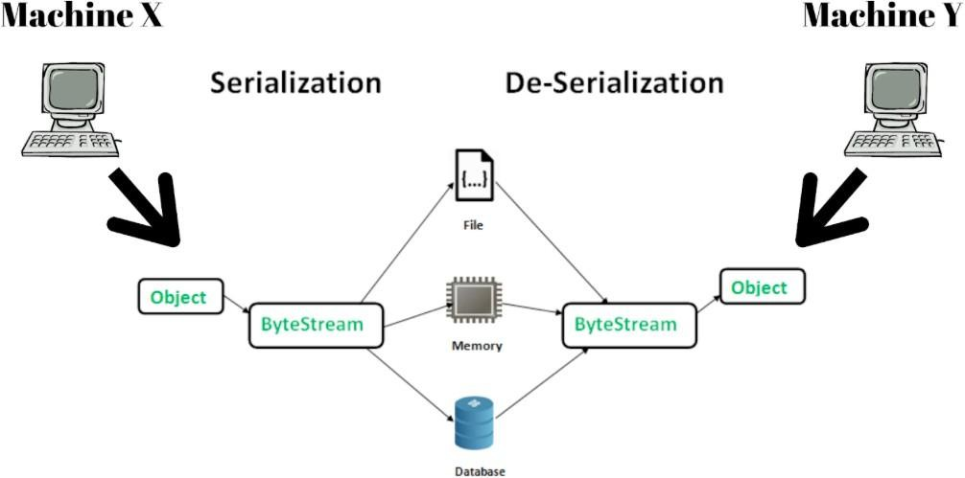

Model serialization

Slide 5





import joblib
from my_module import SimpleModel
model = SimpleModel()
model_path = "model.joblib"
joblib.dump(model, model_path)
loaded_model = joblib.load(model_path)
print("Model loaded successfully")

Slide 6







Easy
Insecure
You must save part of the code separately (move to modules)
You must capture the runtime environment yourself
Security: pickle / joblib / cloudpickle are for trusted internal artifacts only. Loading an untrusted artifact can execute arbitrary code.

Slide 7

Framework‑specific ways (PyTorch)
import torch
from my_module import SimpleModel
model = SimpleModel()
state = {
"model_state_dict": model.state_dict(),
"model_config": {"hidden_dim": 128},
}
torch.save(state, "checkpoint.pt")
checkpoint = torch.load(
"checkpoint.pt", map_location="cpu", weights_only=True,
)
loaded_model = SimpleModel(**checkpoint["model_config"])
loaded_model.load_state_dict(checkpoint["model_state_dict"])
loaded_model.eval()

Slide 8

Framework‑specific ways
Available in almost every framework
Not universal
Part of the code and environment must still be saved separately

Slide 9



import torch
import torch.optim as optim
import mlflow.pytorch
from my_module import SimpleModel
model = SimpleModel()
optimizer = optim.SGD(model.parameters(), lr=0.01)
mlflow.pytorch.save_model(model,"torch_model_mlflow") # Load the model back
loaded_model = mlflow.pytorch.load_model("torch_model_mlflow")

Slide 10

Supports many ML frameworks
Works well on the happy path; weaker for edge cases
Can also save environment and pre/post-processing code

Slide 11


import torch
from my_module import SimpleModel
model = SimpleModel()
model.eval()
example_input = torch.randn(1, 10)
torch.onnx.export(
model,
(example_input,),
"model.onnx",
input_names=["features"],
output_names=["logits"],
dynamic_shapes={"features": {0: "batch_size"}},
dynamo=True,
verify=True,
)

Slide 12

import onnxruntime as ort
session = ort.InferenceSession("model.onnx")
input_name = session.get_inputs()[0].name
outputs = session.run(
None, {input_name: example_input.numpy()}
)
print(outputs)

Slide 13

Does not serialise everything
Language‑agnostic
Optimised for inference

Slide 14
How to Choose a Serialization Method
Scenario | Better default
Quick internal sklearn prototype | joblib / pickle — trusted artifacts only
PyTorch checkpoint for retraining | state_dict + config + code version
Hugging Face model weights | safetensors + pinned revision
Portable tensor inference | ONNX / TensorRT / OpenVINO
Registry + signature + dependencies | MLflow Model
Edge / mobile PyTorch | torch.export / ExecuTorch (by target)

Slide 15





Preparing a model
for deployment
01
Weights & architecture. Prefer safetensors; use pickle only for trusted internal artifacts.
Should be done under the control of whoever is deploying (MLE), or per their instructions — e.g., saved to the Model Registry in the required way.
Code & preprocessing. Loading logic, tokenizer, pre/post-processing, and the I/O schema.
02
Environment & metadata. Locked runtime deps (lockfile), config, version, and smoke tests.
03

Slide 16


Slide 17






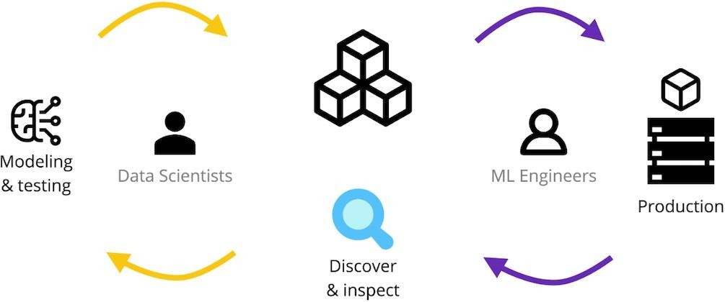


Slide 18










There can be one tool for tracking experiments:
Or there may be several:

Slide 19

Model Registry tasks
Lifecycle management:
Store models (weights + deps)
Version them & track changes
Promote versions to production
Production history tracking:
Investigate incidents during training: which code/data lead to the problematic model in prod?
Investigate incidents in prod: which tests/monitoring did we miss?
Model sharing across teams:
Search: find the right model, e.g., on HuggingFace
Usage: load a model ready for inference

Slide 20



import mlflow.sklearn
from mlflow import MlflowClient
from mlflow.models import infer_signature
signature = infer_signature(X_train, model.predict(X_train))
with mlflow.start_run():
info = mlflow.sklearn.log_model(
sk_model=model,
name="classifier",
signature=signature,
input_example=X_train[:3],
registered_model_name="bot_classifier",
)
client = MlflowClient()
client.set_registered_model_alias(
"bot_classifier", "champion", info.registered_model_version,
)

Slide 21

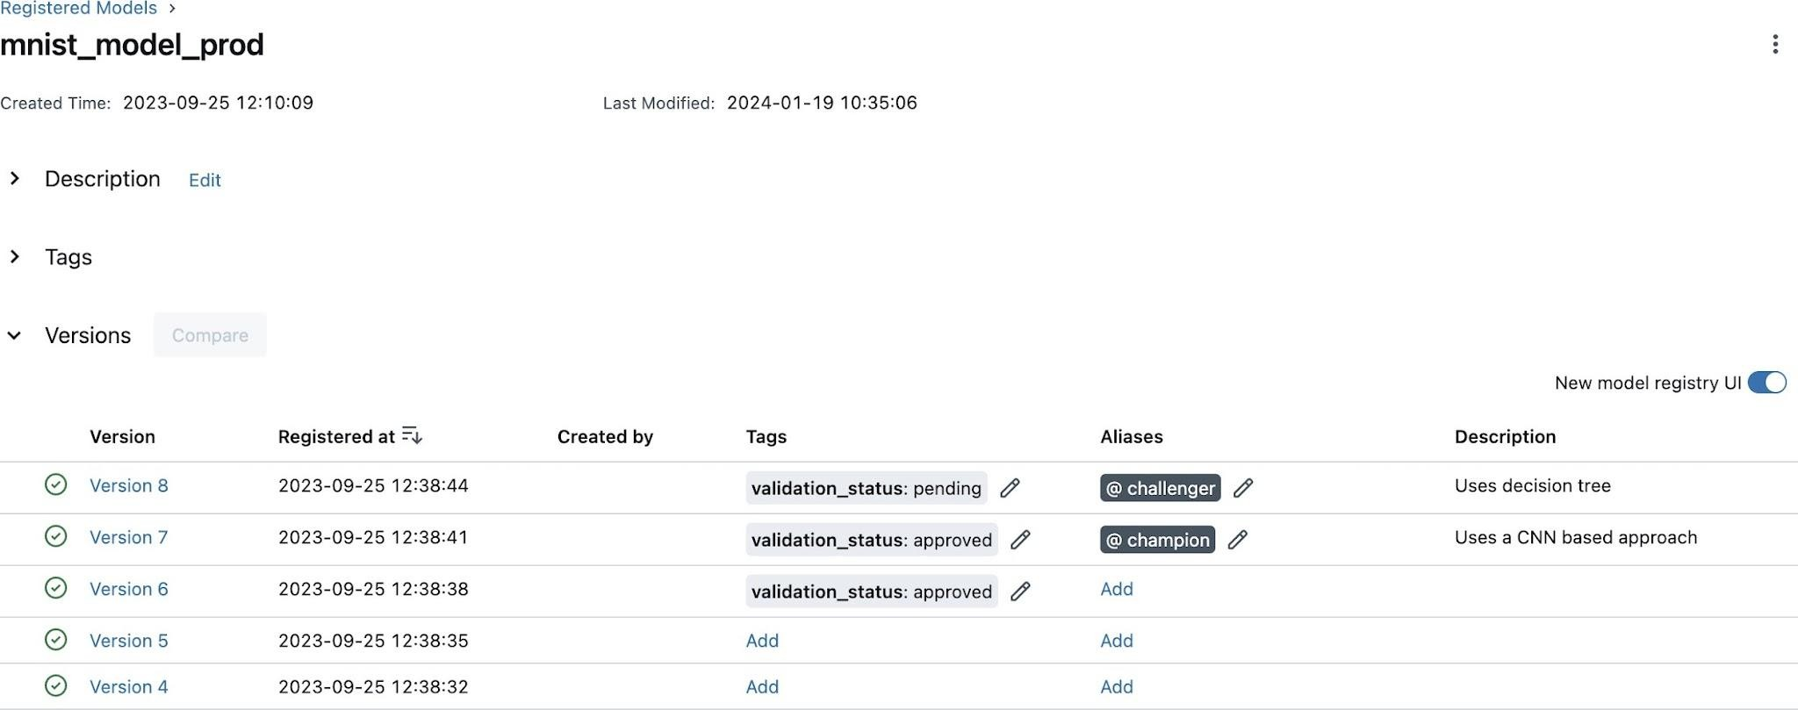

Versions of the same model
Tags: free-form metadata & labels
Aliases — shortcuts to the model, like `:latest` in Docker images.

Slide 22
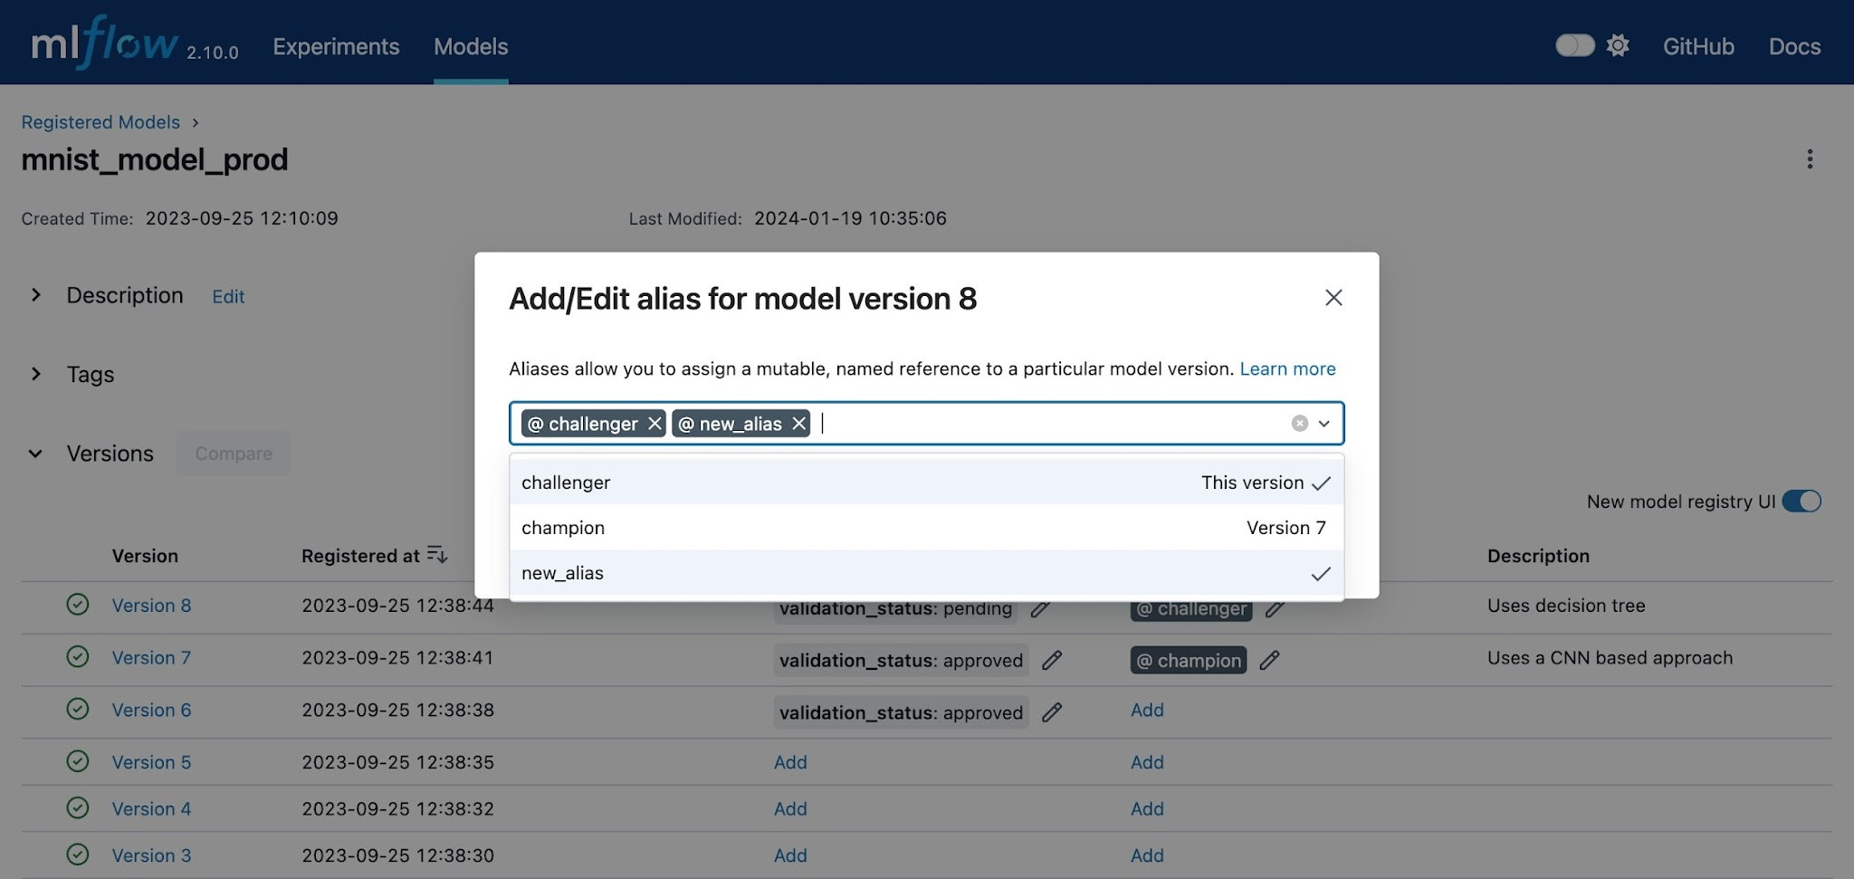


Slide 23

MLFlow - getting the model via API
import mlflow
from mlflow import MlflowClient
# Load the champion by alias
model_uri = "models:/bot_classifier@champion"
model = mlflow.pyfunc.load_model(model_uri)
# Resolve concrete version for logs
mv = MlflowClient().get_model_version_by_alias(
"bot_classifier", "champion"
)
version = mv.version
Pull method. The alias eases rollout — but log the resolved concrete version, not just the alias, for reproducibility.

Slide 24






Which tasks do we solve?
What will deployment look like (push/pull)?
How much will it cost us?
What else exists in the ecosystem?
How to choose a Model Registry

Slide 25
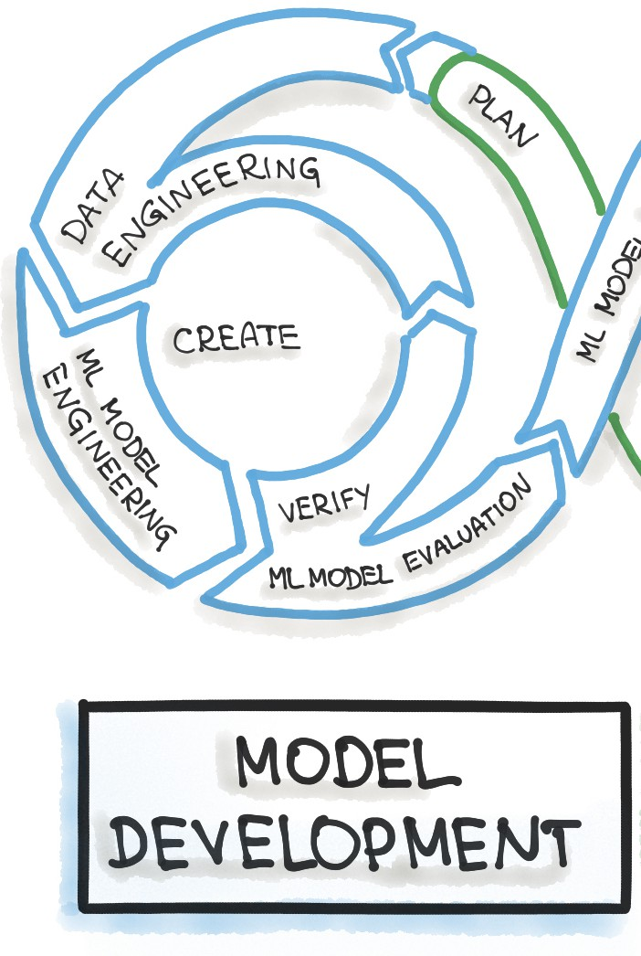
Model Lifecycle
So far we have:
Trained several model versions.
Chosen the best one (via MLflow experiments)
Stored the best checkpoint in a registry (S3, MLflow, etc.)
What’s next?

Slide 26
Model Usage Scenarios
There are several most typical scenarios for using the model:
01
Request–Response (real‑time): the client sends data and receives a prediction.
Response
Request
App

Slide 27

Model Usage Scenarios
There are several most typical scenarios for using the model:
01
Request–Response (real‑time): the client sends data and receives a prediction.
Batch Scoring (offline): periodically score a large data dump via cron/Airflow (tasks on the schedule)
02

Slide 28
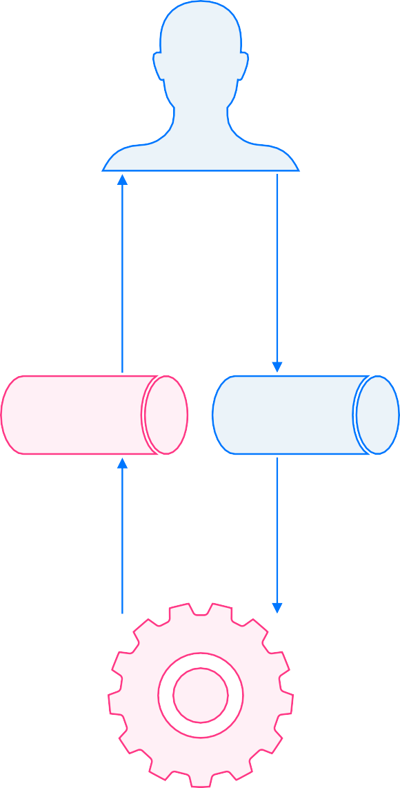
Model Usage Scenarios
There are several most typical scenarios for using the model:
Response
Request
Request–Response (real‑time): the client sends data and receives a prediction.
Batch Scoring (offline): periodically score a large data dump via cron/Airflow (tasks on the schedule)
Streaming: tasks enter a queue for inference.
01
02
03

Slide 29
Integration Approaches
Today we will discuss only the request–response scenario.
How can a model be integrated into existing business logic from an architectural point of view?
Response
Request
Response
Request
Application
Business Logic
Application
Business Logic
Model
You can keep the call to the model inside the main application, while moving the model itself into a separate service (model as a service, MaaS) — a micro‑service approach.
The model can be embedded directly in the existing application’s code — a monolithic approach.
Model Service
Model
13

Slide 30


Docker compose
Docker Compose is a tool for describing and running multi‑container applications.
It simplifies development and debugging of projects that consist of several components.
To get started you write one shared YAML file describing all components and the relationships between them.

Slide 31
Docker compose:
commands
# Bring up all services from compose.yaml
docker compose up
# Same, but detached
docker compose up -d
# Stop and remove services & networks
docker compose down
# Tail logs of all services
docker compose logs
# Tail logs of one service
docker compose logs service_name
# List running services
docker compose ps
# Restart services (ignores edits in compose.yaml)
docker compose restart
# Pre‑pull images defined in compose.yaml
docker compose pull
For the commands to run correctly, one of the following service‑configuration files must be present in the working directory:
compose.yaml
compose.yml;
docker-compose.yaml;
docker-compose.yml.
To point Compose to a different file — or to merge several configuration files into one effective stack — use the ‑f flag

Slide 32
Docker compose:
example
# compose.yaml
services:
inference-service:
build: .
environment:
MODEL_URI: "models:/bot_classifier@champion"
MLFLOW_TRACKING_URI: "http://mlflow:5000"
ports:
- "8000:8000"
depends_on:
- mlflow
mlflow:
image: ghcr.io/mlflow/mlflow:v3.1.0
ports:
- "5000:5000"
A minimal serving stack: your inference API plus an MLflow server, wired together for a local run.

Slide 33
Docker compose:
example
# build images and start the stack
docker compose up --build
# run detached, then follow logs
docker compose up -d
docker compose logs -f inference-service
# stop and remove containers + network
docker compose down
Bring the whole stack up with one command — and tear it down just as easily.

Slide 34
Compose vs production orchestration
Compose is for local integration and reproducible demos — not your production runtime.
Production orchestration is a platform job:
VM + systemd
Cloud Run
Amazon ECS
Kubernetes / KServe
Fly.io

Slide 35
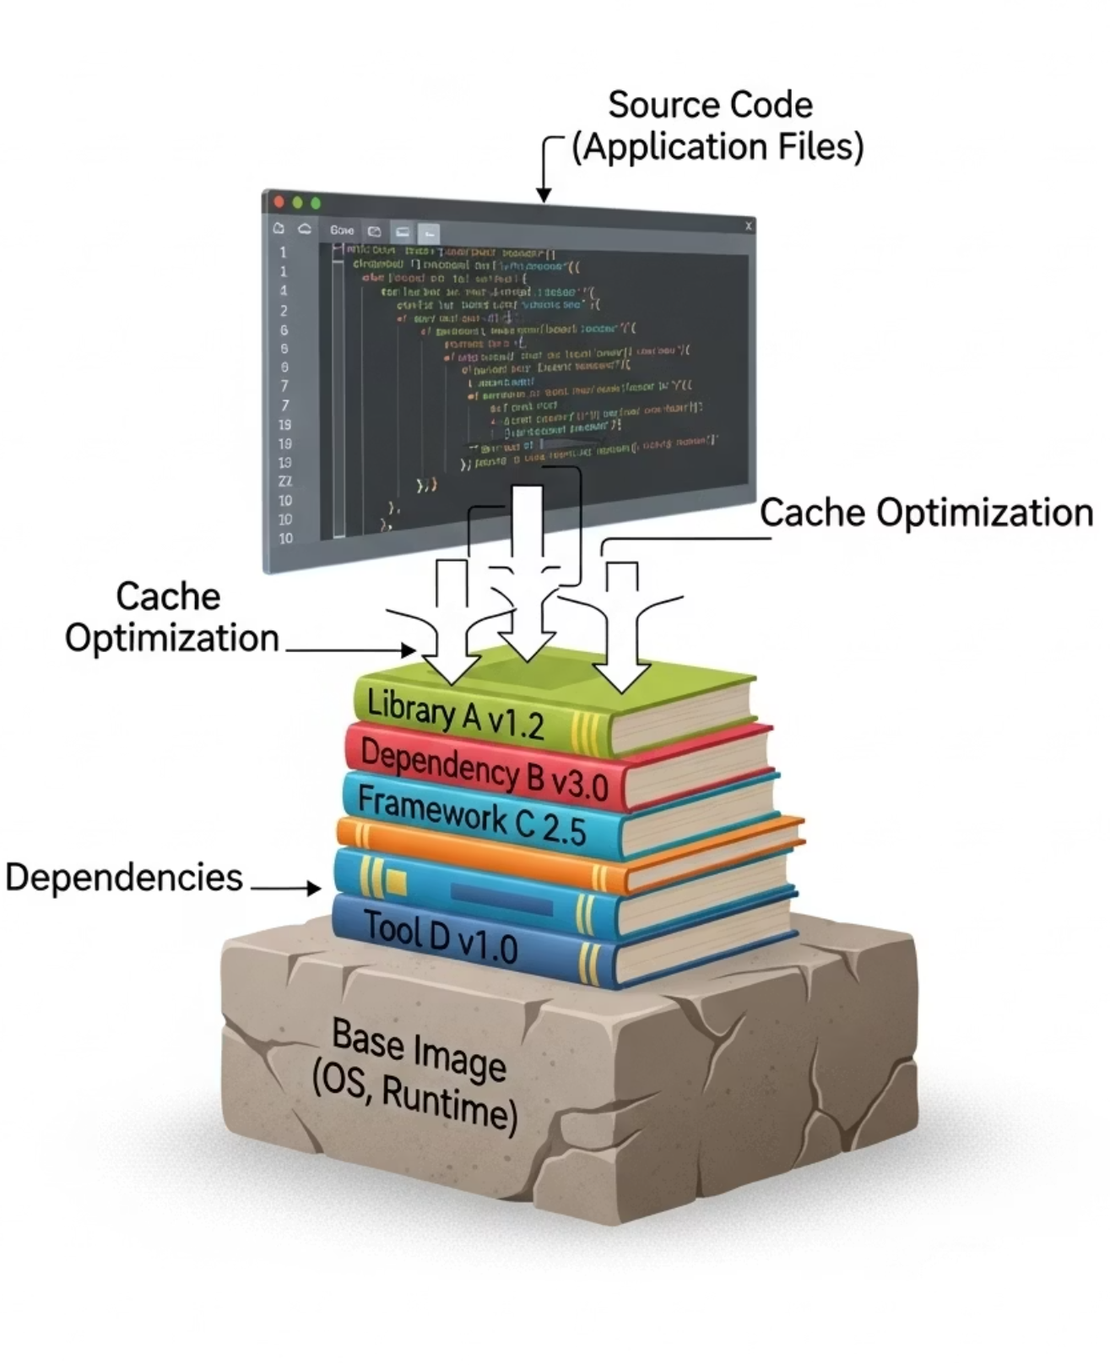
Production Dockerfile with uv
FROM python:3.12-slim AS runtime
WORKDIR /app
RUN pip install --no-cache-dir uv
COPY pyproject.toml uv.lock ./
RUN uv sync --frozen --no-dev --no-install-project
COPY src ./src
RUN useradd --create-home --uid 10001 appuser
USER appuser
CMD ["/app/.venv/bin/uvicorn", "src.main:app",
"--host", "0.0.0.0", "--port", "8000"]
Copy the lockfile before source code.
Install from the lockfile (uv sync --frozen).
No dev dependencies in the runtime image.
Run as a non-root user.
Never bake in .env, secrets, notebooks, raw data, or model caches.

Slide 36
REST/HTTP and gRPC

Slide 37
HTTP
Method
Path
Protocol version
HTTP (HyperText Transfer Protocol) is an application‑layer protocol used for communication between a client and a web service.
For example, when you open a URL in a browser, the browser sends a GET request to the web server at the specified host.
A request contains:
GET
Host:
/ HTTP/1.1
developer.mozilla.org
Accept-Language: fr
Headers
a path plus optional headers;
and, optionally, a body placed at the end of the request.

Slide 38

HTTP
Protocol version
Status code
Status message
The server answers with an HTTP response that includes:
a status code and status message.
HTTP/1.1 200 OK
1xx – informational
2xx – success
3xx – redirection
4xx – client error
5xx – server error
date: Tue, 18 Jun 2024 10:03:55 GMT
cache-control: public, max-age=3600 content-type: text/html
Headers
Headers and, optionally, a body ( the HTML of a page).

Slide 39
HTTP CRUD
HTTP has many verbs, but they boil down to four CRUD actions:
Create — add a resource (POST).
Read — fetch a resource (GET).
Update — modify a resource (PUT, PATCH).
Delete — remove a resource (DELETE).

Slide 40

REST
A RESTful API follows five key rules:
Client–Server separation
Uniform Interface (consistent endpoints)
Stateless requests (each one is self‑contained)
Cacheable resources
Layered Architecture (proxies, gateways, etc.)

Slide 41
REST API
Situation | Status code
Valid prediction | 200
Invalid JSON / schema | 422 / 400
Model not loaded / not ready | 503
Upstream timeout | 504
Internal crash | 500
What Is a REST API?
A REST API is an architectural style, usually implemented over HTTP(S):
JSON payloads dominate in ML services — easy to inspect, validate, log safely, and test with curl;
stateless, uniform and cacheable requests keep client and server decoupled.
response
request
API
APP

Slide 42
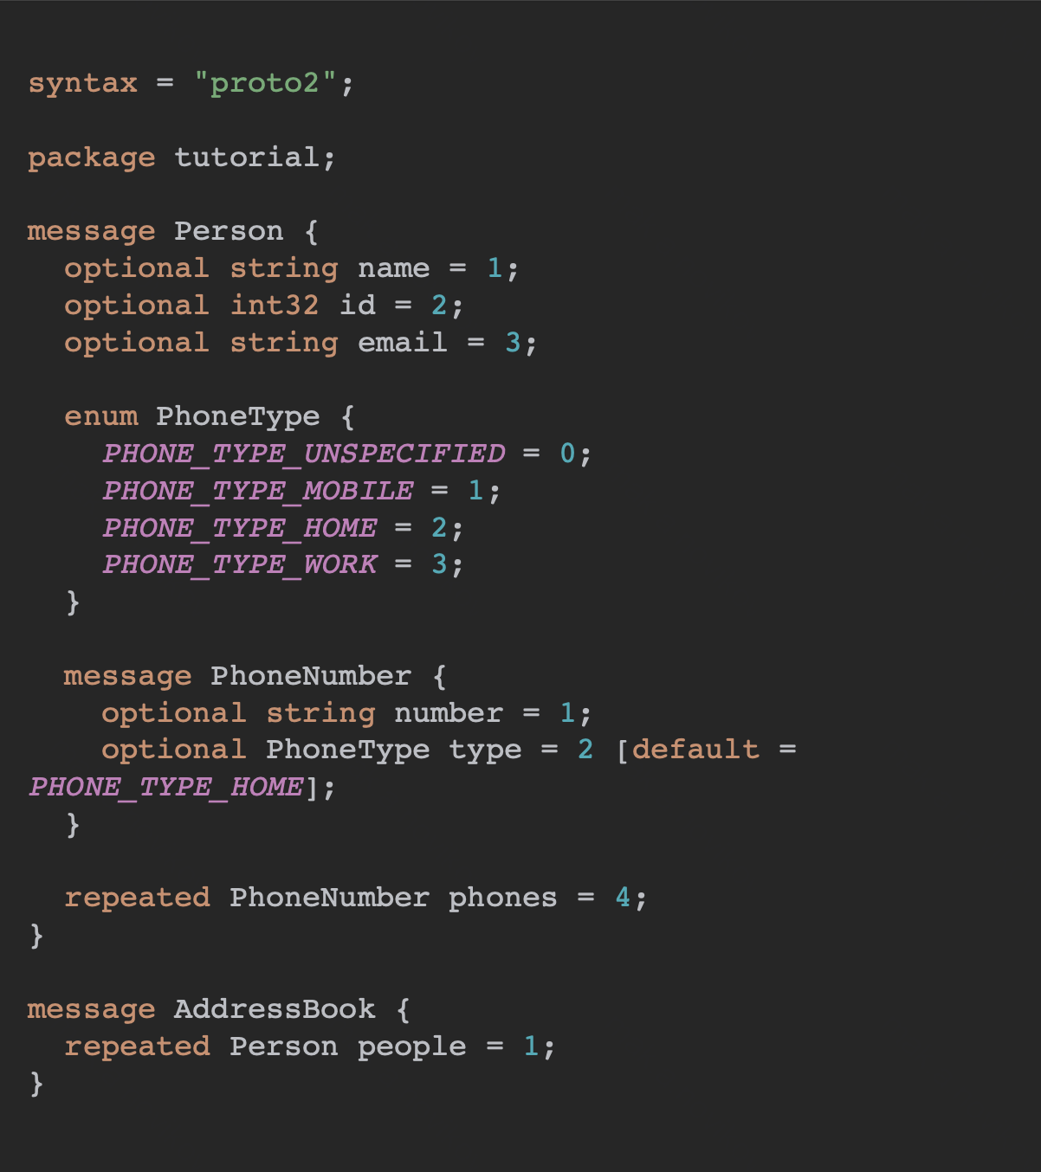
Protobuf
Protobuf is a binary, schema‑based data format.
Like JSON, it is structured, but its binary form is smaller and faster.
You must compile the .proto schema for every language you intend to use.

Slide 43
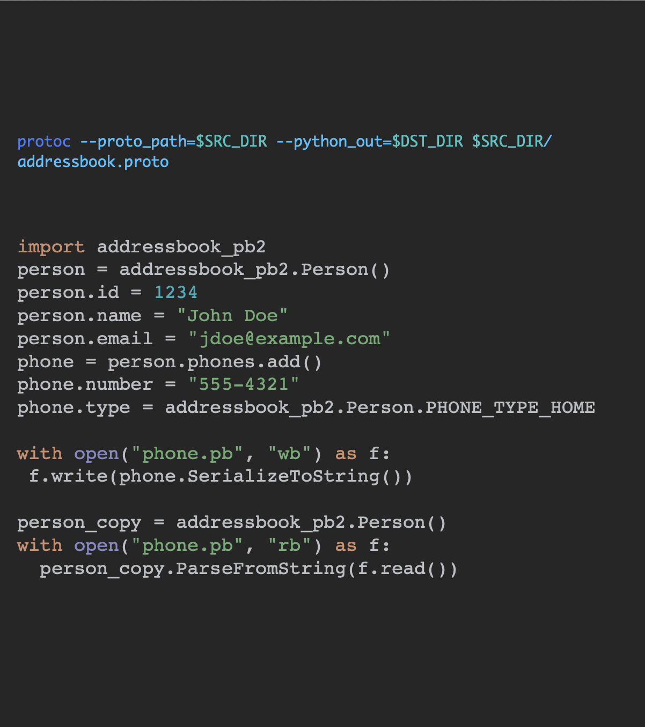
Protobuf
protoc --proto_path=$SRC_DIR --python_out=$DST_DIR $SRC_DIR/ addressbook.proto
import addressbook_pb2
person = addressbook_pb2.Person() person.id = 1234
person.name = "John Doe" person.email = "jdoe@example.com" phone = person.phones.add() phone.number = "555-4321"
phone.type = addressbook_pb2.Person.PHONE_TYPE
with open("phone.pb", "wb") as f: f.write(phone.SerializeToString())
person_copy = addressbook_pb2.Person() with open("phone.pb", "rb") as f:
person_copy.ParseFromString(f.read())
Protobuf is a binary, schema‑based data format.
Like JSON, it is structured, but its binary form is smaller and faster.
You must compile the .proto schema for every language you intend to use.

Slide 44
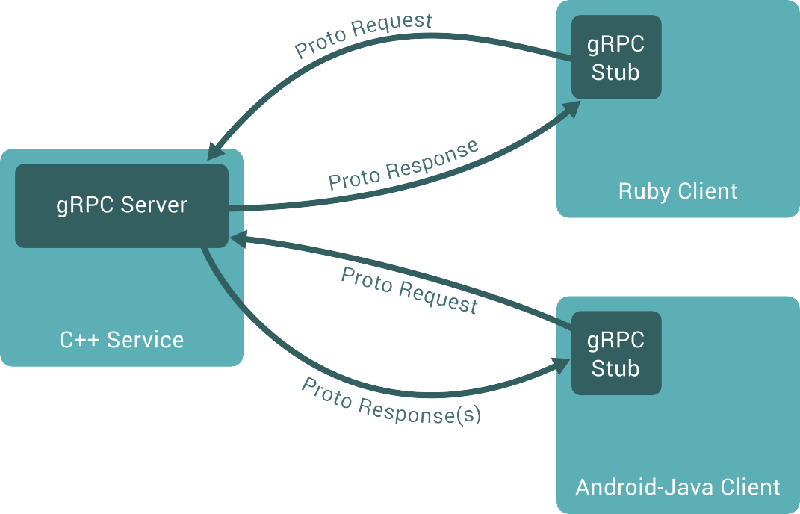
gRPC
gRPC (from Google) extends RPC for the cloud era.
It lets you call remote procedures as if they were local functions.
Data travels as Protobuf over HTTP/2, enabling streaming and multiplexing.
24

Slide 45
gRPC
syntax = "proto3";
package inference;
service Classifier {
rpc Predict (PredictRequest) returns (PredictResponse);
}
message PredictRequest {
string text = 1;
string dialog_id = 2;
string id = 3;
int32 participant_index = 4;
}
message PredictResponse {
string id = 1;
string message_id = 2;
string dialog_id = 3;
int32 participant_index = 4;
float is_bot_probability = 5;
}
Let's look at a simple example
First, you need to define the request and response format, as well as the service itself, in the protobuf format.

Slide 46
REST/HTTP vs gRPC
Use REST / OpenAPI when:
Public or course-facing API
curl / Swagger / browser tooling matters
Schema is simple JSON
Team is early-stage
Use gRPC when:
Internal service-to-service
Generated typed clients matter
Strict binary schema matters
High throughput / streaming matters
Not "faster, so better": gRPC wins for internal typed interfaces and streaming, at the cost of tooling and schema discipline.

Slide 47
Deployment: FastAPI

Slide 48
FastAPI: quick start
We will need two python packages:
FastAPI.
Uvicorn.
pip install fastapi "uvicorn[standard]"

Slide 49
FastAPI: quick start
from fastapi import FastAPI
app = FastAPI(title="Bot Classifier API")
@app.get("/health")
def health():
return {"status": "ok"}
# run: uvicorn src.main:app --reload
We will need two python packages:
FastAPI.
Uvicorn.
Let's throw together a simple application for demonstration.
Let's launch a web service.
Let's try to make a request.

Slide 50
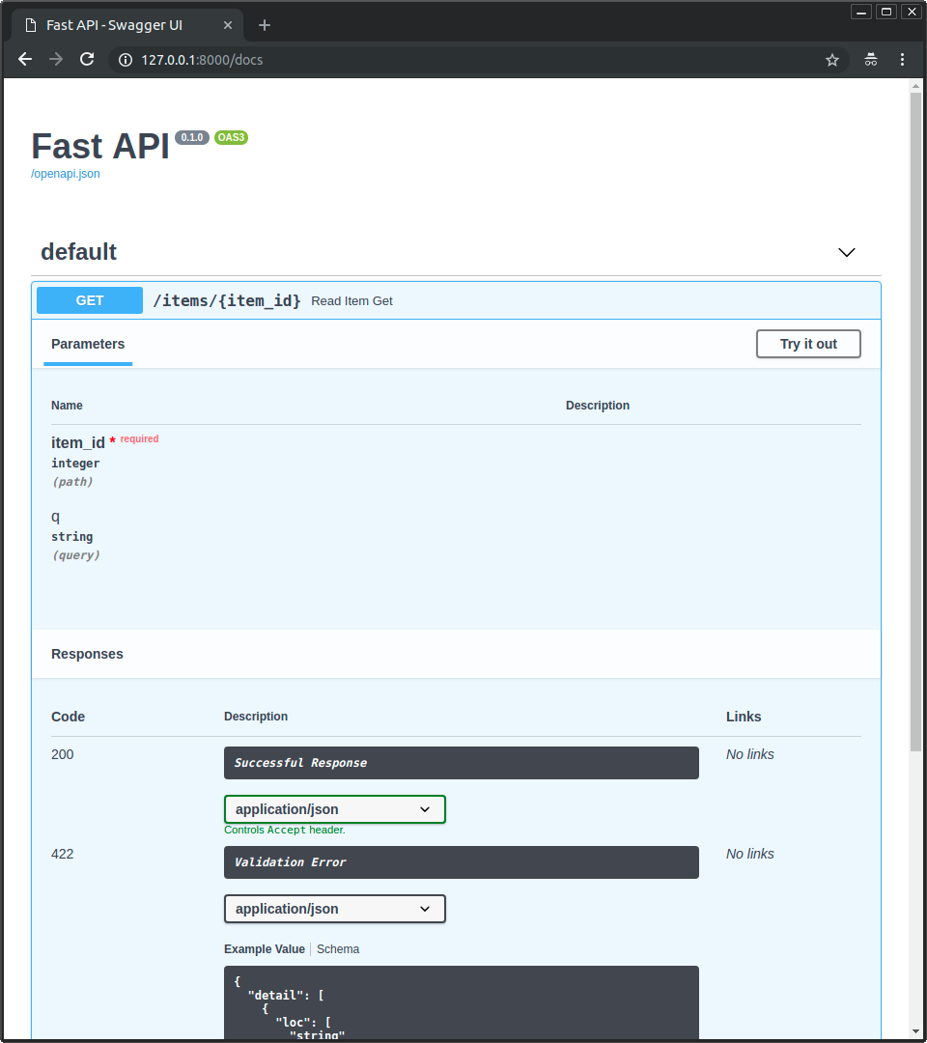
FastAPI: Swagger
Fast API automatically generates documentation for the API using Swagger UI.
It is available at /docs.
There is also an alternative version that is generated using ReDoc.
It is available at /redoc.

Slide 51
Pydantic
from uuid import UUID, uuid4
from pydantic import BaseModel, Field
class IncomingMessage(BaseModel):
text: str = Field(min_length=1, max_length=5000)
dialog_id: UUID
id: UUID
participant_index: int = Field(ge=0)
class Prediction(BaseModel):
id: UUID
message_id: UUID
dialog_id: UUID
participant_index: int
is_bot_probability: float = Field(ge=0.0, le=1.0)
Pydantic is a library for data validation.
Tightly integrated with Python's built-in typing.
The core logic is implemented in Rust, so it works quickly.
Let's look at an example of using Pydantic and FastAPI.

Slide 52
Essential API Endpoints
@asynccontextmanager
async def lifespan(app: FastAPI):
app.state.model = load_from_mlflow()
app.state.version = resolve_version()
yield
app.state.model = None
app = FastAPI(lifespan=lifespan)
@app.get("/health")
def health():
return {"status": "ok"}
@app.get("/ready")
def ready():
return {"version": app.state.version}
@app.post("/predict",
response_model=Prediction)
def predict(msg: IncomingMessage):
p = app.state.model.predict_proba(msg.text)
return Prediction(
id=uuid4(),
message_id=msg.id,
dialog_id=msg.dialog_id,
participant_index=msg.participant_index,
is_bot_probability=p,
)
@app.get("/metrics")
def metrics():
return Response(generate_latest(),
media_type=CONTENT_TYPE_LATEST)
/health process alive /ready model loaded, safe for traffic /predict external business contract /metrics keep the name stable → Session 13

Slide 53
Bake-in vs Lazy-pull Model Strategy
The trade-off is model-size and infrastructure dependent — measure image size, cold start, warm start, rollback time, and failure mode for your own model.
Strategy | Good for | Risk
Bake into image | Small, stable model; no startup network dependency | Large image; rebuild on every model update
Pull on startup | Frequent updates; registry-driven rollout | Cold start; registry outage; cache invalidation
Mounted cache / volume | Large models reused on the same VM / node | Cache consistency; cleanup; permissions
Init container / sidecar | Controlled Kubernetes-style loading | More moving parts

Slide 54
Problems of manual implementation
Manual FastAPI serving is flexible — but you own concurrency, batching, memory, timeouts, and GPU safety.
async def does not make CPU/GPU-bound inference faster by itself.
CPU-bound preprocessing can block the event loop.
GPU inference may need a queue or semaphore to avoid VRAM OOM.
For PyTorch inference, use model.eval() and torch.inference_mode().
Load the model once at startup — never inside /predict.
Limit request size and input length.
Track p50 / p95 / p99 latency, not just the average.
Warm up the model after loading.

Slide 55
Frameworks

Slide 56



Frameworks for inference
There are many frameworks for serving pre-trained models.
For simple models they require almost zero configuration; for advanced cases they remain highly configurable.
The framework exposes an HTTP API for you; scaling is usually handled by the deployment platform (Kubernetes, Cloud Run, …).
As the developer you usually specify only:
Input / output schema
Dependencies
Optionally — any pre-processing, post-processing, or custom inference logic

Slide 57
MLflow Models Serve
mlflow models serve \
-m "models:/bot_classifier@champion" \
--env-manager local --port 5000
The PyFunc interface provides a consistent contract across different frameworks, making it easy to switch between model types without changing your serving code.

Slide 58

NVIDIA Triton
To serve a model with Triton you need to:
Convert or trace the checkpoint into ONNX (or another format Triton supports).
Assemble a model repository – each model gets a folder containing its config.pbtxt plus one or more version sub‑folders with the actual weights.
Launch the Triton container and point it at that repository; the server will start exposing gRPC/HTTP endpoints automatically.

Slide 59
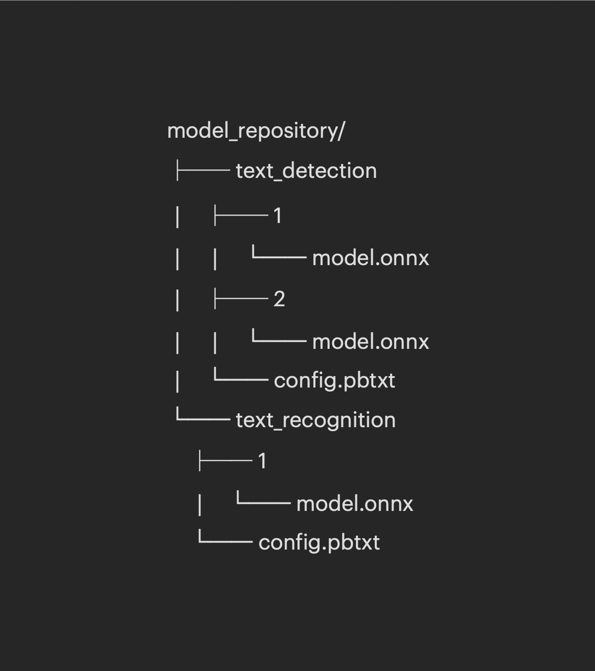
Model repository
model_repository/
├── text_detection
A model repository is a directory tree Triton scans for models and their configs.
Each top-level folder is one model, with version sub-folders (1, 2, 3 …) for the weights.
In simple cases Triton can auto-complete parts of the model configuration.
In production, write config.pbtxt explicitly: inputs, outputs, batching, instance groups, version policy.
│ ├── 1
│ │ └── model.onnx
│ ├── 2
│ │ └── model.onnx
│ └── config.pbtxt
└── text_recognition
├── 1
│ └── model.onnx
└── config.pbtxt

Slide 60
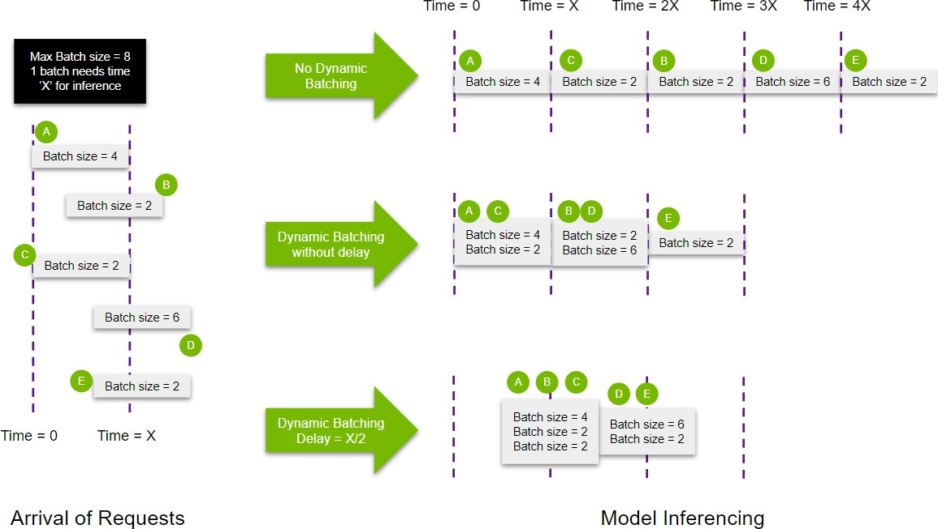
Dynamic batching
Dynamic batching groups incoming requests into a single batch.
It primarily improves throughput and hardware utilization.
It can improve latency under load — but aggressive queue delay hurts p99 latency.
Key params: max_batch_size and max_queue_delay_microseconds.
Typically for stateless models; pairs well with multiple model instances (GPUs / servers).

Slide 61
Inference Framework Comparison
Category | Tools | What they solve
Custom HTTP service | FastAPI | API contract, custom logic — our course service
Model package / demo serve | MLflow Models Serve | Quick validation of a registered model
Tensor / GPU inference runtime | NVIDIA Triton | ONNX/TensorRT/Python backend, batching, model repo
LLM serving runtime | vLLM, TGI, SGLang, llama.cpp | Generation, KV-cache, OpenAI-compatible APIs
Python service packaging | BentoML | Service abstraction and packaging
Kubernetes serving platform | KServe, Seldon, Ray Serve | Rollout, autoscaling, routing, canary
Legacy PyTorch serving | TorchServe | Legacy — limited maintenance

Slide 62
Lecture Takeaways
• A checkpoint is not a deployable package — ship weights, code, preprocessing, config, dependencies, schema and tests. • MLflow Registry aliases/tags select the champion; always log the resolved concrete version. • REST / OpenAPI suits course-facing APIs; gRPC suits internal typed interfaces and streaming. • A production-shaped FastAPI service has lifespan, /health, /ready, /predict and /metrics — on the stable /predict contract. • Inference runtimes (NVIDIA Triton, vLLM) are not the same as serving platforms (KServe, Ray Serve).

Slide 63
Practice / Homework Assignment
Goal: serve the MLflow champion behind the course /predict API.
Load models:/bot_classifier@champion from MLflow once at startup (FastAPI lifespan).
Preserve the real IncomingMessage → Prediction schema.
/health returns 200; /ready returns the model name and resolved version.
/predict returns is_bot_probability in [0, 1].
Tests: valid request → 200, invalid UUID → 422, probability in range.
Log request_id, model_name, model_version, latency_ms, status_code.
Do not log raw user text by default.
Measure p50 / p95 latency over 20 repeated requests.
Add a smoke-test curl command to the README.
Add a Dockerfile and compose.yaml for local run.

