Slide 1
Laboratory: OSPF multiarea

Slide 2
What are OSPF areas?
An abstraction that simplifies administration and improves scalability
the topology of an area is invisible from the outside
routers internal to a given area don’t see the detailed external topology
Each area runs a separate instance of the link state routing algorithm
all routers in an area construct the same lsdb
each router keeps a distinct lsdb for each area it belongs to

Slide 3
OSPF areas
They are identified by a 32-bit number, often in dotted decimal notation (1.2.3.4)
different interfaces of the same router can be assigned to different areas
each
router interface...
network...
router adjacency...
...is associated with a single area

Slide 4
Area types
backbone (0.0.0.0)
must be (virtually) connected
all other areas are connected to it
contains all the area border routers
stub
It does not receive advertisements of external routes (?)
internal nodes are offered a default route
cannot contain autonomous system boundary routers
the backbone can’t be a stub area
transit
used to pass traffic from one adjacent area to another, via virtual links

Slide 5
1.1.1.1
3.3.3.3
2.2.2.2
stub
stub
stub
0.0.0.0
backbone

Slide 6
Router types
internal router
all interfaces belong to the same area
area border router (abr)
connects one or more areas to the backbone
keeps multiple lsdbs, one for each area
backbone router
has at least one interface connected to the backbone
an abr is always a backbone router
autonomous system boundary router (asbr)
imports and floods routing information from other routing protocols (typically, bgp)
note: a router can be of more than one type

Slide 7
1.1.1.1
3.3.3.3
2.2.2.2
r6
r2
r3
r4
r1
r5
0.0.0.0
bb1
bb2
bb0
bb4
bb3

Slide 8
1.1.1.1
3.3.3.3
2.2.2.2
r6
r2
r3
r4
r1
r5
0.0.0.0
bb1
bb2
backbone
routers
bb0
bb4
bb3

Slide 9
1.1.1.1
3.3.3.3
2.2.2.2
r6
r2
r3
r4
r1
r5
0.0.0.0
bb1
bb2
area border
routers
bb0
bb4
bb3
kathara – [ labs: ospf ]

Slide 10
1.1.1.1
3.3.3.3
2.2.2.2
r6
r2
r3
r4
r1
r5
0.0.0.0
bb1
bb2
internal
routers
bb0
bb4
bb3
kathara – [ labs: ospf ]

Slide 11
Path Types
OSPF classifies routes into path types based on their origin and location relative to areas,
strict preference order for shortest path selection:
intra-area > inter-area > external type 1 (E1) > external type 2 (E2).

Slide 12
Path types
Intra-Area (O)
Routes to destinations within the same OSPF area, using the full link-state database for SPF calculation. Highest preference as they reflect local topology details.​
Inter-Area (O IA)
Routes to other OSPF areas, learned via ABR summary LSAs (Type 3). Cost includes intra-area to ABR + backbone path + intra-area from destination ABR; visible as aggregated summaries.​

Slide 13
Path types
External Type 1 (E1)
Redistributed external routes (e.g., from BGP, static) where total cost = external metric + OSPF internal cost to ASBR.
Preferred over E2; used when internal paths vary significantly.
External Type 2 (E2)
Default for external routes; cost = external metric only (OSPF cost to ASBR as tie-breaker).
Ideal when external costs dominate or ASBRs are equidistant.

Slide 14
Example – Intra-Area path

Slide 15
1.1.1.1
3.3.3.3
200.0.0.0/30
2.2.2.2
220.0.0.0/30
2
210.0.0.0/24
1
eth0
r6
2
I
eth0
L
r2
eth0
1
1
K
1
M
eth1
1
eth1
eth2
r3
r4
eth1
N
2
r1
2
2
1
eth0
J
110.0.0.0/30
eth1
eth0
eth1
2
2
r5
eth0
eth1
F
G
220.0.1.0/30
2
200.0.1.0/24
eth2
E
120.0.0.0/30
H
220.0.2.0/30
100.0.0.0/30
1
1
10.0.0.0/24
1
130.0.0.0/30
eth2
eth3
eth3
1
eth2
default cost (10) is assumed where unspecified
bb1
1
A
2
bb2
0.0.0.0
eth0
eth0
1
90
3
100
1
eth1
eth0
eth1
10.0.3.0/24
D
bb0
B
10.0.1.0/24
2
3
2
eth1
eth1
eth0
1
C
2
bb4
eth0
eth1
bb3
10.0.2.0/24
kathara – [ labs: ospf ]

Slide 16
area configuration
area information is found in two places
when enabling ospf on router interfaces network 200.0.0.0/16 area 1.1.1.1
when specifying the area type (not required for the backbone) area 1.1.1.1 stub

Slide 17
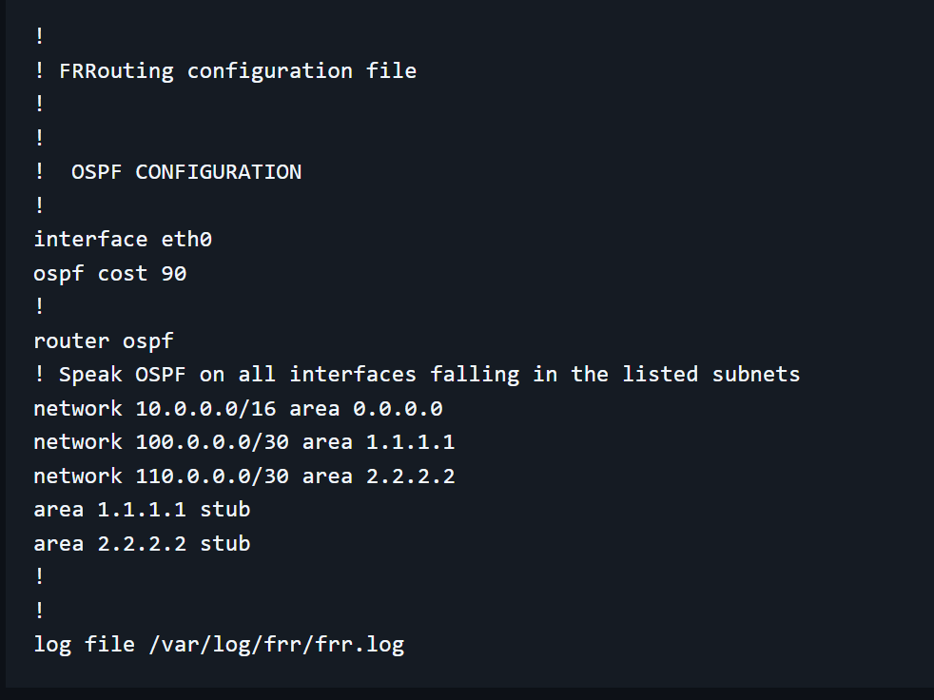

Slide 18
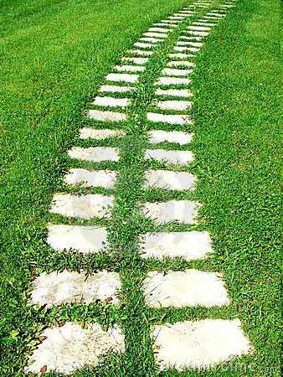
ospf path types
there are 4 path types
intra-area
inter-area
external type 1
external type 2
types can coexist in the same network
each type is preferred over the following ones

Slide 19
ospf path types
intra-area paths
calculated using the shortest-path tree

Slide 20
ospf path types
inter-area paths
abrs inject summary information inside each area, to make it aware of available destinations in other areas
such information includes the cost of the shortest path from the abr to the destination
if multiple subnets are summarized into a single network, the route cost will be the maximum cost to any of the component subnets
an inter-area path is always composed of:
an intra-area path from the source to the abr
a backbone path between the source and destination areas
an intra-area path to the destination

Slide 21
ospf path types
external paths are learned from other routing protocols (e.g., bgp)
type 1: the cost is expressed in terms of
the external (bgp) route cost* +
the ospf cost to the asbr
example with bgp cost=495, ospf cost=10: N E1 50.0.0.0/16 [505] tag: 0 via 10.0.1.2, eth1
* cost used when redistributing the protocol (bgp) into ospf; default for bgp=20; configurable by using redistribute bgp metric value

Slide 22
ospf path types
type 2: the cost is expressed in terms of
the external (bgp) route cost* only (distance to the asbr is only used to break ties)
example with bgp cost=495, ospf cost=10: N E2 50.0.0.0/16 [10/495] tag: 0
via 10.0.1.2, eth1
metric type is user-configurable redistribute bgp metric-type 2 metric 495

Slide 23
experiments
check that routers know detailed topology information only about their own area
r2
r2# show ip ospf neighbor
Neighbor ID Pri State Up Time Dead Time Address Interface RXmtL RqstL DBsmL
200.0.0.1 1 Full/Backup 1m17s 32.279s 200.0.0.1 eth0:200.0.0.2 0 0 0

Slide 24
experiments
check that routers know detailed topology information only about their own area
r2
r2# show ip ospf database router
OSPF Router with ID (200.0.1.1)
Router Link States (Area 1.1.1.1 [Stub])
...
Link State ID: 110.0.0.1
...
Number of Links: 1
Link connected to: a Transit Network
(Link ID) Designated Router address: 100.0.0.2
(Link Data) Router Interface address: 100.0.0.1
...
Link State ID: 200.0.0.1
...
Number of Links: 2
Link connected to: a Transit Network
(Link ID) Designated Router address: 100.0.0.2
(Link Data) Router Interface address: 100.0.0.2
...
Link connected to: a Transit Network
(Link ID) Designated Router address: 200.0.0.2
(Link Data) Router Interface address: 200.0.0.1
...
note: the output has been summarized

Slide 25
experiments
check that routers know detailed topology information only about their own area
r2
r2# show ip ospf database network
OSPF Router with ID (200.0.1.1)
Net Link States (Area 1.1.1.1 [Stub])
LS age: 759
Options: 0x0 : *|-|-|-|-|-|-|-
LS Flags: 0x6
LS Type: network-LSA
Link State ID: 100.0.0.2 (address of Designated Router)
Advertising Router: 200.0.0.1
LS Seq Number: 80000001
Checksum: 0x09ec
Length: 32
Network Mask: /30
Attached Router: 110.0.0.1
Attached Router: 200.0.0.1
LS age: 763
Options: 0x0 : *|-|-|-|-|-|-|-
LS Flags: 0x3
LS Type: network-LSA
Link State ID: 200.0.0.2 (address of Designated Router)
Advertising Router: 200.0.1.1
LS Seq Number: 80000001
...
note: the output has been summarized

Slide 26
experiments
check what routers know about the outside of the area, using the show ip ospf database summary command
in particular, check the Metric values, that show how far away the destination is from the advertising abr
check that routers in stub areas are offered a default route, whereas routers in the backbone are not
also check what Metric is assigned to the default route

Slide 27
experiments
experiment ospf’s recovery capabilities
when multiple equal cost routes are available, ospf keeps all of them
check it by verifying what r3 knows about the default route
r3
r3# show ip ospf route
============ OSPF network routing table ============
N IA 0.0.0.0/0 [11] area: 2.2.2.2
via 110.0.0.1, eth1
via 120.0.0.1, eth0
...
inter-area path
equal cost routes

Slide 28
experiments
experiment ospf’s recovery capabilities
when multiple equal cost routes are available, ospf keeps all of them
check it by verifying what r3 knows about the default route
zebra performs the actual selection
r3
r3# show ip route
Codes: K - kernel route, C - connected, S - static, R - RIP, O - OSPF,
I - IS-IS, B - BGP, E - EIGRP, N - NHRP, T - Table, v - VNC,
V - VNC-Direct, A - Babel, F - PBR, f - OpenFabric, > - selected route,
* - FIB route, q - queued, r - rejected, b - backup t - trapped, o - offload failure
O>* 0.0.0.0/0 [110/11] via 110.0.0.1, eth1, weight 1, 00:18:15
* via 120.0.0.1, eth0, weight 1, 00:18:15

Slide 29
experiments
experiment ospf’s recovery capabilities
when multiple equal cost routes are available, ospf keeps all of them
check it by verifying what r3 knows about the default route
zebra performs the actual selection
now bring bb1’s eth3 down using ifconfig, wait a few seconds and check how the routing is changed
bring bb1’s eth3 back up and check again how the routing is changed

Slide 30
lab: ospf-complex

Slide 31

1.1.1.1
3.3.3.3
200.0.0.0/30
2.2.2.2
220.0.0.0/30
2
210.0.0.0/24
1
eth0
r6
2
I
eth0
L
r2
eth0
1
1
K
1
M
eth1
1
eth1
eth2
r3
r4
eth1
N
2
r1
2
2
1
eth0
J
110.0.0.0/30
eth1
eth0
eth1
2
2
r5
eth0
eth1
F
G
220.0.1.0/30
2
200.0.1.0/24
eth2
E
120.0.0.0/30
H
220.0.2.0/30
100.0.0.0/30
1
1
10.0.0.0/24
1
130.0.0.0/30
eth2
eth3
eth3
1
AS10
eth2
bb1
1
A
2
bb2
0.0.0.0
eth0
eth0
1
90
3
100
1
eth1
eth0
eth1
10.0.3.0/24
D
bb0
B
10.0.1.0/24
2
3
2
50.0.0.0/16
eth1
eth1
eth0
1
C
2
1
default cost (10) is assumed where unspecified
bb4
eth0
eth1
bb3
eth2
O
2
eth0
as100r1
10.0.2.0/24
140.0.0.0/30
AS100
kathara – [ labs: ospf ]
last update: Nov 2018

Slide 32
lab description
same as multiarea + some information is injected via bgp from an external as
also, abrs are configured to just inject the default route area 1.1.1.1 stub no-summary
perform the same experiments as for the multiarea lab
in addition, check asbr information using
show ip ospf database asbr-summary
also check that such information is not propagated inside stub areas

Slide 33
A quick note about stub networks
r2
“stub” = not used for transit
three possible situations:
1
eth1
J
200.0.1.0/24
ospf is enabled also on the stub network’s interface
the stub network is advertised in the entire ospf domain
then
but
interface uselessly sends hello packets
the stub network is advertised as an AS-external route (hence, only through the backbone)
ospf is not enabled on the stub network’s interface
the stub network is advertised
then
but
ospf is enabled on the stub network’s interface, which is configured as passive-interface
the stub network is advertised in the entire ospf domain
then
but
N/A
kathara – [ labs: ospf ]

