Slide 1

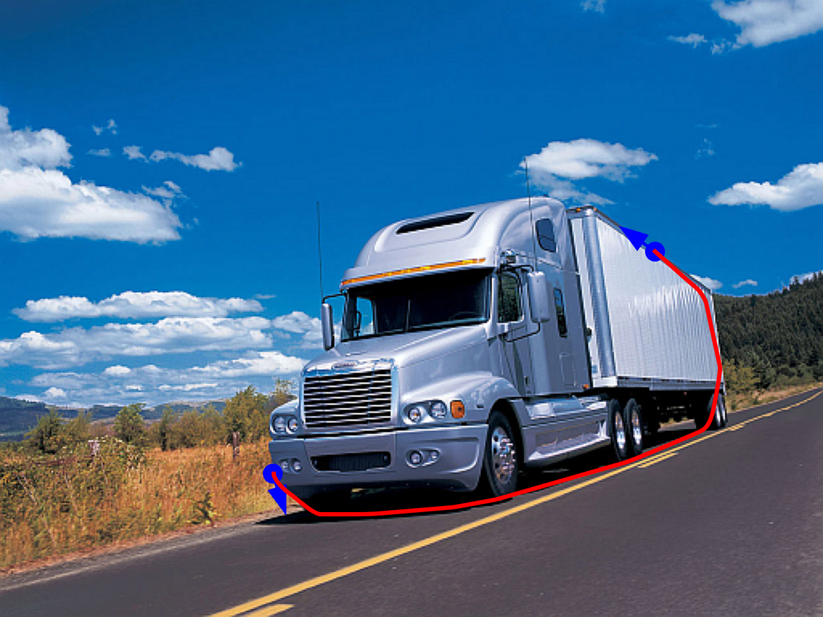

Geodesic models with convexity shape prior
Motivation
Convex shapes arise frequently in nature.
We propose an image segmentation method taking advantage of a convexity prior
Relies on an active contour model, with an infinite penalization of negative curvature
Keywords : Non-holonomic vehicle, Reeds-Shepp car, Euler elastica, Dubins car
Demo proposal
Allow the user to place two (or more) points on a contour, and adjust a few parameters.
Compute and display the globally optimal paths.
Requires a GPU, and the cupy library,...
Related preprint : Geodesic Models with Convexity Shape Prior, Chen, M, Shu, Tai, Cohen
MLBriefs
Jean-Marie Mirebeau

