Slide 1
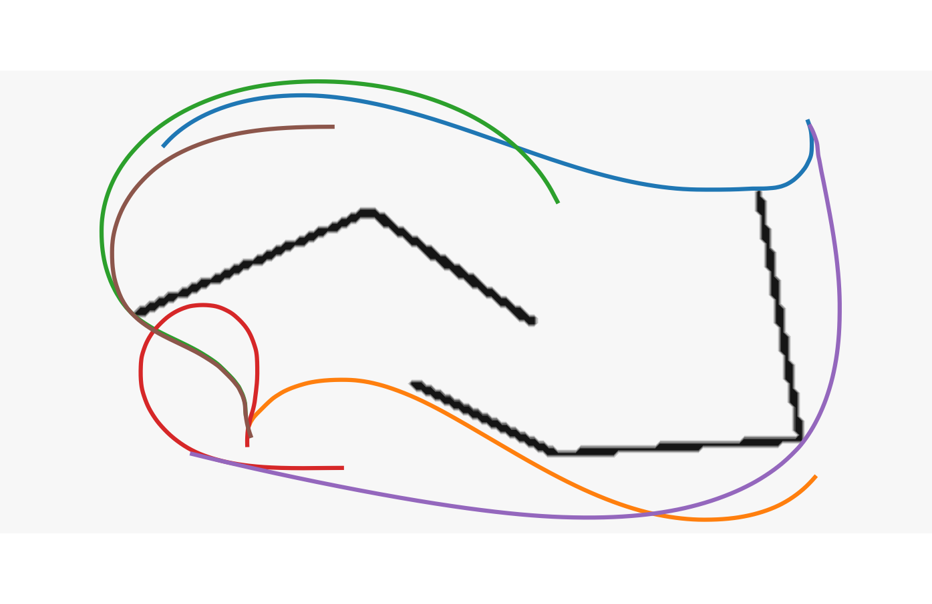
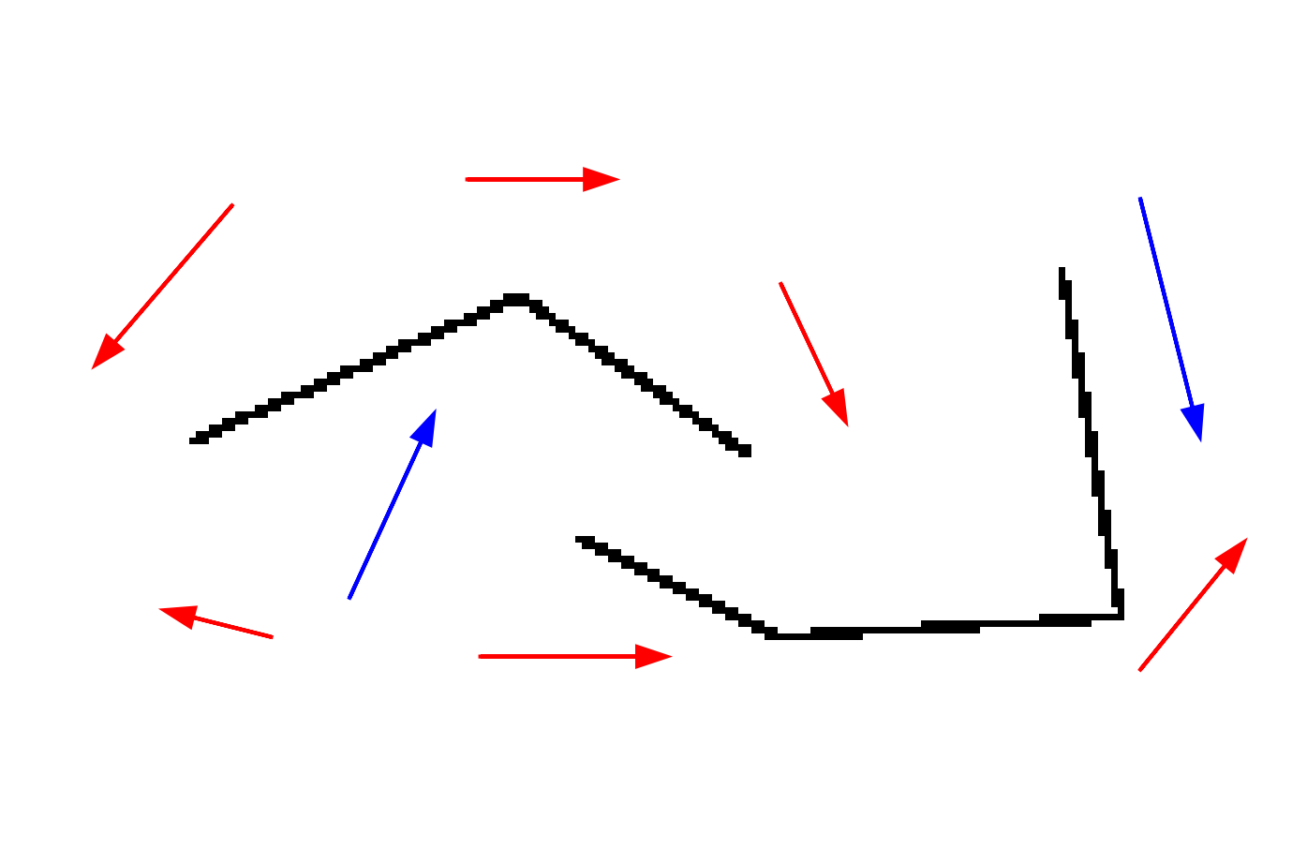

Globally optimal paths with obstacles and a curvature penalty
Motivation
Geodesic paths are at the foundation of various motion planning and image processing problems.
Imposing a curvature penalty leads to a variety of
Keywords : Non-holonomic vehicle, Reeds-Shepp car, Euler elastica, Dubins car
Demo proposal
Allow the user to interactively place obstacles, seed points and tip points, and choose a vehicle model.
Compute and display the globally optimal paths.
Works best on a GPU...
Related preprint : Massively parallel computation of globally optimal shortest paths with curvature penalization, M, Chen, Desquilbet, Dreo, Gayraud
MLBriefs
Jean-Marie Mirebeau

