Slide 1
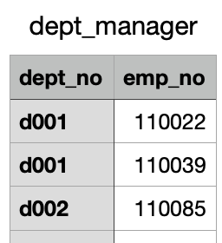
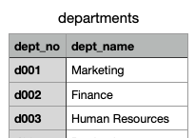
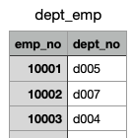
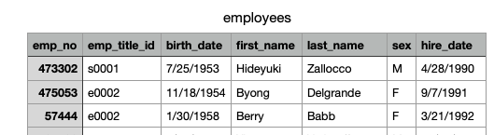
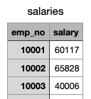
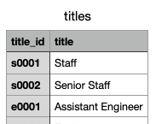

Slide 2
https://app.quickdatabasediagrams.com/#/
departments
-
dept_no PK int
dept_name string INDEX
dept_manager
-
dept_no PK int
emp_no FK int
dept_emp
-
emp_no PK int
dept_no FK int
titles
-
title_id PK int
title string
salaries
-
emp_no PK int
salary int
employees
-
emp_no PK int
title_id int
birth_date date
first_name string
last_name string
gender string
hire_date date

Slide 3
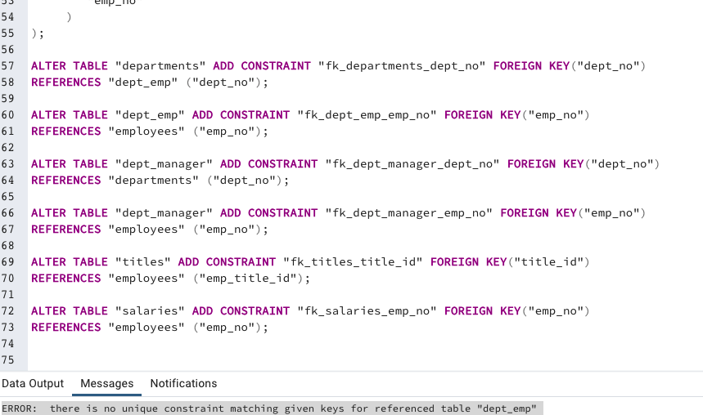
departments
-
dept_no VARCHAR PK FK -< dept_emp.dept_no
dept_name VARCHAR
dept_emp
-
emp_no INT PK FK >- employees.emp_no
dept_no VARCHAR PK FK
dept_manager
-
dept_no VARCHAR PK FK >- departments.dept_no
emp_no INT PK FK >- employees.emp_no
titles
-
title_id VARCHAR PK FK -< employees.emp_title_id
title VARCHAR
salaries
-
emp_no INT PK FK - employees.emp_no
salary INT
employees
-
emp_no INT PK
emp_title_id VARCHAR FK
birth_date DATE
first_name VARCHAR
last_name VARCHAR
sex VARCHAR
hire_date DATE

