Slide 1

Implementing and displaying a site
By Dumitru Mirel

Slide 2


In the first stage, the user must open a browser (Chrome, Opera, Edge, ...) and establish a set of rules via HTTPS (HyperText Transfer Protocol / Secure,) from where he wants to obtain certain resources.
Example:

Slide 3
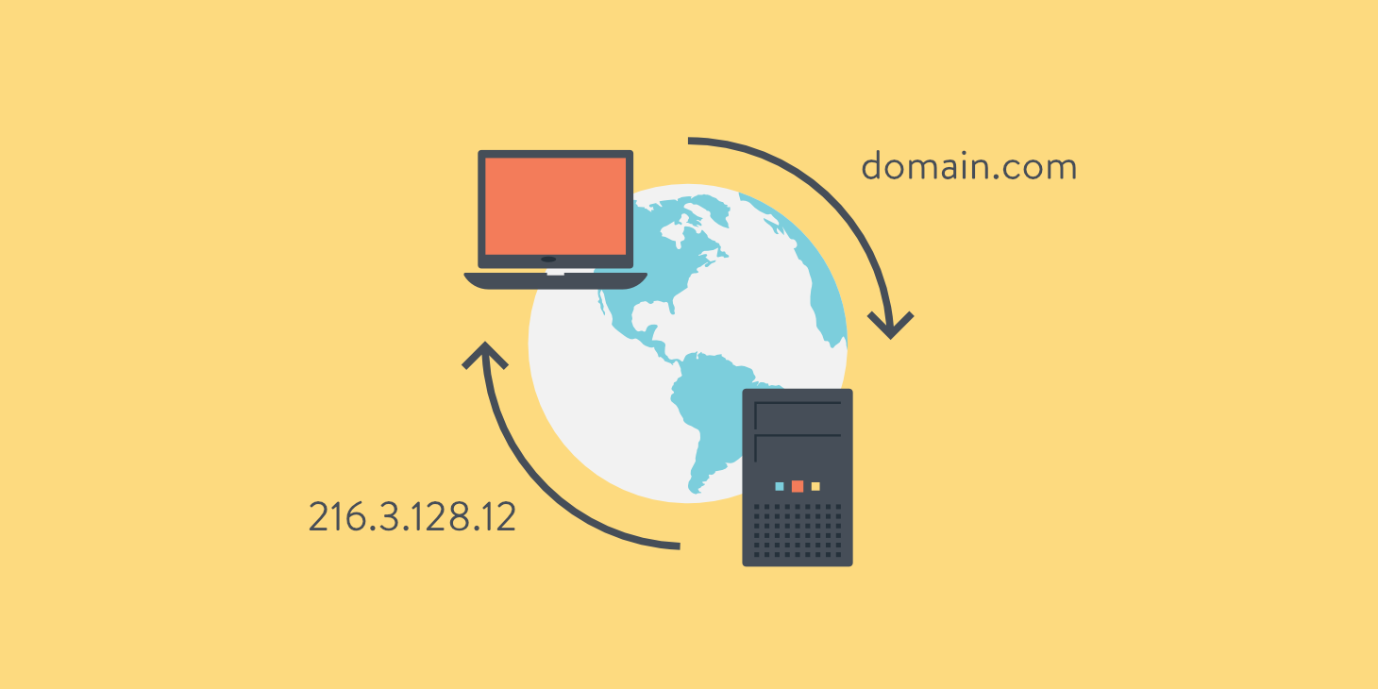
Computers and routers to understand our message and send traffic to the Internet need an IP address. Our help comes the DNS (Domain Name Services) which has the role of transforming the domain name into an IP address.

Slide 4
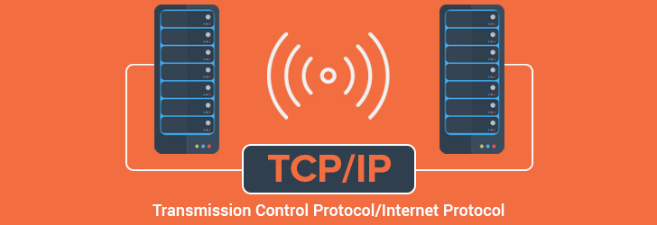
TCP / IP - Transport Layer
● Protocols: ○ TCP = Transmission Control Protocol
● TCP is responsible for breaking datadown into small packets before they can be sent over a network, and for assembling the packets again
● Provides backbone to data flow between two hosts

Slide 5
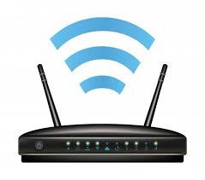
The browser then transmits the command to gain access to the main servers from where the information requested by the user can be collected.

Slide 6

The web server transmits the information through cables. This information is transposed in an abstract form of type 0 and 1.

Slide 7
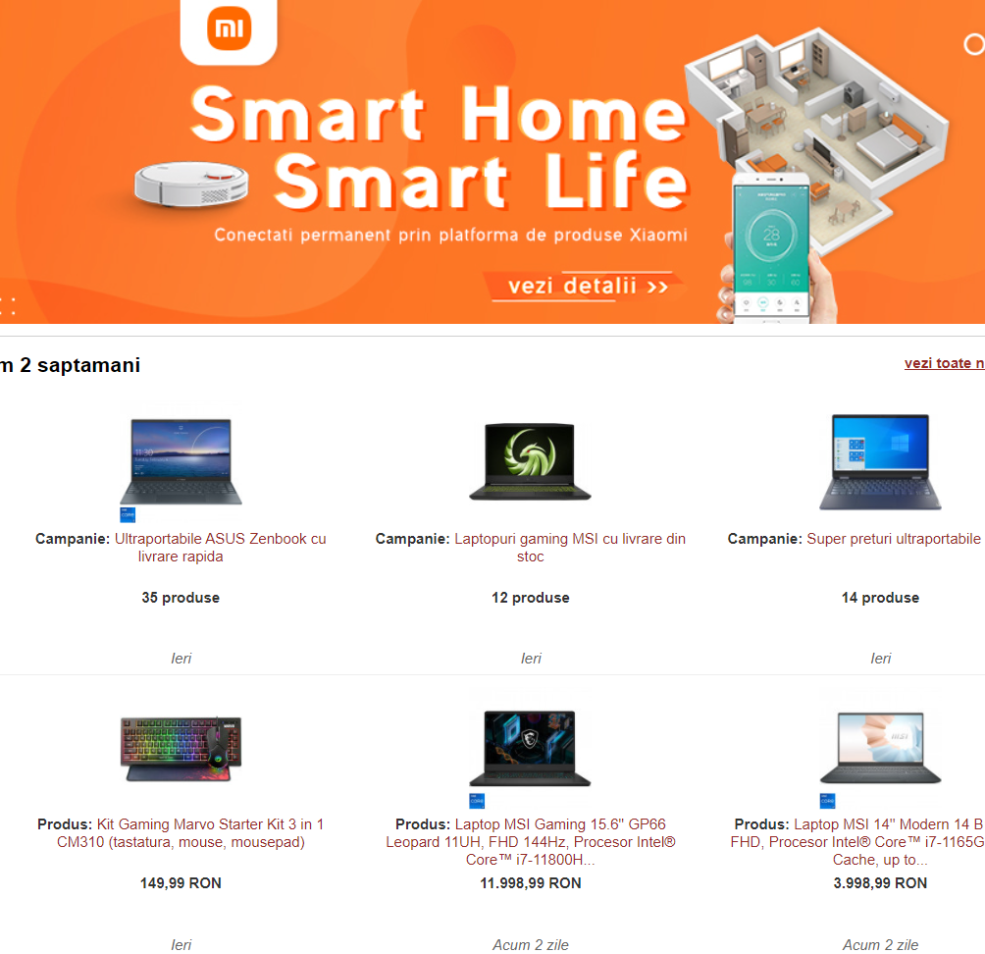
The final result displayed represents the way in which the browser perceives the website formed by certain brand languages (html, css) or programming languages (javascript).

