Slide 1
Where to sit at the movies?
By: Mărunț Georgiana
Găman Flavia

Slide 2
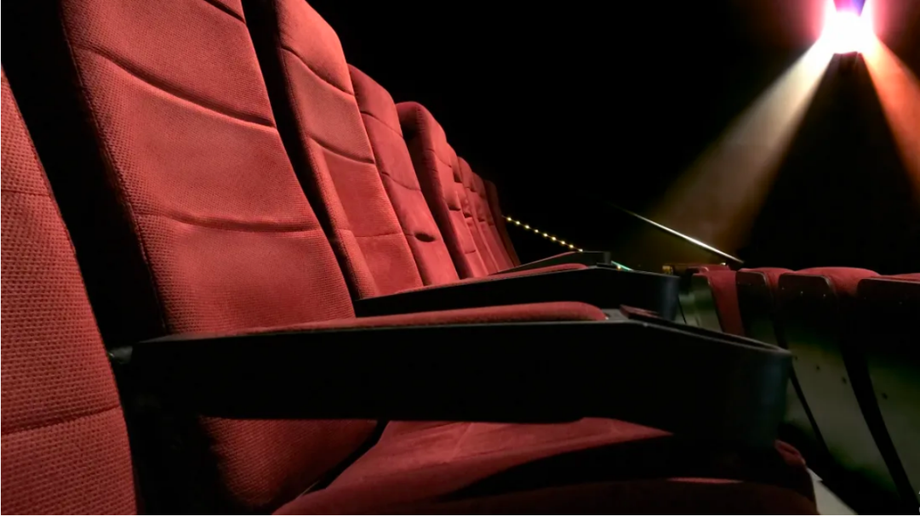
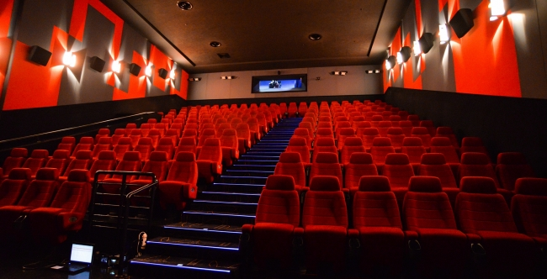
Have you ever wondered what were the best seats in a movie theatre to sit in?

Slide 3
The Real World Problem
A movie theater that is positioned 10 ft off the floor and is 25 ft high.
The first row of seats is placed 9 ft from the screen and the rows are set 3 ft apart.
The floor of the seating area is inclined at an angle of ᾱ=20 above the horizontal and the distance up the incline that you sit is x.
The theater has 21 rows of seats so 0 <x<60.
Suppose you decide that the best place to sit is in the row where the angle θ subtended by the screen at your eyes is a maximum.
Lets also suppose that your eyes are 4 ft above the floor, as shown in the figure.

Slide 4
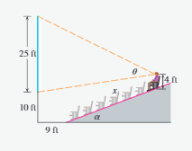
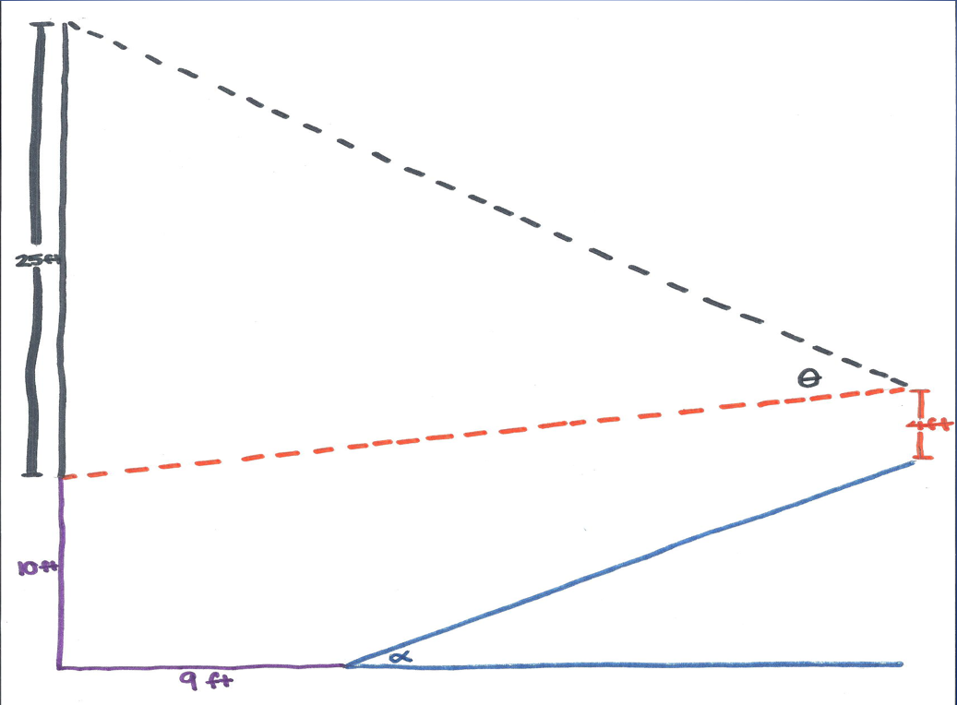

Slide 5
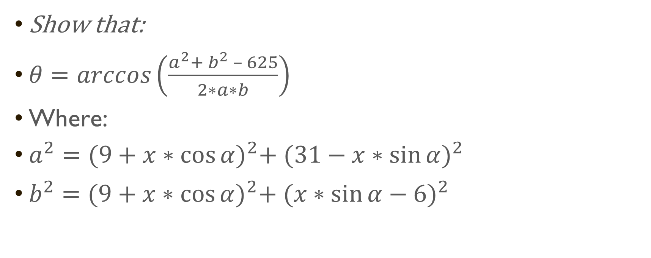
Part 1
Show that:
$θ=arccos\left(\frac{a^{2}+ b^{2} – 625}{2∗a∗b}\right)$
Where:
$a^{2}={(9+x∗\cos{α)}}^{2}+ {(31−x∗\sin{α})}^{2}$
$b^{2}={(9+x∗\cos{α)}}^{2}+ {(x∗\sin{α}−6)}^{2}$

Slide 6
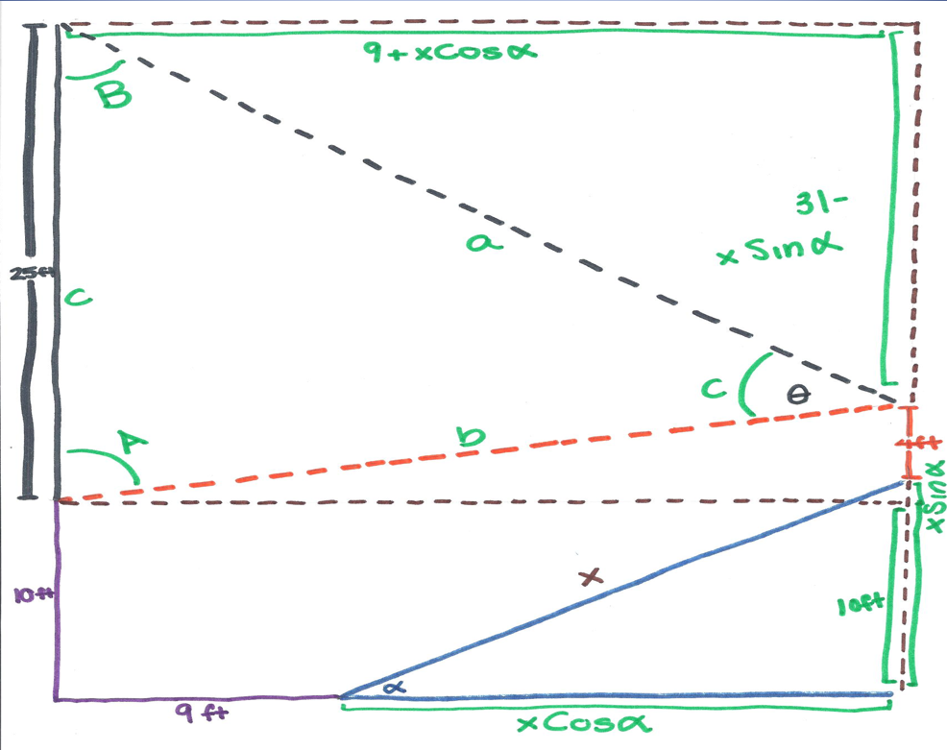

Slide 7
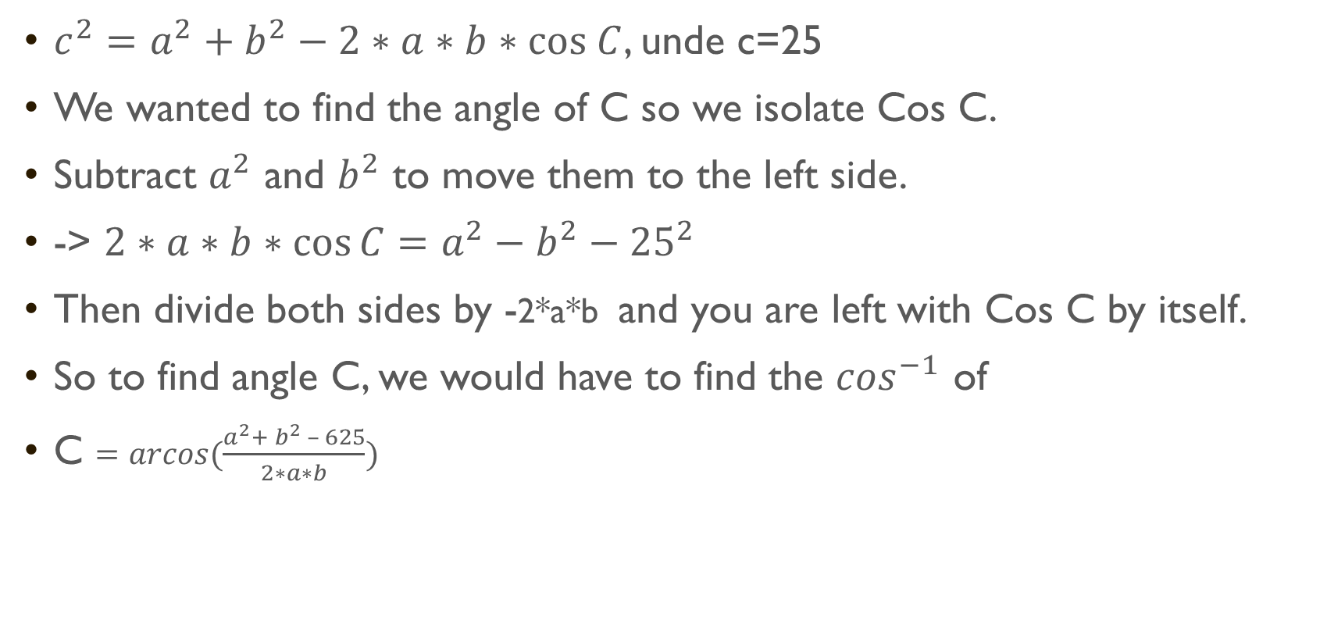
Law of Cosine
$c^{2}=a^{2}+b^{2}−2∗a∗b∗cos C$, unde c=25
We wanted to find the angle of C so we isolate Cos C.
Subtract $a^{2}$ and $b^{2}$ to move them to the left side.
-> $2∗a∗b∗\cos{C}=a^{2}−b^{2}−{25}^{2}$
Then divide both sides by -2*a*b and you are left with Cos C by itself.
So to find angle C, we would have to find the $\cos^{−1}$ of
C $=arcos(\frac{a^{2}+ b^{2} – 625}{2∗a∗b})$

Slide 8
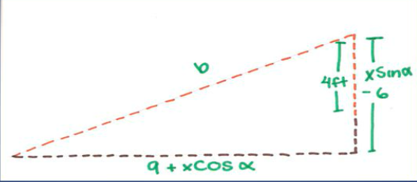
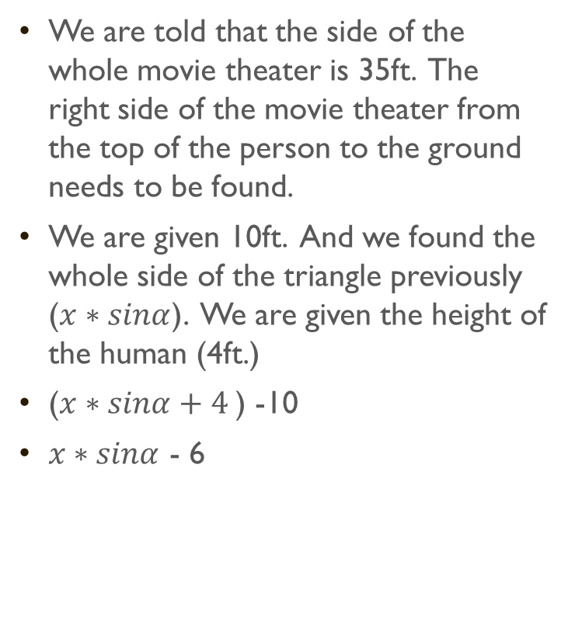
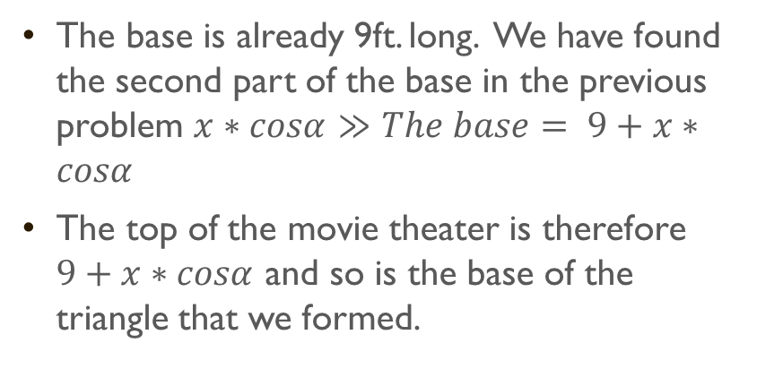
The base and the sides
We are told that the side of the whole movie theater is 35ft. The right side of the movie theater from the top of the person to the ground needs to be found.
We are given 10ft. And we found the whole side of the triangle previously ($x∗sinα$). We are given the height of the human (4ft.)
($x∗sinα+4$) -10
$x∗sinα$ - 6
The base is already 9ft. long. We have found the second part of the base in the previous problem $x∗cosα$ $≫The base= 9+x∗cosα$
The top of the movie theater is therefore $9+x∗cosα$ and so is the base of the triangle that we formed.

Slide 9
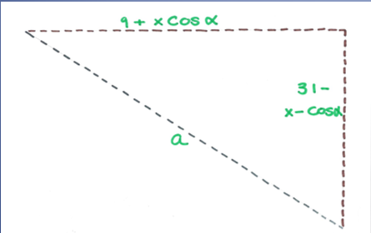
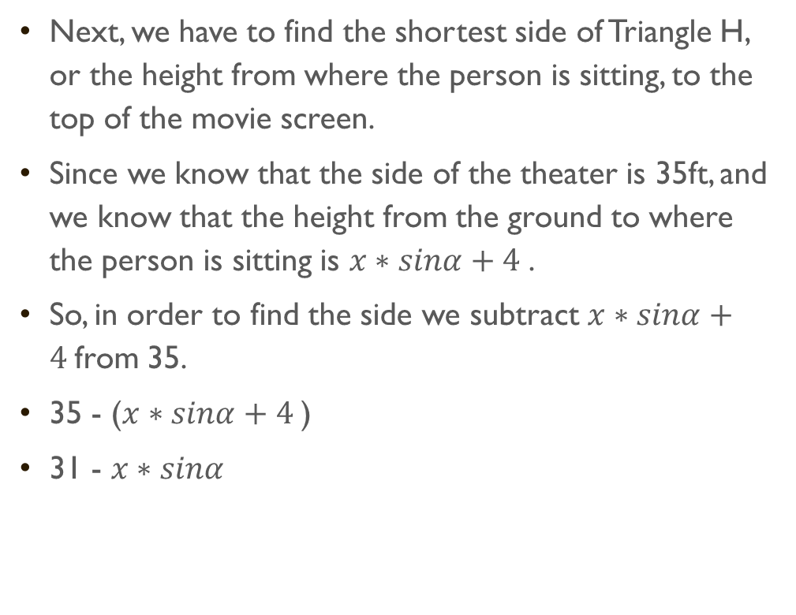
The sides
Next, we have to find the shortest side of Triangle H, or the height from where the person is sitting, to the top of the movie screen.
Since we know that the side of the theater is 35ft, and we know that the height from the ground to where the person is sitting is $x∗sinα+4$.
So, in order to find the side we subtract $x∗sinα+4$from 35.
35 - ($x∗sinα+4$)
31 - $x∗sinα$

Slide 10
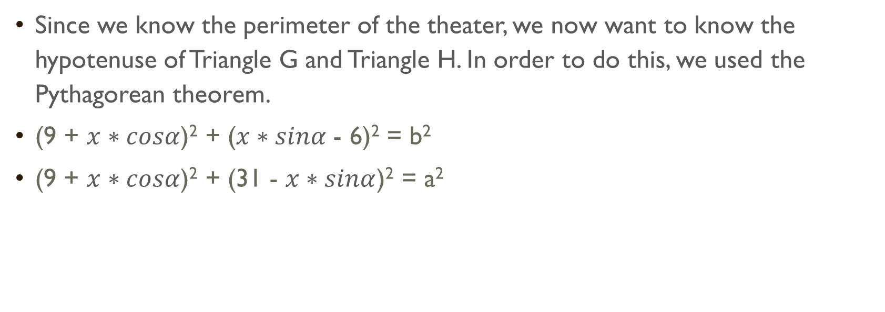
Proving it all
Since we know the perimeter of the theater, we now want to know the hypotenuse of Triangle G and Triangle H. In order to do this, we used the Pythagorean theorem.
(9 + $x∗cosα$)² + ($x∗sinα$- 6)² = b²
(9 + $x∗cosα$)² + (31 - $x∗sinα$)² = a²

Slide 11
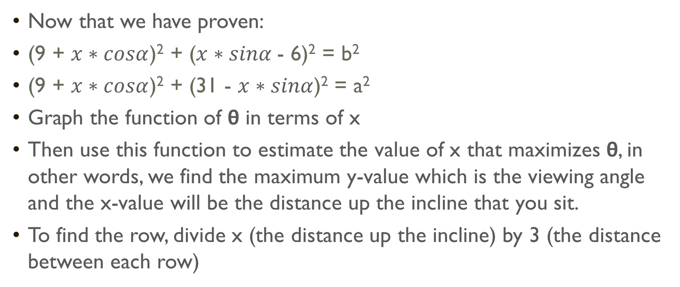
Part 2: Which row?
Now that we have proven:
(9 + $x∗cosα$)² + ($x∗sinα$- 6)² = b²
(9 + $x∗cosα$)² + (31 - $x∗sinα$)² = a²
Graph the function of θ in terms of x
Then use this function to estimate the value of x that maximizes θ, in other words, we find the maximum y-value which is the viewing angle and the x-value will be the distance up the incline that you sit.
To find the row, divide x (the distance up the incline) by 3 (the distance between each row)

Slide 12
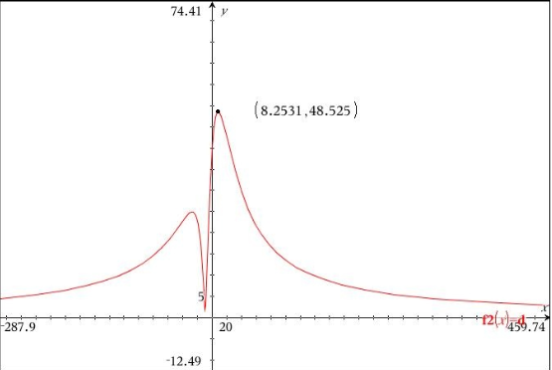

Graph of $θ$
.

Slide 13
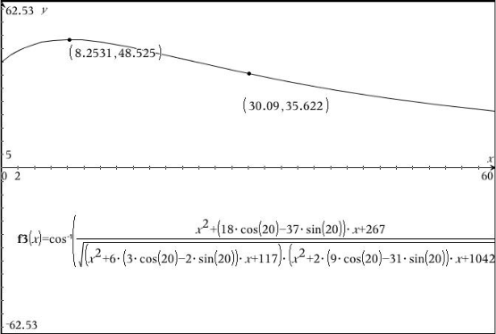

Graph of $θ$

Slide 14
The answer
Largest viewing angle is 48.5 degrees.
Row: the 3rd row ( x is 8.25 ft) because:
The rows are 3 feet apart, so we have to divide the distance up the incline by 3 in order to find the row number.
Also 8.25/3 is equal to 2.75, so the row you should sit in is the third.

Slide 15
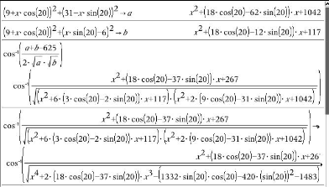
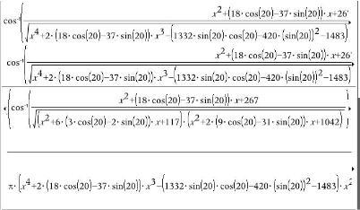
Part 3
Using a CAS, differentiate θ and find value for equation: dθ/dx−0.

Slide 16
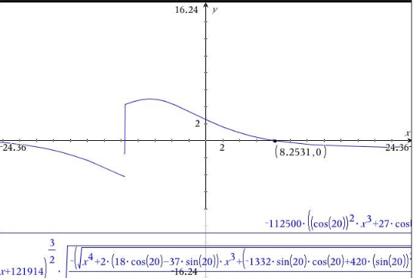
Does this value confirm your result in Problem 2?

Slide 17
Part 2&3
Ideal seat for viewing is the largest viewing angle to see the full movie.

Slide 18
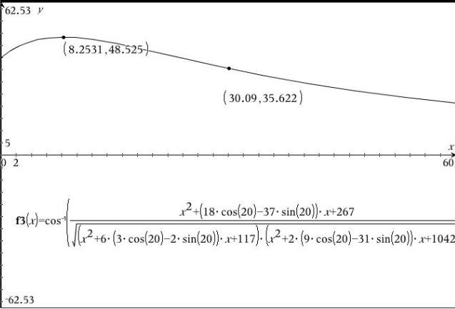
Part 4
Use the graph of θ to estimate the average value of θ on the interval 0 < x < 60.

Slide 19
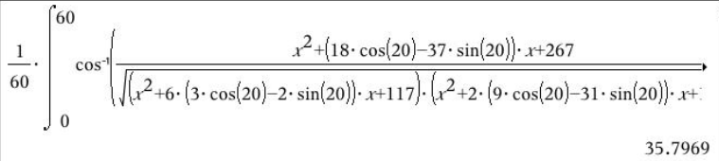
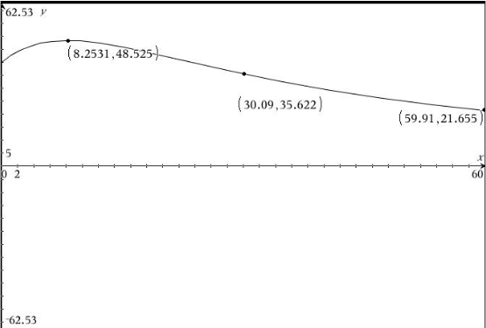
.
Then use your CAS to compute the average value.
Compare with the maximum and minimum values of θ.

Slide 20

.
So…The next time you go see a movie, you’ll know exactly where to sit.

Slide 21
bibliography
James Stewart – Calculus –
Applied Project: Where to Sit at the Movies - https://www.youtube.com/watch?v=oEkFJuCE-4A
https://euvtro-my.sharepoint.com/:b:/g/personal/eva_kaslik_e-uvt_ro/EU7KmCoO4xxDtzZEHd-UhvsBZNPXOBEAoK1oWtsOcdflig?e=vt6RZf

