Slide 1
Predicting PM2.5 Air Quality from AirQo Sensor Data
CSC3119 AI Deployment & Scalability · Assignment 4
Mirembe Peace Mercy / M24B23/005 / B27499
Norah Angel Nakaye / M24B23/008 / B27502
Notes:
We built a complete pipeline that turns raw AirQo low-cost sensor readings into a trained, evaluated, monitored and deployable PM2.5 forecasting model.

Slide 2
Why forecast PM2.5 in Uganda?
39 µg/m³
7,257
149
Kampala annual mean PM2.5 (2018–21), ≈ 8× WHO guideline of 5 µg/m³
deaths in Kampala attributed to long-term PM2.5 exposure (2018–21)
AirQo sensors in this dataset · 14,600 hourly rows · 2026
Objective Build a deployable pipeline that predicts hourly PM2.5 (as a Z-score) from sensor, time and weather data, and forecasts August 2026.
Who uses it Health sector (early warning), NEMA (enforcement), Ministry of Energy (clean cooking), Works & Transport (traffic).
Deliverables cleaned data → EDA → 5 tuned models + ensemble → saved model → August forecasts → Evidently monitoring → RunPod run.
AQI bands used throughout Good ≤ 9 · Moderate ≤ 35.49 · USG ≤ 55.49 · Unhealthy ≤ 125.49 · Very Unhealthy ≤ 225.49 · Hazardous above.
Notes:
PM2.5 penetrates deep into the lungs and bloodstream. Kampala's annual mean is about eight times the WHO guideline. Forecasts let the health sector, NEMA, the Ministry of Energy and Works & Transport act before bad-air days.

Slide 3
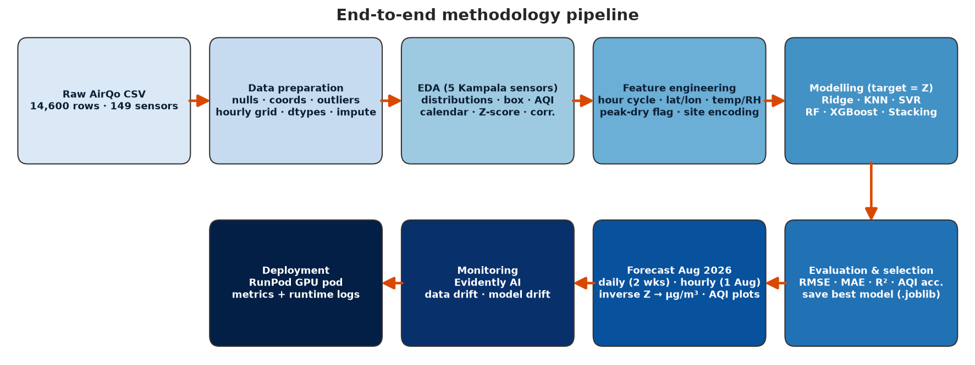
Methodology pipeline
Notes:
Each stage feeds the next; every heavy step is wrapped in try/except so the pipeline never crashes.

Slide 4
The data: 3 short windows, many nulls
3
758,112
1.9%
28–30%
observation windows (1–3 Jan, 1–2 Apr, 1–3 Jun)
rows in the full hourly grid (149 sensors × 5,088 h)
of grid hours have a valid PM2.5 reading
of temperature / humidity values are 0 (= null)
Field | Empty | Zero | % null
latitude / longitude | 1 | 3,085 | 21%
temperature | 54 | 4,066 | 28%
humidity | 206 | 4,159 | 30%
PM2.5 calibrated | 325 | 0 | 2%
site_id | 7,508 | – | 51%
• PM2.5 maximum of 998 µg/m³ → sensor saturation
• frequency is constant; site_id duplicates site_name
• GPS jitters up to 119 positions per fixed device
• 6 devices never report a valid GPS fix
Notes:
Although labelled Jan–Jul, the file holds only 1–3 Jan, 1–2 Apr and 1–3 Jun. After resampling to a full hourly grid only 1.9% of sensor-hours are observed. Zeros in temp/humidity/coords are nulls per the brief.

Slide 5
Data preparation decisions
Situation | Action | Why
0 or empty in temp, RH, PM, lat, lon | → NaN | Brief: 0 is a placeholder, not a measurement
PM2.5 > 500 µg/m³ (3 rows) | → NaN, logged | Beyond low-cost sensor range (Barkjohn et al., 2021)
Per-sensor IQR outliers (650 rows) | Flag & keep | Real rush-hour / inversion episodes, not errors
Gap ≤ 3 h | Linear time interpolation | Accurate for short gaps (Junninen et al., 2004)
Gap > 3 h (device offline) | Keep NaN + is_observed = 0 | Never fabricate labels for long outages (Okure et al., 2022)
Missing temp / RH at observed hour | IDW of 3 nearest sensors → hour median | Weather is spatially smooth
Missing coordinates | Device median; gazetteer for 6 | Fixed installations; GPS noise averaged out
Hourly resampling | Full grid 1 Jan – 31 Jul | Offline hours missing, not absent
Notes:
Junninen et al. (2004): linear interpolation is best for short gaps; long gaps should not be filled. AirQo papers (Okure 2022, Adong 2022) and Barkjohn 2021 guide validity checks.

Slide 6
Feature selection
Used (9 features)
Excluded
• Hour of day (sin/cos) – diurnal traffic, cooking, inversions
• Temperature, humidity – boundary layer & particle growth
• Latitude, longitude – city centre vs suburbs vs towns
• Peak dry season flag – Jan ≈ 2× Apr/Jun levels
• Device level – season-adjusted site encoding
• Network – AirQo vs AirGradient hardware
• PM10 – same-sensor leakage; unavailable in a forecast
• site_name, site_id – identifiers, covered by device level
• frequency – constant ('hourly')
• Day of week – only Mon–Fri observed; unlearnable
• Target – PM2.5 Z-score, z = (x − μ)/σ with μ = 34.2, σ = 28.4 µg/m³ (train set)
Notes:
PM10 is excluded: it's co-measured (leakage), unknown at forecast time, and driven by dust rather than temperature/humidity.

Slide 7
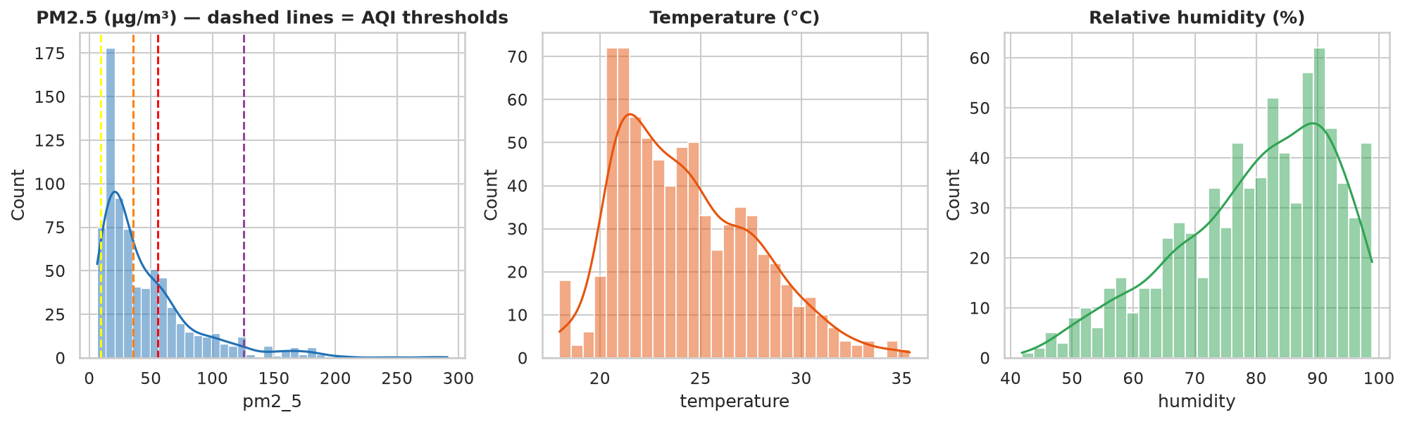
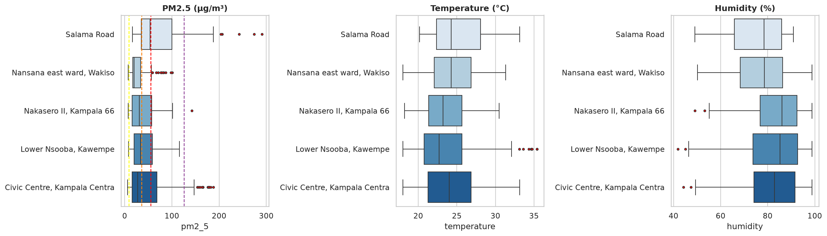
EDA: distributions and outliers
Notes:
Five Kampala sensors: Nansana, Nakasero II, Lower Nsooba, Civic Centre, Salama Road. Skewness ≈ 2.1. Outliers flagged but kept.

Slide 8
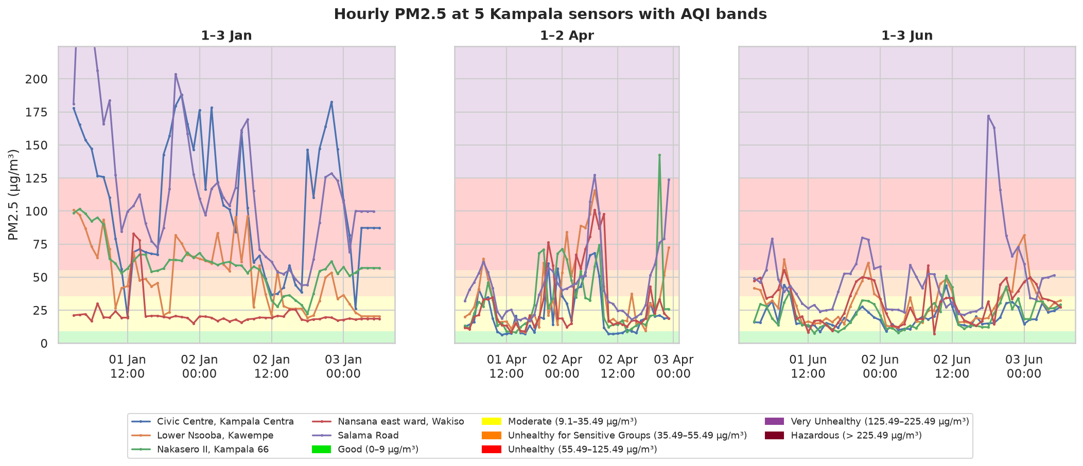
EDA: hourly PM2.5 vs AQI bands
• January (peak dry season) daily means 44–55 µg/m³
• April & June ≈ 21–28 µg/m³
• Salama Road and Civic Centre are the worst sites
• Peaks 06:00–09:00 and 19:00–23:00
Notes:
January is far dirtier (Unhealthy to Very Unhealthy) than April and June (mostly Moderate). Morning and evening peaks are visible every day.

Slide 9
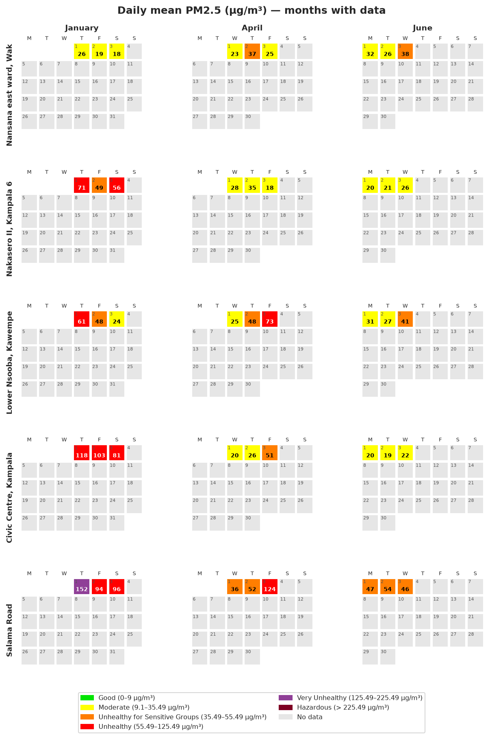
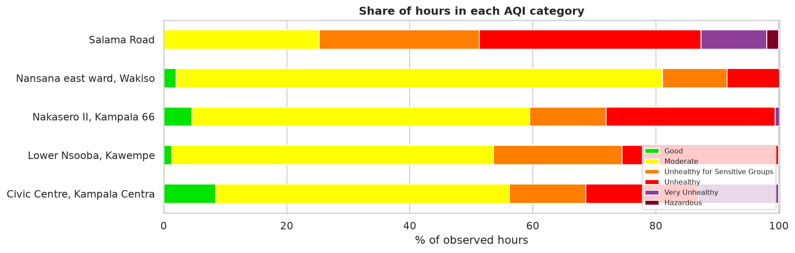
EDA: AQI calendar, Jan–Jul 2026
• Only 0–9% of hours are Good at any site
• Salama Road: ~49% of hours Unhealthy or worse
• Nansana (peri-urban): 79% Moderate
Notes:
Grey days are offline/no data — the calendar makes the three observation windows obvious.

Slide 10
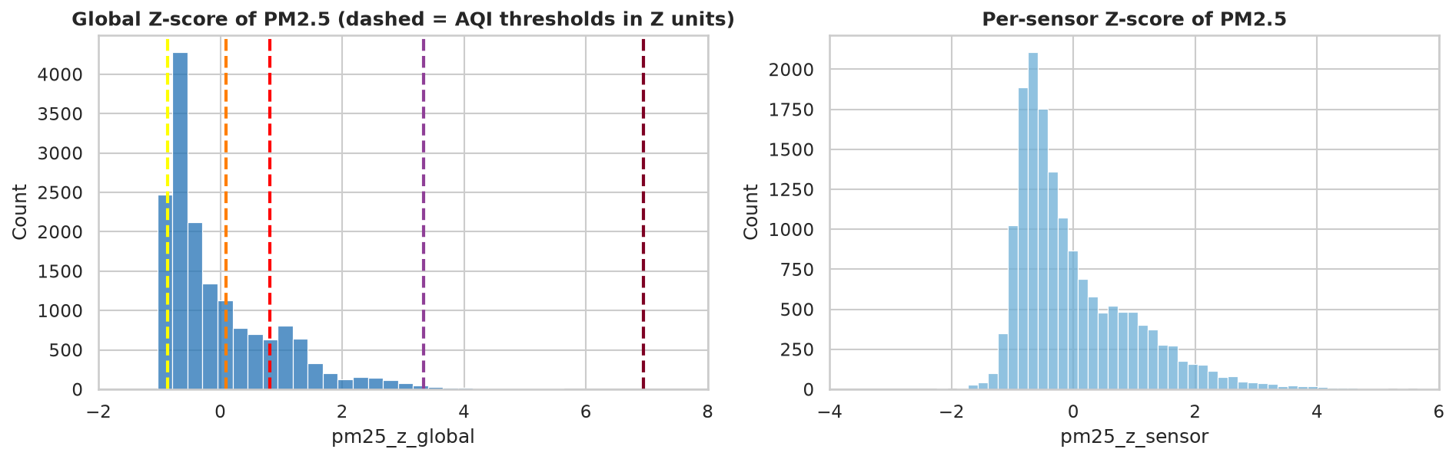
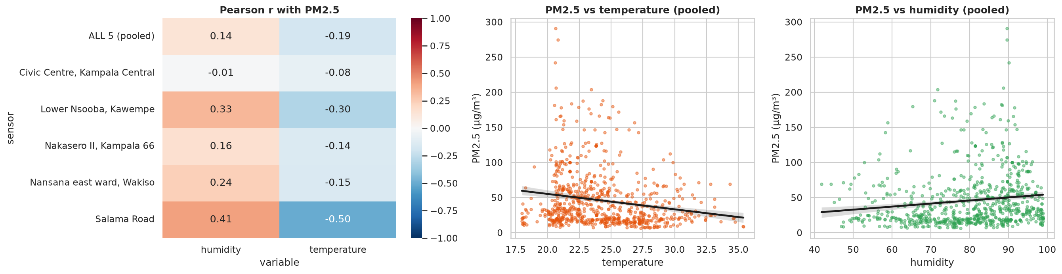
Z-scores and the weather link
• Z-score re-centres and re-scales but keeps the skew: lowest z ≈ −1.0, spikes reach about +14
• 4.7% of hours have |z| > 2; 1.5% have |z| > 3
• Temperature is negatively correlated (r up to −0.50)
• Humidity is positively correlated (r up to +0.41)
• Physics: cool, humid nights and mornings mean a shallow boundary layer that traps smoke
Notes:
z = 0 is the network-average hour; z = +1 one standard deviation dirtier. The USG threshold (35.49) sits at z ≈ 0.1, so above-average already means unhealthy for sensitive groups.

Slide 11
Five tuned models + ensemble
Model | Hyperparameters tuned | Why they matter
Ridge (+ poly) | alpha, polynomial degree | Shrinkage vs overfitting; interactions
K-Nearest Neighbours | k, weights, distance p | Small k memorises noise, large k over-smooths
SVR (RBF) | C, gamma, epsilon | Error penalty, kernel width, noise tolerance
Random Forest | n_estimators, max_depth, min_samples_leaf, max_features | Variance reduction; tree de-correlation
XGBoost | learning_rate, n_estimators, max_depth, min_child_weight, subsample, colsample, lambda | Step size × rounds; complexity; regularisation
Stacking ensemble | Meta RidgeCV alpha over RF + XGB + KNN + SVR | Combines models that err differently
Validation: train = Jan, Apr, 1 Jun; test = last full 24 h (2 Jun 06:00 → 3 Jun 06:00), never used in tuning
Notes:
RandomizedSearchCV with GroupKFold by calendar day (blocked CV). TimeSeriesSplit was rejected because early folds trained only on January.

Slide 12
Results: XGBoost has the lowest RMSE
Model | RMSE µg/m³ | MAE µg/m³ | R² | AQI acc.
XGBoost | 20.0 | 12.3 | 0.22 | 71%
Stacking Ensemble | 20.0 | 12.1 | 0.22 | 72%
Random Forest | 20.1 | 12.0 | 0.21 | 71%
KNN | 20.8 | 12.4 | 0.16 | 69%
Ridge | 20.8 | 12.4 | 0.15 | 72%
SVR | 21.6 | 11.8 | 0.09 | 74%
Base: sensor mean | 23.9 | 18.4 | -0.11 | 49%
Base: global mean | 24.1 | 18.8 | -0.14 | 73%
Note: the global-mean baseline scores 73% AQI accuracy simply because most test hours are Moderate — accuracy alone misleads
Notes:
RMSE is the primary metric because big misses on pollution spikes are the costly errors. All models beat both baselines.

Slide 13
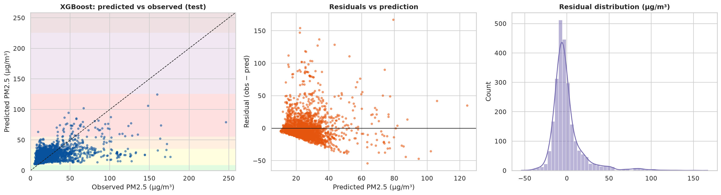
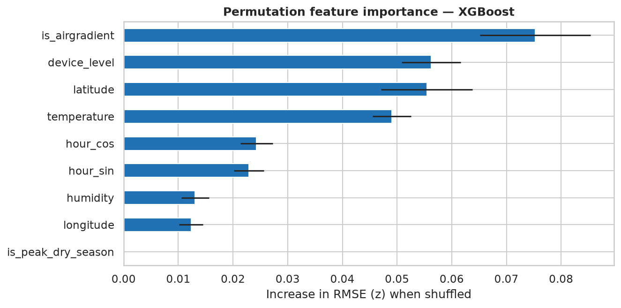
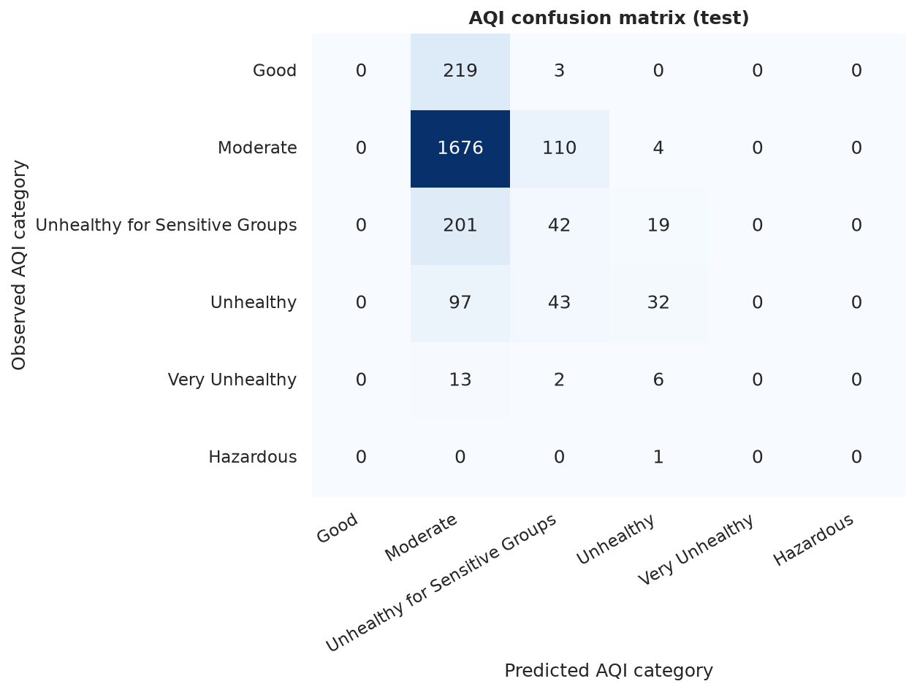
Best model: XGBoost diagnostics
• R² = 0.22: explains ~22% of hourly variance with no recent readings
• Overfit gap 0.19 z (train 0.52 vs test 0.70)
Notes:
Test RMSE 20.0 µg/m³, MAE 12.3, R² 0.22. Residuals are centred near zero but the model under-predicts the largest spikes.

Slide 14
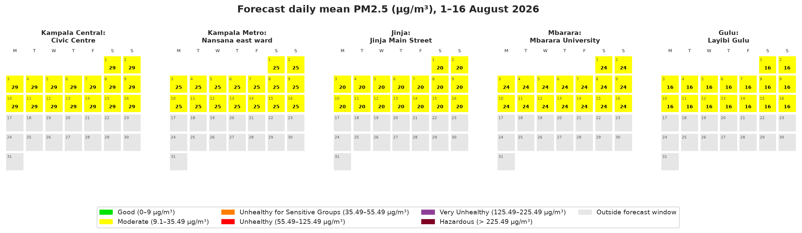
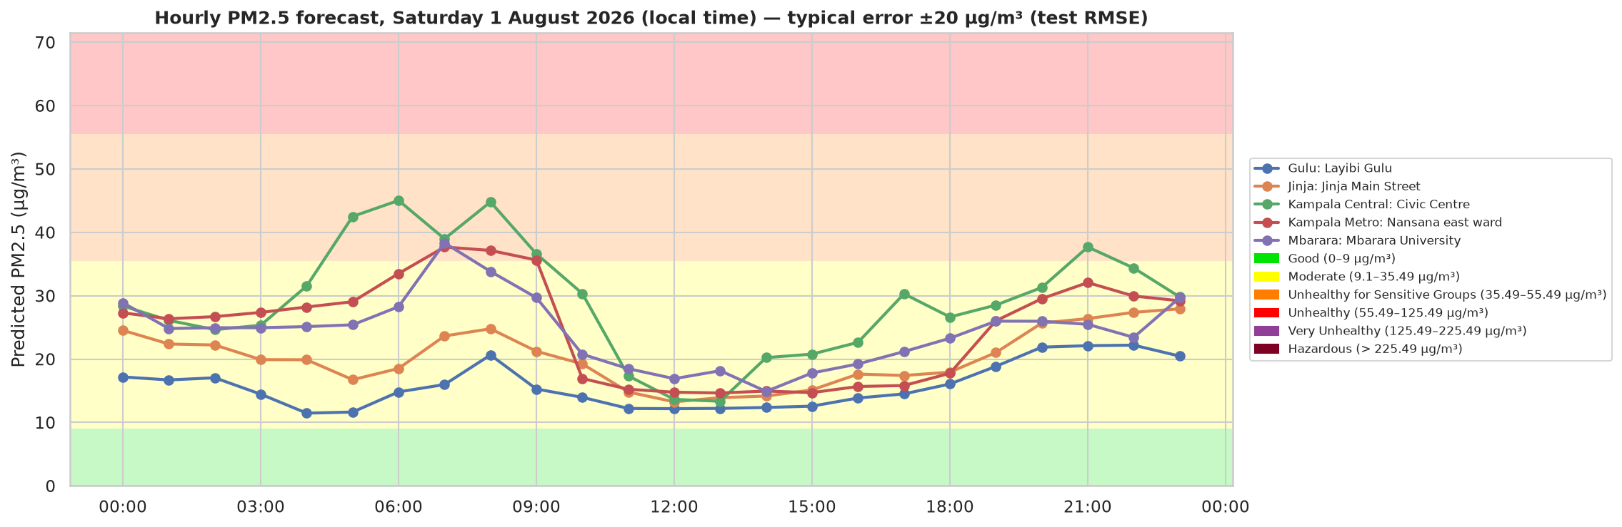
August 2026 forecasts
• Daily (1–16 Aug): 93% of sensor-days Moderate, 6% USG
• 1 Aug peaks at 06:00–08:00 and 21:00
• Band = ±1 test RMSE (≈ 20 µg/m³)
Notes:
pm2.5 = z × σ + μ. Daily forecasts are near-constant because August weather is climatological; the hourly forecast shows the morning and evening peaks.

Slide 15
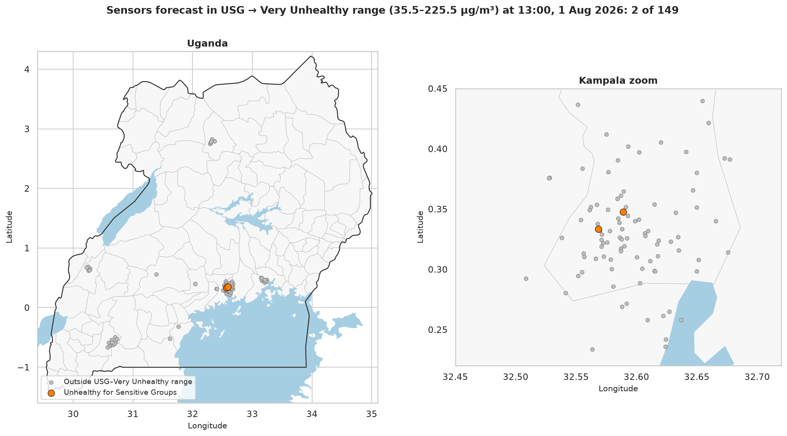
Bonus: at-risk sensors, 1 Aug 13:00
• 2 of 149 sensors in the USG → Very Unhealthy range
• Sir Apollo Kagwa Road ≈ 50 µg/m³
• Kamwokya Primary School ≈ 37 µg/m³
• Both in central Kampala: dense traffic and roadside exposure
• At 07:00 or 21:00 many more sites cross 35.5 µg/m³
Notes:
Natural Earth shapefiles. At midday the boundary layer is deep, so only 2 of 149 sensors are forecast in the USG range.

Slide 16
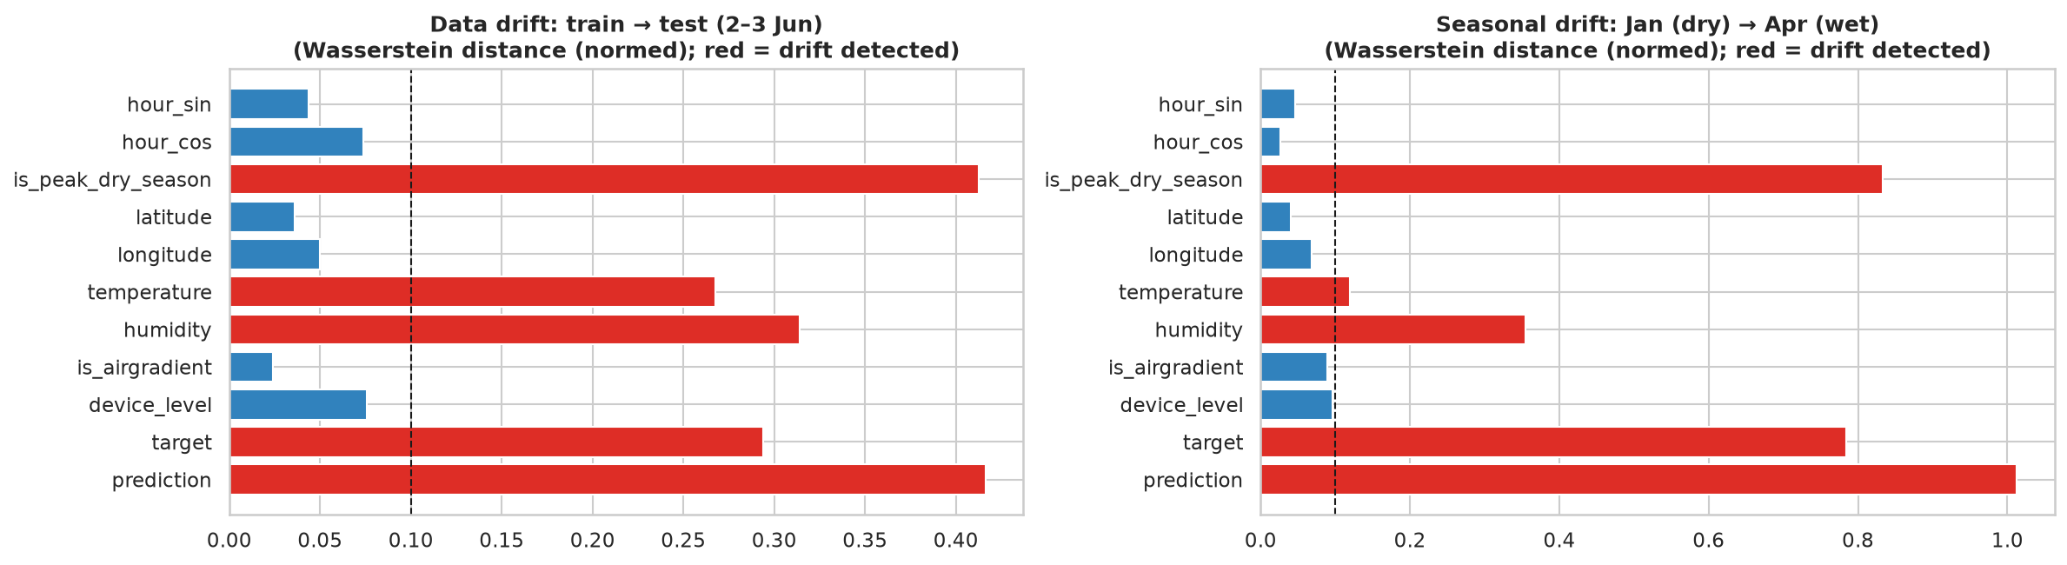
Monitoring with Evidently AI
• Data drift 5 of 11 columns drift train → test: temperature, humidity, season flag, target and prediction
• No drift in hour, location or device mix: coverage is stable
• Model drift RMSE +36% on new data with bias ≈ 0: generalisation gap, not a systematic shift
• Action retrain when RMSE rises > 20% or bias moves from 0; keep the previous version for rollback
Metric (z units) | Train | Test
RMSE | 0.52 | 0.70
MAE | 0.35 | 0.43
Mean error (bias) | 0.00 | −0.01
R² | 0.73 | 0.22
Notes:
Wasserstein distance > 0.1 or Jensen-Shannon > 0.1 marks drift. Temperature and humidity drift is seasonal; target drift means the pollution regime changed.

Slide 17
Deployment on RunPod
1
Pod
2
Template
3
Import
Community Cloud GPU under $2/h (RTX A4000 / 3090 ≈ $0.2–0.7/h)
RunPod PyTorch 2.x with Jupyter Lab, 20 GB disk
git clone the repo / upload data, pip install -r requirements
4
Run
5
Evidence
6
Stop
bash deployment/run_on_runpod.sh, XGBoost on CUDA
pipeline_run.log, run_summary_runpod.json, screenshots
download outputs, terminate the pod (≈ $0.10 total)
Notes:
Debugged locally first (full run ≈ 4 min on 4 CPUs). On the pod, run deployment/run_on_runpod.sh; it logs GPU, pod ID, stage timings and metrics. Terminate the pod afterwards.

Slide 18
Conclusions and next steps
What we found
Limitations → next steps
• Kampala air is mostly Moderate to USG, with Unhealthy spikes in the peak dry season
• Clear diurnal cycle; cool, humid hours are dirtier
• XGBoost is the best model: RMSE 20.0 µg/m³, R² 0.22, 71% AQI accuracy
• Tree ensembles beat linear, KNN and SVR models
• Only 7 days of history → pull months of data from the AirQo API
• Climatological weather → use UNMA / Open-Meteo forecasts
• No lag features → add a nowcasting model for the next hours
• Automate Evidently checks, retraining and model rollback
Notes:
Be upfront about the data limitation: seven days of history caps what any model can learn.

Slide 19
Notes:
Thank you. Questions?

