Slide 1
Predicting PM2.5 Air Quality from AirQo Sensor Data
CSC3119: AI Deployment & Scalability · Assignment 4
Mirembe Peace Mercy / M24B23/005 / B27499
Notes:
Introduce the assignment: we build an end-to-end pipeline that takes raw AirQo sensor readings, cleans them, explores them, trains and tunes machine-learning models to predict PM2.5, forecasts August 2026, monitors drift with Evidently AI and runs on RunPod. Replace the name and registration placeholders before presenting.

Slide 2
Why forecasting PM2.5 matters for Kampala
39 µg/m³
8×
7,257
Kampala annual mean PM2.5 (2018–2021)
above the WHO annual guideline of 5 µg/m³
deaths attributed to long-term PM2.5 exposure
1
Health sector
2
NEMA
3
Ministry of Energy
4
Works & Transport
early warning of respiratory and cardiac admission spikes
enforcement of air-quality standards and monitor siting
target clean-cooking programmes where biomass smoke is worst
traffic management and fleet-age regulation at peak hours
Notes:
Kampala's annual mean PM2.5 of 39 µg/m³ (2018–2021 reference monitoring) is about eight times the WHO guideline of 5 µg/m³, and an estimated 7,257 deaths were attributed to long-term exposure. A forecast lets institutions act before bad-air days rather than after.

Slide 3
Methodology: one pipeline, CSV
1
Load & audit
2
Clean
3
Hourly resample
4
EDA
14,600 rows, zeros → null
coords, ranges, outlier flags, types
Jan–Jul grid, offline = NaN, ≤3 h interp.
5 Kampala sensors, AQI plots, Z-score
8
Monitor & deploy
7
Forecast
6
Save best
5
Model
Evidently drift, RunPod logs
Aug daily & hourly, inverse Z
joblib bundle incl. μ, σ
5 models + 2 ensembles, tuned
Notes:
Walk the pipeline left to right then right to left. Each stage writes its outputs and a log line, so the same notebook run on RunPod leaves evidence behind.

Slide 4
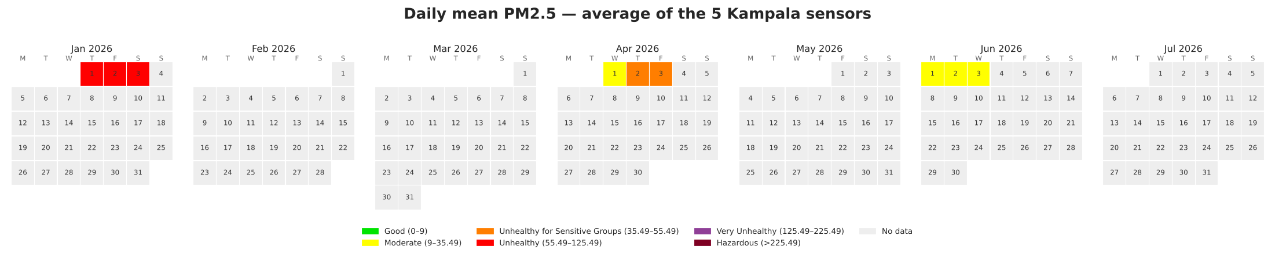
149 sensors, but only 8 days of readings
14,600
149
8 days
1.9 %
hourly records
sensors · 145 sites
1–3 Jan · 1–2 Apr · 1–3 Jun
of the Jan–Jul hourly grid observed
Daily mean PM2.5, average of 5 Kampala sensors, coloured by AQI category. Grey = sensors offline / no data.
Notes:
Important honesty point. The file is labelled January to July 2026, but readings exist only for 1–3 January, 1–2 April and 1–3 June. After building the full hourly grid, just 1.9% of sensor-hours are observed. We keep the rest as missing, as the brief asks, and design validation around this.

Slide 5
Cleaning: fix errors, keep real spikes
Step | Rule | Effect
Zeros → null | temp, humidity, PM, lat, lon = 0 means 'no reading' | ≈28 % of temp/RH, 21 % of coords
Coordinates | since a GPS is fixed we just used the same value last recorded | 103 bad fixes; 6 devices geocoded
Physical limits | PM2.5 > 500, temp ∉ 5–45 °C, RH ∉ 1–100 % → null | 3 PM2.5 values removed
Outliers | per-sensor robust Z > 3.5 → flagged, kept | 1,161 flagged (real spikes)
Columns dropped | site_id (51 % empty), frequency (constant) | device_name is the key
Types | UTC → Kampala time; floats; IDs as category | consistent across fields
Hourly grid | every sensor × every hour, 1 Jan–31 Jul | 758,112 rows, is_observed flag
Gap filling | linear interpolation only for gaps ≤ 3 h and the rest considered as null | 1,976 hours filled
Notes:
Each rule has a reason. Zeros are nulls per the brief. Coordinates: a fixed monitor does not move, so we use the device median and reject GPS fixes more than 5.5 km away. Only physically impossible PM2.5 values above 500 are removed. Statistical outliers are flagged but kept because they line up with traffic and cooking peaks. Short gaps are interpolated, long gaps stay missing (Junninen et al., 2004).

Slide 6
Exploratory Data Analysis
Five Kampala sensors · distributions · AQI time series · calendar · Z-score · weather correlation
Notes:
The EDA uses five Kampala sensors with the most data: Nakasero, Civic Centre, Bukoto, Lower Nsooba and Salama Road (an AirGradient unit).

Slide 7
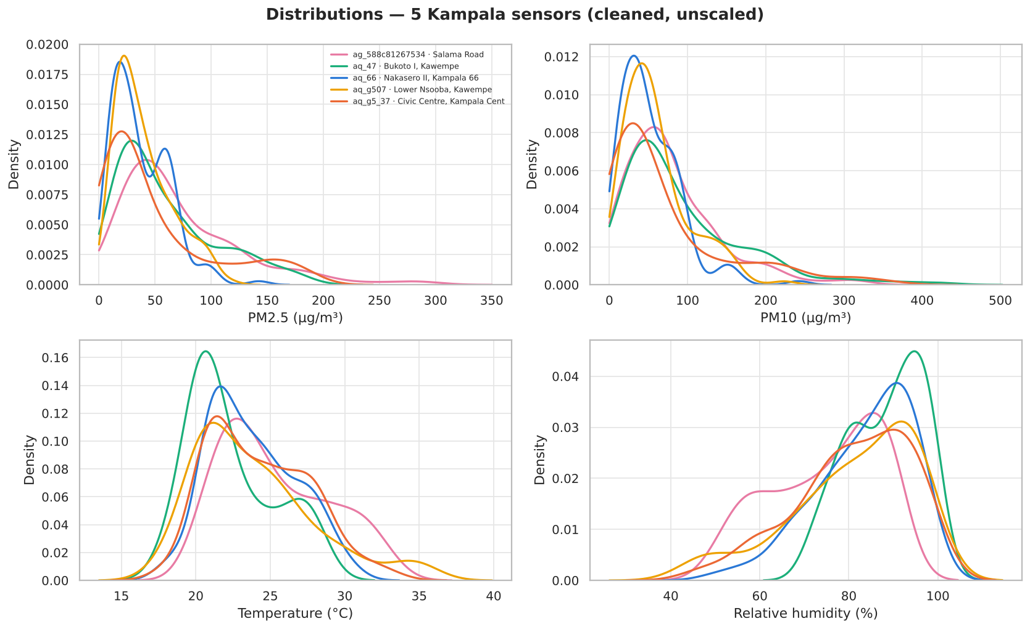
PM2.5 is right-skewed, with real pollution spikes
What we see
• PM2.5 skewness 1.74: mean > median, long right tail
• Salama Road and Bukoto have the heaviest tails (max 291 and 186 µg/m³)
• PM10 has the same shape, about 1.3× larger: it is a sibling of PM2.5, not a predictor
• Kampala is humid: RH mostly 70–95 %, temperature 18–32 °C
Outlier treatment
• IQR and robust-Z outliers are flagged and kept: they coincide with rush hours, so they are pollution, not error
Notes:
Most hours sit between 15 and 60 µg/m³, but there is a long tail up to about 290 µg/m³ at Salama Road. Skewness is 1.7, so the mean is pulled above the median. The box plots flag these spikes; we keep them because they happen at the morning and evening peaks.

Slide 8
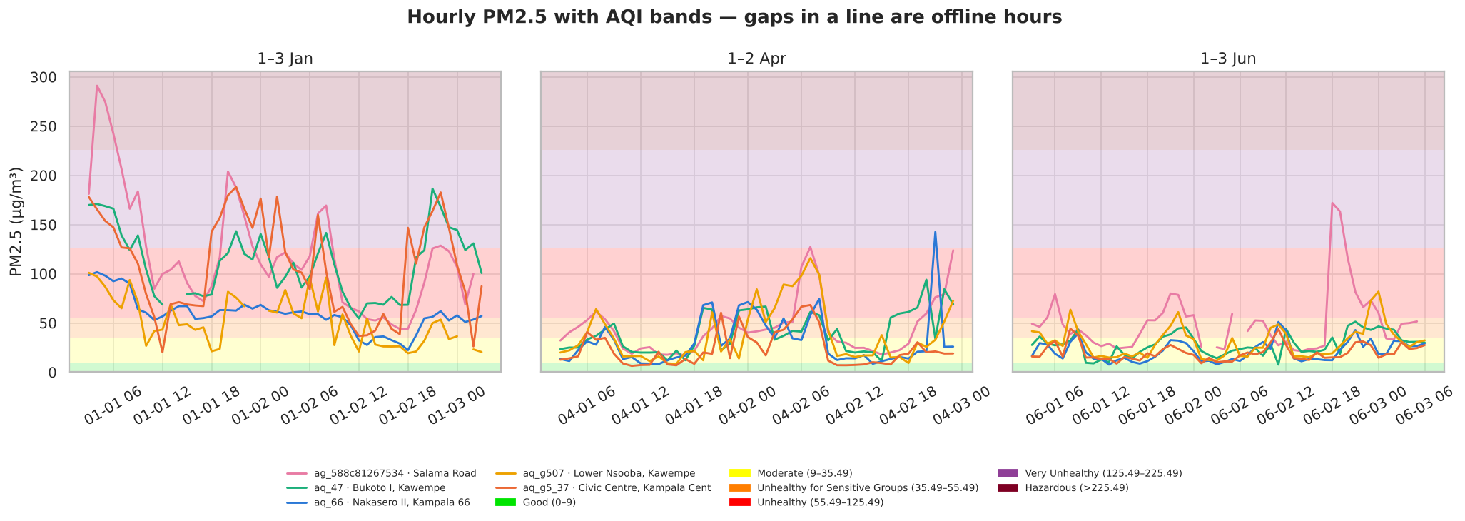
Hourly PM2.5 against the AQI bands
January (dry season) mean 48.7 µg/m³ vs ≈ 24 µg/m³ in April and June: January spends most hours in the red 'Unhealthy' band.
Notes:
Each panel is one observation window. Background colours are the AQI categories from the brief. January is far worse than April and June: many hours in the red Unhealthy band. April and June mostly sit in Moderate with short excursions into Unhealthy for Sensitive Groups.

Slide 9
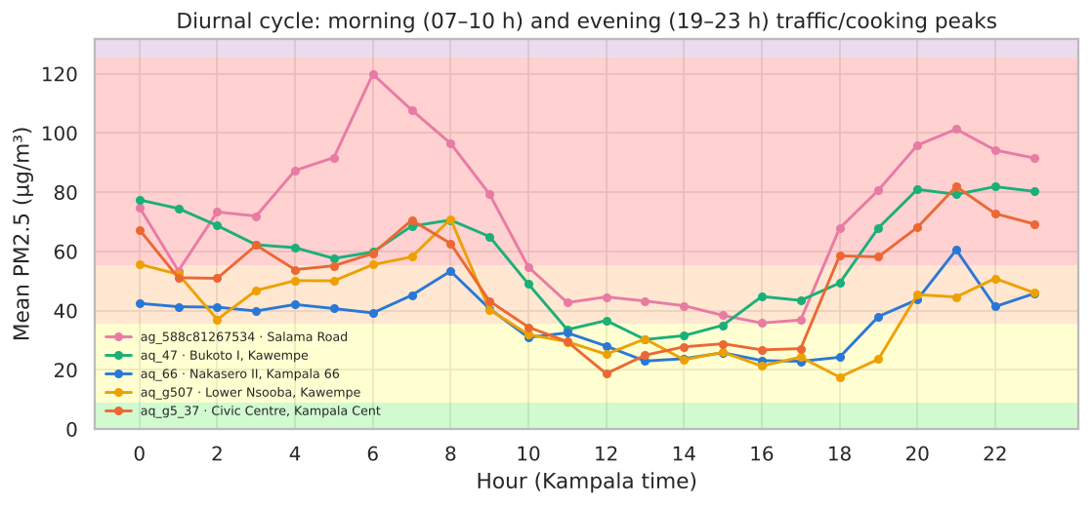
Two daily peaks: morning and evening
Why the shape matters
• 07–10 h: commuter traffic + breakfast cooking under a shallow, stable morning layer
• 13–16 h: sun heats the ground, the mixing layer deepens and PM2.5 is diluted
• 19–23 h: evening traffic and cooking; the air cools and pollutants are trapped again
→ Hour of day enters the model as sin/cos so 23 h and 0 h are neighbours
Notes:
Averaging by hour of day shows two peaks: 7 to 10 am and 7 to 11 pm, matching traffic and charcoal cooking, and a mid-afternoon minimum when the boundary layer is deepest. This is why hour of day is a key model feature.

Slide 10
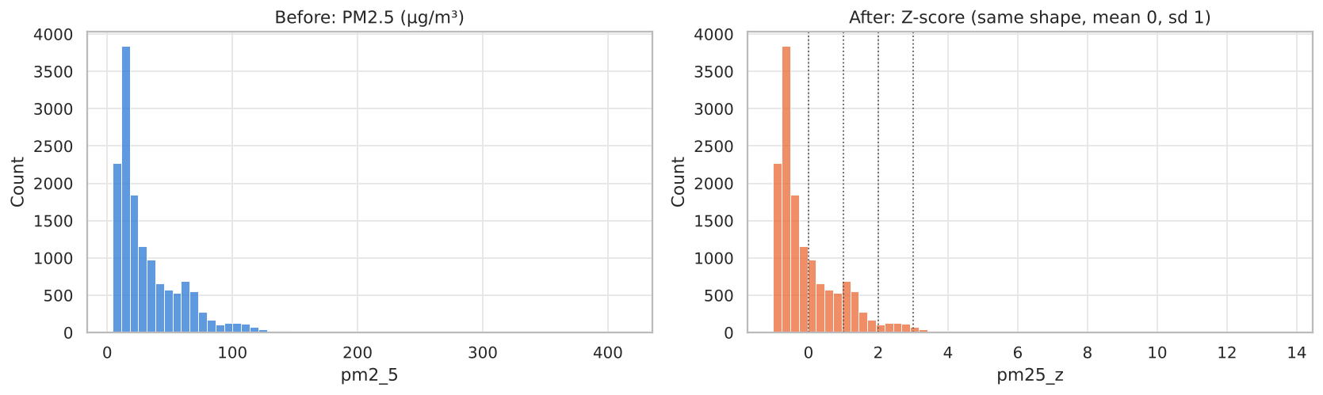
Z-score: PM2.5 as 'how unusual'
z | PM2.5 (µg/m³) | AQI
-1 | 4.7 | Good
0 | 32.5 | Moderate
+1 | 60.4 | Unhealthy
+3 | 116.1 | Unhealthy
+5 | 171.8 | Very Unhealthy
z = (x − μ) / σ with μ = 32.53 µg/m³, σ = 27.86 µg/m³ · inverse: x = z·σ + μ
• Shape and ranking are unchanged: Z only re-centres and re-scales, so KNN, SVR and Ridge see a unit-scale target.
• AQI thresholds in z-units: USG starts at z = +0.11, Unhealthy at +0.82, Very Unhealthy at +3.34.
• Negative z is bounded (PM2.5 ≥ 0, so z ≥ −1.17); large positive z flags genuinely bad hours.
Notes:
z equals x minus the mean, divided by the standard deviation, using all sensors. The mean is 32.5 and sigma 27.9 µg/m³. z of zero is an average hour; plus one is one standard deviation dirtier. Because the data is skewed, positive z values go much further than negative ones. We keep mu and sigma to convert predictions back to micrograms.

Slide 11
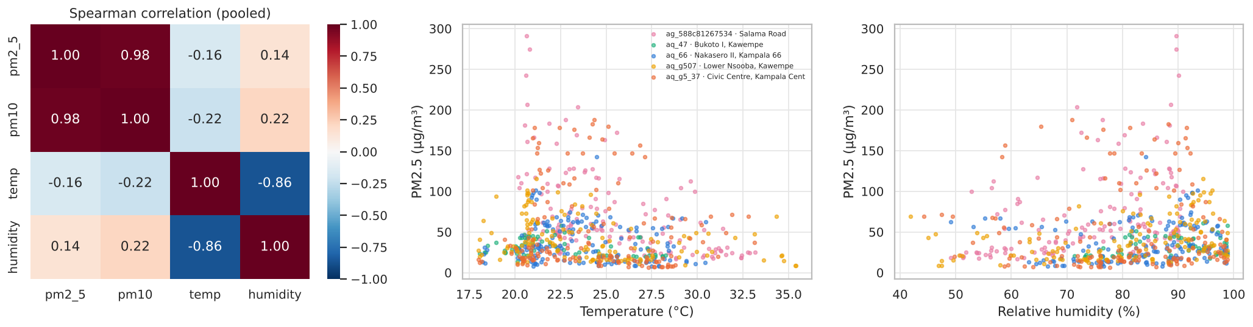
Temperature down, humidity up, PM2.5 up
Temperature: −0.07 to −0.56
Warmer hours → deeper mixing layer → lower PM2.5
Humidity: +0.04 to +0.48
Humid nights → stable air + particle growth → higher PM2.5
PM10: ρ ≈ 0.98 with PM2.5
Measured at the same moment, so excluded as a predictor (leakage)
Notes:
Pearson and Spearman correlations for the five sensors. Temperature is negatively correlated with PM2.5 and humidity positively, strongest at Salama Road: Spearman minus 0.56 and plus 0.48. Pooled correlations are weaker because sensors have different baselines. Physics: cool humid nights mean shallow mixing layers that trap particles.

Slide 12
Modelling & results
Feature selection · validation design · 5 models + 2 ensembles · metrics · August 2026 forecasts

Slide 13
Features and an honest validation design
Inputs kept
• temp, humidity (physics, §EDA)
• hour of day as sin/cos (diurnal cycle)
• month (level shift between windows)
• latitude, longitude, network type
• sensor ID → target-encoded (each site's baseline)
Dropped
• PM10 (leaks the target) · site_id (51 % empty) · frequency (constant) · day-of-week & dry-season flag (overfit on 8 days)
Validation
• Train = first day of each window (1 Jan, 1 Apr, 1 Jun): 6,126 hours
• Test = later days (2–3 Jan, 2 Apr, 2–3 Jun): 8,146 hours, all in the future of their training day
• Tuning: RandomizedSearchCV, GroupKFold over 6-hour blocks (no leakage between neighbouring hours)
• Missing temp/RH handled inside the pipeline (median + missing-indicator), so API nulls never crash the model
• Rejected: Jan+Apr → June gave R² ≤ 0 for every model (kept as a drift case study)
Notes:
We kept only inputs that are known when forecasting. PM10 would leak the answer. Day of week and a dry-season flag were tested and removed because with only 8 days they act as date identifiers. The first attempt, train January plus April and test June, gave R squared at or below zero for every model: January is twice as polluted and nothing in the features explains it. So we test on the later day or days of every window, training on the first day.

Slide 14
Five models and two ensembles, each tuned
Model | Hyperparameters tuned | Why they matter | CV RMSE (z)
Ridge | alpha | L2 shrinkage: over- vs under-fitting | 0.893
KNN | n_neighbors, weights, p | small K = noisy, large K = over-smoothed | 0.843
SVR (RBF) | C, epsilon, gamma | fit tightness, error tube, locality | 0.801
Decision Tree | max_depth, min_samples_leaf/split, max_features | depth and leaf size control overfitting | 0.825
Random Forest (bagging) | n_estimators, max_depth, max_features, min_samples_leaf | more trees = stability; fewer features = diversity | 0.732
HistGradientBoosting | learning_rate, max_iter, max_leaf_nodes, depth, l2, leaf | speed vs generalisation; leaf-value shrinkage | 0.738
Stacking (KNN+RF+HGB → Ridge) | meta-learner alpha | how much to trust each base model | 0.720
Notes:
Each row lists the hyperparameters tuned and the best values. Ridge's alpha controls shrinkage; KNN's K trades noise for smoothing; SVR's C, epsilon and gamma set fit tightness, tolerance and locality; tree depth and leaf size control overfitting; for boosting, learning rate times iterations is the classic speed versus generalisation trade-off.

Slide 15
Random Forest wins: RMSE 21% below baseline
20.8
14.2
RMSE µg/m³ (z: 0.747)
MAE µg/m³: typical error
0.37
64 %
R²: share of variance explained
hours in the right AQI band
Bias +3.4 µg/m³: slight over-prediction, which errs on the side of caution for health warnings.
Notes:
Test RMSE in micrograms per cubic metre on the hold-out days. Random Forest is best at 20.8, against 26.2 for always predicting the mean. Stacking had the best cross-validation score but generalised worse on the test days, a reminder that CV and test can disagree with little data.

Slide 16
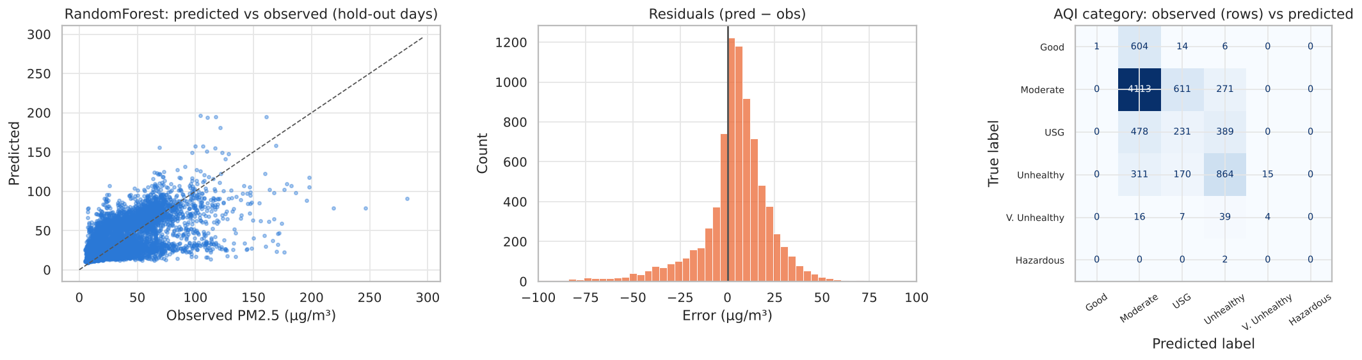
Where the model hits and misses
• Spikes above ~120 µg/m³ are under-predicted: no input says 'a fire is burning now'. Adding lagged PM2.5 would fix this for next-hour forecasts but is unavailable for a 2-month-ahead August forecast.
• Errors mostly fall into the neighbouring AQI band, rarely two bands away.
Notes:
Left: predictions track observations but are compressed toward the middle; the highest spikes are under-predicted. Middle: errors are centred near zero. Right: most confusion is between neighbouring AQI bands. Permutation importance shows sensor identity and hour of day dominate.

Slide 17
What drives the predictions
Reading the chart
• Top inputs: month, device_name, hour_cos.
• month = the season / window level: January was twice as polluted as April and June.
• device_name (target-encoded) = the site's own baseline: roadside and market sites sit higher.
• hour_sin / hour_cos = the morning and evening peaks seen in the EDA.
• temp and humidity add the weather signal; an importance near 0 means the model barely uses that input.
• Decision: more months of data would help far more than a more complex model.
Notes:
Permutation importance: shuffle one input on the test set and measure how much RMSE gets worse. The bigger the increase, the more the model relies on that input. Month matters most because it captures the January versus April and June level shift. Next comes sensor identity, which carries each site's typical level, then the hour-of-day features. Temperature and humidity add a smaller weather signal.

Slide 18
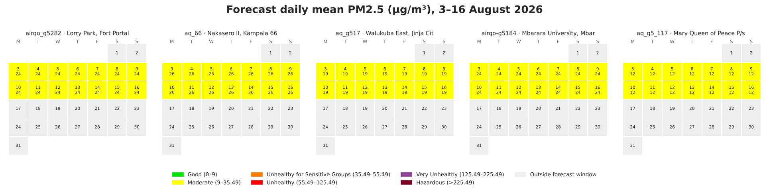
Daily forecast: 3–16 August 2026
1,862
154
70
Why flat? Weather and weekday are unknown for August, so each sensor gets its typical August day. Feed a weather forecast into temp/RH to make days differ.
sensor-days Moderate
sensor-days USG
sensor-days Unhealthy
Notes:
Predictions from the saved model, inverse-transformed from z to micrograms. Five sensors, one per geographic zone: Fort Portal, Kampala, Jinja, Mbarara and Gulu. Values are flat across days because no day-varying input is known for August; the information is in the differences between places. Across all 149 sensors most days are Moderate, with about 150 sensor-days Unhealthy for Sensitive Groups and 70 Unhealthy.

Slide 19
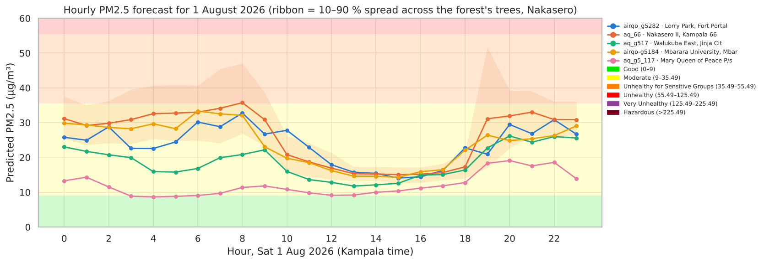
Hourly forecast: Saturday 1 August
Outputs: forecast_hourly_2026-08-01.csv (149 sensors × 24 h) and forecast_daily_2026-08-03_to_16.csv, both in µg/m³ after inverse Z-scoring.
Notes:
The hourly forecast keeps the double-peak shape learnt from the data: morning and late-evening highs, mid-afternoon low. Nakasero in central Kampala approaches the USG threshold around 8 am. The ribbon is the 10 to 90 percent spread across the trees of the forest, a rough indication of uncertainty.

Slide 20
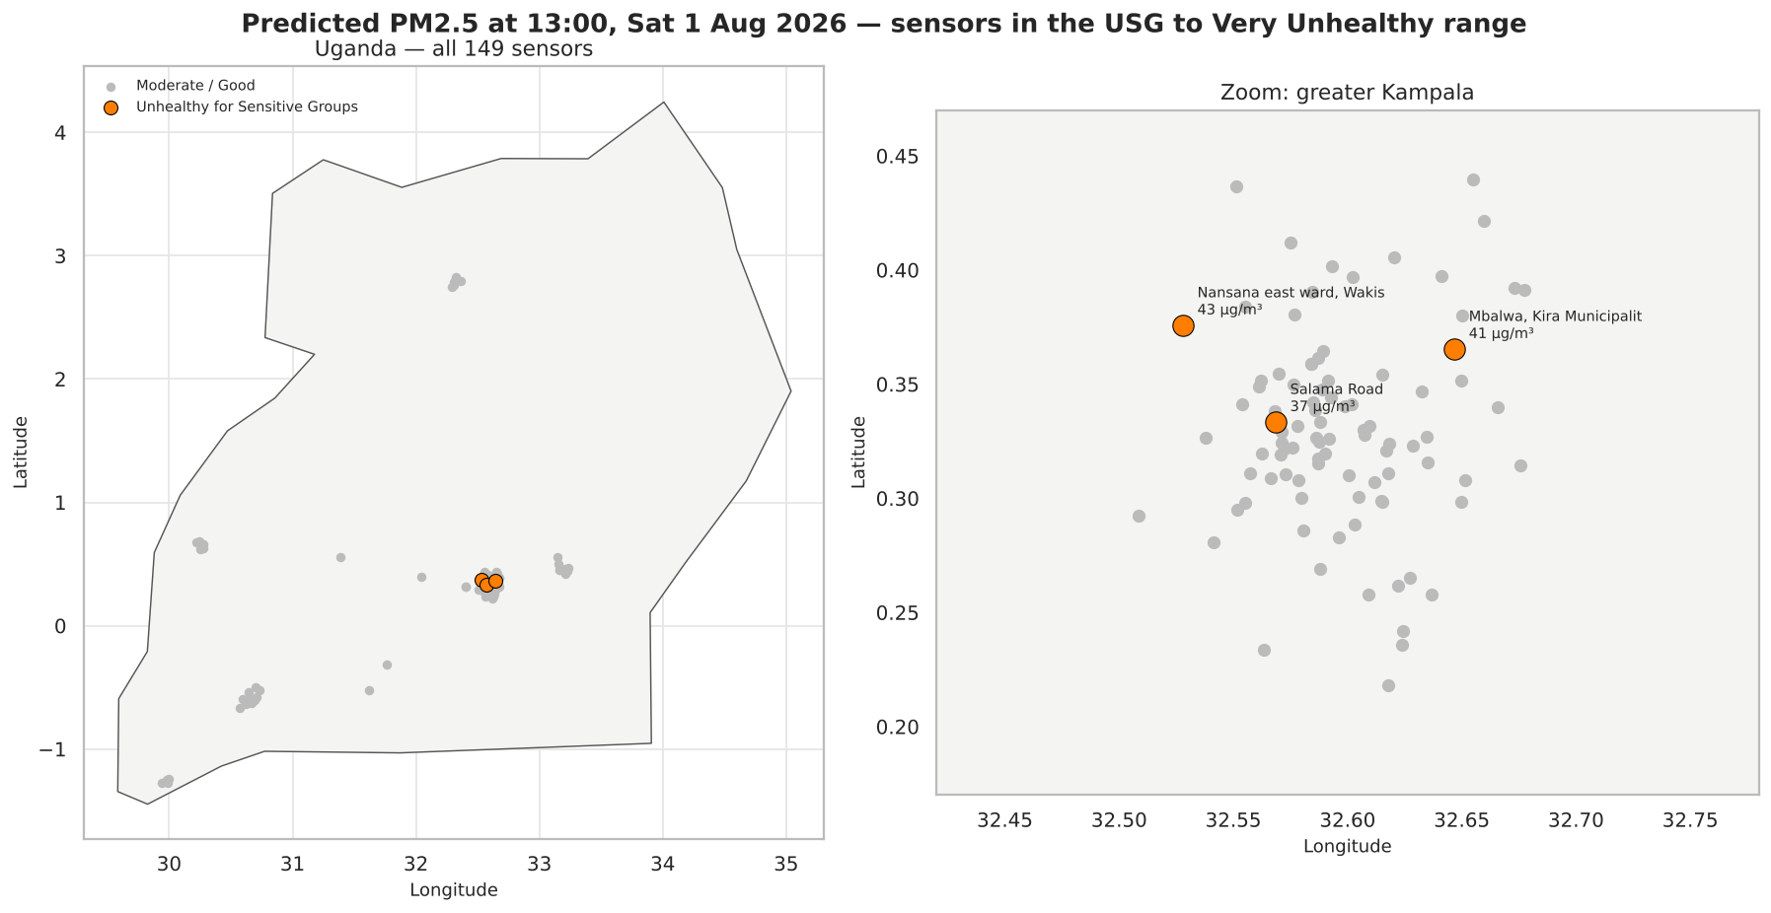
Unhealthy air at 13:00, 1 August
Notes:
The map uses a Uganda boundary shapefile. At 1 pm, normally the cleanest time of day, three sensors are predicted in the Unhealthy for Sensitive Groups band, all in greater Kampala: Nansana East, Mbalwa in Kira, and Salama Road. None reach Very Unhealthy.

Slide 21
Monitoring & deployment
Evidently AI data drift and model drift · running the pipeline on a RunPod pod for under $5

Slide 22
Evidently AI: is anything drifting?
Run A feature | Wasserstein | Drift?
temp | 0.160 | Yes
humidity | 0.261 | Yes
latitude | 0.005 | No
longitude | 0.003 | No
hour_sin | 0.179 | Yes
hour_cos | 0.340 | Yes
pm25_z | 0.084 | No
prediction | 0.186 | Yes
Model quality | Reference | Current
RMSE | 0.730 | 0.747
MAE | 0.470 | 0.510
Mean error | -0.033 | 0.124
R² | 0.538 | 0.367
Run B: Jan vs Jun | Distance | Drift?
temp | 0.368 | Yes
humidity | 0.588 | Yes
hour_sin | 0.026 | No
hour_cos | 0.018 | No
pm25_z | 0.787 | Yes
How to read it
• Wasserstein distance > 0.1 (or K-S p < 0.05 on small samples) → column drifted; dataset drifts when ≥ 50 % of columns drift.
• Run A: 62 % of columns drifted (weather, hour), the target did not, and RMSE moved only +0.017. R² fell because the hold-out has less variance, not because errors grew: keep watching, no retrain yet.
• Run B: PM2.5 distance 0.79 between January and June → retrain with recent data, or roll back to a saved model version.
Notes:
Two runs. Run A compares the training hours with out-of-fold predictions to the hold-out hours: weather and hour features drift, the target does not, and RMSE rises only slightly, so no model drift. Run B compares January with June: temperature, humidity and PM2.5 itself all drift strongly; a model trained only in January would fail in June, which is exactly what we observed.

Slide 23
Limitations and next steps
Only 8 days of data
Seasonality and weekday effects cannot be learnt; August forecasts assume June-like conditions.
No future weather
Temp/RH for August use hour-of-day climatology; real deployment should use a forecast API.
Spikes under-predicted
Burning events are invisible to the inputs; consider lag features for next-hour nowcasts.
Monitoring loop
Schedule Evidently on new data; retrain or roll back to a versioned model when RMSE rises.
Notes:
Be upfront about the data: 8 days cannot teach seasons or weekdays. The biggest gains would come from more continuous data, a weather forecast feed and lag features for short-term forecasting.

