Slide 1

Predicting customer buying behaviour
Build a predictive model to understand factors that influence buying behaviour
26/06/2023

Slide 2
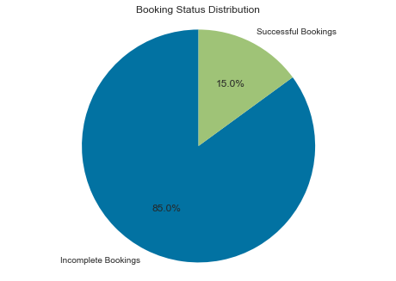
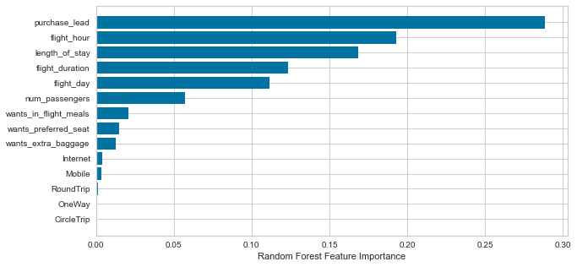
predictive model Results
Inbalanced Data set:
50 000 Bookings in total
42 522 Incomplete Bookings
7 478 Successful Bookings
Data set was trained with Random Forest classifier Model
Accuracy
85%
Model accuracy in predicting
complete and incomplete Bookings
Top features that can affect successful bookings
AUC-ROC Score 52%
Model is heavily biased towards the majority class
Precision
48 %
Predicted as actual complete bookings out of all successful Bookings
Recall Value
99% Chance of predicting True Incomplete Bookings
6% Chance of predicting True Successful Bookings
Our concern is with not predicting complete bookings accurately.
More measures should be done to balance the data.

