Slide 1
British Airline Reviews
Analysis

Slide 2
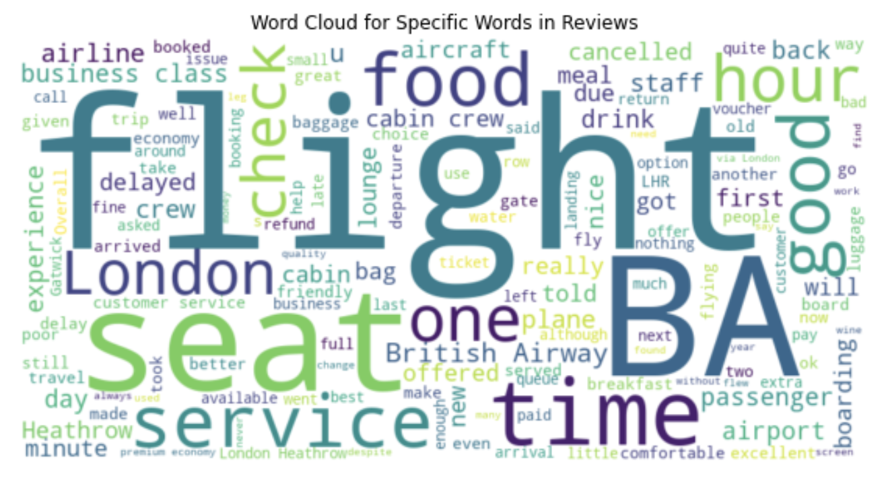
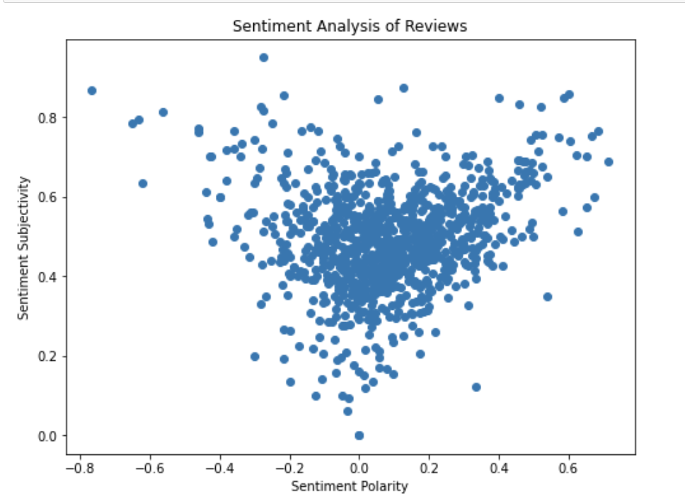
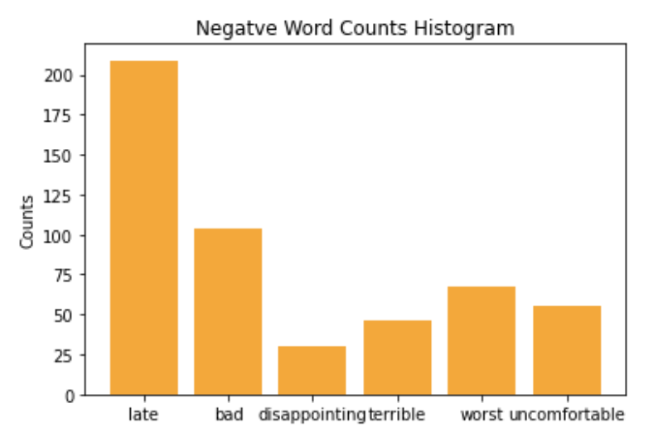
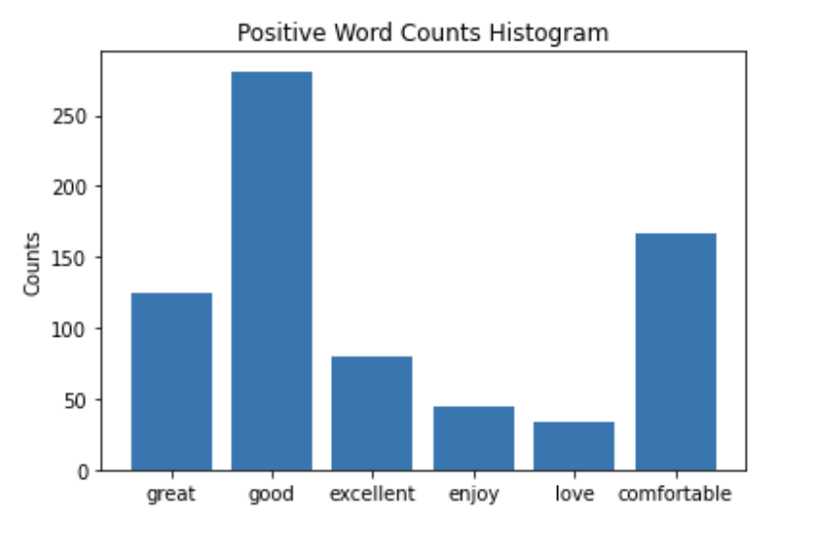
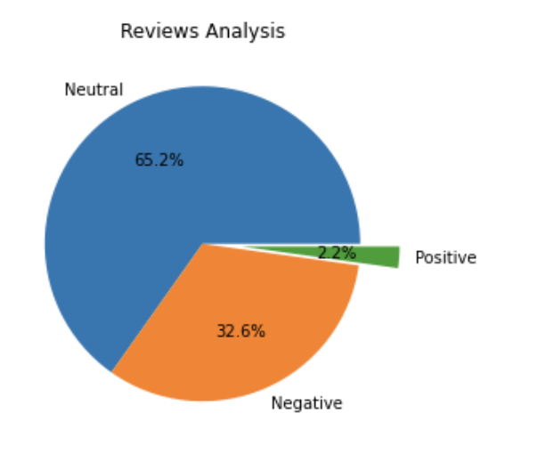
Total of 1000 reviews
666 reviews with a positive sentiment
21 reviews with a sentiment polarity above 0.5
- 326 reviews with a negative sentiment

